Slide 1
GROW / SCIENCE
OVERVIEW
Spherical Bodies: Shape Evidence
I can use observations from different viewpoints to describe the Sun, Earth and Moon as approximately spherical bodies.
Disc versus sphere
use evidence
More than one viewpoint
use evidence
Approximately spherical
use evidence
Open the original interactive lesson
40 MINUTES
1 / 17
Notes:
Companion for SCI_G_W9A_Spherical_Bodies_Explore.html. Overview: 0 minutes TOTAL across all slides in this stage.
Read setup, safety and sensory notes before pupils enter.
Set predictable Space and keep the learning goal visible.
Model limit: A smooth classroom ball hides mountains, valleys, craters and slight flattening. It models overall shape only.
Full source-stage teaching text:
GROW · Science · Week 9A · Explore
Learning objective: I can use observations from different viewpoints to describe the Sun, Earth and Moon as approximately spherical bodies.
Success criteria
Distinguish a flat disc from a three-dimensional sphere.
Use more than one viewpoint as shape evidence.
Explain why approximately spherical is more accurate than perfect sphere.
HTML controls remain in the original HTML file. PowerPoint contains editable teaching text and static source visuals; use the paper response route for sorting and investigation.
[Sources]
Uploaded lesson: SCI_G_W9A_Spherical_Bodies_Explore.html
[/Sources]

Slide 2
GROW / SCIENCE
OVERVIEW
What success looks like
• Distinguish a flat disc from a three-dimensional sphere.
• Use more than one viewpoint as shape evidence.
• Explain why approximately spherical is more accurate than perfect sphere.
40 MINUTES
2 / 17
Notes:
Companion for SCI_G_W9A_Spherical_Bodies_Explore.html. Overview: 0 minutes TOTAL across all slides in this stage.
Read setup, safety and sensory notes before pupils enter.
Set predictable Space and keep the learning goal visible.
Model limit: A smooth classroom ball hides mountains, valleys, craters and slight flattening. It models overall shape only.
Full source-stage teaching text:
GROW · Science · Week 9A · Explore
Learning objective: I can use observations from different viewpoints to describe the Sun, Earth and Moon as approximately spherical bodies.
Success criteria
Distinguish a flat disc from a three-dimensional sphere.
Use more than one viewpoint as shape evidence.
Explain why approximately spherical is more accurate than perfect sphere.
HTML controls remain in the original HTML file. PowerPoint contains editable teaching text and static source visuals; use the paper response route for sorting and investigation.
[Sources]
Uploaded lesson: SCI_G_W9A_Spherical_Bodies_Explore.html
[/Sources]

Slide 3
GROW / SCIENCE
ARRIVAL
Retrieve and reconnect
• Last lesson: why did the globe model have a day side and a night side?
• Last week: what stayed fixed while Earth rotated?
• Earlier space learning: name the three bodies in the Sun-Earth-Moon system.
• Lead-in: how could a disc and sphere both look circular from one viewpoint?
ARRIVAL · 4 min across this stage
3 / 17
Notes:
Companion for SCI_G_W9A_Spherical_Bodies_Explore.html. Arrival: 4 minutes TOTAL across all slides in this stage.
Wait, regulate and retrieve through the lightest workable route.
If recall is inaccessible, point to one retrieval sentence; do not teach today’s answer.
Model limit: A smooth classroom ball hides mountains, valleys, craters and slight flattening. It models overall shape only.
Full source-stage teaching text:
Retrieve only what has already been taught
Last week, the rotating globe model used Earth's curved body to separate a lit half from an unlit half.
Prior week: point to or describe one useful model.
Older learning: what makes an observation useful as evidence?
Lead-in: what do you notice in today’s first picture?
New to this class, absent, or not sure? Everything needed is in the retrieval box above. Read it, point to it or ask a familiar adult to read it exactly.
▲ Standard
Last lesson: why did the globe model have a day side and a night side?
Last week: what stayed fixed while Earth rotated?
Earlier space learning: name the three bodies in the Sun-Earth-Moon system.
Lead-in: how could a disc and sphere both look circular from one viewpoint?
Read-aloud route: a familiar adult may read the task exactly while the text remains visible. No device voice or media permission is required.
HTML controls remain in the original HTML file. PowerPoint contains editable teaching text and static source visuals; use the paper response route for sorting and investigation.
[Sources]
Uploaded lesson: SCI_G_W9A_Spherical_Bodies_Explore.html
[/Sources]

Slide 4
GROW / SCIENCE
STARTER
A distant body looks like a circle in one photograph. What shape do you predict it is? First ideas are held, not marked.
Think first. Point, say, sign or write your choice. Give one reason.
A. It must be a flat disc.
B. It must be a sphere.
C. One view is not enough; collect shape evidence from other views.
STARTER · 4 min across this stage
4 / 17
Notes:
Companion for SCI_G_W9A_Spherical_Bodies_Explore.html. Starter: 4 minutes TOTAL across all slides in this stage.
Protect curiosity: receive every first idea without judgement.
Ask ‘What makes you think that?’ and preserve the prediction for later evidence.
Model limit: A smooth classroom ball hides mountains, valleys, craters and slight flattening. It models overall shape only.
Full source-stage teaching text:
LOCAL VISUAL HOOK · FRAME 1
Observation 1: both have a round front outline.
From the front, A and B look the same: a circle.
LOCAL VISUAL HOOK · FRAME 2
Observation 2: after a quarter turn, A looks oval; B still looks round.
One turn, two different results. Evidence.
LOCAL VISUAL HOOK · FRAME 3
Observation 3: from the edge, A is a thin line; B still looks round.
A flat disc hides. A sphere looks round from every side.
Commit one first idea. Predictions are held, not marked. Pointing, selecting, saying or signing all count.
It must be a flat disc.
It must be a sphere.
One view is not enough; collect shape evidence from other views.
HTML controls remain in the original HTML file. PowerPoint contains editable teaching text and static source visuals; use the paper response route for sorting and investigation.
[Sources]
Uploaded lesson: SCI_G_W9A_Spherical_Bodies_Explore.html
[/Sources]

Slide 5
GROW / SCIENCE
STARTER
Look closely · what is the evidence?
Observation 1: Object A and Object B both have a round front outline.
Observation 2: after a quarter turn, Object A looks oval and Object B still looks round.
Observation 3: from the edge direction, Object A is a thin line and Object B still looks round.
STARTER · 4 min across this stage
5 / 17
Notes:
Companion for SCI_G_W9A_Spherical_Bodies_Explore.html. Starter: 4 minutes TOTAL across all slides in this stage.
Protect curiosity: receive every first idea without judgement.
Ask ‘What makes you think that?’ and preserve the prediction for later evidence.
Model limit: A smooth classroom ball hides mountains, valleys, craters and slight flattening. It models overall shape only.
Full source-stage teaching text:
LOCAL VISUAL HOOK · FRAME 1
Observation 1: both have a round front outline.
From the front, A and B look the same: a circle.
LOCAL VISUAL HOOK · FRAME 2
Observation 2: after a quarter turn, A looks oval; B still looks round.
One turn, two different results. Evidence.
LOCAL VISUAL HOOK · FRAME 3
Observation 3: from the edge, A is a thin line; B still looks round.
A flat disc hides. A sphere looks round from every side.
Commit one first idea. Predictions are held, not marked. Pointing, selecting, saying or signing all count.
It must be a flat disc.
It must be a sphere.
One view is not enough; collect shape evidence from other views.
HTML controls remain in the original HTML file. PowerPoint contains editable teaching text and static source visuals; use the paper response route for sorting and investigation.
[Sources]
Uploaded lesson: SCI_G_W9A_Spherical_Bodies_Explore.html
[/Sources]

Slide 6
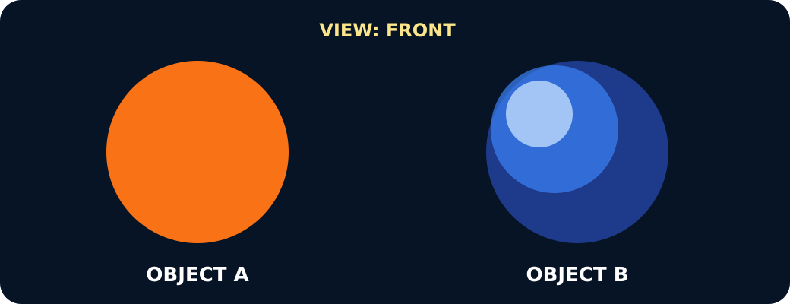
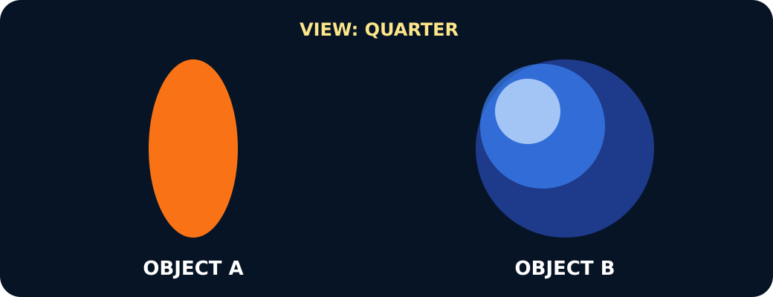
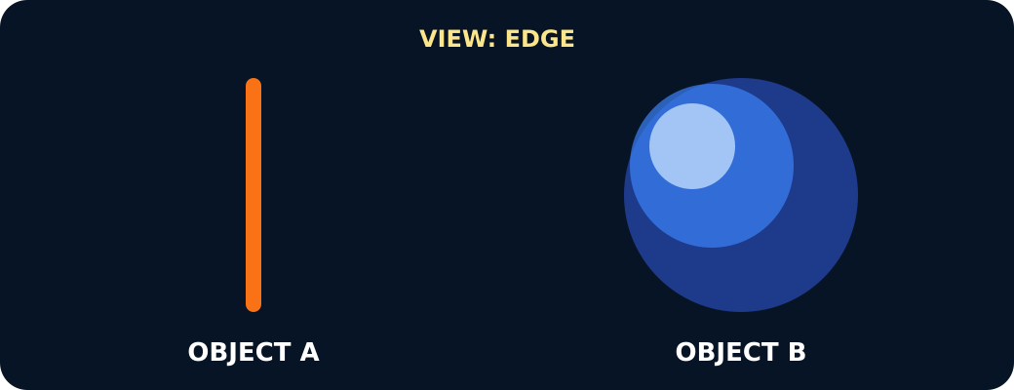
GROW / SCIENCE
STARTER
Look closely · what is the evidence?
A disc and a sphere both look round from the front
After a quarter turn the disc looks oval, the sphere still round
From the edge the disc is a line, the sphere still round
STARTER · 4 min across this stage
6 / 17
Notes:
Companion for SCI_G_W9A_Spherical_Bodies_Explore.html. Starter: 4 minutes TOTAL across all slides in this stage.
Protect curiosity: receive every first idea without judgement.
Ask ‘What makes you think that?’ and preserve the prediction for later evidence.
Model limit: A smooth classroom ball hides mountains, valleys, craters and slight flattening. It models overall shape only.
Full source-stage teaching text:
LOCAL VISUAL HOOK · FRAME 1
Observation 1: both have a round front outline.
From the front, A and B look the same: a circle.
LOCAL VISUAL HOOK · FRAME 2
Observation 2: after a quarter turn, A looks oval; B still looks round.
One turn, two different results. Evidence.
LOCAL VISUAL HOOK · FRAME 3
Observation 3: from the edge, A is a thin line; B still looks round.
A flat disc hides. A sphere looks round from every side.
Commit one first idea. Predictions are held, not marked. Pointing, selecting, saying or signing all count.
It must be a flat disc.
It must be a sphere.
One view is not enough; collect shape evidence from other views.
HTML controls remain in the original HTML file. PowerPoint contains editable teaching text and static source visuals; use the paper response route for sorting and investigation.
[Sources]
Uploaded lesson: SCI_G_W9A_Spherical_Bodies_Explore.html
[/Sources]

Slide 7
GROW / SCIENCE
I DO
Words we will use
• sphere — ball shape
• disc — flat circle
• approximately — close to
I DO · 5 min across this stage
7 / 17
Notes:
Companion for SCI_G_W9A_Spherical_Bodies_Explore.html. I do: 5 minutes TOTAL across all slides in this stage.
Let the teacher/model carry the explanation; pupils watch, point or track.
Use a visual cue only if access is the barrier, then fade it.
Model limit: A smooth classroom ball hides mountains, valleys, craters and slight flattening. It models overall shape only.
Full source-stage teaching text:
SPHERE ball shape a three-dimensional shape with a curved surface around a centre
DISC flat circle a thin, flat circular shape
APPROXIMATELY close to nearly, but not exactly
WHAT THIS MODEL HELPS US SEE
Use the comparison frame: When turned, the disc __, but the sphere __. Therefore…
WHAT THIS MODEL DOES NOT SHOW
A smooth classroom ball hides mountains, valleys, craters and slight flattening. It models overall shape only.
Step 1
Hold a flat disc and a ball front-on. Record honestly that both outlines can look circular.
Step 2
Turn each object by a quarter turn and then edge-on. Record how the disc outline changes but the ball's outline stays round.
Step 3
Conclude from several views: repeated round outlines support a sphere; a single circle does not prove it.
Viewpoint viewer · turn both objects together
Same turn for both. Say what you SEE before you say what it IS.
Front
↻ Quarter turn
↻ Edge on
Front: A looks round. B looks round. Not enough evidence yet.
A is a flat disc
B is a sphere
One photo proves a sphere
Real space evidence uses the same idea: photographs of Earth from many directions all show a round outline, and the Moon's lit edge is always curved. Approximately spherical — not perfect: Earth bulges slightly at the equator.
HTML controls remain in the original HTML file. PowerPoint contains editable teaching text and static source visuals; use the paper response route for sorting and investigation.
[Sources]
Uploaded lesson: SCI_G_W9A_Spherical_Bodies_Explore.html
[/Sources]

Slide 8
GROW / SCIENCE
I DO
Watch the model
• Hold a flat disc and a ball front-on. Record honestly that both outlines can look circular.
• Turn each object by a quarter turn and then edge-on. Record how the disc outline changes but the ball's outline stays round.
• Conclude from several views: repeated round outlines support a sphere; a single circle does not prove it.
I DO · 5 min across this stage
8 / 17
Notes:
Companion for SCI_G_W9A_Spherical_Bodies_Explore.html. I do: 5 minutes TOTAL across all slides in this stage.
Let the teacher/model carry the explanation; pupils watch, point or track.
Use a visual cue only if access is the barrier, then fade it.
Model limit: A smooth classroom ball hides mountains, valleys, craters and slight flattening. It models overall shape only.
Full source-stage teaching text:
SPHERE ball shape a three-dimensional shape with a curved surface around a centre
DISC flat circle a thin, flat circular shape
APPROXIMATELY close to nearly, but not exactly
WHAT THIS MODEL HELPS US SEE
Use the comparison frame: When turned, the disc __, but the sphere __. Therefore…
WHAT THIS MODEL DOES NOT SHOW
A smooth classroom ball hides mountains, valleys, craters and slight flattening. It models overall shape only.
Step 1
Hold a flat disc and a ball front-on. Record honestly that both outlines can look circular.
Step 2
Turn each object by a quarter turn and then edge-on. Record how the disc outline changes but the ball's outline stays round.
Step 3
Conclude from several views: repeated round outlines support a sphere; a single circle does not prove it.
Viewpoint viewer · turn both objects together
Same turn for both. Say what you SEE before you say what it IS.
Front
↻ Quarter turn
↻ Edge on
Front: A looks round. B looks round. Not enough evidence yet.
A is a flat disc
B is a sphere
One photo proves a sphere
Real space evidence uses the same idea: photographs of Earth from many directions all show a round outline, and the Moon's lit edge is always curved. Approximately spherical — not perfect: Earth bulges slightly at the equator.
HTML controls remain in the original HTML file. PowerPoint contains editable teaching text and static source visuals; use the paper response route for sorting and investigation.
[Sources]
Uploaded lesson: SCI_G_W9A_Spherical_Bodies_Explore.html
[/Sources]

Slide 9
GROW / SCIENCE
I DO
Watch the model
A disc and a sphere seen from the chosen viewpoint
I DO · 5 min across this stage
9 / 17
Notes:
Companion for SCI_G_W9A_Spherical_Bodies_Explore.html. I do: 5 minutes TOTAL across all slides in this stage.
Let the teacher/model carry the explanation; pupils watch, point or track.
Use a visual cue only if access is the barrier, then fade it.
Model limit: A smooth classroom ball hides mountains, valleys, craters and slight flattening. It models overall shape only.
Full source-stage teaching text:
SPHERE ball shape a three-dimensional shape with a curved surface around a centre
DISC flat circle a thin, flat circular shape
APPROXIMATELY close to nearly, but not exactly
WHAT THIS MODEL HELPS US SEE
Use the comparison frame: When turned, the disc __, but the sphere __. Therefore…
WHAT THIS MODEL DOES NOT SHOW
A smooth classroom ball hides mountains, valleys, craters and slight flattening. It models overall shape only.
Step 1
Hold a flat disc and a ball front-on. Record honestly that both outlines can look circular.
Step 2
Turn each object by a quarter turn and then edge-on. Record how the disc outline changes but the ball's outline stays round.
Step 3
Conclude from several views: repeated round outlines support a sphere; a single circle does not prove it.
Viewpoint viewer · turn both objects together
Same turn for both. Say what you SEE before you say what it IS.
Front
↻ Quarter turn
↻ Edge on
Front: A looks round. B looks round. Not enough evidence yet.
A is a flat disc
B is a sphere
One photo proves a sphere
Real space evidence uses the same idea: photographs of Earth from many directions all show a round outline, and the Moon's lit edge is always curved. Approximately spherical — not perfect: Earth bulges slightly at the equator.
HTML controls remain in the original HTML file. PowerPoint contains editable teaching text and static source visuals; use the paper response route for sorting and investigation.
[Sources]
Uploaded lesson: SCI_G_W9A_Spherical_Bodies_Explore.html
[/Sources]

Slide 10
GROW / SCIENCE
WE DO
Which observation best separates a sphere from a flat disc?
A. Both look circular from directly in front.
B. The sphere keeps a round outline when turned; the disc narrows.
C. Both can roll in some way.
Commit to an answer. Show the evidence you used. Listen, then revise if needed.
WE DO · 5 min across this stage
10 / 17
Notes:
Companion for SCI_G_W9A_Spherical_Bodies_Explore.html. We do: 5 minutes TOTAL across all slides in this stage.
Scan every response mode. Do not infer understanding from handwriting or confidence.
Secure: transfer. Mixed: contrast. Misconception: counterexample then a fresh question.
Ask every learner to commit privately before feedback. Use the pupil cards, table or evidence sheet; pointing, saying, signing and directing a partner are valid routes.
Model limit: A smooth classroom ball hides mountains, valleys, craters and slight flattening. It models overall shape only.
Full source-stage teaching text:
Everyone commits before explanation.
Use a button, point, say/sign or let an adult operate the chosen button. A retry is information, not a penalty.
Audience move:
Both look circular from directly in front.
The sphere keeps a round outline when turned; the disc narrows.
Both can roll in some way.
HTML controls remain in the original HTML file. PowerPoint contains editable teaching text and static source visuals; use the paper response route for sorting and investigation.
[Sources]
Uploaded lesson: SCI_G_W9A_Spherical_Bodies_Explore.html
[/Sources]

Slide 11
GROW / SCIENCE
I DO 2
Build the explanation
• The ball-and-disc test shows what two shapes can look like, but it is only a model. Check it against real observations.
• Real Earth and Moon evidence: changing spacecraft views keep showing round whole-body outlines. During a lunar eclipse, Earth's shadow on the Moon is curved.
• Real Sun evidence: its edge is curved and features move across its face as it rotates. Together the observations support approximately spherical bodies; gravity makes large bodies nearly round, rotation slightly flattens them and surface features add small bumps.
I DO 2 · 4 min across this stage
11 / 17
Notes:
Companion for SCI_G_W9A_Spherical_Bodies_Explore.html. I do 2: 4 minutes TOTAL across all slides in this stage.
Model one complete evidence-to-explanation sentence, then pause.
Keep the science words; change density, modality or adult role before changing the goal.
Model limit: A smooth classroom ball hides mountains, valleys, craters and slight flattening. It models overall shape only.
Full source-stage teaching text:
Connection: the model is useful when its visible pattern is translated into a scientific explanation.
Connection 1
The ball-and-disc test shows what two shapes can look like, but it is only a model. Check it against real observations.
Connection 2
Real Earth and Moon evidence: changing spacecraft views keep showing round whole-body outlines. During a lunar eclipse, Earth's shadow on the Moon is curved.
Connection 3
Real Sun evidence: its edge is curved and features move across its face as it rotates. Together the observations support approximately spherical bodies; gravity makes large bodies nearly round, rotation slightly flattens them and surface features add small bumps.
MODEL STRENGTH
Use the comparison frame: When turned, the disc __, but the sphere __. Therefore…
MODEL LIMIT
A smooth classroom ball hides mountains, valleys, craters and slight flattening. It models overall shape only.
HTML controls remain in the original HTML file. PowerPoint contains editable teaching text and static source visuals; use the paper response route for sorting and investigation.
[Sources]
Uploaded lesson: SCI_G_W9A_Spherical_Bodies_Explore.html
[/Sources]

Slide 12
GROW / SCIENCE
I DO 2
Find and repair the misconception
Evidence glitch: Earth looks circular in one photograph, so that photograph proves it is a sphere.
A. Keep it: every circle must be a sphere.
B. Repair it: one view fits a disc too; combine evidence from different viewpoints.
C. Repair it: every distant object is flat.
I DO 2 · 4 min across this stage
12 / 17
Notes:
Companion for SCI_G_W9A_Spherical_Bodies_Explore.html. I do 2: 4 minutes TOTAL across all slides in this stage.
Model one complete evidence-to-explanation sentence, then pause.
Keep the science words; change density, modality or adult role before changing the goal.
Model limit: A smooth classroom ball hides mountains, valleys, craters and slight flattening. It models overall shape only.
Full source-stage teaching text:
Connection: the model is useful when its visible pattern is translated into a scientific explanation.
Connection 1
The ball-and-disc test shows what two shapes can look like, but it is only a model. Check it against real observations.
Connection 2
Real Earth and Moon evidence: changing spacecraft views keep showing round whole-body outlines. During a lunar eclipse, Earth's shadow on the Moon is curved.
Connection 3
Real Sun evidence: its edge is curved and features move across its face as it rotates. Together the observations support approximately spherical bodies; gravity makes large bodies nearly round, rotation slightly flattens them and surface features add small bumps.
MODEL STRENGTH
Use the comparison frame: When turned, the disc __, but the sphere __. Therefore…
MODEL LIMIT
A smooth classroom ball hides mountains, valleys, craters and slight flattening. It models overall shape only.
HTML controls remain in the original HTML file. PowerPoint contains editable teaching text and static source visuals; use the paper response route for sorting and investigation.
[Sources]
Uploaded lesson: SCI_G_W9A_Spherical_Bodies_Explore.html
[/Sources]

Slide 13
GROW / SCIENCE
WE DO 2
Shape evidence sorter
Sort model observations and real space evidence. Use both kinds before making the shape claim.
• Select an observation card.
• Commit it to disc, sphere or real space evidence.
• Use the feedback to compare what was seen.
• Freeze model and real evidence, then state the shape claim.
Use the numbered cards in your pupil pack. Take turns to choose, justify and check. You may direct a partner to move a card.
WE DO 2 · 4 min across this stage
13 / 17
Notes:
Companion for SCI_G_W9A_Spherical_Bodies_Explore.html. We do 2: 4 minutes TOTAL across all slides in this stage.
Protect pupil operation and thinking; support handling only where needed.
Ask what changed and what stayed the same before supplying a scientific word.
Ask every learner to commit privately before feedback. Use the pupil cards, table or evidence sheet; pointing, saying, signing and directing a partner are valid routes.
Model limit: A smooth classroom ball hides mountains, valleys, craters and slight flattening. It models overall shape only.
Full source-stage teaching text:
Sort model observations and real space evidence. Use both kinds before making the shape claim.
Select an observation card. Commit it to disc, sphere or real space evidence. Use the feedback to compare what was seen. Freeze model and real evidence, then state the shape claim.
Cards to place
Object A · front It looks circular from the front but becomes oval as it turns.
Object A · edge It becomes a very thin line when viewed edge-on.
Object A · full turn Its outline repeats circle, oval, line, oval, circle.
Object B · front It has a round outline from the first viewpoint.
Object B · quarter turn After a quarter turn, its outline remains round rather than becoming oval.
Object B · edge direction From the direction that made the disc a line, this object still looks round.
Spacecraft views Pictures taken from changing positions and times show Earth and the Moon with round whole-body outlines.
Lunar eclipse When Earth passes between the Sun and Moon, Earth's shadow moving across the Moon has a curved edge.
Curved day-night edge Space images show a curved line between day and night moving across Earth and the Moon as lighting and viewpoint change.
Sun observations Space instruments show the Sun's curved edge, while visible features move across its face as the Sun rotates.
Matching groups
Flat disc evidence
Sphere model evidence
Real space evidence
Freeze evidence
↺ Reset and retry
Science glitch · find and repair it
Claim: Evidence glitch: Earth looks circular in one photograph, so that photograph proves it is a sphere.
Keep it: every circle must be a sphere.
Repair it: one view fits a disc too; combine evidence from different viewpoints.
Repair it: every distant object is flat.
HTML controls remain in the original HTML file. PowerPoint contains editable teaching text and static source visuals; use the paper response route for sorting and investigation.
[Sources]
Uploaded lesson: SCI_G_W9A_Spherical_Bodies_Explore.html
[/Sources]

Slide 14
GROW / SCIENCE
WE DO 2
Choose a group · defend your placement
• Flat disc evidence
• Sphere model evidence
• Real space evidence
Use one model comparison and one real space observation to justify your conclusion.
WE DO 2 · 4 min across this stage
14 / 17
Notes:
Companion for SCI_G_W9A_Spherical_Bodies_Explore.html. We do 2: 4 minutes TOTAL across all slides in this stage.
Protect pupil operation and thinking; support handling only where needed.
Ask what changed and what stayed the same before supplying a scientific word.
Ask every learner to commit privately before feedback. Use the pupil cards, table or evidence sheet; pointing, saying, signing and directing a partner are valid routes.
Model limit: A smooth classroom ball hides mountains, valleys, craters and slight flattening. It models overall shape only.
Full source-stage teaching text:
Sort model observations and real space evidence. Use both kinds before making the shape claim.
Select an observation card. Commit it to disc, sphere or real space evidence. Use the feedback to compare what was seen. Freeze model and real evidence, then state the shape claim.
Cards to place
Object A · front It looks circular from the front but becomes oval as it turns.
Object A · edge It becomes a very thin line when viewed edge-on.
Object A · full turn Its outline repeats circle, oval, line, oval, circle.
Object B · front It has a round outline from the first viewpoint.
Object B · quarter turn After a quarter turn, its outline remains round rather than becoming oval.
Object B · edge direction From the direction that made the disc a line, this object still looks round.
Spacecraft views Pictures taken from changing positions and times show Earth and the Moon with round whole-body outlines.
Lunar eclipse When Earth passes between the Sun and Moon, Earth's shadow moving across the Moon has a curved edge.
Curved day-night edge Space images show a curved line between day and night moving across Earth and the Moon as lighting and viewpoint change.
Sun observations Space instruments show the Sun's curved edge, while visible features move across its face as the Sun rotates.
Matching groups
Flat disc evidence
Sphere model evidence
Real space evidence
Freeze evidence
↺ Reset and retry
Science glitch · find and repair it
Claim: Evidence glitch: Earth looks circular in one photograph, so that photograph proves it is a sphere.
Keep it: every circle must be a sphere.
Repair it: one view fits a disc too; combine evidence from different viewpoints.
Repair it: every distant object is flat.
HTML controls remain in the original HTML file. PowerPoint contains editable teaching text and static source visuals; use the paper response route for sorting and investigation.
[Sources]
Uploaded lesson: SCI_G_W9A_Spherical_Bodies_Explore.html
[/Sources]

Slide 15
GROW / SCIENCE
INDEPENDENT
Your independent mission
Create a multi-view evidence case that distinguishes a disc from a sphere and applies the conclusion to the Sun, Earth and Moon.
Record: A three-view model comparison, one cited real space observation and a conclusion naming the Sun, Earth and Moon as approximately spherical.
INDEPENDENT · 10 min across this stage
15 / 17
Notes:
Companion for SCI_G_W9A_Spherical_Bodies_Explore.html. Independent: 10 minutes TOTAL across all slides in this stage.
Protect independence. Accept equivalent evidence routes and scribe exact meaning.
Prompt only as much as needed; fade as soon as the pupil continues.
Model limit: A smooth classroom ball hides mountains, valleys, craters and slight flattening. It models overall shape only.
Full source-stage teaching text:
Physical route
Ball, safe card disc or large counter, viewing mat, three-view recording strip and pencil.
Same outcome: I can use observations from different viewpoints to describe the Sun, Earth and Moon as approximately spherical bodies.
Offline digital / director route
Use the included front, quarter and edge frames plus the local spacecraft, eclipse and curved day-night-edge cards. Mark which evidence shows the clearest difference.
Same evidence: A three-view model comparison, one cited real space observation and a conclusion naming the Sun, Earth and Moon as approximately spherical.
Equipment / setup Ball, safe card disc or large counter, viewing mat, three-view recording strip and pencil.
Safety / sensory Use large objects that cannot be swallowed. Keep objects on the table and do not throw or shine lights at anyone.
Offline parity Use the included front, quarter and edge frames plus the local spacecraft, eclipse and curved day-night-edge cards. Mark which evidence shows the clearest difference.
No-equipment/access route: Use printed silhouettes for front, quarter and edge views, or trace around a cup lid and a ball shown by an adult.
▲ Standard
Record three views of each model, then add one real space observation before making the shape claim.
Scaffold
Use one model difference, one real observation and the phrase approximately spherical.
Evidence gate
HTML controls remain in the original HTML file. PowerPoint contains editable teaching text and static source visuals; use the paper response route for sorting and investigation.
[Sources]
Uploaded lesson: SCI_G_W9A_Spherical_Bodies_Explore.html
[/Sources]

Slide 16
GROW / SCIENCE
INDEPENDENT
Choose your support and challenge
• Supported: Sort six view cards, then complete: A disc changes from __ to __. A sphere stays __.
• Standard: Record three views of each model, then add one real space observation before making the shape claim.
• Stretch: Explain why one circular picture is insufficient and why perfect sphere is also too strong.
INDEPENDENT · 10 min across this stage
16 / 17
Notes:
Companion for SCI_G_W9A_Spherical_Bodies_Explore.html. Independent: 10 minutes TOTAL across all slides in this stage.
Protect independence. Accept equivalent evidence routes and scribe exact meaning.
Prompt only as much as needed; fade as soon as the pupil continues.
Model limit: A smooth classroom ball hides mountains, valleys, craters and slight flattening. It models overall shape only.
Full source-stage teaching text:
Physical route
Ball, safe card disc or large counter, viewing mat, three-view recording strip and pencil.
Same outcome: I can use observations from different viewpoints to describe the Sun, Earth and Moon as approximately spherical bodies.
Offline digital / director route
Use the included front, quarter and edge frames plus the local spacecraft, eclipse and curved day-night-edge cards. Mark which evidence shows the clearest difference.
Same evidence: A three-view model comparison, one cited real space observation and a conclusion naming the Sun, Earth and Moon as approximately spherical.
Equipment / setup Ball, safe card disc or large counter, viewing mat, three-view recording strip and pencil.
Safety / sensory Use large objects that cannot be swallowed. Keep objects on the table and do not throw or shine lights at anyone.
Offline parity Use the included front, quarter and edge frames plus the local spacecraft, eclipse and curved day-night-edge cards. Mark which evidence shows the clearest difference.
No-equipment/access route: Use printed silhouettes for front, quarter and edge views, or trace around a cup lid and a ball shown by an adult.
▲ Standard
Record three views of each model, then add one real space observation before making the shape claim.
Scaffold
Use one model difference, one real observation and the phrase approximately spherical.
Evidence gate
HTML controls remain in the original HTML file. PowerPoint contains editable teaching text and static source visuals; use the paper response route for sorting and investigation.
[Sources]
Uploaded lesson: SCI_G_W9A_Spherical_Bodies_Explore.html
[/Sources]

Slide 17
GROW / SCIENCE
EXIT
Show what you know
Use one model observation and one real space observation to explain why Earth is described as approximately spherical.
Point to, read or explain the evidence you made. Choose one next step after the adult has listened.
EXIT · 4 min across this stage
17 / 17
Notes:
Companion for SCI_G_W9A_Spherical_Bodies_Explore.html. Exit: 4 minutes TOTAL across all slides in this stage.
Genuinely receive one final response and name back the Science heard or seen.
Choose one visible next move. The pupil writes what they said and what changed.
Model limit: A smooth classroom ball hides mountains, valleys, craters and slight flattening. It models overall shape only.
Full source-stage teaching text:
Standard
Use one model observation and one real space observation to explain why Earth is described as approximately spherical.
Adult Audience
The familiar adult genuinely receives the pupil response, then says back the Science they heard or saw. The adult does not add a score or rewrite the pupil.
What I said, and what it changed:
Next I will ______. One next step chosen after the adult listened.
HTML controls remain in the original HTML file. PowerPoint contains editable teaching text and static source visuals; use the paper response route for sorting and investigation.
[Sources]
Uploaded lesson: SCI_G_W9A_Spherical_Bodies_Explore.html
[/Sources]

