Slide 1
GROW / SCIENCE
OVERVIEW
Spherical Bodies: World Shape Lab
I can collect fair comparison observations and combine them with real space evidence to describe the Sun, Earth and Moon as approximately spherical.
Same viewpoints
use evidence
Six observations
use evidence
Evidenceled conclusion
use evidence
Open the original interactive lesson
40 MINUTES
1 / 17
Notes:
Companion for SCI_G_W9B_Spherical_Bodies_Do.html. Overview: 0 minutes TOTAL across all slides in this stage.
Read setup, safety and sensory notes before pupils enter.
Set predictable Space and keep the learning goal visible.
Model limit: The models show overall shape but not real size, surface detail, gravity, distance or the slight flattening of rotating bodies.
Full source-stage teaching text:
GROW · Science · Week 9B · Do
Learning objective: I can collect fair comparison observations and combine them with real space evidence to describe the Sun, Earth and Moon as approximately spherical.
Success criteria
Observe a disc and sphere from the same three viewpoints.
Record similarities and differences without changing the claim to fit a guess.
Combine model and real space evidence in a conclusion with one honest limitation.
HTML controls remain in the original HTML file. PowerPoint contains editable teaching text and static source visuals; use the paper response route for sorting and investigation.
[Sources]
Uploaded lesson: SCI_G_W9B_Spherical_Bodies_Do.html
[/Sources]

Slide 2
GROW / SCIENCE
OVERVIEW
What success looks like
• Observe a disc and sphere from the same three viewpoints.
• Record similarities and differences without changing the claim to fit a guess.
• Combine model and real space evidence in a conclusion with one honest limitation.
40 MINUTES
2 / 17
Notes:
Companion for SCI_G_W9B_Spherical_Bodies_Do.html. Overview: 0 minutes TOTAL across all slides in this stage.
Read setup, safety and sensory notes before pupils enter.
Set predictable Space and keep the learning goal visible.
Model limit: The models show overall shape but not real size, surface detail, gravity, distance or the slight flattening of rotating bodies.
Full source-stage teaching text:
GROW · Science · Week 9B · Do
Learning objective: I can collect fair comparison observations and combine them with real space evidence to describe the Sun, Earth and Moon as approximately spherical.
Success criteria
Observe a disc and sphere from the same three viewpoints.
Record similarities and differences without changing the claim to fit a guess.
Combine model and real space evidence in a conclusion with one honest limitation.
HTML controls remain in the original HTML file. PowerPoint contains editable teaching text and static source visuals; use the paper response route for sorting and investigation.
[Sources]
Uploaded lesson: SCI_G_W9B_Spherical_Bodies_Do.html
[/Sources]

Slide 3
GROW / SCIENCE
ARRIVAL
Retrieve and reconnect
• Last lesson: why was one circular view insufficient?
• Last lesson: what happened to the disc outline as it turned?
• Last week: how did Earth's curved surface affect light and darkness?
• Lead-in: what must stay the same for a fair shape comparison?
ARRIVAL · 3 min across this stage
3 / 17
Notes:
Companion for SCI_G_W9B_Spherical_Bodies_Do.html. Arrival: 3 minutes TOTAL across all slides in this stage.
Wait, regulate and retrieve through the lightest workable route.
If recall is inaccessible, point to one retrieval sentence; do not teach today’s answer.
Model limit: The models show overall shape but not real size, surface detail, gravity, distance or the slight flattening of rotating bodies.
Full source-stage teaching text:
Retrieve only what has already been taught
In Explore, several viewpoints separated a flat disc from a sphere; one circular view was insufficient.
Prior week: point to or describe one useful model.
Older learning: what makes an observation useful as evidence?
Lead-in: what do you notice in today’s first picture?
New to this class, absent, or not sure? Everything needed is in the retrieval box above. Read it, point to it or ask a familiar adult to read it exactly.
▲ Standard
Last lesson: why was one circular view insufficient?
Last lesson: what happened to the disc outline as it turned?
Last week: how did Earth's curved surface affect light and darkness?
Lead-in: what must stay the same for a fair shape comparison?
Read-aloud route: a familiar adult may read the task exactly while the text remains visible. No device voice or media permission is required.
HTML controls remain in the original HTML file. PowerPoint contains editable teaching text and static source visuals; use the paper response route for sorting and investigation.
[Sources]
Uploaded lesson: SCI_G_W9B_Spherical_Bodies_Do.html
[/Sources]

Slide 4
GROW / SCIENCE
STARTER
Which result would most strongly challenge a flat-disc model? Commit before seeing the method.
Think first. Point, say, sign or write your choice. Give one reason.
A. The body looks circular from the front.
B. The outline stays round from front, quarter and edge directions.
C. The object can move across a table.
STARTER · 3 min across this stage
4 / 17
Notes:
Companion for SCI_G_W9B_Spherical_Bodies_Do.html. Starter: 3 minutes TOTAL across all slides in this stage.
Protect curiosity: receive every first idea without judgement.
Ask ‘What makes you think that?’ and preserve the prediction for later evidence.
Model limit: The models show overall shape but not real size, surface detail, gravity, distance or the slight flattening of rotating bodies.
Full source-stage teaching text:
LOCAL VISUAL HOOK · FRAME 1
Observation 1: both look round from the front.
Same distance, same view, same result.
LOCAL VISUAL HOOK · FRAME 2
Observation 2: after the same quarter turn, one looks oval and one stays round.
A fair comparison: the same turn for both.
LOCAL VISUAL HOOK · FRAME 3
Observation 3: from the edge, one is a thin line and one stays round.
Record it. Then add real space evidence.
Commit one first idea. Predictions are held, not marked. Pointing, selecting, saying or signing all count.
The body looks circular from the front.
The outline stays round from front, quarter and edge directions.
The object can move across a table.
HTML controls remain in the original HTML file. PowerPoint contains editable teaching text and static source visuals; use the paper response route for sorting and investigation.
[Sources]
Uploaded lesson: SCI_G_W9B_Spherical_Bodies_Do.html
[/Sources]

Slide 5
GROW / SCIENCE
STARTER
Look closely · what is the evidence?
Observation 1: both objects look round from the front.
Observation 2: after the same quarter turn, one looks oval and one stays round.
Observation 3: from the edge direction, one is a thin line and one stays round.
STARTER · 3 min across this stage
5 / 17
Notes:
Companion for SCI_G_W9B_Spherical_Bodies_Do.html. Starter: 3 minutes TOTAL across all slides in this stage.
Protect curiosity: receive every first idea without judgement.
Ask ‘What makes you think that?’ and preserve the prediction for later evidence.
Model limit: The models show overall shape but not real size, surface detail, gravity, distance or the slight flattening of rotating bodies.
Full source-stage teaching text:
LOCAL VISUAL HOOK · FRAME 1
Observation 1: both look round from the front.
Same distance, same view, same result.
LOCAL VISUAL HOOK · FRAME 2
Observation 2: after the same quarter turn, one looks oval and one stays round.
A fair comparison: the same turn for both.
LOCAL VISUAL HOOK · FRAME 3
Observation 3: from the edge, one is a thin line and one stays round.
Record it. Then add real space evidence.
Commit one first idea. Predictions are held, not marked. Pointing, selecting, saying or signing all count.
The body looks circular from the front.
The outline stays round from front, quarter and edge directions.
The object can move across a table.
HTML controls remain in the original HTML file. PowerPoint contains editable teaching text and static source visuals; use the paper response route for sorting and investigation.
[Sources]
Uploaded lesson: SCI_G_W9B_Spherical_Bodies_Do.html
[/Sources]

Slide 6
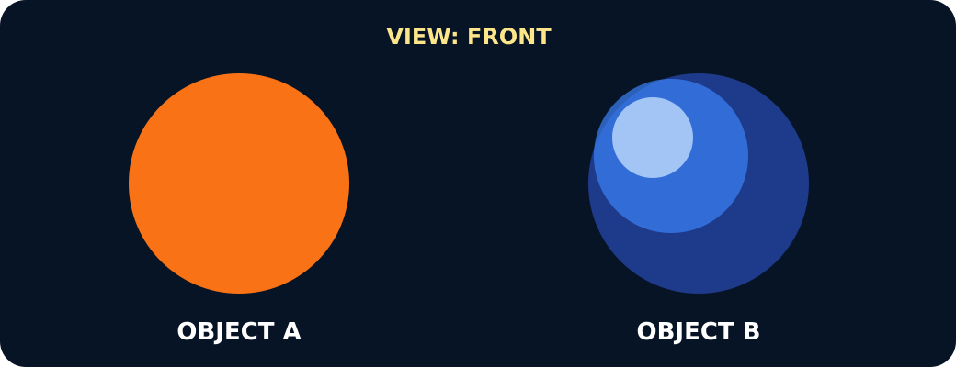
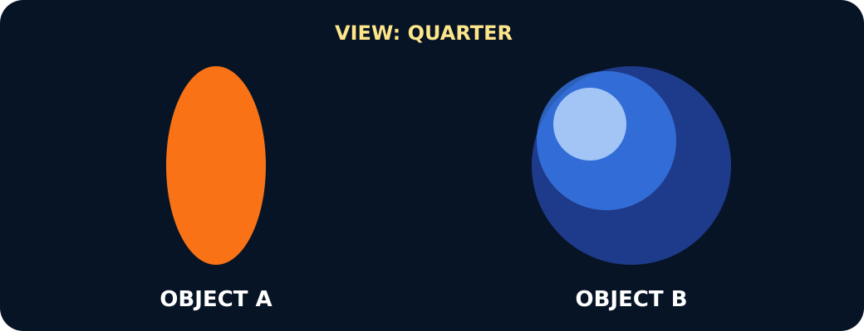
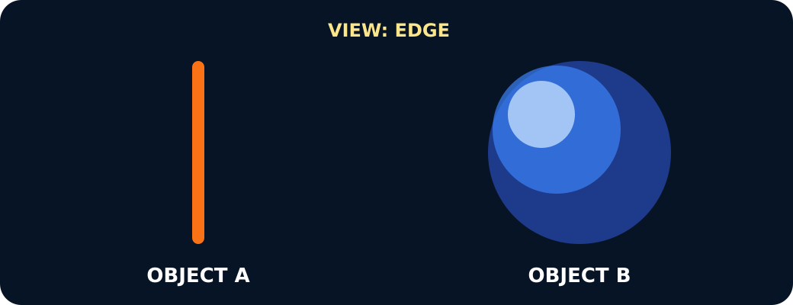
GROW / SCIENCE
STARTER
Look closely · what is the evidence?
Both objects round from the front
One oval, one round after the same turn
One a line, one round from the edge
STARTER · 3 min across this stage
6 / 17
Notes:
Companion for SCI_G_W9B_Spherical_Bodies_Do.html. Starter: 3 minutes TOTAL across all slides in this stage.
Protect curiosity: receive every first idea without judgement.
Ask ‘What makes you think that?’ and preserve the prediction for later evidence.
Model limit: The models show overall shape but not real size, surface detail, gravity, distance or the slight flattening of rotating bodies.
Full source-stage teaching text:
LOCAL VISUAL HOOK · FRAME 1
Observation 1: both look round from the front.
Same distance, same view, same result.
LOCAL VISUAL HOOK · FRAME 2
Observation 2: after the same quarter turn, one looks oval and one stays round.
A fair comparison: the same turn for both.
LOCAL VISUAL HOOK · FRAME 3
Observation 3: from the edge, one is a thin line and one stays round.
Record it. Then add real space evidence.
Commit one first idea. Predictions are held, not marked. Pointing, selecting, saying or signing all count.
The body looks circular from the front.
The outline stays round from front, quarter and edge directions.
The object can move across a table.
HTML controls remain in the original HTML file. PowerPoint contains editable teaching text and static source visuals; use the paper response route for sorting and investigation.
[Sources]
Uploaded lesson: SCI_G_W9B_Spherical_Bodies_Do.html
[/Sources]

Slide 7
GROW / SCIENCE
I DO
Words we will use
• observation — what is noticed
• comparison — same test for both
• conclusion — what the evidence means
I DO · 4 min across this stage
7 / 17
Notes:
Companion for SCI_G_W9B_Spherical_Bodies_Do.html. I do: 4 minutes TOTAL across all slides in this stage.
Let the teacher/model carry the explanation; pupils watch, point or track.
Use a visual cue only if access is the barrier, then fade it.
Model limit: The models show overall shape but not real size, surface detail, gravity, distance or the slight flattening of rotating bodies.
Full source-stage teaching text:
OBSERVATION what is noticed information directly seen, heard or measured
COMPARISON same test for both looking for what is the same and different using the same method
CONCLUSION what the evidence means a statement supported by results
WHAT THIS MODEL HELPS US SEE
Record with the frame: From the __ view, the disc looked __ while the sphere looked __.
WHAT THIS MODEL DOES NOT SHOW
The models show overall shape but not real size, surface detail, gravity, distance or the slight flattening of rotating bodies.
Step 1
Place the disc and sphere at the same marked distance. Observe both from the front without naming the expected answer.
Step 2
Turn both through the same quarter turn, then to the edge direction. Record only the outline seen each time.
Step 3
Check the six observations before concluding. A fair comparison uses the same viewpoints for both objects.
World Shape Lab · fair test, then real evidence
Same turn for both. Say what you SEE before you say what it IS.
Front
↻ Quarter turn
↻ Edge on
Front: A looks round. B looks round. Not enough evidence yet.
A is a flat disc
B is a sphere
One photo proves a sphere
Real space evidence uses the same idea: photographs of Earth from many directions all show a round outline, and the Moon's lit edge is always curved. Approximately spherical — not perfect: Earth bulges slightly at the equator.
Real space evidence · does it fit a sphere?
Press each piece of evidence. Decide: does it SUPPORT approximately spherical, or is it a LIMIT?
Photos of Earth from different directions all show a round outline
The Moon’s lit edge is always a curve, never a straight line
Earth’s shadow on the Moon in a lunar eclipse is round
Standing on a beach, the ground looks flat
Careful measurements show Earth is slightly wider at the equator
SUPPORTS sphere
LIMIT / needs care
Press one piece of evidence.
HTML controls remain in the original HTML file. PowerPoint contains editable teaching text and static source visuals; use the paper response route for sorting and investigation.
[Sources]
Uploaded lesson: SCI_G_W9B_Spherical_Bodies_Do.html
[/Sources]

Slide 8
GROW / SCIENCE
I DO
Watch the model
• Place the disc and sphere at the same marked distance. Observe both from the front without naming the expected answer.
• Turn both through the same quarter turn, then to the edge direction. Record only the outline seen each time.
• Check the six observations before concluding. A fair comparison uses the same viewpoints for both objects.
I DO · 4 min across this stage
8 / 17
Notes:
Companion for SCI_G_W9B_Spherical_Bodies_Do.html. I do: 4 minutes TOTAL across all slides in this stage.
Let the teacher/model carry the explanation; pupils watch, point or track.
Use a visual cue only if access is the barrier, then fade it.
Model limit: The models show overall shape but not real size, surface detail, gravity, distance or the slight flattening of rotating bodies.
Full source-stage teaching text:
OBSERVATION what is noticed information directly seen, heard or measured
COMPARISON same test for both looking for what is the same and different using the same method
CONCLUSION what the evidence means a statement supported by results
WHAT THIS MODEL HELPS US SEE
Record with the frame: From the __ view, the disc looked __ while the sphere looked __.
WHAT THIS MODEL DOES NOT SHOW
The models show overall shape but not real size, surface detail, gravity, distance or the slight flattening of rotating bodies.
Step 1
Place the disc and sphere at the same marked distance. Observe both from the front without naming the expected answer.
Step 2
Turn both through the same quarter turn, then to the edge direction. Record only the outline seen each time.
Step 3
Check the six observations before concluding. A fair comparison uses the same viewpoints for both objects.
World Shape Lab · fair test, then real evidence
Same turn for both. Say what you SEE before you say what it IS.
Front
↻ Quarter turn
↻ Edge on
Front: A looks round. B looks round. Not enough evidence yet.
A is a flat disc
B is a sphere
One photo proves a sphere
Real space evidence uses the same idea: photographs of Earth from many directions all show a round outline, and the Moon's lit edge is always curved. Approximately spherical — not perfect: Earth bulges slightly at the equator.
Real space evidence · does it fit a sphere?
Press each piece of evidence. Decide: does it SUPPORT approximately spherical, or is it a LIMIT?
Photos of Earth from different directions all show a round outline
The Moon’s lit edge is always a curve, never a straight line
Earth’s shadow on the Moon in a lunar eclipse is round
Standing on a beach, the ground looks flat
Careful measurements show Earth is slightly wider at the equator
SUPPORTS sphere
LIMIT / needs care
Press one piece of evidence.
HTML controls remain in the original HTML file. PowerPoint contains editable teaching text and static source visuals; use the paper response route for sorting and investigation.
[Sources]
Uploaded lesson: SCI_G_W9B_Spherical_Bodies_Do.html
[/Sources]

Slide 9
GROW / SCIENCE
I DO
Watch the model
A disc and a sphere seen from the chosen viewpoint
I DO · 4 min across this stage
9 / 17
Notes:
Companion for SCI_G_W9B_Spherical_Bodies_Do.html. I do: 4 minutes TOTAL across all slides in this stage.
Let the teacher/model carry the explanation; pupils watch, point or track.
Use a visual cue only if access is the barrier, then fade it.
Model limit: The models show overall shape but not real size, surface detail, gravity, distance or the slight flattening of rotating bodies.
Full source-stage teaching text:
OBSERVATION what is noticed information directly seen, heard or measured
COMPARISON same test for both looking for what is the same and different using the same method
CONCLUSION what the evidence means a statement supported by results
WHAT THIS MODEL HELPS US SEE
Record with the frame: From the __ view, the disc looked __ while the sphere looked __.
WHAT THIS MODEL DOES NOT SHOW
The models show overall shape but not real size, surface detail, gravity, distance or the slight flattening of rotating bodies.
Step 1
Place the disc and sphere at the same marked distance. Observe both from the front without naming the expected answer.
Step 2
Turn both through the same quarter turn, then to the edge direction. Record only the outline seen each time.
Step 3
Check the six observations before concluding. A fair comparison uses the same viewpoints for both objects.
World Shape Lab · fair test, then real evidence
Same turn for both. Say what you SEE before you say what it IS.
Front
↻ Quarter turn
↻ Edge on
Front: A looks round. B looks round. Not enough evidence yet.
A is a flat disc
B is a sphere
One photo proves a sphere
Real space evidence uses the same idea: photographs of Earth from many directions all show a round outline, and the Moon's lit edge is always curved. Approximately spherical — not perfect: Earth bulges slightly at the equator.
Real space evidence · does it fit a sphere?
Press each piece of evidence. Decide: does it SUPPORT approximately spherical, or is it a LIMIT?
Photos of Earth from different directions all show a round outline
The Moon’s lit edge is always a curve, never a straight line
Earth’s shadow on the Moon in a lunar eclipse is round
Standing on a beach, the ground looks flat
Careful measurements show Earth is slightly wider at the equator
SUPPORTS sphere
LIMIT / needs care
Press one piece of evidence.
HTML controls remain in the original HTML file. PowerPoint contains editable teaching text and static source visuals; use the paper response route for sorting and investigation.
[Sources]
Uploaded lesson: SCI_G_W9B_Spherical_Bodies_Do.html
[/Sources]

Slide 10
GROW / SCIENCE
WE DO
Which method gives the fairest shape comparison?
A. View the disc close-up and the sphere from across the room.
B. Use the same distance and the same three viewpoints for both.
C. View only the front of whichever object looks roundest.
Commit to an answer. Show the evidence you used. Listen, then revise if needed.
WE DO · 4 min across this stage
10 / 17
Notes:
Companion for SCI_G_W9B_Spherical_Bodies_Do.html. We do: 4 minutes TOTAL across all slides in this stage.
Scan every response mode. Do not infer understanding from handwriting or confidence.
Secure: transfer. Mixed: contrast. Misconception: counterexample then a fresh question.
Ask every learner to commit privately before feedback. Use the pupil cards, table or evidence sheet; pointing, saying, signing and directing a partner are valid routes.
Model limit: The models show overall shape but not real size, surface detail, gravity, distance or the slight flattening of rotating bodies.
Full source-stage teaching text:
Everyone commits before explanation.
Use a button, point, say/sign or let an adult operate the chosen button. A retry is information, not a penalty.
Audience move:
View the disc close-up and the sphere from across the room.
Use the same distance and the same three viewpoints for both.
View only the front of whichever object looks roundest.
HTML controls remain in the original HTML file. PowerPoint contains editable teaching text and static source visuals; use the paper response route for sorting and investigation.
[Sources]
Uploaded lesson: SCI_G_W9B_Spherical_Bodies_Do.html
[/Sources]

Slide 11
GROW / SCIENCE
I DO 2
Build the explanation
• Turn the six model observations into a comparison: the disc outline changes; the sphere's outline stays round.
• Add real observations: spacecraft views keep showing round whole-body outlines, Earth's eclipse shadow is curved, and the curved day-night edge moves across Earth and the Moon.
• Make the careful claim: gravity makes large bodies nearly round; rotation can flatten them slightly, and surface features add small bumps. The Sun, Earth and Moon are approximately spherical.
I DO 2 · 3 min across this stage
11 / 17
Notes:
Companion for SCI_G_W9B_Spherical_Bodies_Do.html. I do 2: 3 minutes TOTAL across all slides in this stage.
Model one complete evidence-to-explanation sentence, then pause.
Keep the science words; change density, modality or adult role before changing the goal.
Model limit: The models show overall shape but not real size, surface detail, gravity, distance or the slight flattening of rotating bodies.
Full source-stage teaching text:
Connection: the model is useful when its visible pattern is translated into a scientific explanation.
Connection 1
Turn the six model observations into a comparison: the disc outline changes; the sphere's outline stays round.
Connection 2
Add real observations: spacecraft views keep showing round whole-body outlines, Earth's eclipse shadow is curved, and the curved day-night edge moves across Earth and the Moon.
Connection 3
Make the careful claim: gravity makes large bodies nearly round; rotation can flatten them slightly, and surface features add small bumps. The Sun, Earth and Moon are approximately spherical.
MODEL STRENGTH
Record with the frame: From the __ view, the disc looked __ while the sphere looked __.
MODEL LIMIT
The models show overall shape but not real size, surface detail, gravity, distance or the slight flattening of rotating bodies.
HTML controls remain in the original HTML file. PowerPoint contains editable teaching text and static source visuals; use the paper response route for sorting and investigation.
[Sources]
Uploaded lesson: SCI_G_W9B_Spherical_Bodies_Do.html
[/Sources]

Slide 12
GROW / SCIENCE
I DO 2
Find and repair the misconception
Conclusion glitch: the Sun, Earth and Moon are perfectly smooth, perfect spheres.
A. Keep it: every spherical body must be perfectly smooth.
B. Repair it: they are approximately spherical, with real surface features and small departures from perfection.
C. Repair it: surface features make all three bodies flat.
I DO 2 · 3 min across this stage
12 / 17
Notes:
Companion for SCI_G_W9B_Spherical_Bodies_Do.html. I do 2: 3 minutes TOTAL across all slides in this stage.
Model one complete evidence-to-explanation sentence, then pause.
Keep the science words; change density, modality or adult role before changing the goal.
Model limit: The models show overall shape but not real size, surface detail, gravity, distance or the slight flattening of rotating bodies.
Full source-stage teaching text:
Connection: the model is useful when its visible pattern is translated into a scientific explanation.
Connection 1
Turn the six model observations into a comparison: the disc outline changes; the sphere's outline stays round.
Connection 2
Add real observations: spacecraft views keep showing round whole-body outlines, Earth's eclipse shadow is curved, and the curved day-night edge moves across Earth and the Moon.
Connection 3
Make the careful claim: gravity makes large bodies nearly round; rotation can flatten them slightly, and surface features add small bumps. The Sun, Earth and Moon are approximately spherical.
MODEL STRENGTH
Record with the frame: From the __ view, the disc looked __ while the sphere looked __.
MODEL LIMIT
The models show overall shape but not real size, surface detail, gravity, distance or the slight flattening of rotating bodies.
HTML controls remain in the original HTML file. PowerPoint contains editable teaching text and static source visuals; use the paper response route for sorting and investigation.
[Sources]
Uploaded lesson: SCI_G_W9B_Spherical_Bodies_Do.html
[/Sources]

Slide 13
GROW / SCIENCE
WE DO 2
Six-observation world shape lab
Sort the model results and real space observations, then freeze enough evidence for a careful conclusion.
• Choose one recorded observation.
• Commit it to disc, sphere or real space evidence.
• Repair using the named view or sky observation.
• Freeze model and real evidence, then conclude.
Use the numbered cards in your pupil pack. Take turns to choose, justify and check. You may direct a partner to move a card.
WE DO 2 · 4 min across this stage
13 / 17
Notes:
Companion for SCI_G_W9B_Spherical_Bodies_Do.html. We do 2: 4 minutes TOTAL across all slides in this stage.
Protect pupil operation and thinking; support handling only where needed.
Ask what changed and what stayed the same before supplying a scientific word.
Ask every learner to commit privately before feedback. Use the pupil cards, table or evidence sheet; pointing, saying, signing and directing a partner are valid routes.
Model limit: The models show overall shape but not real size, surface detail, gravity, distance or the slight flattening of rotating bodies.
Full source-stage teaching text:
Sort the model results and real space observations, then freeze enough evidence for a careful conclusion.
Choose one recorded observation. Commit it to disc, sphere or real space evidence. Repair using the named view or sky observation. Freeze model and real evidence, then conclude.
Cards to place
Front result Round from the front, then oval after the object turns.
Quarter-turn result An oval outline reveals that the circular face is tilted away.
Edge result A thin line is seen from the edge direction.
Front result A round outline is seen from the first direction.
Quarter-turn result The outline remains round after the same quarter turn.
Edge-direction result The outline is still round from the direction that made the disc a line.
Changing spacecraft views Images from changing positions and times show Earth and the Moon with round whole-body outlines.
Earth's eclipse shadow During a lunar eclipse, the edge of Earth's shadow moving across the Moon is curved.
Moving day-night edge Space images show a curved day-night line moving across Earth and the Moon as the view and lighting change.
Sun's curved edge Space instruments show a curved Sun edge and features moving across its face as the Sun rotates.
Matching groups
Disc record
Sphere model record
Real space record
Freeze evidence
↺ Reset and retry
Science glitch · find and repair it
Claim: Conclusion glitch: the Sun, Earth and Moon are perfectly smooth, perfect spheres.
Keep it: every spherical body must be perfectly smooth.
Repair it: they are approximately spherical, with real surface features and small departures from perfection.
Repair it: surface features make all three bodies flat.
HTML controls remain in the original HTML file. PowerPoint contains editable teaching text and static source visuals; use the paper response route for sorting and investigation.
[Sources]
Uploaded lesson: SCI_G_W9B_Spherical_Bodies_Do.html
[/Sources]

Slide 14
GROW / SCIENCE
WE DO 2
Choose a group · defend your placement
• Disc record
• Sphere model record
• Real space record
Use one paired model view and one real space observation in your conclusion.
WE DO 2 · 4 min across this stage
14 / 17
Notes:
Companion for SCI_G_W9B_Spherical_Bodies_Do.html. We do 2: 4 minutes TOTAL across all slides in this stage.
Protect pupil operation and thinking; support handling only where needed.
Ask what changed and what stayed the same before supplying a scientific word.
Ask every learner to commit privately before feedback. Use the pupil cards, table or evidence sheet; pointing, saying, signing and directing a partner are valid routes.
Model limit: The models show overall shape but not real size, surface detail, gravity, distance or the slight flattening of rotating bodies.
Full source-stage teaching text:
Sort the model results and real space observations, then freeze enough evidence for a careful conclusion.
Choose one recorded observation. Commit it to disc, sphere or real space evidence. Repair using the named view or sky observation. Freeze model and real evidence, then conclude.
Cards to place
Front result Round from the front, then oval after the object turns.
Quarter-turn result An oval outline reveals that the circular face is tilted away.
Edge result A thin line is seen from the edge direction.
Front result A round outline is seen from the first direction.
Quarter-turn result The outline remains round after the same quarter turn.
Edge-direction result The outline is still round from the direction that made the disc a line.
Changing spacecraft views Images from changing positions and times show Earth and the Moon with round whole-body outlines.
Earth's eclipse shadow During a lunar eclipse, the edge of Earth's shadow moving across the Moon is curved.
Moving day-night edge Space images show a curved day-night line moving across Earth and the Moon as the view and lighting change.
Sun's curved edge Space instruments show a curved Sun edge and features moving across its face as the Sun rotates.
Matching groups
Disc record
Sphere model record
Real space record
Freeze evidence
↺ Reset and retry
Science glitch · find and repair it
Claim: Conclusion glitch: the Sun, Earth and Moon are perfectly smooth, perfect spheres.
Keep it: every spherical body must be perfectly smooth.
Repair it: they are approximately spherical, with real surface features and small departures from perfection.
Repair it: surface features make all three bodies flat.
HTML controls remain in the original HTML file. PowerPoint contains editable teaching text and static source visuals; use the paper response route for sorting and investigation.
[Sources]
Uploaded lesson: SCI_G_W9B_Spherical_Bodies_Do.html
[/Sources]

Slide 15
GROW / SCIENCE
INDEPENDENT
Your independent mission
Complete the fair three-view comparison and present an evidence-led conclusion about Solar System body shape.
Record: Six model observations, one named real space observation, an approximately spherical conclusion and one model limitation.
INDEPENDENT · 15 min across this stage
15 / 17
Notes:
Companion for SCI_G_W9B_Spherical_Bodies_Do.html. Independent: 15 minutes TOTAL across all slides in this stage.
Protect independence. Accept equivalent evidence routes and scribe exact meaning.
Prompt only as much as needed; fade as soon as the pupil continues.
Model limit: The models show overall shape but not real size, surface detail, gravity, distance or the slight flattening of rotating bodies.
Full source-stage teaching text:
Physical route
Large ball, rigid card disc, three-position viewing mat, six-row record and pencil or camera on a school device.
Same outcome: I can collect fair comparison observations and combine them with real space evidence to describe the Sun, Earth and Moon as approximately spherical.
Offline digital / director route
Annotate the six local model frames and at least one local spacecraft, eclipse or curved day-night-edge card. No web access is needed.
Same evidence: Six model observations, one named real space observation, an approximately spherical conclusion and one model limitation.
Equipment / setup Large ball, rigid card disc, three-position viewing mat, six-row record and pencil or camera on a school device.
Safety / sensory Use large clean models, keep them on the table, maintain clear walkways and use a camera only under school routines.
Offline parity Annotate the six local model frames and at least one local spacecraft, eclipse or curved day-night-edge card. No web access is needed.
No-equipment/access route: Use the prepared model and real-space card set; record similarities, differences and the conclusion on paper.
▲ Standard
Record all six model observations, add one real space observation and justify the approximately spherical description.
Scaffold
Cite a matched model view and a real observation; keep observations separate from the conclusion.
Evidence gate
HTML controls remain in the original HTML file. PowerPoint contains editable teaching text and static source visuals; use the paper response route for sorting and investigation.
[Sources]
Uploaded lesson: SCI_G_W9B_Spherical_Bodies_Do.html
[/Sources]

Slide 16
GROW / SCIENCE
INDEPENDENT
Choose your support and challenge
• Supported: Complete a six-row picture table and choose the conclusion supported.
• Standard: Record all six model observations, add one real space observation and justify the approximately spherical description.
• Stretch: Evaluate the evidence, identify an alternative explanation from one view and state why combined views are stronger.
INDEPENDENT · 15 min across this stage
16 / 17
Notes:
Companion for SCI_G_W9B_Spherical_Bodies_Do.html. Independent: 15 minutes TOTAL across all slides in this stage.
Protect independence. Accept equivalent evidence routes and scribe exact meaning.
Prompt only as much as needed; fade as soon as the pupil continues.
Model limit: The models show overall shape but not real size, surface detail, gravity, distance or the slight flattening of rotating bodies.
Full source-stage teaching text:
Physical route
Large ball, rigid card disc, three-position viewing mat, six-row record and pencil or camera on a school device.
Same outcome: I can collect fair comparison observations and combine them with real space evidence to describe the Sun, Earth and Moon as approximately spherical.
Offline digital / director route
Annotate the six local model frames and at least one local spacecraft, eclipse or curved day-night-edge card. No web access is needed.
Same evidence: Six model observations, one named real space observation, an approximately spherical conclusion and one model limitation.
Equipment / setup Large ball, rigid card disc, three-position viewing mat, six-row record and pencil or camera on a school device.
Safety / sensory Use large clean models, keep them on the table, maintain clear walkways and use a camera only under school routines.
Offline parity Annotate the six local model frames and at least one local spacecraft, eclipse or curved day-night-edge card. No web access is needed.
No-equipment/access route: Use the prepared model and real-space card set; record similarities, differences and the conclusion on paper.
▲ Standard
Record all six model observations, add one real space observation and justify the approximately spherical description.
Scaffold
Cite a matched model view and a real observation; keep observations separate from the conclusion.
Evidence gate
HTML controls remain in the original HTML file. PowerPoint contains editable teaching text and static source visuals; use the paper response route for sorting and investigation.
[Sources]
Uploaded lesson: SCI_G_W9B_Spherical_Bodies_Do.html
[/Sources]

Slide 17
GROW / SCIENCE
EXIT
Show what you know
Cite one paired model view and one real space observation to justify approximately spherical.
Point to, read or explain the evidence you made. Choose one next step after the adult has listened.
EXIT · 4 min across this stage
17 / 17
Notes:
Companion for SCI_G_W9B_Spherical_Bodies_Do.html. Exit: 4 minutes TOTAL across all slides in this stage.
Genuinely receive one final response and name back the Science heard or seen.
Choose one visible next move. The pupil writes what they said and what changed.
Model limit: The models show overall shape but not real size, surface detail, gravity, distance or the slight flattening of rotating bodies.
Full source-stage teaching text:
Standard
Cite one paired model view and one real space observation to justify approximately spherical.
Adult Audience
The familiar adult genuinely receives the pupil response, then says back the Science they heard or saw. The adult does not add a score or rewrite the pupil.
What I said, and what it changed:
Next I will ______. One next step chosen after the adult listened.
HTML controls remain in the original HTML file. PowerPoint contains editable teaching text and static source visuals; use the paper response route for sorting and investigation.
[Sources]
Uploaded lesson: SCI_G_W9B_Spherical_Bodies_Do.html
[/Sources]

