Slide 1
BUILD CAREERS
1 / 12
Apprenticeships — earn and learn
Year A · Tuesday 19 January 2027 · P3 · 40 minutes
The examples are made up. We use short steps.
Theme: Resilience & Change
We earn pay. We learn job skills.
CAREERS-BUILD-S1-W03
Public edition
Lesson resource · CC BY-NC-SA 4.0: free for classroom use, share and adapt with credit, no resale
Notes:
State that all profiles, entry needs and pictures are invented for practice. No real vacancy or application is involved. Supported is the default; retain normal aids, reader or exact scribe. No learner must disclose a future plan.
Source: scheme_references/Careers_Scheme.xlsx, BUILD Careers, physical row 18 / Spring 1 row 3, E18–N18. Original invented profiles A–C in Support_Cards. Generic generated work/support illustrations in assets/apprenticeship_picture_bank.png; no real person or place is represented. Lesson resource · CC BY-NC-SA 4.0: free for classroom use, share and adapt with credit, no resale

Slide 2
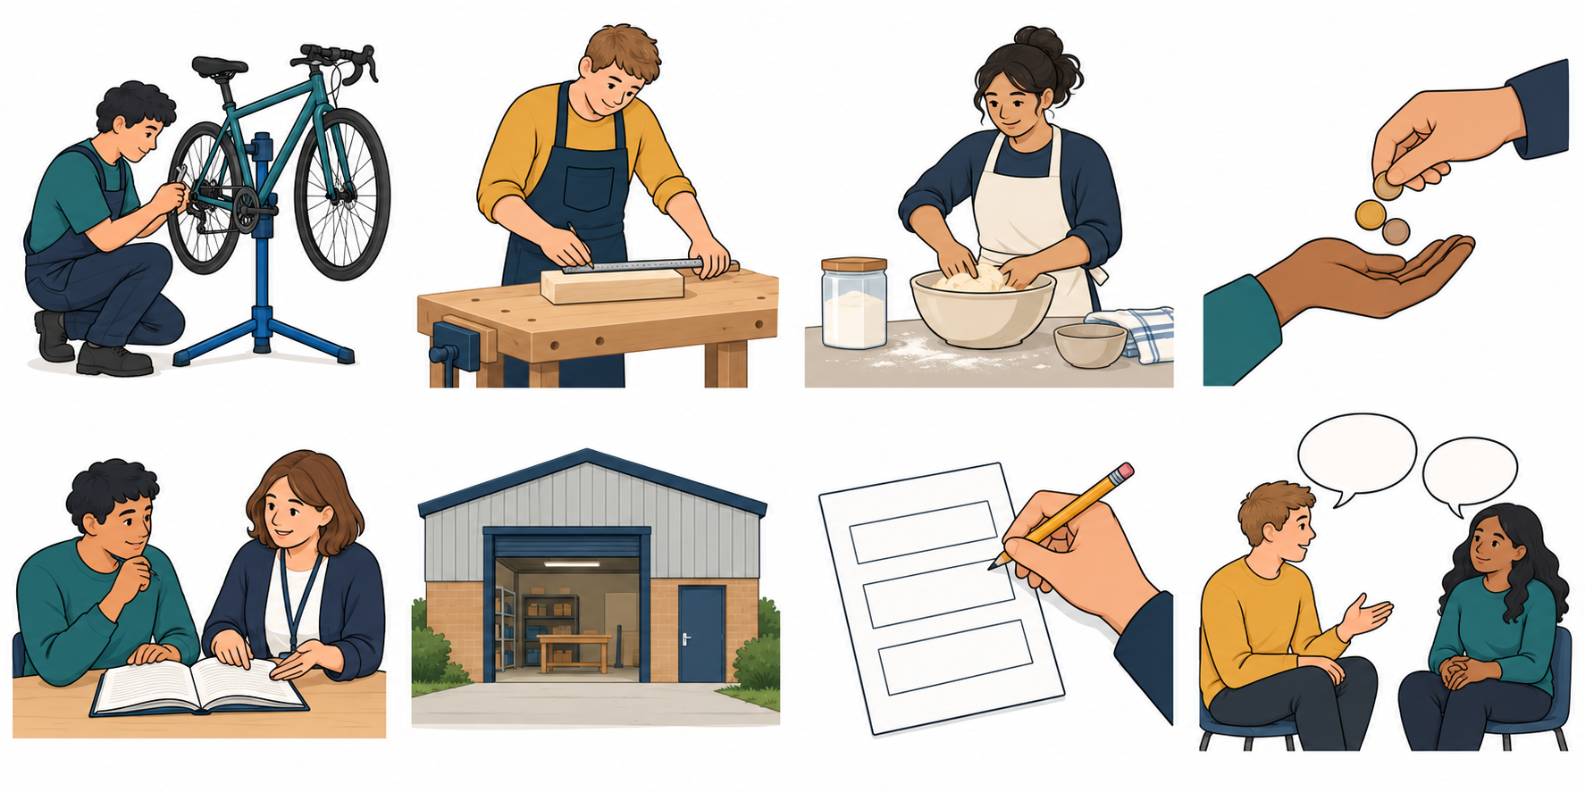
ARRIVAL AND RETRIEVAL
2 / 12 · 0–5 min
Earn and learn
Recall two words: earn and learn. Match each picture.
Earn: get pay for work.
Learn: gain a skill.
You may point, say the words or use your aid.
CAREERS-BUILD-S1-W03
Public edition
Lesson resource · CC BY-NC-SA 4.0: free for classroom use, share and adapt with credit, no resale
Notes:
Recall Week 2 without testing attendance. Earn means get pay for work; learn means gain a skill. Read the captions. Offer two choices privately. Model a missing word. Pictures are cues, not evidence of a real job.
Source: scheme_references/Careers_Scheme.xlsx, BUILD Careers, physical row 18 / Spring 1 row 3, E18–N18. Original invented profiles A–C in Support_Cards. Generic generated work/support illustrations in assets/apprenticeship_picture_bank.png; no real person or place is represented. Lesson resource · CC BY-NC-SA 4.0: free for classroom use, share and adapt with credit, no resale

Slide 3
I DO WORDS
3 / 12 · 5–9 min
Our learning
I can explain that an apprenticeship combines paid work with training and identify one thing I would need to apply.
Earn means get pay for work.
Training helps us learn job skills.
An employer gives someone a job.
Apply means ask to be considered.
We will find paid work and training.
CAREERS-BUILD-S1-W03
Public edition
Lesson resource · CC BY-NC-SA 4.0: free for classroom use, share and adapt with credit, no resale
Notes:
Read the exact outcome aloud in short parts. Pre-teach apprenticeship, paid work, training, employer, entry need and apply using the Vocabulary Mat. Entry needs in the cards are made up for practice. Actual roles differ; no real eligibility is judged.
Source: scheme_references/Careers_Scheme.xlsx, BUILD Careers, physical row 18 / Spring 1 row 3, E18–N18. Original invented profiles A–C in Support_Cards. Generic generated work/support illustrations in assets/apprenticeship_picture_bank.png; no real person or place is represented. Lesson resource · CC BY-NC-SA 4.0: free for classroom use, share and adapt with credit, no resale

Slide 4
I DO MODEL
4 / 12 · 9–13 min
A: bike repair
A works in a small bike repair workshop. This is made up.
Paid to check and mend bikes.
Lessons and practice with a trainer.
A has paid work and training. Entry: read a short safety note.
CAREERS-BUILD-S1-W03
Public edition
Lesson resource · CC BY-NC-SA 4.0: free for classroom use, share and adapt with credit, no resale
Notes:
Use complete profile A on Support Card 1. Model labels pay, training, employer and entry need. The employer offers the job; a trainer helps teach skills. They can work together. Read To apply: complete a short form about a skill to learn. Model explanation: an apprentice gets pay for work and learns through training. Model one need: read a short safety note, from Entry need. Check A paid work and training or B paid work only; key A. Re-model if unclear.
Source: scheme_references/Careers_Scheme.xlsx, BUILD Careers, physical row 18 / Spring 1 row 3, E18–N18. Original invented profiles A–C in Support_Cards. Generic generated work/support illustrations in assets/apprenticeship_picture_bank.png; no real person or place is represented. Lesson resource · CC BY-NC-SA 4.0: free for classroom use, share and adapt with credit, no resale

Slide 5
WE DO
5 / 12 · 13–19 min
Find the fields
Use A. Find the employer and the entry need.
Employer: a small workshop.
Entry: read a safety note.
Then find To apply. A asks for a short form about a skill.
CAREERS-BUILD-S1-W03
Public edition
Lesson resource · CC BY-NC-SA 4.0: free for classroom use, share and adapt with credit, no resale
Notes:
Read profile A and offer two labels at a time. Label pay, training, employer and entry need, then locate To apply separately. Compare A with B: A asks for reading a safety note, B measuring with a ruler. Do not imply everyone needs the same skill. Support Card 4 has three myth/fact claims, keys Fact, Myth, Myth. Compare the relevant fields. Keep response private; no practical tool task.
Source: scheme_references/Careers_Scheme.xlsx, BUILD Careers, physical row 18 / Spring 1 row 3, E18–N18. Original invented profiles A–C in Support_Cards. Generic generated work/support illustrations in assets/apprenticeship_picture_bank.png; no real person or place is represented. Lesson resource · CC BY-NC-SA 4.0: free for classroom use, share and adapt with credit, no resale

Slide 6
WE DO CHECK
6 / 12 · 19–23 min
Paid work and training
Which one fits an apprenticeship?
A: paid work only.
B: paid work and training.
“An apprentice has no training.” Myth or fact?
Choose in private. You may use your aid.
CAREERS-BUILD-S1-W03
Public edition
Lesson resource · CC BY-NC-SA 4.0: free for classroom use, share and adapt with credit, no resale
Notes:
Main hinge B. The no-training claim is a myth. Re-model with A if unsure. Parallel: A a paid job with planned lessons or B a course without a paid job; key A. Use accessible words without giving the answer. Record actual response and any supplied answer; a pass is unobserved. Return to the two-part concept before independent practice.
Source: scheme_references/Careers_Scheme.xlsx, BUILD Careers, physical row 18 / Spring 1 row 3, E18–N18. Original invented profiles A–C in Support_Cards. Generic generated work/support illustrations in assets/apprenticeship_picture_bank.png; no real person or place is represented. Lesson resource · CC BY-NC-SA 4.0: free for classroom use, share and adapt with credit, no resale

Slide 7
YOU DO
7 / 12 · 23–35 min
Make your fact card
Choose B or C. Label pay, training, employer and entry need.
B Woodwork profile.
C Food making profile.
Explain earn and learn. Find one need to apply on your card.
CAREERS-BUILD-S1-W03
Public edition
Lesson resource · CC BY-NC-SA 4.0: free for classroom use, share and adapt with credit, no resale
Notes:
Both choices use the same outcome and fact-card fields. Keep the full chosen profile, word bank, A model and picture captions. Connect the profile to its sector. Supported: one field at a time, two labels/details, usual aid or exact scribe. Independent: full card with normal access. Aspire: compare one need with A and suggest a question before a real application. Entry need or To apply is acceptable for the final need if correctly sourced. Do not count pay or a job title as an application need. Book default; typed fields Evidence Sheet page 2.
Source: scheme_references/Careers_Scheme.xlsx, BUILD Careers, physical row 18 / Spring 1 row 3, E18–N18. Original invented profiles A–C in Support_Cards. Generic generated work/support illustrations in assets/apprenticeship_picture_bank.png; no real person or place is represented. Lesson resource · CC BY-NC-SA 4.0: free for classroom use, share and adapt with credit, no resale

Slide 8
SAME TASK TIME
8 / 12 · 23–35 min
One field at a time
Choose B: woodwork, or C: food making.
Find pay. Then find training.
Find the employer. Then find the entry need.
Say: “Paid work and training.”
Find one thing needed to apply.
Point to the field that gave you the clue.
CAREERS-BUILD-S1-W03
Public edition
Lesson resource · CC BY-NC-SA 4.0: free for classroom use, share and adapt with credit, no resale
Notes:
Alternative to slide 7 within the same twelve minutes. Read each field aloud. Offer two labels or two details and log the choices. Keep normal reading and communication aids. Use the blank typed fact card or exact scribe. Accept Entry need or To apply for the final need; read back for confirmation. A supplied answer is supported evidence, not independent recall. Do not add extra lesson time.
Source: scheme_references/Careers_Scheme.xlsx, BUILD Careers, physical row 18 / Spring 1 row 3, E18–N18. Original invented profiles A–C in Support_Cards. Generic generated work/support illustrations in assets/apprenticeship_picture_bank.png; no real person or place is represented. Lesson resource · CC BY-NC-SA 4.0: free for classroom use, share and adapt with credit, no resale

Slide 9
REVIEW
9 / 12 · 35–38 min
Check both parts
Does your answer include paid work and training?
Have you found one need to apply?
Show where your profile gives that clue.
Use your words, cards or aid.
Keep your first try, one next step and your reply.
CAREERS-BUILD-S1-W03
Public edition
Lesson resource · CC BY-NC-SA 4.0: free for classroom use, share and adapt with credit, no resale
Notes:
Judge the two parts separately: earn and learn; one relevant sourced application need. Accept accessible equivalent wording and normal communication aid. Label matching alone does not prove the two-part explanation. Keep partial evidence, actual support, first response, one NS and reply. E means actual banked work; R follows Voice, Audience, NS and response. No public questioning or judgement of actual eligibility.
Source: scheme_references/Careers_Scheme.xlsx, BUILD Careers, physical row 18 / Spring 1 row 3, E18–N18. Original invented profiles A–C in Support_Cards. Generic generated work/support illustrations in assets/apprenticeship_picture_bank.png; no real person or place is represented. Lesson resource · CC BY-NC-SA 4.0: free for classroom use, share and adapt with credit, no resale

Slide 10
EXIT
10 / 12 · 38–40 min
Your private exit
Show: paid work and training.
Show one need from your chosen profile.
Point, say, type or use your aid.
You may pass and return with help.
Add your fact card to the Careers Portfolio.
CAREERS-BUILD-S1-W03
Public edition
Lesson resource · CC BY-NC-SA 4.0: free for classroom use, share and adapt with credit, no resale
Notes:
Exit checks the exact outcome privately and completes one correction where possible. No personal grades, finances or future plans required. Keep the fact card, labels and actual response. A pass is unobserved. Offer to Communication portfolio; staff confirm any accredited mapping. Do not complete a real application.
Source: scheme_references/Careers_Scheme.xlsx, BUILD Careers, physical row 18 / Spring 1 row 3, E18–N18. Original invented profiles A–C in Support_Cards. Generic generated work/support illustrations in assets/apprenticeship_picture_bank.png; no real person or place is represented. Lesson resource · CC BY-NC-SA 4.0: free for classroom use, share and adapt with credit, no resale

Slide 11
AVAILABLE THROUGHOUT
11 / 12
Help in private
Point to HELP or ask for a private talk.
Ask a trusted adult or use the school’s help route.
If one adult is busy, ask another adult.
You may pass, pause and return with help.
You do not need to share private plans.
CAREERS-BUILD-S1-W03
Public edition
Lesson resource · CC BY-NC-SA 4.0: free for classroom use, share and adapt with credit, no resale
Notes:
Confirm a trusted adult and pause/return arrangement before teaching. No public questioning or personal family work/finance prompts. Listen calmly, avoid probing or secrecy promises and follow normal procedures. Keep concerns outside public evidence. This slide adds no extra teaching minutes.
Source: scheme_references/Careers_Scheme.xlsx, BUILD Careers, physical row 18 / Spring 1 row 3, E18–N18. Original invented profiles A–C in Support_Cards. Generic generated work/support illustrations in assets/apprenticeship_picture_bank.png; no real person or place is represented. Lesson resource · CC BY-NC-SA 4.0: free for classroom use, share and adapt with credit, no resale

Slide 12
STAFF ONLY
12 / 12
Staff reference
BUILD Careers, Spring 1 row 3, physical row 18.
Tuesday 19 January 2027. P3. Up to five learners.
Timing: 5, 8, 10, 12 and 5 minutes.
Apprenticeship fact card.
Week 3 is formative. Week 6 is assessing.
CAREERS-BUILD-S1-W03
Public edition
Lesson resource · CC BY-NC-SA 4.0: free for classroom use, share and adapt with credit, no resale
Notes:
Hidden staff slide. Exact focus, outcomes and evidence from source row 18. Source sequence and timing retained. Invented profiles replace real vacancies or websites. No named employer, provider, scheme or place. All example needs are practice facts, not universal requirements. Staff check actual role requirements and support through the usual advice route before a real application. Next BUILD Weeks 4–6 one per return; further GROW Careers paused.
Source: scheme_references/Careers_Scheme.xlsx, BUILD Careers, physical row 18 / Spring 1 row 3, E18–N18. Original invented profiles A–C in Support_Cards. Generic generated work/support illustrations in assets/apprenticeship_picture_bank.png; no real person or place is represented. Lesson resource · CC BY-NC-SA 4.0: free for classroom use, share and adapt with credit, no resale

