Slide 1
HUM-BUILD-S1-W02 · Year A
Public edition
Old and new objects
Then and now
Look at two designs of one thing.
Find what is the same and what has changed.
You can point or ask an adult to write.
Thursday 14 January 2027 · P3 · 40 minutes
01
CC BY-NC-SA 4.0: free for classroom use, share and adapt with credit, no resale
Notes:
HUM-BUILD-S1-W02 · Year A · Thursday 14 January 2027 · P3
Old and new objects: 0 minutes.
Teacher: Set out Source Cards pages 1 and 2, Support Cards page 1, the word mat and books before arrival. Group three to four. Three blocks: 0–10 arrive/match; 10–25 learn/compare; 25–40 record/check. All tasks keep word bank, sentence starters and a visible model. Use pictures; no functioning appliances or pupil devices are needed.
Outcome verbatim: Compare old and new objects (then & now).
Theme: Resilience & Change
Unit: Then & now, how things change
Source: BUILD Weekly - Spring!A40/B41/C41; BUILD - Spring!C10/D10/E10/J10. Picture designs and model comparisons: assets/MODEL_DATA.json.
CC BY-NC-SA 4.0: free for classroom use, share and adapt with credit, no resale

Slide 2
HUM-BUILD-S1-W02 · Year A
Public edition
A calm start
Check how you feel.
BLUE
GREEN
AMBER
RED
Low energy
Ready
Pause
Adult help
Words: look, help, pass. Start: I choose __.
Model: I choose to look. Show an adult quietly.
02
CC BY-NC-SA 4.0: free for classroom use, share and adapt with credit, no resale
Notes:
HUM-BUILD-S1-W02 · Year A · Thursday 14 January 2027 · P3
A calm start: 2 minutes.
Teacher: Private settle. Words: look, help, pass. Stem: I choose __. Model: I choose to look. Pointing or the usual aid is enough. Offer quiet support or an agreed supervised pause. No public questioning, cold calling or required reading aloud.
Outcome verbatim: Compare old and new objects (then & now).
Theme: Resilience & Change
Unit: Then & now, how things change
Source: BUILD Weekly - Spring!A40/B41/C41; BUILD - Spring!C10/D10/E10/J10. Picture designs and model comparisons: assets/MODEL_DATA.json.
CC BY-NC-SA 4.0: free for classroom use, share and adapt with credit, no resale

Slide 3
HUM-BUILD-S1-W02 · Year A
Public edition
Ready starter
Use the six pictures on the card.
Match the two kettles, phones or bags.
Words: kettle, phone, bag, both.
Start: Both are __. Model: Both are kettles.
Finish: show one pair in a quiet way.
An adult can read or write with you.
03
CC BY-NC-SA 4.0: free for classroom use, share and adapt with credit, no resale
Notes:
HUM-BUILD-S1-W02 · Year A · Thursday 14 January 2027 · P3
Ready starter: 8 minutes.
Teacher: Ready starter: use Source Cards page 1. Match the top kettle with the bottom kettle, or choose another pair. Position key: kettle left, telephone middle, school bag right. Words: kettle, phone, bag, both. Stem: Both are __. Model: Both are kettles. Finish one matching pair, shown privately. Adults may read and scribe exact selected labels.
Outcome verbatim: Compare old and new objects (then & now).
Theme: Resilience & Change
Unit: Then & now, how things change
Source: BUILD Weekly - Spring!A40/B41/C41; BUILD - Spring!C10/D10/E10/J10. Picture designs and model comparisons: assets/MODEL_DATA.json.
CC BY-NC-SA 4.0: free for classroom use, share and adapt with credit, no resale

Slide 4
HUM-BUILD-S1-W02 · Year A
Public edition
Today
Compare old and new objects (then & now).
Find one thing the same and one thing not the same.
Words: both, same, different, buckles, zip.
Start: Both __. Then __. Now __.
Model: Both bags carry things. Then has buckles. Now has a zip.
Theme: Resilience & Change
04
CC BY-NC-SA 4.0: free for classroom use, share and adapt with credit, no resale
Notes:
HUM-BUILD-S1-W02 · Year A · Thursday 14 January 2027 · P3
Today: 0 minutes.
Teacher: State the exact outcome. Explain the finish: choose one object pair, keep one shared use or visible feature and one paired difference. Use both pictures and the supplied labels. The older/more recent design labels are given context, not a dating test.
Outcome verbatim: Compare old and new objects (then & now).
Theme: Resilience & Change
Unit: Then & now, how things change
Source: BUILD Weekly - Spring!A40/B41/C41; BUILD - Spring!C10/D10/E10/J10. Picture designs and model comparisons: assets/MODEL_DATA.json.
CC BY-NC-SA 4.0: free for classroom use, share and adapt with credit, no resale

Slide 5
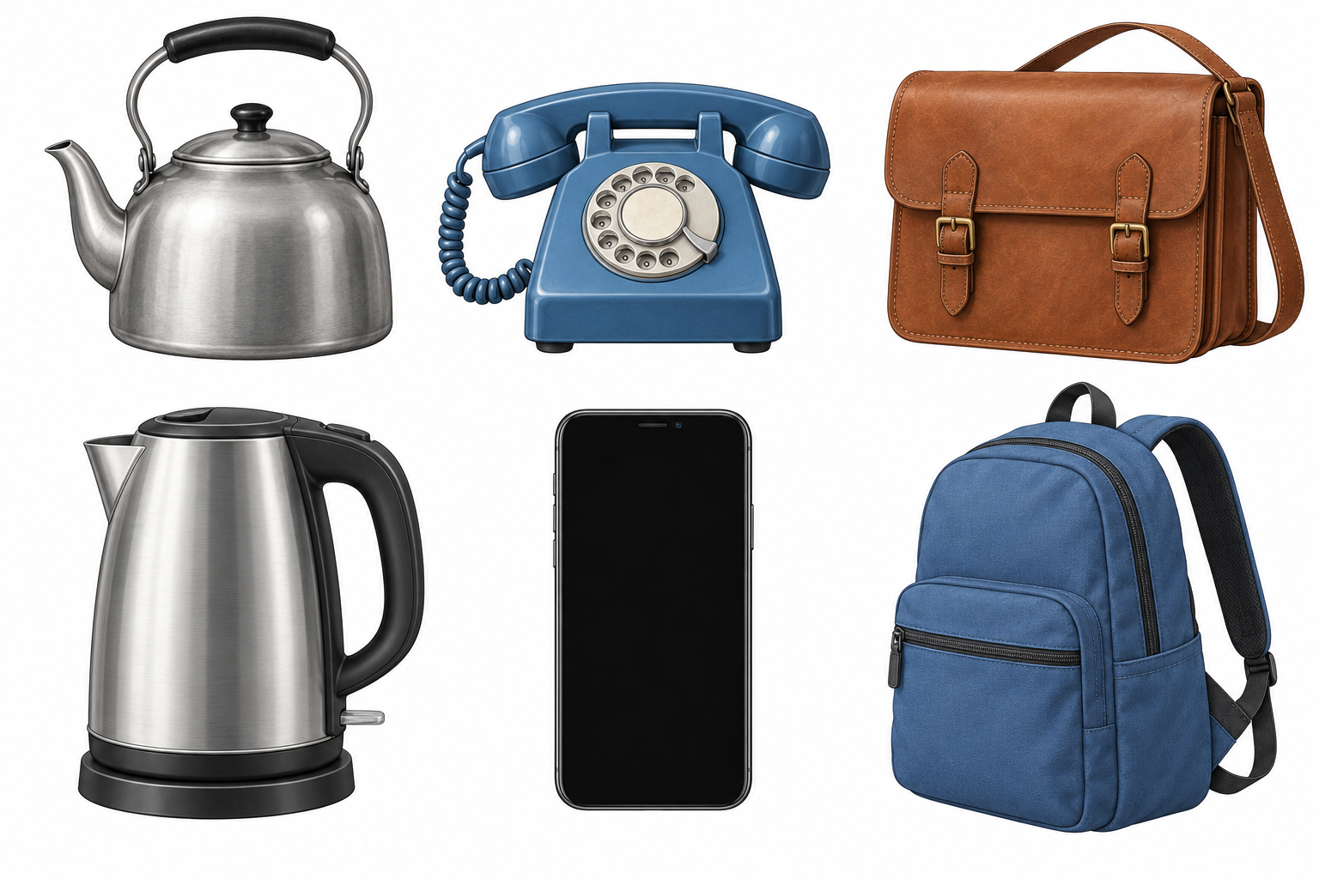
HUM-BUILD-S1-W02 · Year A
Public edition
Object picture cards
Top: then. Bottom: now.
Left: kettle. Middle: phone.
Right: school bag.
Words: both, pair.
Start: Both are __.
Model: Both are kettles.
Both styles can be used now.
05
CC BY-NC-SA 4.0: free for classroom use, share and adapt with credit, no resale
Notes:
HUM-BUILD-S1-W02 · Year A · Thursday 14 January 2027 · P3
Object picture cards: 5 minutes.
Teacher: Show the generic illustrations. Top row: older designs, then; bottom row: more recent designs, now. Both styles may still be used today. These are invented teaching designs, not records of particular historical objects. Do not infer exact date, maker, weight, working condition or quality from appearance. Left kettle, middle telephone, right school bag. Source Cards page 2 gives uses and comparison clues.
Outcome verbatim: Compare old and new objects (then & now).
Theme: Resilience & Change
Unit: Then & now, how things change
Source: BUILD Weekly - Spring!A40/B41/C41; BUILD - Spring!C10/D10/E10/J10. Picture designs and model comparisons: assets/MODEL_DATA.json.
CC BY-NC-SA 4.0: free for classroom use, share and adapt with credit, no resale

Slide 6
HUM-BUILD-S1-W02 · Year A
Public edition
A fair comparison
Use both pictures and their labels.
Part | Model
Same use | Both bags carry things.
Then | Buckles.
Now | A zip.
Words | both, same, different
Start | Both __.
Check | Use both pictures.
A quiet check.
Compare the bag fasteners.
Words: buckles, zip.
Start: Both __.
Model: Both close a bag.
Compare the same feature on both objects.
06
CC BY-NC-SA 4.0: free for classroom use, share and adapt with credit, no resale
Notes:
HUM-BUILD-S1-W02 · Year A · Thursday 14 January 2027 · P3
A fair comparison: 5 minutes.
Teacher: Model the school-bag pair using the editable table. Both carry things. The then bag has buckles; the now bag has a zip. This compares fastening with fastening. Quiet hinge: buckle/zip or buckle/screen is a matched-feature pair? Buckle/zip. If unsure, point to each bag closure and rematch. Parallel check: compare kettle handle with kettle handle. Keep bank, stems and model visible.
Outcome verbatim: Compare old and new objects (then & now).
Theme: Resilience & Change
Unit: Then & now, how things change
Source: BUILD Weekly - Spring!A40/B41/C41; BUILD - Spring!C10/D10/E10/J10. Picture designs and model comparisons: assets/MODEL_DATA.json.
CC BY-NC-SA 4.0: free for classroom use, share and adapt with credit, no resale

Slide 7
HUM-BUILD-S1-W02 · Year A
Public edition
My object pair
Pick one pair. Use both pictures.
Words: both, same, different, handle, dial, screen.
Start: Both __. Then __. Now __.
Model: Both kettles heat water. Top handle then, side handle now.
SUPPORTED
INDEPENDENT
ASPIRE
Match one pair. Point to a shared use and a difference. An adult can write. Use the words and model.
Use both pictures. Keep one thing the same and one paired difference in your book. Use the words and model.
Add a second pair. Or ask: How __? Words: how, heavy. Model: How heavy is it? We cannot tell.
07
CC BY-NC-SA 4.0: free for classroom use, share and adapt with credit, no resale
Notes:
HUM-BUILD-S1-W02 · Year A · Thursday 14 January 2027 · P3
My object pair: 5 minutes.
Teacher: Guided practice: choose the kettle or telephone pair, identify the shared use from the supplied card, then point to one difference across both pictures. Do not rely on colour to decide age. Words: both, handle, dial, screen. Stems: Both __. Then __. Now __. Model: Both kettles heat water. Then has a top handle. Now has a side handle. Adult reads if wanted.
Outcome verbatim: Compare old and new objects (then & now).
Theme: Resilience & Change
Unit: Then & now, how things change
Source: BUILD Weekly - Spring!A40/B41/C41; BUILD - Spring!C10/D10/E10/J10. Picture designs and model comparisons: assets/MODEL_DATA.json.
CC BY-NC-SA 4.0: free for classroom use, share and adapt with credit, no resale

Slide 8
HUM-BUILD-S1-W02 · Year A
Public edition
My book record
Keep one thing the same and one paired difference.
Words: both, same, different, buckles, zip.
Start: Both __. Then __. Now __.
Model: Both bags carry things. Then has buckles. Now has a zip.
SUPPORTED
INDEPENDENT
ASPIRE
Match one pair. Point to a shared use and a difference. An adult can write. Use the words and model.
Use both pictures. Keep one thing the same and one paired difference in your book. Use the words and model.
Add a second pair. Or ask: How __? Words: how, heavy. Model: How heavy is it? We cannot tell.
08
CC BY-NC-SA 4.0: free for classroom use, share and adapt with credit, no resale
Notes:
HUM-BUILD-S1-W02 · Year A · Thursday 14 January 2027 · P3
My book record: 10 minutes.
Teacher: At minute 25, include a short reset inside this ten-minute block. Each pupil chooses one pair and records one shared use or visible feature and one paired difference in their book. Supported: point, choose labels and direct an exact scribe. Independent: record using all scaffolds. Aspire: add a second pair with the same stem and model, or a question the pictures do not answer. Never require personal home details.
Outcome verbatim: Compare old and new objects (then & now).
Theme: Resilience & Change
Unit: Then & now, how things change
Source: BUILD Weekly - Spring!A40/B41/C41; BUILD - Spring!C10/D10/E10/J10. Picture designs and model comparisons: assets/MODEL_DATA.json.
CC BY-NC-SA 4.0: free for classroom use, share and adapt with credit, no resale

Slide 9
HUM-BUILD-S1-W02 · Year A
Public edition
My quiet check
Show the two picture clues to an adult.
Words: both, same, different, keep, change.
Start: Both __. Then __. Now __.
Model: Both bags carry things.
Hear one next step in a quiet way.
Finish: keep a change or point to it.
09
CC BY-NC-SA 4.0: free for classroom use, share and adapt with credit, no resale
Notes:
HUM-BUILD-S1-W02 · Year A · Thursday 14 January 2027 · P3
My quiet check: 3 minutes.
Teacher: Private review. Ask the pupil to show which two pictures support the response. Adult reads exact scribed words back for keep/change. Record actual help. Give one actual audience reply and one NS, then retain the pupil’s response in the same colour, on the same page or usual mode before R. No public performance.
Outcome verbatim: Compare old and new objects (then & now).
Theme: Resilience & Change
Unit: Then & now, how things change
Source: BUILD Weekly - Spring!A40/B41/C41; BUILD - Spring!C10/D10/E10/J10. Picture designs and model comparisons: assets/MODEL_DATA.json.
CC BY-NC-SA 4.0: free for classroom use, share and adapt with credit, no resale

Slide 10
HUM-BUILD-S1-W02 · Year A
Public edition
Keep and finish
Keep your pair and comparison in your book.
Words: both, same, different, help.
Start: Both __. Then __. Now __.
Model: Both bags carry things.
Show one part to an adult quietly.
You can point or ask an adult to write.
10
CC BY-NC-SA 4.0: free for classroom use, share and adapt with credit, no resale
Notes:
HUM-BUILD-S1-W02 · Year A · Thursday 14 January 2027 · P3
Keep and finish: 2 minutes.
Teacher: Private exit: retain one individual comparison and note any missing element. Words: both, same, different, help. Stem: Both __. Visible model: Both bags carry things. E follows actual banking. This is formative; Week 6 is assessing in the owner brief.
Outcome verbatim: Compare old and new objects (then & now).
Theme: Resilience & Change
Unit: Then & now, how things change
Source: BUILD Weekly - Spring!A40/B41/C41; BUILD - Spring!C10/D10/E10/J10. Picture designs and model comparisons: assets/MODEL_DATA.json.
CC BY-NC-SA 4.0: free for classroom use, share and adapt with credit, no resale

Slide 11
HUM-BUILD-S1-W02 · Year A
Public edition
Comparison words
object
then
A thing we can look at.
An earlier time.
now
compare
The time we are in.
Find what is the same or not the same.
both
use
The two things.
The job a thing does.
feature
change
A part we can see.
To become different.
11
CC BY-NC-SA 4.0: free for classroom use, share and adapt with credit, no resale
Notes:
HUM-BUILD-S1-W02 · Year A · Thursday 14 January 2027 · P3
Comparison words: 0 minutes.
Teacher: Keep the word mat available. Read labels quietly on request. Plan in any language. Point, match, draw, write, use the usual communication aid or direct an exact scribe. Do not infer independent reading or comparing from copying alone.
Outcome verbatim: Compare old and new objects (then & now).
Theme: Resilience & Change
Unit: Then & now, how things change
Source: BUILD Weekly - Spring!A40/B41/C41; BUILD - Spring!C10/D10/E10/J10. Picture designs and model comparisons: assets/MODEL_DATA.json.
CC BY-NC-SA 4.0: free for classroom use, share and adapt with credit, no resale

Slide 12
HUM-BUILD-S1-W02 · Year A
Public edition
Adult support brief
Three to four pupils. Pupil number: ____.
Keep word bank, starter and model in view.
Use 10, 15 and 15 minute blocks.
One pair, one similarity, one paired difference.
Record picture clues and actual help.
Generic illustrations with supplied design labels.
No public questions or required reading aloud.
Point, private prompt, rephrase, choice.
No live appliances, calls or personal home details.
R: reply, NS, own response. E: actual banking.
12
CC BY-NC-SA 4.0: free for classroom use, share and adapt with credit, no resale
Notes:
HUM-BUILD-S1-W02 · Year A · Thursday 14 January 2027 · P3
Adult support brief: 0 minutes.
Teacher: Hidden adult brief: Level 2 means word bank, sentence starter and visible model on every task, not a qualification level. Prompt ladder: point, short private prompt, rephrase, choice/scaffold, model the first step then return the task. Use generic picture cards. No heat, plugs, calls, live devices or personal disclosures. Supplied design labels are not proof of an individual object’s age. Actual reply, NS and own response precede R; actual banking precedes E.
Outcome verbatim: Compare old and new objects (then & now).
Theme: Resilience & Change
Unit: Then & now, how things change
Source: BUILD Weekly - Spring!A40/B41/C41; BUILD - Spring!C10/D10/E10/J10. Picture designs and model comparisons: assets/MODEL_DATA.json.
CC BY-NC-SA 4.0: free for classroom use, share and adapt with credit, no resale

