Slide 1
HUM-BUILD-S1-W03 · Year A
Public edition
Pictures on a timeline
First next last
Put three pictures in time order.
Use the story clues.
You can point or ask an adult to help.
Thursday 21 January 2027 · P3 · 40 minutes
01
CC BY-NC-SA 4.0: free for classroom use, share and adapt with credit, no resale
Notes:
HUM-BUILD-S1-W03 · Year A · Thursday 21 January 2027 · P3
Pictures on a timeline: 0 minutes.
Teacher: Set out the six mixed Source Cards, Support Cards page 1, word mat and books. Adult may cut along the white gaps and label reverse A B C across top, D E F across bottom. Keep a full key on view. Three blocks: 0–10 arrive/find; 10–25 learn/order; 25–40 record/check. Every task has bank, starter and visible model. Two sets have three pictures each.
Outcome verbatim: Order pictures on a simple timeline.
Theme: Resilience & Change
Unit: Then & now, how things change
Source: BUILD Weekly - Spring!A40/B42/C42; BUILD - Spring!C10/D10/E10/J10. Fictional stories and order: assets/MODEL_DATA.json.
CC BY-NC-SA 4.0: free for classroom use, share and adapt with credit, no resale

Slide 2
HUM-BUILD-S1-W03 · Year A
Public edition
A calm start
Check how you feel.
BLUE
GREEN
AMBER
RED
Low energy
Ready
Pause
Adult help
Words: look, help, pass. Start: I choose __.
Model: I choose to look. Show an adult quietly.
02
CC BY-NC-SA 4.0: free for classroom use, share and adapt with credit, no resale
Notes:
HUM-BUILD-S1-W03 · Year A · Thursday 21 January 2027 · P3
A calm start: 2 minutes.
Teacher: Private settle. Words: look, help, pass. Stem: I choose __. Model: I choose to look. A point or usual aid is enough. Quiet support or an agreed supervised pause is available. No public questioning, cold calling or reading aloud required.
Outcome verbatim: Order pictures on a simple timeline.
Theme: Resilience & Change
Unit: Then & now, how things change
Source: BUILD Weekly - Spring!A40/B42/C42; BUILD - Spring!C10/D10/E10/J10. Fictional stories and order: assets/MODEL_DATA.json.
CC BY-NC-SA 4.0: free for classroom use, share and adapt with credit, no resale

Slide 3
HUM-BUILD-S1-W03 · Year A
Public edition
Ready starter
Use the three bag pictures on the card.
Find a whole strap and a torn strap.
Words: bag, whole, torn.
Start: This strap is __. Model: This strap is whole. It is B.
Finish: show the two straps in a quiet way.
An adult can read or write with you.
03
CC BY-NC-SA 4.0: free for classroom use, share and adapt with credit, no resale
Notes:
HUM-BUILD-S1-W03 · Year A · Thursday 21 January 2027 · P3
Ready starter: 8 minutes.
Teacher: Ready starter: find a whole strap and a torn strap on the top row. Words: bag, whole, torn. Stem: This strap is __. Model: This strap is whole, card B. Finish by showing two different straps privately. This retrieves comparison from Week 2 without asking a pupil to read aloud.
Outcome verbatim: Order pictures on a simple timeline.
Theme: Resilience & Change
Unit: Then & now, how things change
Source: BUILD Weekly - Spring!A40/B42/C42; BUILD - Spring!C10/D10/E10/J10. Fictional stories and order: assets/MODEL_DATA.json.
CC BY-NC-SA 4.0: free for classroom use, share and adapt with credit, no resale

Slide 4
HUM-BUILD-S1-W03 · Year A
Public edition
Today
Order pictures on a simple timeline.
Keep three pictures and one time phrase.
Words: first, next, last, whole, torn, sewn.
Start: First __. Next __. Last __.
Model: First whole. Next torn. Last sewn.
Theme: Resilience & Change
04
CC BY-NC-SA 4.0: free for classroom use, share and adapt with credit, no resale
Notes:
HUM-BUILD-S1-W03 · Year A · Thursday 21 January 2027 · P3
Today: 0 minutes.
Teacher: State the exact outcome. Finish one set of three pictures in first/next/last order, left to right, with one time sentence or selected phrase. Keep supplied story clues and visible model available. A photo of the placed cards or glued pictures may capture the timeline in a book.
Outcome verbatim: Order pictures on a simple timeline.
Theme: Resilience & Change
Unit: Then & now, how things change
Source: BUILD Weekly - Spring!A40/B42/C42; BUILD - Spring!C10/D10/E10/J10. Fictional stories and order: assets/MODEL_DATA.json.
CC BY-NC-SA 4.0: free for classroom use, share and adapt with credit, no resale

Slide 5
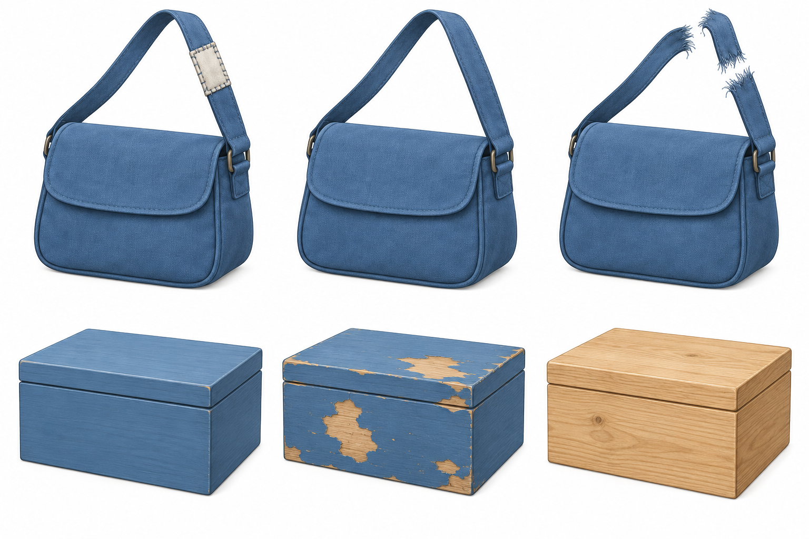
HUM-BUILD-S1-W03 · Year A
Public edition
Object story cards
Top: A sewn, B whole, C torn.
Bottom: D paint, E chips, F bare.
The pictures are mixed up.
Words: first, next, last.
Start: First __.
Model: First the strap is whole.
Use the story clues on the card.
05
CC BY-NC-SA 4.0: free for classroom use, share and adapt with credit, no resale
Notes:
HUM-BUILD-S1-W03 · Year A · Thursday 21 January 2027 · P3
Object story cards: 5 minutes.
Teacher: Show the six mixed generic pictures. Top A sewn strap, B whole strap, C torn strap. Bottom D painted box, E chipped paint, F bare wood. Read the fictional stories on Source Cards page 2 quietly as needed. Bag: whole strap, then torn, then sewn. Box: bare wood, then painted, then chipped. These are invented stories, not product histories. No dates or makers are asserted.
Outcome verbatim: Order pictures on a simple timeline.
Theme: Resilience & Change
Unit: Then & now, how things change
Source: BUILD Weekly - Spring!A40/B42/C42; BUILD - Spring!C10/D10/E10/J10. Fictional stories and order: assets/MODEL_DATA.json.
CC BY-NC-SA 4.0: free for classroom use, share and adapt with credit, no resale

Slide 6
HUM-BUILD-S1-W03 · Year A
Public edition
The bag timeline
Read from first to last. Use the story clues.
Time | Bag story
First | B · Whole strap
Next | C · Torn strap
Last | A · Sewn strap
Words | first, next, last
Start | First __.
Check | Use the story clues.
A quiet check.
Sewn comes before or after torn?
Words: after, torn, sewn.
Start: __ comes after __.
Model: Sewn comes after torn.
Three pictures tell one made-up story.
06
CC BY-NC-SA 4.0: free for classroom use, share and adapt with credit, no resale
Notes:
HUM-BUILD-S1-W03 · Year A · Thursday 21 January 2027 · P3
The bag timeline: 5 minutes.
Teacher: Model the bag timeline B C A, reading left to right: first whole, next torn, last sewn. The editable table gives positions and captions. Physically place the three cards on the strip in Support Cards. Quiet hinge: does the sewn strap go before or after the tear in this story? After. If unsure, reread the last story clue and trace torn then sewn. Parallel hinge: does bare wood come before or after paint in the box story? Before.
Outcome verbatim: Order pictures on a simple timeline.
Theme: Resilience & Change
Unit: Then & now, how things change
Source: BUILD Weekly - Spring!A40/B42/C42; BUILD - Spring!C10/D10/E10/J10. Fictional stories and order: assets/MODEL_DATA.json.
CC BY-NC-SA 4.0: free for classroom use, share and adapt with credit, no resale

Slide 7
HUM-BUILD-S1-W03 · Year A
Public edition
The box timeline
Use the box story and three pictures.
Words: first, next, last, bare, paint, chips.
Start: First __. Next __. Last __.
Model: First bare wood. Next paint. Last chips.
SUPPORTED
INDEPENDENT
ASPIRE
Pick a card for each space. Point or ask an adult to move it. Use the words and model.
Use the story clues. Keep three pictures and one time phrase in your book. Use the words and model.
Order the other set. Or use: __ comes after __. Words: after, torn, sewn. Model: Sewn comes after torn.
07
CC BY-NC-SA 4.0: free for classroom use, share and adapt with credit, no resale
Notes:
HUM-BUILD-S1-W03 · Year A · Thursday 21 January 2027 · P3
The box timeline: 5 minutes.
Teacher: Guided practice: use the box set D E F. Reread the box story. Place F D E from first to last. Words: first, next, last, bare, paint, chips. Stem: First __. Next __. Last __. Model: First bare wood. Next paint. Last chips. All scaffolds remain in view; the teacher guides rather than tests memory.
Outcome verbatim: Order pictures on a simple timeline.
Theme: Resilience & Change
Unit: Then & now, how things change
Source: BUILD Weekly - Spring!A40/B42/C42; BUILD - Spring!C10/D10/E10/J10. Fictional stories and order: assets/MODEL_DATA.json.
CC BY-NC-SA 4.0: free for classroom use, share and adapt with credit, no resale

Slide 8
HUM-BUILD-S1-W03 · Year A
Public edition
My book timeline
Choose a set. Place three pictures from first to last.
Words: first, next, last, whole, torn, sewn.
Start: First __. Next __. Last __.
Model: First whole. Next torn. Last sewn.
SUPPORTED
INDEPENDENT
ASPIRE
Pick a card for each space. Point or ask an adult to move it. Use the words and model.
Use the story clues. Keep three pictures and one time phrase in your book. Use the words and model.
Order the other set. Or use: __ comes after __. Words: after, torn, sewn. Model: Sewn comes after torn.
08
CC BY-NC-SA 4.0: free for classroom use, share and adapt with credit, no resale
Notes:
HUM-BUILD-S1-W03 · Year A · Thursday 21 January 2027 · P3
My book timeline: 10 minutes.
Teacher: At minute 25 include a short reset in the ten-minute book block. Each pupil chooses the bag or box story, mixes its three cards and places them left to right on a simple timeline. Supported: offer two choices for each slot and an exact scribe. Independent: order and retain one time sentence using all supports. Aspire: order the other set and add a before/after link with bank, stem and model. Do not remove supports to test independence.
Outcome verbatim: Order pictures on a simple timeline.
Theme: Resilience & Change
Unit: Then & now, how things change
Source: BUILD Weekly - Spring!A40/B42/C42; BUILD - Spring!C10/D10/E10/J10. Fictional stories and order: assets/MODEL_DATA.json.
CC BY-NC-SA 4.0: free for classroom use, share and adapt with credit, no resale

Slide 9
HUM-BUILD-S1-W03 · Year A
Public edition
My quiet check
Point from first to last. Show one clue.
Words: first, next, last, keep, change.
Start: First __. Next __. Last __.
Model: First the strap is whole.
Hear one next step in a quiet way.
Finish: keep a change or point to it.
09
CC BY-NC-SA 4.0: free for classroom use, share and adapt with credit, no resale
Notes:
HUM-BUILD-S1-W03 · Year A · Thursday 21 January 2027 · P3
My quiet check: 3 minutes.
Teacher: Private review. Pupil points from first to last and chooses one clue for a placement. Scribe reads exact selected labels or words for keep/change. Adult reply, one NS and actual pupil response in the same colour, on the same page or usual mode precede R. Record actual help. Model copying alone does not show picture ordering.
Outcome verbatim: Order pictures on a simple timeline.
Theme: Resilience & Change
Unit: Then & now, how things change
Source: BUILD Weekly - Spring!A40/B42/C42; BUILD - Spring!C10/D10/E10/J10. Fictional stories and order: assets/MODEL_DATA.json.
CC BY-NC-SA 4.0: free for classroom use, share and adapt with credit, no resale

Slide 10
HUM-BUILD-S1-W03 · Year A
Public edition
Keep and finish
Keep three pictures and one time phrase in your book.
Words: first, next, last, help.
Start: First __. Next __. Last __.
Model: First the strap is whole.
Show your line to an adult quietly.
You can point or ask an adult to write.
10
CC BY-NC-SA 4.0: free for classroom use, share and adapt with credit, no resale
Notes:
HUM-BUILD-S1-W03 · Year A · Thursday 21 January 2027 · P3
Keep and finish: 2 minutes.
Teacher: Private exit. Keep one three-picture timeline and one time phrase in a book; a photo or glued cards is valid. Words: first, next, last, help. Stem: First __. Model: First the strap is whole. E follows actual banking. This lesson is formative; owner sets Week 6 as assessing.
Outcome verbatim: Order pictures on a simple timeline.
Theme: Resilience & Change
Unit: Then & now, how things change
Source: BUILD Weekly - Spring!A40/B42/C42; BUILD - Spring!C10/D10/E10/J10. Fictional stories and order: assets/MODEL_DATA.json.
CC BY-NC-SA 4.0: free for classroom use, share and adapt with credit, no resale

Slide 11
HUM-BUILD-S1-W03 · Year A
Public edition
Timeline words
timeline
first
A line that shows time order.
At the start.
next
last
After that.
At the end.
before
after
At an earlier time.
At a later time.
clue
change
A sign that helps us.
To become different.
11
CC BY-NC-SA 4.0: free for classroom use, share and adapt with credit, no resale
Notes:
HUM-BUILD-S1-W03 · Year A · Thursday 21 January 2027 · P3
Timeline words: 0 minutes.
Teacher: Keep word mat on view. Read labels privately on request. Plan in any language. Point, place, draw, write, use the usual communication aid or direct an exact scribe. A learner may direct an adult to move cards. Record who chose the order and any adult-supplied content.
Outcome verbatim: Order pictures on a simple timeline.
Theme: Resilience & Change
Unit: Then & now, how things change
Source: BUILD Weekly - Spring!A40/B42/C42; BUILD - Spring!C10/D10/E10/J10. Fictional stories and order: assets/MODEL_DATA.json.
CC BY-NC-SA 4.0: free for classroom use, share and adapt with credit, no resale

Slide 12
HUM-BUILD-S1-W03 · Year A
Public edition
Adult support brief
Three to four pupils. Pupil number: ____.
Keep word bank, starter and model in view.
Use 10, 15 and 15 minute blocks.
Three pictures on a line and one time phrase.
Record actual choices, clues and help.
Generic invented object stories with no product dates.
No public questions or required reading aloud.
Point, private prompt, rephrase, choice.
Adult cuts. Pupil may direct card moves.
R: reply, NS, own response. E: actual banking.
12
CC BY-NC-SA 4.0: free for classroom use, share and adapt with credit, no resale
Notes:
HUM-BUILD-S1-W03 · Year A · Thursday 21 January 2027 · P3
Adult support brief: 0 minutes.
Teacher: Hidden adult brief: Level 2 means bank, starter and visible model on every task, not qualification level. Prompt ladder: point, short private prompt, rephrase, choice/scaffold, model first step then return task. Use invented stories and picture clues, not guesses about product age. Touch and cutting optional; adult cuts. Keep three pictures per set. No real dates, makers or personal disclosures. R follows actual reply/NS/response; E follows banking.
Outcome verbatim: Order pictures on a simple timeline.
Theme: Resilience & Change
Unit: Then & now, how things change
Source: BUILD Weekly - Spring!A40/B42/C42; BUILD - Spring!C10/D10/E10/J10. Fictional stories and order: assets/MODEL_DATA.json.
CC BY-NC-SA 4.0: free for classroom use, share and adapt with credit, no resale

