Slide 1
BUILD RE Spring 1 Week 4
Caring in our community
Identify how people care in their community.
Resilience & Change
Tuesday 26 January 2027, P5
1

Slide 2
BUILD RE Spring 1 Week 4
Our task
Match the care shown in each invented picture.
A community can share a place or activity.
You may point, speak, pass or ask for a quiet pause.
Tuesday 26 January 2027, P5
2

Slide 3
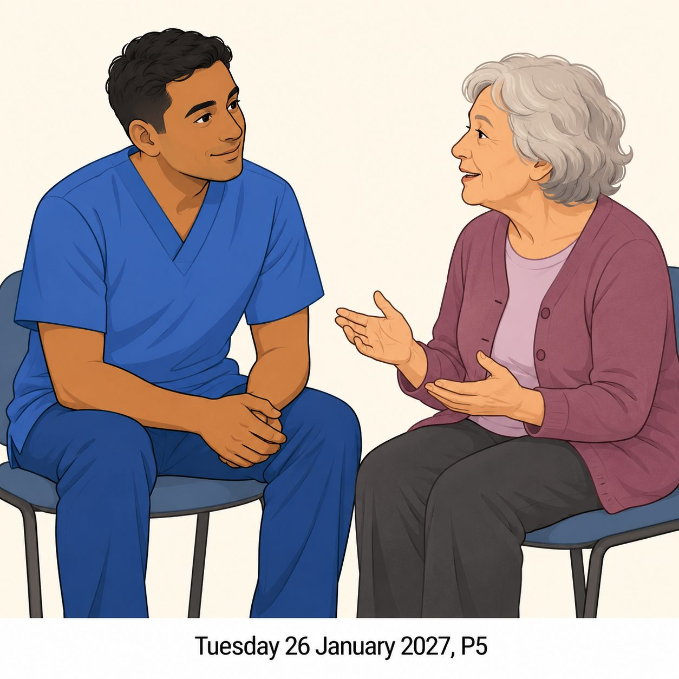
BUILD RE Spring 1 Week 4
A nurse
Listens to an adult's health worry.
Invented illustration
Tuesday 26 January 2027, P5
3

Slide 4

BUILD RE Spring 1 Week 4
A food-bank volunteer
Packs food ready to share.
Invented illustration
Tuesday 26 January 2027, P5
4

Slide 5
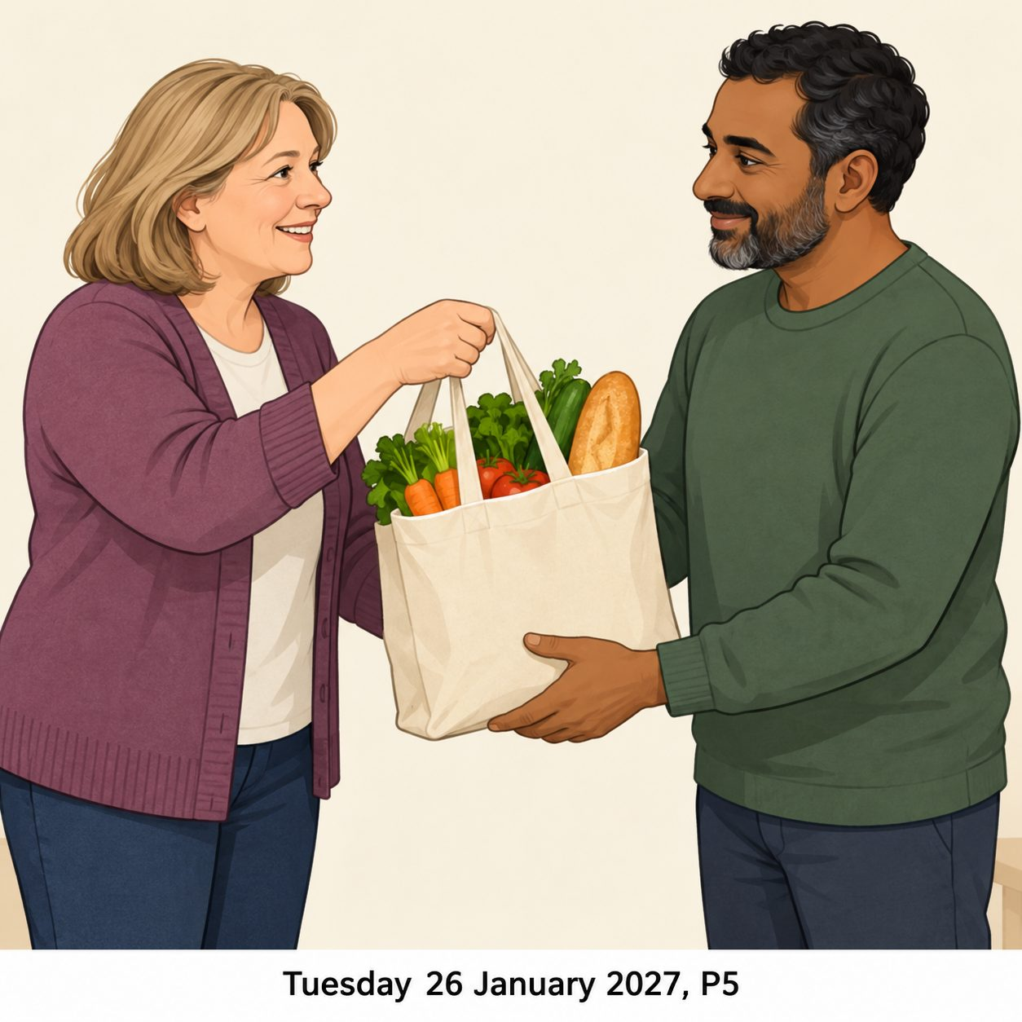
BUILD RE Spring 1 Week 4
A neighbour
Brings shopping the person asked for.
Invented illustration
Tuesday 26 January 2027, P5
5

Slide 6

BUILD RE Spring 1 Week 4
A faith group's helpers
Prepare a shared meal to show care.
Invented illustration
Tuesday 26 January 2027, P5
6

Slide 7
BUILD RE Spring 1 Week 4
Match the care
Match each pictured role to an action.
Pictured role | Action
A Nurse
B Food-bank volunteer
C Neighbour
D Faith group's helpers
1 Prepare a shared meal
2 Bring agreed shopping
3 Listen to a health worry
4 Pack food to share
These are care examples. People may care in other ways.
Tuesday 26 January 2027, P5
7

Slide 8
BUILD RE Spring 1 Week 4
Our talk
The ____ cares by ____.
This helps because ____.
People with different beliefs can all care.
Tuesday 26 January 2027, P5
8

Slide 9
BUILD RE Spring 1 Week 4
My one line
People care in my community by…
Finish one general line.
Tell an adult or use your book.
No names or addresses needed.
Tuesday 26 January 2027, P5
9

Slide 10
BUILD RE Spring 1 Week 4
Exit
Choose a picture. Who is helping?
What are they doing?
Helpful care includes asking what someone wants.
Tuesday 26 January 2027, P5
10

