Slide 1

SCIENCE · LAUNCH · AUTUMN 2 · WEEK 4 · SCI-LAUNCH-A2-W04
DNA, genes and chromosomes
0 min
I am learning to show how a gene is part of DNA and how DNA is packed into chromosomes.
Today I can
I can label DNA, a gene and a chromosome in a simple model.
I can explain that a gene is a section of DNA with a protein instruction.
I can distinguish one chromosome from the genome.
40 minutes. Point, sign, speak, draw, type or write. You may pass or take a pause.
Work as a pair. One explains a label. One asks which part it names. Swap roles. Each keeps their own response.
Made by Matt · © Matt Roper · CC BY-NC-SA 4.0: free for classroom use, share and adapt with credit, no resale
Notes:
Source: Launch/Autumn_2_2026-27/SCI_LAUNCH_A2_W04/SCI_LAUNCH_A2_W04.html; revision c4ca8ffab98e6186a9ef2fed3921644b177f0d6d. Workbook: _authoring/science_2026-27/_toolchain/scheme_references/LAUNCH_SOW.xlsx; LAUNCH Weekly - Autumn C42 Describe DNA, genes & chromosomes. Generic recommended S4, not detailed W12L1 alternative. Stage continuations share source40minutes: Arrival5 Starter3 Ido5 Wedo7 Wedo2five Independent8 Review4 Exit3. Three reset minutes are INSIDE We do, Independent and Review. Ido words2/fullmodel2/picture1. Hinge correct B/second, gene within DNA. Hear BOTH learners own choices/reasons; both secure means transfer, otherwise re-model unsure learner and parallel genome hinge while other continues. Pair explain/question then swap, separate evidence; no forced speech/disclosure/handling. Optional shortcord/bluntclips/tray must be counted out/back, supervised, away from necks and removed immediately if dysregulated; confirm local risk assessment. Source models simplified/nottoscale; clip marks DNA section, genome includes other DNA. Comparison Model A accurate, Model B reverses gene/DNA; audit both diagrams faulty and must be repaired with reasons. Prompt ladder and staff keys/diagnoses/parallel in pack. No pupil answer storage. No third science task at Exit; two prompts group unchanged source work.

Slide 2
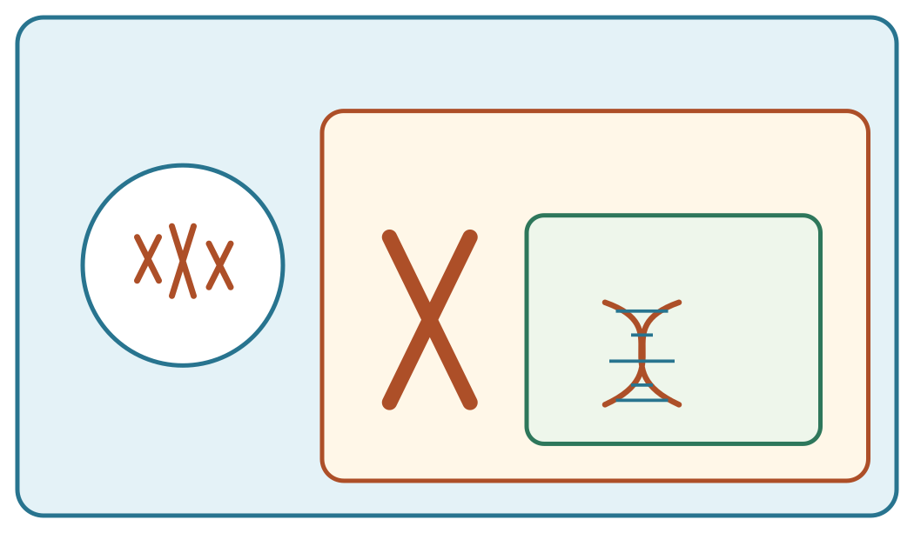
SCIENCE · LAUNCH · AUTUMN 2 · WEEK 4 · SCI-LAUNCH-A2-W04
Arrival
5 min
Look at this week’s string-and-clip DNA model. Point to one detail you notice.
Genome · full DNA set
One chromosome
Gene
nucleus
packed DNA
The genome is the full DNA set; a chromosome carries part of it; a gene is a section of DNA on a chromosome. Nested view; not to scale.
Made by Matt · © Matt Roper · CC BY-NC-SA 4.0: free for classroom use, share and adapt with credit, no resale
Notes:
Source: Launch/Autumn_2_2026-27/SCI_LAUNCH_A2_W04/SCI_LAUNCH_A2_W04.html; revision c4ca8ffab98e6186a9ef2fed3921644b177f0d6d. Workbook: _authoring/science_2026-27/_toolchain/scheme_references/LAUNCH_SOW.xlsx; LAUNCH Weekly - Autumn C42 Describe DNA, genes & chromosomes. Generic recommended S4, not detailed W12L1 alternative. Stage continuations share source40minutes: Arrival5 Starter3 Ido5 Wedo7 Wedo2five Independent8 Review4 Exit3. Three reset minutes are INSIDE We do, Independent and Review. Ido words2/fullmodel2/picture1. Hinge correct B/second, gene within DNA. Hear BOTH learners own choices/reasons; both secure means transfer, otherwise re-model unsure learner and parallel genome hinge while other continues. Pair explain/question then swap, separate evidence; no forced speech/disclosure/handling. Optional shortcord/bluntclips/tray must be counted out/back, supervised, away from necks and removed immediately if dysregulated; confirm local risk assessment. Source models simplified/nottoscale; clip marks DNA section, genome includes other DNA. Comparison Model A accurate, Model B reverses gene/DNA; audit both diagrams faulty and must be repaired with reasons. Prompt ladder and staff keys/diagnoses/parallel in pack. No pupil answer storage. No third science task at Exit; two prompts group unchanged source work.

Slide 3
SCIENCE · LAUNCH · AUTUMN 2 · WEEK 4 · SCI-LAUNCH-A2-W04
Starter
3 min
Recall three ideas from earlier lessons. Show one answer at a time.
1. What is one reason a claim of a new stem-cell treatment needs evidence?
2. Which structure carries the matching chromosome sets after mitosis?
3. Where are chromosomes found in a eukaryotic animal cell?
Today I can:
I can label DNA, a gene and a chromosome in a simple model.
I can explain that a gene is a section of DNA with a protein instruction.
I can distinguish one chromosome from the genome.
Made by Matt · © Matt Roper · CC BY-NC-SA 4.0: free for classroom use, share and adapt with credit, no resale
Notes:
Source: Launch/Autumn_2_2026-27/SCI_LAUNCH_A2_W04/SCI_LAUNCH_A2_W04.html; revision c4ca8ffab98e6186a9ef2fed3921644b177f0d6d. Workbook: _authoring/science_2026-27/_toolchain/scheme_references/LAUNCH_SOW.xlsx; LAUNCH Weekly - Autumn C42 Describe DNA, genes & chromosomes. Generic recommended S4, not detailed W12L1 alternative. Stage continuations share source40minutes: Arrival5 Starter3 Ido5 Wedo7 Wedo2five Independent8 Review4 Exit3. Three reset minutes are INSIDE We do, Independent and Review. Ido words2/fullmodel2/picture1. Hinge correct B/second, gene within DNA. Hear BOTH learners own choices/reasons; both secure means transfer, otherwise re-model unsure learner and parallel genome hinge while other continues. Pair explain/question then swap, separate evidence; no forced speech/disclosure/handling. Optional shortcord/bluntclips/tray must be counted out/back, supervised, away from necks and removed immediately if dysregulated; confirm local risk assessment. Source models simplified/nottoscale; clip marks DNA section, genome includes other DNA. Comparison Model A accurate, Model B reverses gene/DNA; audit both diagrams faulty and must be repaired with reasons. Prompt ladder and staff keys/diagnoses/parallel in pack. No pupil answer storage. No third science task at Exit; two prompts group unchanged source work.

Slide 4
SCIENCE · LAUNCH · AUTUMN 2 · WEEK 4 · SCI-LAUNCH-A2-W04
I do · words
2 min
Watch the full model. Point to the step that answers today’s question.
Word | Meaning | Example
DNA | the molecule that stores genetic instructions | DNA contains the instructions for making proteins.
gene | a section of DNA that codes for a specific protein | The coloured section of the model stands for one gene.
chromosome | a long DNA molecule packaged with proteins in a cell | A chromosome contains many DNA sections, including genes.
genome | the entire DNA of an organism | The genome includes all of the organism’s chromosomes and other DNA.
Made by Matt · © Matt Roper · CC BY-NC-SA 4.0: free for classroom use, share and adapt with credit, no resale
Notes:
Source: Launch/Autumn_2_2026-27/SCI_LAUNCH_A2_W04/SCI_LAUNCH_A2_W04.html; revision c4ca8ffab98e6186a9ef2fed3921644b177f0d6d. Workbook: _authoring/science_2026-27/_toolchain/scheme_references/LAUNCH_SOW.xlsx; LAUNCH Weekly - Autumn C42 Describe DNA, genes & chromosomes. Generic recommended S4, not detailed W12L1 alternative. Stage continuations share source40minutes: Arrival5 Starter3 Ido5 Wedo7 Wedo2five Independent8 Review4 Exit3. Three reset minutes are INSIDE We do, Independent and Review. Ido words2/fullmodel2/picture1. Hinge correct B/second, gene within DNA. Hear BOTH learners own choices/reasons; both secure means transfer, otherwise re-model unsure learner and parallel genome hinge while other continues. Pair explain/question then swap, separate evidence; no forced speech/disclosure/handling. Optional shortcord/bluntclips/tray must be counted out/back, supervised, away from necks and removed immediately if dysregulated; confirm local risk assessment. Source models simplified/nottoscale; clip marks DNA section, genome includes other DNA. Comparison Model A accurate, Model B reverses gene/DNA; audit both diagrams faulty and must be repaired with reasons. Prompt ladder and staff keys/diagnoses/parallel in pack. No pupil answer storage. No third science task at Exit; two prompts group unchanged source work.

Slide 5
SCIENCE · LAUNCH · AUTUMN 2 · WEEK 4 · SCI-LAUNCH-A2-W04
I do · full model
2 min
Full model: Mark a short section of a DNA cord as a gene. Coil the cord as one chromosome; place it inside a border for the genome. Name the section, molecule, package and complete DNA set.
The genome is the full DNA set; a chromosome carries part of it; a gene is a section of DNA on a chromosome. Nested view; not to scale.
Show me: is a gene a section of DNA, or is all DNA inside one gene?
Made by Matt · © Matt Roper · CC BY-NC-SA 4.0: free for classroom use, share and adapt with credit, no resale
Notes:
Source: Launch/Autumn_2_2026-27/SCI_LAUNCH_A2_W04/SCI_LAUNCH_A2_W04.html; revision c4ca8ffab98e6186a9ef2fed3921644b177f0d6d. Workbook: _authoring/science_2026-27/_toolchain/scheme_references/LAUNCH_SOW.xlsx; LAUNCH Weekly - Autumn C42 Describe DNA, genes & chromosomes. Generic recommended S4, not detailed W12L1 alternative. Stage continuations share source40minutes: Arrival5 Starter3 Ido5 Wedo7 Wedo2five Independent8 Review4 Exit3. Three reset minutes are INSIDE We do, Independent and Review. Ido words2/fullmodel2/picture1. Hinge correct B/second, gene within DNA. Hear BOTH learners own choices/reasons; both secure means transfer, otherwise re-model unsure learner and parallel genome hinge while other continues. Pair explain/question then swap, separate evidence; no forced speech/disclosure/handling. Optional shortcord/bluntclips/tray must be counted out/back, supervised, away from necks and removed immediately if dysregulated; confirm local risk assessment. Source models simplified/nottoscale; clip marks DNA section, genome includes other DNA. Comparison Model A accurate, Model B reverses gene/DNA; audit both diagrams faulty and must be repaired with reasons. Prompt ladder and staff keys/diagnoses/parallel in pack. No pupil answer storage. No third science task at Exit; two prompts group unchanged source work.

Slide 6
SCIENCE · LAUNCH · AUTUMN 2 · WEEK 4 · SCI-LAUNCH-A2-W04
I do · model picture
1 min
Genome · full DNA set
One chromosome
Gene
nucleus
packed DNA
Made by Matt · © Matt Roper · CC BY-NC-SA 4.0: free for classroom use, share and adapt with credit, no resale
Notes:
Source: Launch/Autumn_2_2026-27/SCI_LAUNCH_A2_W04/SCI_LAUNCH_A2_W04.html; revision c4ca8ffab98e6186a9ef2fed3921644b177f0d6d. Workbook: _authoring/science_2026-27/_toolchain/scheme_references/LAUNCH_SOW.xlsx; LAUNCH Weekly - Autumn C42 Describe DNA, genes & chromosomes. Generic recommended S4, not detailed W12L1 alternative. Stage continuations share source40minutes: Arrival5 Starter3 Ido5 Wedo7 Wedo2five Independent8 Review4 Exit3. Three reset minutes are INSIDE We do, Independent and Review. Ido words2/fullmodel2/picture1. Hinge correct B/second, gene within DNA. Hear BOTH learners own choices/reasons; both secure means transfer, otherwise re-model unsure learner and parallel genome hinge while other continues. Pair explain/question then swap, separate evidence; no forced speech/disclosure/handling. Optional shortcord/bluntclips/tray must be counted out/back, supervised, away from necks and removed immediately if dysregulated; confirm local risk assessment. Source models simplified/nottoscale; clip marks DNA section, genome includes other DNA. Comparison Model A accurate, Model B reverses gene/DNA; audit both diagrams faulty and must be repaired with reasons. Prompt ladder and staff keys/diagnoses/parallel in pack. No pupil answer storage. No third science task at Exit; two prompts group unchanged source work.

Slide 7
SCIENCE · LAUNCH · AUTUMN 2 · WEEK 4 · SCI-LAUNCH-A2-W04
We do · missing step
2 min
Complete the missing step in the part-done model. Speak, then match the cards.
One-minute reset: use the agreed move, then return to one step.
Part-done model: DNA cord → a short marked ________ codes for a protein → chromosome package → the genome contains all DNA.
Speak first: “A gene is part of …; a chromosome contains …”
Work as a pair. One explains a label. One asks which part it names. Swap roles. Each keeps their own response.
Made by Matt · © Matt Roper · CC BY-NC-SA 4.0: free for classroom use, share and adapt with credit, no resale
Notes:
Source: Launch/Autumn_2_2026-27/SCI_LAUNCH_A2_W04/SCI_LAUNCH_A2_W04.html; revision c4ca8ffab98e6186a9ef2fed3921644b177f0d6d. Workbook: _authoring/science_2026-27/_toolchain/scheme_references/LAUNCH_SOW.xlsx; LAUNCH Weekly - Autumn C42 Describe DNA, genes & chromosomes. Generic recommended S4, not detailed W12L1 alternative. Stage continuations share source40minutes: Arrival5 Starter3 Ido5 Wedo7 Wedo2five Independent8 Review4 Exit3. Three reset minutes are INSIDE We do, Independent and Review. Ido words2/fullmodel2/picture1. Hinge correct B/second, gene within DNA. Hear BOTH learners own choices/reasons; both secure means transfer, otherwise re-model unsure learner and parallel genome hinge while other continues. Pair explain/question then swap, separate evidence; no forced speech/disclosure/handling. Optional shortcord/bluntclips/tray must be counted out/back, supervised, away from necks and removed immediately if dysregulated; confirm local risk assessment. Source models simplified/nottoscale; clip marks DNA section, genome includes other DNA. Comparison Model A accurate, Model B reverses gene/DNA; audit both diagrams faulty and must be repaired with reasons. Prompt ladder and staff keys/diagnoses/parallel in pack. No pupil answer storage. No third science task at Exit; two prompts group unchanged source work.

Slide 8
SCIENCE · LAUNCH · AUTUMN 2 · WEEK 4 · SCI-LAUNCH-A2-W04
We do · match the labels
3 min
Select where each label belongs in the string model and explain one mismatch.
Word bank, in source order: DNA / chromosome / gene / genome.
Clue | Your match
short coloured DNA section | Choose from the word bank.
whole genetic molecule | Choose from the word bank.
long DNA package | Choose from the word bank.
all of the organism’s DNA | Choose from the word bank.
Made by Matt · © Matt Roper · CC BY-NC-SA 4.0: free for classroom use, share and adapt with credit, no resale
Notes:
Source: Launch/Autumn_2_2026-27/SCI_LAUNCH_A2_W04/SCI_LAUNCH_A2_W04.html; revision c4ca8ffab98e6186a9ef2fed3921644b177f0d6d. Workbook: _authoring/science_2026-27/_toolchain/scheme_references/LAUNCH_SOW.xlsx; LAUNCH Weekly - Autumn C42 Describe DNA, genes & chromosomes. Generic recommended S4, not detailed W12L1 alternative. Stage continuations share source40minutes: Arrival5 Starter3 Ido5 Wedo7 Wedo2five Independent8 Review4 Exit3. Three reset minutes are INSIDE We do, Independent and Review. Ido words2/fullmodel2/picture1. Hinge correct B/second, gene within DNA. Hear BOTH learners own choices/reasons; both secure means transfer, otherwise re-model unsure learner and parallel genome hinge while other continues. Pair explain/question then swap, separate evidence; no forced speech/disclosure/handling. Optional shortcord/bluntclips/tray must be counted out/back, supervised, away from necks and removed immediately if dysregulated; confirm local risk assessment. Source models simplified/nottoscale; clip marks DNA section, genome includes other DNA. Comparison Model A accurate, Model B reverses gene/DNA; audit both diagrams faulty and must be repaired with reasons. Prompt ladder and staff keys/diagnoses/parallel in pack. No pupil answer storage. No third science task at Exit; two prompts group unchanged source work.

Slide 9
SCIENCE · LAUNCH · AUTUMN 2 · WEEK 4 · SCI-LAUNCH-A2-W04
We do · choose a route
2 min
Supported: Use the full cord model. Place the gene label on the short marked section.
Independent: Explain how the short DNA section relates to one gene and the larger package.
Aspire: Explain why “one chromosome = one gene” misrepresents scale and role.
Made by Matt · © Matt Roper · CC BY-NC-SA 4.0: free for classroom use, share and adapt with credit, no resale
Notes:
Source: Launch/Autumn_2_2026-27/SCI_LAUNCH_A2_W04/SCI_LAUNCH_A2_W04.html; revision c4ca8ffab98e6186a9ef2fed3921644b177f0d6d. Workbook: _authoring/science_2026-27/_toolchain/scheme_references/LAUNCH_SOW.xlsx; LAUNCH Weekly - Autumn C42 Describe DNA, genes & chromosomes. Generic recommended S4, not detailed W12L1 alternative. Stage continuations share source40minutes: Arrival5 Starter3 Ido5 Wedo7 Wedo2five Independent8 Review4 Exit3. Three reset minutes are INSIDE We do, Independent and Review. Ido words2/fullmodel2/picture1. Hinge correct B/second, gene within DNA. Hear BOTH learners own choices/reasons; both secure means transfer, otherwise re-model unsure learner and parallel genome hinge while other continues. Pair explain/question then swap, separate evidence; no forced speech/disclosure/handling. Optional shortcord/bluntclips/tray must be counted out/back, supervised, away from necks and removed immediately if dysregulated; confirm local risk assessment. Source models simplified/nottoscale; clip marks DNA section, genome includes other DNA. Comparison Model A accurate, Model B reverses gene/DNA; audit both diagrams faulty and must be repaired with reasons. Prompt ladder and staff keys/diagnoses/parallel in pack. No pupil answer storage. No third science task at Exit; two prompts group unchanged source work.

Slide 10
SCIENCE · LAUNCH · AUTUMN 2 · WEEK 4 · SCI-LAUNCH-A2-W04
We do 2 · hinge
5 min
Choose one hinge answer. Both learners show their answer at the same time.
A new diagram marks a short DNA region carrying instructions for one protein. Which label belongs to that region?
A. A genome containing the whole cell.
B. A gene within the DNA molecule.
C. A complete cell containing no DNA.
D. A chromosome containing the whole genome.
Show one answer to the adult. Point or use a card, too. Then explain to your partner. You may pass on speaking.
Made by Matt · © Matt Roper · CC BY-NC-SA 4.0: free for classroom use, share and adapt with credit, no resale
Notes:
Source: Launch/Autumn_2_2026-27/SCI_LAUNCH_A2_W04/SCI_LAUNCH_A2_W04.html; revision c4ca8ffab98e6186a9ef2fed3921644b177f0d6d. Workbook: _authoring/science_2026-27/_toolchain/scheme_references/LAUNCH_SOW.xlsx; LAUNCH Weekly - Autumn C42 Describe DNA, genes & chromosomes. Generic recommended S4, not detailed W12L1 alternative. Stage continuations share source40minutes: Arrival5 Starter3 Ido5 Wedo7 Wedo2five Independent8 Review4 Exit3. Three reset minutes are INSIDE We do, Independent and Review. Ido words2/fullmodel2/picture1. Hinge correct B/second, gene within DNA. Hear BOTH learners own choices/reasons; both secure means transfer, otherwise re-model unsure learner and parallel genome hinge while other continues. Pair explain/question then swap, separate evidence; no forced speech/disclosure/handling. Optional shortcord/bluntclips/tray must be counted out/back, supervised, away from necks and removed immediately if dysregulated; confirm local risk assessment. Source models simplified/nottoscale; clip marks DNA section, genome includes other DNA. Comparison Model A accurate, Model B reverses gene/DNA; audit both diagrams faulty and must be repaired with reasons. Prompt ladder and staff keys/diagnoses/parallel in pack. No pupil answer storage. No third science task at Exit; two prompts group unchanged source work.

Slide 11
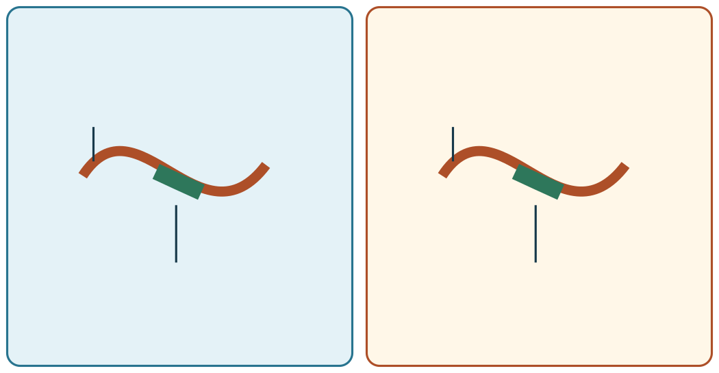
SCIENCE · LAUNCH · AUTUMN 2 · WEEK 4 · SCI-LAUNCH-A2-W04
Independent · compare the models
Within 8
Check these two models. One has a false label. Choose the accurate model and explain one reason.
Model A
Model B
DNA
gene
gene
DNA
Both pictures are models to check, not real cells. Sizes are not to scale.
Talk before write: “Move this label because …”
Made by Matt · © Matt Roper · CC BY-NC-SA 4.0: free for classroom use, share and adapt with credit, no resale
Notes:
Source: Launch/Autumn_2_2026-27/SCI_LAUNCH_A2_W04/SCI_LAUNCH_A2_W04.html; revision c4ca8ffab98e6186a9ef2fed3921644b177f0d6d. Workbook: _authoring/science_2026-27/_toolchain/scheme_references/LAUNCH_SOW.xlsx; LAUNCH Weekly - Autumn C42 Describe DNA, genes & chromosomes. Generic recommended S4, not detailed W12L1 alternative. This continuation/optional view stays WITHIN the chosen8-minute Independent block. Stage continuations share source40minutes: Arrival5 Starter3 Ido5 Wedo7 Wedo2five Independent8 Review4 Exit3. Three reset minutes are INSIDE We do, Independent and Review. Ido words2/fullmodel2/picture1. Hinge correct B/second, gene within DNA. Hear BOTH learners own choices/reasons; both secure means transfer, otherwise re-model unsure learner and parallel genome hinge while other continues. Pair explain/question then swap, separate evidence; no forced speech/disclosure/handling. Optional shortcord/bluntclips/tray must be counted out/back, supervised, away from necks and removed immediately if dysregulated; confirm local risk assessment. Source models simplified/nottoscale; clip marks DNA section, genome includes other DNA. Comparison Model A accurate, Model B reverses gene/DNA; audit both diagrams faulty and must be repaired with reasons. Prompt ladder and staff keys/diagnoses/parallel in pack. No pupil answer storage. No third science task at Exit; two prompts group unchanged source work.

Slide 12
SCIENCE · LAUNCH · AUTUMN 2 · WEEK 4 · SCI-LAUNCH-A2-W04
Independent · Supported
8 min
Two diagrams label a gene differently. Choose the accurate model and explain one reason.
One-minute reset: use the agreed move, then return to one step.
Talk before write: “Move this label because …”
You can plan in any language. Point, sign, speak, draw, type, write, use an exact scribe or a staff-captured photo.
Label a gene, DNA, chromosome and genome on the model.
This short marked section is a …; the long package is a …
Choose one route. Use the full 8 minutes for your own task.
I · S · C □
Independent · choose one route · 8 min total
Made by Matt · © Matt Roper · CC BY-NC-SA 4.0: free for classroom use, share and adapt with credit, no resale
Notes:
Source: Launch/Autumn_2_2026-27/SCI_LAUNCH_A2_W04/SCI_LAUNCH_A2_W04.html; revision c4ca8ffab98e6186a9ef2fed3921644b177f0d6d. Workbook: _authoring/science_2026-27/_toolchain/scheme_references/LAUNCH_SOW.xlsx; LAUNCH Weekly - Autumn C42 Describe DNA, genes & chromosomes. Generic recommended S4, not detailed W12L1 alternative. ONE chosen route uses the FULL8-minute Independent budget. Alternatives do not add time. Stage continuations share source40minutes: Arrival5 Starter3 Ido5 Wedo7 Wedo2five Independent8 Review4 Exit3. Three reset minutes are INSIDE We do, Independent and Review. Ido words2/fullmodel2/picture1. Hinge correct B/second, gene within DNA. Hear BOTH learners own choices/reasons; both secure means transfer, otherwise re-model unsure learner and parallel genome hinge while other continues. Pair explain/question then swap, separate evidence; no forced speech/disclosure/handling. Optional shortcord/bluntclips/tray must be counted out/back, supervised, away from necks and removed immediately if dysregulated; confirm local risk assessment. Source models simplified/nottoscale; clip marks DNA section, genome includes other DNA. Comparison Model A accurate, Model B reverses gene/DNA; audit both diagrams faulty and must be repaired with reasons. Prompt ladder and staff keys/diagnoses/parallel in pack. No pupil answer storage. No third science task at Exit; two prompts group unchanged source work.

Slide 13
SCIENCE · LAUNCH · AUTUMN 2 · WEEK 4 · SCI-LAUNCH-A2-W04
Independent · Independent
8 min
Two diagrams label a gene differently. Choose the accurate model and explain one reason.
One-minute reset: use the agreed move, then return to one step.
Talk before write: “Move this label because …”
You can plan in any language. Point, sign, speak, draw, type, write, use an exact scribe or a staff-captured photo.
Explain why a gene is a DNA section, not another material.
A gene is part of … and codes for …
Choose one route. Use the full 8 minutes for your own task.
I · S · C □
Independent · choose one route · 8 min total
Made by Matt · © Matt Roper · CC BY-NC-SA 4.0: free for classroom use, share and adapt with credit, no resale
Notes:
Source: Launch/Autumn_2_2026-27/SCI_LAUNCH_A2_W04/SCI_LAUNCH_A2_W04.html; revision c4ca8ffab98e6186a9ef2fed3921644b177f0d6d. Workbook: _authoring/science_2026-27/_toolchain/scheme_references/LAUNCH_SOW.xlsx; LAUNCH Weekly - Autumn C42 Describe DNA, genes & chromosomes. Generic recommended S4, not detailed W12L1 alternative. ONE chosen route uses the FULL8-minute Independent budget. Alternatives do not add time. Stage continuations share source40minutes: Arrival5 Starter3 Ido5 Wedo7 Wedo2five Independent8 Review4 Exit3. Three reset minutes are INSIDE We do, Independent and Review. Ido words2/fullmodel2/picture1. Hinge correct B/second, gene within DNA. Hear BOTH learners own choices/reasons; both secure means transfer, otherwise re-model unsure learner and parallel genome hinge while other continues. Pair explain/question then swap, separate evidence; no forced speech/disclosure/handling. Optional shortcord/bluntclips/tray must be counted out/back, supervised, away from necks and removed immediately if dysregulated; confirm local risk assessment. Source models simplified/nottoscale; clip marks DNA section, genome includes other DNA. Comparison Model A accurate, Model B reverses gene/DNA; audit both diagrams faulty and must be repaired with reasons. Prompt ladder and staff keys/diagnoses/parallel in pack. No pupil answer storage. No third science task at Exit; two prompts group unchanged source work.

Slide 14
SCIENCE · LAUNCH · AUTUMN 2 · WEEK 4 · SCI-LAUNCH-A2-W04
Independent · Aspire
8 min
Two diagrams label a gene differently. Choose the accurate model and explain one reason.
One-minute reset: use the agreed move, then return to one step.
Talk before write: “Move this label because …”
You can plan in any language. Point, sign, speak, draw, type, write, use an exact scribe or a staff-captured photo.
Correct a faulty gene label and explain the protein instruction.
The faulty label is …; it should be … because …
Choose one route. Use the full 8 minutes for your own task.
I · S · C □
Independent · choose one route · 8 min total
Made by Matt · © Matt Roper · CC BY-NC-SA 4.0: free for classroom use, share and adapt with credit, no resale
Notes:
Source: Launch/Autumn_2_2026-27/SCI_LAUNCH_A2_W04/SCI_LAUNCH_A2_W04.html; revision c4ca8ffab98e6186a9ef2fed3921644b177f0d6d. Workbook: _authoring/science_2026-27/_toolchain/scheme_references/LAUNCH_SOW.xlsx; LAUNCH Weekly - Autumn C42 Describe DNA, genes & chromosomes. Generic recommended S4, not detailed W12L1 alternative. ONE chosen route uses the FULL8-minute Independent budget. Alternatives do not add time. Stage continuations share source40minutes: Arrival5 Starter3 Ido5 Wedo7 Wedo2five Independent8 Review4 Exit3. Three reset minutes are INSIDE We do, Independent and Review. Ido words2/fullmodel2/picture1. Hinge correct B/second, gene within DNA. Hear BOTH learners own choices/reasons; both secure means transfer, otherwise re-model unsure learner and parallel genome hinge while other continues. Pair explain/question then swap, separate evidence; no forced speech/disclosure/handling. Optional shortcord/bluntclips/tray must be counted out/back, supervised, away from necks and removed immediately if dysregulated; confirm local risk assessment. Source models simplified/nottoscale; clip marks DNA section, genome includes other DNA. Comparison Model A accurate, Model B reverses gene/DNA; audit both diagrams faulty and must be repaired with reasons. Prompt ladder and staff keys/diagnoses/parallel in pack. No pupil answer storage. No third science task at Exit; two prompts group unchanged source work.

Slide 15
SCIENCE · LAUNCH · AUTUMN 2 · WEEK 4 · SCI-LAUNCH-A2-W04
Independent · Go deeper
8 min
What distinctions disappear if the whole genome is called one gene?
Two-diagram audit: Repair two faulty diagrams: DNA inside a gene, and one chromosome as the entire genome. Justify both.
You can plan in any language. Point, sign, speak, draw, type, write, use an exact scribe or a staff-captured photo.
Choose one route. Use the full 8 minutes for your own task.
I · S · C □
Independent · choose one route · 8 min total
Made by Matt · © Matt Roper · CC BY-NC-SA 4.0: free for classroom use, share and adapt with credit, no resale
Notes:
Source: Launch/Autumn_2_2026-27/SCI_LAUNCH_A2_W04/SCI_LAUNCH_A2_W04.html; revision c4ca8ffab98e6186a9ef2fed3921644b177f0d6d. Workbook: _authoring/science_2026-27/_toolchain/scheme_references/LAUNCH_SOW.xlsx; LAUNCH Weekly - Autumn C42 Describe DNA, genes & chromosomes. Generic recommended S4, not detailed W12L1 alternative. ONE chosen route uses the FULL8-minute Independent budget. Alternatives do not add time. Stage continuations share source40minutes: Arrival5 Starter3 Ido5 Wedo7 Wedo2five Independent8 Review4 Exit3. Three reset minutes are INSIDE We do, Independent and Review. Ido words2/fullmodel2/picture1. Hinge correct B/second, gene within DNA. Hear BOTH learners own choices/reasons; both secure means transfer, otherwise re-model unsure learner and parallel genome hinge while other continues. Pair explain/question then swap, separate evidence; no forced speech/disclosure/handling. Optional shortcord/bluntclips/tray must be counted out/back, supervised, away from necks and removed immediately if dysregulated; confirm local risk assessment. Source models simplified/nottoscale; clip marks DNA section, genome includes other DNA. Comparison Model A accurate, Model B reverses gene/DNA; audit both diagrams faulty and must be repaired with reasons. Prompt ladder and staff keys/diagnoses/parallel in pack. No pupil answer storage. No third science task at Exit; two prompts group unchanged source work.

Slide 16
SCIENCE · LAUNCH · AUTUMN 2 · WEEK 4 · SCI-LAUNCH-A2-W04
Independent · prepared model
Within 8
This is model rehearsal, not a core practical.
Kit: Short DNA cord, large blunt clips, genome and chromosome frames, tray.
Mark one gene with a blunt clip and nest the cord model in its frames.
Risk: A clip could pinch a finger, and a loose cord could catch.
Safe: Use large blunt clips and short cord on a tray. Keep the cord away from necks.
Made by Matt · © Matt Roper · CC BY-NC-SA 4.0: free for classroom use, share and adapt with credit, no resale
Notes:
Source: Launch/Autumn_2_2026-27/SCI_LAUNCH_A2_W04/SCI_LAUNCH_A2_W04.html; revision c4ca8ffab98e6186a9ef2fed3921644b177f0d6d. Workbook: _authoring/science_2026-27/_toolchain/scheme_references/LAUNCH_SOW.xlsx; LAUNCH Weekly - Autumn C42 Describe DNA, genes & chromosomes. Generic recommended S4, not detailed W12L1 alternative. This continuation/optional view stays WITHIN the chosen8-minute Independent block. Stage continuations share source40minutes: Arrival5 Starter3 Ido5 Wedo7 Wedo2five Independent8 Review4 Exit3. Three reset minutes are INSIDE We do, Independent and Review. Ido words2/fullmodel2/picture1. Hinge correct B/second, gene within DNA. Hear BOTH learners own choices/reasons; both secure means transfer, otherwise re-model unsure learner and parallel genome hinge while other continues. Pair explain/question then swap, separate evidence; no forced speech/disclosure/handling. Optional shortcord/bluntclips/tray must be counted out/back, supervised, away from necks and removed immediately if dysregulated; confirm local risk assessment. Source models simplified/nottoscale; clip marks DNA section, genome includes other DNA. Comparison Model A accurate, Model B reverses gene/DNA; audit both diagrams faulty and must be repaired with reasons. Prompt ladder and staff keys/diagnoses/parallel in pack. No pupil answer storage. No third science task at Exit; two prompts group unchanged source work.

Slide 17
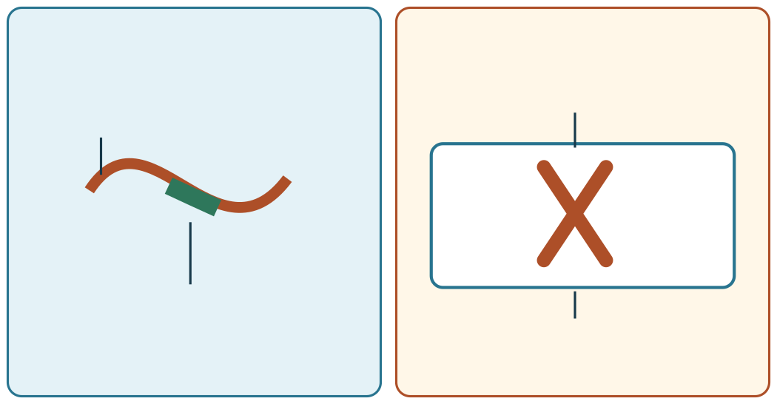
SCIENCE · LAUNCH · AUTUMN 2 · WEEK 4 · SCI-LAUNCH-A2-W04
Two-diagram audit
Within 8
Both diagrams below contain a false label. Repair each one and justify both changes.
Diagram 1
Diagram 2
entire genome
gene
DNA
one chromosome
These are deliberately faulty challenge models. They are not teaching facts. Sizes are not to scale.
Made by Matt · © Matt Roper · CC BY-NC-SA 4.0: free for classroom use, share and adapt with credit, no resale
Notes:
Source: Launch/Autumn_2_2026-27/SCI_LAUNCH_A2_W04/SCI_LAUNCH_A2_W04.html; revision c4ca8ffab98e6186a9ef2fed3921644b177f0d6d. Workbook: _authoring/science_2026-27/_toolchain/scheme_references/LAUNCH_SOW.xlsx; LAUNCH Weekly - Autumn C42 Describe DNA, genes & chromosomes. Generic recommended S4, not detailed W12L1 alternative. This continuation/optional view stays WITHIN the chosen8-minute Independent block. Stage continuations share source40minutes: Arrival5 Starter3 Ido5 Wedo7 Wedo2five Independent8 Review4 Exit3. Three reset minutes are INSIDE We do, Independent and Review. Ido words2/fullmodel2/picture1. Hinge correct B/second, gene within DNA. Hear BOTH learners own choices/reasons; both secure means transfer, otherwise re-model unsure learner and parallel genome hinge while other continues. Pair explain/question then swap, separate evidence; no forced speech/disclosure/handling. Optional shortcord/bluntclips/tray must be counted out/back, supervised, away from necks and removed immediately if dysregulated; confirm local risk assessment. Source models simplified/nottoscale; clip marks DNA section, genome includes other DNA. Comparison Model A accurate, Model B reverses gene/DNA; audit both diagrams faulty and must be repaired with reasons. Prompt ladder and staff keys/diagnoses/parallel in pack. No pupil answer storage. No third science task at Exit; two prompts group unchanged source work.

Slide 18
SCIENCE · LAUNCH · AUTUMN 2 · WEEK 4 · SCI-LAUNCH-A2-W04
Review and improve
4 min
Tell your partner what you changed after feedback. Mark a real edit // and read it back when asked ?.
One-minute reset: use the agreed move, then return to one step.
My feedback was … Name the actual point an adult or partner noticed. Make one true self-edit //. Ask “Read this back to me” ? if that helps.
Made by Matt · © Matt Roper · CC BY-NC-SA 4.0: free for classroom use, share and adapt with credit, no resale
Notes:
Source: Launch/Autumn_2_2026-27/SCI_LAUNCH_A2_W04/SCI_LAUNCH_A2_W04.html; revision c4ca8ffab98e6186a9ef2fed3921644b177f0d6d. Workbook: _authoring/science_2026-27/_toolchain/scheme_references/LAUNCH_SOW.xlsx; LAUNCH Weekly - Autumn C42 Describe DNA, genes & chromosomes. Generic recommended S4, not detailed W12L1 alternative. Stage continuations share source40minutes: Arrival5 Starter3 Ido5 Wedo7 Wedo2five Independent8 Review4 Exit3. Three reset minutes are INSIDE We do, Independent and Review. Ido words2/fullmodel2/picture1. Hinge correct B/second, gene within DNA. Hear BOTH learners own choices/reasons; both secure means transfer, otherwise re-model unsure learner and parallel genome hinge while other continues. Pair explain/question then swap, separate evidence; no forced speech/disclosure/handling. Optional shortcord/bluntclips/tray must be counted out/back, supervised, away from necks and removed immediately if dysregulated; confirm local risk assessment. Source models simplified/nottoscale; clip marks DNA section, genome includes other DNA. Comparison Model A accurate, Model B reverses gene/DNA; audit both diagrams faulty and must be repaired with reasons. Prompt ladder and staff keys/diagnoses/parallel in pack. No pupil answer storage. No third science task at Exit; two prompts group unchanged source work.

Slide 19
SCIENCE · LAUNCH · AUTUMN 2 · WEEK 4 · SCI-LAUNCH-A2-W04
Exit ticket
2 min
1. What does your model show, and why?
Show what you know with a model and explain one reason.
My learning: I am learning to show how a gene is part of DNA and how DNA is packed into chromosomes.
How I know: I can show a gene within DNA, DNA packaged in a chromosome, and the genome as all DNA.
Made by Matt · © Matt Roper · CC BY-NC-SA 4.0: free for classroom use, share and adapt with credit, no resale
Notes:
Source: Launch/Autumn_2_2026-27/SCI_LAUNCH_A2_W04/SCI_LAUNCH_A2_W04.html; revision c4ca8ffab98e6186a9ef2fed3921644b177f0d6d. Workbook: _authoring/science_2026-27/_toolchain/scheme_references/LAUNCH_SOW.xlsx; LAUNCH Weekly - Autumn C42 Describe DNA, genes & chromosomes. Generic recommended S4, not detailed W12L1 alternative. Stage continuations share source40minutes: Arrival5 Starter3 Ido5 Wedo7 Wedo2five Independent8 Review4 Exit3. Three reset minutes are INSIDE We do, Independent and Review. Ido words2/fullmodel2/picture1. Hinge correct B/second, gene within DNA. Hear BOTH learners own choices/reasons; both secure means transfer, otherwise re-model unsure learner and parallel genome hinge while other continues. Pair explain/question then swap, separate evidence; no forced speech/disclosure/handling. Optional shortcord/bluntclips/tray must be counted out/back, supervised, away from necks and removed immediately if dysregulated; confirm local risk assessment. Source models simplified/nottoscale; clip marks DNA section, genome includes other DNA. Comparison Model A accurate, Model B reverses gene/DNA; audit both diagrams faulty and must be repaired with reasons. Prompt ladder and staff keys/diagnoses/parallel in pack. No pupil answer storage. No third science task at Exit; two prompts group unchanged source work.

Slide 20
SCIENCE · LAUNCH · AUTUMN 2 · WEEK 4 · SCI-LAUNCH-A2-W04
Exit reflection
1 min
2. What feedback did you hear, and what is your next step?
My feedback was … Name what you heard at Review.
Next I need to … Use “section of DNA” and “codes for a protein” precisely in one sentence.
Check today’s success:
I can label DNA, a gene and a chromosome in a simple model.
I can explain that a gene is a section of DNA with a protein instruction.
I can distinguish one chromosome from the genome.
Your teacher hears your answer and uses it to choose our next model, prompt or example.
Made by Matt · © Matt Roper · CC BY-NC-SA 4.0: free for classroom use, share and adapt with credit, no resale
Notes:
Source: Launch/Autumn_2_2026-27/SCI_LAUNCH_A2_W04/SCI_LAUNCH_A2_W04.html; revision c4ca8ffab98e6186a9ef2fed3921644b177f0d6d. Workbook: _authoring/science_2026-27/_toolchain/scheme_references/LAUNCH_SOW.xlsx; LAUNCH Weekly - Autumn C42 Describe DNA, genes & chromosomes. Generic recommended S4, not detailed W12L1 alternative. Stage continuations share source40minutes: Arrival5 Starter3 Ido5 Wedo7 Wedo2five Independent8 Review4 Exit3. Three reset minutes are INSIDE We do, Independent and Review. Ido words2/fullmodel2/picture1. Hinge correct B/second, gene within DNA. Hear BOTH learners own choices/reasons; both secure means transfer, otherwise re-model unsure learner and parallel genome hinge while other continues. Pair explain/question then swap, separate evidence; no forced speech/disclosure/handling. Optional shortcord/bluntclips/tray must be counted out/back, supervised, away from necks and removed immediately if dysregulated; confirm local risk assessment. Source models simplified/nottoscale; clip marks DNA section, genome includes other DNA. Comparison Model A accurate, Model B reverses gene/DNA; audit both diagrams faulty and must be repaired with reasons. Prompt ladder and staff keys/diagnoses/parallel in pack. No pupil answer storage. No third science task at Exit; two prompts group unchanged source work.

