Slide 1

SCIENCE · LAUNCH · AUTUMN 2 · WEEK 7 · SCI-LAUNCH-A2-W07-L2
Exam-style reasoning: evidence to explanation
Opening · 0 min
Use command words, selected evidence and a clear scientific link to improve exam-style responses.
Respond to the command word.
Select a value or mechanism that supports the answer.
Improve a claim by adding an appropriate limitation.
Point, speak, draw, type or write. Pass or pause. Keep your own first answer, source and next step.
Made by Matt · © Matt Roper · CC BY-NC-SA 4.0: free for classroom use, share and adapt with credit, no resale
Notes:
Source: Launch/Autumn2_W7_2026-27/SCI_L_A2_W7L2_Topics_2_3_Assessment_Explore.html; revision c4ca8ffab98e6186a9ef2fed3921644b177f0d6d. Workbook: _authoring/science_2026-27/_toolchain/scheme_references/LAUNCH_SOW.xlsx; LAUNCH Weekly - Autumn C45: Topics 2 to 3 assessment (Dec). Exact goal: Use command words, selected evidence and a clear scientific link to improve exam-style responses. Full sources: . Source stage timing totals 40 minutes. Continuation and alternative route views share the stated stage budget; do not add their times. Each learner keeps an individual response. No cold calling; pass, pause and exact scribing remain valid. Staff answers, safety, the prompt ladder and responsive next steps are in the pack. Use prepared cards and large model pieces on a tray. No biological samples or personal family details. Check the local risk assessment. No forced touch, cutting, public reading or pupil phone.

Slide 2
SCIENCE · LAUNCH · AUTUMN 2 · WEEK 7 · SCI-LAUNCH-A2-W07-L2
Arrival · Supported
Arrival · 4 min across this stage
Four checks. Point, speak, sign, draw, write or direct an adult. An adult may read or scribe your exact words. Choose one route; do not complete all three.
1. Describe
What does “describe” ask you to do?
Help: Read or point first. State the pattern or what happens.
2. Explain
What must an explanation add?
Help: Read or point first. A scientific reason or link.
3. Calculate
What should accompany a calculated answer?
Made by Matt · © Matt Roper · CC BY-NC-SA 4.0: free for classroom use, share and adapt with credit, no resale
Notes:
Source: Launch/Autumn2_W7_2026-27/SCI_L_A2_W7L2_Topics_2_3_Assessment_Explore.html; revision c4ca8ffab98e6186a9ef2fed3921644b177f0d6d. Workbook: _authoring/science_2026-27/_toolchain/scheme_references/LAUNCH_SOW.xlsx; LAUNCH Weekly - Autumn C45: Topics 2 to 3 assessment (Dec). Exact goal: Use command words, selected evidence and a clear scientific link to improve exam-style responses. Full sources: . Source stage timing totals 40 minutes. Continuation and alternative route views share the stated stage budget; do not add their times. Each learner keeps an individual response. No cold calling; pass, pause and exact scribing remain valid. Staff answers, safety, the prompt ladder and responsive next steps are in the pack. Use prepared cards and large model pieces on a tray. No biological samples or personal family details. Check the local risk assessment. No forced touch, cutting, public reading or pupil phone.

Slide 3
SCIENCE · LAUNCH · AUTUMN 2 · WEEK 7 · SCI-LAUNCH-A2-W07-L2
Arrival · Supported · continued
Arrival · 4 min across this stage
Help: Read or point first. Working and any appropriate units.
4. Evaluate
What should an evaluation consider?
Help: Read or point first. Evidence and limitations, not just an opinion.
My response: ______________________________
Made by Matt · © Matt Roper · CC BY-NC-SA 4.0: free for classroom use, share and adapt with credit, no resale
Notes:
Source: Launch/Autumn2_W7_2026-27/SCI_L_A2_W7L2_Topics_2_3_Assessment_Explore.html; revision c4ca8ffab98e6186a9ef2fed3921644b177f0d6d. Workbook: _authoring/science_2026-27/_toolchain/scheme_references/LAUNCH_SOW.xlsx; LAUNCH Weekly - Autumn C45: Topics 2 to 3 assessment (Dec). Exact goal: Use command words, selected evidence and a clear scientific link to improve exam-style responses. Full sources: . Source stage timing totals 40 minutes. Continuation and alternative route views share the stated stage budget; do not add their times. Each learner keeps an individual response. No cold calling; pass, pause and exact scribing remain valid. Staff answers, safety, the prompt ladder and responsive next steps are in the pack. Use prepared cards and large model pieces on a tray. No biological samples or personal family details. Check the local risk assessment. No forced touch, cutting, public reading or pupil phone.

Slide 4
SCIENCE · LAUNCH · AUTUMN 2 · WEEK 7 · SCI-LAUNCH-A2-W07-L2
Arrival · Independent
Arrival · 4 min across this stage
Four checks. Point, speak, sign, draw, write or direct an adult. An adult may read or scribe your exact words. Choose one route; do not complete all three.
1. Describe
What does “describe” ask you to do?
Help: State the pattern or what happens.
2. Explain
What must an explanation add?
Help: A scientific reason or link.
3. Calculate
What should accompany a calculated answer?
Made by Matt · © Matt Roper · CC BY-NC-SA 4.0: free for classroom use, share and adapt with credit, no resale
Notes:
Source: Launch/Autumn2_W7_2026-27/SCI_L_A2_W7L2_Topics_2_3_Assessment_Explore.html; revision c4ca8ffab98e6186a9ef2fed3921644b177f0d6d. Workbook: _authoring/science_2026-27/_toolchain/scheme_references/LAUNCH_SOW.xlsx; LAUNCH Weekly - Autumn C45: Topics 2 to 3 assessment (Dec). Exact goal: Use command words, selected evidence and a clear scientific link to improve exam-style responses. Full sources: . Source stage timing totals 40 minutes. Continuation and alternative route views share the stated stage budget; do not add their times. Each learner keeps an individual response. No cold calling; pass, pause and exact scribing remain valid. Staff answers, safety, the prompt ladder and responsive next steps are in the pack. Use prepared cards and large model pieces on a tray. No biological samples or personal family details. Check the local risk assessment. No forced touch, cutting, public reading or pupil phone.

Slide 5
SCIENCE · LAUNCH · AUTUMN 2 · WEEK 7 · SCI-LAUNCH-A2-W07-L2
Arrival · Independent · continued
Arrival · 4 min across this stage
Help: Working and any appropriate units.
4. Evaluate
What should an evaluation consider?
Help: Evidence and limitations, not just an opinion.
My response: ______________________________
Made by Matt · © Matt Roper · CC BY-NC-SA 4.0: free for classroom use, share and adapt with credit, no resale
Notes:
Source: Launch/Autumn2_W7_2026-27/SCI_L_A2_W7L2_Topics_2_3_Assessment_Explore.html; revision c4ca8ffab98e6186a9ef2fed3921644b177f0d6d. Workbook: _authoring/science_2026-27/_toolchain/scheme_references/LAUNCH_SOW.xlsx; LAUNCH Weekly - Autumn C45: Topics 2 to 3 assessment (Dec). Exact goal: Use command words, selected evidence and a clear scientific link to improve exam-style responses. Full sources: . Source stage timing totals 40 minutes. Continuation and alternative route views share the stated stage budget; do not add their times. Each learner keeps an individual response. No cold calling; pass, pause and exact scribing remain valid. Staff answers, safety, the prompt ladder and responsive next steps are in the pack. Use prepared cards and large model pieces on a tray. No biological samples or personal family details. Check the local risk assessment. No forced touch, cutting, public reading or pupil phone.

Slide 6
SCIENCE · LAUNCH · AUTUMN 2 · WEEK 7 · SCI-LAUNCH-A2-W07-L2
Arrival · Aspire
Arrival · 4 min across this stage
Four checks. Point, speak, sign, draw, write or direct an adult. An adult may read or scribe your exact words. Choose one route; do not complete all three.
1. Describe
What does “describe” ask you to do?
Help: State the pattern or what happens.
2. Explain
What must an explanation add?
Help: A scientific reason or link.
3. Calculate
What should accompany a calculated answer?
Made by Matt · © Matt Roper · CC BY-NC-SA 4.0: free for classroom use, share and adapt with credit, no resale
Notes:
Source: Launch/Autumn2_W7_2026-27/SCI_L_A2_W7L2_Topics_2_3_Assessment_Explore.html; revision c4ca8ffab98e6186a9ef2fed3921644b177f0d6d. Workbook: _authoring/science_2026-27/_toolchain/scheme_references/LAUNCH_SOW.xlsx; LAUNCH Weekly - Autumn C45: Topics 2 to 3 assessment (Dec). Exact goal: Use command words, selected evidence and a clear scientific link to improve exam-style responses. Full sources: . Source stage timing totals 40 minutes. Continuation and alternative route views share the stated stage budget; do not add their times. Each learner keeps an individual response. No cold calling; pass, pause and exact scribing remain valid. Staff answers, safety, the prompt ladder and responsive next steps are in the pack. Use prepared cards and large model pieces on a tray. No biological samples or personal family details. Check the local risk assessment. No forced touch, cutting, public reading or pupil phone.

Slide 7
SCIENCE · LAUNCH · AUTUMN 2 · WEEK 7 · SCI-LAUNCH-A2-W07-L2
Arrival · Aspire · continued
Arrival · 4 min across this stage
Help: Working and any appropriate units.
4. Evaluate
What should an evaluation consider? Give a reason.
Help: Evidence and limitations, not just an opinion.
My response: ______________________________
Made by Matt · © Matt Roper · CC BY-NC-SA 4.0: free for classroom use, share and adapt with credit, no resale
Notes:
Source: Launch/Autumn2_W7_2026-27/SCI_L_A2_W7L2_Topics_2_3_Assessment_Explore.html; revision c4ca8ffab98e6186a9ef2fed3921644b177f0d6d. Workbook: _authoring/science_2026-27/_toolchain/scheme_references/LAUNCH_SOW.xlsx; LAUNCH Weekly - Autumn C45: Topics 2 to 3 assessment (Dec). Exact goal: Use command words, selected evidence and a clear scientific link to improve exam-style responses. Full sources: . Source stage timing totals 40 minutes. Continuation and alternative route views share the stated stage budget; do not add their times. Each learner keeps an individual response. No cold calling; pass, pause and exact scribing remain valid. Staff answers, safety, the prompt ladder and responsive next steps are in the pack. Use prepared cards and large model pieces on a tray. No biological samples or personal family details. Check the local risk assessment. No forced touch, cutting, public reading or pupil phone.

Slide 8
SCIENCE · LAUNCH · AUTUMN 2 · WEEK 7 · SCI-LAUNCH-A2-W07-L2
Starter
Starter · 4 min across this stage
Which answer best explains identical daughter nuclei?
A. They are identical because they match
B. DNA is copied, then chromosome copies are separated into two complete sets
C. The cell gets bigger
Keep your first choice. Give a reason before the answer is checked.
Made by Matt · © Matt Roper · CC BY-NC-SA 4.0: free for classroom use, share and adapt with credit, no resale
Notes:
Source: Launch/Autumn2_W7_2026-27/SCI_L_A2_W7L2_Topics_2_3_Assessment_Explore.html; revision c4ca8ffab98e6186a9ef2fed3921644b177f0d6d. Workbook: _authoring/science_2026-27/_toolchain/scheme_references/LAUNCH_SOW.xlsx; LAUNCH Weekly - Autumn C45: Topics 2 to 3 assessment (Dec). Exact goal: Use command words, selected evidence and a clear scientific link to improve exam-style responses. Full sources: . Source stage timing totals 40 minutes. Continuation and alternative route views share the stated stage budget; do not add their times. Each learner keeps an individual response. No cold calling; pass, pause and exact scribing remain valid. Staff answers, safety, the prompt ladder and responsive next steps are in the pack. Use prepared cards and large model pieces on a tray. No biological samples or personal family details. Check the local risk assessment. No forced touch, cutting, public reading or pupil phone.

Slide 9
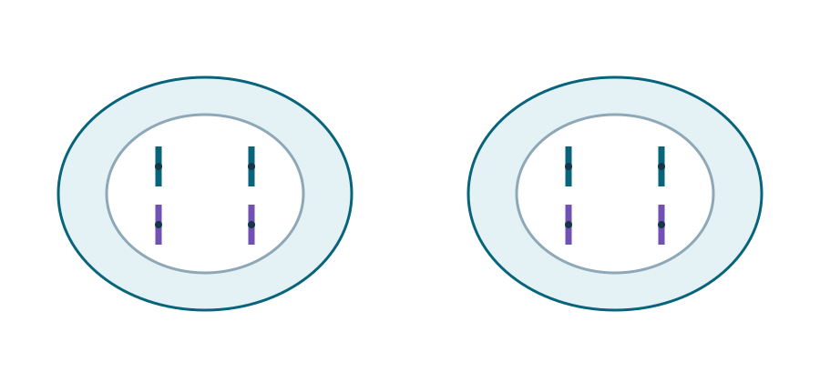
SCIENCE · LAUNCH · AUTUMN 2 · WEEK 7 · SCI-LAUNCH-A2-W07-L2
Cells
I do · 5 min across this stage
Telophase and cytokinesis
4 chromosomes
4 chromosomes
Two daughter cells • same complete chromosome set
The DNA is copied before mitosis. The copies move apart into two sets. Each new cell gets a full set of genes.
Made by Matt · © Matt Roper · CC BY-NC-SA 4.0: free for classroom use, share and adapt with credit, no resale
Notes:
Source: Launch/Autumn2_W7_2026-27/SCI_L_A2_W7L2_Topics_2_3_Assessment_Explore.html; revision c4ca8ffab98e6186a9ef2fed3921644b177f0d6d. Workbook: _authoring/science_2026-27/_toolchain/scheme_references/LAUNCH_SOW.xlsx; LAUNCH Weekly - Autumn C45: Topics 2 to 3 assessment (Dec). Exact goal: Use command words, selected evidence and a clear scientific link to improve exam-style responses. Full sources: . Source stage timing totals 40 minutes. Continuation and alternative route views share the stated stage budget; do not add their times. Each learner keeps an individual response. No cold calling; pass, pause and exact scribing remain valid. Staff answers, safety, the prompt ladder and responsive next steps are in the pack. Use prepared cards and large model pieces on a tray. No biological samples or personal family details. Check the local risk assessment. No forced touch, cutting, public reading or pupil phone.

Slide 10
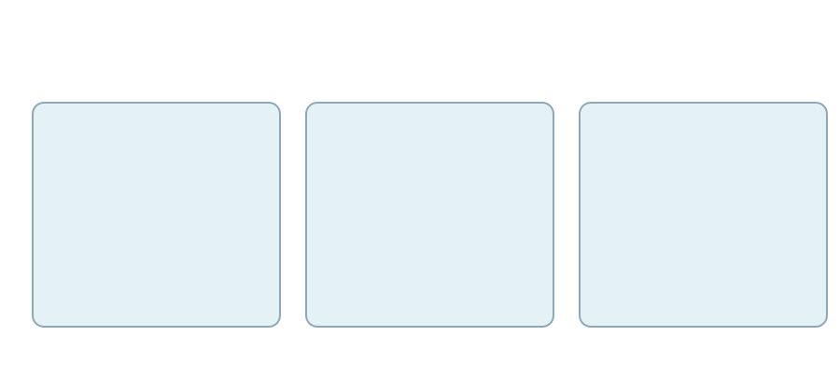
SCIENCE · LAUNCH · AUTUMN 2 · WEEK 7 · SCI-LAUNCH-A2-W07-L2
Evidence
I do · 5 min across this stage
SIMULATED STUDY • invented teaching data
Size
Time
Unknown
20 people per
8-week follow-up
Longer-term
group
outcomes
A possible benefit is not a guarantee of safety or a cure.
Use numbers and a comparison before making a stem cell claim.
Made by Matt · © Matt Roper · CC BY-NC-SA 4.0: free for classroom use, share and adapt with credit, no resale
Notes:
Source: Launch/Autumn2_W7_2026-27/SCI_L_A2_W7L2_Topics_2_3_Assessment_Explore.html; revision c4ca8ffab98e6186a9ef2fed3921644b177f0d6d. Workbook: _authoring/science_2026-27/_toolchain/scheme_references/LAUNCH_SOW.xlsx; LAUNCH Weekly - Autumn C45: Topics 2 to 3 assessment (Dec). Exact goal: Use command words, selected evidence and a clear scientific link to improve exam-style responses. Full sources: . Source stage timing totals 40 minutes. Continuation and alternative route views share the stated stage budget; do not add their times. Each learner keeps an individual response. No cold calling; pass, pause and exact scribing remain valid. Staff answers, safety, the prompt ladder and responsive next steps are in the pack. Use prepared cards and large model pieces on a tray. No biological samples or personal family details. Check the local risk assessment. No forced touch, cutting, public reading or pupil phone.

Slide 11
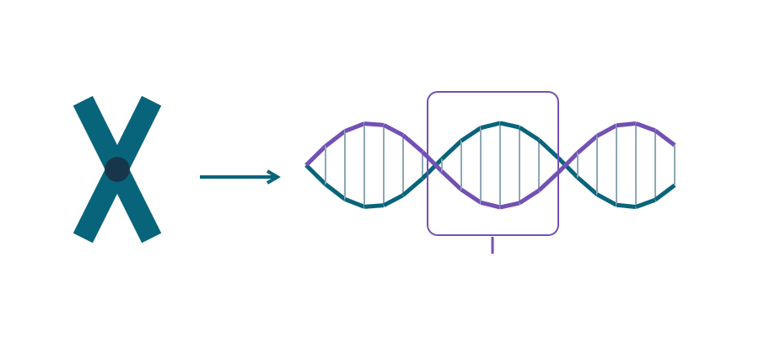
SCIENCE · LAUNCH · AUTUMN 2 · WEEK 7 · SCI-LAUNCH-A2-W07-L2
Genetic information
I do · 5 min across this stage
Chromosome → DNA → gene section
Chromosome
Gene: one section
Long DNA molecule
Connect nucleus, chromosome, DNA and gene; pair A–T and C–G.
Made by Matt · © Matt Roper · CC BY-NC-SA 4.0: free for classroom use, share and adapt with credit, no resale
Notes:
Source: Launch/Autumn2_W7_2026-27/SCI_L_A2_W7L2_Topics_2_3_Assessment_Explore.html; revision c4ca8ffab98e6186a9ef2fed3921644b177f0d6d. Workbook: _authoring/science_2026-27/_toolchain/scheme_references/LAUNCH_SOW.xlsx; LAUNCH Weekly - Autumn C45: Topics 2 to 3 assessment (Dec). Exact goal: Use command words, selected evidence and a clear scientific link to improve exam-style responses. Full sources: . Source stage timing totals 40 minutes. Continuation and alternative route views share the stated stage budget; do not add their times. Each learner keeps an individual response. No cold calling; pass, pause and exact scribing remain valid. Staff answers, safety, the prompt ladder and responsive next steps are in the pack. Use prepared cards and large model pieces on a tray. No biological samples or personal family details. Check the local risk assessment. No forced touch, cutting, public reading or pupil phone.

Slide 12
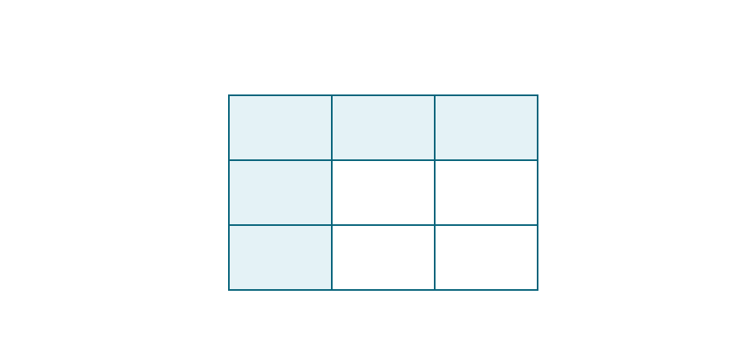
SCIENCE · LAUNCH · AUTUMN 2 · WEEK 7 · SCI-LAUNCH-A2-W07-L2
Inheritance
I do · 5 min across this stage
Aa × Aa • one-gene model
Parent 1 gametes
A
a
Parent 2
A
AA
Aa
gametes
a
Aa
aa
aa: 1/4 = 25% • chance for each fertilisation
Use gametes and a Punnett square, then interpret chance cautiously.
Made by Matt · © Matt Roper · CC BY-NC-SA 4.0: free for classroom use, share and adapt with credit, no resale
Notes:
Source: Launch/Autumn2_W7_2026-27/SCI_L_A2_W7L2_Topics_2_3_Assessment_Explore.html; revision c4ca8ffab98e6186a9ef2fed3921644b177f0d6d. Workbook: _authoring/science_2026-27/_toolchain/scheme_references/LAUNCH_SOW.xlsx; LAUNCH Weekly - Autumn C45: Topics 2 to 3 assessment (Dec). Exact goal: Use command words, selected evidence and a clear scientific link to improve exam-style responses. Full sources: . Source stage timing totals 40 minutes. Continuation and alternative route views share the stated stage budget; do not add their times. Each learner keeps an individual response. No cold calling; pass, pause and exact scribing remain valid. Staff answers, safety, the prompt ladder and responsive next steps are in the pack. Use prepared cards and large model pieces on a tray. No biological samples or personal family details. Check the local risk assessment. No forced touch, cutting, public reading or pupil phone.

Slide 13
SCIENCE · LAUNCH · AUTUMN 2 · WEEK 7 · SCI-LAUNCH-A2-W07-L2
We do · sort the cards
We do · 5 min across this stage
Card | Your group
The length rose from 2.0 to 2.8 mm | ________________
Chromosomes line up at the centre | ________________
Copies separate so each nucleus receives a full set | ________________
A root hair increases surface area for absorption | ________________
The small sample limits generalisation | ________________
A benefit is possible, but harms and follow-up matter | ________________
Made by Matt · © Matt Roper · CC BY-NC-SA 4.0: free for classroom use, share and adapt with credit, no resale
Notes:
Source: Launch/Autumn2_W7_2026-27/SCI_L_A2_W7L2_Topics_2_3_Assessment_Explore.html; revision c4ca8ffab98e6186a9ef2fed3921644b177f0d6d. Workbook: _authoring/science_2026-27/_toolchain/scheme_references/LAUNCH_SOW.xlsx; LAUNCH Weekly - Autumn C45: Topics 2 to 3 assessment (Dec). Exact goal: Use command words, selected evidence and a clear scientific link to improve exam-style responses. Full sources: . Source stage timing totals 40 minutes. Continuation and alternative route views share the stated stage budget; do not add their times. Each learner keeps an individual response. No cold calling; pass, pause and exact scribing remain valid. Staff answers, safety, the prompt ladder and responsive next steps are in the pack. Use prepared cards and large model pieces on a tray. No biological samples or personal family details. Check the local risk assessment. No forced touch, cutting, public reading or pupil phone.

Slide 14
SCIENCE · LAUNCH · AUTUMN 2 · WEEK 7 · SCI-LAUNCH-A2-W07-L2
We do · sort the cards · continued
We do · 5 min across this stage
Groups: Describe / Explain / Evaluate.
Choose first on your own. One partner explains and the other asks for the clue. Swap roles. Each learner keeps their own response.
Made by Matt · © Matt Roper · CC BY-NC-SA 4.0: free for classroom use, share and adapt with credit, no resale
Notes:
Source: Launch/Autumn2_W7_2026-27/SCI_L_A2_W7L2_Topics_2_3_Assessment_Explore.html; revision c4ca8ffab98e6186a9ef2fed3921644b177f0d6d. Workbook: _authoring/science_2026-27/_toolchain/scheme_references/LAUNCH_SOW.xlsx; LAUNCH Weekly - Autumn C45: Topics 2 to 3 assessment (Dec). Exact goal: Use command words, selected evidence and a clear scientific link to improve exam-style responses. Full sources: . Source stage timing totals 40 minutes. Continuation and alternative route views share the stated stage budget; do not add their times. Each learner keeps an individual response. No cold calling; pass, pause and exact scribing remain valid. Staff answers, safety, the prompt ladder and responsive next steps are in the pack. Use prepared cards and large model pieces on a tray. No biological samples or personal family details. Check the local risk assessment. No forced touch, cutting, public reading or pupil phone.

Slide 15
SCIENCE · LAUNCH · AUTUMN 2 · WEEK 7 · SCI-LAUNCH-A2-W07-L2
I do 2 · one example
I do 2 · 4 min across this stage
Find the percent for 8 out of 25.
8 ÷ 25 = 0.32.
0.32 × 100 = 32%.
In this sample, 32 in each 100 is the same share as 8 in 25.
The sample may differ from a wider group. We cannot give that group’s chance from this result alone.
Made by Matt · © Matt Roper · CC BY-NC-SA 4.0: free for classroom use, share and adapt with credit, no resale
Notes:
Source: Launch/Autumn2_W7_2026-27/SCI_L_A2_W7L2_Topics_2_3_Assessment_Explore.html; revision c4ca8ffab98e6186a9ef2fed3921644b177f0d6d. Workbook: _authoring/science_2026-27/_toolchain/scheme_references/LAUNCH_SOW.xlsx; LAUNCH Weekly - Autumn C45: Topics 2 to 3 assessment (Dec). Exact goal: Use command words, selected evidence and a clear scientific link to improve exam-style responses. Full sources: . Source stage timing totals 40 minutes. Continuation and alternative route views share the stated stage budget; do not add their times. Each learner keeps an individual response. No cold calling; pass, pause and exact scribing remain valid. Staff answers, safety, the prompt ladder and responsive next steps are in the pack. Use prepared cards and large model pieces on a tray. No biological samples or personal family details. Check the local risk assessment. No forced touch, cutting, public reading or pupil phone.

Slide 16
SCIENCE · LAUNCH · AUTUMN 2 · WEEK 7 · SCI-LAUNCH-A2-W07-L2
Three practice answers
We do 2 · 4 min across this stage
These are practice items, not the final test. Keep each first answer. Add a science link or a useful value, and qualify a claim that is too strong.
Prompt | Weak answer
Explain mitosis outcome | The cells match because they match
Calculate 7/20 as percent | It is about a third
Evaluate a short study | It proves the treatment is safe forever
My evidence and reasoning: __________________
One limit or useful check: __________________
Made by Matt · © Matt Roper · CC BY-NC-SA 4.0: free for classroom use, share and adapt with credit, no resale
Notes:
Source: Launch/Autumn2_W7_2026-27/SCI_L_A2_W7L2_Topics_2_3_Assessment_Explore.html; revision c4ca8ffab98e6186a9ef2fed3921644b177f0d6d. Workbook: _authoring/science_2026-27/_toolchain/scheme_references/LAUNCH_SOW.xlsx; LAUNCH Weekly - Autumn C45: Topics 2 to 3 assessment (Dec). Exact goal: Use command words, selected evidence and a clear scientific link to improve exam-style responses. Full sources: . Source stage timing totals 40 minutes. Continuation and alternative route views share the stated stage budget; do not add their times. Each learner keeps an individual response. No cold calling; pass, pause and exact scribing remain valid. Staff answers, safety, the prompt ladder and responsive next steps are in the pack. Use prepared cards and large model pieces on a tray. No biological samples or personal family details. Check the local risk assessment. No forced touch, cutting, public reading or pupil phone.

Slide 17
SCIENCE · LAUNCH · AUTUMN 2 · WEEK 7 · SCI-LAUNCH-A2-W07-L2
My improvement and next check
We do 2 · 4 min across this stage
First answer: __________________
The value or model detail I used: __________________
My science link: __________________
My fair limit: __________________
Keep your first answer. Hear the actual feedback. Make one real change, or give a reason to keep it. Record the next step you chose.
My next response: __________________
Made by Matt · © Matt Roper · CC BY-NC-SA 4.0: free for classroom use, share and adapt with credit, no resale
Notes:
Source: Launch/Autumn2_W7_2026-27/SCI_L_A2_W7L2_Topics_2_3_Assessment_Explore.html; revision c4ca8ffab98e6186a9ef2fed3921644b177f0d6d. Workbook: _authoring/science_2026-27/_toolchain/scheme_references/LAUNCH_SOW.xlsx; LAUNCH Weekly - Autumn C45: Topics 2 to 3 assessment (Dec). Exact goal: Use command words, selected evidence and a clear scientific link to improve exam-style responses. Full sources: . Source stage timing totals 40 minutes. Continuation and alternative route views share the stated stage budget; do not add their times. Each learner keeps an individual response. No cold calling; pass, pause and exact scribing remain valid. Staff answers, safety, the prompt ladder and responsive next steps are in the pack. Use prepared cards and large model pieces on a tray. No biological samples or personal family details. Check the local risk assessment. No forced touch, cutting, public reading or pupil phone.

Slide 18
SCIENCE · LAUNCH · AUTUMN 2 · WEEK 7 · SCI-LAUNCH-A2-W07-L2
Independent · Supported
Independent · 10 min across this stage
Point, speak, sign, draw, write or direct an adult. An adult may read or scribe your exact words. Choose one route; do not complete all three.
1. Explain
Improve the mitosis answer in two linked sentences.
Help: Use two linked sentences: DNA is copied during ___. The copies then ___ so each new nucleus ___.
2. Calculate
Show the working for 7/20 as a percentage.
Help: Write the fraction 7/20. Divide 7 by 20, then multiply by 100. Show the intermediate decimal.
Made by Matt · © Matt Roper · CC BY-NC-SA 4.0: free for classroom use, share and adapt with credit, no resale
Notes:
Source: Launch/Autumn2_W7_2026-27/SCI_L_A2_W7L2_Topics_2_3_Assessment_Explore.html; revision c4ca8ffab98e6186a9ef2fed3921644b177f0d6d. Workbook: _authoring/science_2026-27/_toolchain/scheme_references/LAUNCH_SOW.xlsx; LAUNCH Weekly - Autumn C45: Topics 2 to 3 assessment (Dec). Exact goal: Use command words, selected evidence and a clear scientific link to improve exam-style responses. Full sources: . Source stage timing totals 40 minutes. Continuation and alternative route views share the stated stage budget; do not add their times. Each learner keeps an individual response. No cold calling; pass, pause and exact scribing remain valid. Staff answers, safety, the prompt ladder and responsive next steps are in the pack. Use prepared cards and large model pieces on a tray. No biological samples or personal family details. Check the local risk assessment. No forced touch, cutting, public reading or pupil phone.

Slide 19
SCIENCE · LAUNCH · AUTUMN 2 · WEEK 7 · SCI-LAUNCH-A2-W07-L2
Independent · Supported · continued
Independent · 10 min across this stage
3. Evaluate
Replace the safety claim with a qualified conclusion and a relevant improvement.
Help: Use: the study suggests ___, but does not establish ___. A useful improvement would be ___ because ___.
My response: ______________________________
Use one route within the stated stage time. Keep your own original response.
Made by Matt · © Matt Roper · CC BY-NC-SA 4.0: free for classroom use, share and adapt with credit, no resale
Notes:
Source: Launch/Autumn2_W7_2026-27/SCI_L_A2_W7L2_Topics_2_3_Assessment_Explore.html; revision c4ca8ffab98e6186a9ef2fed3921644b177f0d6d. Workbook: _authoring/science_2026-27/_toolchain/scheme_references/LAUNCH_SOW.xlsx; LAUNCH Weekly - Autumn C45: Topics 2 to 3 assessment (Dec). Exact goal: Use command words, selected evidence and a clear scientific link to improve exam-style responses. Full sources: . Source stage timing totals 40 minutes. Continuation and alternative route views share the stated stage budget; do not add their times. Each learner keeps an individual response. No cold calling; pass, pause and exact scribing remain valid. Staff answers, safety, the prompt ladder and responsive next steps are in the pack. Use prepared cards and large model pieces on a tray. No biological samples or personal family details. Check the local risk assessment. No forced touch, cutting, public reading or pupil phone.

Slide 20
SCIENCE · LAUNCH · AUTUMN 2 · WEEK 7 · SCI-LAUNCH-A2-W07-L2
Independent · Independent
Independent · 10 min across this stage
Point, speak, sign, draw, write or direct an adult. An adult may read or scribe your exact words. Choose one route; do not complete all three.
1. Explain
Improve the mitosis answer in two linked sentences.
Help: Use before / then / so.
2. Calculate
Show the working for 7/20 as a percentage.
Help: Divide, multiply by 100, add %.
3. Evaluate
Replace the safety claim with a qualified conclusion and a relevant improvement.
Made by Matt · © Matt Roper · CC BY-NC-SA 4.0: free for classroom use, share and adapt with credit, no resale
Notes:
Source: Launch/Autumn2_W7_2026-27/SCI_L_A2_W7L2_Topics_2_3_Assessment_Explore.html; revision c4ca8ffab98e6186a9ef2fed3921644b177f0d6d. Workbook: _authoring/science_2026-27/_toolchain/scheme_references/LAUNCH_SOW.xlsx; LAUNCH Weekly - Autumn C45: Topics 2 to 3 assessment (Dec). Exact goal: Use command words, selected evidence and a clear scientific link to improve exam-style responses. Full sources: . Source stage timing totals 40 minutes. Continuation and alternative route views share the stated stage budget; do not add their times. Each learner keeps an individual response. No cold calling; pass, pause and exact scribing remain valid. Staff answers, safety, the prompt ladder and responsive next steps are in the pack. Use prepared cards and large model pieces on a tray. No biological samples or personal family details. Check the local risk assessment. No forced touch, cutting, public reading or pupil phone.

Slide 21
SCIENCE · LAUNCH · AUTUMN 2 · WEEK 7 · SCI-LAUNCH-A2-W07-L2
Independent · Independent · continued
Independent · 10 min across this stage
Help: Match the improvement to short follow-up.
My response: ______________________________
Use one route within the stated stage time. Keep your own original response.
Made by Matt · © Matt Roper · CC BY-NC-SA 4.0: free for classroom use, share and adapt with credit, no resale
Notes:
Source: Launch/Autumn2_W7_2026-27/SCI_L_A2_W7L2_Topics_2_3_Assessment_Explore.html; revision c4ca8ffab98e6186a9ef2fed3921644b177f0d6d. Workbook: _authoring/science_2026-27/_toolchain/scheme_references/LAUNCH_SOW.xlsx; LAUNCH Weekly - Autumn C45: Topics 2 to 3 assessment (Dec). Exact goal: Use command words, selected evidence and a clear scientific link to improve exam-style responses. Full sources: . Source stage timing totals 40 minutes. Continuation and alternative route views share the stated stage budget; do not add their times. Each learner keeps an individual response. No cold calling; pass, pause and exact scribing remain valid. Staff answers, safety, the prompt ladder and responsive next steps are in the pack. Use prepared cards and large model pieces on a tray. No biological samples or personal family details. Check the local risk assessment. No forced touch, cutting, public reading or pupil phone.

Slide 22
SCIENCE · LAUNCH · AUTUMN 2 · WEEK 7 · SCI-LAUNCH-A2-W07-L2
Independent · Aspire
Independent · 10 min across this stage
Point, speak, sign, draw, write or direct an adult. An adult may read or scribe your exact words. Choose one route; do not complete all three.
1. Explain
Improve the mitosis answer in two linked sentences.
Help: Use before / then / so.
2. Calculate
Show the working for 7/20 as a percentage.
Help: Divide, multiply by 100, add %.
3. Choose evidence
A response lists four numbers but explains none. How would you improve it without making it much longer?
Made by Matt · © Matt Roper · CC BY-NC-SA 4.0: free for classroom use, share and adapt with credit, no resale
Notes:
Source: Launch/Autumn2_W7_2026-27/SCI_L_A2_W7L2_Topics_2_3_Assessment_Explore.html; revision c4ca8ffab98e6186a9ef2fed3921644b177f0d6d. Workbook: _authoring/science_2026-27/_toolchain/scheme_references/LAUNCH_SOW.xlsx; LAUNCH Weekly - Autumn C45: Topics 2 to 3 assessment (Dec). Exact goal: Use command words, selected evidence and a clear scientific link to improve exam-style responses. Full sources: . Source stage timing totals 40 minutes. Continuation and alternative route views share the stated stage budget; do not add their times. Each learner keeps an individual response. No cold calling; pass, pause and exact scribing remain valid. Staff answers, safety, the prompt ladder and responsive next steps are in the pack. Use prepared cards and large model pieces on a tray. No biological samples or personal family details. Check the local risk assessment. No forced touch, cutting, public reading or pupil phone.

Slide 23
SCIENCE · LAUNCH · AUTUMN 2 · WEEK 7 · SCI-LAUNCH-A2-W07-L2
Independent · Aspire · continued
Independent · 10 min across this stage
Help: Select the most relevant comparison and link it to the conclusion.
My response: ______________________________
Use one route within the stated stage time. Keep your own original response.
Made by Matt · © Matt Roper · CC BY-NC-SA 4.0: free for classroom use, share and adapt with credit, no resale
Notes:
Source: Launch/Autumn2_W7_2026-27/SCI_L_A2_W7L2_Topics_2_3_Assessment_Explore.html; revision c4ca8ffab98e6186a9ef2fed3921644b177f0d6d. Workbook: _authoring/science_2026-27/_toolchain/scheme_references/LAUNCH_SOW.xlsx; LAUNCH Weekly - Autumn C45: Topics 2 to 3 assessment (Dec). Exact goal: Use command words, selected evidence and a clear scientific link to improve exam-style responses. Full sources: . Source stage timing totals 40 minutes. Continuation and alternative route views share the stated stage budget; do not add their times. Each learner keeps an individual response. No cold calling; pass, pause and exact scribing remain valid. Staff answers, safety, the prompt ladder and responsive next steps are in the pack. Use prepared cards and large model pieces on a tray. No biological samples or personal family details. Check the local risk assessment. No forced touch, cutting, public reading or pupil phone.

Slide 24
SCIENCE · LAUNCH · AUTUMN 2 · WEEK 7 · SCI-LAUNCH-A2-W07-L2
Exit · Supported
Exit · 4 min across this stage
1. Improve
Improve “the cells grew” using a supplied change from 2.0 to 2.8 mm.
Help: Use: my answer is ___ because ___. Point to a model or card first. Use a value and unit; do not invent a cause.
2. Explain
Why is “because it does” not a useful explanation of identical daughter nuclei?
Help: Use: my answer is ___ because ___. Point to a model or card first. Add copying and separation.
My response: ______________________________
Made by Matt · © Matt Roper · CC BY-NC-SA 4.0: free for classroom use, share and adapt with credit, no resale
Notes:
Source: Launch/Autumn2_W7_2026-27/SCI_L_A2_W7L2_Topics_2_3_Assessment_Explore.html; revision c4ca8ffab98e6186a9ef2fed3921644b177f0d6d. Workbook: _authoring/science_2026-27/_toolchain/scheme_references/LAUNCH_SOW.xlsx; LAUNCH Weekly - Autumn C45: Topics 2 to 3 assessment (Dec). Exact goal: Use command words, selected evidence and a clear scientific link to improve exam-style responses. Full sources: . Source stage timing totals 40 minutes. Continuation and alternative route views share the stated stage budget; do not add their times. Each learner keeps an individual response. No cold calling; pass, pause and exact scribing remain valid. Staff answers, safety, the prompt ladder and responsive next steps are in the pack. Use prepared cards and large model pieces on a tray. No biological samples or personal family details. Check the local risk assessment. No forced touch, cutting, public reading or pupil phone.

Slide 25
SCIENCE · LAUNCH · AUTUMN 2 · WEEK 7 · SCI-LAUNCH-A2-W07-L2
Exit · Independent
Exit · 4 min across this stage
1. Improve
Improve “the cells grew” using a supplied change from 2.0 to 2.8 mm.
Help: Use a value and unit; do not invent a cause.
2. Explain
Why is “because it does” not a useful explanation of identical daughter nuclei?
Help: Add copying and separation.
My response: ______________________________
Made by Matt · © Matt Roper · CC BY-NC-SA 4.0: free for classroom use, share and adapt with credit, no resale
Notes:
Source: Launch/Autumn2_W7_2026-27/SCI_L_A2_W7L2_Topics_2_3_Assessment_Explore.html; revision c4ca8ffab98e6186a9ef2fed3921644b177f0d6d. Workbook: _authoring/science_2026-27/_toolchain/scheme_references/LAUNCH_SOW.xlsx; LAUNCH Weekly - Autumn C45: Topics 2 to 3 assessment (Dec). Exact goal: Use command words, selected evidence and a clear scientific link to improve exam-style responses. Full sources: . Source stage timing totals 40 minutes. Continuation and alternative route views share the stated stage budget; do not add their times. Each learner keeps an individual response. No cold calling; pass, pause and exact scribing remain valid. Staff answers, safety, the prompt ladder and responsive next steps are in the pack. Use prepared cards and large model pieces on a tray. No biological samples or personal family details. Check the local risk assessment. No forced touch, cutting, public reading or pupil phone.

Slide 26
SCIENCE · LAUNCH · AUTUMN 2 · WEEK 7 · SCI-LAUNCH-A2-W07-L2
Exit · Aspire
Exit · 4 min across this stage
1. Improve
Improve “the cells grew” using a supplied change from 2.0 to 2.8 mm.
Help: Use a value and unit; do not invent a cause.
2. Choose evidence
A response lists four numbers but explains none. How would you improve it without making it much longer?
Help: Select the most relevant comparison and link it to the conclusion.
My response: ______________________________
Made by Matt · © Matt Roper · CC BY-NC-SA 4.0: free for classroom use, share and adapt with credit, no resale
Notes:
Source: Launch/Autumn2_W7_2026-27/SCI_L_A2_W7L2_Topics_2_3_Assessment_Explore.html; revision c4ca8ffab98e6186a9ef2fed3921644b177f0d6d. Workbook: _authoring/science_2026-27/_toolchain/scheme_references/LAUNCH_SOW.xlsx; LAUNCH Weekly - Autumn C45: Topics 2 to 3 assessment (Dec). Exact goal: Use command words, selected evidence and a clear scientific link to improve exam-style responses. Full sources: . Source stage timing totals 40 minutes. Continuation and alternative route views share the stated stage budget; do not add their times. Each learner keeps an individual response. No cold calling; pass, pause and exact scribing remain valid. Staff answers, safety, the prompt ladder and responsive next steps are in the pack. Use prepared cards and large model pieces on a tray. No biological samples or personal family details. Check the local risk assessment. No forced touch, cutting, public reading or pupil phone.

