Slide 1

Use less, use again, sort waste
I am learning to choose ways to care for a place.
I can use less.
I can use a thing again.
I can say why I chose it.
SCI-BUILD-A2-W01 • BUILD Science
1
Made by Matt · madebymatt.uk · © Matt Roper · CC BY-NC-SA 4.0: free for classroom use, share and adapt with credit, no resale · v9 · 25 Sep 2026
Notes:
Lesson code: SCI-BUILD-A2-W01
SoW objective: Describe how we can care for our environment: reduce, reuse and recycle (sustainability).
Reading band: BUILD below age 8
Staff focus: {'i_do': 'Watch the clean tub. What do I do again?', 'we_do': 'Point to the blank back. Which group fits?', 'independent': 'What can you do with this clean item before you take a new one?'}
Prompt ladder: ['Wait and count to 5.', 'Point to the sheet or tub.', 'Ask: Which one can you use again?', 'Model one card, then hand back.', 'Finish one card together, then let the pupil try the next.']
Sources:
https://www.gov.uk/government/publications/national-curriculum-in-england-science-programmes-of-study/national-curriculum-in-england-science-programmes-of-study ; BUILD scheme of work, Autumn 1 week 7
https://www.gov.uk/government/publications/national-curriculum-in-england-science-programmes-of-study/national-curriculum-in-england-science-programmes-of-study ; BUILD scheme of work, Autumn 1 weeks 4 and 1
https://www.gov.uk/government/publications/national-planning-policy-for-waste/national-planning-policy-for-waste ; WRAP Recycle Now https://www.recyclenow.com/how-to-recycle/how-to-reduce-waste
https://www.gov.uk/government/publications/national-planning-policy-for-waste/national-planning-policy-for-waste
https://www.recyclenow.com/how-to-recycle/why-is-recycling-important
https://www.gov.uk/government/publications/waste-prevention-programme-for-england-maximising-resources-minimising-waste/the-waste-prevention-programme-for-england-maximising-resources-minimising-waste
https://www.gov.uk/guidance/simpler-recycling-household-recycling-in-england
https://www.gov.uk/government/publications/national-curriculum-in-england-science-programmes-of-study/national-curriculum-in-england-science-programmes-of-study
Local school risk assessment and exact prepared kit; staff confirm

Slide 2
Arrival
Look at the kit. Point to one thing you know.
SCI-BUILD-A2-W01 • BUILD Science
2
Made by Matt · madebymatt.uk · © Matt Roper · CC BY-NC-SA 4.0: free for classroom use, share and adapt with credit, no resale · v9 · 25 Sep 2026
Notes:
Offer one safe, clean sheet and one clean tub; use first–then and a visual cue.

Slide 3
Starter
Think back. Say it, sign it or point.
Where do animals get food?
What helps bones move?
What helps hold your body up?
SCI-BUILD-A2-W01 • BUILD Science
3
Made by Matt · madebymatt.uk · © Matt Roper · CC BY-NC-SA 4.0: free for classroom use, share and adapt with credit, no resale · v9 · 25 Sep 2026
Notes:
Ask all three retrieval questions orally; source cells and answers are in this note.
Where do animals get food? → From what they eat.
What helps bones move? → Muscles.
What helps hold your body up? → A skeleton.

Slide 4
Model
Watch me sort one clean card.
A clean tub can be filled again. I put it in Use again. It needs no new tub.
SCI-BUILD-A2-W01 • BUILD Science
4
Made by Matt · madebymatt.uk · © Matt Roper · CC BY-NC-SA 4.0: free for classroom use, share and adapt with credit, no resale · v9 · 25 Sep 2026
Notes:
Pre-teach the four words with the kit; model the full sort; then ask the show-me check.

Slide 5
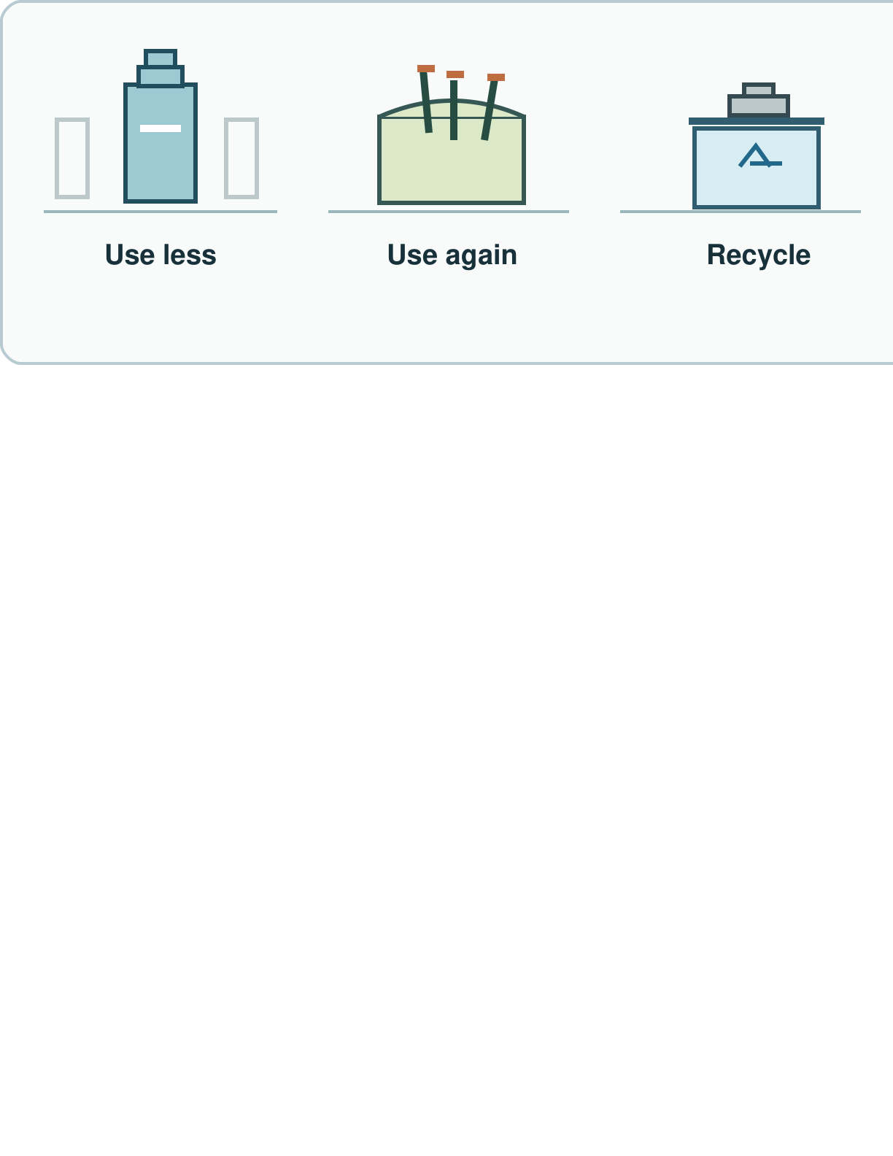
Picture model
SCI-BUILD-A2-W01 • BUILD Science
5
Made by Matt · madebymatt.uk · © Matt Roper · CC BY-NC-SA 4.0: free for classroom use, share and adapt with credit, no resale · v9 · 25 Sep 2026
Notes:
Three waste choices. Reuse only when safe; check local bins before recycling. Simplified; not to scale.

Slide 6
Show me
I write on the back. Do I need a new sheet?
SCI-BUILD-A2-W01 • BUILD Science
6
Made by Matt · madebymatt.uk · © Matt Roper · CC BY-NC-SA 4.0: free for classroom use, share and adapt with credit, no resale · v9 · 25 Sep 2026
Notes:
No.

Slide 7
Our turn
Sort the clean cards with us.
This sheet has a blank back. I can write there. I put it in ____.
SCI-BUILD-A2-W01 • BUILD Science
7
Made by Matt · madebymatt.uk · © Matt Roper · CC BY-NC-SA 4.0: free for classroom use, share and adapt with credit, no resale · v9 · 25 Sep 2026
Notes:
Use the part-done model, then the live card sort; offer F and H routes without changing the goal.
Missing step: The category Use less is missing; pupil completes the category and gives a reason.

Slide 8
Talk, then sort
Use less
Use again
Check local bin
Write on a sheet's blank back
Fill a clean tub again
Check the local bin for a can
SCI-BUILD-A2-W01 • BUILD Science
8
Made by Matt · madebymatt.uk · © Matt Roper · CC BY-NC-SA 4.0: free for classroom use, share and adapt with credit, no resale · v9 · 25 Sep 2026
Notes:
Write on a sheet's blank back → See the lesson teacher note.
Fill a clean tub again → See the lesson teacher note.
Check the local bin for a can → See the lesson teacher note.

Slide 9
Check
A clean cloth bag is ready for another trip. Which choice uses less new material?
A. Take a fresh new bag.
B. Throw the cloth bag away.
C. Use the cloth bag again.
D. Keep two new bags ready.
SCI-BUILD-A2-W01 • BUILD Science
9
Made by Matt · madebymatt.uk · © Matt Roper · CC BY-NC-SA 4.0: free for classroom use, share and adapt with credit, no resale · v9 · 25 Sep 2026
Notes:
Use symbol or point by default. Apply the 3-in-4 rule and a parallel hinge if needed; include one quiet-minute reset.
A. Take a fresh new bag. | Not correct | Takes a new item rather than reusing one.
B. Throw the cloth bag away. | Not correct | Confuses disposal with using less.
C. Use the cloth bag again. | Correct | Reuses the clean item before needing a new one.
D. Keep two new bags ready. | Not correct | Adds new items without a need.
About 3 in 4 or more right → move on; otherwise re-model with a clean refillable tub and ask the parallel hinge. Do not save or score.

Slide 10
Independent · F
Choose a clean item. Show what you can do.
Pick one way to use less.
I use less when I ____.
SCI-BUILD-A2-W01 • BUILD Science
10
Made by Matt · madebymatt.uk · © Matt Roper · CC BY-NC-SA 4.0: free for classroom use, share and adapt with credit, no resale · v9 · 25 Sep 2026
Notes:
One adult supports pupils and the other holds the group; swap over the week. Hands-on item or card is valid.

Slide 11
Independent · M
Choose a clean item. Show what you can do.
Show one item you can use again. Say why.
I can use ____ again because ____.
SCI-BUILD-A2-W01 • BUILD Science
11
Made by Matt · madebymatt.uk · © Matt Roper · CC BY-NC-SA 4.0: free for classroom use, share and adapt with credit, no resale · v9 · 25 Sep 2026
Notes:
One adult supports pupils and the other holds the group; swap over the week. Hands-on item or card is valid.

Slide 12
Independent · H
Choose a clean item. Show what you can do.
Which uses less new stuff: fill a clean tub again or take a new tub? Why?
I choose ____ because it needs less ____.
SCI-BUILD-A2-W01 • BUILD Science
12
Made by Matt · madebymatt.uk · © Matt Roper · CC BY-NC-SA 4.0: free for classroom use, share and adapt with credit, no resale · v9 · 25 Sep 2026
Notes:
One adult supports pupils and the other holds the group; swap over the week. Hands-on item or card is valid.

Slide 13
Go deeper
Could one safe item be used again before it is sorted for a bin? Show how.
Tub or sheet: pick a first step for each. Which avoids a new item? Why?
SCI-BUILD-A2-W01 • BUILD Science
13
Made by Matt · madebymatt.uk · © Matt Roper · CC BY-NC-SA 4.0: free for classroom use, share and adapt with credit, no resale · v9 · 25 Sep 2026

Slide 14
Review
Show one step. Hear one next step. Try it.
SCI-BUILD-A2-W01 • BUILD Science
14
Made by Matt · madebymatt.uk · © Matt Roper · CC BY-NC-SA 4.0: free for classroom use, share and adapt with credit, no resale · v9 · 25 Sep 2026
Notes:
Give VF and a specific NS(+); let the pupil edit (//). Include one quiet-minute reset.

Slide 15
Exit
Show how you know. Tell your teacher.
Read it back: I am learning to choose ways to care for a place.
My feedback was… I showed…
Next I need to… try one small fix.
How I know: I can use less. I can use a thing again. I can say why I chose it.
Tell your teacher. They will pick our next start.
Take one quiet minute before the next lesson.
SCI-BUILD-A2-W01 • BUILD Science
15
Made by Matt · madebymatt.uk · © Matt Roper · CC BY-NC-SA 4.0: free for classroom use, share and adapt with credit, no resale · v9 · 25 Sep 2026
Notes:
Hear the pupil by speech, sign, point, drawing or writing; use the response to choose the next starter. Include one quiet-minute reset.

Slide 16
Word help · reduce
use less
I use the back. I need less paper.
SCI-BUILD-A2-W01 • BUILD Science
16
Made by Matt · madebymatt.uk · © Matt Roper · CC BY-NC-SA 4.0: free for classroom use, share and adapt with credit, no resale · v9 · 25 Sep 2026

Slide 17
Word help · reuse
use a thing again
I fill a clean tub again.
SCI-BUILD-A2-W01 • BUILD Science
17
Made by Matt · madebymatt.uk · © Matt Roper · CC BY-NC-SA 4.0: free for classroom use, share and adapt with credit, no resale · v9 · 25 Sep 2026

Slide 18
Word help · recycle
make new things from old stuff
An old can can be made into a new thing.
SCI-BUILD-A2-W01 • BUILD Science
18
Made by Matt · madebymatt.uk · © Matt Roper · CC BY-NC-SA 4.0: free for classroom use, share and adapt with credit, no resale · v9 · 25 Sep 2026

Slide 19
Word help · material
what a thing is made of
This can is made of metal.
SCI-BUILD-A2-W01 • BUILD Science
19
Made by Matt · madebymatt.uk · © Matt Roper · CC BY-NC-SA 4.0: free for classroom use, share and adapt with credit, no resale · v9 · 25 Sep 2026

