Slide 1

Natural and made materials
I am learning to sort things from nature and things people make.
I can sort one raw item.
I can sort one made item.
I can add a row to a table.
SCI-BUILD-A2-W05 • BUILD Science
1
Made by Matt · madebymatt.uk · © Matt Roper · CC BY-NC-SA 4.0: free for classroom use, share and adapt with credit, no resale · v9 · 25 Sep 2026
Notes:
Lesson code: SCI-BUILD-A2-W05
SoW objective: Group natural and human-made materials; record results in a table (ICT).
Reading band: BUILD below age 8
Staff focus: {'i_do': 'Watch my first step. What do you see?', 'we_do': 'What step is missing? Show it with the kit.', 'independent': 'What can you do first on your own?'}
Prompt ladder: ['Wait and count to 5.', 'Point to the object or model.', 'Ask: What will you check next?', 'Model one step and give the next turn back.', 'Finish one example together, then let the pupil try.']
Sources:
https://www.gov.uk/government/publications/national-curriculum-in-england-science-programmes-of-study/national-curriculum-in-england-science-programmes-of-study
https://www.brick.org.uk/better-with-brick/quality/natural-raw-materials
https://www.gov.uk/government/publications/national-curriculum-in-england-science-programmes-of-study/national-curriculum-in-england-science-programmes-of-study ; https://www.brick.org.uk/better-with-brick/quality/natural-raw-materials
BUILD scheme of work, Autumn 2 week 4
BUILD scheme of work, Autumn 2 week 3
BUILD scheme of work, Autumn 1 week 5
Local school risk assessment and exact prepared kit; staff confirm

Slide 2
Arrival
Hold a safe raw rock. Look at a brick card.
SCI-BUILD-A2-W05 • BUILD Science
2
Made by Matt · madebymatt.uk · © Matt Roper · CC BY-NC-SA 4.0: free for classroom use, share and adapt with credit, no resale · v9 · 25 Sep 2026
Notes:
Offer a safe kit choice and short first–then cue.

Slide 3
Starter
Think back. Say, sign or point.
Name one use of a rock.
What does a water test check?
What do people and animals get from food?
SCI-BUILD-A2-W05 • BUILD Science
3
Made by Matt · madebymatt.uk · © Matt Roper · CC BY-NC-SA 4.0: free for classroom use, share and adapt with credit, no resale · v9 · 25 Sep 2026
Notes:
Ask three low-stakes prior questions; answers in note.
Name one use of a rock. → Slate can cover roofs, where suitable.
What does a water test check? → Whether water passes through the sample.
What do people and animals get from food? → Nutrition.

Slide 4
Model
Watch a row go in a table.
This raw rock is from nature. I write raw rock in the Natural row.
SCI-BUILD-A2-W05 • BUILD Science
4
Made by Matt · madebymatt.uk · © Matt Roper · CC BY-NC-SA 4.0: free for classroom use, share and adapt with credit, no resale · v9 · 25 Sep 2026
Notes:
Pre-teach words; show the full model; ask the show-me check.

Slide 5
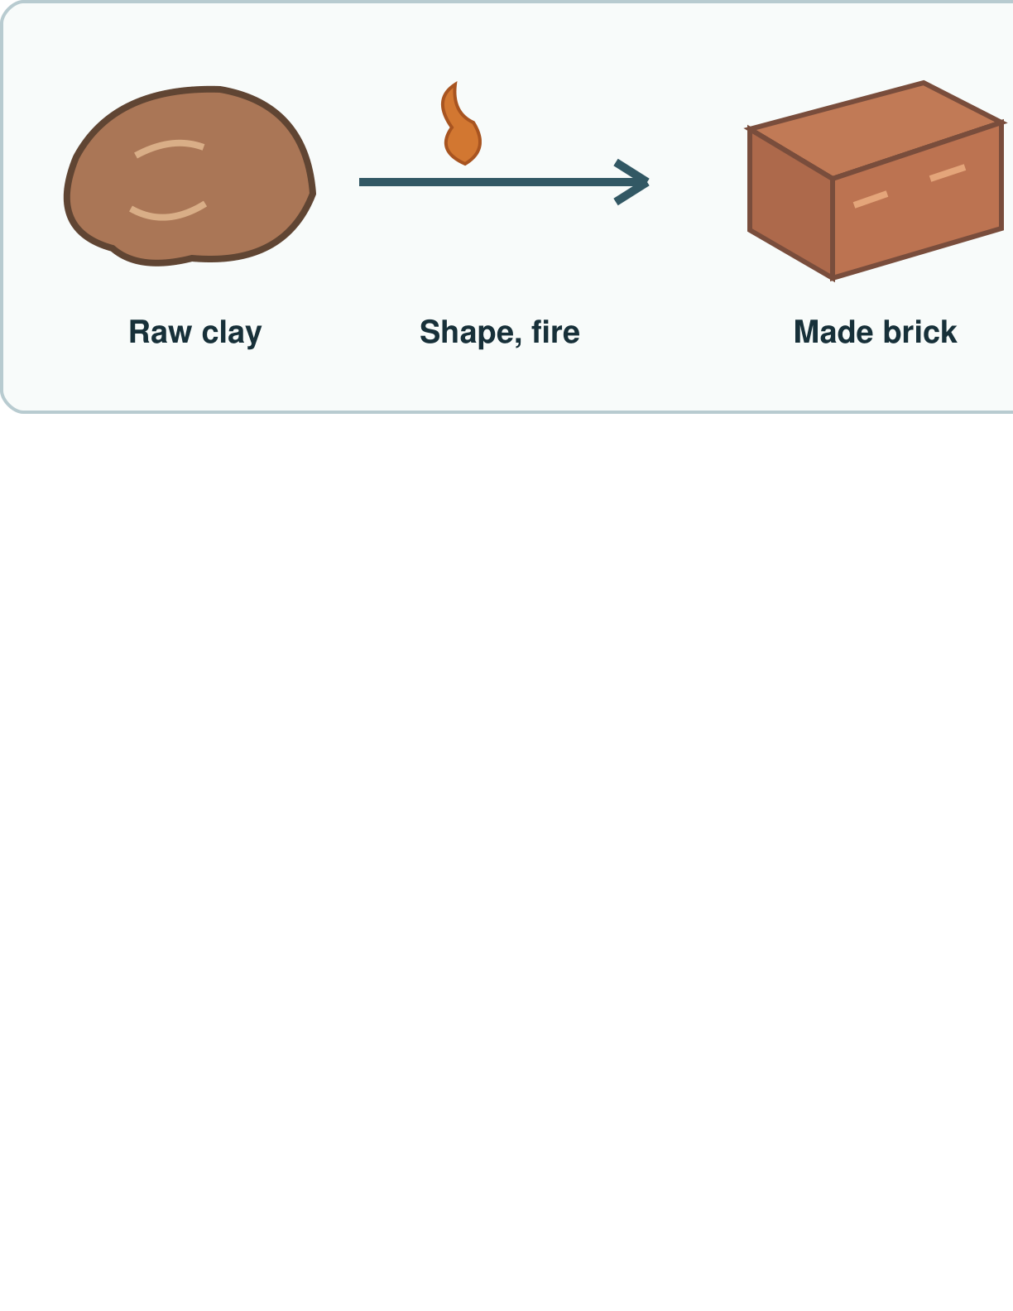
Picture model
SCI-BUILD-A2-W05 • BUILD Science
5
Made by Matt · madebymatt.uk · © Matt Roper · CC BY-NC-SA 4.0: free for classroom use, share and adapt with credit, no resale · v9 · 25 Sep 2026
Notes:
People shape and fire natural clay to make a brick. Simplified; not to scale.

Slide 6
Show me
Is a finished brick raw clay, or an item made by people?
SCI-BUILD-A2-W05 • BUILD Science
6
Made by Matt · madebymatt.uk · © Matt Roper · CC BY-NC-SA 4.0: free for classroom use, share and adapt with credit, no resale · v9 · 25 Sep 2026
Notes:
It is made by people from clay.

Slide 7
Our turn
Sort safe samples and cards.
People shape and fire clay to make a brick. I write brick in the ____ row.
SCI-BUILD-A2-W05 • BUILD Science
7
Made by Matt · madebymatt.uk · © Matt Roper · CC BY-NC-SA 4.0: free for classroom use, share and adapt with credit, no resale · v9 · 25 Sep 2026
Notes:
Hand over the missing step; offer F or H route. Reset once.
Missing step: Choose Human-made as the group for the finished brick.

Slide 8
Talk, then sort
Natural raw item
Human-made item
Raw rock
Leaf on a branch
Finished clay brick
Glass bottle
SCI-BUILD-A2-W05 • BUILD Science
8
Made by Matt · madebymatt.uk · © Matt Roper · CC BY-NC-SA 4.0: free for classroom use, share and adapt with credit, no resale · v9 · 25 Sep 2026
Notes:
Raw rock → Natural raw item
Leaf on a branch → Natural raw item
Finished clay brick → Human-made item
Glass bottle → Human-made item

Slide 9
Check
People shape sand into a glass bottle. What is the finished bottle?
A. A raw, natural sand sample.
B. A raw and finished rock.
C. A human-made glass item.
D. A thing outside all groups.
SCI-BUILD-A2-W05 • BUILD Science
9
Made by Matt · madebymatt.uk · © Matt Roper · CC BY-NC-SA 4.0: free for classroom use, share and adapt with credit, no resale · v9 · 25 Sep 2026
Notes:
Take all pupil responses at once; use decision rule and parallel hinge.
A. A raw, natural sand sample. | Not correct | Confuses the source material with the finished object.
B. A raw and finished rock. | Not correct | Calls a finished item raw at the same time.
C. A human-made glass item. | Correct | Names the finished object as made by people.
D. A thing outside all groups. | Not correct | Misses the natural or human-made grouping.
About 3 in 4 or more right → move on; otherwise re-model This raw rock is from nature. I write raw rock in the Natural row. Ask the parallel hinge. No scores or answers saved.

Slide 10
Independent · F
Make a row for raw and made items.
Put one raw and one made item in groups. Fill one row.
This ____ goes in the ____ group.
SCI-BUILD-A2-W05 • BUILD Science
10
Made by Matt · madebymatt.uk · © Matt Roper · CC BY-NC-SA 4.0: free for classroom use, share and adapt with credit, no resale · v9 · 25 Sep 2026
Notes:
Choose one adult for supported pupils, one for group; swap across the week.

Slide 11
Independent · M
Make a row for raw and made items.
Sort four items. Add two rows to a table.
I put ____ in the table as ____.
SCI-BUILD-A2-W05 • BUILD Science
11
Made by Matt · madebymatt.uk · © Matt Roper · CC BY-NC-SA 4.0: free for classroom use, share and adapt with credit, no resale · v9 · 25 Sep 2026
Notes:
Choose one adult for supported pupils, one for group; swap across the week.

Slide 12
Independent · H
Make a row for raw and made items.
Why is clay natural but a brick made?
The raw ____ is ____, but the finished ____ is ____.
SCI-BUILD-A2-W05 • BUILD Science
12
Made by Matt · madebymatt.uk · © Matt Roper · CC BY-NC-SA 4.0: free for classroom use, share and adapt with credit, no resale · v9 · 25 Sep 2026
Notes:
Choose one adult for supported pupils, one for group; swap across the week.

Slide 13
Go deeper
An object has two materials. How can your table show both?
Choose a made item with two raw materials. Plan a fair row.
SCI-BUILD-A2-W05 • BUILD Science
13
Made by Matt · madebymatt.uk · © Matt Roper · CC BY-NC-SA 4.0: free for classroom use, share and adapt with credit, no resale · v9 · 25 Sep 2026

Slide 14
Review
Check one row. Hear one next step.
SCI-BUILD-A2-W05 • BUILD Science
14
Made by Matt · madebymatt.uk · © Matt Roper · CC BY-NC-SA 4.0: free for classroom use, share and adapt with credit, no resale · v9 · 25 Sep 2026
Notes:
Give VF and one NS(+); invite one self-edit. Reset once.

Slide 15
Exit
Show your row to an adult.
Read it back: I am learning to sort things from nature and things people make.
My feedback was… I showed…
Next I need to… try one small fix.
How I know: I can sort one raw item. I can sort one made item. I can add a row to a table.
Tell your teacher. They will pick our next start.
Take one quiet minute before the next lesson.
SCI-BUILD-A2-W05 • BUILD Science
15
Made by Matt · madebymatt.uk · © Matt Roper · CC BY-NC-SA 4.0: free for classroom use, share and adapt with credit, no resale · v9 · 25 Sep 2026
Notes:
Hear feedback and next step, choose next start, then one-minute reset.

Slide 16
Word help · natural
from nature, not made into a new item
A raw rock is natural.
SCI-BUILD-A2-W05 • BUILD Science
16
Made by Matt · madebymatt.uk · © Matt Roper · CC BY-NC-SA 4.0: free for classroom use, share and adapt with credit, no resale · v9 · 25 Sep 2026

Slide 17
Word help · human-made
made or changed by people
People make a brick from clay.
SCI-BUILD-A2-W05 • BUILD Science
17
Made by Matt · madebymatt.uk · © Matt Roper · CC BY-NC-SA 4.0: free for classroom use, share and adapt with credit, no resale · v9 · 25 Sep 2026

Slide 18
Word help · material
what a thing is made of
The brick has clay in it.
SCI-BUILD-A2-W05 • BUILD Science
18
Made by Matt · madebymatt.uk · © Matt Roper · CC BY-NC-SA 4.0: free for classroom use, share and adapt with credit, no resale · v9 · 25 Sep 2026

Slide 19
Word help · table
rows and columns for facts
This row says brick: made.
SCI-BUILD-A2-W05 • BUILD Science
19
Made by Matt · madebymatt.uk · © Matt Roper · CC BY-NC-SA 4.0: free for classroom use, share and adapt with credit, no resale · v9 · 25 Sep 2026

