Slide 1

Show what we know about bodies and rocks
I am learning to show a fact about bodies, food and rocks.
I can show one fact.
I can show what I used to find it.
I can name one next step.
SCI-BUILD-A2-W07 • BUILD Science
1
Made by Matt · madebymatt.uk · © Matt Roper · CC BY-NC-SA 4.0: free for classroom use, share and adapt with credit, no resale · v9 · 25 Sep 2026
Notes:
Lesson code: SCI-BUILD-A2-W07
SoW objective: Review and evidence learning on skeletons, nutrition & rocks (Entry Level Science / UAS).
Reading band: BUILD below age 8
Staff focus: {'i_do': 'Watch my first step. What do you see?', 'we_do': 'What step is missing? Show it with the kit.', 'independent': 'What can you do first on your own?'}
Prompt ladder: ['Wait and count to 5.', 'Point to the object or model.', 'Ask: What will you check next?', 'Model one step and give the next turn back.', 'Finish one example together, then let the pupil try.']
Sources:
https://www.gov.uk/government/publications/national-curriculum-in-england-science-programmes-of-study/national-curriculum-in-england-science-programmes-of-study
BUILD scheme of work, Autumn 2 week 6
BUILD scheme of work, Autumn 2 week 5
BUILD scheme of work, Autumn 1 week 7
Local school risk assessment and exact prepared kit; staff confirm

Slide 2
Arrival
Pick a safe model or card to look at.
SCI-BUILD-A2-W07 • BUILD Science
2
Made by Matt · madebymatt.uk · © Matt Roper · CC BY-NC-SA 4.0: free for classroom use, share and adapt with credit, no resale · v9 · 25 Sep 2026
Notes:
Offer a safe kit choice and short first–then cue.

Slide 3
Starter
Think back. Say, sign or point.
What stays the same in a fair water test?
Is a finished brick raw or made?
Where do animals get food?
SCI-BUILD-A2-W07 • BUILD Science
3
Made by Matt · madebymatt.uk · © Matt Roper · CC BY-NC-SA 4.0: free for classroom use, share and adapt with credit, no resale · v9 · 25 Sep 2026
Notes:
Ask three low-stakes prior questions; answers in note.
What stays the same in a fair water test? → The drops and waiting time.
Is a finished brick raw or made? → It is human-made.
Where do animals get food? → From what they eat.

Slide 4
Model
Watch one fact with one clue.
I point to the bone model. It shows a skeleton. The bones help hold the body up.
SCI-BUILD-A2-W07 • BUILD Science
4
Made by Matt · madebymatt.uk · © Matt Roper · CC BY-NC-SA 4.0: free for classroom use, share and adapt with credit, no resale · v9 · 25 Sep 2026
Notes:
Pre-teach words; show the full model; ask the show-me check.

Slide 5
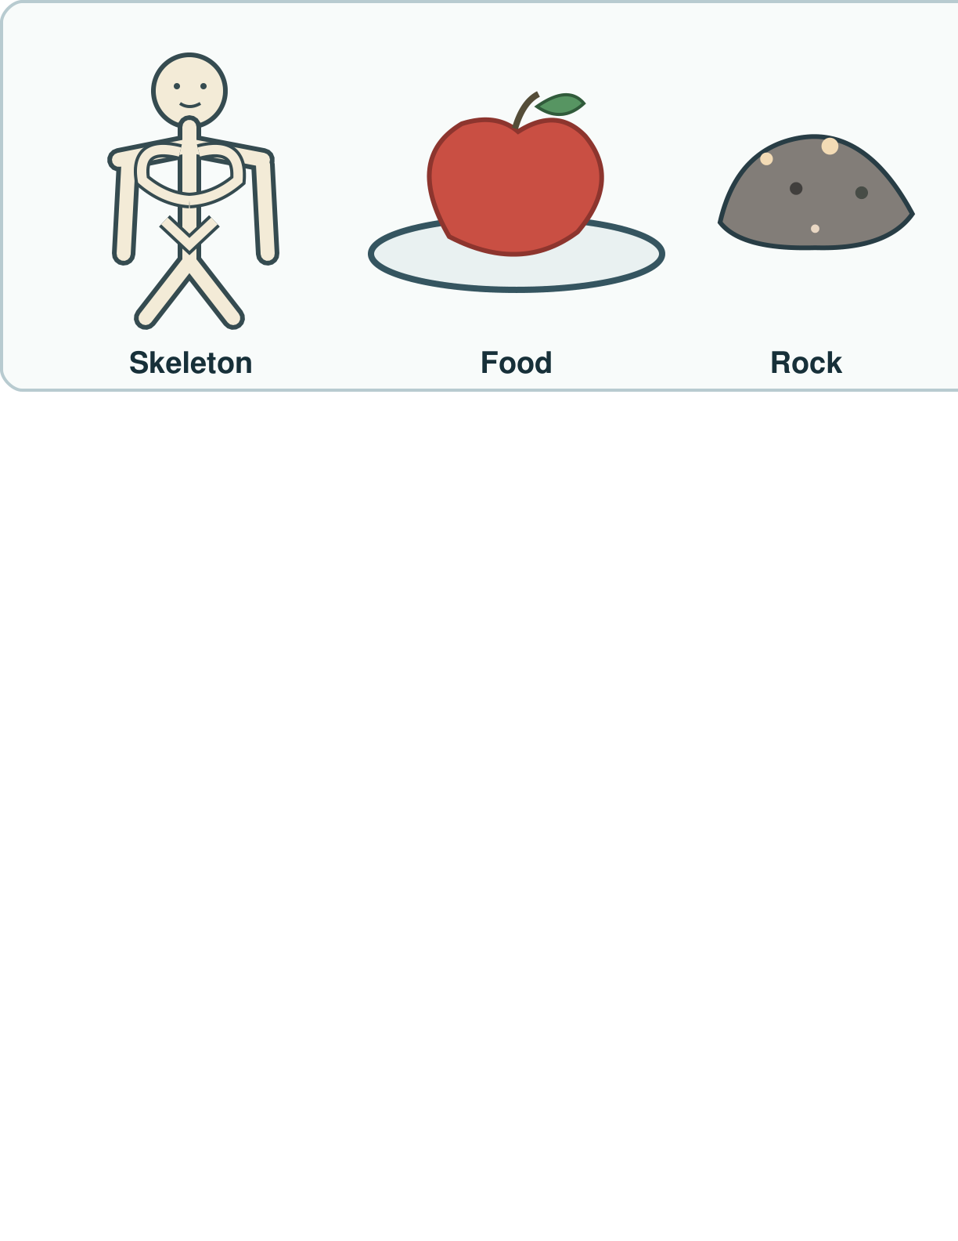
Picture model
SCI-BUILD-A2-W07 • BUILD Science
5
Made by Matt · madebymatt.uk · © Matt Roper · CC BY-NC-SA 4.0: free for classroom use, share and adapt with credit, no resale · v9 · 25 Sep 2026
Notes:
Point to the skeleton, food and rock you studied. These pictures stand for ideas, not a new test result. Simplified; not to scale.

Slide 6
Show me
Which object can show a fact about a rock: a safe sample or a food picture?
SCI-BUILD-A2-W07 • BUILD Science
6
Made by Matt · madebymatt.uk · © Matt Roper · CC BY-NC-SA 4.0: free for classroom use, share and adapt with credit, no resale · v9 · 25 Sep 2026
Notes:
A safe rock sample.

Slide 7
Our turn
Match a real model to a fact.
I point to a safe rock. I felt a rough side. My fact is ____.
SCI-BUILD-A2-W07 • BUILD Science
7
Made by Matt · madebymatt.uk · © Matt Roper · CC BY-NC-SA 4.0: free for classroom use, share and adapt with credit, no resale · v9 · 25 Sep 2026
Notes:
Hand over the missing step; offer F or H route. Reset once.
Missing step: Use the real observation to state a fact about the rock.

Slide 8
Talk, then sort
Body
Food
Rock
Bone model
Food-group picture
Safe rough sample
SCI-BUILD-A2-W07 • BUILD Science
8
Made by Matt · madebymatt.uk · © Matt Roper · CC BY-NC-SA 4.0: free for classroom use, share and adapt with credit, no resale · v9 · 25 Sep 2026
Notes:
Bone model → Body
Food-group picture → Food
Safe rough sample → Rock

Slide 9
Check
A class claims a clean plastic lid floats. Which evidence could check the claim?
A. A photo of a different lid.
B. A guess from the lid colour.
C. A card about another rock.
D. A safe water test of that lid.
SCI-BUILD-A2-W07 • BUILD Science
9
Made by Matt · madebymatt.uk · © Matt Roper · CC BY-NC-SA 4.0: free for classroom use, share and adapt with credit, no resale · v9 · 25 Sep 2026
Notes:
Take all pupil responses at once; use decision rule and parallel hinge.
A. A photo of a different lid. | Not correct | A different item is not direct evidence for this lid.
B. A guess from the lid colour. | Not correct | Colour alone does not test floating.
C. A card about another rock. | Not correct | Evidence about another item misses the claim.
D. A safe water test of that lid. | Correct | Selects a direct safe observation of the claimed behaviour.
About 3 in 4 or more right → move on; otherwise re-model I point to the bone model. It shows a skeleton. The bones help hold the body up. Ask the parallel hinge. No scores or answers saved.

Slide 10
Independent · F
Show work you did about body, food or rock.
Show one fact about a body or rock.
I show ____.
SCI-BUILD-A2-W07 • BUILD Science
10
Made by Matt · madebymatt.uk · © Matt Roper · CC BY-NC-SA 4.0: free for classroom use, share and adapt with credit, no resale · v9 · 25 Sep 2026
Notes:
Choose one adult for supported pupils, one for group; swap across the week.

Slide 11
Independent · M
Show work you did about body, food or rock.
Show two facts. Tell how you found one.
I know ____ as I saw ____.
SCI-BUILD-A2-W07 • BUILD Science
11
Made by Matt · madebymatt.uk · © Matt Roper · CC BY-NC-SA 4.0: free for classroom use, share and adapt with credit, no resale · v9 · 25 Sep 2026
Notes:
Choose one adult for supported pupils, one for group; swap across the week.

Slide 12
Independent · H
Show work you did about body, food or rock.
Pick your best real evidence. Why does it fit?
This is good evidence as ____.
SCI-BUILD-A2-W07 • BUILD Science
12
Made by Matt · madebymatt.uk · © Matt Roper · CC BY-NC-SA 4.0: free for classroom use, share and adapt with credit, no resale · v9 · 25 Sep 2026
Notes:
Choose one adult for supported pupils, one for group; swap across the week.

Slide 13
Go deeper
Pick a claim you cannot show. What could you check?
Pick the best real result. Why does it fit?
SCI-BUILD-A2-W07 • BUILD Science
13
Made by Matt · madebymatt.uk · © Matt Roper · CC BY-NC-SA 4.0: free for classroom use, share and adapt with credit, no resale · v9 · 25 Sep 2026

Slide 14
Review
Hear one next step. Fix a part if you can.
SCI-BUILD-A2-W07 • BUILD Science
14
Made by Matt · madebymatt.uk · © Matt Roper · CC BY-NC-SA 4.0: free for classroom use, share and adapt with credit, no resale · v9 · 25 Sep 2026
Notes:
Give VF and one NS(+); invite one self-edit. Reset once.

Slide 15
Exit
Tell an adult what you know and how.
Read it back: I am learning to show a fact about bodies, food and rocks.
My feedback was… I showed…
Next I need to… try one small fix.
How I know: I can show one fact. I can show what I used to find it. I can name one next step.
Tell your teacher. They will pick our next start.
Take one quiet minute before the next lesson.
SCI-BUILD-A2-W07 • BUILD Science
15
Made by Matt · madebymatt.uk · © Matt Roper · CC BY-NC-SA 4.0: free for classroom use, share and adapt with credit, no resale · v9 · 25 Sep 2026
Notes:
Hear feedback and next step, choose next start, then one-minute reset.

Slide 16
Word help · skeleton
bones that help hold a body up
I point to the bone model.
SCI-BUILD-A2-W07 • BUILD Science
16
Made by Matt · madebymatt.uk · © Matt Roper · CC BY-NC-SA 4.0: free for classroom use, share and adapt with credit, no resale · v9 · 25 Sep 2026

Slide 17
Word help · nutrition
what a body gets from food to grow and stay well
An animal gets nutrition from food.
SCI-BUILD-A2-W07 • BUILD Science
17
Made by Matt · madebymatt.uk · © Matt Roper · CC BY-NC-SA 4.0: free for classroom use, share and adapt with credit, no resale · v9 · 25 Sep 2026

Slide 18
Word help · rock
a solid thing from the ground
I can test a safe rock.
SCI-BUILD-A2-W07 • BUILD Science
18
Made by Matt · madebymatt.uk · © Matt Roper · CC BY-NC-SA 4.0: free for classroom use, share and adapt with credit, no resale · v9 · 25 Sep 2026

Slide 19
Word help · evidence
what you saw or did that helps show a claim
My rock sort shows my rule.
SCI-BUILD-A2-W07 • BUILD Science
19
Made by Matt · madebymatt.uk · © Matt Roper · CC BY-NC-SA 4.0: free for classroom use, share and adapt with credit, no resale · v9 · 25 Sep 2026

