Slide 1

Why day turns to night
Show why day turns to night and why the Sun seems to move.
I can point to the day and night sides.
I can turn the model and explain when night comes.
I can explain why the Sun seems to move.
SCI-GROW-A2-W01 • GROW Science
1
Made by Matt · madebymatt.uk · © Matt Roper · CC BY-NC-SA 4.0: free for classroom use, share and adapt with credit, no resale · v9 · 25 Sep 2026
Notes:
Lesson code: SCI-GROW-A2-W01
SoW objective: Explain day and night and the apparent movement of the Sun.
Reading band: GROW 8–11
Staff focus: {'i_do': 'Watch the dot. Point to it when it faces the light.', 'we_do': 'What is done already? What step is left for you?', 'independent': 'Show your first step. What can you do on your own next?'}
Prompt ladder: ['Wait and count to 5.', 'Point to the dot or light.', 'Ask: What changes at the dot?', 'Model one turn; let the pupil try.', 'Finish one example together, then return the next turn to the pupil.']
Sources:
NASA Science, Heliophysics Big Idea 1.1, https://science.nasa.gov/learn/heat/big-ideas/big-idea-1-1/
NASA Science, Facts About Earth, https://science.nasa.gov/earth/facts/; NASA Space Place, Glossary, https://spaceplace.nasa.gov/glossary/en/
NASA Science, Moon Facts, https://science.nasa.gov/moon/facts/
NASA Science, Facts About Earth, https://science.nasa.gov/earth/facts/; NASA Science, Earth spin axis, https://science.nasa.gov/earth/climate-change/scientists-id-three-causes-of-earths-spin-axis-drift/
NASA Science, Eclipse geometry, https://science.nasa.gov/eclipses/geometry/
GROW scheme of work, Autumn 1 weeks 1, 4 and 7
NASA Science, Heliophysics Big Idea 1.1, https://science.nasa.gov/learn/heat/big-ideas/big-idea-1-1/; NASA Science, Earth spin axis, https://science.nasa.gov/earth/climate-change/scientists-id-three-causes-of-earths-spin-axis-drift/
NASA Science, Facts About Earth, https://science.nasa.gov/earth/facts/
Local school risk assessment and CLEAPSS guidance; staff confirm exact kit
lesson content–source checks ruling; static SVG geometry and mechanism check; browser confirmation remains NOT RUN

Slide 2
Arrival
Place a dot on the ball. Point to the side lit by the torch.
SCI-GROW-A2-W01 • GROW Science
2
Made by Matt · madebymatt.uk · © Matt Roper · CC BY-NC-SA 4.0: free for classroom use, share and adapt with credit, no resale · v9 · 25 Sep 2026
Notes:
Offer a seat or standing spot. End with a one-minute reset.

Slide 3
Starter
Think back. Say, point or write one answer for each question.
What goes around Earth?
Name one mechanism from our forces work.
Name one force from our first science week.
SCI-GROW-A2-W01 • GROW Science
3
Made by Matt · madebymatt.uk · © Matt Roper · CC BY-NC-SA 4.0: free for classroom use, share and adapt with credit, no resale · v9 · 25 Sep 2026
Notes:
Ask three low-stakes questions without a public test.
What goes around Earth? → The Moon.
Name one mechanism from our forces work. → A lever, pulley or gear.
Name one force from our first science week. → Gravity, air resistance or friction.

Slide 4
Model
Watch: the torch stays still. I turn the ball. The dot has day when it faces the light. It has night when it faces away.
Torch still → dot faces the torch: day → turn the ball → dot faces away: night. Earth’s rotation makes the Sun seem to move.
SCI-GROW-A2-W01 • GROW Science
4
Made by Matt · madebymatt.uk · © Matt Roper · CC BY-NC-SA 4.0: free for classroom use, share and adapt with credit, no resale · v9 · 25 Sep 2026
Notes:
Model the full sequence. Keep light out of eyes. Ask the show-me check.

Slide 5
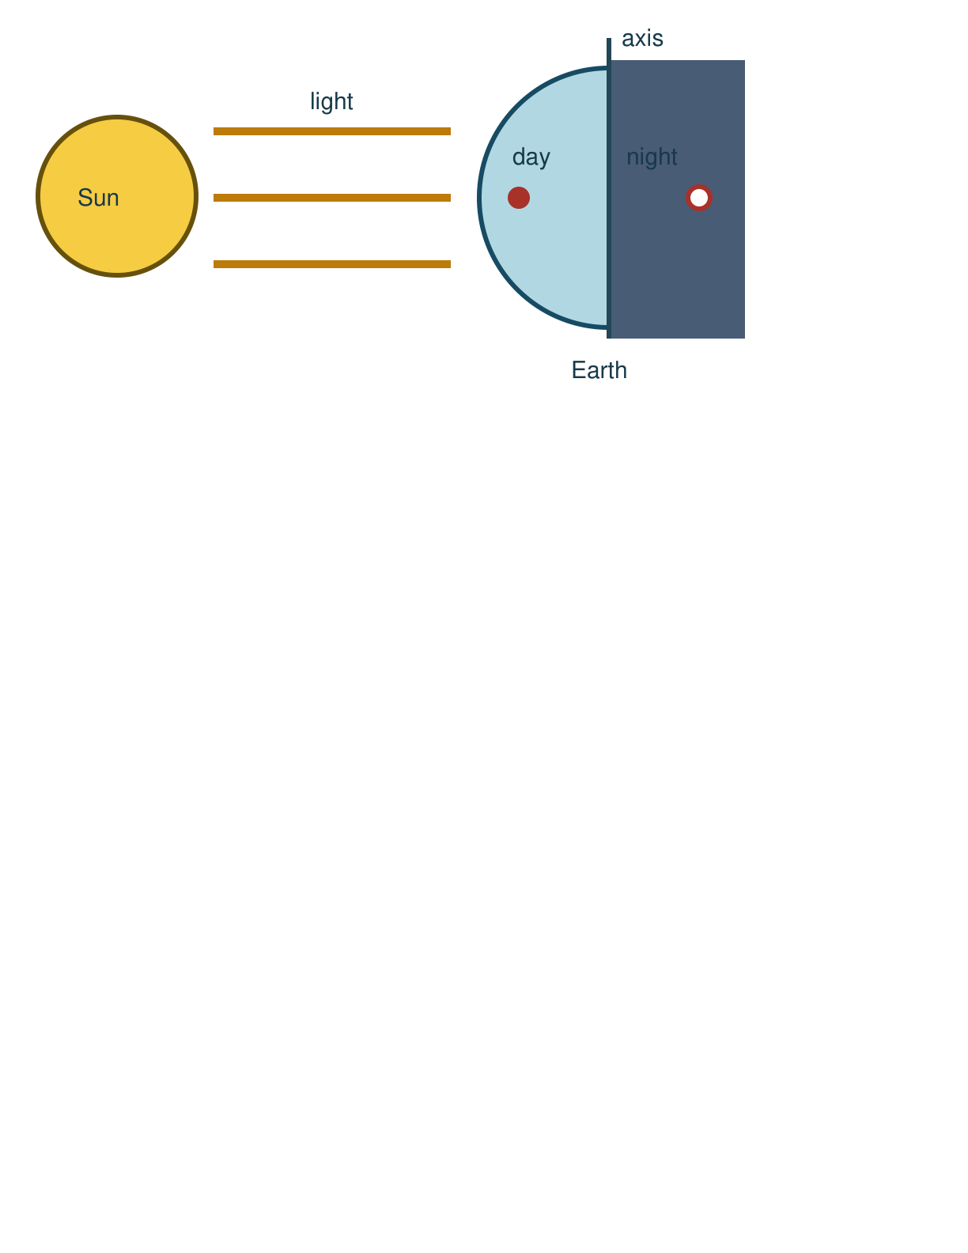
Picture model
SCI-GROW-A2-W01 • GROW Science
5
Made by Matt · madebymatt.uk · © Matt Roper · CC BY-NC-SA 4.0: free for classroom use, share and adapt with credit, no resale · v9 · 25 Sep 2026
Notes:
Light reaches one side of Earth. This model is simplified and not to scale.

Slide 6
Show me
Show me: where is the dot when that place has day?
SCI-GROW-A2-W01 • GROW Science
6
Made by Matt · madebymatt.uk · © Matt Roper · CC BY-NC-SA 4.0: free for classroom use, share and adapt with credit, no resale · v9 · 25 Sep 2026
Notes:
On the side facing the torch or light.

Slide 7
Our turn
Now try the same model. Two steps are done. Complete the last step: turn the dot away and name what comes next.
Torch still → dot faces the torch: day → turn the ball → dot faces away: ____.
SCI-GROW-A2-W01 • GROW Science
7
Made by Matt · madebymatt.uk · © Matt Roper · CC BY-NC-SA 4.0: free for classroom use, share and adapt with credit, no resale · v9 · 25 Sep 2026
Notes:
Wait for the missing step. End with a one-minute reset.
Missing step: Name night when the dot faces away from the torch.

Slide 8
Talk, then sort
day
night
The missing word is
SCI-GROW-A2-W01 • GROW Science
8
Made by Matt · madebymatt.uk · © Matt Roper · CC BY-NC-SA 4.0: free for classroom use, share and adapt with credit, no resale · v9 · 25 Sep 2026
Notes:
The missing word is → See the lesson teacher note.

Slide 9
Check
On a new ball model, the red dot has just turned from light into shade. What does the shade represent?
A. Day at the red dot.
B. The Sun turning off now.
C. The whole Earth going dark.
D. Night at the red dot.
SCI-GROW-A2-W01 • GROW Science
9
Made by Matt · madebymatt.uk · © Matt Roper · CC BY-NC-SA 4.0: free for classroom use, share and adapt with credit, no resale · v9 · 25 Sep 2026
Notes:
Use an all-pupil hinge response and the decision rule in the note.
A. Day at the red dot. | Not correct | Keeps the old day label after the dot has rotated into shade.
B. The Sun turning off now. | Not correct | Treats darkness at one place as the Sun switching off.
C. The whole Earth going dark. | Not correct | Extends one dot’s night to every place on Earth.
D. Night at the red dot. | Correct | Uses the new case accurately.
About 3 in 4 or more right → move on. Otherwise re-model with the dot on the far side of the ball, then ask the parallel hinge.

Slide 10
Independent · F
Show day and night at the dot. Explain why the Sun seems to move, even when our torch stays still.
Point to the lit side and the dark side.
I point to ___ for day and ___ for night.
SCI-GROW-A2-W01 • GROW Science
10
Made by Matt · madebymatt.uk · © Matt Roper · CC BY-NC-SA 4.0: free for classroom use, share and adapt with credit, no resale · v9 · 25 Sep 2026
Notes:
One adult supports agreed pupils, the other holds the group; swap across the week. One-minute reset at end.

Slide 11
Independent · M
Show day and night at the dot. Explain why the Sun seems to move, even when our torch stays still.
Explain what the dot sees as Earth turns.
The dot has night when ___ because ___.
SCI-GROW-A2-W01 • GROW Science
11
Made by Matt · madebymatt.uk · © Matt Roper · CC BY-NC-SA 4.0: free for classroom use, share and adapt with credit, no resale · v9 · 25 Sep 2026
Notes:
One adult supports agreed pupils, the other holds the group; swap across the week. One-minute reset at end.

Slide 12
Independent · H
Show day and night at the dot. Explain why the Sun seems to move, even when our torch stays still.
Explain why the Sun seems to move across our sky while the model torch stays still.
The Sun seems to move because ___. The model shows ___.
SCI-GROW-A2-W01 • GROW Science
12
Made by Matt · madebymatt.uk · © Matt Roper · CC BY-NC-SA 4.0: free for classroom use, share and adapt with credit, no resale · v9 · 25 Sep 2026
Notes:
One adult supports agreed pupils, the other holds the group; swap across the week. One-minute reset at end.

Slide 13
Go deeper
Mark two dots on opposite sides. Explain why one has day while the other has night.
Two dots, one turn: test the claim that the Sun goes round Earth each day. Show the motion that explains both dots. Name one limit of the torch model.
SCI-GROW-A2-W01 • GROW Science
13
Made by Matt · madebymatt.uk · © Matt Roper · CC BY-NC-SA 4.0: free for classroom use, share and adapt with credit, no resale · v9 · 25 Sep 2026

Slide 14
Review
Tell a partner what your model shows. Hear one comment. Change one part and say what you changed.
SCI-GROW-A2-W01 • GROW Science
14
Made by Matt · madebymatt.uk · © Matt Roper · CC BY-NC-SA 4.0: free for classroom use, share and adapt with credit, no resale · v9 · 25 Sep 2026
Notes:
Give one specific comment, invite a self-edit (//) or read-back (?).

Slide 15
Exit
Show how you know. Tell us your feedback and next step. Say, point, sign, draw or write.
I can point to the day and night sides.
I can turn the model and explain when night comes.
I can explain why the Sun seems to move.
How I know: I can turn the model and explain when one place has day and night.
NS(+) · Next I need to: check the dot before I name day or night.
Who hears it: Your teacher or TA sees or hears your answer. They use it to choose the next model or help.
SCI-GROW-A2-W01 • GROW Science
15
Made by Matt · madebymatt.uk · © Matt Roper · CC BY-NC-SA 4.0: free for classroom use, share and adapt with credit, no resale · v9 · 25 Sep 2026
Notes:
Hear answer, choose next model or help; hand over highest prompt and independent part.

Slide 16
Word help · rotation
one turn around an axis
Earth’s rotation brings day and night.
SCI-GROW-A2-W01 • GROW Science
16
Made by Matt · madebymatt.uk · © Matt Roper · CC BY-NC-SA 4.0: free for classroom use, share and adapt with credit, no resale · v9 · 25 Sep 2026

Slide 17
Word help · axis
an imagined line a planet spins around
Earth turns around its axis.
SCI-GROW-A2-W01 • GROW Science
17
Made by Matt · madebymatt.uk · © Matt Roper · CC BY-NC-SA 4.0: free for classroom use, share and adapt with credit, no resale · v9 · 25 Sep 2026

Slide 18
Word help · shadow
an area where an object blocks light
The ball makes a shadow on the desk.
SCI-GROW-A2-W01 • GROW Science
18
Made by Matt · madebymatt.uk · © Matt Roper · CC BY-NC-SA 4.0: free for classroom use, share and adapt with credit, no resale · v9 · 25 Sep 2026

Slide 19
Word help · orbit
a curved path around another object
Earth’s orbit takes it around the Sun.
SCI-GROW-A2-W01 • GROW Science
19
Made by Matt · madebymatt.uk · © Matt Roper · CC BY-NC-SA 4.0: free for classroom use, share and adapt with credit, no resale · v9 · 25 Sep 2026

