Slide 1

Global warming and choices
explain a cause and an effect of global warming, then compare two kinds of action.
I can put cause before effect.
I can say how gases add to warming.
I can compare a cut in emissions with help for an impact.
SCI-GROW-A2-W04 • GROW Science
1
Made by Matt · madebymatt.uk · © Matt Roper · CC BY-NC-SA 4.0: free for classroom use, share and adapt with credit, no resale · v9 · 25 Sep 2026
Notes:
Lesson code: SCI-GROW-A2-W04
SoW objective: Describe causes and effects of global warming and how to reduce our impact.
Reading band: GROW 8–11
Staff focus: {'i_do': 'Watch me place cause before effect.', 'we_do': 'Which link is in place? What might go between gas and impact?', 'independent': 'Point to your first link. Which part can you explain on your own?'}
Prompt ladder: ['Wait and count to 5.', 'Point to the lesson’s diagram, kit or source.', 'Ask: What is done, and what is the next step?', 'Model one step, then return the next step to the pupil.', 'Finish one example together, then fade the help.']
Sources:
Met Office, Causes of Climate Change, https://weather.metoffice.gov.uk/climate-change/causes-of-climate-change; NASA Science, Causes of Climate Change, https://science.nasa.gov/climate-change/causes/
NASA Science, Causes of Climate Change, https://science.nasa.gov/climate-change/causes/; Met Office, Causes of Climate Change, https://weather.metoffice.gov.uk/climate-change/causes-of-climate-change
NASA Science, Causes of Climate Change, https://science.nasa.gov/climate-change/causes/
Met Office, Climate Glossary, https://weather.metoffice.gov.uk/climate-change/climate-glossary
Met Office, Effects of Climate Change, https://weather.metoffice.gov.uk/climate-change/effects-of-climate-change
Met Office, Climate Change Mitigation, https://weather.metoffice.gov.uk/climate/solutions/climate-change-mitigation
Inference from the task design; NASA Science, Causes of Climate Change, https://science.nasa.gov/climate-change/causes/
the GROW scheme of work
NASA Science, Causes of Climate Change, https://science.nasa.gov/climate-change/causes/; Met Office, Climate Change Causes, https://weather.metoffice.gov.uk/climate-change/causes-of-climate-change
Local school risk assessment and CLEAPSS guidance; staff confirm exact kit
lesson content–source checks ruling; static SVG geometry and mechanism check; browser confirmation remains NOT RUN

Slide 2
Arrival
Sort these: weather today; climate over many years. Point to the long-term idea.
SCI-GROW-A2-W04 • GROW Science
2
Made by Matt · madebymatt.uk · © Matt Roper · CC BY-NC-SA 4.0: free for classroom use, share and adapt with credit, no resale · v9 · 25 Sep 2026
Notes:
Offer a predictable seat or standing spot and the first visual cue. No public test.

Slide 3
Starter
Think back. Say, point or write one answer for each question.
Name one fact about the Solar System and its class card.
Why does one place have night?
Name one way friction can affect motion.
SCI-GROW-A2-W04 • GROW Science
3
Made by Matt · madebymatt.uk · © Matt Roper · CC BY-NC-SA 4.0: free for classroom use, share and adapt with credit, no resale · v9 · 25 Sep 2026
Notes:
Ask three low-stakes retrieval questions; prior coverage must be checked.
Name one fact about the Solar System and its class card. → The Sun is a star, on card A; or Earth goes round the Sun, on card B.
Why does one place have night? → Earth turns so that place faces away from sunlight.
Name one way friction can affect motion. → It can slow a moving object.

Slide 4
Model
I order the chain: burn fuel → more carbon dioxide → more heat stays → warming. Cutting emissions acts near the start. A flood defence helps with an impact.
Burn fossil fuel → add carbon dioxide → more heat stays → heat risks. Cut fuel use to cut emissions; plan shade to help with heat.
SCI-GROW-A2-W04 • GROW Science
4
Made by Matt · madebymatt.uk · © Matt Roper · CC BY-NC-SA 4.0: free for classroom use, share and adapt with credit, no resale · v9 · 25 Sep 2026
Notes:
Model the full reasoning step, pre-teach four words and ask the show-me question.

Slide 5
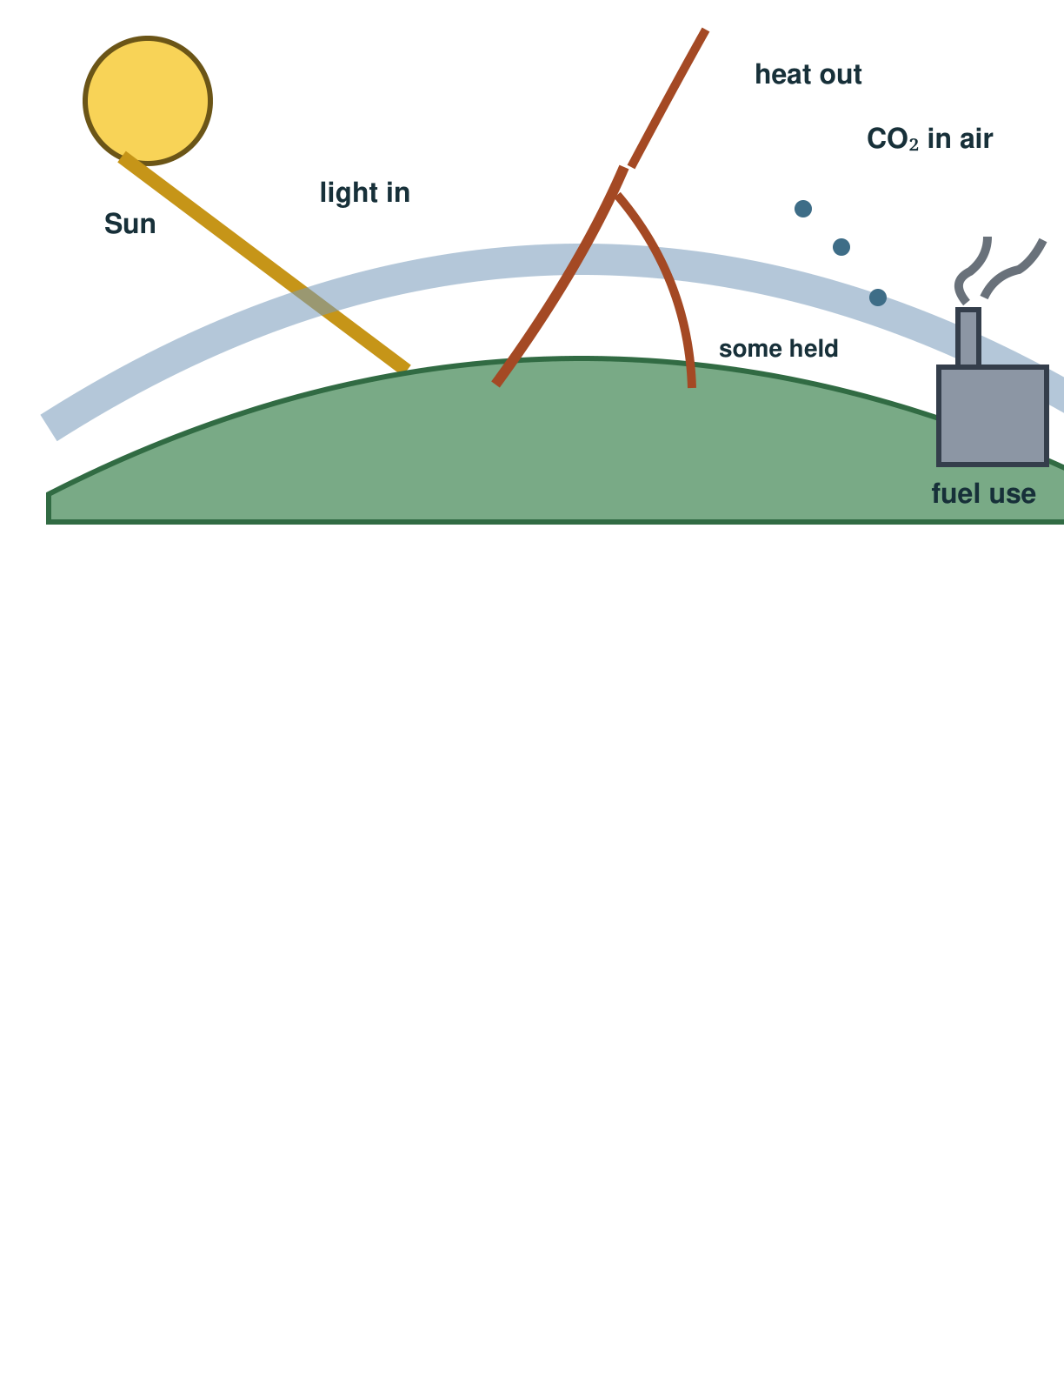
Picture model
SCI-GROW-A2-W04 • GROW Science
5
Made by Matt · madebymatt.uk · © Matt Roper · CC BY-NC-SA 4.0: free for classroom use, share and adapt with credit, no resale · v9 · 25 Sep 2026
Notes:
Light comes in. Earth releases heat. More CO₂ slows heat loss. Simplified mechanism; not to scale.

Slide 6
Show me
Point to the cause card: burning fuel or a hotter day?
SCI-GROW-A2-W04 • GROW Science
6
Made by Matt · madebymatt.uk · © Matt Roper · CC BY-NC-SA 4.0: free for classroom use, share and adapt with credit, no resale · v9 · 25 Sep 2026
Notes:
Burning fuel is the cause card; a hotter day may be an effect.

Slide 7
Our turn
The burn fuel and impact cards are in place. Sort the missing gas and warming cards. Explain the link.
Burn fuel → add carbon dioxide → ____ → heat risks.
SCI-GROW-A2-W04 • GROW Science
7
Made by Matt · madebymatt.uk · © Matt Roper · CC BY-NC-SA 4.0: free for classroom use, share and adapt with credit, no resale · v9 · 25 Sep 2026
Notes:
Show the part-done example, then allow paired talk before an answer. One-minute reset inside this stage.
Missing step: Explain that greenhouse gases slow heat leaving Earth.

Slide 8
Talk, then sort
cause
middle link
impact
action
Burn fossil fuel
More greenhouse gas
Heat risk in some places
Cut fuel use
SCI-GROW-A2-W04 • GROW Science
8
Made by Matt · madebymatt.uk · © Matt Roper · CC BY-NC-SA 4.0: free for classroom use, share and adapt with credit, no resale · v9 · 25 Sep 2026
Notes:
Burn fossil fuel → cause
More greenhouse gas → middle link
Heat risk in some places → impact
Cut fuel use → action

Slide 9
Check
A bus depot burns more diesel. Which immediate link belongs in its emissions chain?
A. More carbon dioxide is released.
B. The extra carbon dioxide appears only when the depot has less daylight.
C. The depot warms first; that warmth makes its engines release carbon dioxide.
D. Only local air pollution changes; the amount of carbon dioxide stays the same.
SCI-GROW-A2-W04 • GROW Science
9
Made by Matt · madebymatt.uk · © Matt Roper · CC BY-NC-SA 4.0: free for classroom use, share and adapt with credit, no resale · v9 · 25 Sep 2026
Notes:
All pupils answer the four-option hinge; use the decision rule, not a score.
A. More carbon dioxide is released. | Correct | Uses the new case accurately.
B. The extra carbon dioxide appears only when the depot has less daylight. | Not correct | Makes the emissions depend on daylight instead of fuel burnt.
C. The depot warms first; that warmth makes its engines release carbon dioxide. | Not correct | Reverses the chain: warming follows added greenhouse gases, rather than causing this exhaust.
D. Only local air pollution changes; the amount of carbon dioxide stays the same. | Not correct | Confuses a local air-quality effect with the absence of carbon-dioxide emissions.
About 3 in 4 or more right → move on. Otherwise re-model with the named I-do example, then ask the parallel hinge.

Slide 10
Independent · F
Build a cause-to-impact chain. Compare an emissions cut with help for an impact. Give one reason for each.
Order one cause and effect.
First ___, then ___.
SCI-GROW-A2-W04 • GROW Science
10
Made by Matt · madebymatt.uk · © Matt Roper · CC BY-NC-SA 4.0: free for classroom use, share and adapt with credit, no resale · v9 · 25 Sep 2026
Notes:
One adult supports agreed pupils, the other holds the group; swap across the week. One-minute reset inside this stage.

Slide 11
Independent · M
Build a cause-to-impact chain. Compare an emissions cut with help for an impact. Give one reason for each.
Explain two chain links.
Burning ___ adds ___; this leads to ___ because ___.
SCI-GROW-A2-W04 • GROW Science
11
Made by Matt · madebymatt.uk · © Matt Roper · CC BY-NC-SA 4.0: free for classroom use, share and adapt with credit, no resale · v9 · 25 Sep 2026
Notes:
One adult supports agreed pupils, the other holds the group; swap across the week. One-minute reset inside this stage.

Slide 12
Independent · H
Build a cause-to-impact chain. Compare an emissions cut with help for an impact. Give one reason for each.
Compare an emissions cut with an adaptation.
Action A changes ___, while action B helps with ___; I would choose ___ because ___.
SCI-GROW-A2-W04 • GROW Science
12
Made by Matt · madebymatt.uk · © Matt Roper · CC BY-NC-SA 4.0: free for classroom use, share and adapt with credit, no resale · v9 · 25 Sep 2026
Notes:
One adult supports agreed pupils, the other holds the group; swap across the week. One-minute reset inside this stage.

Slide 13
Go deeper
Why might a council cut fuel use and plan flood defences? Name a limit of each.
Choose a council goal, justify the first action and explain the problem still left.
SCI-GROW-A2-W04 • GROW Science
13
Made by Matt · madebymatt.uk · © Matt Roper · CC BY-NC-SA 4.0: free for classroom use, share and adapt with credit, no resale · v9 · 25 Sep 2026

Slide 14
Review
Hear feedback. Move one chain card and say why.
SCI-GROW-A2-W04 • GROW Science
14
Made by Matt · madebymatt.uk · © Matt Roper · CC BY-NC-SA 4.0: free for classroom use, share and adapt with credit, no resale · v9 · 25 Sep 2026
Notes:
Give a specific verbal comment (VF) and invite one self-edit (//) or read-back (?).

Slide 15
Exit
Name a cause, an effect and an action. Which link does your action change?
? Read it back: explain a cause and an effect of global warming, then compare two kinds of action.
My feedback was… say what changed. Next I need to… name a fix.
How I know: I can put cause before effect. I can say how gases add to warming. I can compare a cut in emissions with help for an impact.
The adult hears you and chooses our next example. Take one quiet minute.
SCI-GROW-A2-W04 • GROW Science
15
Made by Matt · madebymatt.uk · © Matt Roper · CC BY-NC-SA 4.0: free for classroom use, share and adapt with credit, no resale · v9 · 25 Sep 2026
Notes:
Hear the answer and name how it changes the next example or support. One-minute reset and handoff.

Slide 16
Word help · climate
the pattern of weather over many years
Climate is not the weather on one day.
SCI-GROW-A2-W04 • GROW Science
16
Made by Matt · madebymatt.uk · © Matt Roper · CC BY-NC-SA 4.0: free for classroom use, share and adapt with credit, no resale · v9 · 25 Sep 2026

Slide 17
Word help · carbon dioxide
a gas added to the air when fossil fuels burn
Burning coal adds carbon dioxide to the air.
SCI-GROW-A2-W04 • GROW Science
17
Made by Matt · madebymatt.uk · © Matt Roper · CC BY-NC-SA 4.0: free for classroom use, share and adapt with credit, no resale · v9 · 25 Sep 2026

Slide 18
Word help · greenhouse gas
a gas in the air that slows heat leaving Earth
Carbon dioxide is a greenhouse gas.
SCI-GROW-A2-W04 • GROW Science
18
Made by Matt · madebymatt.uk · © Matt Roper · CC BY-NC-SA 4.0: free for classroom use, share and adapt with credit, no resale · v9 · 25 Sep 2026

Slide 19
Word help · impact
an effect on people or places
More heat can have an impact on people.
SCI-GROW-A2-W04 • GROW Science
19
Made by Matt · madebymatt.uk · © Matt Roper · CC BY-NC-SA 4.0: free for classroom use, share and adapt with credit, no resale · v9 · 25 Sep 2026

