Slide 1

Stem-cell decisions
I am learning to weigh a possible benefit and risk of stem-cell research using evidence.
I can name a possible benefit and risk.
I can ask for evidence that tests a claim.
I can justify further research without claiming a cure.
SCI-LAUNCH-A2-W03 • LAUNCH Science
1
Made by Matt · madebymatt.uk · © Matt Roper · CC BY-NC-SA 4.0: free for classroom use, share and adapt with credit, no resale · v9 · 25 Sep 2026
Notes:
Lesson code: SCI-LAUNCH-A2-W03
SoW objective: Stem-cell ethics discussion (links RE/PSHE).
Reading band: LAUNCH 11+
Staff focus: {'i_do': '“Which statement is a possible result, and which is measured evidence?”', 'we_do': '“The risk column is blank. What question could the panel ask?”', 'independent': '“What is your reason for more research or a pause? Which evidence would test it?”'}
Prompt ladder: ['Wait five seconds for the pupil to choose a column.', 'Point to a card heading and the last completed model sentence.', 'Ask “What would a careful panel need to find out?”', 'Model the first benefit card only; pupil places the risk card.', 'Place one card together, then invite a new evidence request independently.']
Sources:
Pearson Edexcel GCSE Biology 1BI0 / Combined Science 1SC0, Biology specification, 2.9; https://qualifications.pearson.com/content/dam/pdf/GCSE/Science/2016/Specification/gcse-biology-spec.pdf; https://qualifications.pearson.com/content/dam/pdf/GCSE/Science/2016/Specification/gcse-combinedscience-spec.pdf
UK Health Research Authority, role in protecting participants; https://www.hra.nhs.uk/about-us/what-we-do/our-role-protecting-research-participants/
UK Health Research Authority, informed-consent guidance; https://www.hra.nhs.uk/planning-and-improving-research/best-practice/informing-participants-and-seeking-consent/applying-a-proportionate-approach-to-seeking-and-evidencing-informed-consent-in-health-and-social-care-research/
Authored scenario in this lesson; no real trial or patient claim.
Health Research Authority, protecting participants, https://www.hra.nhs.uk/about-us/what-we-do/our-role-protecting-research-participants/
lesson content–source checks ruling; static SVG geometry and mechanism check; browser confirmation remains NOT RUN
Local school risk assessment and exact prepared kit; staff confirm

Slide 2
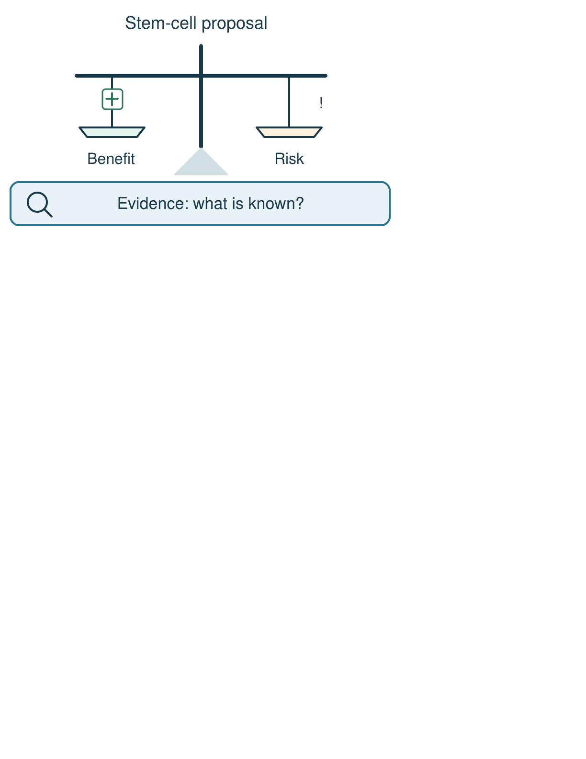
Arrival
Look at this week’s fictional stem-cell proposal card. Point to one detail you notice.
SCI-LAUNCH-A2-W03 • LAUNCH Science
2
Made by Matt · madebymatt.uk · © Matt Roper · CC BY-NC-SA 4.0: free for classroom use, share and adapt with credit, no resale · v9 · 25 Sep 2026
Notes:
Offer a private, predictable start. Do not require previous knowledge.

Slide 3
Starter
Recall three ideas from earlier lessons. Show one answer at a time.
What is the name for a cell gaining a specialised job?
What two cells follow mitosis and cell splitting?
In which direction do particles spread by diffusion?
SCI-LAUNCH-A2-W03 • LAUNCH Science
3
Made by Matt · madebymatt.uk · © Matt Roper · CC BY-NC-SA 4.0: free for classroom use, share and adapt with credit, no resale · v9 · 25 Sep 2026
Notes:
All pupils respond; reveal the answers only after attempts. Revisit success criteria.
What is the name for a cell gaining a specialised job? → Differentiation.
What two cells follow mitosis and cell splitting? → Two matching daughter body cells.
In which direction do particles spread by diffusion? → From a higher to a lower concentration overall.

Slide 4
Model
Watch the full model. Point to the step that answers today’s question.
A fictional proposal may replace damaged cells. A possible harm is unknown. A careful study must measure both benefit and risk; possible use is not proven treatment.
SCI-LAUNCH-A2-W03 • LAUNCH Science
4
Made by Matt · madebymatt.uk · © Matt Roper · CC BY-NC-SA 4.0: free for classroom use, share and adapt with credit, no resale · v9 · 25 Sep 2026
Notes:
Model one complete example; check every pupil’s response to the show-me question.

Slide 5
Picture model
SCI-LAUNCH-A2-W03 • LAUNCH Science
5
Made by Matt · madebymatt.uk · © Matt Roper · CC BY-NC-SA 4.0: free for classroom use, share and adapt with credit, no resale · v9 · 25 Sep 2026
Notes:
Fictional proposal: weigh a possible benefit and risk against evidence. Simplified decision aid; no medical decision is made here.

Slide 6
Show me
Show me: is “it might help” evidence that the treatment already works?
SCI-LAUNCH-A2-W03 • LAUNCH Science
6
Made by Matt · madebymatt.uk · © Matt Roper · CC BY-NC-SA 4.0: free for classroom use, share and adapt with credit, no resale · v9 · 25 Sep 2026
Notes:
No. It is a possible benefit; evidence from an appropriate study is needed.

Slide 7
Our turn
Complete the missing step in the part-done model. Speak, then match the cards.
Possible benefit: may replace damaged cells. Possible risk: ________. Evidence needed: a fair check of benefit and harm.
SCI-LAUNCH-A2-W03 • LAUNCH Science
7
Made by Matt · madebymatt.uk · © Matt Roper · CC BY-NC-SA 4.0: free for classroom use, share and adapt with credit, no resale · v9 · 25 Sep 2026
Notes:
Wait five seconds, gesture, then cue if needed. Support the route without supplying the missing answer.
Missing step: Identify an uncertain harmful result as a risk, without stating it has already happened.

Slide 8
Talk, then sort
evidence request
possible benefit
possible harm
unsupported assertion
The trial records how much damaged tissue changes.
A treatment may help a damaged tissue.
It must work because many people want it.
A study could find a harmful effect.
SCI-LAUNCH-A2-W03 • LAUNCH Science
8
Made by Matt · madebymatt.uk · © Matt Roper · CC BY-NC-SA 4.0: free for classroom use, share and adapt with credit, no resale · v9 · 25 Sep 2026
Notes:
The trial records how much damaged tissue changes. → evidence request
A treatment may help a damaged tissue. → possible benefit
It must work because many people want it. → unsupported assertion
A study could find a harmful effect. → possible harm

Slide 9
Check
A new fictional cell study reports improved movement but does not report harmful effects. Which review is justified?
A. A. The benefit can establish safety despite the missing report on harms.
B. B. The missing report proves the study cannot have produced any benefit.
C. C. The improved movement proves the study will work for every person.
D. D. The benefit needs checking alongside missing risk evidence before a decision.
SCI-LAUNCH-A2-W03 • LAUNCH Science
9
Made by Matt · madebymatt.uk · © Matt Roper · CC BY-NC-SA 4.0: free for classroom use, share and adapt with credit, no resale · v9 · 25 Sep 2026
Notes:
Collect simultaneous responses, apply the decision rule and parallel hinge in the staff note.
A. A. The benefit can establish safety despite the missing report on harms. | Not correct | Treats an observed benefit as proof of safety without harm data.
B. B. The missing report proves the study cannot have produced any benefit. | Not correct | Treats missing harm reporting as proof that the reported benefit did not occur.
C. C. The improved movement proves the study will work for every person. | Not correct | Generalises one study result to every person.
D. D. The benefit needs checking alongside missing risk evidence before a decision. | Correct | Uses the new case accurately.
About 3 in 4 or more correct: proceed; otherwise re-model a fictional claim card beside an empty evidence column and ask the parallel hinge. No auto-grade.

Slide 10
Independent · F
A fictional stem-cell proposal lacks safety results. Decide what to test next.
Sort the fictional proposal statements under possible benefit, possible risk and evidence needed.
A possible benefit is …; a possible risk is …
SCI-LAUNCH-A2-W03 • LAUNCH Science
10
Made by Matt · madebymatt.uk · © Matt Roper · CC BY-NC-SA 4.0: free for classroom use, share and adapt with credit, no resale · v9 · 25 Sep 2026
Notes:
At lesson start choose one adult with supported pupils and one holding the group; swap during the week. Record independence and prompt level.

Slide 11
Independent · M
A fictional stem-cell proposal lacks safety results. Decide what to test next.
Explain why a proposal needs evidence of both effect and harm before a decision.
The claim is not yet proven because we need evidence that …
SCI-LAUNCH-A2-W03 • LAUNCH Science
11
Made by Matt · madebymatt.uk · © Matt Roper · CC BY-NC-SA 4.0: free for classroom use, share and adapt with credit, no resale · v9 · 25 Sep 2026
Notes:
At lesson start choose one adult with supported pupils and one holding the group; swap during the week. Record independence and prompt level.

Slide 12
Independent · H
A fictional stem-cell proposal lacks safety results. Decide what to test next.
Evaluate whether to support further research with a qualified reason, risk and evidence request.
I would support/review further research if …; however, before treatment use I would need …
SCI-LAUNCH-A2-W03 • LAUNCH Science
12
Made by Matt · madebymatt.uk · © Matt Roper · CC BY-NC-SA 4.0: free for classroom use, share and adapt with credit, no resale · v9 · 25 Sep 2026
Notes:
At lesson start choose one adult with supported pupils and one holding the group; swap during the week. Record independence and prompt level.

Slide 13
Go deeper
If a careful new study showed no improvement, how should the panel change its recommendation and why?
Separate further research from routine treatment; explain the evidence needed for each.
SCI-LAUNCH-A2-W03 • LAUNCH Science
13
Made by Matt · madebymatt.uk · © Matt Roper · CC BY-NC-SA 4.0: free for classroom use, share and adapt with credit, no resale · v9 · 25 Sep 2026

Slide 14
Review
Tell a partner what you changed after feedback. Mark a real edit // and read it back when asked ?.
SCI-LAUNCH-A2-W03 • LAUNCH Science
14
Made by Matt · madebymatt.uk · © Matt Roper · CC BY-NC-SA 4.0: free for classroom use, share and adapt with credit, no resale · v9 · 25 Sep 2026
Notes:
Give a precise VF or NS(+) only when it actually happens. Invite a true self-edit and read-back.

Slide 15
Exit
Show what you know with a model and explain one reason.
Check today’s success:
I can name a possible benefit and risk.
I can ask for evidence that tests a claim.
I can justify further research without claiming a cure.
What am I learning? I am learning to weigh a possible benefit and risk of stem-cell research using evidence.
My feedback was … Name what you heard at Review.
Next I need to … Add one precise piece of benefit or safety evidence you would request before deciding.
How I know: I can name a possible benefit and risk, then request evidence before recommending a next step.
Your teacher hears your answer and uses it to choose our next model, prompt or example.
SCI-LAUNCH-A2-W03 • LAUNCH Science
15
Made by Matt · madebymatt.uk · © Matt Roper · CC BY-NC-SA 4.0: free for classroom use, share and adapt with credit, no resale · v9 · 25 Sep 2026
Notes:
Hear the answer privately in a valid mode and use it to change the next example or prompt.

Slide 16
Word help · stem cell
a cell that can divide and form specialised cell types
Stem cells are being studied for possible medical uses.
SCI-LAUNCH-A2-W03 • LAUNCH Science
16
Made by Matt · madebymatt.uk · © Matt Roper · CC BY-NC-SA 4.0: free for classroom use, share and adapt with credit, no resale · v9 · 25 Sep 2026

Slide 17
Word help · benefit
a possible helpful result
A possible benefit would be replacing damaged cells.
SCI-LAUNCH-A2-W03 • LAUNCH Science
17
Made by Matt · madebymatt.uk · © Matt Roper · CC BY-NC-SA 4.0: free for classroom use, share and adapt with credit, no resale · v9 · 25 Sep 2026

Slide 18
Word help · risk
a possible harmful result or uncertain effect
A study must consider a risk to volunteers.
SCI-LAUNCH-A2-W03 • LAUNCH Science
18
Made by Matt · madebymatt.uk · © Matt Roper · CC BY-NC-SA 4.0: free for classroom use, share and adapt with credit, no resale · v9 · 25 Sep 2026

Slide 19
Word help · evidence
information that tests or supports a claim
The trial needs evidence of both benefit and harm.
SCI-LAUNCH-A2-W03 • LAUNCH Science
19
Made by Matt · madebymatt.uk · © Matt Roper · CC BY-NC-SA 4.0: free for classroom use, share and adapt with credit, no resale · v9 · 25 Sep 2026

