Slide 1

Researching a genetic condition
I am learning to use a named source to present careful facts about a genetic condition.
I can name the condition and source.
I can explain CFTR inheritance without personal details.
I can tell a sourced fact from a guess.
SCI-LAUNCH-A2-W06 • LAUNCH Science
1
Made by Matt · madebymatt.uk · © Matt Roper · CC BY-NC-SA 4.0: free for classroom use, share and adapt with credit, no resale · v9 · 25 Sep 2026
Notes:
Lesson code: SCI-LAUNCH-A2-W06
SoW objective: Research a genetic condition online; present.
Reading band: LAUNCH 11+
Staff focus: {'i_do': '“Watch me underline the exact source sentence for one claim.”', 'we_do': '“Which sentence on the card supports your point?”', 'independent': '“What can you name from the card before adding your reason?”'}
Prompt ladder: ['Wait five seconds while pupil finds a source line.', 'Point to the three labelled parts of the offline card.', 'Ask “Which line says how the condition is inherited?”', 'Model underlining one sourced claim; pupil underlines another.', 'Finish one claim and source together, then pupil tries the next one alone.']
Sources:
Pearson Edexcel GCSE Biology 1BI0 Foundation, Biology Topics 2–3, https://qualifications.pearson.com/content/dam/pdf/GCSE/Science/2016/Specification/gcse-biology-spec.pdf; Pearson Edexcel GCSE Combined Science 1SC0 Foundation, Biology Topics 2–3, https://qualifications.pearson.com/content/dam/pdf/GCSE/Science/2016/Specification/gcse-combinedscience-spec.pdf
NHS, Cystic fibrosis, https://www.nhs.uk/conditions/cystic-fibrosis/; NHS Genomics Education Programme, Cystic fibrosis, https://www.genomicseducation.hee.nhs.uk/genotes/knowledge-hub/cystic-fibrosis/
NHS, Cystic fibrosis, https://www.nhs.uk/conditions/cystic-fibrosis/
NHS Genomics Education Programme, Cystic fibrosis, https://www.genomicseducation.hee.nhs.uk/genotes/knowledge-hub/cystic-fibrosis/
NHS, Cystic fibrosis, causes and healthy-living/infection precautions, https://www.nhs.uk/conditions/cystic-fibrosis/; NHS Genomics Education Programme, cystic fibrosis inheritance, https://www.genomicseducation.hee.nhs.uk/genotes/knowledge-hub/cystic-fibrosis/
Pearson 1BI0/1SC0 Working Scientifically; Pearson Edexcel GCSE Biology 1BI0 Foundation, Biology Topics 2–3, https://qualifications.pearson.com/content/dam/pdf/GCSE/Science/2016/Specification/gcse-biology-spec.pdf; Pearson Edexcel GCSE Combined Science 1SC0 Foundation, Biology Topics 2–3, https://qualifications.pearson.com/content/dam/pdf/GCSE/Science/2016/Specification/gcse-combinedscience-spec.pdf
Authored safeguard and limitation grounded in the cited NHS sources.
NHS, Cystic fibrosis, https://www.nhs.uk/conditions/cystic-fibrosis/; NHS Genomics Education Programme, https://www.genomicseducation.hee.nhs.uk/genotes/knowledge-hub/cystic-fibrosis/
Local school risk assessment and exact prepared kit; staff confirm

Slide 2
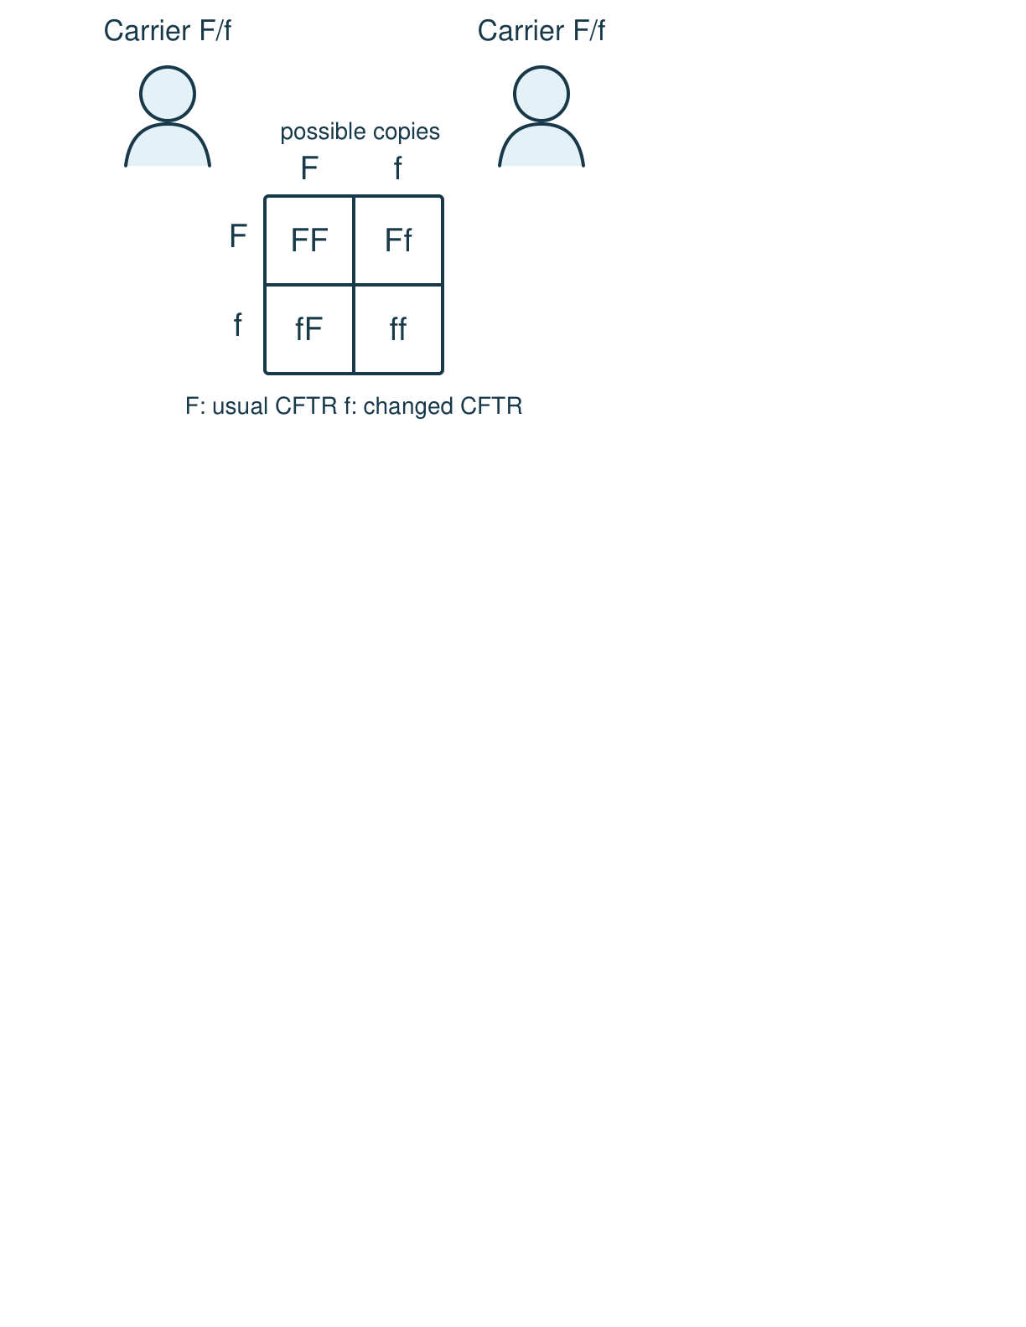
Arrival
Look at this week’s NHS source card. Point to one detail you notice.
SCI-LAUNCH-A2-W06 • LAUNCH Science
2
Made by Matt · madebymatt.uk · © Matt Roper · CC BY-NC-SA 4.0: free for classroom use, share and adapt with credit, no resale · v9 · 25 Sep 2026
Notes:
Offer a private, predictable start. Do not require previous knowledge.

Slide 3
Starter
Recall three ideas from earlier lessons. Show one answer at a time.
What does a Punnett square show?
What is a gene?
Where are chromosomes found in an animal cell?
SCI-LAUNCH-A2-W06 • LAUNCH Science
3
Made by Matt · madebymatt.uk · © Matt Roper · CC BY-NC-SA 4.0: free for classroom use, share and adapt with credit, no resale · v9 · 25 Sep 2026
Notes:
All pupils respond; reveal the answers only after attempts. Revisit success criteria.
What does a Punnett square show? → Possible allele pairs and their model chance.
What is a gene? → A section of DNA that codes for a protein.
Where are chromosomes found in an animal cell? → In the nucleus.

Slide 4
Model
Watch the full model. Point to the step that answers today’s question.
The NHS card says cystic fibrosis is inherited. Changed CFTR copies come from both parents. One changed copy usually means a carrier; two usually cause the condition. Name the NHS card with each claim.
SCI-LAUNCH-A2-W06 • LAUNCH Science
4
Made by Matt · madebymatt.uk · © Matt Roper · CC BY-NC-SA 4.0: free for classroom use, share and adapt with credit, no resale · v9 · 25 Sep 2026
Notes:
Model one complete example; check every pupil’s response to the show-me question.

Slide 5
Picture model
SCI-LAUNCH-A2-W06 • LAUNCH Science
5
Made by Matt · madebymatt.uk · © Matt Roper · CC BY-NC-SA 4.0: free for classroom use, share and adapt with credit, no resale · v9 · 25 Sep 2026
Notes:
Simplified inheritance model: each parent carries one changed CFTR copy. The four grid squares are possibilities for each pregnancy, not a prediction for a person.

Slide 6
Show me
Show me: is the genetic cause of cystic fibrosis inherited or passed by brief contact?
SCI-LAUNCH-A2-W06 • LAUNCH Science
6
Made by Matt · madebymatt.uk · © Matt Roper · CC BY-NC-SA 4.0: free for classroom use, share and adapt with credit, no resale · v9 · 25 Sep 2026
Notes:
Inherited. This says nothing about infection precautions a person with CF may need.

Slide 7
Our turn
Complete the missing step in the part-done model. Speak, then match the cards.
The NHS card says cystic fibrosis is ___. It involves the ___ gene. One changed copy usually means a ___. Source: ___.
SCI-LAUNCH-A2-W06 • LAUNCH Science
7
Made by Matt · madebymatt.uk · © Matt Roper · CC BY-NC-SA 4.0: free for classroom use, share and adapt with credit, no resale · v9 · 25 Sep 2026
Notes:
Wait five seconds, gesture, then cue if needed. Support the route without supplying the missing answer.
Missing step: Link the two changed CFTR copies to inheritance rather than contact; name the NHS source.

Slide 8
Talk, then sort
What it is
Inheritance
Care
Source
Can affect breathing and digestion
Usually two changed CFTR copies
Treatments help manage symptoms
NHS page named and dated
SCI-LAUNCH-A2-W06 • LAUNCH Science
8
Made by Matt · madebymatt.uk · © Matt Roper · CC BY-NC-SA 4.0: free for classroom use, share and adapt with credit, no resale · v9 · 25 Sep 2026
Notes:
Can affect breathing and digestion → What it is
Usually two changed CFTR copies → Inheritance
Treatments help manage symptoms → Care
NHS page named and dated → Source

Slide 9
Check
A fictional family-source card says altered gene copies passed from parents to their child. Which claim does that evidence support?
A. A. The altered copies spread through a shared cough.
B. B. The altered copies arose from the child’s wish.
C. C. The altered copies were inherited from the parents.
D. D. The altered copies travelled through drinking water.
SCI-LAUNCH-A2-W06 • LAUNCH Science
9
Made by Matt · madebymatt.uk · © Matt Roper · CC BY-NC-SA 4.0: free for classroom use, share and adapt with credit, no resale · v9 · 25 Sep 2026
Notes:
Collect simultaneous responses, apply the decision rule and parallel hinge in the staff note.
A. A. The altered copies spread through a shared cough. | Not correct | Confuses an inherited CFTR variant with an infection spread by a cough.
B. B. The altered copies arose from the child’s wish. | Not correct | Attributes inherited gene copies to a child’s wish instead of parental transmission.
C. C. The altered copies were inherited from the parents. | Correct | Uses the new case accurately.
D. D. The altered copies travelled through drinking water. | Not correct | Confuses inherited gene copies with an environmental exposure through water.
About 3 in 4 or more right → move on. Otherwise re-model an anonymous one-copy/two-copy card and the named NHS line, then ask the parallel hinge. No automatic mark or saved response.

Slide 10
Independent · F
Present three sourced facts from the offline NHS card, then correct an unsupported claim.
State the condition and one fact with the NHS source named.
The card says …; the source is …
SCI-LAUNCH-A2-W06 • LAUNCH Science
10
Made by Matt · madebymatt.uk · © Matt Roper · CC BY-NC-SA 4.0: free for classroom use, share and adapt with credit, no resale · v9 · 25 Sep 2026
Notes:
At lesson start choose one adult with supported pupils and one holding the group; swap during the week. Record independence and prompt level.

Slide 11
Independent · M
Present three sourced facts from the offline NHS card, then correct an unsupported claim.
Explain CFTR inheritance and separate it from infection.
The CFTR change is inherited because …; infection advice is separate because …
SCI-LAUNCH-A2-W06 • LAUNCH Science
11
Made by Matt · madebymatt.uk · © Matt Roper · CC BY-NC-SA 4.0: free for classroom use, share and adapt with credit, no resale · v9 · 25 Sep 2026
Notes:
At lesson start choose one adult with supported pupils and one holding the group; swap during the week. Record independence and prompt level.

Slide 12
Independent · H
Present three sourced facts from the offline NHS card, then correct an unsupported claim.
Revise an unsupported claim with the NHS card.
The claim is not supported by …; I would revise it to …
SCI-LAUNCH-A2-W06 • LAUNCH Science
12
Made by Matt · madebymatt.uk · © Matt Roper · CC BY-NC-SA 4.0: free for classroom use, share and adapt with credit, no resale · v9 · 25 Sep 2026
Notes:
At lesson start choose one adult with supported pupils and one holding the group; swap during the week. Record independence and prompt level.

Slide 13
Go deeper
Why does one changed copy in this example not justify saying a carrier has the condition?
Repair a draft saying a CFTR change spreads by touch and outcomes are fixed; source both repairs.
SCI-LAUNCH-A2-W06 • LAUNCH Science
13
Made by Matt · madebymatt.uk · © Matt Roper · CC BY-NC-SA 4.0: free for classroom use, share and adapt with credit, no resale · v9 · 25 Sep 2026

Slide 14
Review
Tell a partner what you changed after feedback. Mark a real edit // and read it back when asked ?.
SCI-LAUNCH-A2-W06 • LAUNCH Science
14
Made by Matt · madebymatt.uk · © Matt Roper · CC BY-NC-SA 4.0: free for classroom use, share and adapt with credit, no resale · v9 · 25 Sep 2026
Notes:
Give a precise VF or NS(+) only when it actually happens. Invite a true self-edit and read-back.

Slide 15
Exit
Show what you know with a model and explain one reason.
Check today’s success:
I can name the condition and source.
I can explain CFTR inheritance without personal details.
I can tell a sourced fact from a guess.
What am I learning? I am learning to use a named source to present careful facts about a genetic condition.
My feedback was … Name what you heard at Review.
Next I need to … Put the NHS source next to each scientific claim.
How I know: I can give accurate CFTR facts, name the NHS card and correct an unsupported claim.
Your teacher hears your answer and uses it to choose our next model, prompt or example.
SCI-LAUNCH-A2-W06 • LAUNCH Science
15
Made by Matt · madebymatt.uk · © Matt Roper · CC BY-NC-SA 4.0: free for classroom use, share and adapt with credit, no resale · v9 · 25 Sep 2026
Notes:
Hear the answer privately in a valid mode and use it to change the next example or prompt.

Slide 16
Word help · inherited
passed to a child through genes
The card says cystic fibrosis is inherited.
SCI-LAUNCH-A2-W06 • LAUNCH Science
16
Made by Matt · madebymatt.uk · © Matt Roper · CC BY-NC-SA 4.0: free for classroom use, share and adapt with credit, no resale · v9 · 25 Sep 2026

Slide 17
Word help · variant
a changed version of a gene
The card describes a changed CFTR variant.
SCI-LAUNCH-A2-W06 • LAUNCH Science
17
Made by Matt · madebymatt.uk · © Matt Roper · CC BY-NC-SA 4.0: free for classroom use, share and adapt with credit, no resale · v9 · 25 Sep 2026

Slide 18
Word help · carrier
a person with one changed copy in this recessive example
A carrier usually does not have cystic fibrosis.
SCI-LAUNCH-A2-W06 • LAUNCH Science
18
Made by Matt · madebymatt.uk · © Matt Roper · CC BY-NC-SA 4.0: free for classroom use, share and adapt with credit, no resale · v9 · 25 Sep 2026

Slide 19
Word help · source
where a claim comes from
The NHS page is the source for this card.
SCI-LAUNCH-A2-W06 • LAUNCH Science
19
Made by Matt · madebymatt.uk · © Matt Roper · CC BY-NC-SA 4.0: free for classroom use, share and adapt with credit, no resale · v9 · 25 Sep 2026

