Slide 1

Cells and genetics check
I am learning to use cell and inheritance models to show what I know and choose one next step.
I can order copy, separate and split for mitosis.
I can mark one gene as part of DNA.
I can use a simple cross as probability, not a promise.
SCI-LAUNCH-A2-W07 • LAUNCH Science
1
Made by Matt · madebymatt.uk · © Matt Roper · CC BY-NC-SA 4.0: free for classroom use, share and adapt with credit, no resale · v9 · 25 Sep 2026
Notes:
Lesson code: SCI-LAUNCH-A2-W07
SoW objective: Topics 2 to 3 assessment (Dec).
Reading band: LAUNCH 11+
Staff focus: {'i_do': '“Watch how I use a different model detail in my answer.”', 'we_do': '“Which detail can you point to as evidence?”', 'independent': '“Read the command. Choose one valid response mode; this item is yours.”'}
Prompt ladder: ['Wait five seconds for a self-start with command words.', 'Point to the command word, not the answer location.', 'Ask “Which item are you on?” without hinting at content.', 'Model a parallel non-test item only; pupil then returns to a fresh check item.', 'Correct the procedure (for example, which box to use), never a test answer.']
Sources:
Pearson Edexcel GCSE Biology 1BI0 Foundation, Biology Topics 2–3, https://qualifications.pearson.com/content/dam/pdf/GCSE/Science/2016/Specification/gcse-biology-spec.pdf; Pearson Edexcel GCSE Combined Science 1SC0 Foundation, Biology Topics 2–3, https://qualifications.pearson.com/content/dam/pdf/GCSE/Science/2016/Specification/gcse-combinedscience-spec.pdf
NHS, Cystic fibrosis, https://www.nhs.uk/conditions/cystic-fibrosis/; NHS Genomics Education Programme, Cystic fibrosis, https://www.genomicseducation.hee.nhs.uk/genotes/knowledge-hub/cystic-fibrosis/
Authored classroom model grounded in Pearson Edexcel GCSE Biology 1BI0 Foundation, Biology Topics 2–3, https://qualifications.pearson.com/content/dam/pdf/GCSE/Science/2016/Specification/gcse-biology-spec.pdf; Pearson Edexcel GCSE Combined Science 1SC0 Foundation, Biology Topics 2–3, https://qualifications.pearson.com/content/dam/pdf/GCSE/Science/2016/Specification/gcse-combinedscience-spec.pdf
Pearson Edexcel GCSE Biology 1BI0 and Combined Science 1SC0, specification, Biology Topics 2–3; https://qualifications.pearson.com/content/dam/pdf/GCSE/Science/2016/Specification/gcse-biology-spec.pdf; https://qualifications.pearson.com/content/dam/pdf/GCSE/Science/2016/Specification/gcse-combinedscience-spec.pdf
lesson content–source checks ruling; static SVG geometry and mechanism check; browser confirmation remains NOT RUN
Local school risk assessment and exact prepared kit; staff confirm

Slide 2
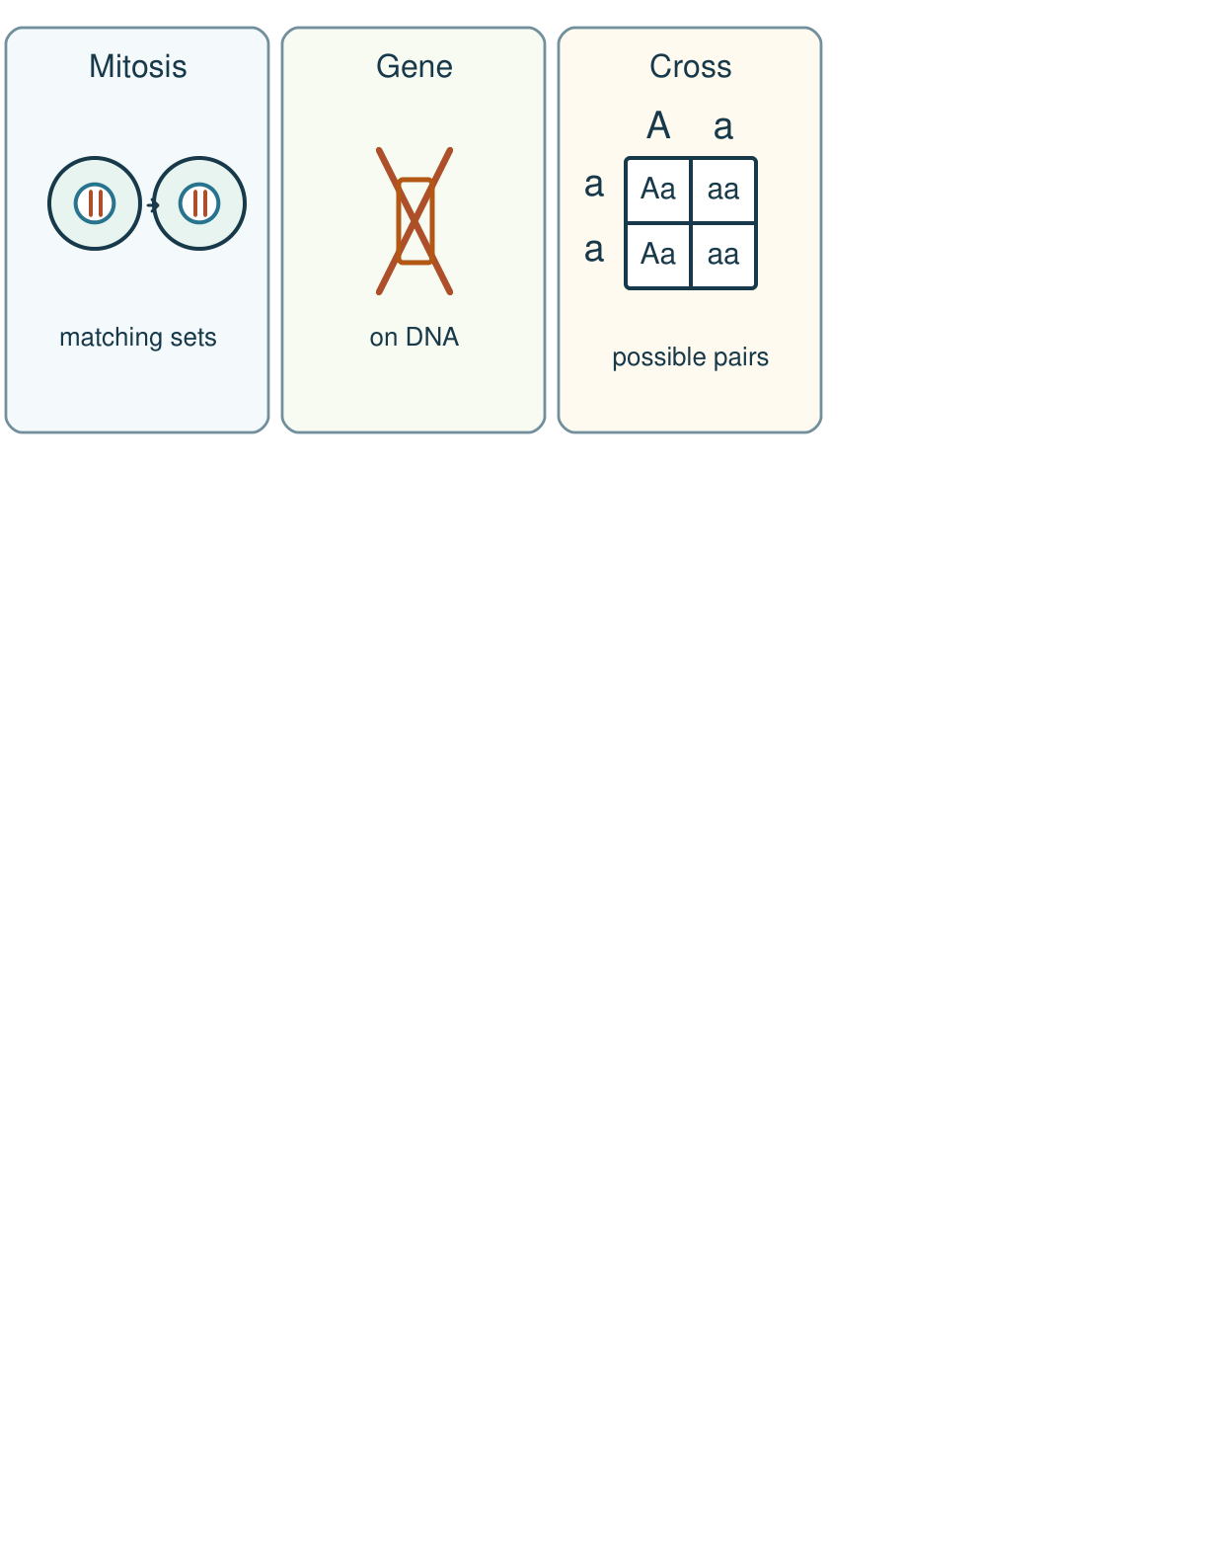
Arrival
Look at this week’s familiar cell and allele models. Point to one detail you notice.
SCI-LAUNCH-A2-W07 • LAUNCH Science
2
Made by Matt · madebymatt.uk · © Matt Roper · CC BY-NC-SA 4.0: free for classroom use, share and adapt with credit, no resale · v9 · 25 Sep 2026
Notes:
Offer a private, predictable start. Do not require previous knowledge.

Slide 3
Starter
Recall three ideas from earlier lessons. Show one answer at a time.
Which named source supports our cystic fibrosis card?
How does a gene relate to DNA?
Which part of an animal cell holds chromosomes?
SCI-LAUNCH-A2-W07 • LAUNCH Science
3
Made by Matt · madebymatt.uk · © Matt Roper · CC BY-NC-SA 4.0: free for classroom use, share and adapt with credit, no resale · v9 · 25 Sep 2026
Notes:
All pupils respond; reveal the answers only after attempts. Revisit success criteria.
Which named source supports our cystic fibrosis card? → The NHS page and NHS Genomics Education Programme.
How does a gene relate to DNA? → A gene is a section of DNA.
Which part of an animal cell holds chromosomes? → The nucleus.

Slide 4
Model
Watch the full model. Point to the step that answers today’s question.
Parallel example (not one of the check items): label a body-cell model with copied chromosome sets, then explain that mitosis separates them into two nuclei. Point to a model detail that supports the answer. Now cover the labels for the independent check.
SCI-LAUNCH-A2-W07 • LAUNCH Science
4
Made by Matt · madebymatt.uk · © Matt Roper · CC BY-NC-SA 4.0: free for classroom use, share and adapt with credit, no resale · v9 · 25 Sep 2026
Notes:
Model one complete example; check every pupil’s response to the show-me question.

Slide 5
Picture model
SCI-LAUNCH-A2-W07 • LAUNCH Science
5
Made by Matt · madebymatt.uk · © Matt Roper · CC BY-NC-SA 4.0: free for classroom use, share and adapt with credit, no resale · v9 · 25 Sep 2026
Notes:
Three separate rehearsal pictures: mitosis, a gene on DNA, and a Punnett square. Simplified; not to scale; not answers to the independent check.

Slide 6
Show me
Show me: does “describe” need a model detail or a personal story?
SCI-LAUNCH-A2-W07 • LAUNCH Science
6
Made by Matt · madebymatt.uk · © Matt Roper · CC BY-NC-SA 4.0: free for classroom use, share and adapt with credit, no resale · v9 · 25 Sep 2026
Notes:
A scientific model detail.

Slide 7
Our turn
Complete the missing step in the part-done model. Speak, then match the cards.
Parallel example: the chromosome sets are copied. Mitosis moves the sets to ___ nuclei; the evidence detail is ___.
SCI-LAUNCH-A2-W07 • LAUNCH Science
7
Made by Matt · madebymatt.uk · © Matt Roper · CC BY-NC-SA 4.0: free for classroom use, share and adapt with credit, no resale · v9 · 25 Sep 2026
Notes:
Wait five seconds, gesture, then cue if needed. Support the route without supplying the missing answer.
Missing step: State that matching chromosome sets go into two nuclei and cite a labelled detail.

Slide 8
Talk, then sort
Cell model
DNA model
Cross model
Two matching chromosome sets
Short marked part of a DNA string
Four possible allele pairs
SCI-LAUNCH-A2-W07 • LAUNCH Science
8
Made by Matt · madebymatt.uk · © Matt Roper · CC BY-NC-SA 4.0: free for classroom use, share and adapt with credit, no resale · v9 · 25 Sep 2026
Notes:
Two matching chromosome sets → Cell model
Short marked part of a DNA string → DNA model
Four possible allele pairs → Cross model

Slide 9
Check
Which paired statement is scientifically accurate?
A. A. Mitosis halves chromosome number; a gene is the whole genome.
B. B. Mitosis removes DNA; an allele is a separate cell.
C. C. Mitosis makes one unsplit cell; DNA is only in proteins.
D. D. Mitosis gives matching body cells; a gene is a section of DNA.
SCI-LAUNCH-A2-W07 • LAUNCH Science
9
Made by Matt · madebymatt.uk · © Matt Roper · CC BY-NC-SA 4.0: free for classroom use, share and adapt with credit, no resale · v9 · 25 Sep 2026
Notes:
Collect simultaneous responses, apply the decision rule and parallel hinge in the staff note.
A. A. Mitosis halves chromosome number; a gene is the whole genome. | Not correct | Confuses mitosis with meiosis and gene with genome.
B. B. Mitosis removes DNA; an allele is a separate cell. | Not correct | Treats DNA as used up and allele as a cell.
C. C. Mitosis makes one unsplit cell; DNA is only in proteins. | Not correct | Misses cell splitting and confuses DNA with protein.
D. D. Mitosis gives matching body cells; a gene is a section of DNA. | Correct | Secure cell-cycle and gene distinction.
About 3 in 4 or more right → begin the check. Otherwise re-model a two-colour copy/separate/split strip and a short gene mark on a DNA string, then ask the parallel hinge. Do not pre-answer the three check items.

Slide 10
Independent · F
Complete a short three-part check: order copy/separate/split, mark a gene on DNA, and use Aa × aa to state a possible pair and chance.
In the independent check, order the three stages and mark one gene on the model.
First …; then …; last …
SCI-LAUNCH-A2-W07 • LAUNCH Science
10
Made by Matt · madebymatt.uk · © Matt Roper · CC BY-NC-SA 4.0: free for classroom use, share and adapt with credit, no resale · v9 · 25 Sep 2026
Notes:
At lesson start choose one adult with supported pupils and one holding the group; swap during the week. Record independence and prompt level.

Slide 11
Independent · M
Complete a short three-part check: order copy/separate/split, mark a gene on DNA, and use Aa × aa to state a possible pair and chance.
Explain matching body cells and why a gene is only part of DNA.
The model shows … because …
SCI-LAUNCH-A2-W07 • LAUNCH Science
11
Made by Matt · madebymatt.uk · © Matt Roper · CC BY-NC-SA 4.0: free for classroom use, share and adapt with credit, no resale · v9 · 25 Sep 2026
Notes:
At lesson start choose one adult with supported pupils and one holding the group; swap during the week. Record independence and prompt level.

Slide 12
Independent · H
Complete a short three-part check: order copy/separate/split, mark a gene on DNA, and use Aa × aa to state a possible pair and chance.
Use Aa × aa to reject the claim that a probability promises an exact family count.
The model chance is …; the real count may differ because …
SCI-LAUNCH-A2-W07 • LAUNCH Science
12
Made by Matt · madebymatt.uk · © Matt Roper · CC BY-NC-SA 4.0: free for classroom use, share and adapt with credit, no resale · v9 · 25 Sep 2026
Notes:
At lesson start choose one adult with supported pupils and one holding the group; swap during the week. Record independence and prompt level.

Slide 13
Go deeper
Which model feature supports an explanation that transfers to a fresh example, and which detail is only the model?
After submitting the check, compare two wrong cross explanations. Name each misconception and a precise repair without altering the checked answer.
SCI-LAUNCH-A2-W07 • LAUNCH Science
13
Made by Matt · madebymatt.uk · © Matt Roper · CC BY-NC-SA 4.0: free for classroom use, share and adapt with credit, no resale · v9 · 25 Sep 2026

Slide 14
Review
Tell a partner what you changed after feedback. Mark a real edit // and read it back when asked ?.
SCI-LAUNCH-A2-W07 • LAUNCH Science
14
Made by Matt · madebymatt.uk · © Matt Roper · CC BY-NC-SA 4.0: free for classroom use, share and adapt with credit, no resale · v9 · 25 Sep 2026
Notes:
Give a precise VF or NS(+) only when it actually happens. Invite a true self-edit and read-back.

Slide 15
Exit
Show what you know with a model and explain one reason.
Check today’s success:
I can order copy, separate and split for mitosis.
I can mark one gene as part of DNA.
I can use a simple cross as probability, not a promise.
What am I learning? I am learning to use cell and inheritance models to show what I know and choose one next step.
My feedback was … Name what you heard at Review.
Next I need to … Choose one model error you found; repair it and explain that change in the next lesson.
How I know: I can use a correct model detail to explain one answer, and I can name one precise improvement.
Your teacher hears your answer and uses it to choose our next model, prompt or example.
SCI-LAUNCH-A2-W07 • LAUNCH Science
15
Made by Matt · madebymatt.uk · © Matt Roper · CC BY-NC-SA 4.0: free for classroom use, share and adapt with credit, no resale · v9 · 25 Sep 2026
Notes:
Hear the answer privately in a valid mode and use it to change the next example or prompt.

Slide 16
Word help · mitosis
division of the nucleus to separate matching chromosome sets
Mitosis helps make matching body cells.
SCI-LAUNCH-A2-W07 • LAUNCH Science
16
Made by Matt · madebymatt.uk · © Matt Roper · CC BY-NC-SA 4.0: free for classroom use, share and adapt with credit, no resale · v9 · 25 Sep 2026

Slide 17
Word help · gene
a section of DNA that codes for a protein
A gene is a part of the DNA string.
SCI-LAUNCH-A2-W07 • LAUNCH Science
17
Made by Matt · madebymatt.uk · © Matt Roper · CC BY-NC-SA 4.0: free for classroom use, share and adapt with credit, no resale · v9 · 25 Sep 2026

Slide 18
Word help · allele
a version of a gene
A and a stand for two alleles in our invented model.
SCI-LAUNCH-A2-W07 • LAUNCH Science
18
Made by Matt · madebymatt.uk · © Matt Roper · CC BY-NC-SA 4.0: free for classroom use, share and adapt with credit, no resale · v9 · 25 Sep 2026

Slide 19
Word help · evidence
a fact or model detail that supports a claim
The labelled chromosome sets are evidence for my answer.
SCI-LAUNCH-A2-W07 • LAUNCH Science
19
Made by Matt · madebymatt.uk · © Matt Roper · CC BY-NC-SA 4.0: free for classroom use, share and adapt with credit, no resale · v9 · 25 Sep 2026

