Slide 1
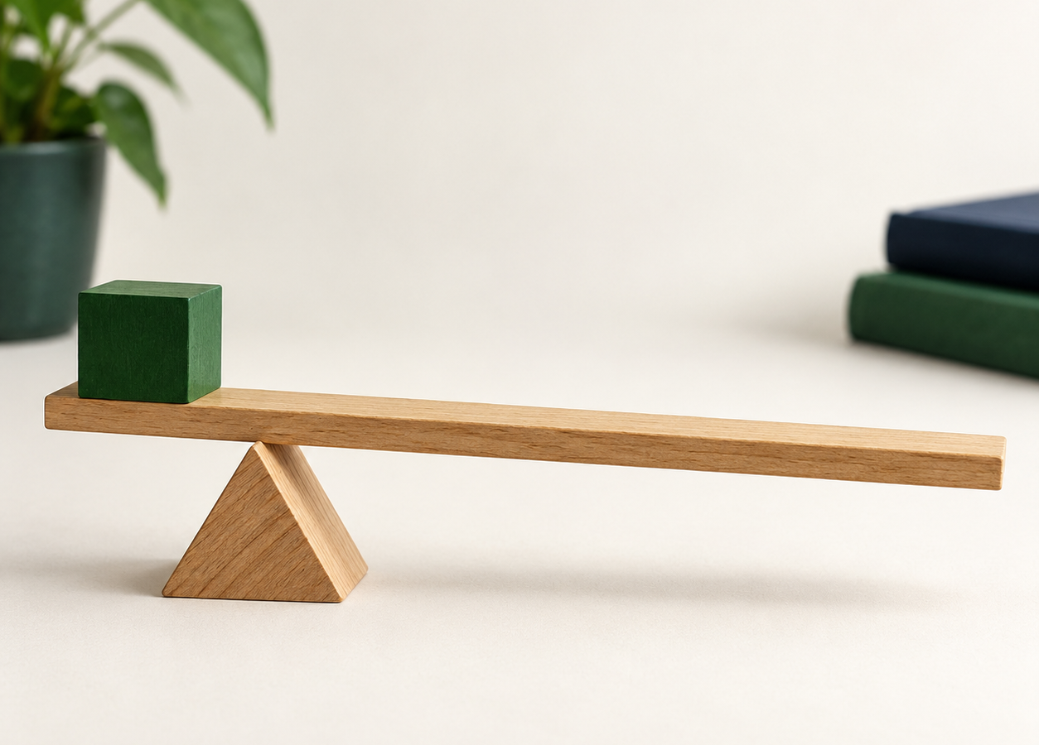
MADE BY MATT / TRACK SCIENCE
Levers, pulleys and gears
Change the force.
Notice the trade-off.
Name mechanisms, find a pivot and explain a gain and a cost.
SCIENCE · TRACK
01
Notes:
Title — 1 minutes within the source's 40-minute lesson.
Introduce source learning intention. A mechanism may change force size, direction or both; a fixed pulley need not reduce force. The lesson explores the source's force-distance idea without claiming energy is created. this lesson stops after We Do 2.

Slide 2
MADE BY MATT / TRACK SCIENCE
Find the turning point
01
Supported: point to where scissors turn.
02
Independent: name that turning point.
03
Aspire: find it on a wheelbarrow drawing too.
Look, point, describe or draw.
SCIENCE · TRACK
02
Notes:
Arrival Task — 3 minutes within the source's 40-minute lesson.
Source arrival task adapted for safe access: blunt scissors adult-approved or a drawing, no cutting task. Answer: scissors pivot is the screw/joint; wheelbarrow lever pivot is wheel axle. Wheelbarrow example can be drawn on board, no publisher image required. Never handle sharp blades to point. Use the next slide for the wheelbarrow drawing and one-minute check within this same Arrival stage.

Slide 3
MADE BY MATT / TRACK SCIENCE
Check the wheelbarrow’s pivot
The wheel axle is the turning point when you lift the handles.
LOAD IN TRAY
handles
A wheelbarrow is a lever. The load sits between pivot and effort.
PIVOT: wheel axle
SCIENCE · TRACK
03
Notes:
Arrival Task — 1 minutes within the source's 40-minute lesson.
Final minute of source four-minute Arrival stage. Original editable schematic supplied as the wheelbarrow picture: the small amber centre of the wheel is its axle/pivot. Ask learner to locate the turning point before reading the explanation. Wheelbarrow is a second-class lever: load between wheel axle and effort at handles. Drawing is schematic, not a scale force diagram. No physical wheelbarrow or heavy load needed.

Slide 4
MADE BY MATT / TRACK SCIENCE
Three things to notice
1 Find the pivot.
2 Move it and compare the effort.
3 Explain what you gain and what it costs.
SCIENCE · TRACK
04
Notes:
Today at a Glance — 2 minutes within the source's 40-minute lesson.
Retain current source sequence. Agree response and sensory choices. Today's controlled adult demonstration prepares this lesson's pupil/director comparison; don't count it as their independent practical.

Slide 5
MADE BY MATT / TRACK SCIENCE
A lever turns about a pivot
EFFORT
LOAD
The effort pushes one end. The load rises at the other end.
PIVOT
The pivot is the turning point.
SCIENCE · TRACK
05
Notes:
I Do 1 — 4 minutes within the source's 40-minute lesson.
First four minutes of source nine-minute I Do 1. Define lever: rigid bar rotating about pivot; mechanism changes force size or direction. Arrow diagram schematic only, not force magnitude. The little secured eraser is the load. Effort arm is distance pivot-to-effort; load arm pivot-to-load. No numerical calculations needed.

Slide 6
MADE BY MATT / TRACK SCIENCE
Move the pivot, keep the load
01
Watch the adult use the middle pivot.
02
Predict what changes when it moves near the load.
03
Keep the effort point and small load rise the same.
04
Compare the effort and the hand’s travel.
SCIENCE · TRACK
06
Notes:
I Do 1 — 5 minutes within the source's 40-minute lesson.
Completes source nine-minute demonstration. Adult-secured broad pivot, ruler/card lever and light secured load, small lift target; never launch objects, hands clear. Near-load pivot lengthens effort arm relative to load arm, reducing needed effort force ideally; for same load rise, effort end travels farther. Repeat both positions. Real friction/bending means report observations honestly. No kit: use lever sketch as explanation/prediction only.

Slide 7
MADE BY MATT / TRACK SCIENCE
Which objects are levers?
01
Wheelbarrow
02
Scissors
03
Spanner on a bolt
Point to a turning point before naming it.
SCIENCE · TRACK
07
Notes:
We Do 1 — 2 minutes within the source's 40-minute lesson.
First two of source ten-minute We Do 1. Wheelbarrow rotates around wheel axle; scissors are a pair of levers around joint; spanner turns around bolt axis. Name where effort is applied. Adult models the wheelbarrow using drawing rather than heavy equipment. Pointing, speech or annotations equally valid.

Slide 8
MADE BY MATT / TRACK SCIENCE
A fixed pulley changes direction
At a flagpole, pull the rope down and the flag goes up.
One fixed pulley changes the pull’s direction. It does not give free lifting force.
pull down
load rises
SCIENCE · TRACK
08
Notes:
We Do 1 — 3 minutes within the source's 40-minute lesson.
Next three minutes source We Do 1. Trace rope over fixed top wheel on board/native sketch. Ideal fixed pulley effort force is approximately load weight; real friction can increase it. This differs from a pulley system with more supporting rope sections. No pupil lifting, hanging or rope-around-body activity. Offline diagram fully substitutes animation.

Slide 9
MADE BY MATT / TRACK SCIENCE
Gears trade speed for turning effect
01
Gears have teeth and pass on turning movement.
02
A bicycle uses chainrings, a chain and sprockets.
03
A lower gear can help turn the wheel against a load.
04
The wheel turns fewer times per pedal turn.
SCIENCE · TRACK
09
Notes:
We Do 1 — 3 minutes within the source's 40-minute lesson.
Next three minutes of source We Do 1. Source everyday example 'bicycle chain and cogs' is a chain drive with gear ratios, not two directly meshing gears. Explain torque as turning effect in accessible words. With lower gearing, wheel torque is greater for comparable pedal torque but wheel speed per pedal turn is lower; rider must turn pedals more often for same distance. Keep fingers away from real moving gears. No ratio maths required.

Slide 10
MADE BY MATT / TRACK SCIENCE
Check the mechanism and its job
MECHANISM
EVERYDAY EXAMPLE
Lever
Fixed pulley
Geared chain drive
Scissors, wheelbarrow, spanner
Flagpole rope over top wheel
Bicycle chain and cogs
SCIENCE · TRACK
10
Notes:
We Do 1 — 2 minutes within the source's 40-minute lesson.
Final two minutes source We Do 1. Reveal after classification. Learner chooses one example and describes force or movement direction. Do not imply each example reduces force in every use; names alone do not establish a benefit. Correct one label with reason.

Slide 11
MADE BY MATT / TRACK SCIENCE
Explain the gain and the cost
This is a ___ because ___. It helps by ___, but you have to ___.
Name the mechanism, its job and the trade-off.
SCIENCE · TRACK
11
Notes:
I Do 2 — 4 minutes within the source's 40-minute lesson.
Exact four-minute I Do 2 evidence loop. Model lever: rigid bar about pivot; near-load pivot can need less effort force but hand travels farther for same load rise. Record named mechanisms, correctly identified pivot and gain/cost. Do not require photographs: labelled diagram and explanation suffice. Actual comparison evidence follows this lesson.

Slide 12
MADE BY MATT / TRACK SCIENCE
Sort the gain and the cost
01
Less effort force needed
02
Hand travels farther
03
Pull down instead of up
04
Mechanism creates extra energy
05
Slower turning, greater turning effect
SCIENCE · TRACK
12
Notes:
We Do 2 — 5 minutes within the source's 40-minute lesson.
First five of source ten-minute We Do 2. Sort into GAIN, COST, NEITHER, or GAIN AND COST. Give an attempt before next slide. Explain intended task matters. 'Creates extra energy' is false, not a legitimate benefit. Spoken pointing or paper cards replace tap/drag controls.

Slide 13
MADE BY MATT / TRACK SCIENCE
Check your choices
GAIN OR GAIN + COST
COST OR FALSE CLAIM
Less effort: gain
Pull down: direction benefit
Slower + stronger turn: both
Farther hand travel: cost
Extra energy created: false
SCIENCE · TRACK
13
Notes:
We Do 2 — 3 minutes within the source's 40-minute lesson.
Next three minutes. Source bins classify false energy claim as NEITHER. Explain gears' 'stronger turn' means greater turning effect/torque, not energy creation. For lever, compare same load and rise before claiming easier. Invite pupil to move/draw model showing both outcomes.

Slide 14
MADE BY MATT / TRACK SCIENCE
Keep both halves of the explanation
Moving the pivot nearer the load can reduce the effort force needed.
EFFORT
LOAD
For the same small load rise, the effort end must travel farther.
PIVOT
SCIENCE · TRACK
14
Notes:
We Do 2 — 2 minutes within the source's 40-minute lesson.
Final two minutes of source We Do 2. No mechanism creates energy; real mechanisms also dissipate some. Stop this lesson here, label and keep work. this lesson uses 32-minute lever comparison, 4-minute feedback and 4-minute exit. Do not add practical or exit today.

