Slide 1
Using Microsoft Entra ID to Secure Your Web Applications
Matt Ruwe
Software Architect

Slide 2
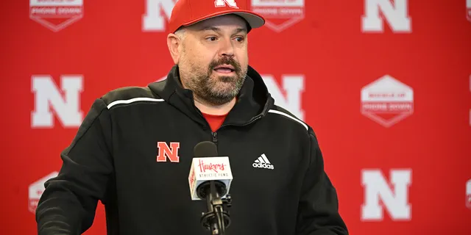
Introduction – Who am I?
Matt Ruwe
no – I don’t coach football
That’s this guy:

Slide 3

Introduction – What do I do?
25+ years of experience in a variety of industries
Banking, agri-business, niche ERP solutions, e-commerce, genetics, healthcare, real estate, and construction
Software Architect at Kiewit
Lead the App Dev Center of Excellence
Work with software developers across the North American Continent
Learn about the types of software problems each district within the company is trying to solve
Make software developers better by providing guidance, patterns, practices, and libraries with a goal of enhancing efficiency
Lead the Omaha .NET User’s Group for 15+ years

Slide 4
Technologies I work with
Things I’ve worked with a lot
Software Architecture
.NET / C#
Azure
Azure DevOps
Regular Expressions
Powershell
Things I’m comfortable with
Azure AD (Entra ID)
GitHub
Linux
Things I’m trying to learn more about
React
Python
Containers – Docker/K8
DAPR

Slide 5
What are we going to talk about?
OAuth Basics - Authentication
Entra ID (Azure AD)
Supporting Software Libraries
Demo
Other considerations

Slide 6
What are we NOT going to talk about?
Authorization While OAuth is technically an authorization framework, we will be treating it more like an authentication framework

Slide 7
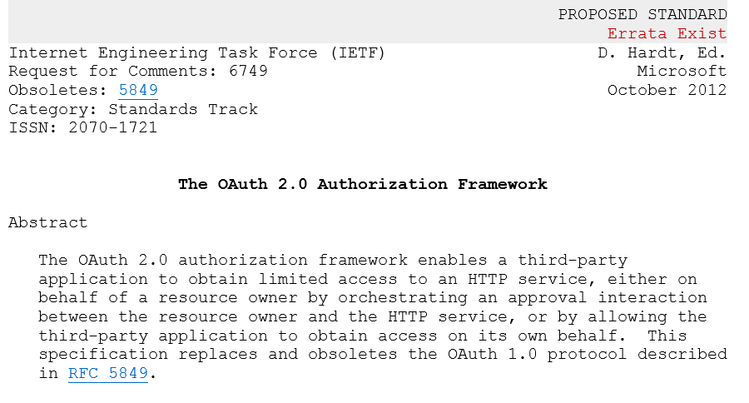
OAuth 2.0

Slide 8
OAuth 2.0 Basic Operation
Client (application)
Resource Server
(needs protection)
Call with token
Get token
Issue token
Resource Owner (you)
Authorization Server
(can verify you)
Authenticate and Consent
The above defines general interactions (abstract flow) – OAuth2 protocols defines a variety of concrete flows (grant types) to minimize security risks for specific types of clients (defined later)

Slide 9
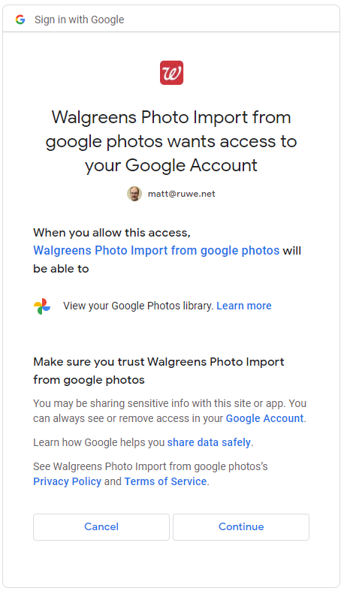
Actors
Client
Resource Owner
Resource Server
Authorization Server
Application that needs to use the resource
Various types –
browser-Web-App, Native, Daemons, etc.
Often end-user facing
E.g. Photo printing service that imports from Google Photos
Owner of the requested resource
Typically the user of the application
E.g. “Owner of the OneDrive account/photos”
Hosts the resource
Typically an API provider
E.g., Microsoft Graph API
Trusts tokens from an Authorization Server
E.g. OneDrive “Photo library”
Issues access tokens to clients
Authenticates resource owners
Gets access consent from the resource owner
Could be “Photo library provider”

Slide 10
Tokens and grants
Access Token
Id token
Refresh tokens
Flows/Grant types
JWT
Requested by client
For a resource
Provide authz data, e.g. scope
JWT
Requested by client
For own use
Claims describing a user
Use MS Graph to get detailed user info
Allow clients to renew an access token
Opaque to both client and resource
OAuth2 defined interactions for obtaining tokens
Designed to minimize risks of token misuse
Choice dependent on the nature of client

Slide 11
Secrets
Symmetric
Asymmetric (usually X509)
Both caller and callee use same value
Secret passed as part of the message
Caller has a private and a public key
Callee has public key only
Caller creates and signs an assertion (request) with private key
Signed assertion passed in the call – private key never disclosed!

Slide 12
OAuth 2.0 Basic Operation
Client (application)
Resource Server
(needs protection)
Call with token
Get token
Issue token
Resource Owner (you)
Authorization Server
(can verify you)
Authenticate and Consent
The above defines general interactions (abstract flow) – OAuth2 protocols defines a variety of concrete flows (grant types) to minimize security risks for specific types of clients (defined later)

Slide 13
Why different flows?
Goal:
Minimize risk of token misuse (theft, replay, mis-acquisition)
Choice based on:
User presence – is user available to authenticate and consent?
Browser availability – is http browser redirection possible?
Client type – confidential vs public

Slide 14
OAuth 2.0 Sign-in Flows
Flow name | User? | Browser? | Client type | Typical scenario
Client credential | N | N | C | Back-end service/daemon. Use X509 for stronger auth.
Authorization code grant | Y | Y | C | Web Apps
w/ PKCE | Y | Y | P | Mobile apps, SPA
Implicit flow | Y | ? | P | SPA-legacy
Extension flow (OBO) | Y | N | C | Multi-tier API. Can also be used to exchange a SAML token for JWT.
Device code flow | Y | N | P | Browser-less public devices (e.g. thermostat, TV)
Resource owner pwd | Y | N | P | If all else fails, e.g. un-attended use of services requiring attended use (e.g. testing, offline mailbox processing)

Slide 15
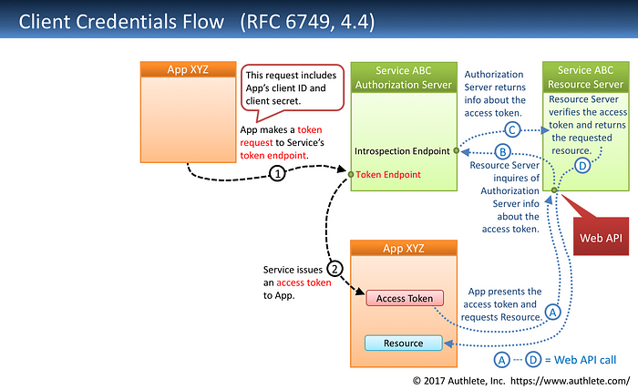
Notes:
https://darutk.medium.com/diagrams-and-movies-of-all-the-oauth-2-0-flows-194f3c3ade85

Slide 16
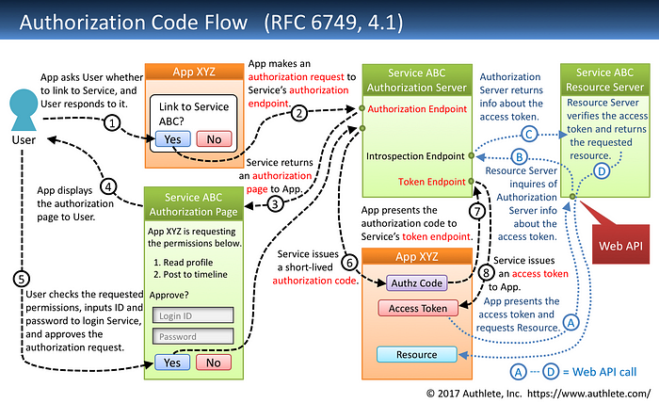
Notes:
https://darutk.medium.com/diagrams-and-movies-of-all-the-oauth-2-0-flows-194f3c3ade85

Slide 17
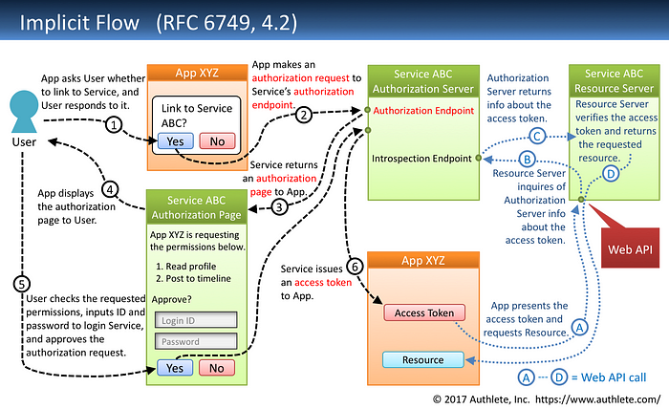
Notes:
https://darutk.medium.com/diagrams-and-movies-of-all-the-oauth-2-0-flows-194f3c3ade85

Slide 18
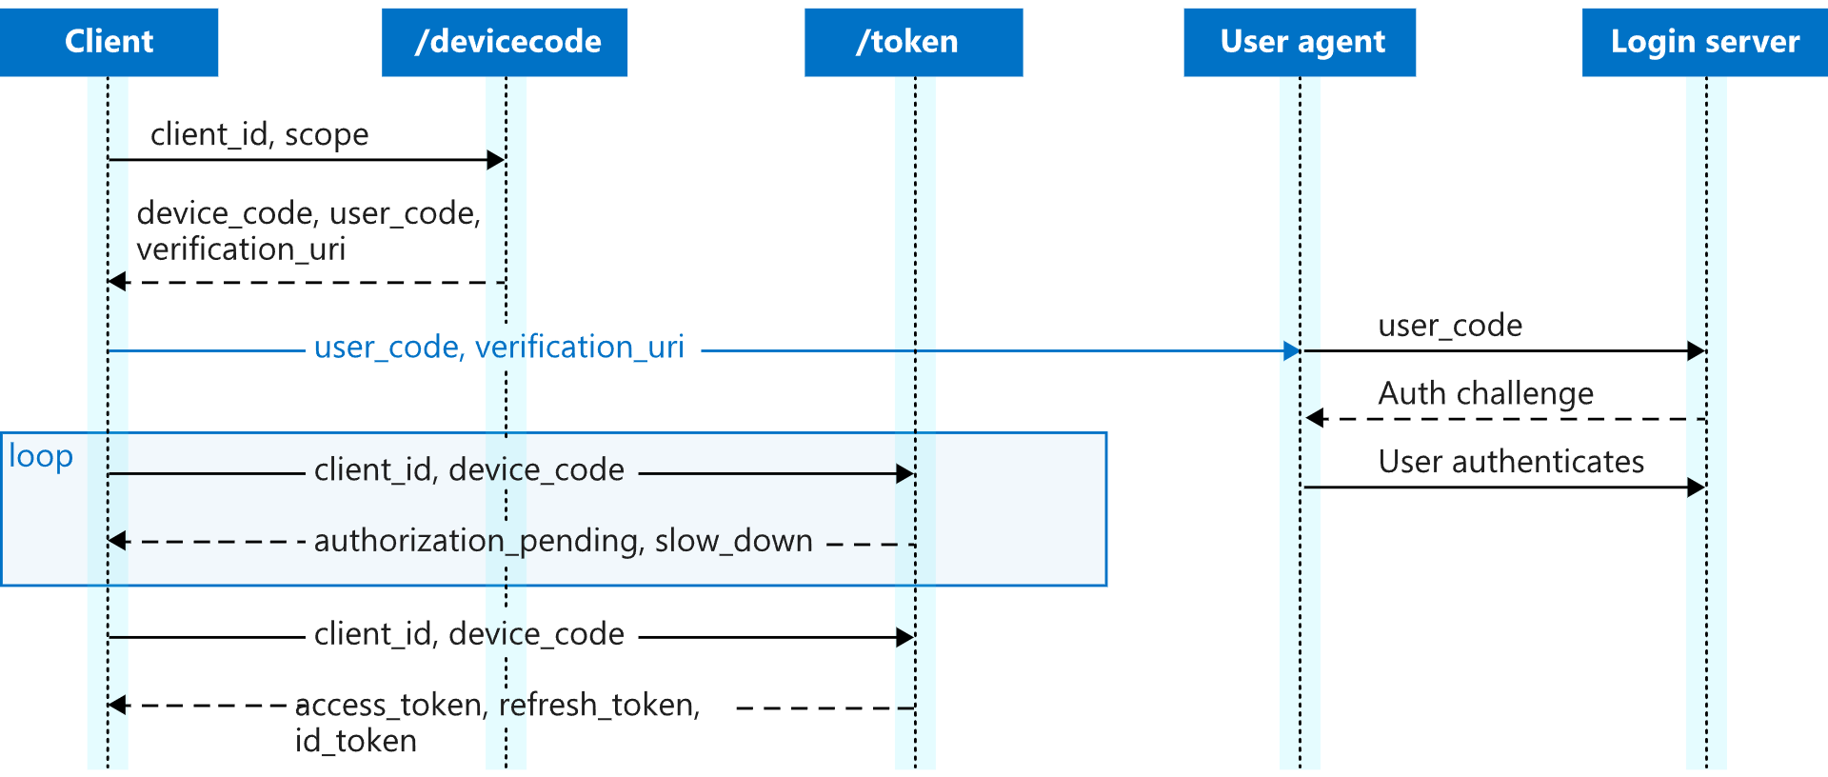
Device Code Flow
Notes:
https://learn.microsoft.com/en-us/azure/active-directory/develop/v2-oauth2-device-code

Slide 19
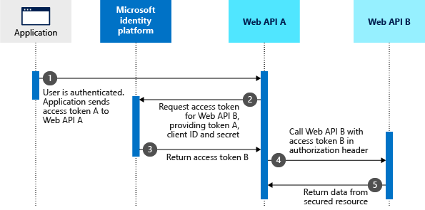
On-Behalf-Of (OBO) Flow

Slide 20
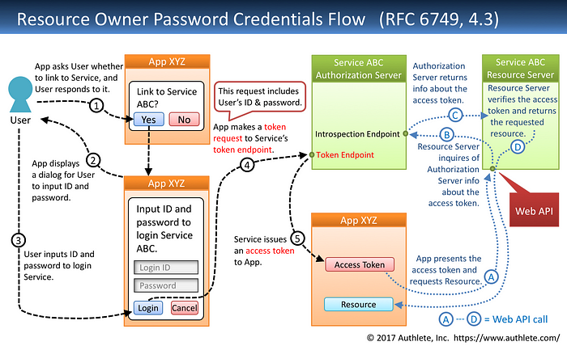
Notes:
https://darutk.medium.com/diagrams-and-movies-of-all-the-oauth-2-0-flows-194f3c3ade85

Slide 21
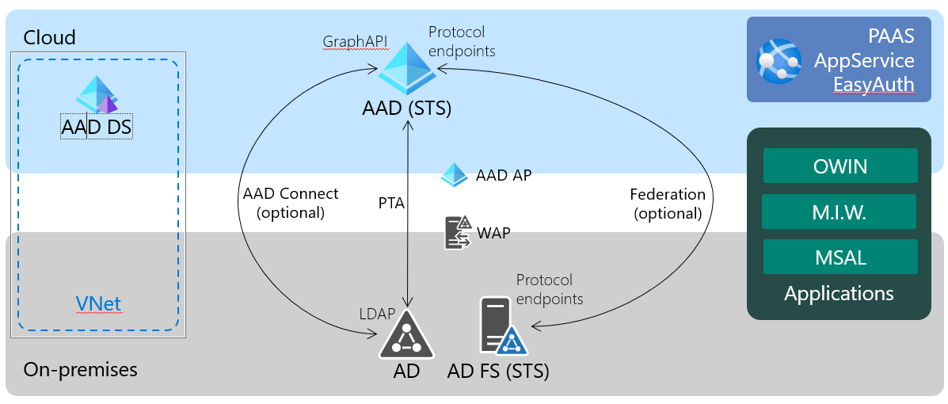
Entra ID

Slide 22
Tenant/Directory
AAD is a SaaS, multi-tenant, cloud service
A tenant may contain users from several domains
A tenant may reference users from other directories (B2B)
Always identified with:
xyz.onmicrosoft.com
a GUID
custom domain name(s)

Slide 23
AAD and applications
Configuration (App Registration)
Privileges
(Enterprise Apps)
Configure token issuance
Reply urls (for passive authentication)
Secrets
Exposed scopes
User roles
Visibility from other tenants
Operates on the Application entity
Creates both Application and Service Principal entities
Give permissions
Decide on access
Operates on Service Principal entities

Slide 24
Application Components
User Interface
Access token is sent to API-A
3
API-A
API-B validates token, extracts user information, and sends expected response
5
API-B
API-A uses on-behalf-of flow with secret to generate new access token
MSAL Redirects User to Authorization endpoint.
1
2
User logs on and AD sends ID/Access tokens
4
5
Access token with audience for API-B is created
Azure AD

Slide 25

Web Application Demo

