Slide 1
The Zappa Framework
Serverless Python Made Easier

Slide 2
Overview
Motivation
Simple example (Flask)
Serverless computing
Zappa
Memories Ninja
Using Django
Summary

Slide 3
Motivation
You have a small, stateless utility app
To do
  Write the code
  Provision a server
  Deploy the code
  Profit ($$$)

Slide 4
Motivation
You have a small, stateless utility app
To do
  Write the code
  Deploy the code
  Profit ($$$)

Slide 5
Motivation
Provision a server
  Spin up virtual machine
  Install and configure NGINX
  Upload code
  Install Python packages
  Configure and run WSGI server

Slide 6
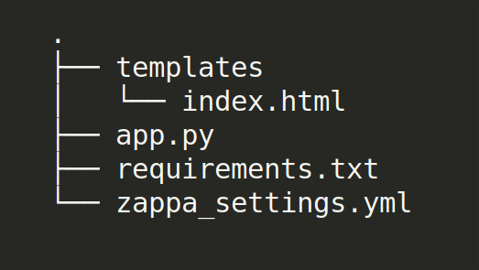
Simple example

Slide 7
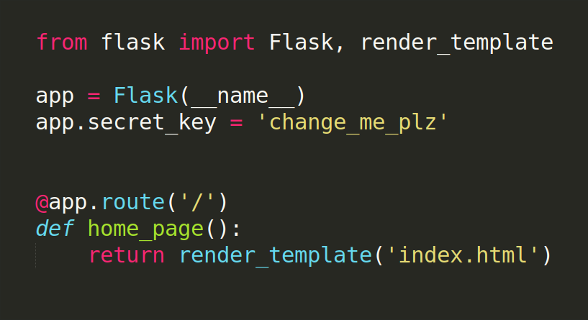
Simple example

Slide 8
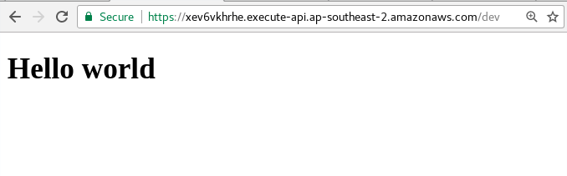
Simple example
>> pip install zappa
>> zappa init
>> zappa deploy dev
https://xev6vkhrhe.execute-api.ap-southeast-2.amazonaws.com/dev

Slide 9
Simple example
Lies and assumptions
  “zappa init” actually asks a few questions
  You have an AWS account
  You have AWS credentions configured
    ~/.aws/credentials

Slide 10



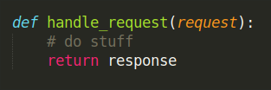
“Serverless” Computing
AWS API
Gateway

Slide 11

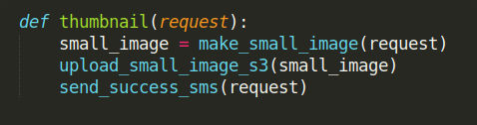

“Serverless” Computing
AWS S3
“original”
AWS S3
“small”
AWS SNS

Slide 12
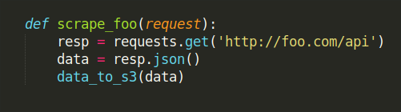

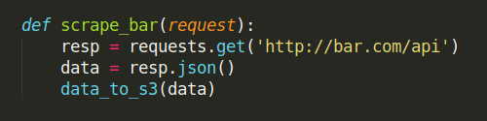
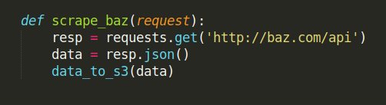
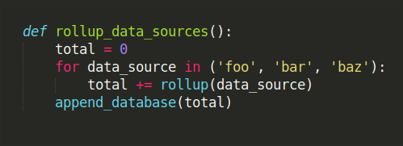
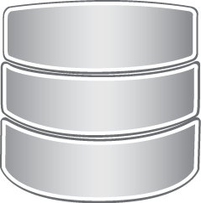
“Serverless” Computing
30 min
AWS S3
12 hours

Slide 13
“Serverless” Computing
Positives
  Pay per execution second
  No infrastructure maintenance
  Scaling handled by host
Use cases
  Handling irregular web traffic (NYT crossword)
  Small CPU bound tasks (image thumbnailing)
  Scheduled tasks (web scraping)

Slide 14
“Serverless” Computing
Negatives
  No persistent state
  Tricky debugging
  Execution time limit (~5m)
  “Cold” starts (5s startup, ~15 minutes “warm”)
  Resource limits
    128MB to ~1GB memory
    500MB disk space
    Concurrent execution (~1000)

Slide 15
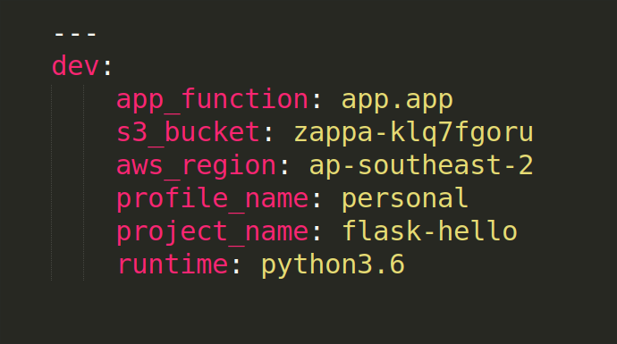
Zappa - Configuration
>> zappa init
# Generates zappa_settings.json (or .yml)

Slide 16
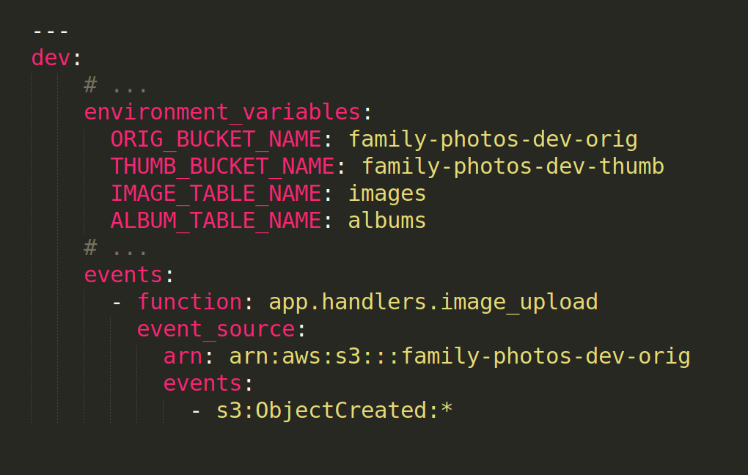
Zappa - Configuration
>> zappa init
# Generates zappa_settings.json (or .yml)

Slide 17
Zappa - Deployment
>> zappa deploy dev
>> zappa update dev
Packages code, templates, static into zip (~35MB)
Uploads zip to… “the cloud”?
Creates lambda functions, scheduled events, event handlers
Creates IAM roles and permissions
Creates API gateway endpoint
Creates a “keep warm” task
Total time ~5 minutes for minimal project

Slide 18
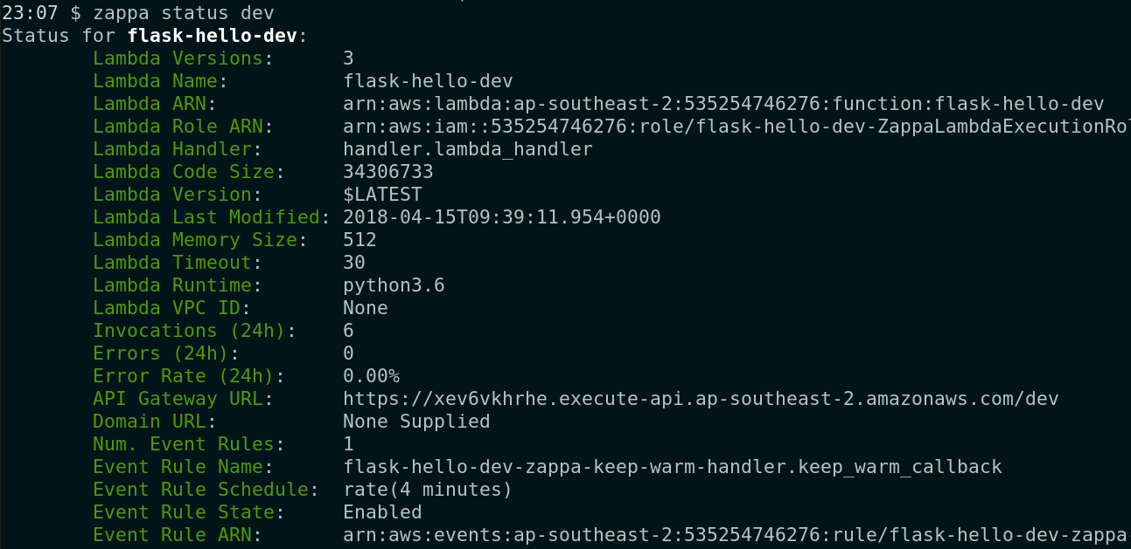
Zappa - Status

Slide 19
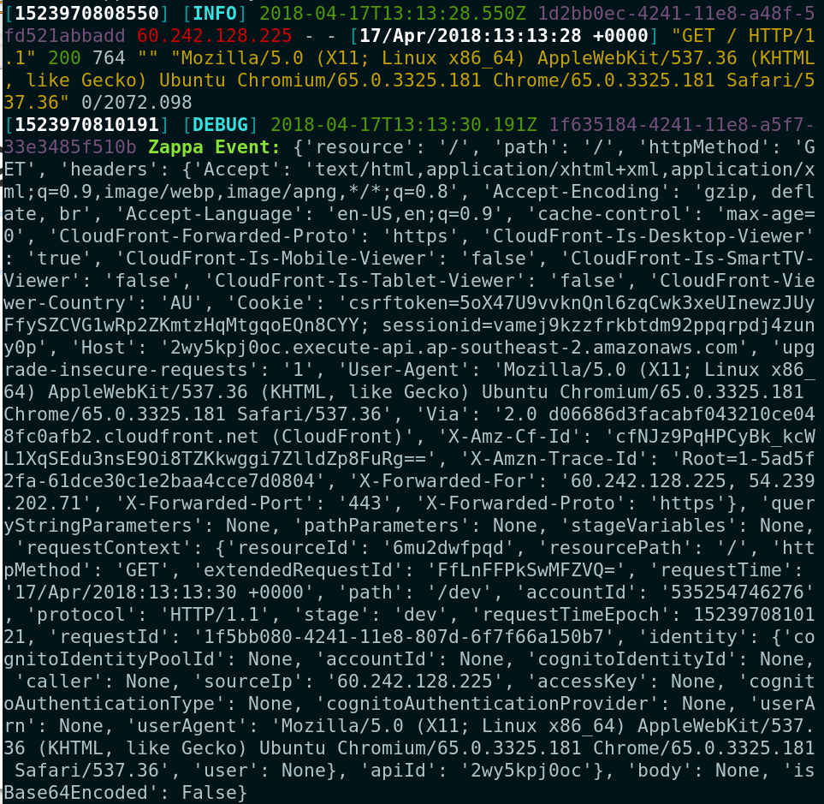
Zappa - Logging
>> zappa tail dev --since 1h
# Fetches CloudWatch logs, quite verbose

Slide 20
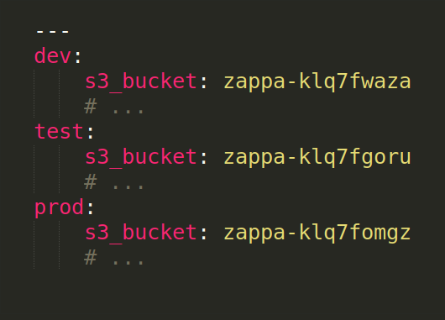
Zappa - Environments
Multiple environments by configuration
>> zappa update dev https://2wy5kpj0oc.execute-api.ap-southeast-2.amazonaws.com/dev
>> zappa update test https://2wy5kpj0oc.execute-api.ap-southeast-2.amazonaws.com/test
>> zappa update prod https://2wy5kpj0oc.execute-api.ap-southeast-2.amazonaws.com/prod

Slide 21
Zappa - Events
Event handlers defined in config
Scheduled tasks defined in config
Asynchronous execution using @task

Slide 22
Zappa – Lamba Packages
https://github.com/Miserlou/lambda-packages
Precompiled packages for lambda env.
Includes
  Psycopg2
  Numpy
  PIL
  OpenCV
  lxml

Slide 23
Zappa – Data storage
AWS S3
DynamoDB
Aurora serverless RDS
Database server
NoDB

Slide 24
Zappa – Not Discussed
Custom domain names
Secret management
Identity and Access Management (IAM)

Slide 25
Memories Ninja
https://memories.ninja
User can upload photos to albums
  Home page
  Album page
  Upload page
Photos upload directly to S3 from browser
Offline image thumbnailing
DynamoDB stores albums and image metadata

Slide 26
Django
https://2wy5kpj0oc.execute-api.ap-southeast-2.amazonaws.com/dev
Similar Zappa API to Flask
Some complications
  External database required
  Static files not bundled
  Management commands

Slide 27
Django – Static files
Static files are not automagically bundled
Use django-storages + AWS S3
>> zappa manage dev "collectstatic --noinput"

Slide 28
Django – manage.py
>> zappa manage dev "XXXX"
You can run management commands with no interactive stdin
Management commands that require stdin (createsuperuser) need to be worked around with various hacks
  echo stdin into a zappa command
  create custom command which requires no stdin
Django interactive shell is limited
  Local execution may be best method

Slide 29
Summary
Serverless has some valid, niche uses
Zappa provides a handy abstraction
Super easy to run small Flask apps
Django requires a little more effort
Don’t go delete all your VMs just yet

Slide 30
References
Zappa
  https://github.com/Miserlou/Zappa
Django Guide
  https://edgarroman.github.io/zappa-django-guide/
This talk
  https://github.com/MattSegal/zappa-talk

