Slide 1
Clearing the Air: Evaluating the Impact of Leaded Fuel Bans on Ambient Lead Levels at Reid-Hillview.

Slide 2
Clearing the Air
Evaluating the Impact of Leaded Fuel Bans on
Ambient Lead Levels at Reid-Hillview Airport
ECON62020
Group Project Presentation

Slide 3

Motivation & Research Question
WHY THIS MATTERS
RESEARCH QUESTION
Lead is a developmental neurotoxin with no safe exposure level (CDC, 2021).
Leaded avgas (100LL) is the largest remaining source of airborne Pb in the U.S. (EPA, 2022).
Reid-Hillview (RHV), San Jose, became the first U.S. GA airport to ban leaded fuel (Jan 2022).
Hollingsworth & Rudik (2021) showed Pb travels up to 4km from airports our radius choice.
Did the 2022 leaded-fuel ban at Reid-Hillview reduce ambient lead concentrations, relative to non-banning U.S. airports?
SUB-QUESTIONS
• Is the effect robust to monitor radius (1, 2, 3, 4 km)?

Slide 4
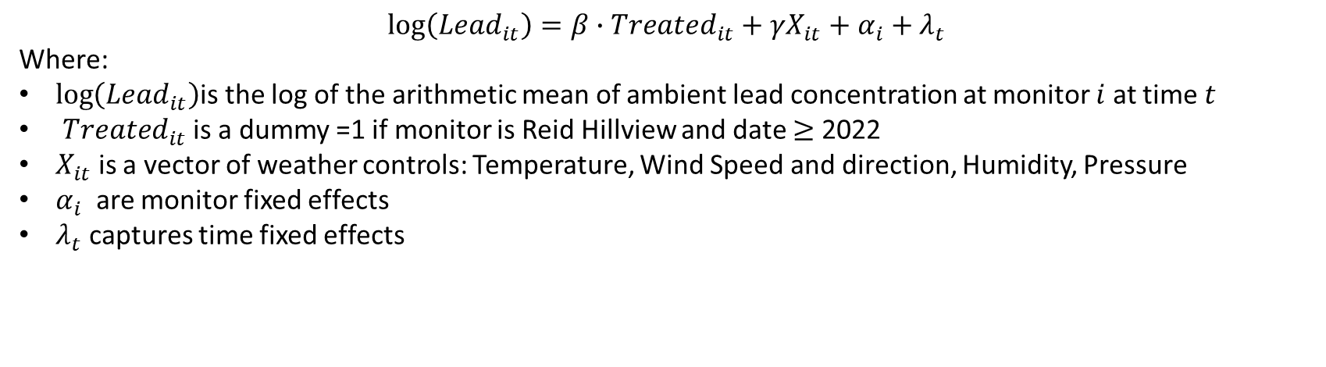
Data & Identification
OUTCOME
TREATMENT
CONTROLS
EPA AQS Pb
RHV ban (Jan 2022)
NCEP Reanalysis
Daily lead concentrations at U.S. monitors near airports. 2012–2025. Aggregated to monthly means.
Reid-Hillview. All other U.S. airports with monitor coverage form the pool of potential controls
Only 3 monitors within 1km of airports have continuous 2000–2025 data -> no clean control group.
Daily air temp, wind speed, humidity, pressure (sigma 995). Spatial join to monitors.
IDENTIFICATION STRATEGY
$$\log\left(Lead_{it}\right)=β∙Treated_{it}+γX_{it}+α_{i}+λ_{t}$$
Where:
$\log\left(Lead_{it}\right)$is the log of the arithmetic mean of ambient lead concentration at monitor $i$ at time $t$
$Treated_{it}$ is a dummy =1 if monitor is Reid Hillview and date $≥$ 2022
$X_{it}$ is a vector of weather controls: Temperature, Wind Speed and direction, Humidity, Pressure
$α_{i}$ are monitor fixed effects
$λ_{t}$ captures time fixed effects

Slide 5
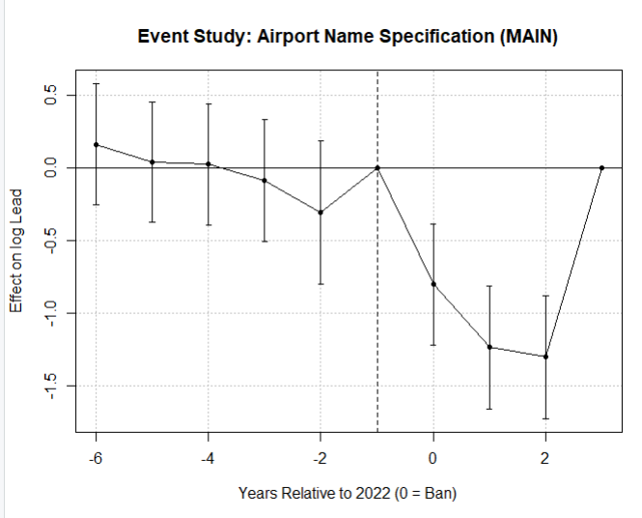
Results
Specification | Estimate | Number of Controls
Airports only
Note: 0-1km refers to the specification for which only monitors within a 1km radius of an airport were used in the control group

Slide 6
Robustness, Takeaways & Q&A
ROBUSTNESS — RADIUS SENSITIVITY
TAKEAWAYS
Method that fits the data
Specification | Estimate | Number of Controls
Airports only
0-1 km
0-2 km
0-3 km
0-4 km
5+ km
……
First evidence on a 100LL ban
Quantifies what a real-world leaded-fuel ban delivers in ambient Pb — informing FAA’s 2030 phase-out.
Honest about scope
…...
Any Questions?

