Slide 1
Foundations of R for Bioinformatics
Dr Matthew Taylor
Institute of Cancer and Genomic Sciences
College of Medicine and Health
m.taylor.1@bham.ac.uk
Attendance code: 44820884
Notes:
QR code is a link to pre-course survey – should take 1 minute to complete.

Slide 2
Course structure
Session | Date | Topic
1 | 12/11/2026, 3-5pm | Introduction to R and the tidyverse
2 | 19/11/2026, 3-5pm | The tidyverse continued: data wrangling
3 | 26/11/2026, 2-5pm | Putting it all together: analysis of RNAseq data with DESeq2
Attendance code: 44820884
Notes:
Note the different start time of the last session – that one is scheduled for 3 hours because we have more to cover (but hopefully we won’t need the full 3 hours!).

Slide 3
Initial setup
Please use the cluster PCs for this session.
At the beginning of the session, open AppsAnywhere and search for RStudio, then run it.
Download the files you need for today from Canvas – should be under Week 7 of modules, the file is called “Session_1.zip”
Extract this zip file by right clicking on it and selecting Extract and accept the default settings.
In RStudio, select File - open project - and select Session_1.Rproj in the extracted folder. Wait for RStudio to load the project.
Then select File - open file - and open Session_1_2026.qmd
Attendance code: 44820884

Slide 4
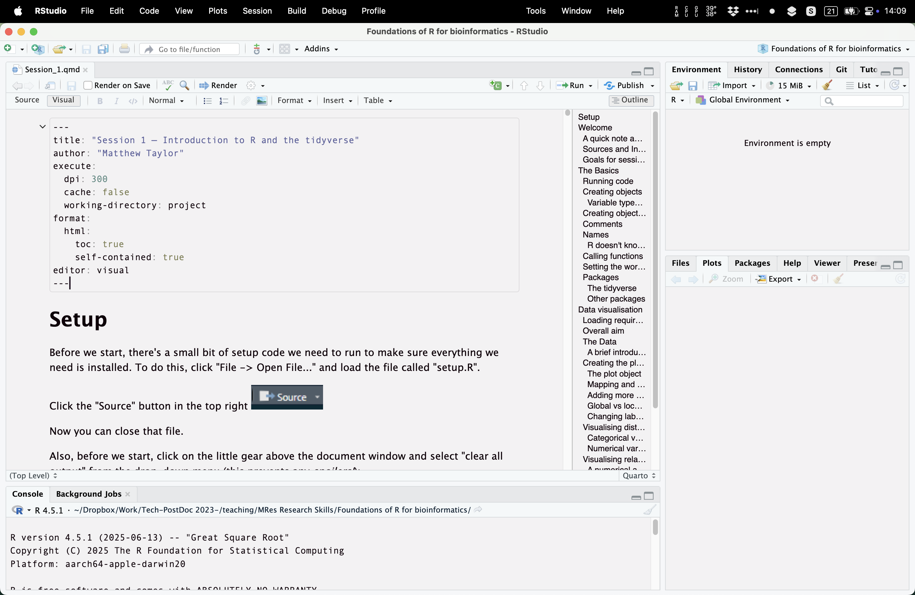
You should then see something like this
Attendance code: 44820884

Slide 5



Some definitions…
R is a programming language for data analysis, statistics, visualisation…although you can really do any programming you want with it.
RStudio is an IDE (Integrated Development Environment) for R—basically a more user-friendly way of accessing the R language in a more familiar graphical user interface (GUI).
Quarto is a tool (built into RStudio) for creating reproducible documents that combine text, code, and output—letting you turn your R analyses into polished reports all in one place.

Slide 6
Why even use R?
Modern biology runs on big data — RNA-seq, proteomics, imaging, single-cell, behaviour tracking… datasets are now too large and complex for manual analysis.
Tools like Excel and GraphPad Prism hit a ceiling — great for small datasets, less good for big data.
R is built for bioinformatics — most cutting-edge methods (DESeq2, Seurat, limma-voom, clusterProfiler, tidybulk, etc.) are developed first and only for R.
Write once, reuse forever — the same script can analyse 5 samples or 500 with no additional effort, and can be reused for different experiments
Highly valued in careers — employers increasingly expect computational skills; knowing R shows analytical ability even outside of academia.
Notes:
And this last one is becoming increasingly relevant e.g., see next slide

Slide 7
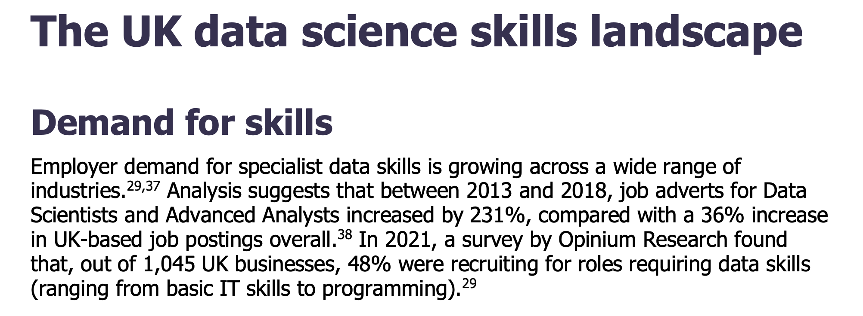
From “UK Parliament Postnote: Data Science skills in the UK workforce”. Josh Fearns, Lydia Harriss, Clare Lally. June 2023

Slide 8
Can’t I just ask ChatGPT (or other AI tool)?
Yes*
* LLMs like ChatGPT can be useful for coding, particularly troubleshooting errors.
* Quality of input = quality of output (if you don’t know what to prompt, you won’t get anything decent out)
* If you don’t understand the code it puts out, how do you know it is doing what you asked for?
Sometimes it’s best to just ask an actual person for help (from a specialist, bioinformatician, or online forums/tutorials etc). But without knowing the basics, it can be difficult to know what to even ask.
Notes:
Had a student who was using ChatGPT to help with bioinformatics. Didn’t realise in the code that it was simulating data as an example and it expected her to edit to use her own data. She didn’t realise this, but would have done if she knew what the code meant.
Imagine you are an author and you have a top selling book. A publisher approaches you asking if you want to publish a translation in a different language. What do you do? Maybe if you know the language, you do it yourself. Maybe you save time and use Google translate. Do you trust that it will be error-free? What if you look through the translation and you realise (even maybe from your weak language skills) that there is an error – how does that then make you feel about the rest of the translation?
The point of this is to illustrate that sometimes it’s best to ask an actual person for help (a translator, or in our case, a bioinformatician). But without even knowing some of the basics it can be difficult to know what to even ask.

Slide 9
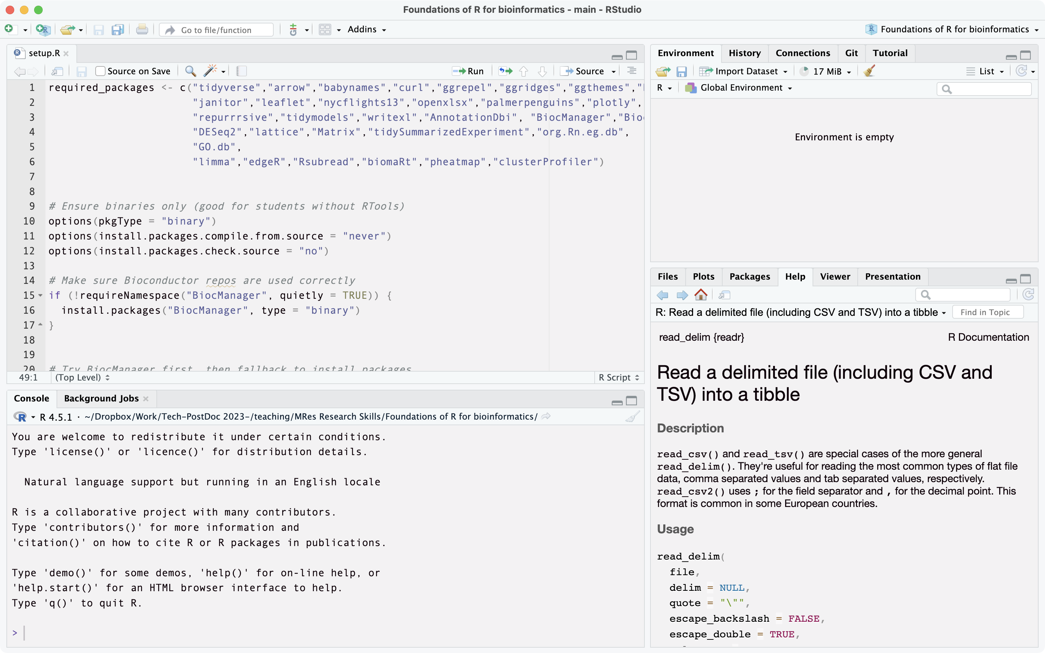
The RStudio interface
Environment / History Pane—Displays your objects, variables, and data frames currently in memory, and a history of commands you’ve run.
Tabs to select scripts/data frames currently loaded
Source (Script/Editor) Pane—Where you write, edit, and save your R scripts or Quarto documents.
Viewer pane—currently showing Help page but can also be used to preview plots and file tree
Console—where code is run and output appears. Can type code in here manually and press Enter to run; or run from a script in the window above.

Slide 10
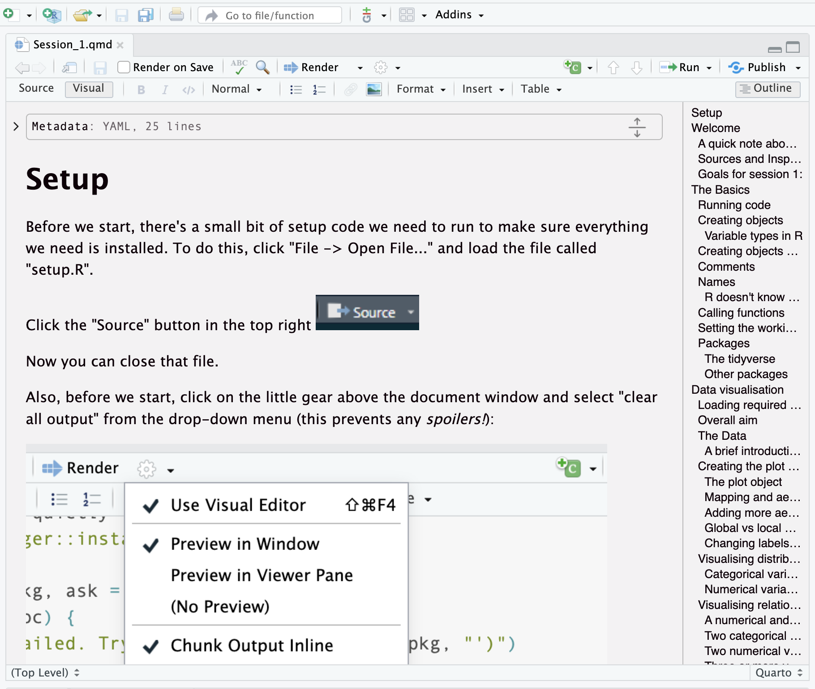
Quarto documents
Tool for inserting code chunk
YAML header—beyond the scope of this course but where you can set rendering and code execution options. Can be hidden or expanded with the little arrow.
To render into a document (e.g., HTML, PDF, word) to use e.g., as a report
Option to select between Source (markdown format) and Visual (more familiar) editor.
Outline to navigate to subsections quickly
Visual editor pane for writing text and inserting code
Example code chunk—can be run by clicking the green arrow.

Slide 11
Format of this course
This course is not directly assessed – it is just to give you some tools which will help you with your future research.
Everything I will cover is contained within the Quarto doc, so if you are more confident with coding or are someone who learns by reading, you are free to read that doc and work at your own pace!
I will also be live coding as we go, and I encourage you to follow along with this and write the code in a new document. I will try not to type too fast although you all probably type faster than me anyway…!
At points throughout the session, I will give you some time to try the exercises in the document and then go through the answers with you.
We have some excellent demonstrators who are happy to help if you get stuck with anything ☺

Slide 12
Learning outcomes
By the end of this session, you will:
Be comfortable with RStudio, Quarto, and running code
Be familiar with the fundamentals of R: objects, variable types, vectors, functions, and packages
Know how to find help for any function
Load a real dataset into R and describe what is in it
Create five figures from real RNAseq results using ggplot2

