Slide 1
CSC529 Advanced Data Mining
Lecture 4
Ensemble Learning

Slide 2
Outline
Ensemble Learning: General Ideas
Methods for independently constructed ensembles
    Bootstrap Sampling
    Bagging
    Random Infusion (Random forests and random spaces)
    Rotation Forests
Methods for coordinated constructed ensembles
  Boosting
  Stacking

Slide 3
Ensemble Learning
So far – learning methods that learn a single hypothesis, chosen from a hypothesis space that is used to make predictions.
Ensemble learning → select a collection (ensemble) of hypotheses and combine their predictions.
Example 1 - generate 100 different decision trees from the same or different training set and have them vote on the best classification for a new example.
Key motivation: reduce the error rate. Hope is that it will become much more unlikely that the ensemble will misclassify an example.

Slide 4
Ensemble Learning
Learn multiple alternative definitions of a concept using different training data or different learning algorithms.
Combine decisions of multiple definitions, e.g. using weighted voting.
Training Data
⋅ ⋅ ⋅ ⋅ ⋅ ⋅ ⋅ ⋅
Data1
Data2
Data m
⋅ ⋅ ⋅ ⋅ ⋅ ⋅ ⋅ ⋅
Learner m
Learner1
Learner2
⋅ ⋅ ⋅ ⋅ ⋅ ⋅ ⋅ ⋅
Model1
Model2
Model m
Model Combiner
Final Model
Source: Ray Mooney

Slide 5
Value of Ensembles
“No Free Lunch” Theorem
  No single algorithm wins all the time!
When combing multiple independent and diverse decisions each of which is at least more accurate than random guessing, random errors cancel each other out, correct decisions are reinforced.
Examples: Human ensembles are demonstrably better
  How many jelly beans in the jar?: Individual estimates vs. group average.
Source: Ray Mooney

Slide 6


Example: Weather Forecast
Reality
1
2
3
4
5
Combine
X
X
X
X
X
X
X
X
X
X
X
X
X

Slide 7

Intuitions
Majority vote
Suppose we have 5 completely independent classifiers…
  If accuracy is 70% for each
    (.7⁵)+5(.7⁴)(.3)+ 10 (.7³)(.3²)
    83.7% majority vote accuracy
  101 such classifiers
    99.9% majority vote accuracy
Note: Binomial Distribution: The probability of observing x heads in a sample of n independent coin tosses,
where in each toss the probability of heads is p, is

Slide 8
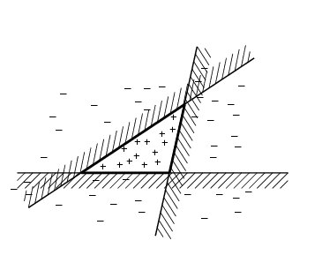
Ensemble Learning
Another way of thinking about ensemble learning:
→ way of enlarging the hypothesis space, i.e., the ensemble itself is a hypothesis and the new hypothesis space is the set of all possible ensembles constructible from hypotheses of the original space.
Increasing power of ensemble learning:
Three linear threshold hypothesis
(positive examples on the non-shaded side);
Ensemble classifies as positive any example classified
positively be all three. The resulting triangular region hypothesis is not expressible in the original hypothesis space.

Slide 9
Why Do Ensembles Work?
Dietterich(2002) showed that ensembles overcome three problems:
The Statistical Problem arises when the hypothesis space is too large for the amount of available data. Hence, there are many hypotheses with the same accuracy on the data and the learning algorithm chooses only one of them! There is a risk that the accuracy of the chosen hypothesis is low on unseen data!
The Computational Problem arises when the learning algorithm cannot guarantee finding the best hypothesis.
The Representational Problem arises when the hypothesis space does not contain any good approximation of the target class(es).
T.G. Dietterich, Ensemble Learning, 2002.

Slide 10
Bias-variance Decomposition
Theoretical tool for analyzing how much specific training set affects performance of a classifier
  Total expected error: bias + variance
  The bias of a classifier is the expected error of the classifier due to the fact that the classifier is not perfect
    The bias is error from erroneous assumptions in the learning algorithm. High bias can cause an algorithm to miss the relevant relations between features and target outputs (underfitting).
  The variance of a classifier is the expected error due to the particular training set used.
    The variance is error from sensitivity to small fluctuations in the training set. High variance can cause overfitting: modeling the random noise in the training data, rather than the intended outputs.

Slide 11
Different Learners
Different learning algorithms
Algorithms with different choice for parameters
Data set with different features
Data set = different subsets

Slide 12
Homogenous Ensembles
Use a single, arbitrary learning algorithm but manipulate training data to make it learn multiple models.
  Data1 ≠ Data2 ≠ … ≠ Data m
  LearnerType1 = LearnerType2 = … = LearnerType m
Different methods for changing training data:
  Bagging: Resample training data
  Boosting: Reweight training data
In WEKA, these are called meta-learners, they take a learning algorithm as an argument (base learner) and create a new learning algorithm.

Slide 13
Categories of Ensemble Learning
Methods for Independent Construction of Ensembles
  Bagging
  Randomness Injection
  Feature-Selection Ensembles
Methods for Coordinated Construction of Ensembles
  Boosting
  Stacking

Slide 14
Methods for Independently Constructing Ensembles
One way to force a learning algorithm to construct multiple hypotheses is to run the algorithm several times and provide it with somewhat different data in each run. This idea is used in the following methods:
Bagging
Randomness Injection
Feature-Selection Ensembles

Slide 15
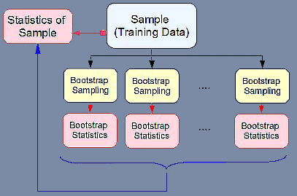
What is Bootstrap (sampling)?
Bootstrap is sampling with replacement from a sample.
The name may come from phrase “pull up by your own bootstraps” which means ‘rely on your own resources’

Slide 16
Bagging Diagram (Bootstrap Aggregration)
ML
Random sample
with replacement
f₁
Voting (for classification)
ML
f₂
f
Averaging (for regression)
ML
Random sample
with replacement
f_{T}
Bagging is only effective when using unstable (i.e. a small change in the training set can cause a significant change in the model) nonlinear models

Slide 17
Algorithm: Bagging - Aggregate Bootstrapping
Given a standard training set D of size n
For i = 1 .. M
  Draw a sample of size n*<n from D uniformly and with replacement
  Learn classifier C_{i}
Final classifier is a vote of C₁ .. C_{M}
Increases classifier stability/reduces variance

Slide 18
Bagging Summary
Create ensembles by “bootstrap aggregation”, i.e., repeatedly randomly resampling the training data (Brieman, 1996).
Bootstrap: draw N items from X with replacement
Bagging
  Train M learners on M bootstrap samples
  Combine outputs by voting (e.g., majority vote)
Decreases error by decreasing the variance in the results due to unstable learners, algorithms (like decision trees and neural networks) whose output can change dramatically when the training data is slightly changed.

Slide 19
Why does bagging work?
Bagging reduces variance by voting/ averaging, thus reducing the overall expected error
  In the case of classification there are pathological situations where the overall error might increase
  Usually, the more classifiers the better

Slide 20
Randomization Injection
Inject some randomization into a standard learning algorithm (usually easy):
  Neural network: random initial weights
  Decision tree: when splitting, choose one of the top N attributes at random (uniformly)
Dietterich (2000) showed that 200 randomized trees are statistically significantly better than C4.5 for over 33 datasets!

Slide 21
Random Forests Definition
Random forest (or random forests) is an ensemble classifier that consists of many decision trees and outputs the class that is the mode of the class's output by individual trees.
The term came from random decision forests that was first proposed by Tin Kam Ho of Bell Labs in 1995.
The method combines Breiman's "bagging" idea and the random selection of features.

Slide 22
Algorithm
Each tree is constructed using the following algorithm:
  Let the number of training cases be N, and the number of variables in the classifier be M.
  We are told the number m of input variables to be used to determine the decision at a node of the tree; m should be much less than M.
  Choose a training set for this tree by choosing n times with replacement from all N available training cases (i.e. take a bootstrap sample). Use the rest of the cases to estimate the error of the tree, by predicting their classes.
  For each node of the tree, randomly choose m variables on which to base the decision at that node. Calculate the best split based on these m variables in the training set.
  Each tree is fully grown and not pruned (as may be done in constructing a normal tree classifier).
For prediction a new sample is pushed down the tree. It is assigned the label of the training sample in the terminal node it ends up in. This procedure is iterated over all trees in the ensemble, and the average vote of all trees is reported as random forest prediction.

Slide 23
Random Forest – practical consideration
Splits are chosen according to a purity measure:
    E.g. Gini index
How to select n =# of classifiers?
  Build trees until the error no longer decreases
How to select m?
  Start with m=sqrt(M) and then vary m around this initial value.

Slide 24
Features of Random Forests
It is unexcelled in accuracy among current algorithms.
It runs efficiently on large data bases.
It can handle thousands of input variables without variable deletion.
It gives estimates of what variables are important in the classification.
More about Random Forests at:
http://oz.berkeley.edu/~breiman/randomforest2001.pdf

Slide 25
Feature-Selection Ensembles
(Random Subspace Method)
Key idea: Provide a different subset of the input features in each call of the learning algorithm.
Example: Venus&Cherkauer (1996) trained an ensemble with 32 neural networks. The 32 networks were based on 8 different subsets of 119 available features and 4 different algorithms. The ensemble was significantly better than any of the neural networks!

Slide 26
Rotation forests
Bagging creates ensembles of accurate classifiers with relatively low diversity
  Bootstrap sampling creates training sets with a distribution that resembles the original data
Randomness in the learning algorithm increases diversity but sacrifices accuracy of individual ensemble members
Rotation forests have the goal of creating accurate and diverse ensemble members
Data Mining: Practical Machine Learning Tools and Techniques (Chapter 8)

Slide 27
Rotation forests
Combine random attribute sets, bagging and principal components to generate an ensemble of decision trees
An iteration involves
  Randomly dividing the input attributes into k disjoint subsets
  Applying PCA to each of the k subsets in turn
  Learning a decision tree from the k sets of PCA directions
Further increases in diversity can be achieved by creating a bootstrap sample in each iteration before applying PCA
Data Mining: Practical Machine Learning Tools and Techniques (Chapter 8)

Slide 28
Rotation forests
More on rotation forests:
J.J. Rodriguez, L.I Kuncheva, and C.J. Alonso, “Rotation Forest: A New Classifier Ensemble Method,” IEEE Transactions on Pattern Analysis and Machine Intelligence, vol. 28, no. 10, pp. 1619-1630, Oct. 2006
http://www.ncbi.nlm.nih.gov/pubmed/16986543
(paper also posted under the course documents for week 4).
Data Mining: Practical Machine Learning Tools and Techniques (Chapter 8)

Slide 29
Methods for Coordinated Construction of Ensembles
The key idea is to learn complementary classifiers so that instance classification is realized by taking a weighted sum of the classifiers. This idea is used in following methods:
  Boosting
  Stacking.

Slide 30

Inefficiency with Bagging
Bagging
Inefficiency with bootstrap sampling:
  Every example has equal chance to be sampled
  No distinction between “easy” examples and “difficult” examples
D
Bootstrap Sampling
D¹
D²
D^{k}
…
h₁
h₂
h_{k}
Inefficiency with model combination
  A constant weight for each classifier
  No distinction between accurate classifiers and inaccurate classifiers

Slide 31
Improve the Efficiency of Bagging
Better sampling strategy
  Focus on the examples that are difficult to classify correctly
Better combination strategy
  Accurate model should be assigned with more weights

Slide 32
Overview of Boosting
“Boosting”: convert a weak learning algorithm into a strong one.
  Strong Learner →Objective of machine learning
    Take labeled data for training
    Produce a classifier which can be arbitrarily accurate
  Weak Learner
    Take labeled data for training
    Produce a classifier which is more accurate than random guessing (i.e., < 50% error over any distribution)
Main idea: Combine many weak classifiers to produce a powerful committee.

Slide 33
Boosting Algorithms
Originally developed by computational learning theorists to guarantee performance improvements on fitting training data for a weak learner that only needs to generate a hypothesis with a training accuracy greater than 0.5 (Schapire, 1990).
Revised to be a practical algorithm, AdaBoost, for building ensembles that empirically improves generalization performance (Freund & Shapire, 1996).
Other Boosting Algorithms:
  Gentle AdaBoost
  BrownBoost
  …

Slide 34
Boosting: Key insights
Iterative procedure: new models are influenced by performance of previously built ones
  New model is encouraged to become expert for instances classified incorrectly by earlier models
  Intuitive justification: models should be experts that complement each other
Instead of sampling (as in bagging) re-weigh examples! At each iteration, a new hypothesis is learned (weak learner) and the examples are reweighted to focus the system on examples that the most recently learned classifier got wrong.
Final classification based on weighted vote of weak classifiers

Slide 35
Boosting Diagram
ML
Training Sample
f₁
ML
Weighted Sample
f₂
f
…
ML
Weighted Sample
f_{T}
Boosting: Use the same sample with different weights to generate classifiers
Bagging: Use different samples with identical weights to generate classifiers

Slide 36

Intuition of Boosting
Train a set of weak hypotheses: h₁, …., h_{T}.
The combined hypothesis H is a weighted majority vote of the T weak hypotheses.
  Each hypothesis h_{t} has a weight α_{t}.
During the training, focus on the examples that are misclassified.
  ➔ At round t, example x_{i} has the weight D_{t}(i).

Slide 37
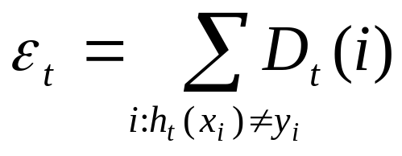
Basic Setting
Binary classification problem
Training data:
D_{t}(i): the weight of x_{i} at round t. D₁(i)=1/m.
A learner L that finds a weak hypothesis h_{t}: X ➔ Y given the training set and D_{t}
The error of a weak hypothesis h_{t}:

Slide 38
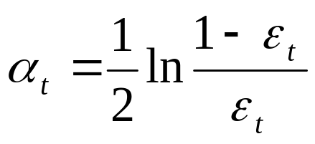
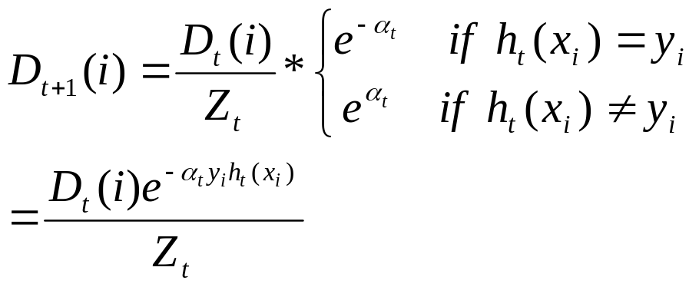
The Basic AdaBoost Algorithm
For t=1, …, T
Train weak learner using training data and D_{t}
Get ht: X ➔ {-1,1} with error
Choose
Update

Slide 39
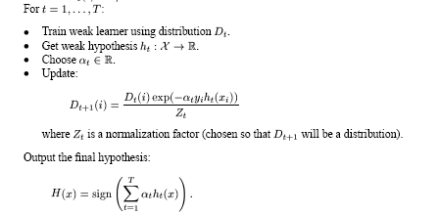
The general AdaBoost algorithm

Slide 40
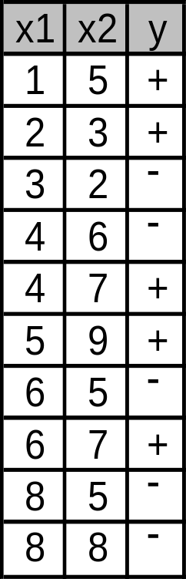
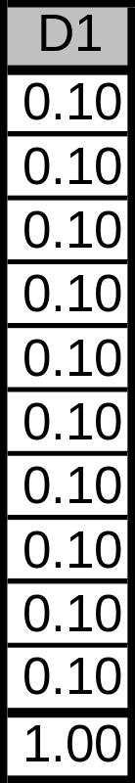
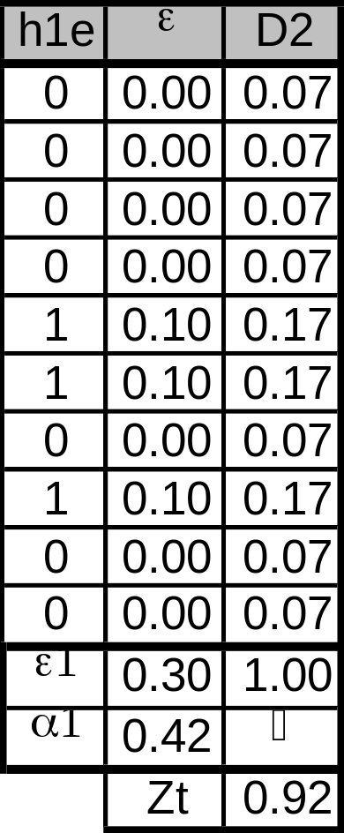
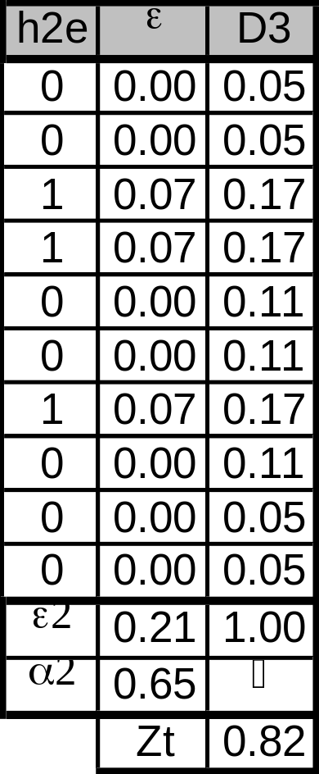
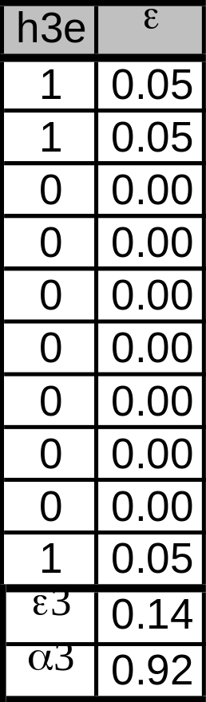
AdaBoost Example
Train data
Round 1
Round 2
Round 3
Initialization

Slide 41
Remarks on Boosting
Boosting can be applied without weights using re-sampling with probability determined by weights;
Boosting decreases exponentially the training error in the number of iterations;
Boosting works well if base classifiers are not too complex and their error doesn’t become too large too quickly!

Slide 42
Strengths of AdaBoost
It has no parameters to tune (except for the number of rounds)
It is fast, simple and easy to program (??)
It comes with a set of theoretical guarantee (e.g., training error, test error)
Instead of trying to design a learning algorithm that is accurate over the entire space, we can focus on finding base learning algorithms that only need to be better than random.
It can identify outliners: i.e. examples that are either mislabeled or that are inherently ambiguous and hard to categorize.

Slide 43
Weakness of AdaBoost
The actual performance of boosting depends on the data and the base learner.
Boosting seems to be especially susceptible to noise.
When the number of outliners is very large, the emphasis placed on the hard examples can hurt the performance.
➔ “Gentle AdaBoost”, “BrownBoost”

Slide 44
Comparison of Bagging and Boosting
Bagging always uses resampling rather than reweighting.
Bagging does not modify the distribution over examples or mislabels, but instead always uses the uniform distribution
In forming the final hypothesis, bagging gives equal weight to each of the weak hypotheses

Slide 45
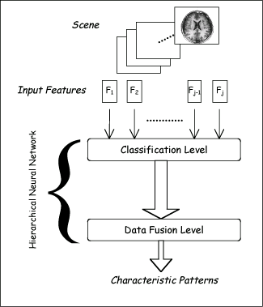
Stacking
Uses meta learner instead of voting to combine predictions of base learners
  Predictions of base learners (level-0 models) are used as input for meta learner (level-1 model)
Base learners usually different learning schemes
Hard to analyze theoretically: “black magic”
Hierarchical Neural Networks

Slide 46
Stacking
BC₁
0
BC₂
1
instance₁
BC_{n}
1
BC₁
BC₂
…
BC_{n}
Class
meta instances
instance₁
0
1
1
1

Slide 47
Stacking
BC₁
1
BC₂
0
instance₂
BC_{n}
0
BC₁
BC₂
…
BC_{n}
Class
meta instances
instance₁
0
1
1
1
instance₂
1
0
0
0

Slide 48
Stacking
Meta Classifier
BC₁
BC₂
…
BC_{n}
Class
meta instances
instance₁
0
1
1
1
instance₂
1
0
0
0

Slide 49
Stacking
BC₁
0
1
BC₂
1
instance
Meta Classifier
BC_{n}
1
BC₁
BC₂
…
BC_{n}
meta instance
instance
0
1
1

Slide 50
More on stacking
Predictions on training data can’t be used to generate data for level-1 model! The reason is that the level-0 classifier that better fit training data will be chosen by the level-1 model! Thus,
k-fold cross-validation-like scheme is employed! An example for k = 3!
train
train
test
train
test
train
test
train
train
Meta Data
test
test
test

Slide 51
More on stacking
If base learners can output probabilities it’s better to use those as input to meta learner
Which algorithm to use to generate meta learner?
  In principle, any learning scheme can be applied
  David Wolpert: “relatively global, smooth” model
    Base learners do most of the work
    Reduces risk of overfitting

Slide 52
Summary & practical advises
If the classifier is unstable (i.e, decision trees) then apply bagging!
If the classifier is stable and simple (e.g. Naïve Bayes) then apply boosting!
If the classifier is stable and complex (e.g. Neural Network) then apply randomization injection!
Boosting combines many weak classifiers to produce a powerful committee.
It comes with a set of theoretical guarantee (e.g., training error, test error)
It performs well on many tasks.

Slide 53
Ensembles of classifiers in Matlab
Examples of Matlab for ensemble of classifiers:
http://www.mathworks.com/help/stats/ensemble-methods.html#br0g6t1-1
Fitensemble.m function documentation
http://www.mathworks.com/help/stats/fitensemble.html

Slide 54
Readings from the Optional Textbooks
The Elements of Statistical Learning: Data Mining, Inference, and Prediction by Hastie, Tibshirani, Friedman
  Chapters 15 & 16
Data Mining: Practical Machine Learning Tools and Techniques by Witten, Frank, and Hall
  Chapter 8

Slide 55
Slides Credits
Slides in this presentation is partially based on the work of
  Jianjun Hu (University of South California)
  Rong Jin (Michigan State University)
  Yaochu Jin (Future Technology Research
  Honda R&D Europe (Germany)
  Evgueni Smirnov (www.cs.unimaas.nl/smirnov)
  Witten’s Data Mining textbook

