Slide 1
CSC529 Advanced Data Mining
Lectures 5 & 6
Ensemble Learning (cont.)

Slide 2
Outline
Ensemble Learning: General Ideas
Methods for independently constructed ensembles
    Bootstrap Sampling
    Bagging
    Random Infusion (Random forests and random spaces)
    Rotation Forests
Methods for coordinated constructed ensembles
  Boosting
  Stacking

Slide 3
Methods for Coordinated Construction of Ensembles
The key idea is to learn complementary classifiers so that instance classification is realized by taking a weighted sum of the classifiers. This idea is used in following methods:
  Boosting
  Stacking.

Slide 4
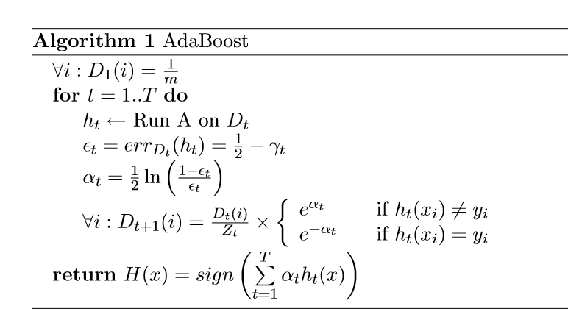
Adaptive Boosting (AdaBoost) Algorithm
Where h_{t} : D_{t} R is a weak classifier better than random classifier
Z_{t} calculated such that D_{t+1} is a probability distribution

Slide 5
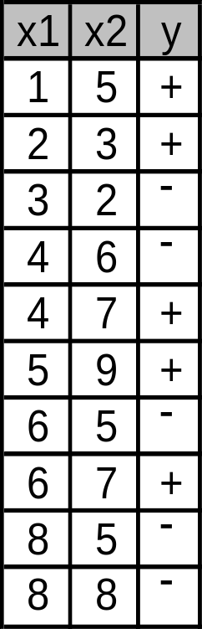
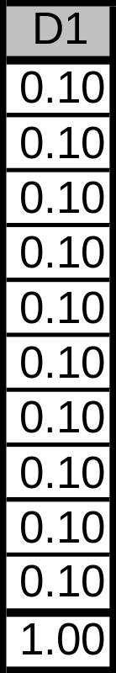
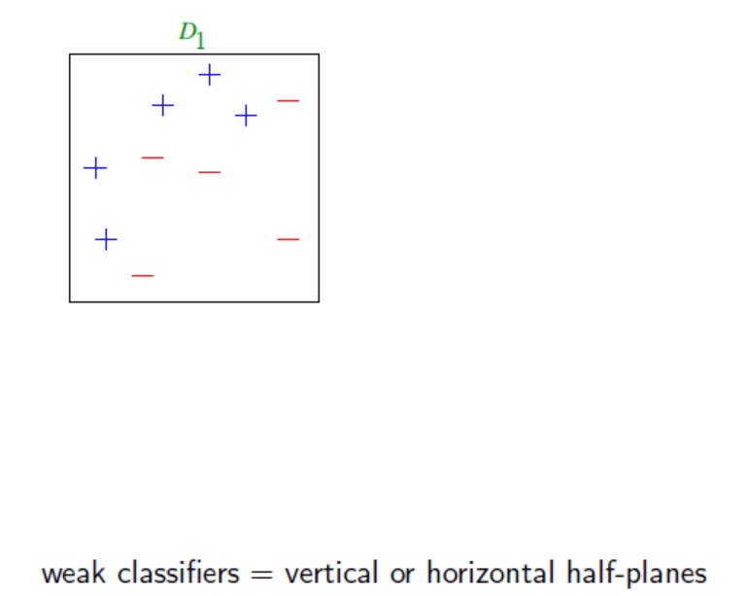
Toy example
Train data
Initialization

Slide 6
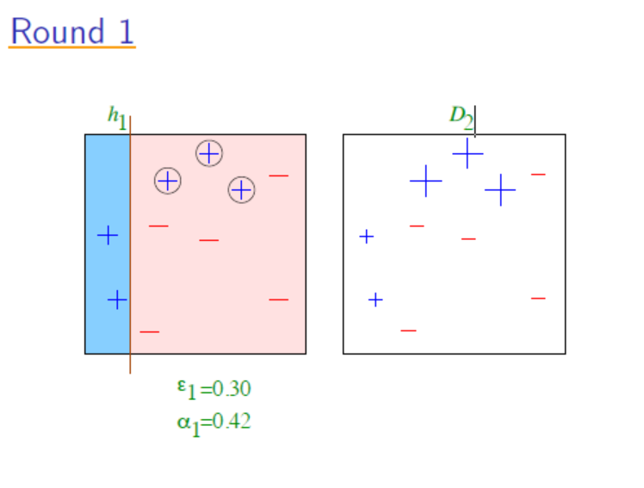
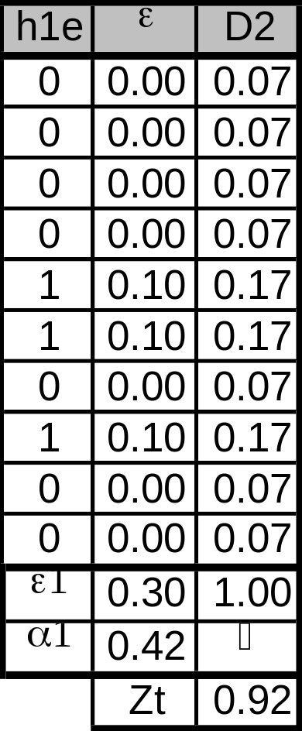
Toy example
Train data
Round 1

Slide 7
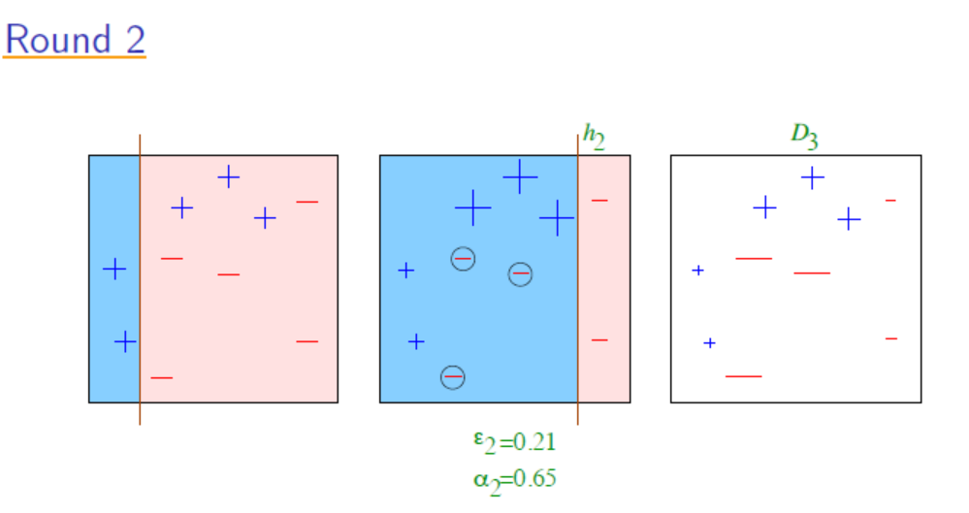
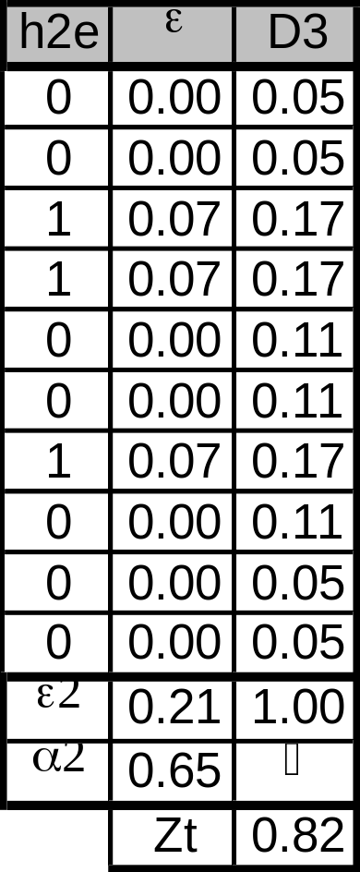
Toy example
Train data
Round 2

Slide 8
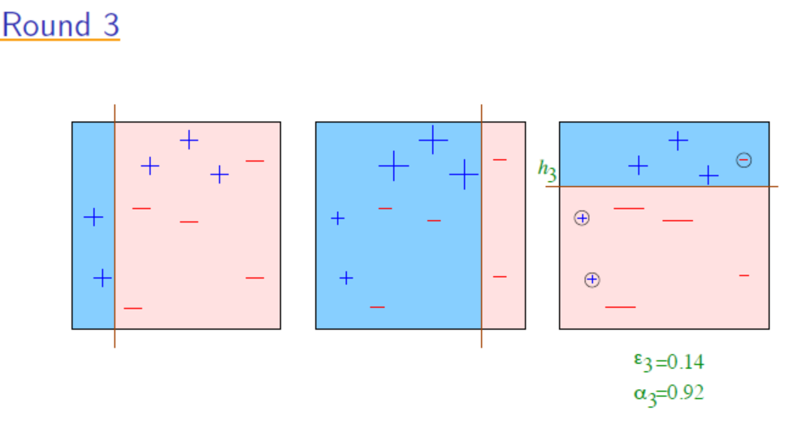
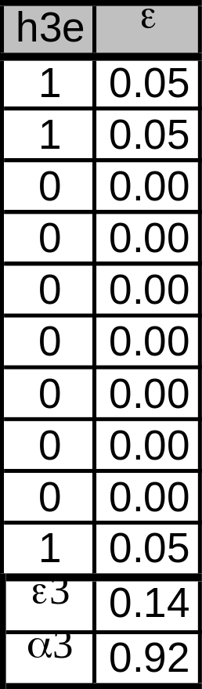
Toy example
Train data
Round 3

Slide 9
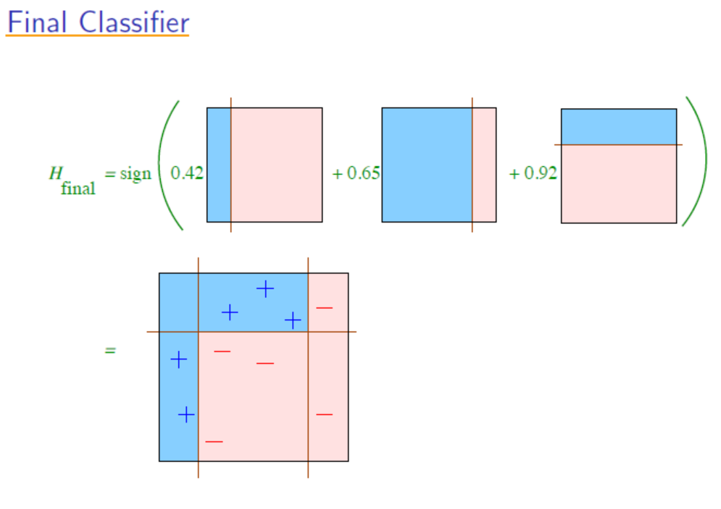
Toy example

Slide 10
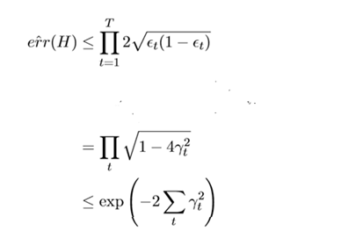
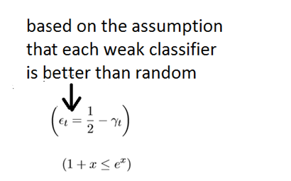


Bounding the Training Error
Theorem: The training error is bounded by the following expression:
Considering the weak learning assumption:
Where T is the #of iterations

Slide 11
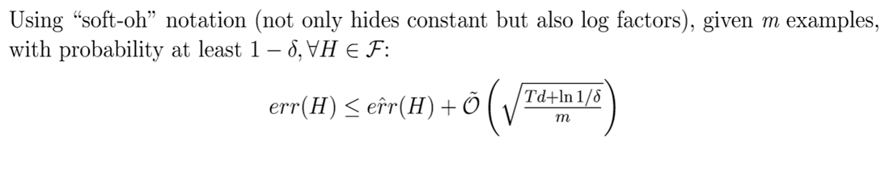
Bounding the generalization error
Where VC-dim(H) = d

Slide 12
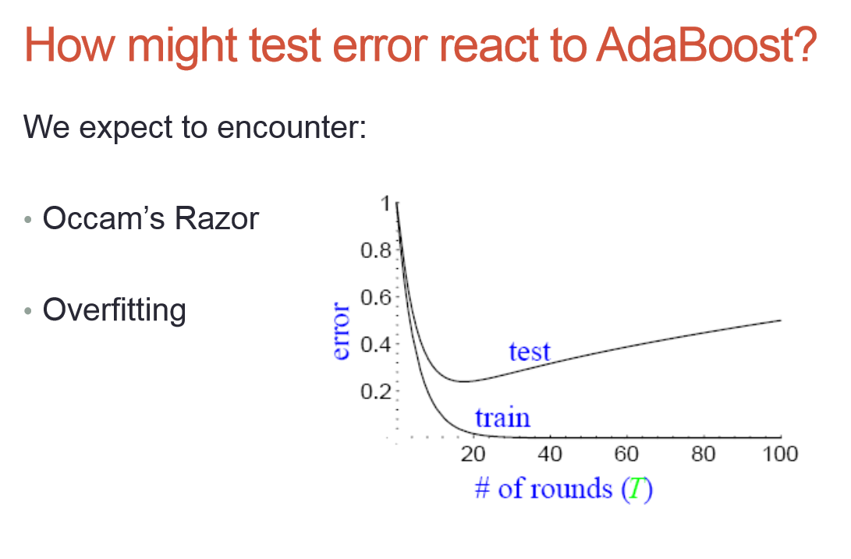
Occam’s Razor: the best theory is the smallest one that describes all the facts
Model selection criteria attempt to find a good compromise between:
  The complexity of a model
  Its prediction accuracy on the training data

Slide 13
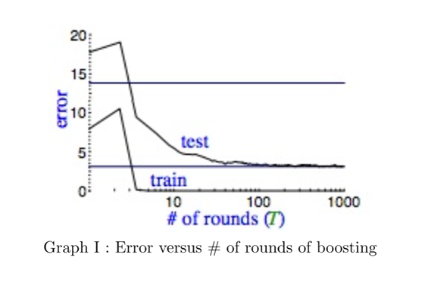
Actual typical run
Contrary to what we would expect based on the previous equation,
as we increase T (the complexity), we do not always get a worse
generalization error even when the training error is already 0.

Slide 14
Why generalization error goes down although the model becomes more complex?
The reason behind this behavior is that, as we keep increasing the
number of rounds, the classifier becomes more “confident”.
Important to introduce the concept of margin to measure this confidence
Shapiro’s theory:
This confidence translates in a lower generalization error.

Slide 15
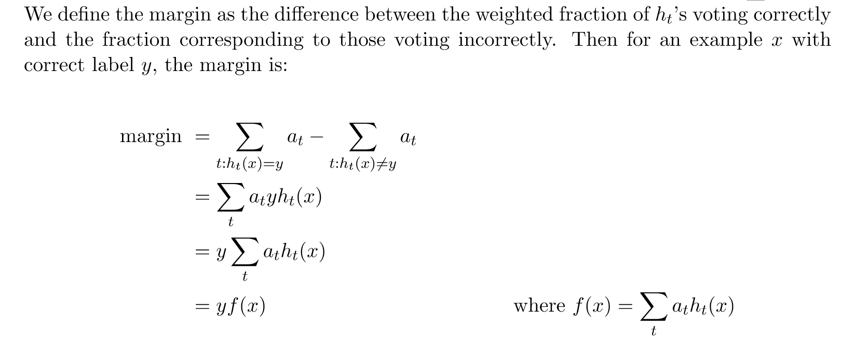
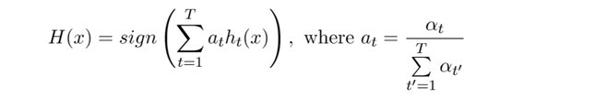

Definition for margin
a_{t} are the normalized weights for each hypothesis

Slide 16
Definition for margin
See example (empirical evidence.pdf) where actually the generalization error
does not increase and how the Cumulative margin is represented.

Slide 17
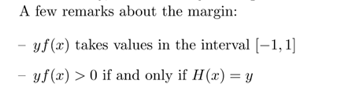
Remarks on Margin
The magnitude of |yf(x)| represents the degree of confidence for the
classification H(x). A number substantially far from zero implies high
confidence, whereas a number close to zero implies low confidence.
- margin close to 1 = high confidence in predicting correctly
- margin close to -1 = high confidence in predicting incorrectly

Slide 18
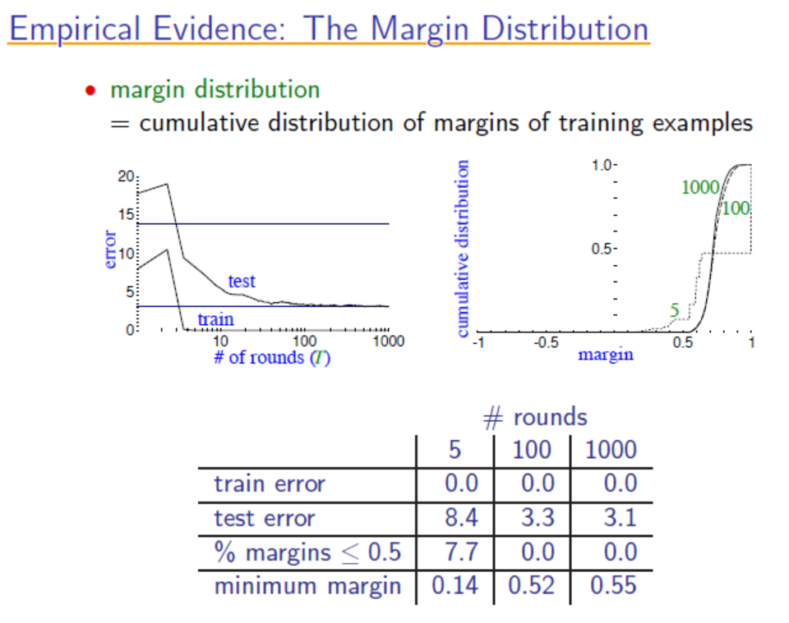
See margin_movie
pdf file to see how
the curve is generated.

Slide 19
How to apply the weights ?
You sample the data using an appropriate sample algorithm which can handle weights (e.g. weighted random sampling) and build classification model on that sample.
The resulting sample contains miss-classified examples with a higher probability than correctly classified ones, hence the model learned on that sample is forced to concentrate on the miss-classified part of the data space.
Matlab example:
>>R=randsample([1 2 3 4],10, true, [0.15,0.35,0.35,0.15]);
>>R=[1 3 3 3 2 3 2 1 2 4]

Slide 20

How to apply the weights ?
You use a classification model which is capable of handling such weights implicitly like e.g. Decision Trees. DT simply count. So instead of using 1 as counter/increment if an example with a certain predictor and class values is presented, it uses the specified weight w. If w = 0, the example is practically ignored.
As a result, the miss-classified examples have more influence on the class probability estimated by the model.
Example for the Gini index calculation for DTs:

Slide 21
How to apply the weights ?
Example for the Gini index calculation for DTs:
Where t is the node and j denotes the class
Train data:
p(C1)=0.5, p(C2)=0.5
Round 1:
p(C1)=0.07+0.07+0.17+0.17+0.17=0.65
p(C2)=0.35
Train data
Round 1

Slide 22
How to apply the weights ?
How can a k-Nearest Neighbor algorithm handle such weights implicitly?
Final Project 1: implement and test k-NN algorithms that handle weights implicitly
Final Project2: implement and test DTs algorithms that handle weights implicitly

Slide 23
Summary on AdaBoost
Boosting decreases exponentially the training error in the number of iterations;
Boosting works well if base classifiers are not too complex and their error doesn’t become too large too quickly!
It has no parameters to tune (except for the number of rounds)
It comes with a set of theoretical guarantee (e.g., training error, test error)

Slide 24
Summary on AdaBoost
Instead of trying to design a learning algorithm that is accurate over the entire space, we can focus on finding base learning algorithms that only need to be better than random.
It can identify outliners: i.e. examples that are either mislabeled or that are inherently ambiguous and hard to categorize.
Final Project 3: Use AdaBoost to identify “either mislabeled or that are inherently ambiguous and hard to categorize” for a certain application.

Slide 25
Weakness of AdaBoost
The actual performance of boosting depends on the data and the base learner.
Boosting seems to be especially susceptible to noise.
When the number of outliners is very large, the emphasis placed on the hard examples can hurt the performance.
➔ “Gentle AdaBoost”, “BrownBoost”

Slide 26
Alternative Approaches to AdaBoost
BrownBoost (Freund)
  Non-monotonic weighting function
    Examples far from boundary decrease in weight
  The Theory of BrownBoost states that each hypothesis takes a variable amount of time © which is directly related to the weight (alpha) given to the hypothesis/classifier. The time parameter is the analogous to the number of iterations T in AdaBoost.
  A larger value of © means that BrownBoost will treat the data as if were less noisy and therefore give up on fewer examples. Conversely, a smaller value of © means that BrownBoost will treat the data as more noisy and give up on more examples.

Slide 27
Alternative Approaches to AdaBoost
GentleBoost
  Rather than minimizing the overall test error as much as possible at each step, GentleBoost features a bounded step size.

Slide 28
Ensembles of classifiers in Matlab
Examples of Matlab for ensemble of classifiers:
http://www.mathworks.com/help/stats/ensemble-methods.html#br0g6t1-1
Fitensemble.m function documentation
http://www.mathworks.com/help/stats/fitensemble.html

Slide 29
Comparison of Bagging and Boosting
Bagging always uses resampling rather than reweighting.
Bagging does not modify the distribution over examples or mislabels, but instead always uses the uniform distribution
In forming the final hypothesis, bagging gives equal weight to each of the weak hypotheses

Slide 30
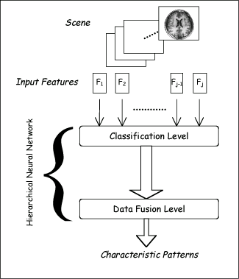
Stacking
Uses meta learner instead of voting to combine predictions of base learners
  Predictions of base learners (level-0 models) are used as input for meta learner (level-1 model)
Base learners usually different learning schemes
Hard to analyze theoretically: “black magic”
Hierarchical Neural Networks

Slide 31
Stacking
BC₁
0
BC₂
1
instance₁
BC_{n}
1
BC₁
BC₂
…
BC_{n}
Class
meta instances
instance₁
0
1
1
1

Slide 32
Stacking
BC₁
1
BC₂
0
instance₂
BC_{n}
0
BC₁
BC₂
…
BC_{n}
Class
meta instances
instance₁
0
1
1
1
instance₂
1
0
0
0

Slide 33
Stacking
Meta Classifier
BC₁
BC₂
…
BC_{n}
Class
meta instances
instance₁
0
1
1
1
instance₂
1
0
0
0

Slide 34
Stacking
BC₁
0
1
BC₂
1
instance
Meta Classifier
BC_{n}
1
BC₁
BC₂
…
BC_{n}
meta instance
instance
0
1
1

Slide 35
More on stacking
Predictions on training data can’t be used to generate data for level-1 model! The reason is that the level-0 classifier that better fit training data will be chosen by the level-1 model! Thus,
k-fold cross-validation-like scheme is employed! An example for k = 3!
train
train
test
train
test
train
test
train
train
Meta Data
test
test
test

Slide 36
More on stacking
If base learners can output probabilities it’s better to use those as input to meta learner
Which algorithm to use to generate meta learner?
  In principle, any learning scheme can be applied
  David Wolpert: “relatively global, smooth” model
    Base learners do most of the work
    Reduces risk of overfitting

Slide 37
Summary & practical advises
If the classifier is unstable (i.e, decision trees) then apply bagging!
If the classifier is stable and simple (e.g. Naïve Bayes) then apply boosting!
If the classifier is stable and complex (e.g. Neural Network) then apply randomization injection!
Boosting combines many weak classifiers to produce a powerful committee.
It comes with a set of theoretical guarantee (e.g., training error, test error)
It performs well on many tasks.

Slide 38
Slides Credits
Slides in this presentation is partially based on the work of
  Jianjun Hu (University of South California)
  Rong Jin (Michigan State University)
  Yaochu Jin (Future Technology Research
  Honda R&D Europe (Germany)
  Evgueni Smirnov (www.cs.unimaas.nl/smirnov)
  Witten’s Data Mining textbook
Proof on theorems at: http://www.cs.princeton.edu/courses/archive/spring14/cos511

Slide 39
Supplemental (Optional) Readings (More on the theory behind machine learning)
Good read on the explanation of AdaBoost by the author of AdaBoost:
https://www.cs.princeton.edu/~schapire/papers/explaining-adaboost.pdf
2. Valiant’s original “Theory of the Learnable” paper which first got theoretical computer scientists working on machine learning: In Communications of the ACM
Volume 27 Issue 11, Nov. 1984, Pages 1134-1142
3. Original “Occam’s Razor” paper by A. Blumer et al. In Information Processing Letters, Volume 24, issue 6, April 1987, Pages 377-380
4. Vapnik and Chervonenkis's original paper "On the Uniform Convergence of Relative Frequencies of Events to Their Probabilities In Theory of Probability & Its Applications, 1971, Vol. 16, No. 2 : pp. 264-280

Slide 40
Supplemental Readings (Applications)
Robust Real Time Face Detection: paper from 2004:
http://www.vision.caltech.edu/html-files/EE148-2005-Spring/pprs/viola04ijcv.pdf

