Slide 1
CSC529: Advanced Data Mining
Daniela Raicu
Winter 2018

Slide 2
Lecture 1:
Overview of Data Mining
Slides for Chapters 1-5 of Data Mining: Practical Machine Learning Tools and Techniques
by I. H. Witten, E. Frank and
M. A. Hall

Slide 3
Outline
Course roadmap
Ensemble of classifiers
Kernel Functions
Bayesian Networks
Hidden Markov Models
Lecture 1: Overview of Data Mining
Data versus information
Data mining definition and stages
Applications
Data mining algorithms
Deterministic versus probabilistic
Lecture 2: Evaluation of data mining algorithms

Slide 4
Data vs. information
Society produces huge amounts of data
Sources: business, science, medicine, economics, geography, environment, sports, …
Raw data is useless: need techniques to automatically extract information from it
Data: recorded facts
Information: patterns underlying the data

Slide 5
Information is crucial
Example 1: in vitro fertilization
Given: embryos described by 60 features
Problem: selection of embryos that will survive
Data: historical records of embryos and outcome
Example 2: cow culling
Given: cows described by 700 features
Problem: selection of cows that should be culled
Data: historical records and farmers’ decisions

Slide 6
Data mining definition
Extracting
implicit,
previously unknown,
potentially useful
information from data
Needed: programs that detect patterns and regularities in the data
Strong patterns make good predictions
Problem 1: most patterns are not interesting
Problem 2: patterns may be inexact (or spurious)
Problem 3: data may be garbled or missing

Slide 7
Data mining stages
Domain Understanding
Data Collection and Selection
Data Preprocessing and Transformation
Data Reduction
Pattern Discovery
Interpretation and Evaluation of the Results
Knowledge Representation

Slide 8
Pattern Discovery Algorithms
Algorithms for acquiring structural descriptions from examples
Structural descriptions represent patterns explicitly
Can be used to predict outcome in new situation
Can be used to understand and explain how prediction is derived
Methods originate from machine learning, artificial intelligence, statistics, and research on databases

Slide 9
Structural descriptions: Example 1
The weather problem
Conditions for playing a certain game
Outlook
Temperature
Humidity
Windy
Play
Sunny
Hot
High
False
No
Sunny
Hot
High
True
No
Overcast
Hot
High
False
Yes
Rainy
Mild
Normal
False
Yes
…
…
…
…
…
if-then rules
If outlook = sunny and humidity = high then play = no
If outlook = rainy and windy = true then play = no
If outlook = overcast then play = yes
If humidity = normal then play = yes
If none of the above then play = yes

Slide 10
Example 2: Classifying iris flowers
Sepal length
Sepal width
Petal length
Petal width
Type
1
5.1
3.5
1.4
0.2
Iris setosa
2
4.9
3.0
1.4
0.2
Iris setosa
…
51
7.0
3.2
4.7
1.4
Iris versicolor
52
6.4
3.2
4.5
1.5
Iris versicolor
…
101
6.3
3.3
6.0
2.5
Iris virginica
102
5.8
2.7
5.1
1.9
Iris virginica
…
if-then rules
If petal length < 2.45 then Iris setosa
If sepal width < 2.10 then Iris versicolor
...

Slide 11
Example 3: Predicting CPU performance
Example: 209 different computer configurations
Linear regression function
Cycle time (ns)
Main memory (Kb)
Cache (Kb)
Channels
Performance
MYCT
MMIN
MMAX
CACH
CHMIN
CHMAX
PRP
1
125
256
6000
256
16
128
198
2
29
8000
32000
32
8
32
269
…
208
480
512
8000
32
0
0
67
209
480
1000
4000
0
0
0
45
PRP = -55.9 + 0.0489 MYCT + 0.0153 MMIN + 0.0056 MMAX + 0.6410 CACH - 0.2700 CHMIN + 1.480 CHMAX

Slide 12
Fielded applications
The result of learning—or the learning method itself—is deployed in practical applications
Processing loan applications
Screening images for oil slicks
Marketing and sales

Slide 13
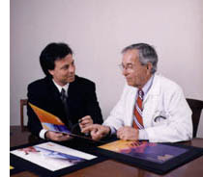
Processing loan applications (American Express)
Given: questionnaire with financial and personal information
Question: should money be lent?
Simple statistical method covers 90% of cases
Borderline cases referred to loan officers
But: 50% of accepted borderline cases defaulted!
Solution: reject all borderline cases?
No! Borderline cases are most active customers

Slide 14
Apply data mining
1000 training examples of borderline cases
20 attributes:
age
years with current employer
years at current address
years with the bank
other credit cards possessed,…
Learned rules: correct on 70% of cases
human experts only 50%
Rules could be used to explain decisions to customers

Slide 15
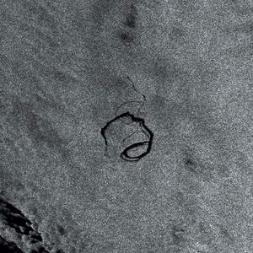
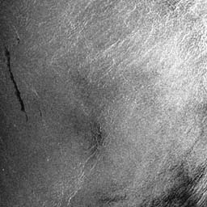
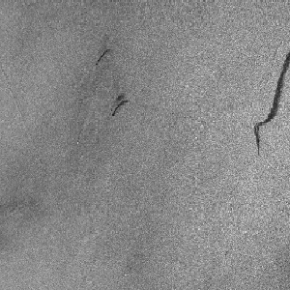
Screening images
Given: radar satellite images of coastal waters
Problem: detect oil slicks in those images
Oil slicks appear as dark regions with changing size and shape
Not easy: lookalike dark regions can be caused by weather conditions (e.g. high wind)
Expensive process requiring highly trained personnel

Slide 16
Apply Data Mining
Extract dark regions from normalized image
Attributes:
size of region
shape, area
intensity
sharpness and jaggedness of boundaries
proximity of other regions
info about background
Constraints:
Few training examples—oil slicks are rare!
Unbalanced data: most dark regions aren’t slicks

Slide 17
Marketing and sales I
Companies precisely record massive amounts of marketing and sales data
Applications:
Customer loyalty: identifying customers that are likely to defect by detecting changes in their behavior (e.g. banks/phone companies)
Special offers: identifying profitable customers (e.g. reliable owners of credit cards that need extra money during the holiday season)

Slide 18
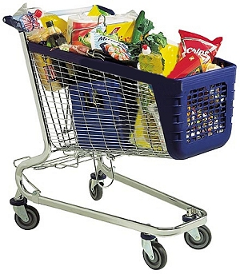
Marketing and sales II
Market basket analysis
Association techniques find groups of items that tend to occur together in a transaction (used to analyze checkout data)
Historical analysis of purchasing patterns
Identifying prospective customers
Focusing promotional mailouts (targeted campaigns are cheaper than mass-marketed ones)

Slide 19
Basic methods for pattern discovery
Bayesian classifier
Decision trees classifier
Instance-based learning
Association rules learning
Regression models
Neural networks
Clustering

Slide 20
Probabilities for weather data
Outlook
Temperature
Humidity
Windy
Play
Yes
No
Yes
No
Yes
No
Yes
No
Yes
No
Sunny
2
3
Hot
2
2
High
3
4
False
6
2
9
5
Overcast
4
0
Mild
4
2
Normal
6
1
True
3
3
Rainy
3
2
Cool
3
1
Sunny
2/9
3/5
Hot
2/9
2/5
High
3/9
4/5
False
6/9
2/5
9/
14
5/
14
Overcast
4/9
0/5
Mild
4/9
2/5
Normal
6/9
1/5
True
3/9
3/5
Rainy
3/9
2/5
Cool
3/9
1/5
Outlook
Temp
Humidity
Windy
Play
Sunny
Hot
High
False
No
Sunny
Hot
High
True
No
Overcast
Hot
High
False
Yes
Rainy
Mild
High
False
Yes
Rainy
Cool
Normal
False
Yes
Rainy
Cool
Normal
True
No
Overcast
Cool
Normal
True
Yes
Sunny
Mild
High
False
No
Sunny
Cool
Normal
False
Yes
Rainy
Mild
Normal
False
Yes
Sunny
Mild
Normal
True
Yes
Overcast
Mild
High
True
Yes
Overcast
Hot
Normal
False
Yes
Rainy
Mild
High
True
No

Slide 21
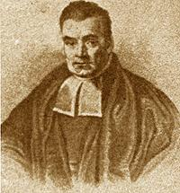

Bayes’s rule
Probability of event H given evidence E:
A priori probability of H :
Probability of event before evidence is seen
A posteriori probability of H :
Probability of event after evidence is seen
Thomas Bayes
Born: 1702 in London, England Died: 1761 in Tunbridge Wells, Kent, England

Slide 22
Naïve Bayes for classification
Classification learning: what’s the probability of the class given an instance?
Evidence E = instance
Event H = class value for instance
Naïve assumption: evidence splits into parts (i.e. attributes) that are independent

Slide 23
Probabilities for weather data
Outlook
Temperature
Humidity
Windy
Play
Yes
No
Yes
No
Yes
No
Yes
No
Yes
No
Sunny
2
3
Hot
2
2
High
3
4
False
6
2
9
5
Overcast
4
0
Mild
4
2
Normal
6
1
True
3
3
Rainy
3
2
Cool
3
1
Sunny
2/9
3/5
Hot
2/9
2/5
High
3/9
4/5
False
6/9
2/5
9/
14
5/
14
Overcast
4/9
0/5
Mild
4/9
2/5
Normal
6/9
1/5
True
3/9
3/5
Rainy
3/9
2/5
Cool
3/9
1/5
Evidence E
A new day:
Outlook
Temp.
Humidity
Windy
Play
Sunny
Cool
High
True
?
Likelihood of the two classes
For “yes” = 2/9 × 3/9 × 3/9 × 3/9 × 9/14 = 0.0053
For “no” = 3/5 × 1/5 × 4/5 × 3/5 × 5/14 = 0.0206
Conversion into a probability by normalization:
P(“yes”) = 0.0053 / (0.0053 + 0.0206) = 0.205
P(“no”) = 0.0206 / (0.0053 + 0.0206) = 0.795
Probability of
class “yes”

Slide 24
Naïve Bayes: discussion: The “zero-frequency problem”
What if an attribute value doesn’t occur with every class value? (e.g. “Humidity = high” for class “yes”)
Probability will be zero!
A posteriori probability will also be zero! (No matter how likely the other values are!)
Remedy: add 1 to the count for every attribute value (Laplace estimator)
Result: probabilities will never be zero! (also: stabilizes probability estimates)

Slide 25
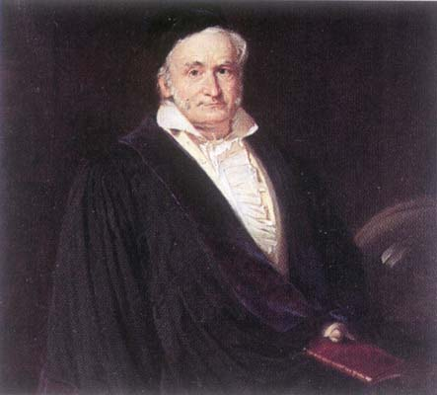
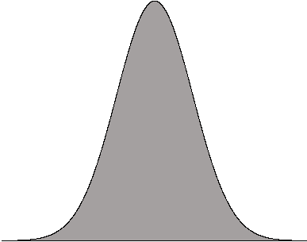
Naïve Bayes: discussion: Missing values
Training: instance is not included in frequency count for attribute value
Classification: attribute will be omitted from calculation
Naïve Bayes: discussion: Numeric Attributes
Usual assumption: attributes have a normal or Gaussian probability distribution (given the class)
The probability density function for the normal distribution is defined by two parameters: mean and standard deviation:

Slide 26
Naïve Bayes: discussion
Naïve Bayes works surprisingly well (even if independence assumption is clearly violated)
Why? Because classification doesn’t require accurate probability estimates as long as maximum probability is assigned to correct class
However: adding too many redundant attributes will cause problems (e.g. identical attributes)
Note also: many numeric attributes are not normally distributed (→ kernel density estimators)

Slide 27
Decision trees classifiers
Strategy: top down Recursive divide-and-conquer fashion
First: select attribute for root node Create branch for each possible attribute value
Then: split instances into subsets Choose split that maximizes certain criterion
Finally: repeat recursively for each branch, using only instances that reach the branch
Stop if all instances have the same class

Slide 28
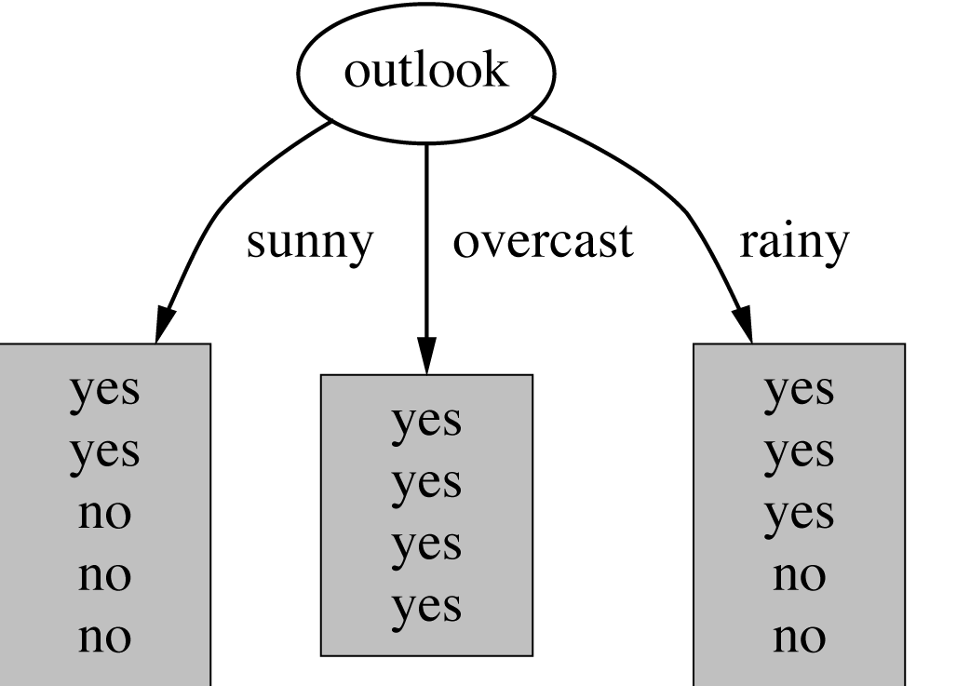
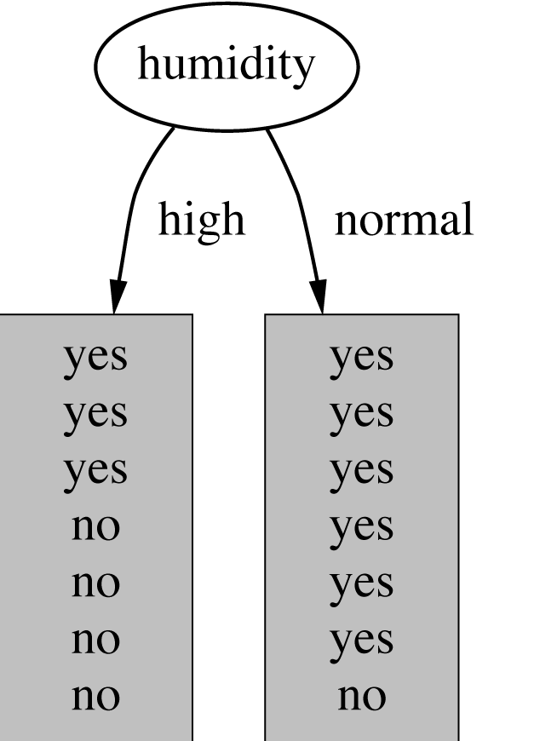
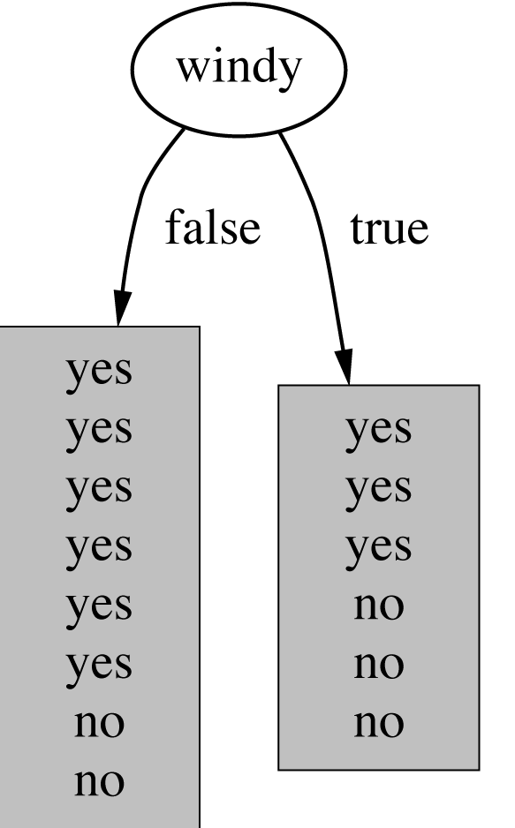
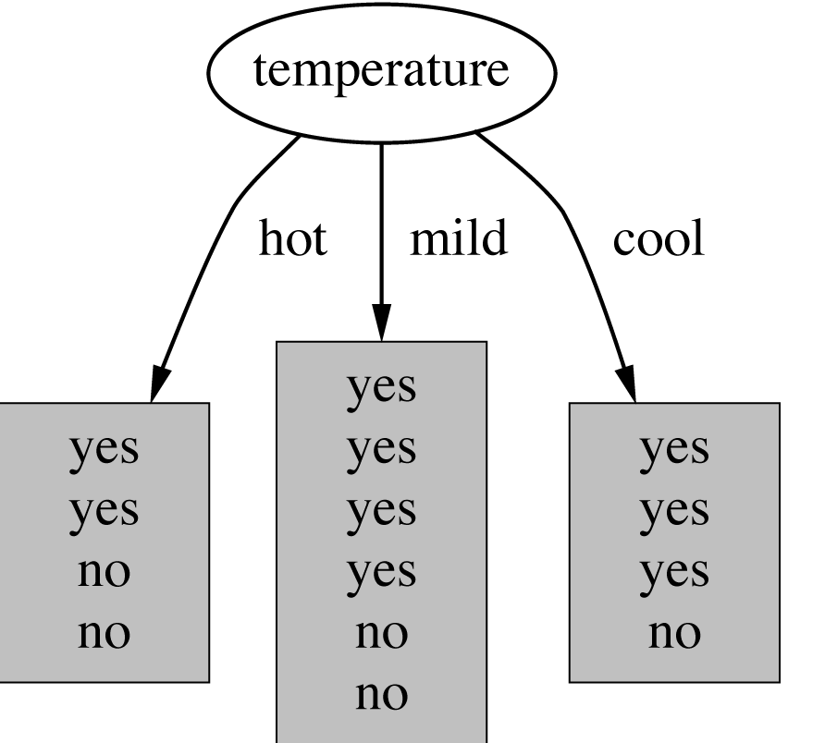
Which attribute to select?

Slide 29
Which attribute to select?

Slide 30
Criterion for attribute selection
Which is the best attribute?
Want to get the smallest tree
Heuristic: choose the attribute that produces the “purest” nodes
Popular impurity criterion: information gain
Information gain increases with the average purity of the subsets
Strategy: choose attribute that gives greatest information gain

Slide 31
Computing information
Measure information in bits
Given a probability distribution, the info required to predict an event is the distribution’s entropy
Entropy gives the information required in bits (can involve fractions of bits!)

Slide 32
Computing information gain for weather data
Information gain: information before splitting – information after splitting
Information gain for attributes from weather data:
gain(Outlook ) = info([9,5]) – info([2,3],[4,0],[3,2])
= 0.940 – 0.693 = 0.247 bits
gain(Outlook ) = 0.247 bits
gain(Temperature ) = 0.029 bits
gain(Humidity ) = 0.152 bits
gain(Windy ) = 0.048 bits

Slide 33
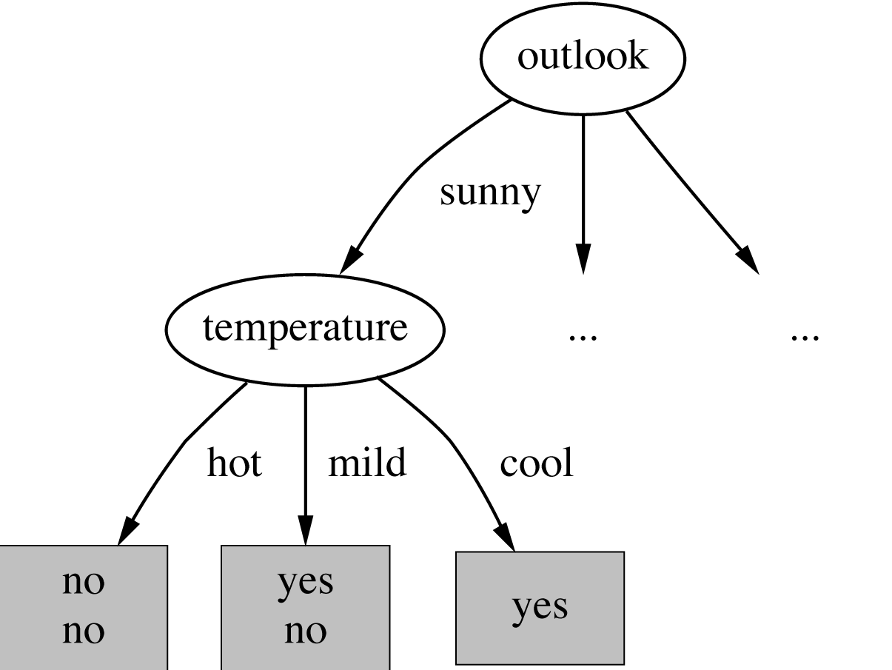
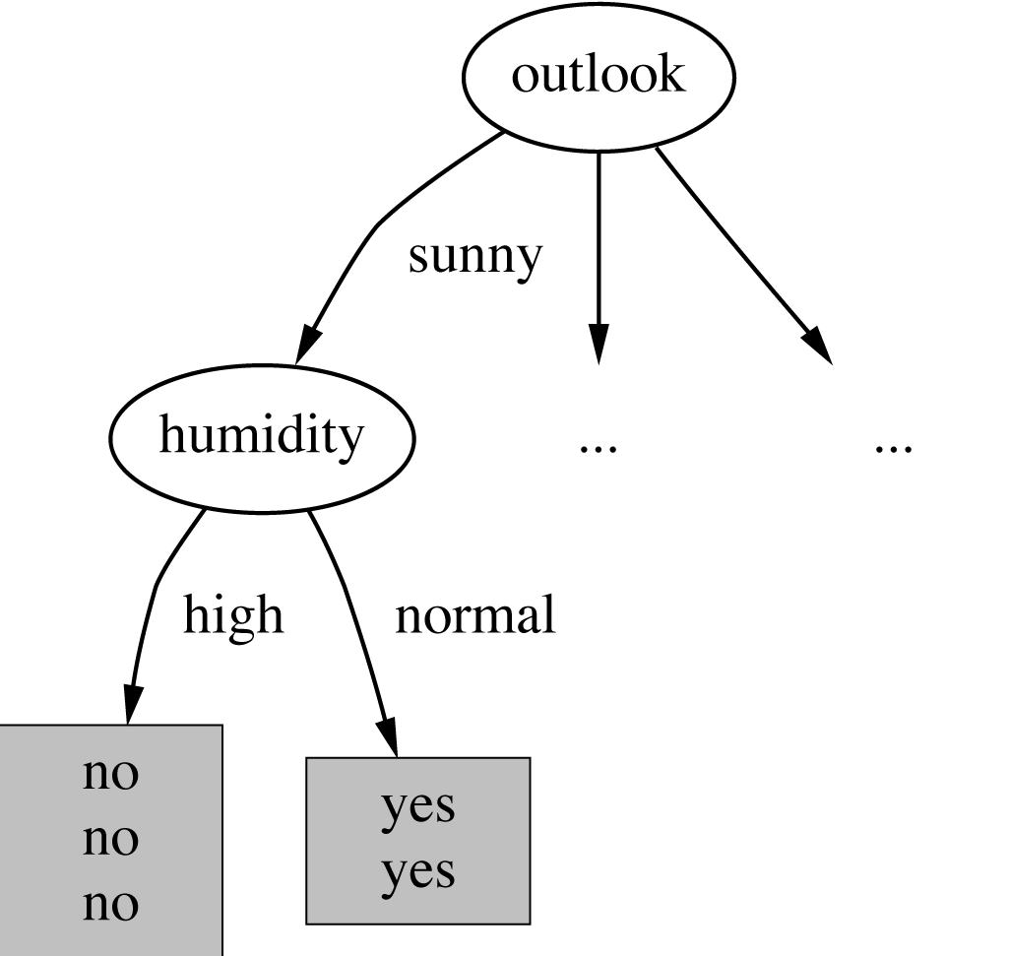
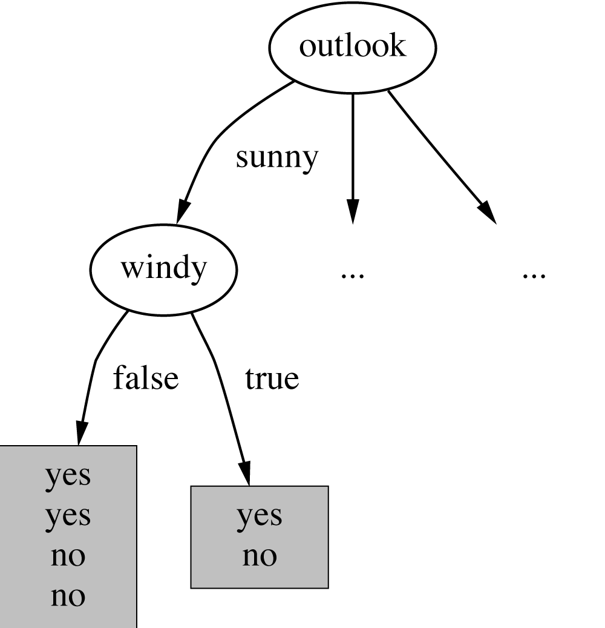
Continuing to split
gain(Temperature ) = 0.571 bits
gain(Humidity ) = 0.971 bits
gain(Windy ) = 0.020 bits

Slide 34
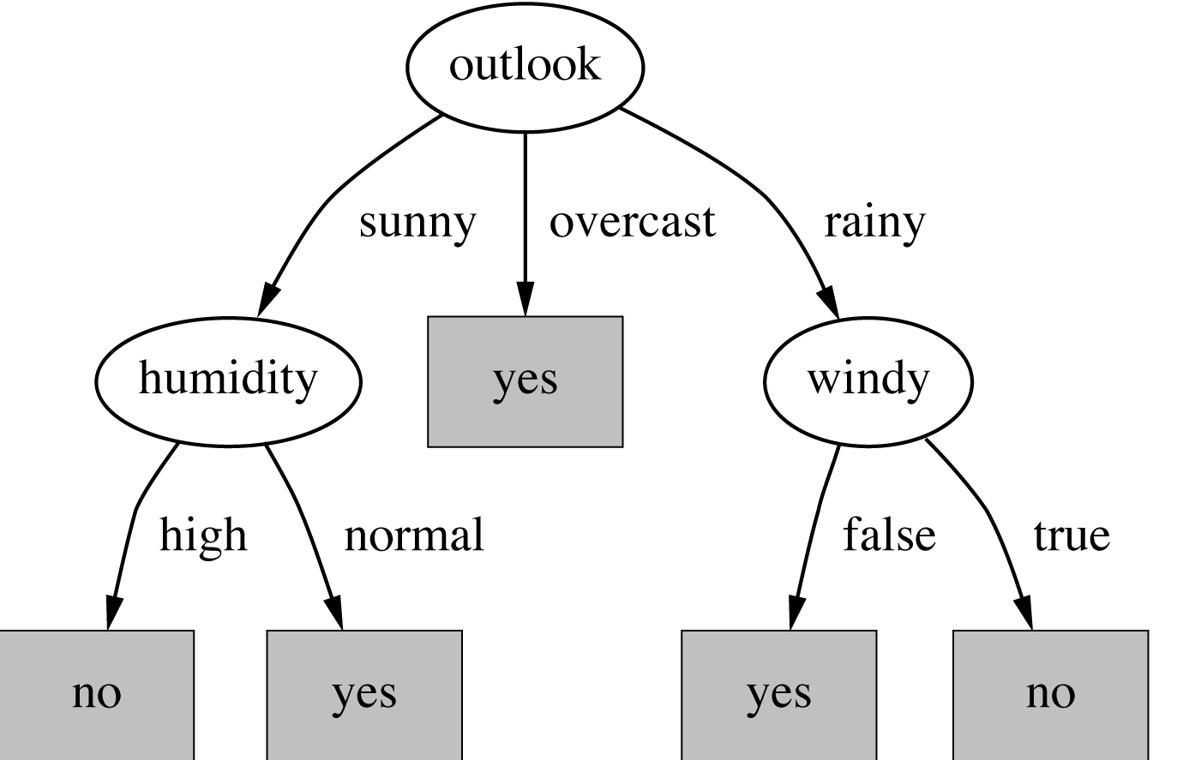
Final decision tree
Note: not all leaves need to be pure; sometimes almost identical instances have different classes
⇒ Splitting stops when data can’t be split any further

Slide 35
Wishlist for a purity measure
Properties we require from a purity measure:
When node is pure, measure should be zero
When impurity is maximal (i.e. all classes equally likely), measure should be maximal
Measure should obey multistage property (i.e. decisions can be made in several stages)
Entropy is the only function that satisfies all three properties!

Slide 36
Highly-branching attributes
Problematic: attributes with a large number of values (extreme case: ID code)
Subsets are more likely to be pure if there is a large number of values
Information gain is biased towards choosing attributes with a large number of values
This may result in overfitting (selection of an attribute that is non-optimal for prediction)
Another problem: fragmentation

Slide 37
Weather data with ID code
ID code
Outlook
Temp.
Humidity
Windy
Play
A
Sunny
Hot
High
False
No
B
Sunny
Hot
High
True
No
C
Overcast
Hot
High
False
Yes
D
Rainy
Mild
High
False
Yes
E
Rainy
Cool
Normal
False
Yes
F
Rainy
Cool
Normal
True
No
G
Overcast
Cool
Normal
True
Yes
H
Sunny
Mild
High
False
No
I
Sunny
Cool
Normal
False
Yes
J
Rainy
Mild
Normal
False
Yes
K
Sunny
Mild
Normal
True
Yes
L
Overcast
Mild
High
True
Yes
M
Overcast
Hot
Normal
False
Yes
N
Rainy
Mild
High
True
No

Slide 38
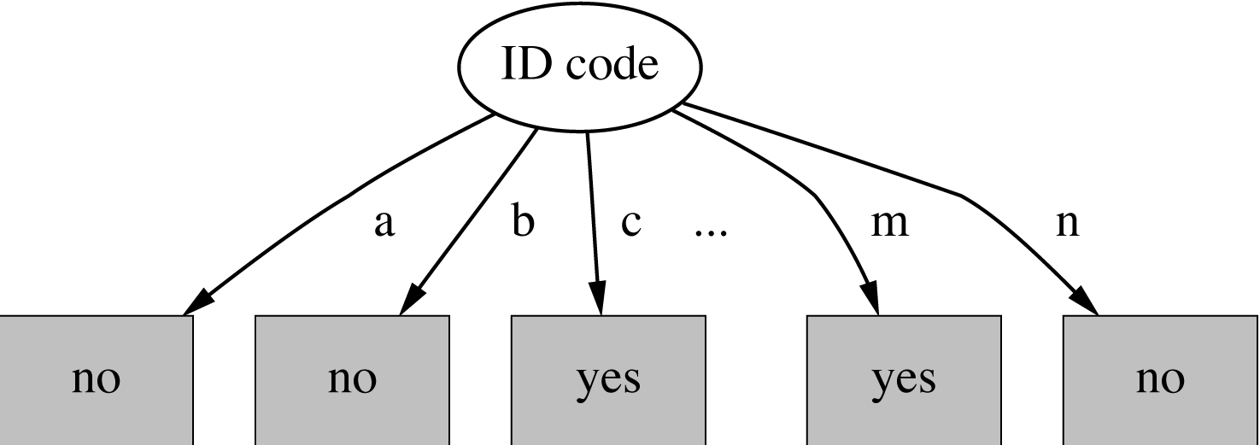
Tree stump for ID code attribute
Entropy of split:
Information gain is maximal for ID code (namely 0.940 bits)

Slide 39
Gain ratio
Gain ratio: a modification of the information gain that reduces its bias
Gain ratio takes number and size of branches into account when choosing an attribute
It corrects the information gain by taking the intrinsic information of a split into account
Intrinsic information: entropy of distribution of instances into branches (i.e. how much info do we need to tell which branch an instance belongs to)

Slide 40
Gain ratios for weather data
Outlook
Temperature
Info:
0.693
Info:
0.911
Gain: 0.940-0.693
0.247
Gain: 0.940-0.911
0.029
Split info: info([5,4,5])
1.577
Split info: info([4,6,4])
1.557
Gain ratio: 0.247/1.577
0.157
Gain ratio: 0.029/1.557
0.019
Humidity
Windy
Info:
0.788
Info:
0.892
Gain: 0.940-0.788
0.152
Gain: 0.940-0.892
0.048
Split info: info([7,7])
1.000
Split info: info([8,6])
0.985
Gain ratio: 0.152/1
0.152
Gain ratio: 0.048/0.985
0.049

Slide 41
More on the gain ratio
“Outlook” still comes out top
Problem with gain ratio: it may overcompensate
May choose an attribute just because its intrinsic information is very low
Standard fix: only consider attributes with greater than average information gain

Slide 42
Decision Trees Discussion
Top-down induction of decision trees: ID3, algorithm developed by Ross Quinlan
Gain ratio just one modification of this basic algorithm
⇒ C4.5: deals with numeric attributes, missing values, noisy data
Similar approach: CART
There are many other attribute selection criteria! (But little difference in accuracy of result)

Slide 43
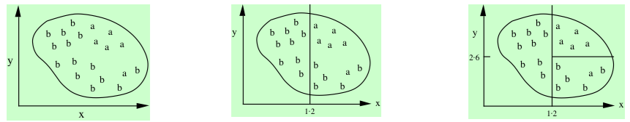
Generating rules from the DTs
If true then class = a
If x > 1.2 and y > 2.6 then class = a
If x > 1.2 then class = a
Possible rule set for class “b”:
Could add more rules, get “perfect” rule set
If x ≤ 1.2 then class = b
If x > 1.2 and y ≤ 2.6 then class = b

Slide 44
Instance-based learning
Distance function defines what’s learned
Most instance-based schemes use Euclidean distance.
Taking the square root is not required when comparing distances
Other popular metric: city-block metric

Slide 45
Discussion of nearest-neighbor learning
Often very accurate
Assumes all attributes are equally important
Remedy: attribute selection or weights
Possible remedies against noisy instances:
Take a majority vote over the k nearest neighbors
Removing noisy instances from dataset (difficult!)
Possible remedies against features on different scales:
Normalization

Slide 46
Clustering
Clustering techniques apply when there is no class to be predicted
Aim: divide instances into “natural” groups
Classic clustering algorithm called k-means
k-means clusters are disjoint, deterministic, and flat

Slide 47
Discussion
Algorithm minimizes squared distance to cluster centers
Result can vary significantly
based on initial choice of seeds
Can get trapped in local minimum
To increase chance of finding global optimum: restart with different random seeds

Slide 48
Next lecture: Credibility: Evaluating what’s been learned
Issues: training, testing, tuning
Predicting performance: confidence limits
Holdout, cross-validation, bootstrap
Comparing schemes: the t-test
Predicting probabilities: loss functions
Cost-sensitive measures
Evaluating numeric prediction
The Minimum Description Length principle

Slide 49
Evaluation: the key to success
How predictive is the model we learned?
Error on the training data is not a good indicator of performance on future data
Otherwise 1-NN would be the optimum classifier!
Simple solution that can be used if lots of (labeled) data is available:
Split data into training and test set
However: (labeled) data is usually limited
More sophisticated techniques need to be used

Slide 50
Issues in evaluation
Statistical reliability of estimated differences in performance (→ significance tests)
Choice of performance measure:
Number of correct classifications
Accuracy of probability estimates
Error in numeric predictions
Costs assigned to different types of errors
Many practical applications involve costs

Slide 51
Complementary Reading to the lecture notes:
Book by Witten, Frank and Hall:
Chapter 1: 1.1-1.3
Chapter 2
Chapter 3
Chapter 4: 4.2-4.4, 4.7-4.8

