Slide 1
CSC529: Advanced Data Mining
Lecture 7
Extending Linear Models: Kernel Methods for feature extraction (KPCA) and classification (SVM)

Slide 2
Lecture Outline
Kernel Methods
Support Vector Machines (SVM)
Kernel Principal Component Analysis
Applications

Slide 3
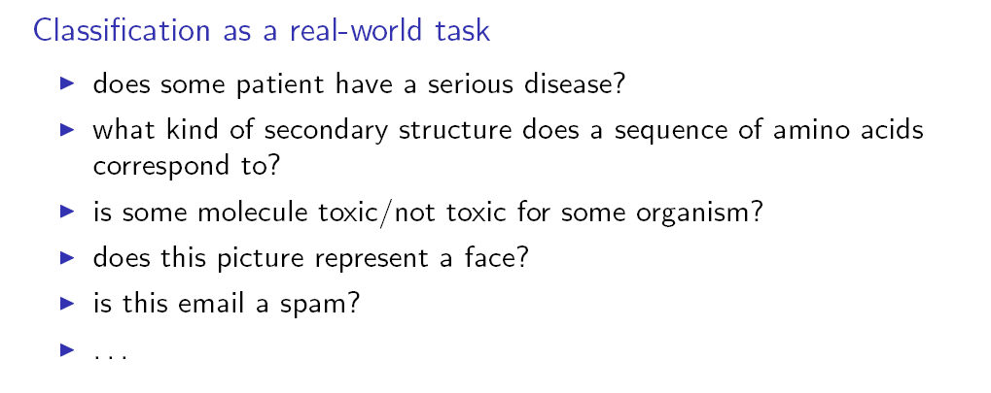
Classification

Slide 4
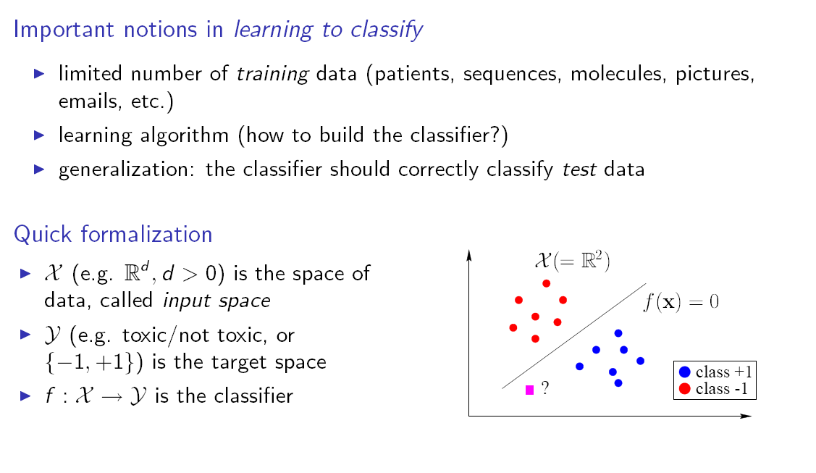
Binary Classification

Slide 5
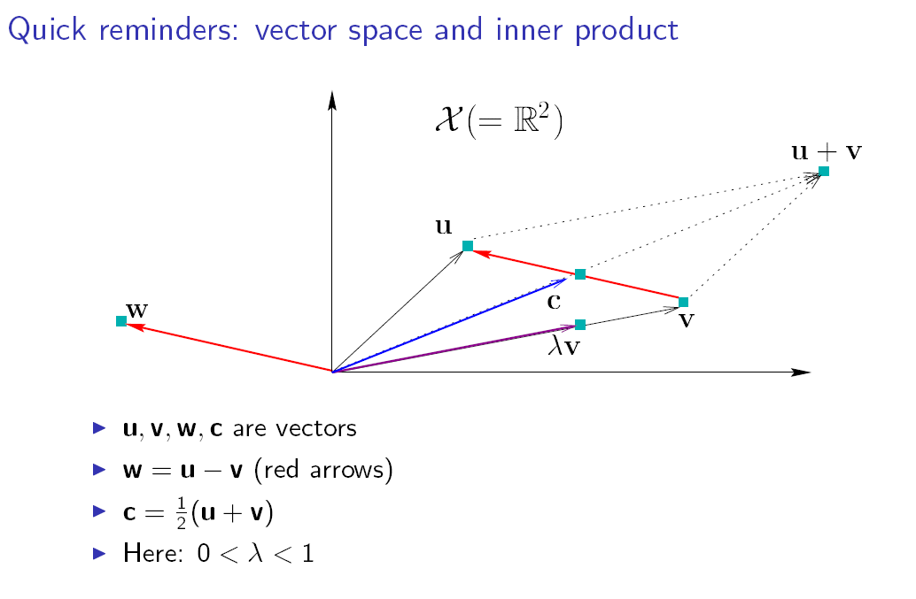
Inner Products

Slide 6
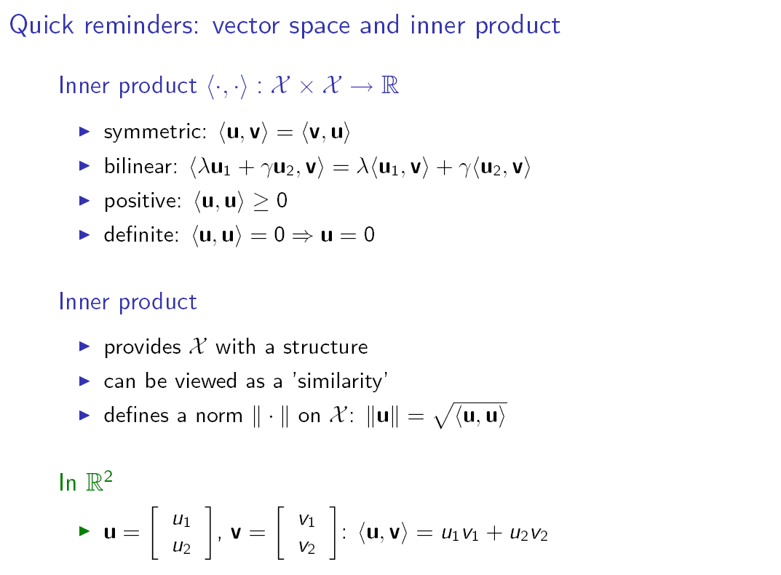
Inner Products (cont.)

Slide 7
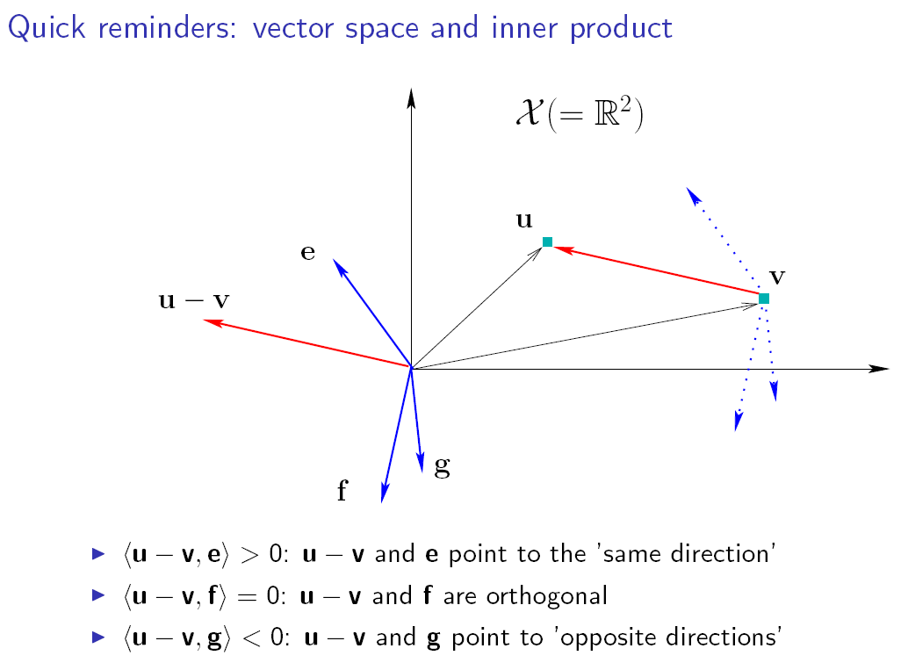

Slide 8
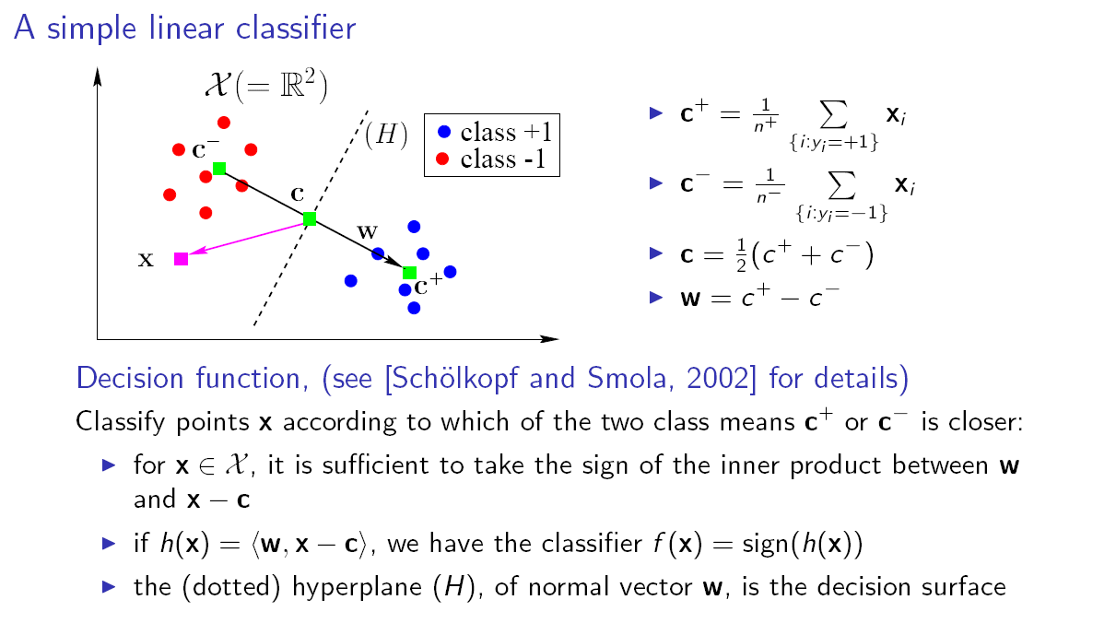
Linear Classification & Inner Products

Slide 9
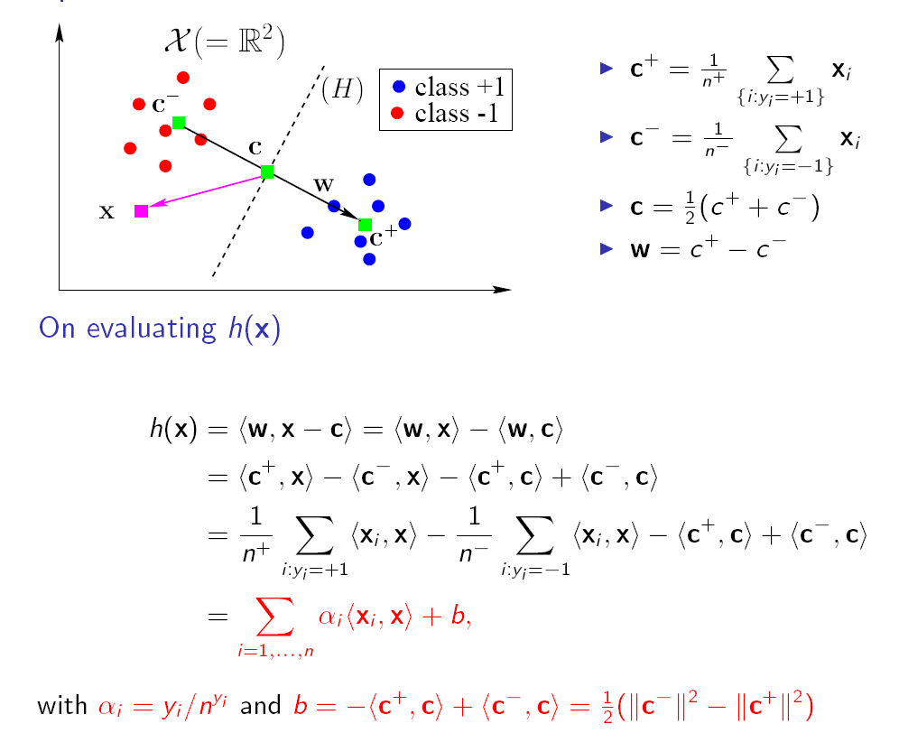
Linear Classification & Inner Products (cont.)

Slide 10
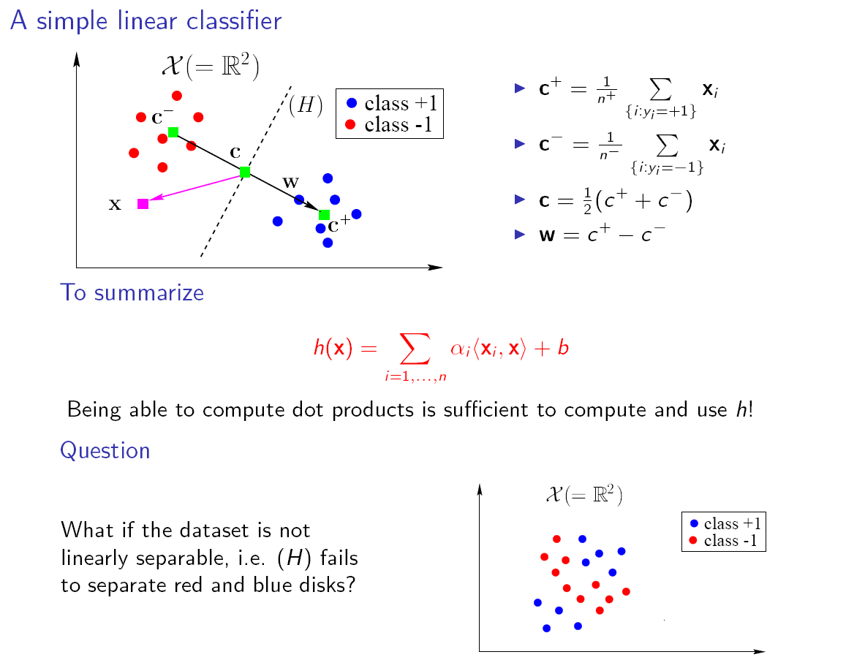
The Kernel Trick

Slide 11
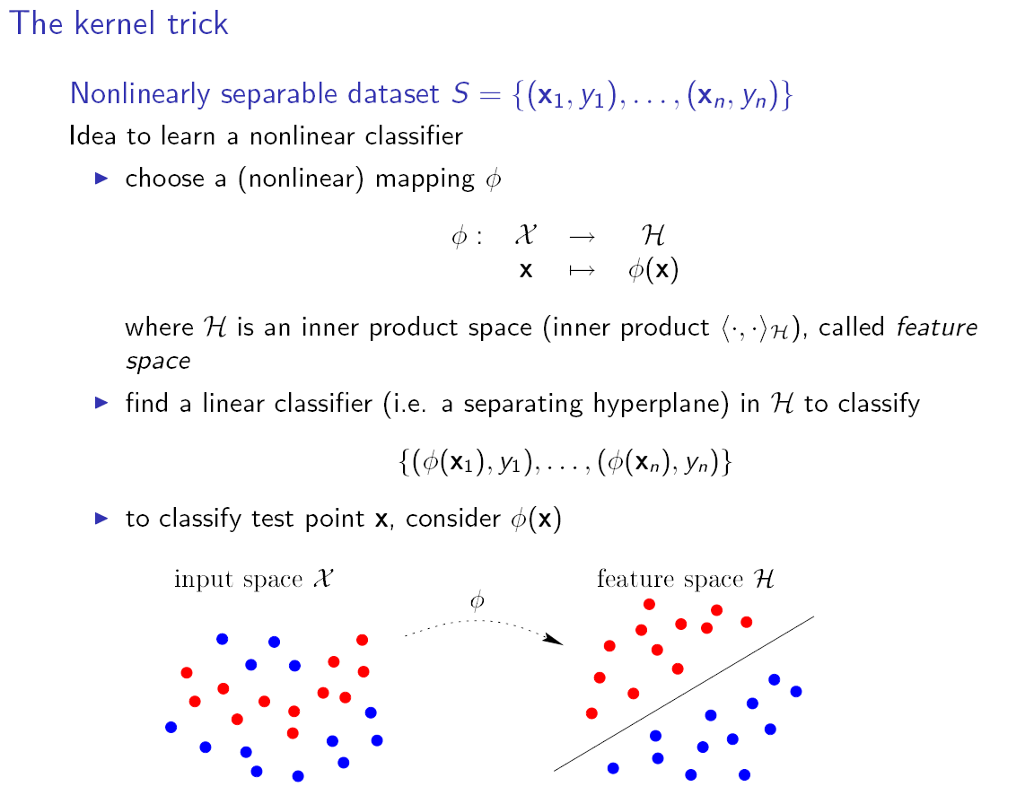
The Kernel Trick

Slide 12
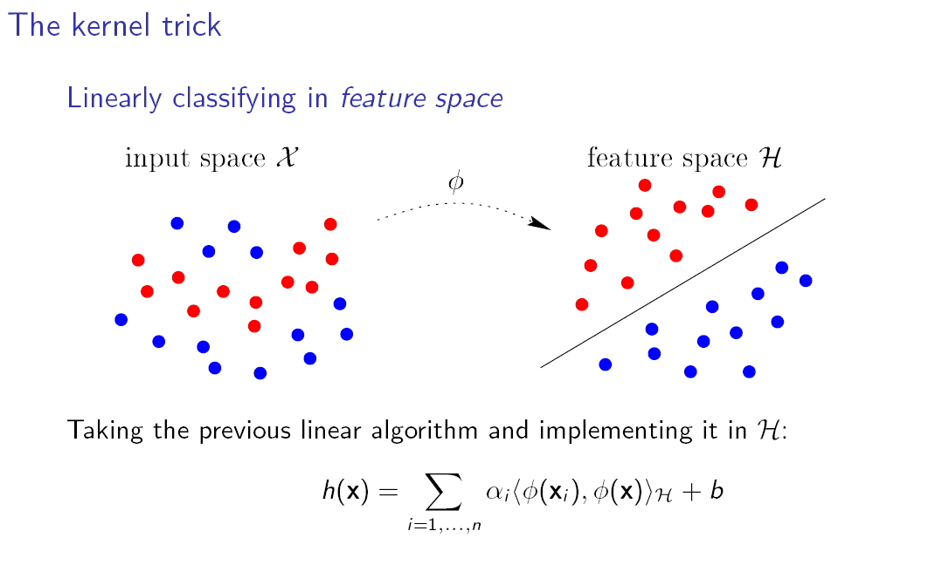
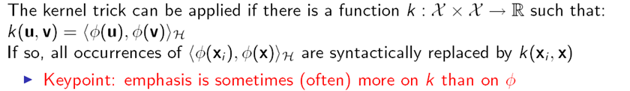
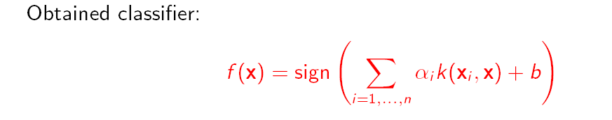

Slide 13
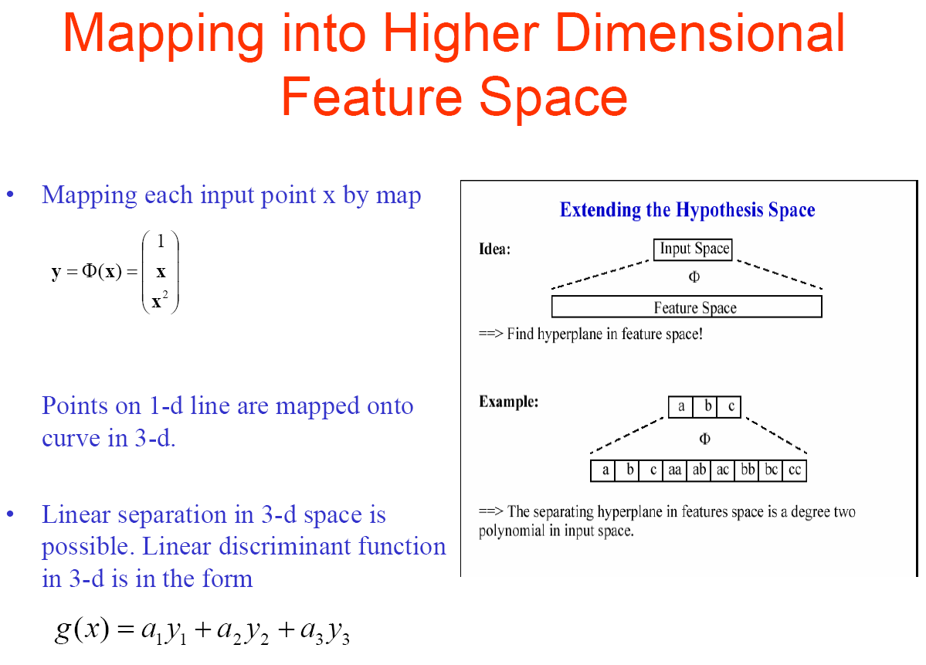
Main idea of kernel methods:

Slide 14
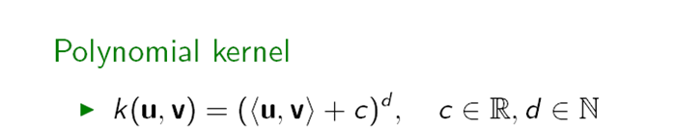
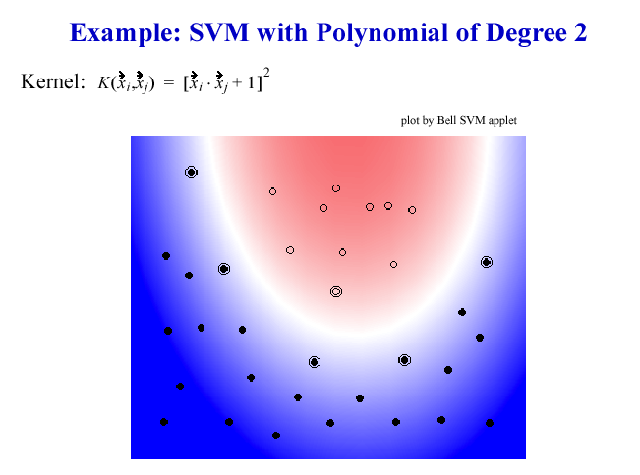
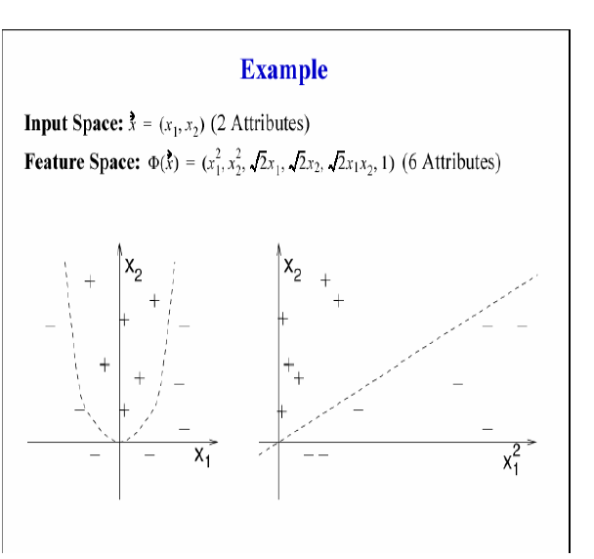
Common Kernels

Slide 15
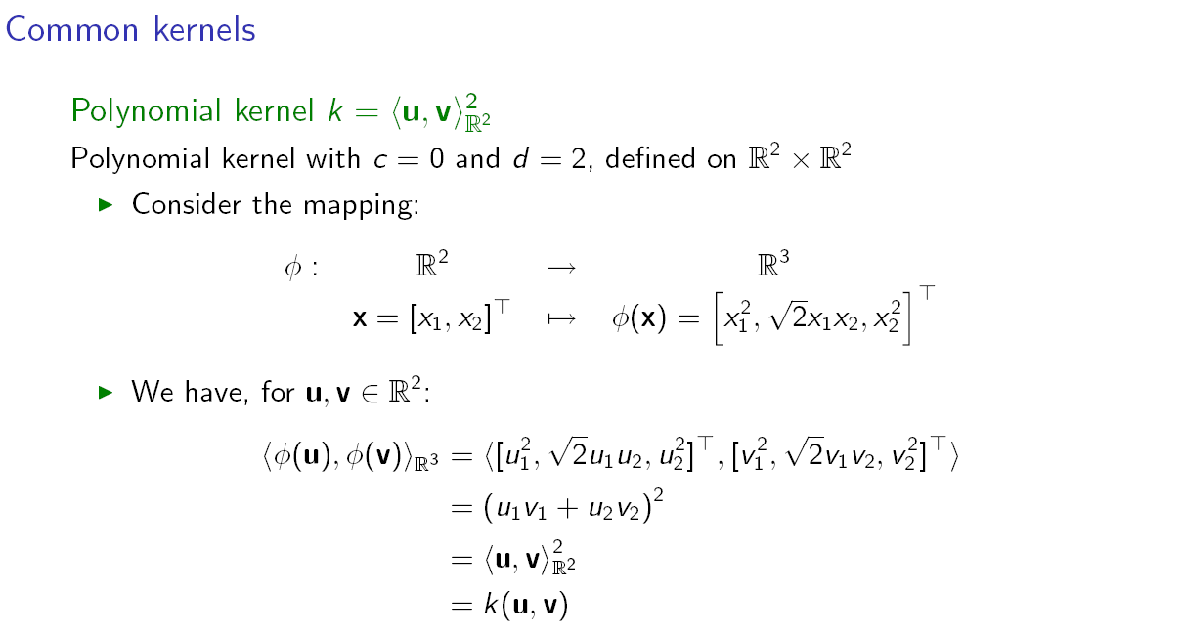
Detailed Example on Polynomial Kernels

Slide 16
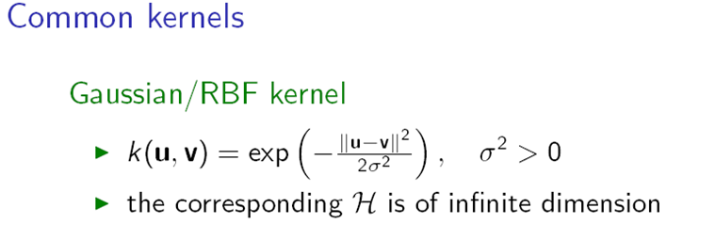
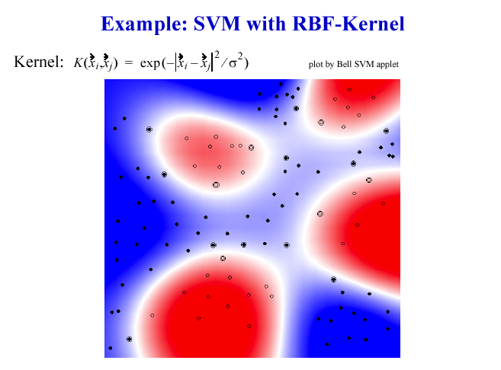

Slide 17
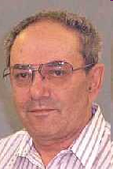
Support Vector Machine (SVM)
A classifier derived from statistical learning theory by Vapnik, et al. in 1992
SVM became famous when, using images as input, it gave accuracy comparable to neural-network with hand-designed features in a handwriting recognition task
Currently, SVM is widely used in object detection & recognition, content-based image retrieval, text recognition, biometrics, speech recognition, etc.
V. Vapnik

Slide 18
Importance of SVM
SVM is a discriminative method that brings together:
1.computational learning theory
2.previously known methods in linear discriminant functions
3.optimization theory
Also called Sparse kernel machines
1. Kernel methods predict based on linear combinations of a kernel function evaluated at the training points
2. Sparse because not all pairs of training points need be used
• Also called Maximum margin classifiers

Slide 19
α
Linear Classifiers
x
f
y^{est}
f(x,w,b) = sign(w x + b)
denotes +1
denotes -1
w x + b>0
w x + b=0
How would you classify this data?
w x + b<0

Slide 20
α
Linear Classifiers
x
f
y^{est}
f(x,w,b) = sign(w x + b)
denotes +1
denotes -1
How would you classify this data?

Slide 21
α
Linear Classifiers
x
f
y^{est}
f(x,w,b) = sign(w x + b)
denotes +1
denotes -1
How would you classify this data?

Slide 22
α
Linear Classifiers
x
f
y^{est}
f(x,w,b) = sign(w x + b)
denotes +1
denotes -1
Any of these would be fine..
..but which is best?

Slide 23
α
Linear Classifiers
x
f
y^{est}
f(x,w,b) = sign(w x + b)
denotes +1
denotes -1
How would you classify this data?
Misclassified
to +1 class

Slide 24
α
α
Classifier Margin
Classifier Margin
x
x
f
f
y^{est}
y^{est}
f(x,w,b) = sign(w x + b)
f(x,w,b) = sign(w x + b)
denotes +1
denotes -1
denotes +1
denotes -1
Define the margin of a linear classifier as the width that the boundary could be increased by before hitting a datapoint.
Define the margin of a linear classifier as the width that the boundary could be increased by before hitting a datapoint.

Slide 25
α
Maximum Margin
x
f
y^{est}
Maximizing the margin is good according to intuition and PAC theory
Implies that only support vectors are important; other training examples are ignorable.
Empirically it works very very well.
f(x,w,b) = sign(w x + b)
denotes +1
denotes -1
The maximum margin linear classifier is the linear classifier with the maximum margin.
This is the simplest kind of SVM (Called an LSVM)
Support Vectors are those datapoints that the margin pushes up against
Linear SVM

Slide 26
What is PAC Theory?
Two important aspects of complexity in pattern discovery:
First, sample complexity: in many learning problems, training data is expensive and we should hope not to need too much of it.
Secondly, computational complexity: A neural network, for example, which takes an hour to train may be of no practical use in complex financial prediction problems.
Important that both the amount of training data required for a prescribed level of performance and the running time of the learning algorithm in learning from this data do not increase too dramatically as the `difficulty' of the learning problem increases.

Slide 27
What is PAC Theory?
Such issues have been formalised and investigated over the past decade within the field of `computational learning theory'.
One popular framework for discussing such problems is the probabilistic framework which has become known as the `probably approximately correct', or PAC, model of learning.

Slide 28
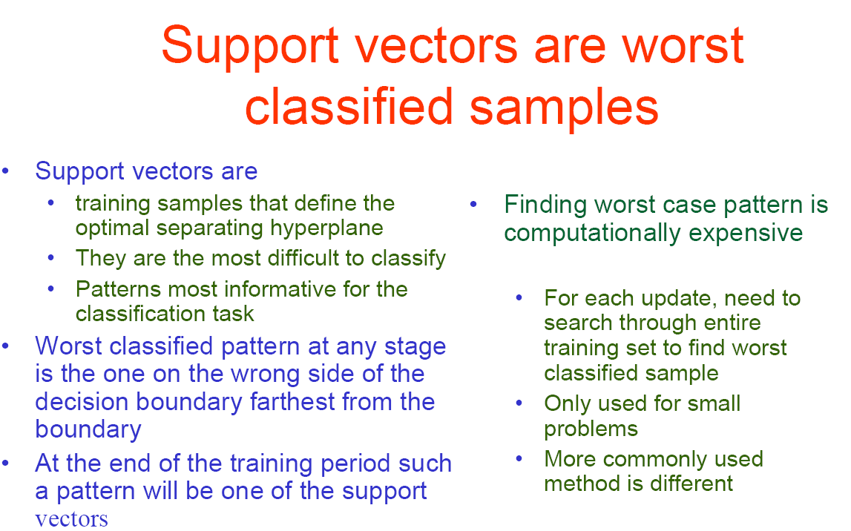
Linear SVMs: Summary
The classifier is a separating hyperplane.
Most “important” training points are support vectors; they define the hyperplane.
Quadratic optimization algorithms can identify which training points x_{i} are support vectors with non-zero Lagrangian multipliers α_{i}.

Slide 29
Non-linear SVMs
Datasets that are linearly separable with some noise work out great:
But what are we going to do if the dataset is just too hard?
How about… mapping data to a higher-dimensional space:
0
x
0
x
x²
0
x

Slide 30
Non-linear SVMs: Feature spaces
General idea: the original input space can always be mapped to some higher-dimensional feature space where the training set is separable:
Φ: x → φ(x)

Slide 31
The “Kernel Trick”: revisited in the context of SVMs
The linear classifier relies on dot product between vectors K(x_{i},x_{j})=x_{i}^{T}x_{j}
If every data point is mapped into high-dimensional space via some transformation Φ: x → φ(x), the dot product becomes:
K(x_{i},x_{j})= φ(x_{i}) ^{T}φ(x_{j})
A kernel function is some function that corresponds to an inner product in some expanded feature space.
Revisited Example of polynomial kernels:
2-dimensional vectors x=[x₁ x₂]; let K(x_{i},x_{j})=(1 + x_{i}^{T}x_{j})²,
Need to show that K(x_{i},x_{j})= φ(x_{i}) ^{T}φ(x_{j}):
K(x_{i},x_{j})=(1 + x_{i}^{T}x_{j})²,
= 1+ x_{i1}²x_{j1}² + 2 x_{i1}x_{j1} x_{i2}x_{j2}+ x_{i2}²x_{j2}² + 2x_{i1}x_{j1} + 2x_{i2}x_{j2}
= [1 x_{i1}² √2 x_{i1}x_{i2} x_{i2}² √2x_{i1} √2x_{i2}]^{T} [1 x_{j1}² √2 x_{j1}x_{j2} x_{j2}² √2x_{j1} √2x_{j2}]
= φ(x_{i}) ^{T}φ(x_{j}), where φ(x) = [1 x₁² √2 x₁x₂ x₂² √2x₁ √2x₂]

Slide 32
Nonlinear SVM - Summary
SVM locates a separating hyperplane in the feature space and classifies points in that space
It does not need to represent the space explicitly, it just simply works by defining a kernel function
The kernel function plays the role of the dot product in the feature space.
Sparseness of solution when dealing with large data sets
only support vectors are used to specify the separating hyperplane
Overfitting can be controlled by soft margin approach
Nice math property: a simple convex optimization problem which is guaranteed to converge to a single global solution

Slide 33
Weakness of SVM
It is sensitive to noise
- A relatively small number of mislabeled examples can dramatically decrease the performance
It only considers two classes
- how to do multi-class classification with SVM?
- Answer:
1) with m classes, learn m SVM’s
SVM 1 learns “Output==1” vs “Output != 1”
SVM 2 learns “Output==2” vs “Output != 2”
:
SVM m learns “Output==m” vs “Output != m”
2)To predict the output for a new input, just predict with each SVM and find out which one puts the prediction the furthest into the positive region.

Slide 34
SVM Application: Text Categorization
Task: The classification of natural text (or hypertext) documents into a fixed number of predefined categories based on their content.
- email filtering, web searching, sorting documents by topic, etc..
A document can be assigned to more than one category, so this can be viewed as a series of binary classification problems, one for each category

Slide 35
Application : Face Expression Recognition
Construct feature space, by use of eigenvectors or other means
Multiple class problem, several expressions
Use multi-class SVM

Slide 36
Some Issues
Choice of kernel
- Gaussian or polynomial kernel is default
- if ineffective, more elaborate kernels are needed
Choice of kernel parameters
- e.g. σ in Gaussian kernel
- σ is the distance between closest points with different classifications
- In the absence of reliable criteria, applications rely on the use of a validation set or cross-validation to set such parameters.
Optimization criterion – Hard margin v.s. Soft margin
- a lengthy series of experiments in which various parameters are tested

Slide 37
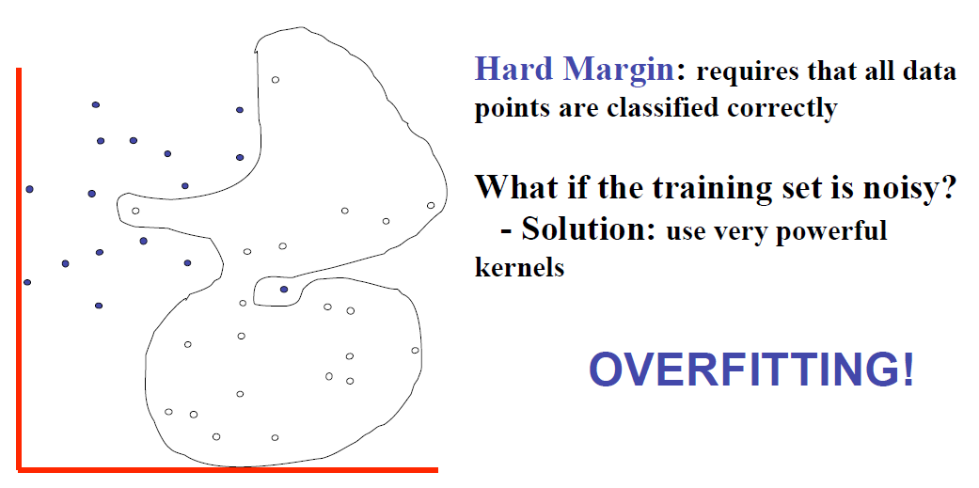
Hard margin classification

Slide 38
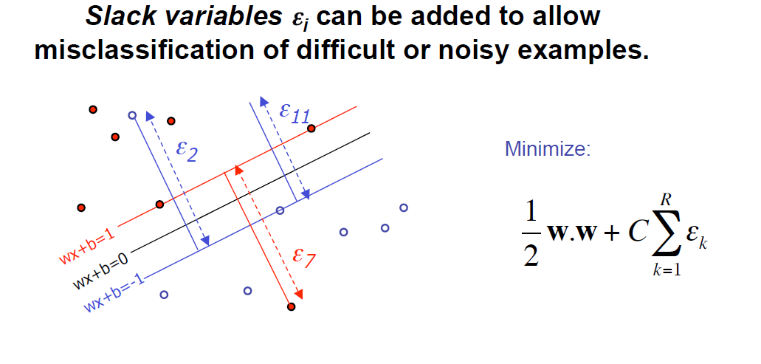
Soft margin classification

Slide 39
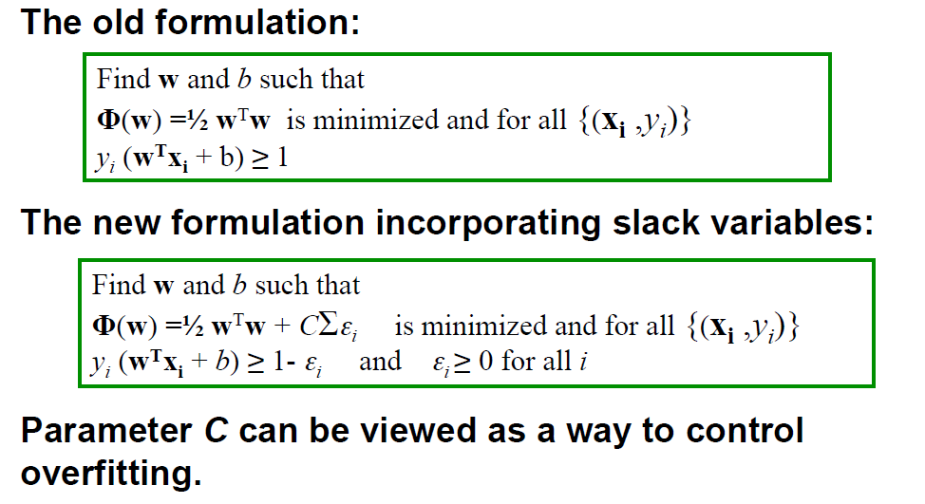
Hard versus soft margin

Slide 40
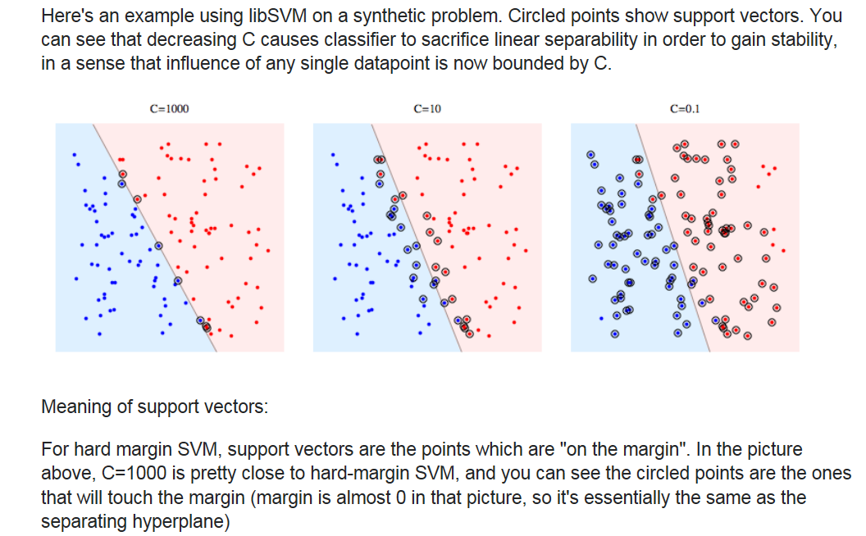
Example

Slide 41
References and Resources
An excellent tutorial on VC-dimension and Support Vector Machines:
C.J.C. Burges. A tutorial on support vector machines for pattern recognition. Data Mining and Knowledge Discovery, 2(2):955-974, 1998.
The VC/SRM/SVM Bible:
Statistical Learning Theory by Vladimir Vapnik, Wiley-Interscience; 1998
http://www.kernel-machines.org/

Slide 42
References and Resources
Support Vector Machine Classification of Microarray Gene Expression Data, Michael P. S. Brown William Noble Grundy, David Lin, Nello Cristianini, Charles Sugnet, Manuel Ares, Jr., David Haussler
Text categorization with Support Vector Machines: learning with many relevant features
T. Joachims, ECML - 98

Slide 43
Additional references
Prof. Andrew Moore’s SVM tutorial at http://www.cs.cmu.edu/~awm/tutorials
Kernels materials:
http://videolectures.net/bootcamp2010_ralaivola_ikm/
Matlab code:
http://cmp.felk.cvut.cz/cmp/software/stprtool/

