Slide 1
CSC529: Advanced Data Mining
Lecture 7
Kernel Methods for feature extraction (KPCA) and classification (SVM)

Slide 2
Lecture Outline
Support Vector Machines (SVM)
  Applications to OCR
  SVM in Matlab
Kernel Principal Component Analysis (k-PCA)
  PCA
    Applications
      Face Recognition
      Facial Expression Recognition
  Kernel PCA
    Applications
      Kernel PCA for Lung Nodule Data Visualization

Slide 3
SVM Applications to Handwritten Digit Recognition
Extracting Support Data for a Given Task
Bernhard Schölkopf Chris Burges Vladimir Vapnik
Proceedings, First International Conference on
Knowledge Discovery & Data Mining. 1995
http://www.aaai.org/Papers/KDD/1995/KDD95-030.pdf

Slide 4
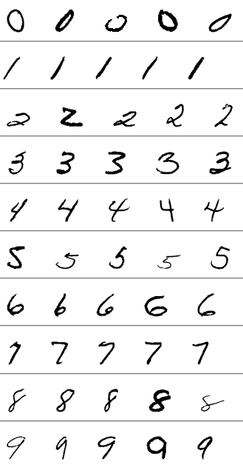
SVM Applications to Handwritten Digit Recognition
Input (the US Postal Service (USPS handwritten digits from mail envelopes in Buffalo – LeCun et al., 1989)
  Training set: 7300
  Testing set: 2000
16x16
  Each digit is a 16×16 image, represented as a 256-dimensional vector with entries between −1 and 1.
  Preprocessing consisted of smoothing with a Gaussian kernel of width σ=0.75.
.
It is known that the USPS test set is rather difficult — the human error rate is 2.5% (Bromley & Sackinger, 1991)

Slide 5
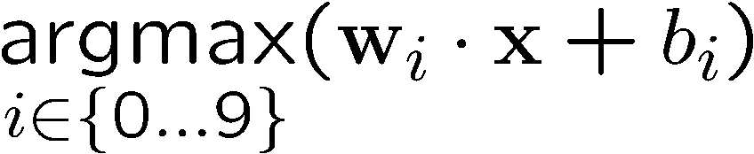
SVM Applications to Handwritten Digit Recognition
One vs. All Constructed SVM Classifiers:
Take the training samples with the same label as one class and the others as the other class, then it becomes a binary classification (digit class/no class) problem.
  Build 10 class/non-class SVM classifiers
The testing sample x belongs to jth class where the j-th class has the maximal output:

Slide 6
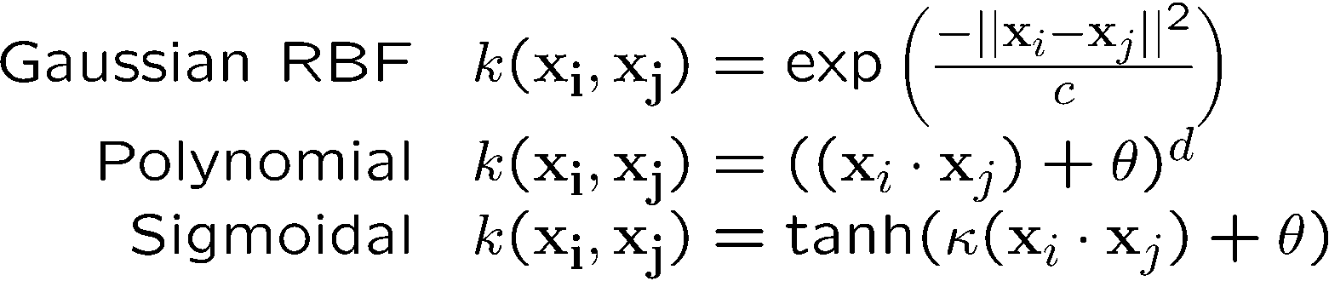
SVM Applications to Handwritten Digit Recognition
Three different types of classifiers for each digit:

Slide 7
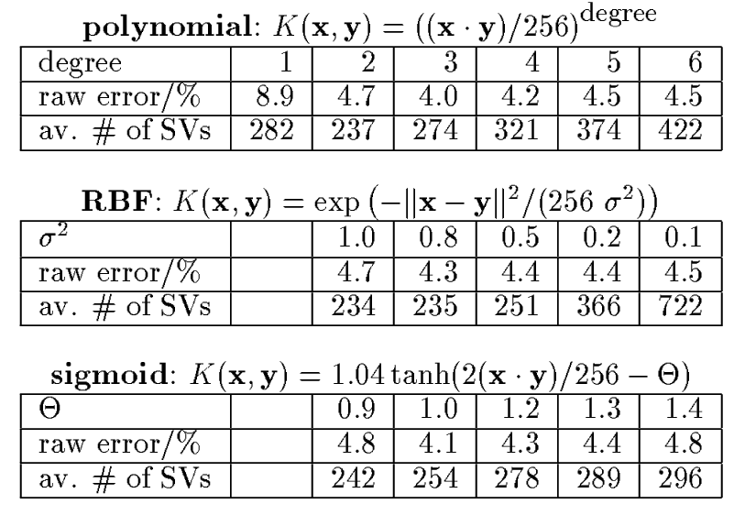
SVM Applications to Handwritten Digit Recognition
Notes:
Similar performance the 3 types of kernels means that it’s more important to control the capacity rather than type of decision function;
Raw errors (i.e. no rejections allowed: Patterns are rejected when the difference between the outputs of the top two classes is smaller than a predefined threshold beta.
Average number of support vectors of the ten two-class classifiers.

Slide 8
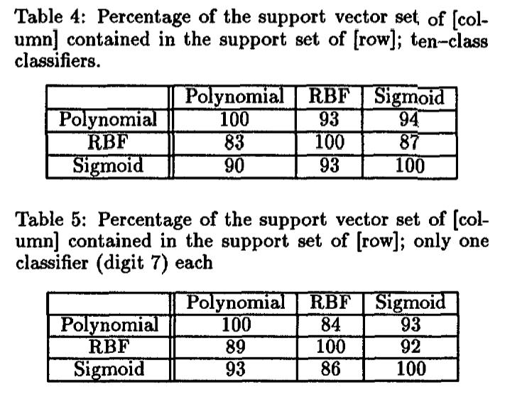

SVM Applications to Handwritten Digit Recognition
Notes:
Tables 4-6 show how many elements the support vector sets of the different classifiers have in common.

Slide 9
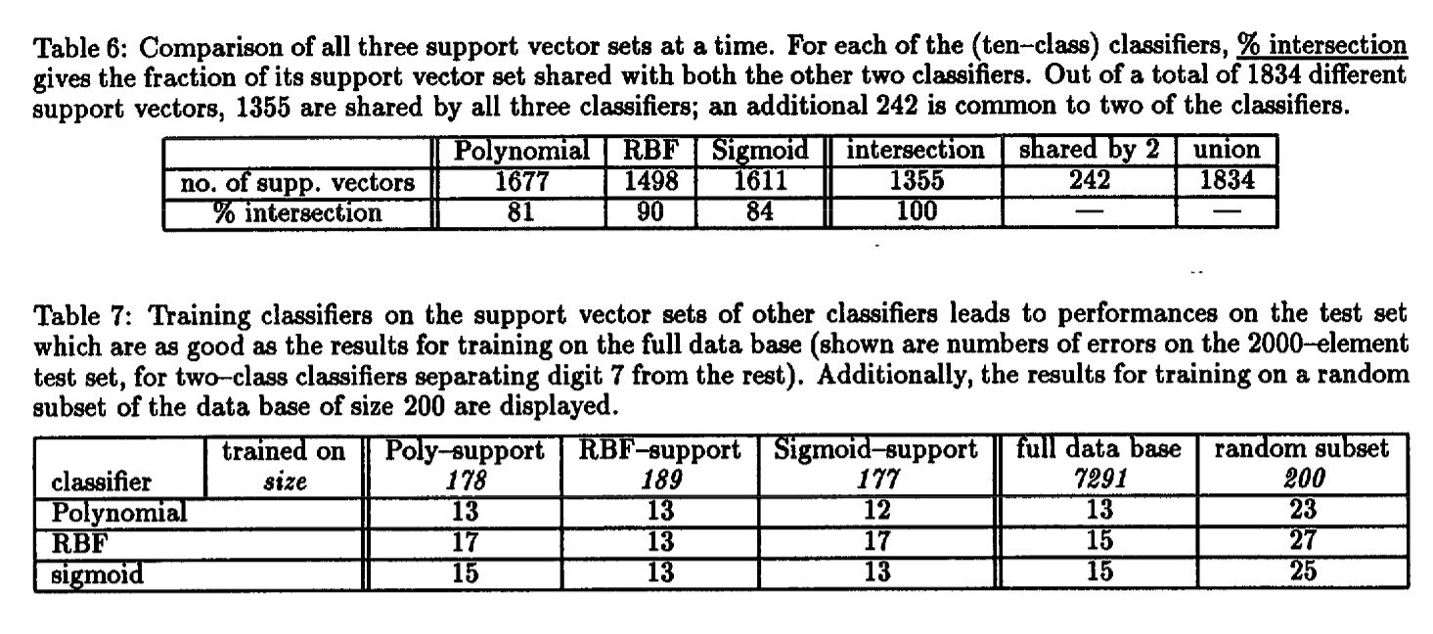
SVM Applications to Handwritten Digit Recognition
Notes:
Tables 4-6 show how many elements the support vector sets of the different classifiers have in common.

Slide 10
SVM Conclusion for Handwritten Character Recognition (I)
The support vector algorithm allows the construction of various learning machines, all of which are performing similarly well.
We were able to predict the degree of polynomial classifiers which leads to high generalization ability.

Slide 11
SVM Conclusion (2)
For the considered classification problem (the US postal handwritten digit database) the three constructed learning machines (polynomial classifiers, neural nets, radial basis function classifiers) construct their decision functions from highly overlapping subsets of the training set.
  Considering that in the experiments these support vector sets constituted less than 4% of the whole training set (for binary classification), the latter point indicates the possibility of a substantial data compression.

Slide 12
SVM in Matlab
Support vector machines in Matlab:
http://www.mathworks.com/help/stats/support-vector-machines-svm.html
Fitcsvm.m = train a SVM classifier
Predict.m = classify new data using an SVM classifier
Step by step SVM on the iris data:
http://www.egr.msu.edu/classes/ece480/capstone/spring11/group04/application_Kan.pdf

Slide 13
Extending PCA to kernel PCA
  PCA
    Motivation
    Theory
    Applications
      Face Recognition
      Facial Expression Recognition
  Kernel PCA
    Theory
    Applications
      Kernel PCA for Lung Nodule Data Visualization

Slide 14
Motivation
Data Visualization
Data Compression
Noise Reduction

Slide 15
Data Visualization
Example:
Given 53 blood and urine samples (features) from 65 people.
How can we visualize the measurements?

Slide 16
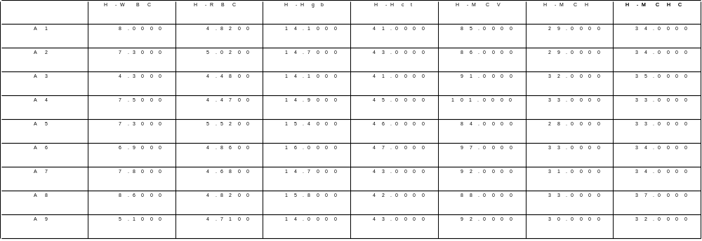
Data Visualization
Matrix format (65x53)
Instances
Features
Difficult to see the correlations between the features...

Slide 17
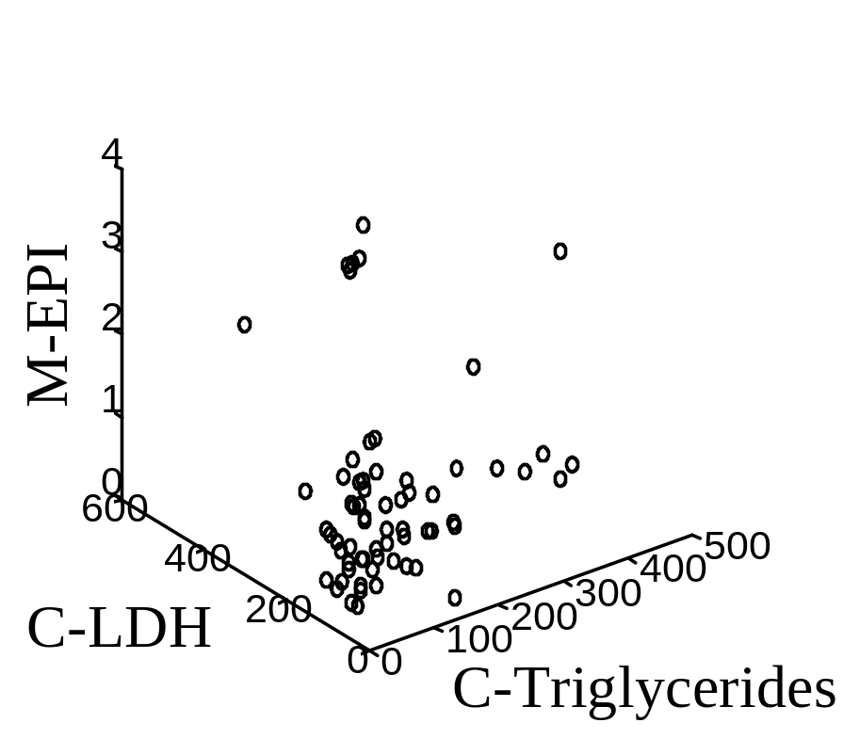
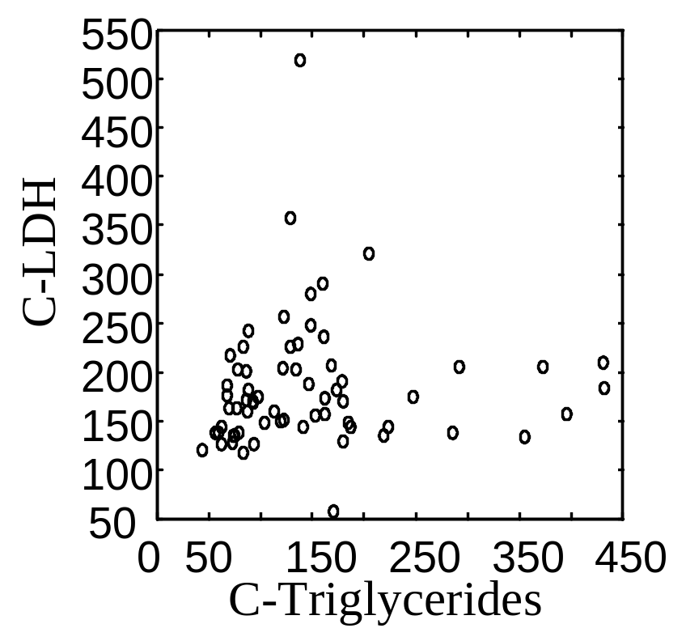
Data Visualization
Bi-variate
Tri-variate
How can we visualize the other variables???
… difficult to see in 4 or higher dimensional spaces...

Slide 18
Data Visualization
Is there a representation better than the coordinate axes?
Is it really necessary to show all the 53 dimensions?
  … what if there are strong correlations between the features?
How could we find
the smallest subspace of the 53-D space that
keeps the most information about the original data?
A solution: Principal Component Analysis

Slide 19
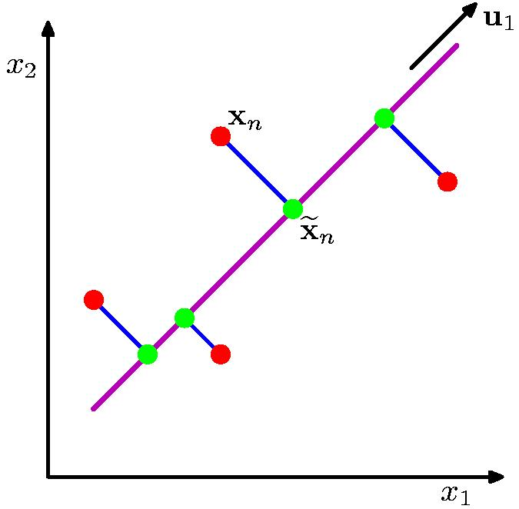
Principle Component Analysis
PCA:
Orthogonal projection of data onto lower-dimension linear space that...
  maximizes variance of projected data (purple line)
  minimizes mean squared distance between
    data point and
    projections (sum of blue lines)

Slide 20
Principle Components Analysis
Idea:
  Given data points in a d-dimensional space,
  project into lower dimensional space while preserving as much information as possible
    Eg, find best planar approximation to 3D data
    Eg, find best 12-D approximation to 10⁴-D data
  In particular, choose projection that
  minimizes squared error
  in reconstructing original data

Slide 21
The Principal Components
Vectors originating from the center of mass
Principal component #1 points
in the direction of the largest variance.
Each subsequent principal component…
  is orthogonal to the previous ones, and
  points in the directions of the largest variance of the residual subspace

Slide 22
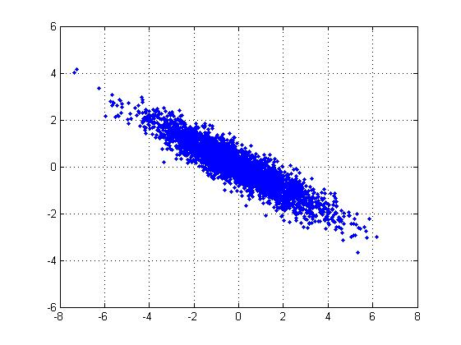
2D Gaussian dataset

Slide 23
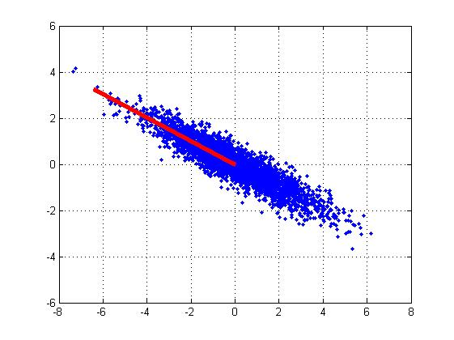
1st PCA axis

Slide 24

2nd PCA axis

Slide 25
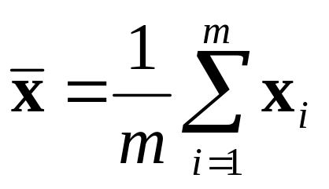
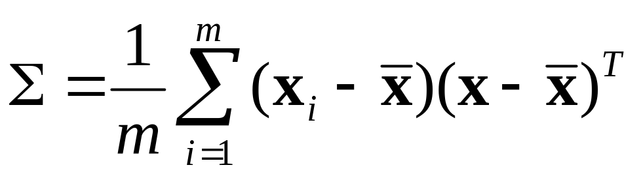
PCA algorithm
(based on sample covariance matrix)
Given data {x₁, …, x_{m}}, compute covariance matrix Σ
PCA basis vectors = the eigenvectors of Σ
{ λ_{i}, u_{i} }_{i=1..N} = eigenvectors/eigenvalues of Σ
... λ₁ ≥ λ₂ ≥ … ≥ λ_{N}
Larger eigenvalue ⇒ more important eigenvectors
where

Slide 26
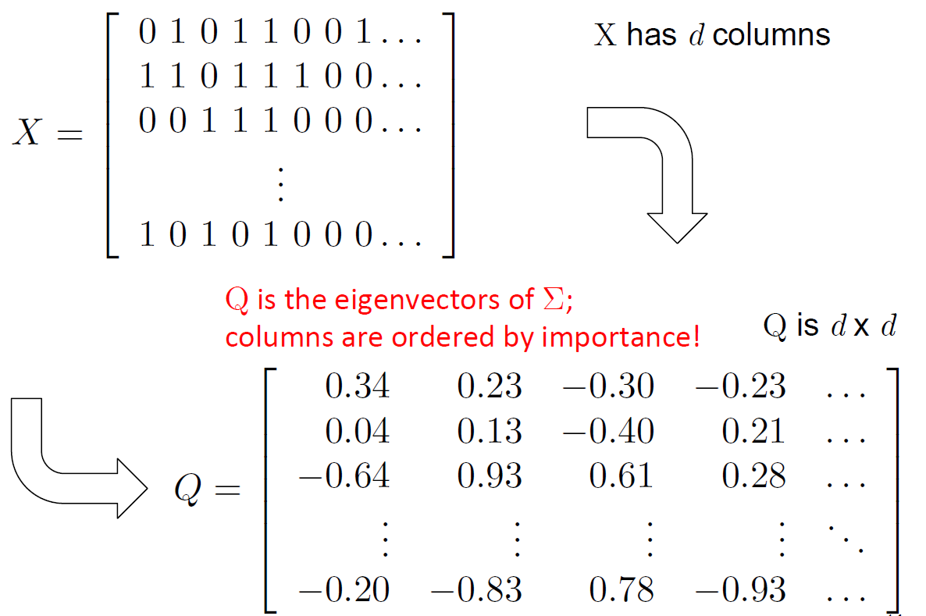
PCA

Slide 27
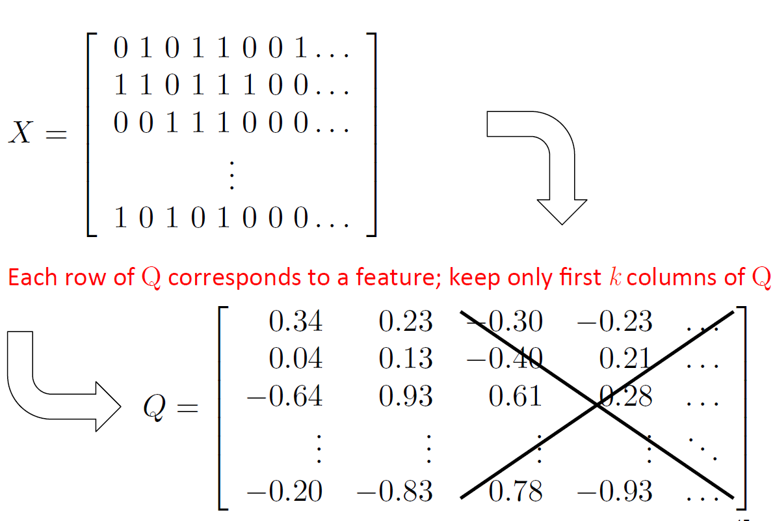

Slide 28
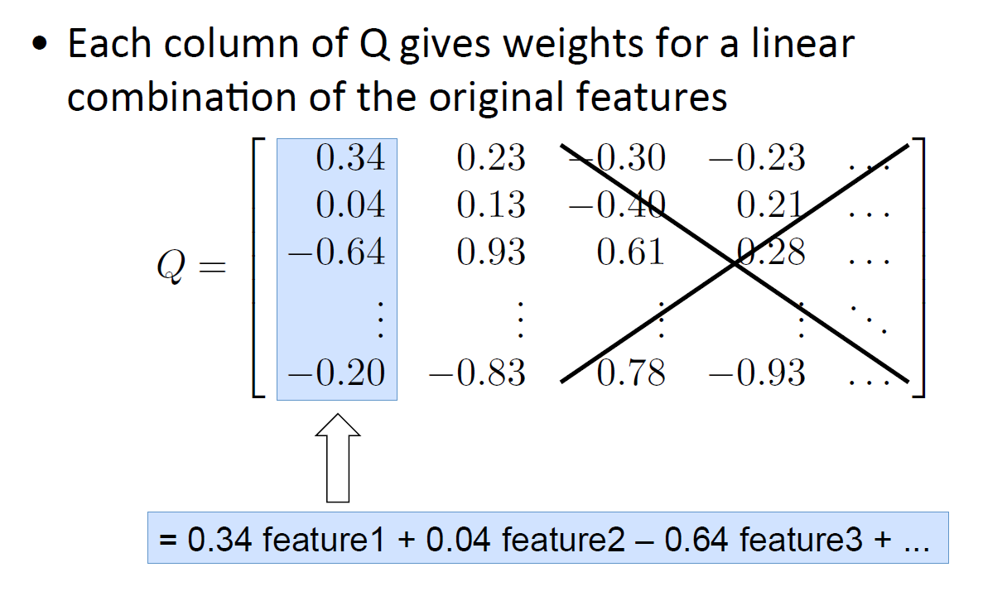

Slide 29
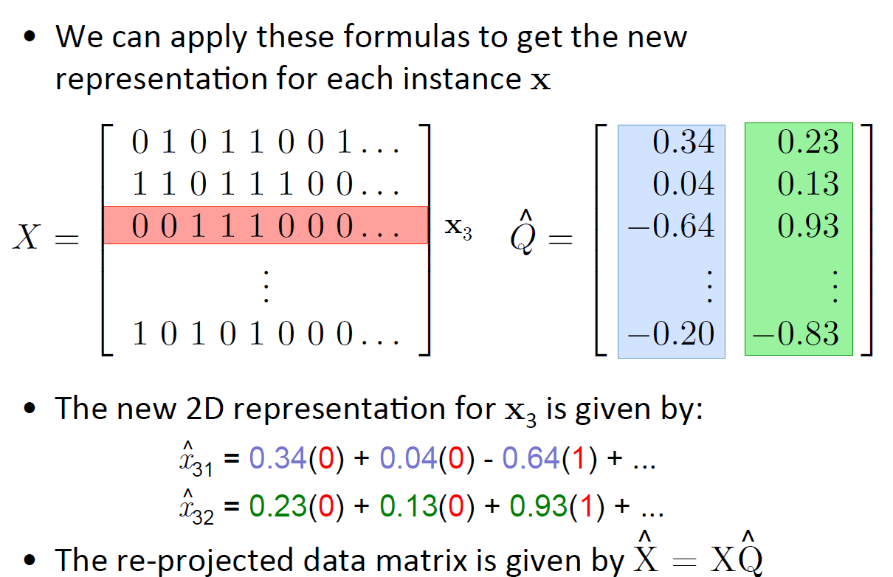

Slide 30
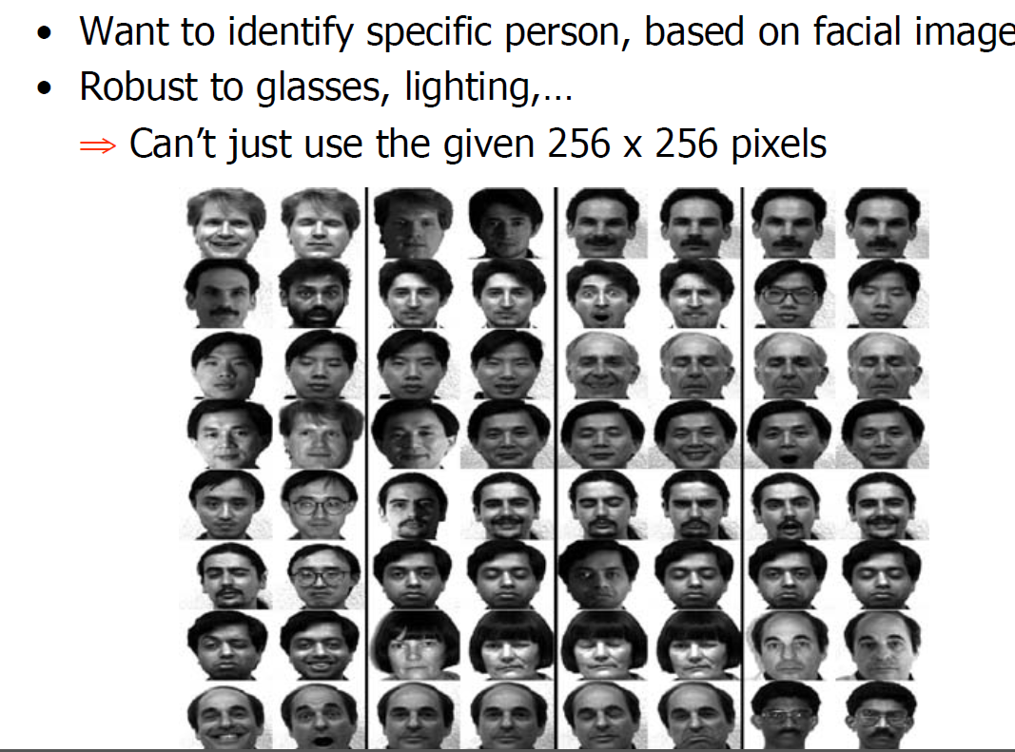

Slide 31
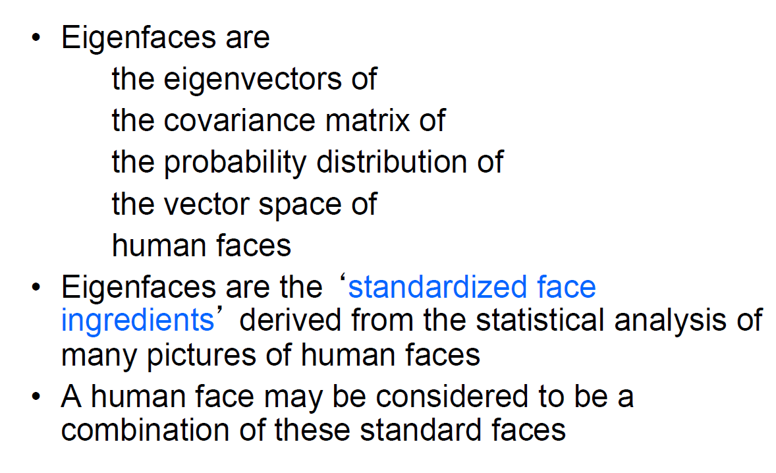

Slide 32
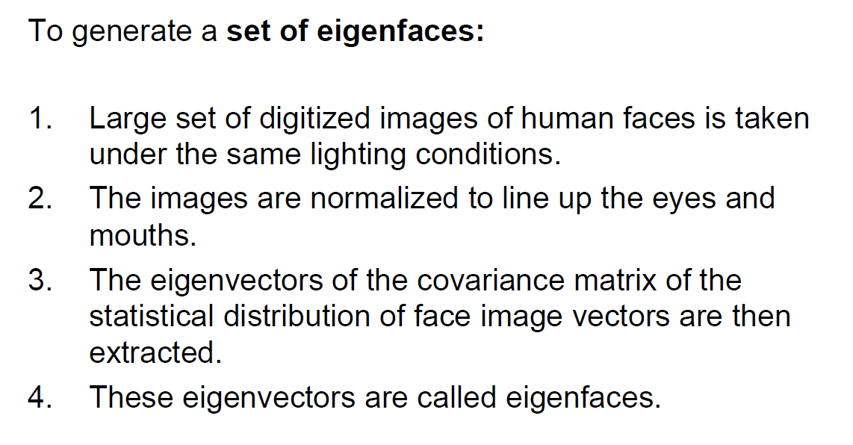

Slide 33
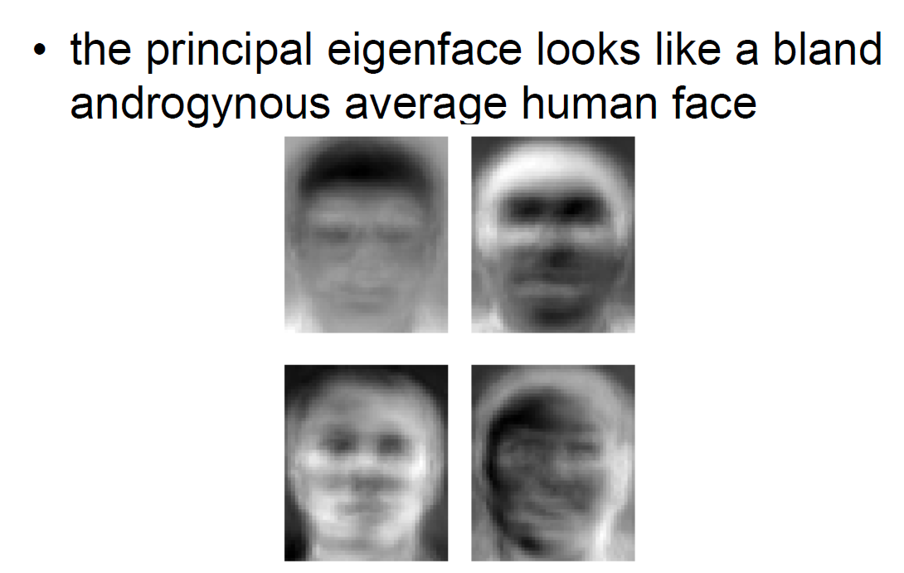

Slide 34
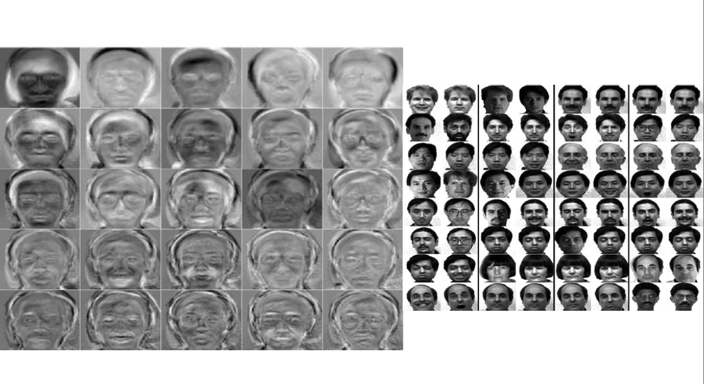

Slide 35
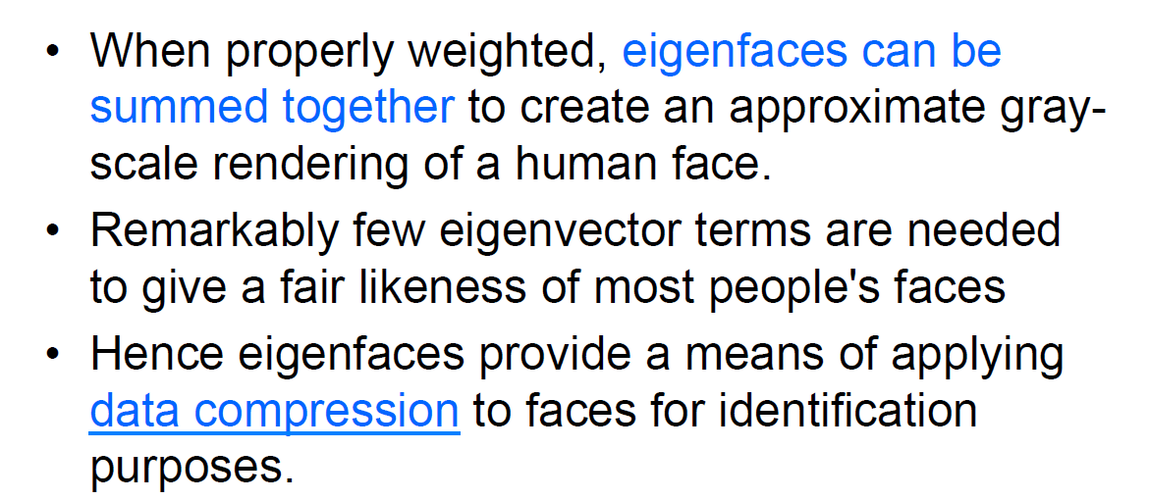

Slide 36
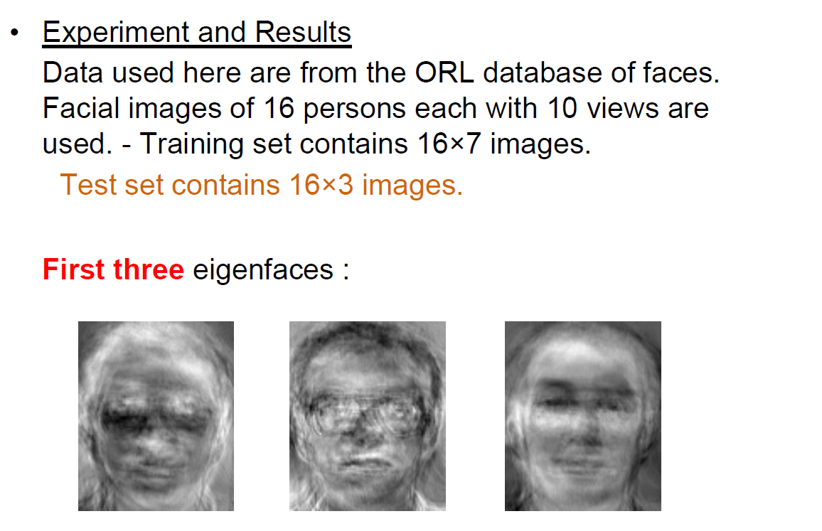

Slide 37
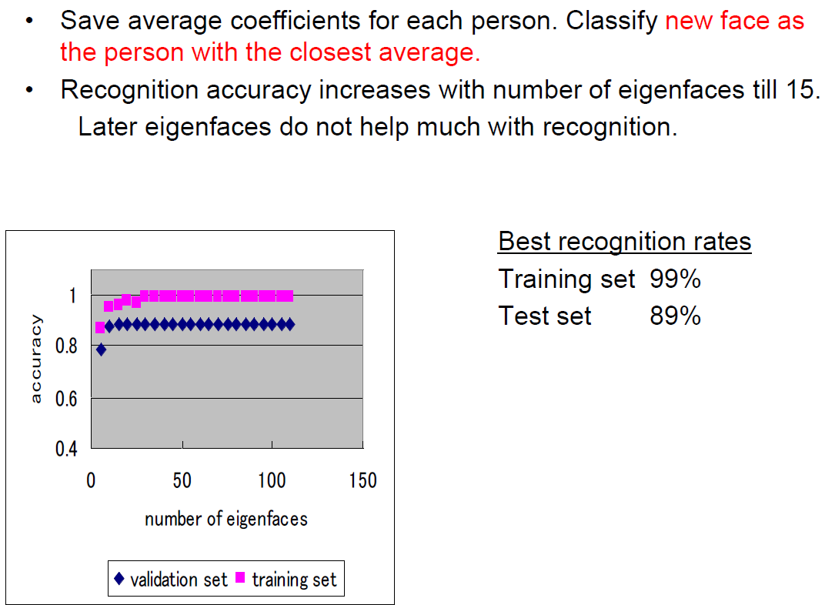

Slide 38
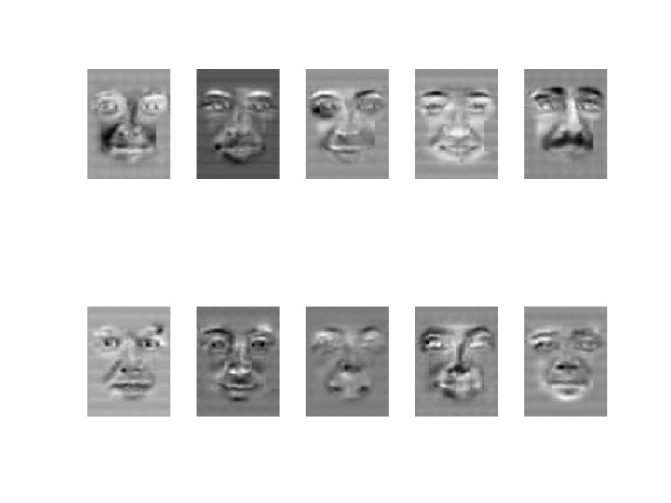
Application: Facial Expression Recognition
Happiness subspace

Slide 39
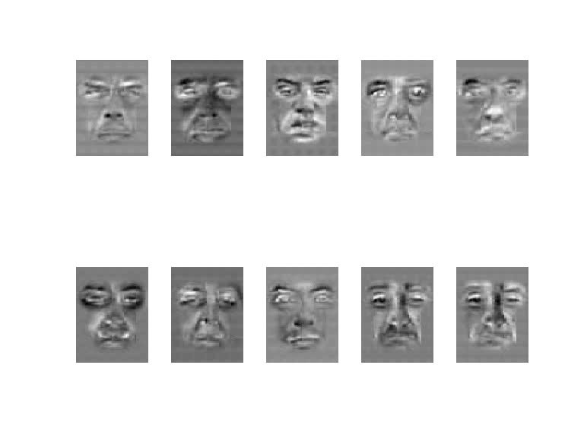
Disgust subspace

Slide 40
PCA: a Problematic Data Set
PCA doesn’t know labels!

Slide 41
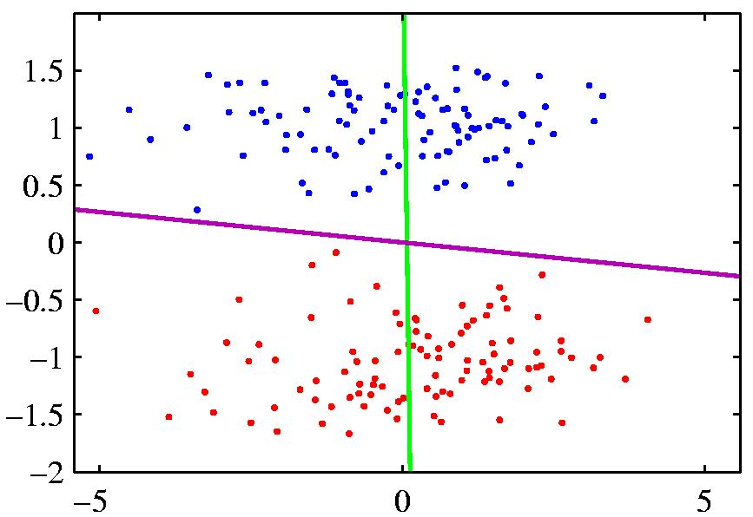
PCA vs Fisher Linear Discriminant
PCA maximizes variance,
independent of class
  ⇒ magenta
FLD attempts to separate classes
  ⇒ green line

Slide 42
PCA: a Problematic Data Set
PCA cannot capture NON-LINEAR structure!

Slide 43
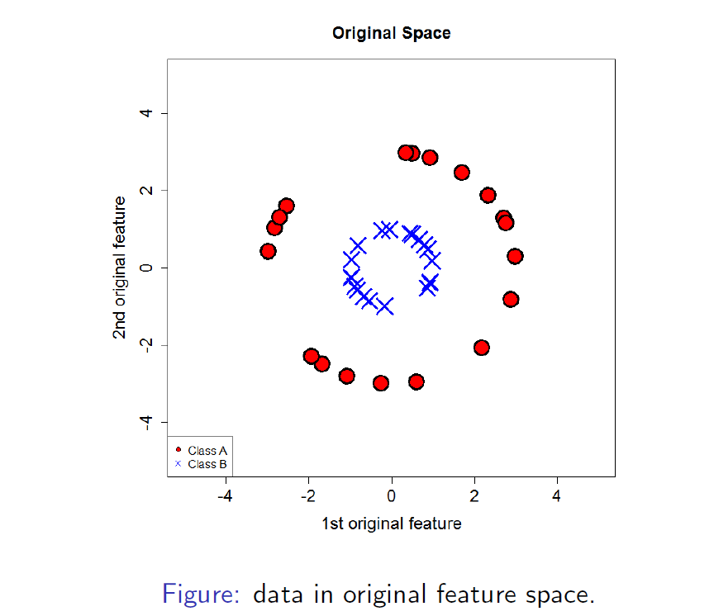
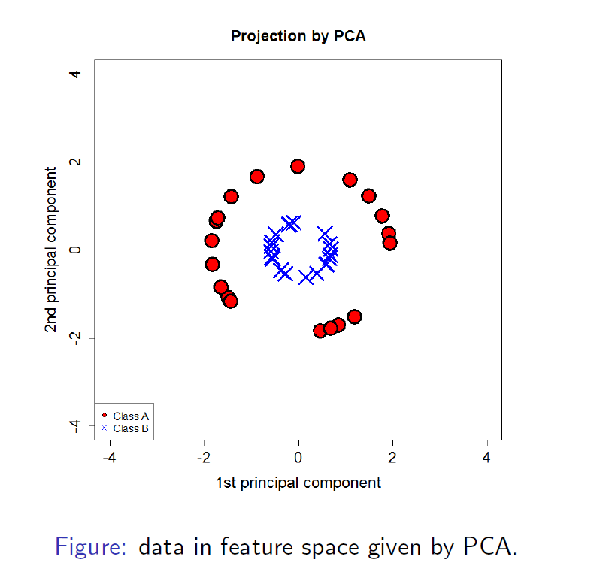
Linear PCA

Slide 44
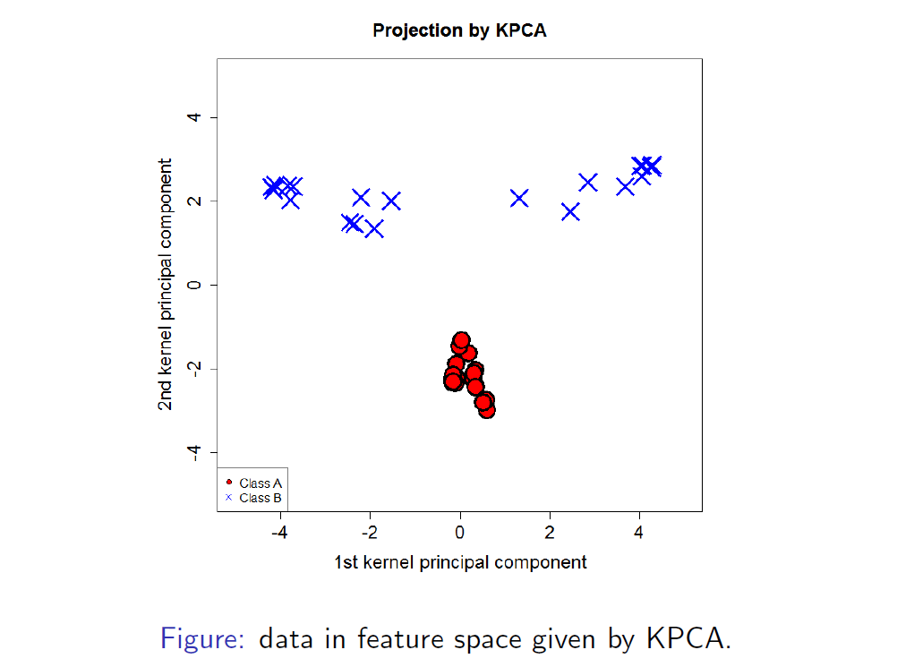
KPCA

Slide 45
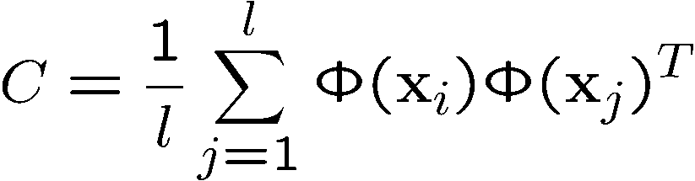
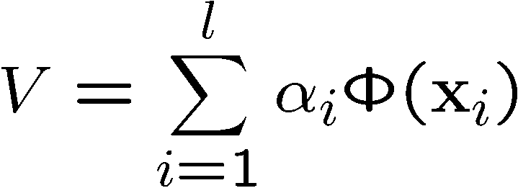
Kernel PCA
Extension to feature space:
  compute covariance matrix
  solve eigenvalue problem CV=λV

Slide 46
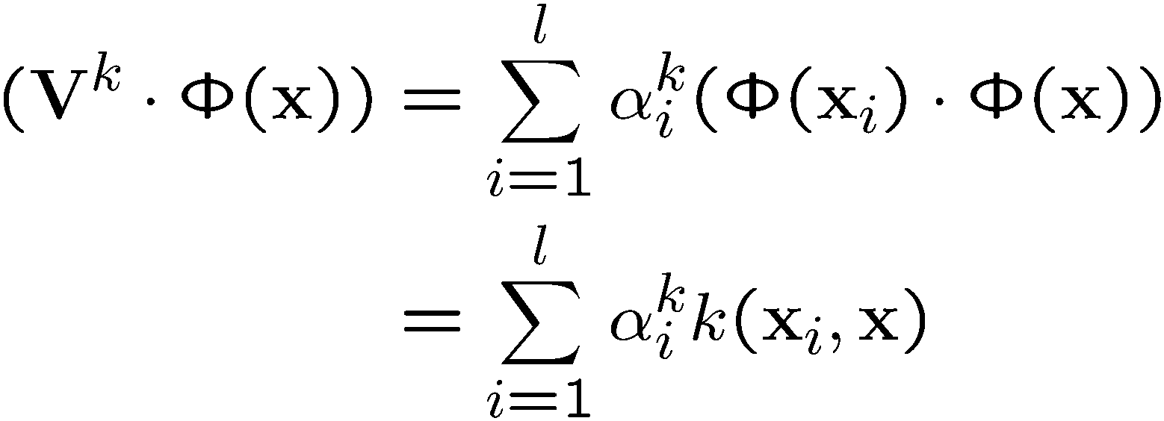
Kernel PCA –
Extracting Features
To extract features of a new pattern x with kernel PCA, project the pattern on the first n eigenvectors

Slide 47
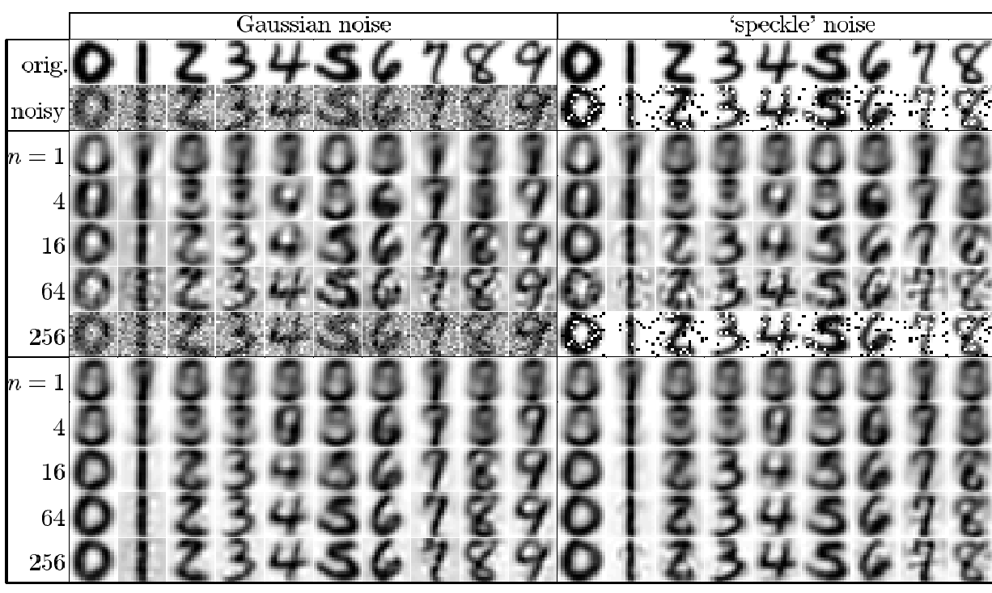
Applications – Kernel PCA
Real world data
Notes:
256 dimensional handwritten digits
Training: 300
Testing: 50
Used RBF
Gaussian noise sigma=0.5
Speckle noise p=0.4

Slide 48
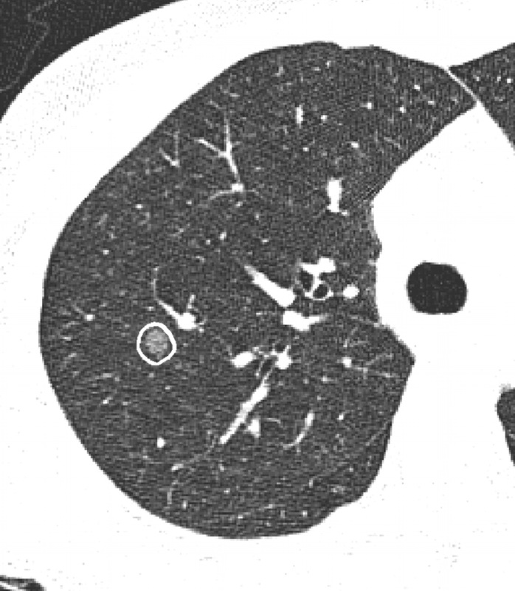
Applications of kernel PCA to visualize LIDC data
See kCCA_project.pdf posted under the course documents for week 7.
Nodule image representative = image slice with the largest area of a nodule across all slices in which nodule appears and across all four radiologists
N ≈ 6,600
65 image features: size, shape, texture, and intensity
9 semantic features
  Our focus: malignancy

Slide 49
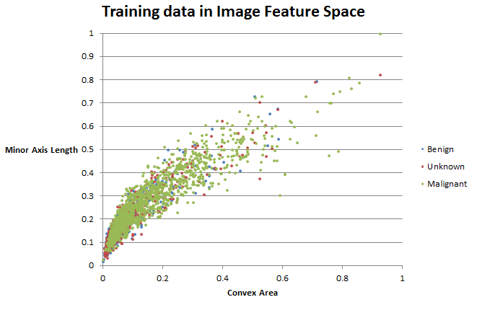
LIDC Data Visualization (based on size features)

Slide 50
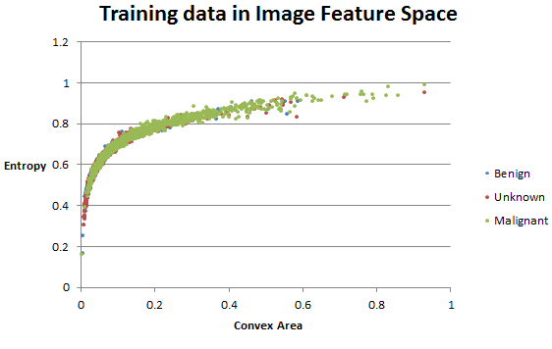
LIDC data visualization (based on texture and size features)

Slide 51
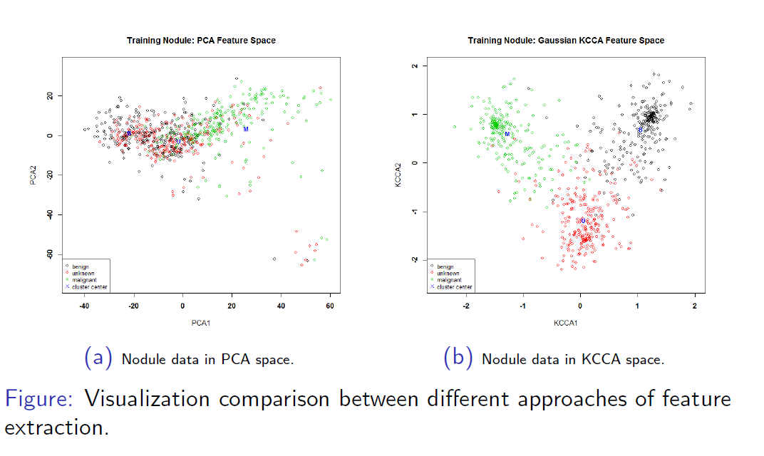
LIDC Data Visualization in PCA and KCCA spaces

