Slide 1
CSC529: Advanced Data Mining
Lectures 8 Probabilistic Graphical Models

Slide 2
Lecture Outline
Chapter 6, Section 6.7 (Witten, Frank, and Hall):
Graphical models – basic concepts
Bayesian Networks
Example of Bayesian Network: Student Model
Reasoning Patterns/Inferences
Causal
Evidential
Intercausal

Slide 3
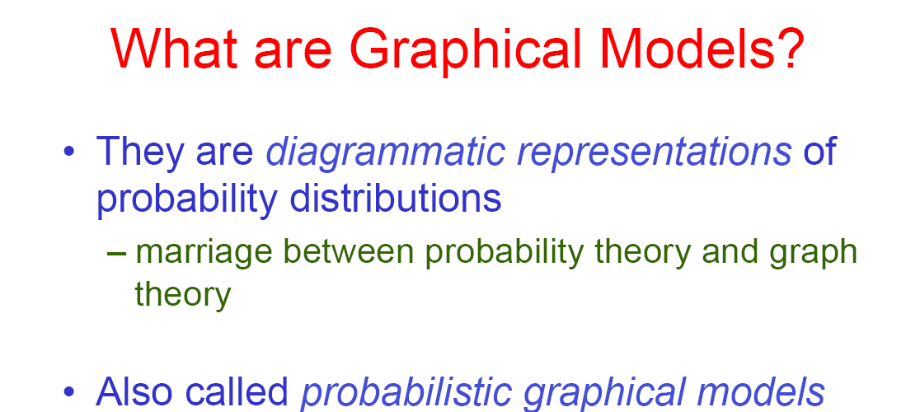

Slide 4
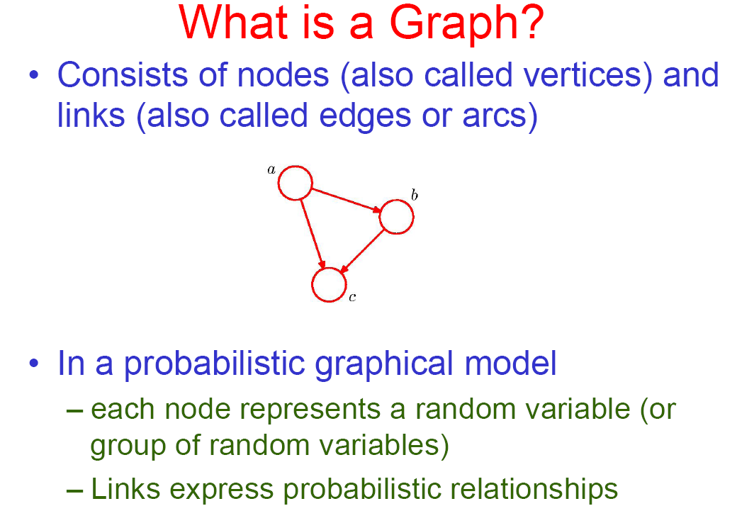

Slide 5
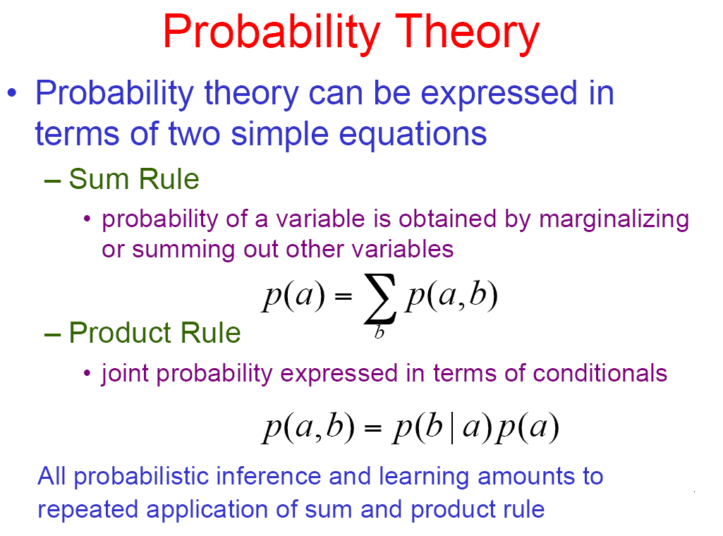

Slide 6
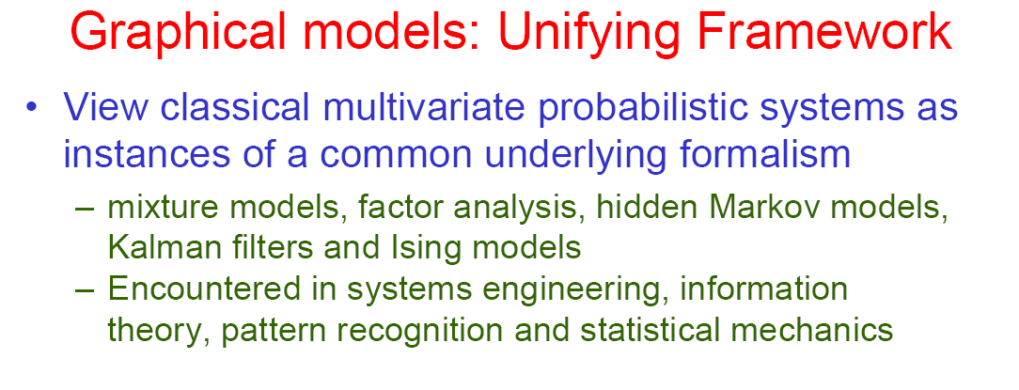

Slide 7
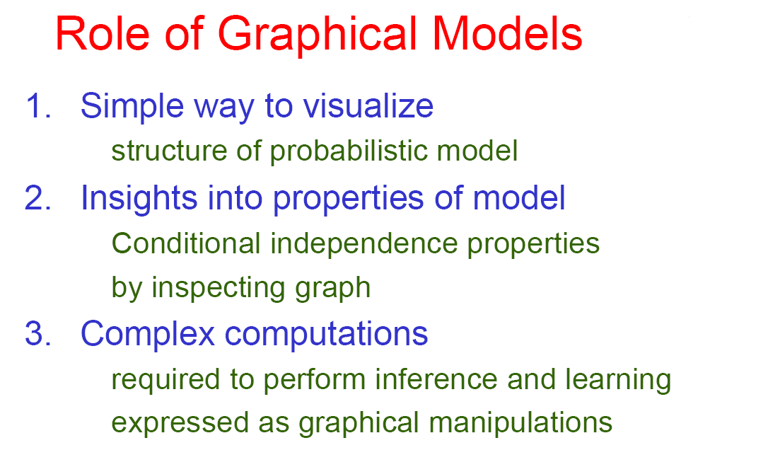

Slide 8
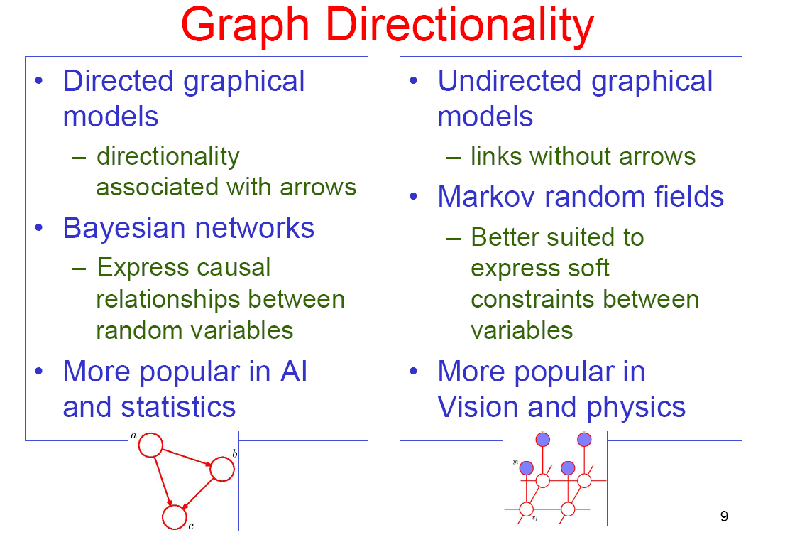

Slide 9
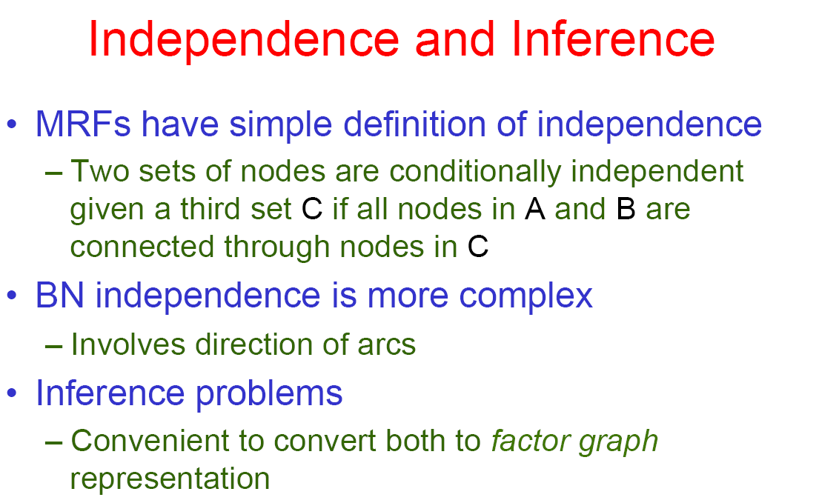

Slide 10
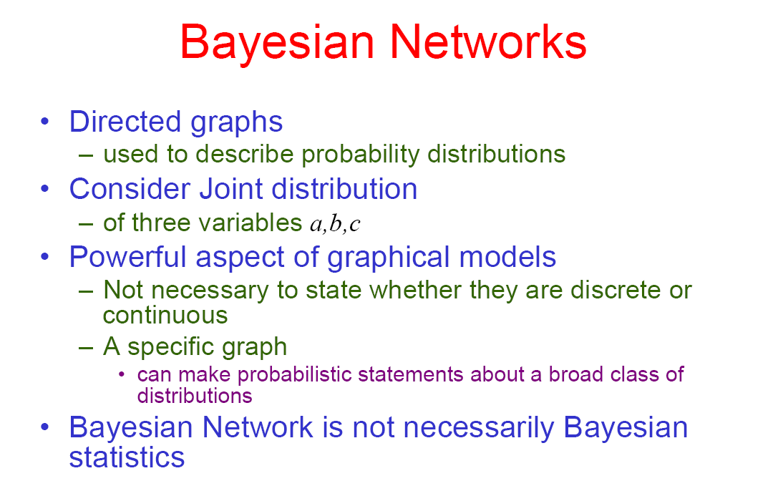

Slide 11
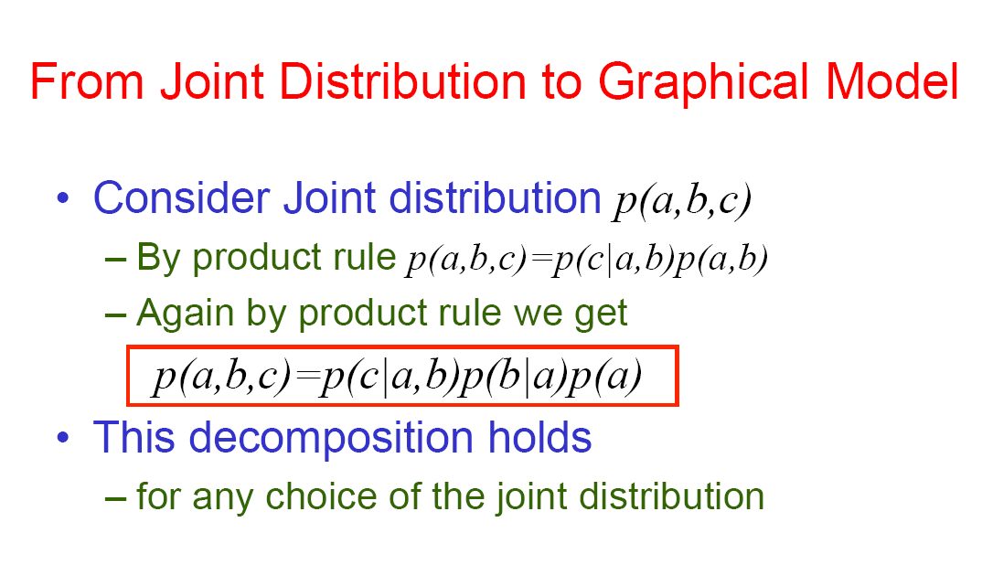

Slide 12
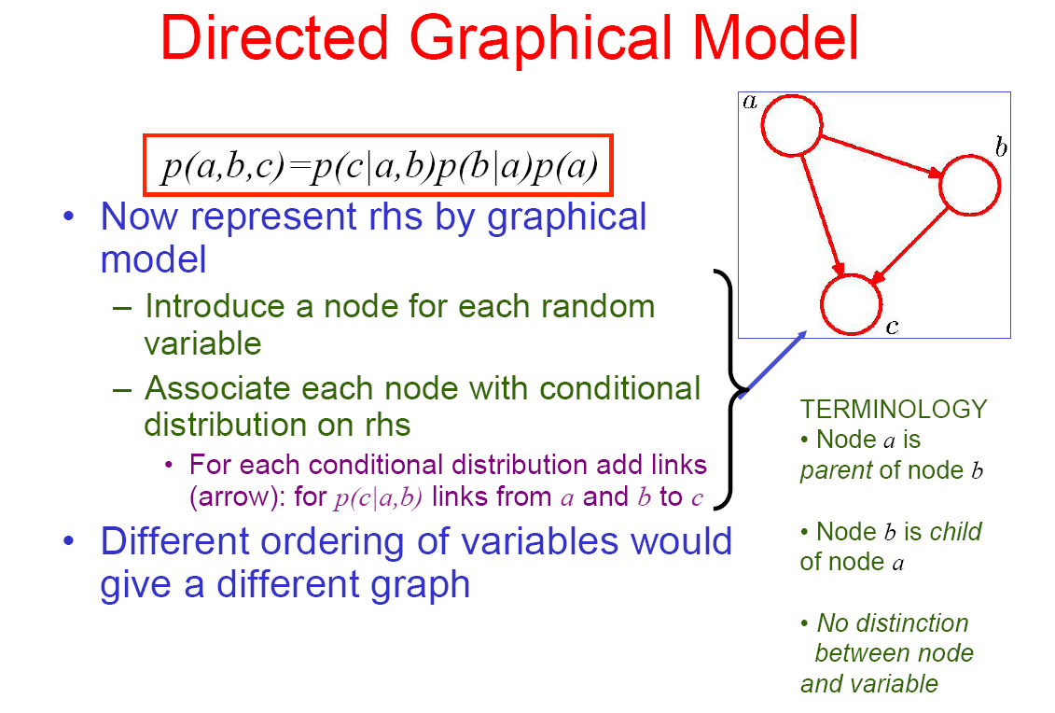

Slide 13
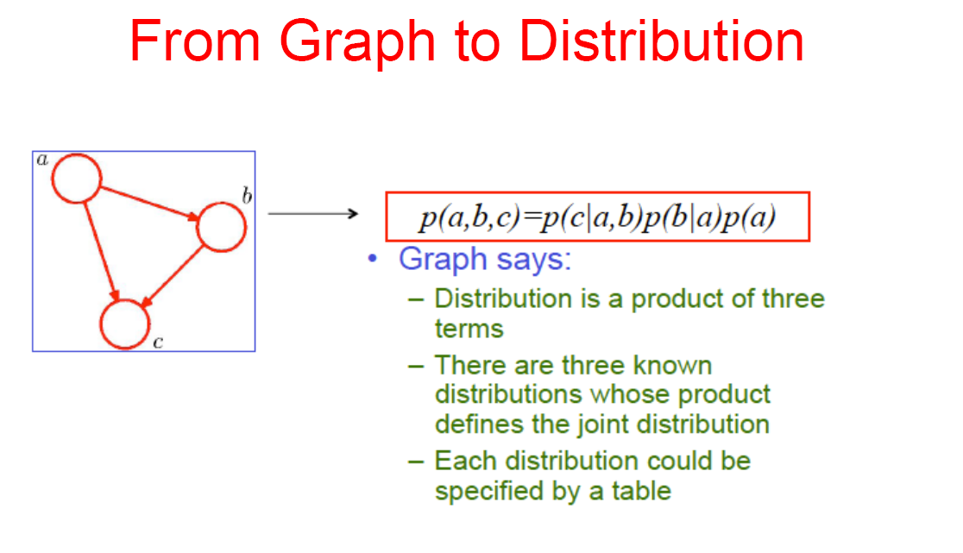

Slide 14
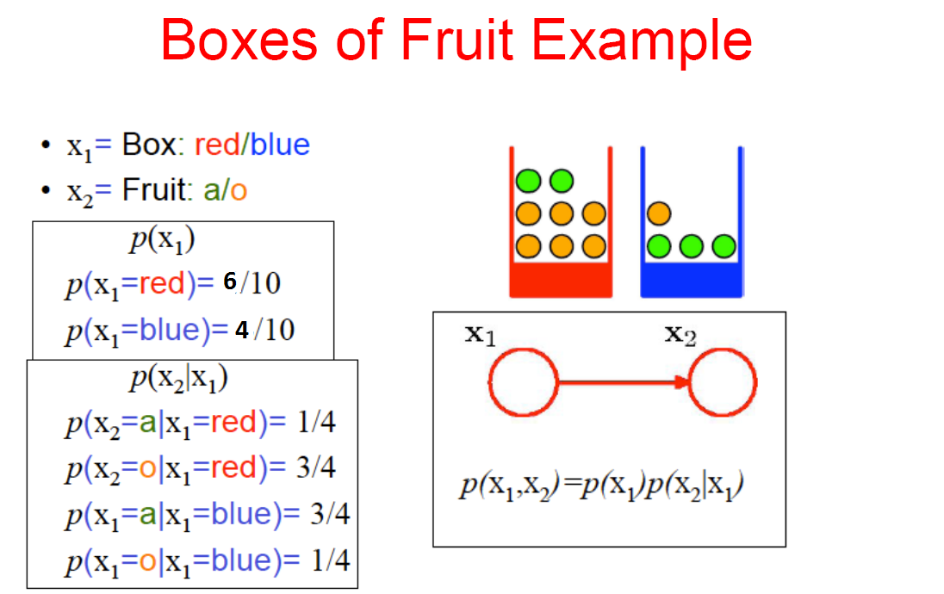

Slide 15
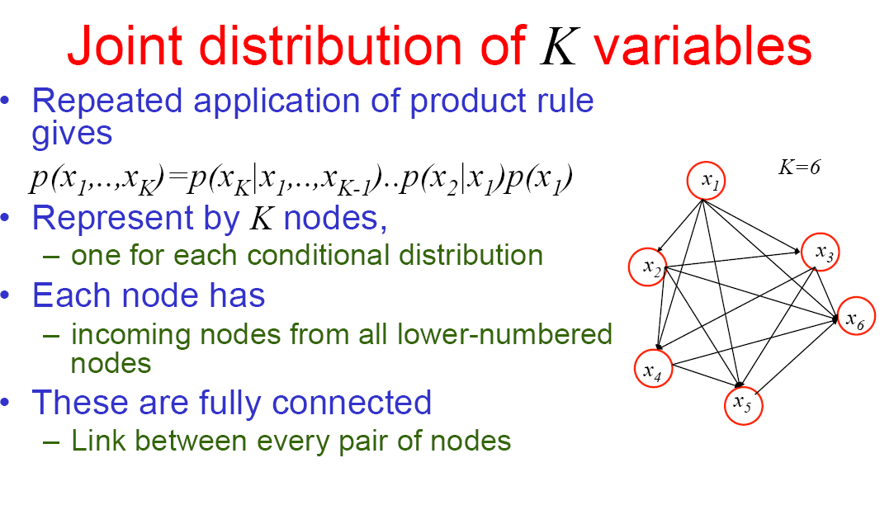

Slide 16
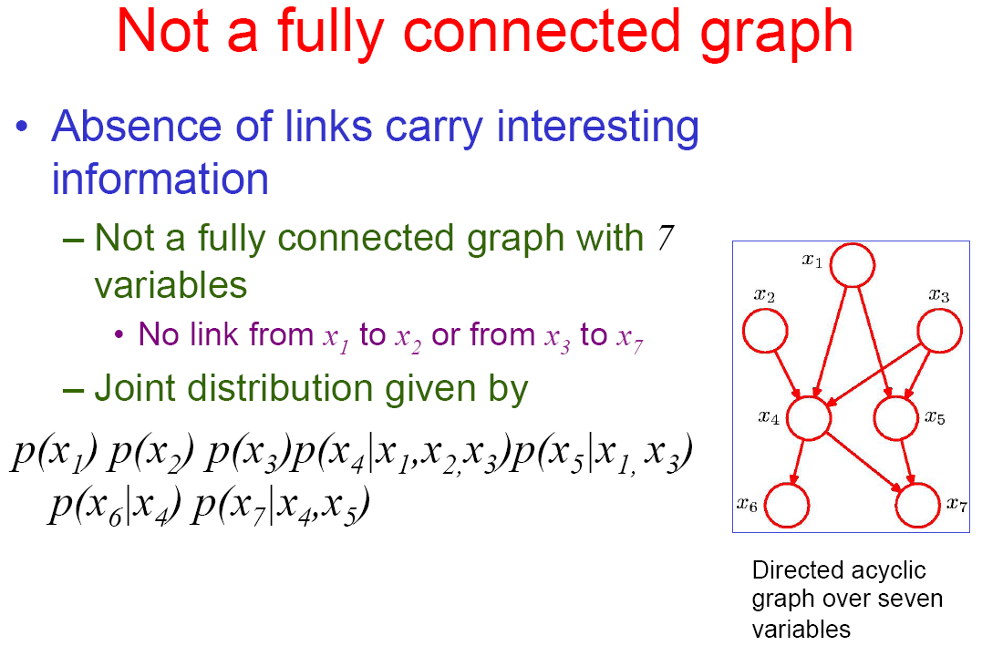

Slide 17
Bayesian Networks’ Properties
Two important properties:
Encodes the conditional independence relationships between the variables in the graph structure
Is a compact representation of the joint probability distribution over the variables

Slide 18
Conditional Independence
The Markov condition: given its parents (P₁, P₂),
a node (X) is conditionally independent of its non-descendants (ND₁, ND₂)
P₁
P₂
ND₁
X
ND₂
C₁
C₂

Slide 19
The Joint Probability Distribution
Due to the Markov condition, we can compute the joint probability distribution over all the variables X₁, …, X_{n} in the Bayesian net using the formula:
Where Parents(X_{i}) means the values of the Parents of the node X_{i} with respect to the graph

Slide 20
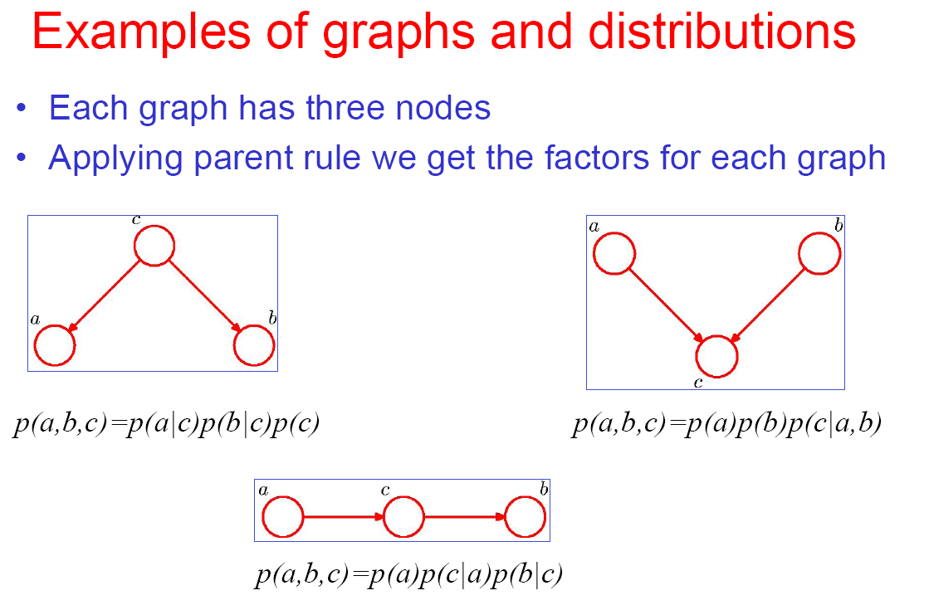

Slide 22
Probabilistic Inference in Bayesian Networks
Using a Bayesian network to compute probabilities is called inference
In general, inference involves queries of the form:
P( X | E )
E = The evidence variable(s)
X = The query variable(s)

Slide 23
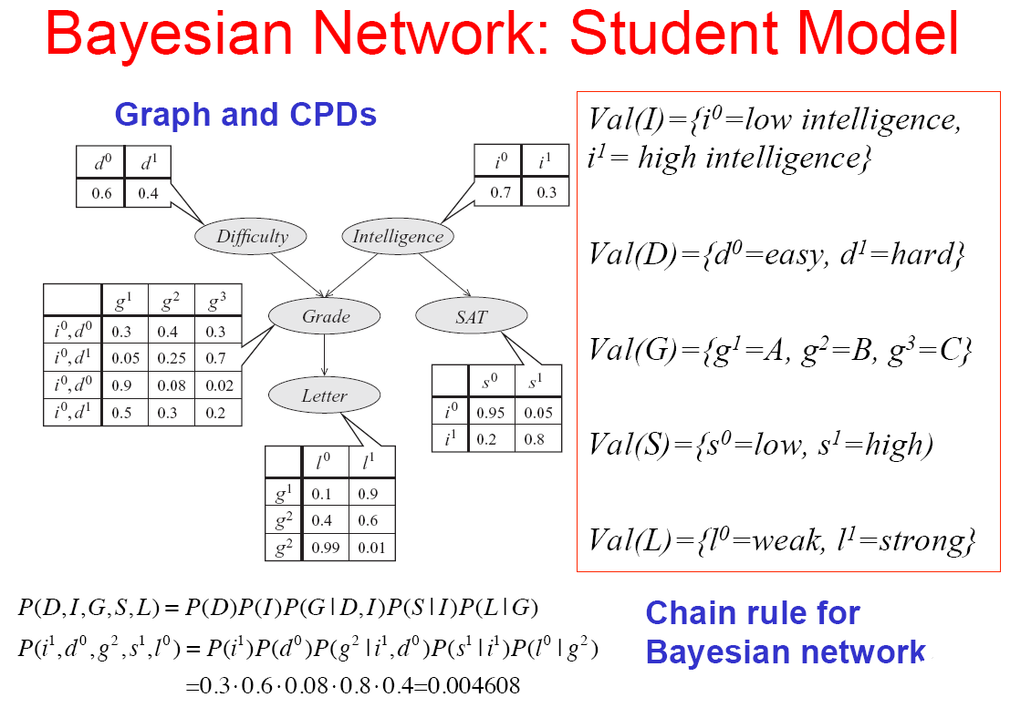

Slide 24
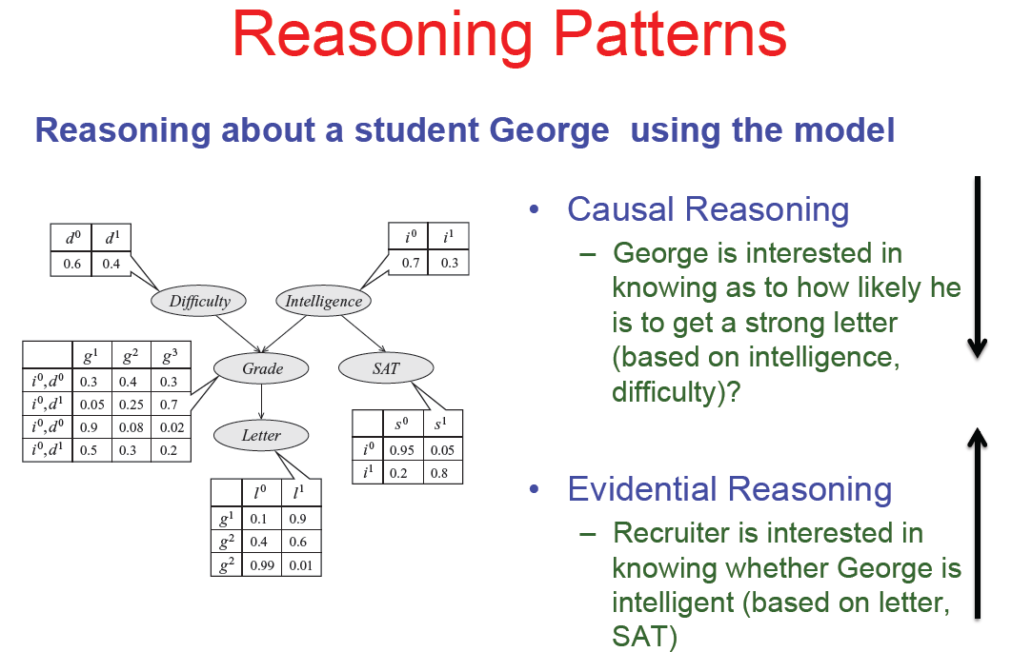

Slide 25
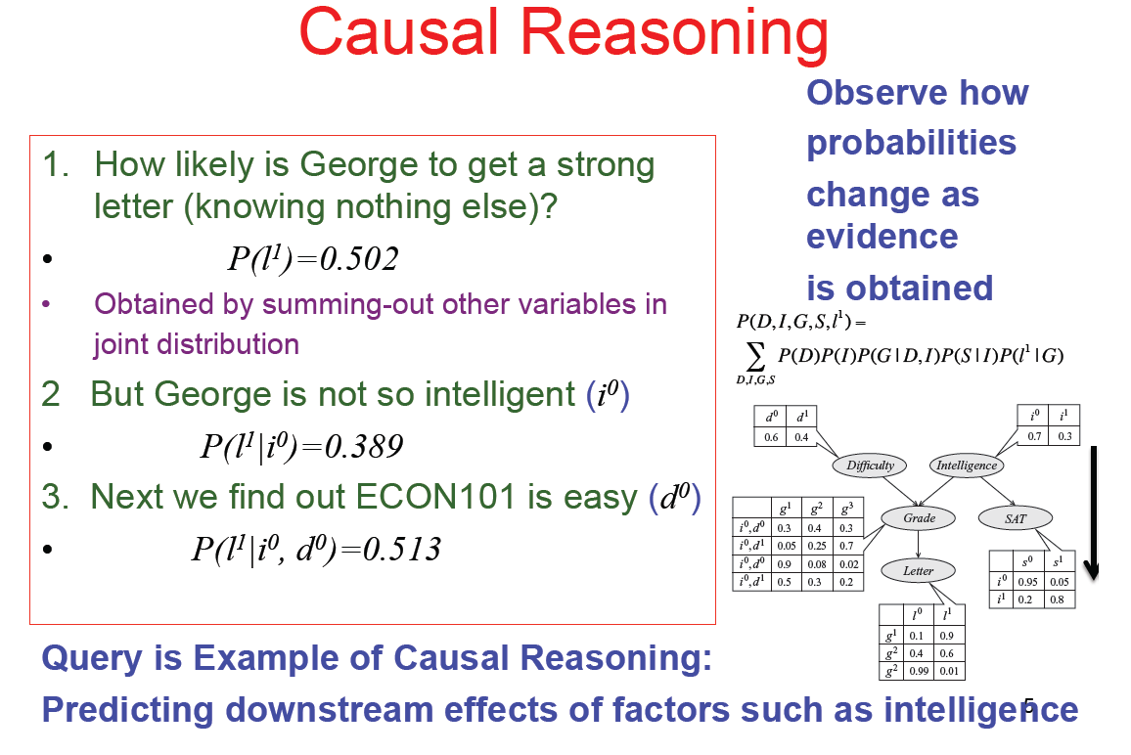
Generative model (not just discriminative): allows arbitrary queries to be answered

Slide 26
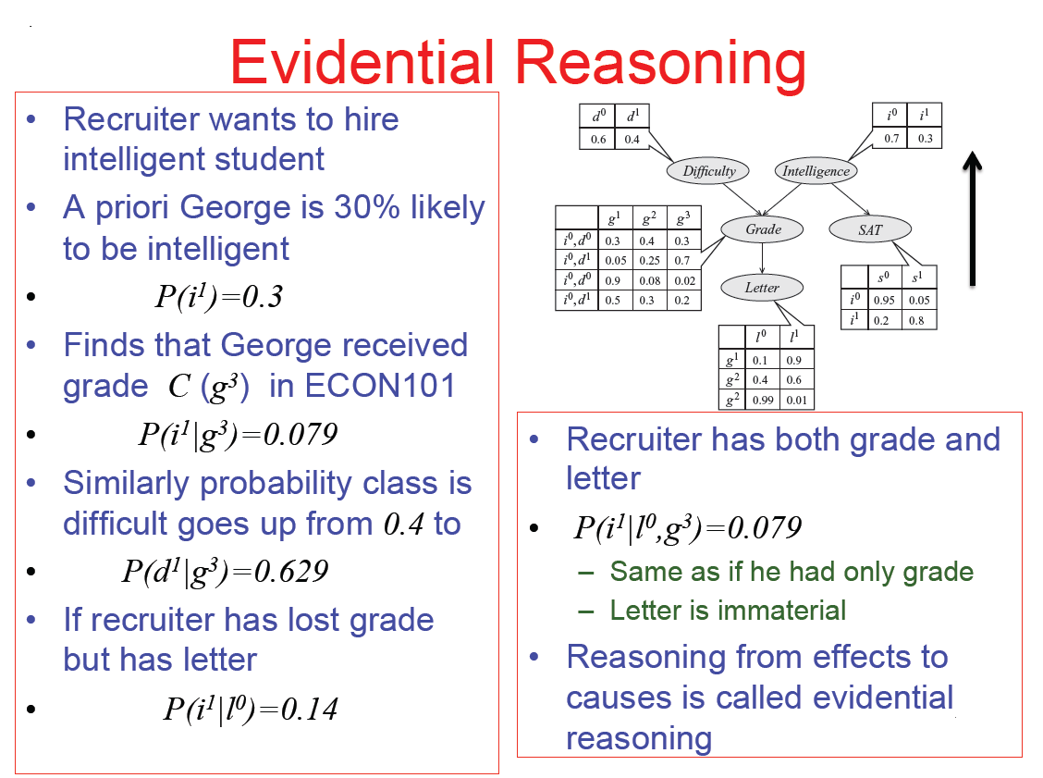

Slide 27
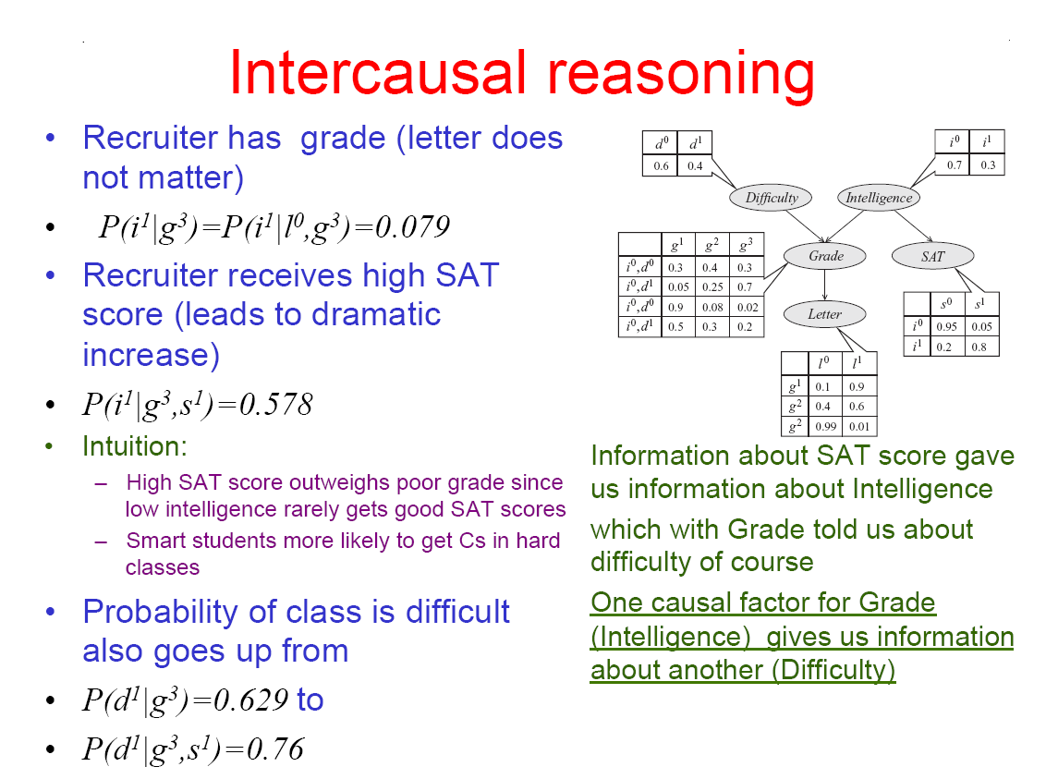

Slide 28
The Bad News
Exact inference is feasible in small to medium-sized networks
Exact inference in large networks takes a very long time
We resort to approximate inference techniques which are much faster and give pretty good results

Slide 29
One last unresolved issue…
We still haven’t said where we get the Bayesian network from. There are two options:
Get an expert to design it
Learn it from data

Slide 31
Learning Bayes nets
Basic components of algorithms for learning Bayes nets:
Method for evaluating the goodness of a given network
Measure based on probability of training data given the network (scoring function)
Method for searching through space of possible networks
Amounts to searching through sets of edges because nodes are fixed

Slide 32
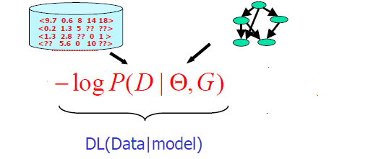
Evaluation Measures
LL: log-likelihood (log of probability of data), θ: number of free parameters, N: #instances
Can’t just maximize probability of the training data
Because then it’s always better to add more edges (fit the training data more closely)
Need to use cross-validation or some penalty for complexity of the network

Slide 33
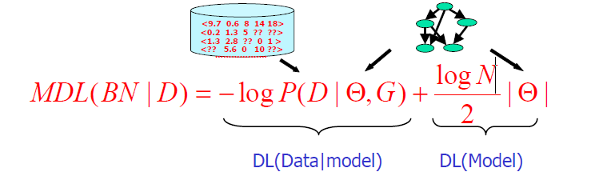
Evaluation Problem: over-fitting
Minimum Description Length (MDL) measure:
Goal: to minimize the MDL score; if instead of the second term is just θ, the measure is called Akaike Information Criterion (AIC); (θ= total number of independent estimates in all the probabilities tables; for each table, the number of independent estimates is the total number of entries minus the number of entries on the last column).

Slide 34
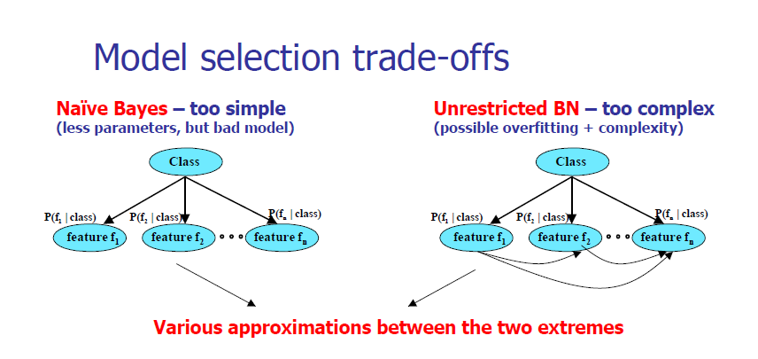
Searching for good Bayes nets

Slide 35
Searching for a good structure
Task can be simplified: can optimize each node separately
Because probability of an instance is product of individual nodes’ probabilities
Also works for AIC and MDL criterion because penalties just add up
Can optimize node by adding or removing edges from other nodes
Must not introduce cycles!

Slide 36
The K2 algorithm
Starts with given ordering of nodes (attributes)
Processes each node in turn
Greedily tries adding edges from previous nodes to current node
Moves to next node when current node can’t be optimized further
Result depends on initial order

Slide 37
Some tricks
Sometimes it helps to start the search with a naïve Bayes network
It can also help to ensure that every node is in Markov blanket of class node
Markov blanket of a node includes all parents, children, and children’s parents of that node
Given values for Markov blanket, node is conditionally independent of nodes outside blanket
I.e. node is irrelevant to classification if not in Markov blanket of class node

Slide 38
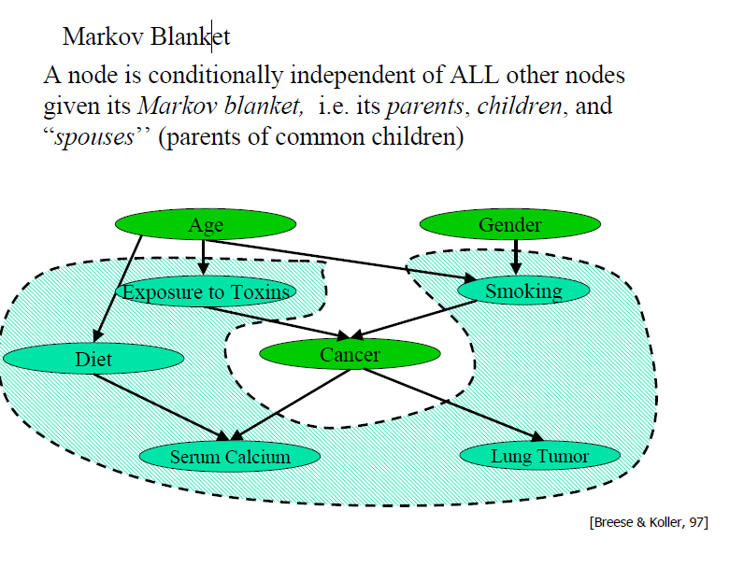

Slide 39
Other algorithms
Extending K2 to consider greedily adding or deleting edges between any pair of nodes
Further step: considering inverting the direction of edges
TAN (Tree Augmented Naïve Bayes):
Starts with naïve Bayes
Considers adding second parent to each node (apart from class node)
Efficient algorithm exists

Slide 40
How to use Bayesian networks for classification Likelihood vs. conditional likelihood
In classification what we really want is to maximize probability of class given other attributes
Not probability of the instances
But: no closed-form solution for probabilities in nodes’ tables that maximize this
However: can easily compute conditional probability of data based on given network
Different method of using Bayes nets for classification: Bayesian multinets
I.e. build one network for each class and make prediction using Bayes’ rule

Slide 41
Data structures for fast learning
Learning Bayes nets involves a lot of counting for computing conditional probabilities
Naïve strategy for storing counts: hash table
Runs into memory problems very quickly
More sophisticated strategy: all-dimensions (AD) tree
Analogous to kD-tree for numeric data
Stores counts in a tree but in a clever way such that redundancy is eliminated
Only makes sense to use it for large datasets

