Slide 1
CSC529: Advanced Data Mining
Lectures 2 & 3:
Performance Evaluation
Daniela Raicu
Winter 2018
Slides for Chapters 5 of Data Mining: Practical Machine Learning Tools and Techniques
by I. H. Witten, E. Frank and
M. A. Hall

Slide 2
Issues in Performance Evaluation: Outline
How to sample the data to provide reliable performance estimates (training, testing, tuning)?
Error rates (substitution, generalization)
Holdout, repeat holdout, cross-validation, leave-one-out, bootstrap
Statistical reliability of estimates:
Confidence intervals
Comparing performance across multiple classifiers:
t-tests

Slide 3
Issues in Performance Evaluation: Outline (cont.)
Evaluation of probabilistic classifiers:
Loss functions
Costs assigned to different types of errors
Cost-sensitive evaluation
Cost-sensitive learning
How to visualize performance for probabilistic classifiers and cost-sensitive evaluation?
Lift and gain charts
ROC curves
Choice of performance measures:
Measures for numeric predictions
The Minimum Description Length principle

Slide 4
How to sample the data to provide reliable performance estimates (training, testing, tuning)?
Error rates (substitution, generalization)
Holdout, repeat holdout, cross-validation, leave-one-out, bootstrap

Slide 5
Performance measures: how predictive is the model we learned?
Natural performance measure for classification problems: error rate
Success: instance’s class is predicted correctly
Error: instance’s class is predicted incorrectly
Error rate: proportion of errors made over the whole set of instances
Error on the training data is not a good indicator of performance on future data
Otherwise 1-NN would be the optimum classifier!
Simple solution that can be used if lots of (labeled) data is available:
Split data into training and testing sets

Slide 6
Training and testing I
Test set: independent instances that have played no part in formation of classifier
Assumption: both training data and test data are representative samples of the underlying problem
Test and training data may differ in nature
Example: classifiers built using customer data from two different towns A and B
To estimate performance of classifier from town A in completely new town, test it on data from B

Slide 7
Note on parameter tuning
It is important that the test data is not used in any way to create the classifier
Some learning schemes operate in two stages:
Stage 1: build the basic structure
Stage 2: optimize parameter settings
The test data can’t be used for parameter tuning!
Proper procedure uses three sets: training data, validation data, and test data
Validation data is used to optimize parameters

Slide 8
Training and testing II
Resubstitution error: error rate obtained from training data
Resubstitution error is (hopelessly) optimistic!
Generalization error: error rate obtained from testing data
Generally, the larger the training data the better the classifier
The larger the test data the more accurate the error estimate
Holdout procedure: method of splitting original data into training and test set
Dilemma: ideally both training set and test set should be large!

Slide 9
Holdout estimation
The holdout method reserves a certain amount for testing and uses the remainder for training
Usually: one third for testing, the rest for training
Problem: the samples might not be representative
Example: class might be missing in the test data
Advanced version uses stratification
Ensures that each class is represented with approximately equal proportions in both subsets

Slide 10
Repeated holdout method
Holdout estimate can be made more reliable by repeating the process with different subsamples
In each iteration, a certain proportion is randomly selected for training (possibly with stratification)
The error rates on the different iterations are averaged to yield an overall error rate
This is called the repeated holdout method
Still not optimum: the different test sets overlap
Can we prevent overlapping?

Slide 11
Cross-validation
Cross-validation avoids overlapping test sets
First step: split data into k subsets of equal size
Second step: use each subset in turn for testing, the remainder for training
Called k-fold cross-validation
Often the subsets are stratified before the cross-validation is performed
The error estimates are averaged to yield an overall error estimate

Slide 12
More on cross-validation
Standard method for evaluation: stratified ten-fold cross-validation
Why ten?
Extensive experiments have shown that this is the best choice to get an accurate estimate
There is also some theoretical evidence for this
Stratification reduces the estimate’s variance
Even better: repeated stratified cross-validation
E.g. ten-fold cross-validation is repeated ten times and results are averaged (reduces the variance)

Slide 13
Leave-One-Out cross-validation
Leave-One-Out: a particular form of cross-validation:
Set number of folds to number of training instances
I.e., for n training instances, build classifier n times
Makes best use of the data
Involves no random subsampling
Very computationally expensive
Disadvantage of Leave-One-Out-CV: stratification is not possible
It guarantees a non-stratified sample because there is only one instance in the test set!

Slide 14
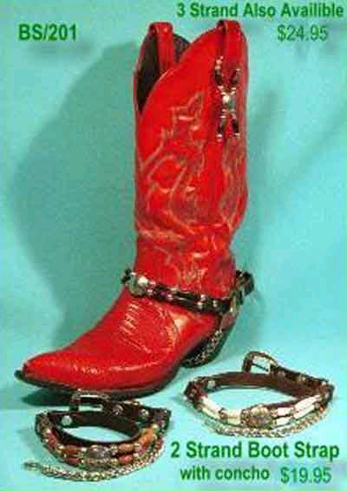
The bootstrap
CV uses sampling without replacement
The same instance, once selected, can not be selected again for a particular training/test set
The bootstrap uses sampling with replacement to form the training set
Sample a dataset of n instances n times with replacement to form a new dataset of n instances
Use this data as the training set
Use the instances from the original dataset that don’t occur in the new training set for testing

Slide 15
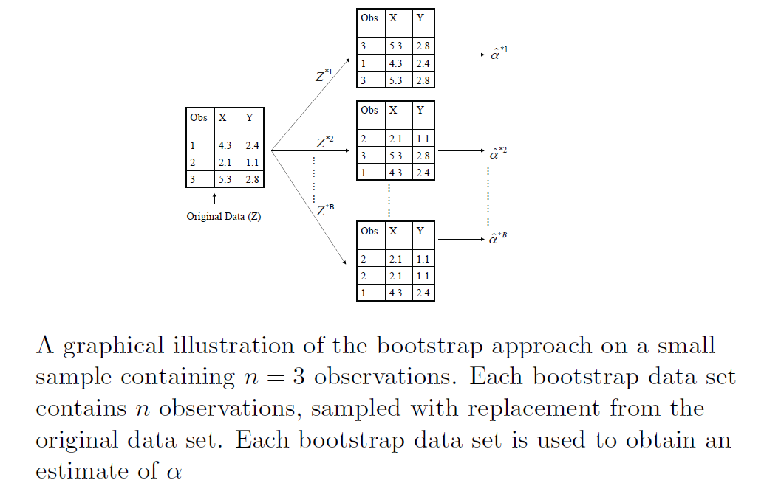
Example: Bootstrapping with 3 observations

Slide 16

The 0.632 bootstrap
Also called the 0.632 bootstrap
A particular instance has a probability of 1–1/n of not being picked
Thus its probability of ending up in the test data is:
This means the training data will contain approximately 63.2% of the instances

Slide 17
Estimating error with the bootstrap
The error estimate on the test data will be very pessimistic
Trained on just ~63% of the instances
Therefore, combine it with the resubstitution error:
The resubstitution error gets less weight than the error on the test data
Repeat process several times with different replacement samples; average the results
Probably the best way of estimating performance for very small datasets

Slide 18
Statistical reliability of estimated performance: confidence intervals

Slide 19
Predicting performance as a Bernoulli Process
Assume the estimated error rate is 25%. How close is this to the true error rate?
Depends on the amount of test data
Prediction is just like tossing a (biased!) coin
“Head” is a “success”, “tail” is an “error”
In statistics, a succession of independent events like this is called a Bernoulli process
Statistical theory provides us with confidence intervals for the true underlying proportion

Slide 20
Confidence intervals
We can say: p lies within a certain specified interval with a certain specified confidence
Example: S=750 successes in N=1000 trials
Estimated success rate: 75%
How close is this to true success rate p?
Answer: with 80% confidence p in [73.2,76.7]
Another example: S=75 and N=100
Estimated success rate: 75%
With 80% confidence p in [69.1,80.1]

Slide 21

Mean and variance
Mean and variance for a Bernoulli trial: p, p (1–p)
Expected success rate f=S/N
Mean and variance for f : p, p (1–p)/N
For large enough N, f follows a Normal distribution
c% confidence interval for random variable X with 0 mean is given by:
With a symmetric distribution:

Slide 22
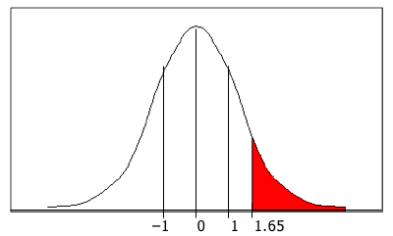
Confidence limits
Confidence limits for the normal distribution with 0 mean and a variance of 1:
To use this we have to reduce our random variable f to have 0 mean and unit variance
Pr[X ≥ z]
z
0.1%
3.09
0.5%
2.58
1%
2.33
5%
1.65
10%
1.28
20%
0.84
–1 0 1 1.65
40%
0.25

Slide 23
Examples
f = 75%, N = 1000, c = 80% (so that z = 1.28):
[73.2,76.7]
f = 75%, N = 100, c = 80% (so that z = 1.28): [69.1,80.1]
Note that normal distribution assumption is only valid for large N (i.e. N > 100)
f = 75%, N = 10, c = 80% (so that z = 1.28): [54.9,88.1] (should be taken with a grain of salt)

Slide 24
Comparing data mining techniques: Paired t-test

Slide 25
Comparing data mining schemes
Want to show that learning scheme A is better than learning scheme B in a particular domain
For a given amount of training data
On average, across all possible training sets
Let's assume we have an infinite amount of data from the domain:
Sample infinitely many datasets of specified size
Obtain cross-validation estimate on each dataset for each scheme
Check if mean accuracy for scheme A is better than mean accuracy for scheme B

Slide 26
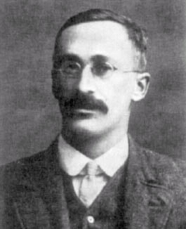
Paired t-test
In practice we have limited data and a limited number of estimates for computing the mean
Student’s t-test tells whether the means of two samples are significantly different
In our case the samples are cross-validation estimates for different datasets from the domain
Use a paired t-test because the individual samples are paired
The same CV is applied twice
William Gosset
Born: 1876 in Canterbury; Died: 1937 in Beaconsfield, England
Obtained a post as a chemist in the Guinness brewery in Dublin in 1899. Invented the t-test to handle small samples for quality control in brewing. Wrote under the name "Student".

Slide 27
Student’s distribution
With small samples (k < 100) the mean follows Student’s distribution with k–1 degrees of freedom
Confidence limits:
9 degrees of freedom normal distribution
Pr[X ≥ z]
z
Pr[X ≥ z]
z
0.1%
4.30
0.1%
3.09
Assuming
we have
10 estimates
0.5%
3.25
0.5%
2.58
1%
2.82
1%
2.33
5%
1.83
5%
1.65
10%
1.38
10%
1.28
20%
0.88
20%
0.84

Slide 28
Performing the test
Fix a α% significance level
If a difference is significant at the α% level, there is a (100-α)% chance that the true means differ
If a difference is significant at the a% level, there is a (100-α)% chance that the true means differ
Divide the significance level by two because the test is two-tailed
Look up the value for z that corresponds to α/2
If t ≤ –t(α/2) or t ≥ t(α/2) then the difference is significant
I.e. the null hypothesis (that the difference is zero) can be rejected

Slide 29
Evaluation of probabilistic classifiers: loss functions

Slide 30
Predicting probabilities
Performance measure so far: success rate
Also called 0-1 loss function: loss is 0 for a correct prediction and 1 for an incorrect one
Most classifiers produces class probabilities
Depending on the application, we might want to check the accuracy of the probability estimates
0-1 loss is not the right thing to use in those cases

Slide 31
Quadratic loss function
p₁ … p_{k} are probability estimates for an instance
c is the index of the instance’s actual class
a₁ … a_{k} = 0, except for a_{c} which is 1
Quadratic loss for each instance is:
Want to minimize
Can show that this is minimized when p_{j} = p_{j}*, the true probabilities

Slide 32
Informational loss function
The informational loss function is –log(p_{c}), where c is the index of the instance’s actual class
Number of bits required to communicate the actual class
Let p₁* … p_{k}* be the true class probabilities. Then the expected value for the loss function is: –p1*log(p₁)-…-pk*log(pk)
Justification: minimized when p_{j} = p_{j}*
Difficulty: zero-frequency problem

Slide 33
Discussion
Which loss function to choose?
Both encourage honesty
Quadratic loss function takes into account all class probability estimates for an instance
Informational loss focuses only on the probability estimate for the actual class
Quadratic loss is bounded: it can never exceed 2
Informational loss can be infinite
Informational loss is related to MDL principle [later]

Slide 34
Cost-sensitive evaluation and learning

Slide 35
Cost-sensitive evaluation
In practice, different types of classification errors often incur different costs
Examples:
Medical diagnosis:
Cost of false positive error: unnecessary treatment; unnecessary worry
Cost of false negative error: Postponed treatment or failure to treat; death or injury
Oil-slick detection
Fraud detection
Promotional mailing

Slide 36
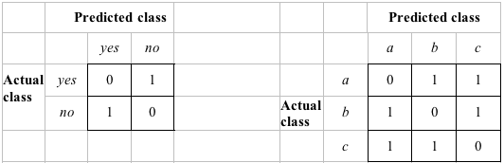
Cost-sensitive evaluation
The confusion matrix:
Predicted class
Yes
No
Actual class
Yes
True positive
False negative
No
False positive
True negative
Examples of two cost matrices: Cost is given by appropriate entry in the cost matrix
Success rate is replaced by average cost per prediction

Slide 37
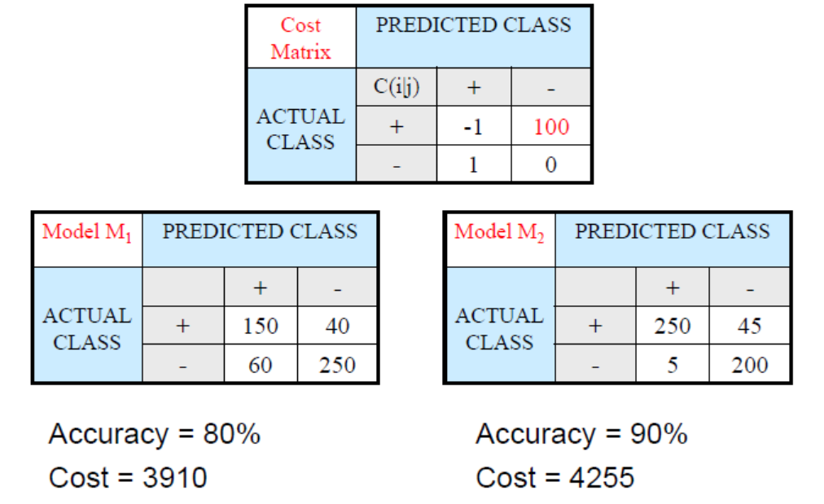
Cost-sensitive evaluation: Example

Slide 38
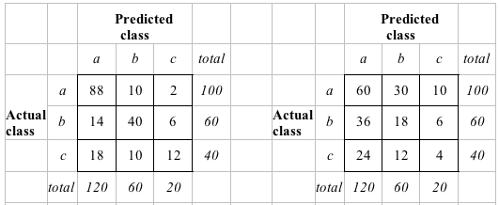
Aside: the kappa statistic
Two confusion matrices for a 3-class problem: actual predictor (left) vs. random predictor (right)
Number of successes: sum of entries in diagonal (D)
Kappa statistic: (140-82)/(200-82)=.492 measures relative improvement over random predictor

Slide 39
Counting the cost
There are many types of cost besides the cost of making the errors!
Examples:
Cost of collecting training data - imbalance data
Cost of improving performance
When the costs are integrated in the learning algorithm, the algorithm is called cost-sensitive learning

Slide 40
Cost-sensitive learning
So far we haven't taken costs into account at training time
Most learning schemes do not perform cost-sensitive learning
They generate the same classifier no matter what costs are assigned to the different classes
Example: standard decision tree learner
Methods for cost-sensitive learning:
Modify the inputs to the learning algorithm to reflect the costs
Modify the learning algorithm to integrate the costs

Slide 41
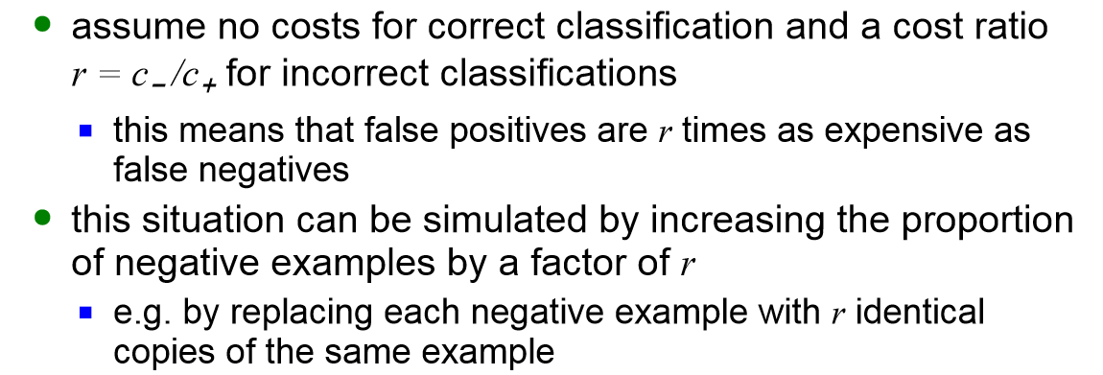
Cost-sensitive learning
Methods for cost-sensitive learning:
Modify the inputs to the learning algorithm to reflect the costs
Re-sampling of instances according to costs
(denote c- is the cost of misclassifying negative examples (that is, cost of false positives) and c+ is the cost of misclassifying positive examples)

Slide 42
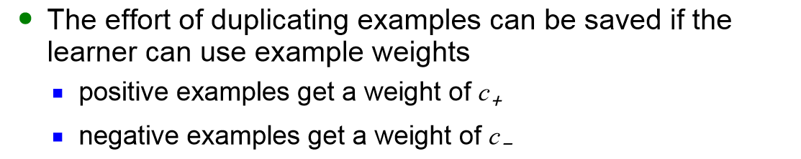
Cost-sensitive learning
Methods for cost-sensitive learning:
Modify the inputs to the learning algorithm to reflect the costs
Weighting of instances according to costs
Examples of weights (where c- is the cost of misclassifying negative examples and c+ is the cost of misclassifying positive examples)

Slide 43
Cost-sensitive learning
Methods for cost-sensitive learning:
Modify the learning algorithm to include the costs
Cost-sensitive boosting
Cost can be incorporated directly into the error criterion when training neural networks (Kukar and Kononenko, 1998)

Slide 44
How to visualize performance for probabilistic classifiers and cost-sensitive evaluation?
Lift and gain charts
ROC curves

Slide 45
Lift charts
In practice, costs are rarely known
Decisions are usually made by comparing possible scenarios
Example: promotional mailout to 1,000,000 households
Mail to all; 0.1% respond (1000)
Data mining tool identifies subset of 100,000 most promising, 0.4% of these respond (400) 40% of responses for 10% of cost may pay off
Identify subset of 400,000 most promising, 0.2% respond (800)
A lift chart allows a visual comparison

Slide 46
Generating a lift chart (see handout)
Sort instances according to predicted probability of being positive:
x axis is sample size y axis is number of true positives
Predicted probability
Actual class
1
0.95
Yes
2
0.93
Yes
3
0.93
No
4
0.88
Yes
…
…
…

Slide 47
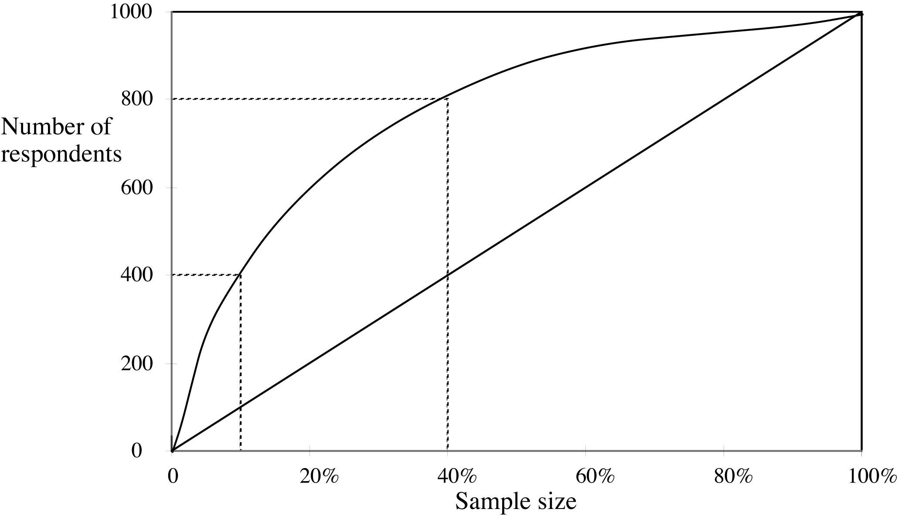
A hypothetical cumulative gain chart
40% of responses for 10% of cost
80% of responses for 40% of cost

Slide 48
ROC curves
ROC curves are similar to lift charts
ROC stands for “receiver operating characteristic”
Used in signal detection to show trade-off between hit rate and false alarm rate over noisy channel
Differences to lift chart:
y axis shows percentage of true positives in sample rather than absolute number
x axis shows percentage of false positives in sample rather than sample size

Slide 49
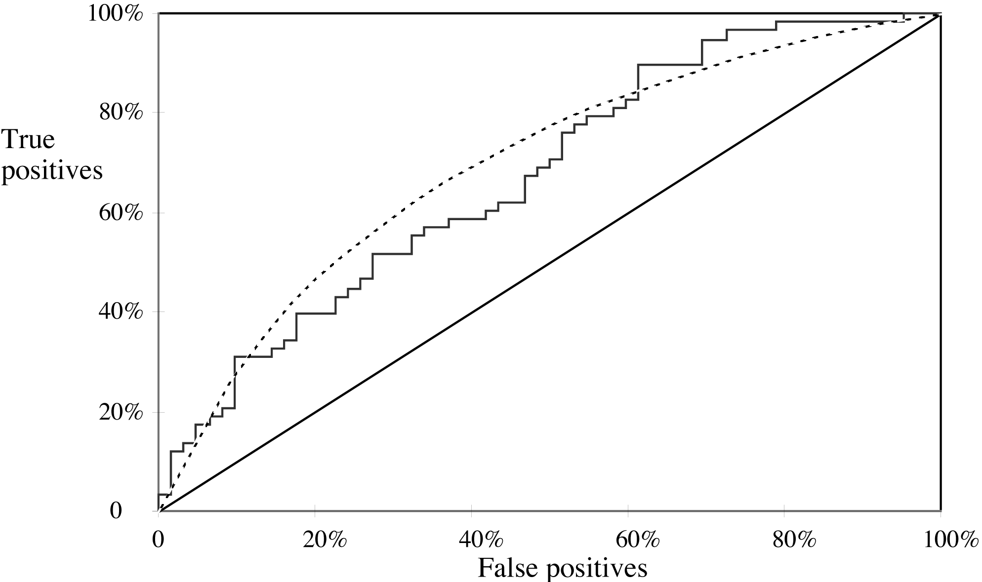
A sample ROC curve
Jagged curve—one set of test data
Smooth curve—use cross-validation

Slide 50
Other performance metrics
Measures for numeric predictions

Slide 51
More measures...
Percentage of retrieved documents that are relevant: precision=TP/(TP+FP)
Percentage of relevant documents that are returned: recall =TP/(TP+FN)
Precision/recall curves have hyperbolic shape
Summary measures: average precision at 20%, 50% and 80% recall (three-point average recall)
F-measure=(2 × recall × precision)/(recall+precision)
sensitivity × specificity = (TP / (TP + FN)) × (TN / (FP + TN))
Area under the ROC curve (AUC): probability that randomly chosen positive instance is ranked above randomly chosen negative one

Slide 52
Evaluating numeric prediction
Actual target values: a₁ a₂ …a_{n}
Predicted target values: p₁ p₂ … p_{n}
Most popular measure: mean-squared error (MSE)
Easy to manipulate mathematically
Root MSE
Mean absolute error
Relative-squared error
Root relative squared error
Relative absolute error
Correlation coefficient

Slide 53
Which measure?
Best to look at all of them
Often it doesn’t matter
Example:
A
B
C
D
Root mean-squared error
67.8
91.7
63.3
57.4
Mean absolute error
41.3
38.5
33.4
29.2
Root rel squared error
42.2%
57.2%
39.4%
35.8%
Relative absolute error
43.1%
40.1%
34.8%
30.4%
Correlation coefficient
0.88
0.88
0.89
0.91
D best
C second-best
A, B arguable

Slide 54
The MDL principle
MDL stands for minimum description length
The description length is defined as: space required to describe a theory + space required to describe the theory’s mistakes
In our case the theory is the classifier and the mistakes are the errors on the training data
Aim: we seek a classifier with minimal DL
MDL principle is a model selection criterion

Slide 55

Model selection criteria
Model selection criteria attempt to find a good compromise between:
The complexity of a model
Its prediction accuracy on the training data
Reasoning: a good model is a simple model that achieves high accuracy on the given data
Also known as Occam’s Razor : the best theory is the smallest one that describes all the facts
William of Ockham, born in the village of Ockham in Surrey (England) about 1285, was the most influential philosopher of the 14th century and a controversial theologian.

Slide 56
Elegance vs. errors
Theory 1: very simple, elegant theory that explains the data almost perfectly
Theory 2: significantly more complex theory that reproduces the data without mistakes
Theory 1 is probably preferable

Slide 57
Summary
How to sample the data to provide reliable estimates?
- Holdout procedure, cross-validation, leave-one out, bootstrap
How to measure statistically reliability of estimators?
- confidence intervals
How to compare data mining schemes?
- t-tests

Slide 58
Summary
How to measure classification performance?
- error rate (substitution, generalization)
- loss-function for probabilistic classifiers
- measures for numeric predictions
How to visualize performance for probabilistic classifiers?
- Lift curves
- ROC Curves
How to take costs into account?
- classification costs
- cost sensitive learning

Slide 59
Interesting related papers
S. Vijayanarasimhan and K. Grauman, “Cost-Sensitive Active Visual Category Learning”, Intl. Journal of Computer Vision (IJCV), Vol. 91, Issue 1 (2011). http://vision.cs.utexas.edu/projects/others/ijcv-preprint.pdf
M. E. Ramirez-Loaiza, A. Culotta and M. Bilgic, “Towards Anytime Active Learning: Interrupting Experts to Reduce Annotation Costs,” in Proceedings of the 19th Conference on Knowledge Discovery and Data Mining, Chicago, IL, August 2013.
http://poloclub.gatech.edu/idea2013/papers/p88-ramirez.pdf

