Slide 1
My internship in 300s
Efficient implementation of learning algorithms for remote sensing
Matthieu Verlynde
Supervisor : Ammar Mian
Academic tutor : Antoine Cornuéjols
19/06/2024

Slide 2
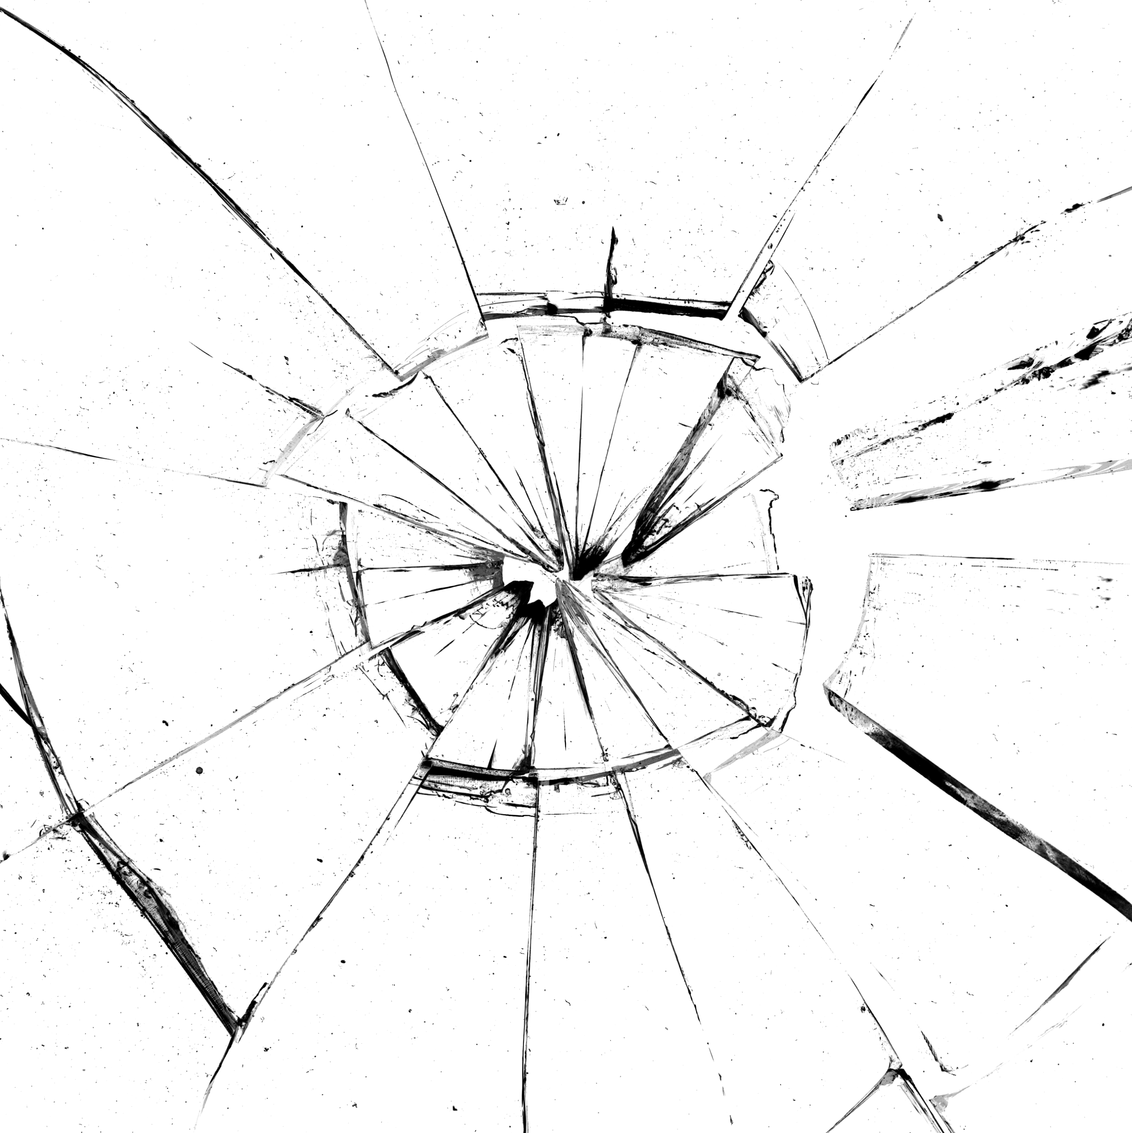
Context and objectives
AI efficiency, a “must have” in data science
Specificities for remote sensing
High dimensions
Poorly labeled data
Complexity of interpretation
552
Evaluation metrics energy + performance
?
Optimization methods
Patterson et al. (2021)
Strubell et al. (2019)
2

Slide 3




State of the art
Runtime
Performances of the model
On the targeted task
Ex : classification accuracy, F1 score…
Complexity
Bachmann-Landeau descriptor (Big O)
Lines of code, Halstead volume, cyclomatic number…
Empirical measurements
Emissions in eCO₂
Energy (kWh) × carbon intensity (eCO₂/kWh)
19/06/2024
3

Slide 4



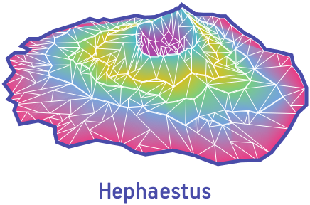



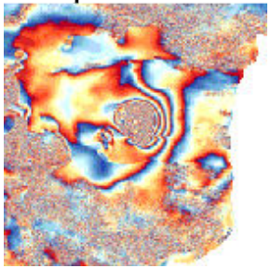
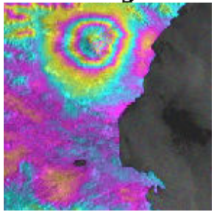
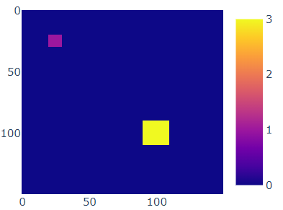
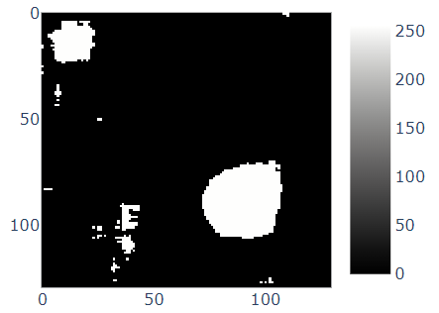
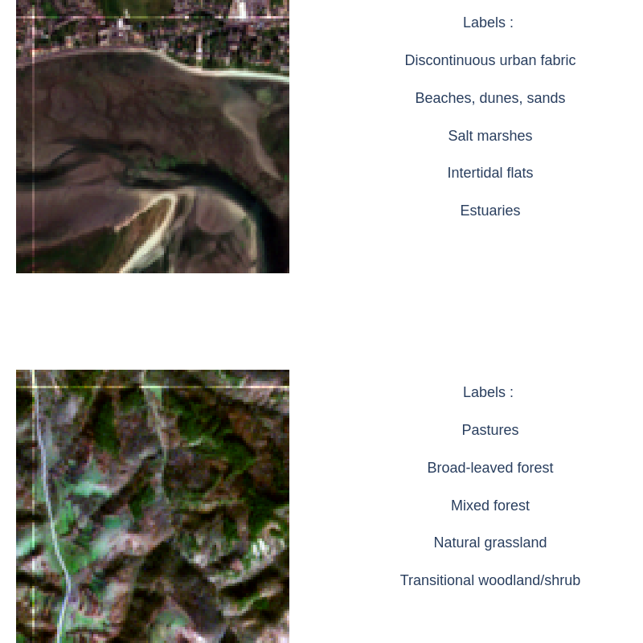
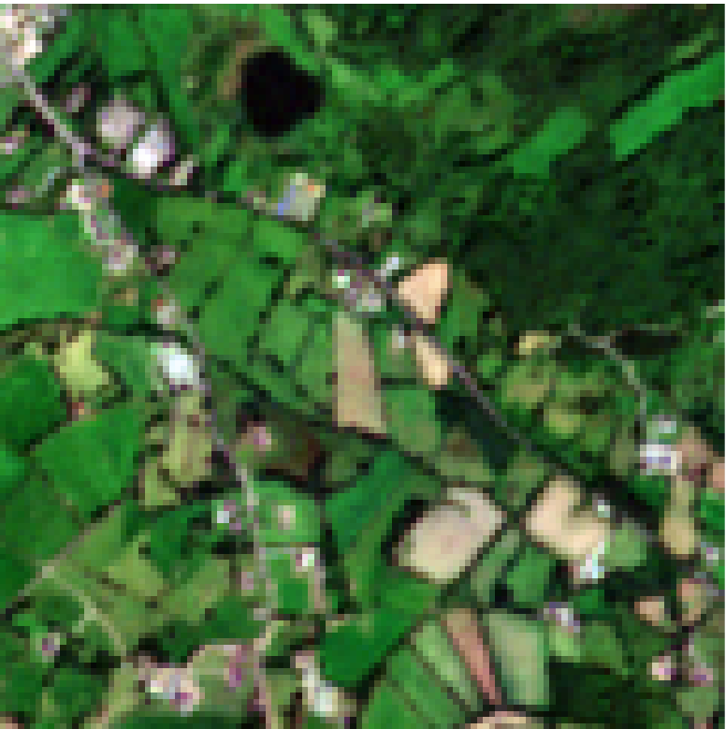
Methods
II. Standard deep learning
I. Standard algorithms
III. Semi-supervised learning
Consumption data :
Model performances :
1. Training from scratch
2. Transfer learning
ImageNet BigEarthNet
3. Looking for new information
Complex scenario :
Poorly labeled data
kWh
CPU
GPU
Acc.
AUC
SSIM
Statistical analysis
Bountos et al. (2022)
Sumbul et al. (2019)
4

Slide 5
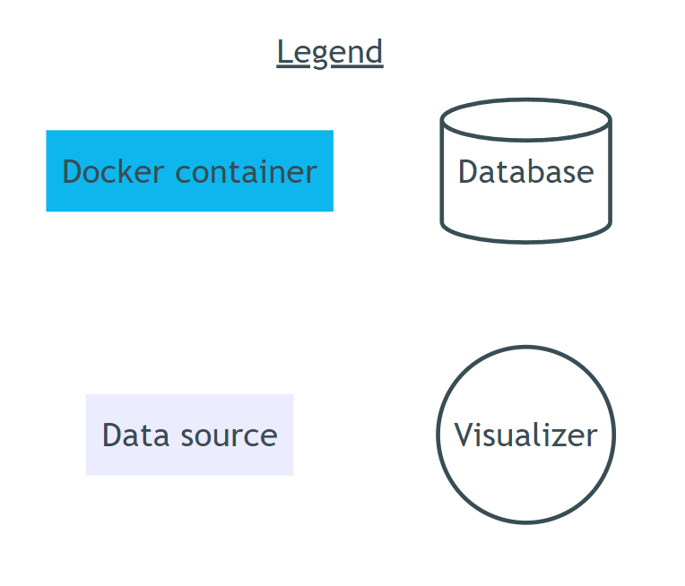
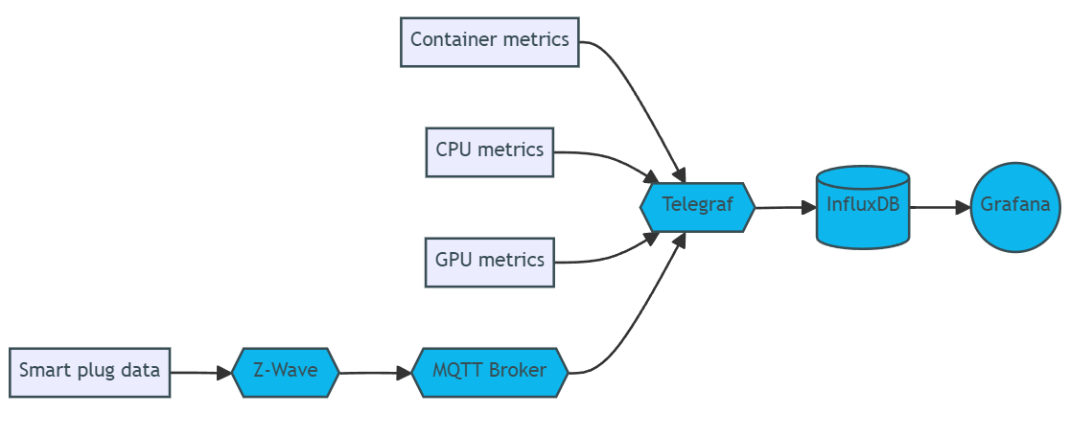

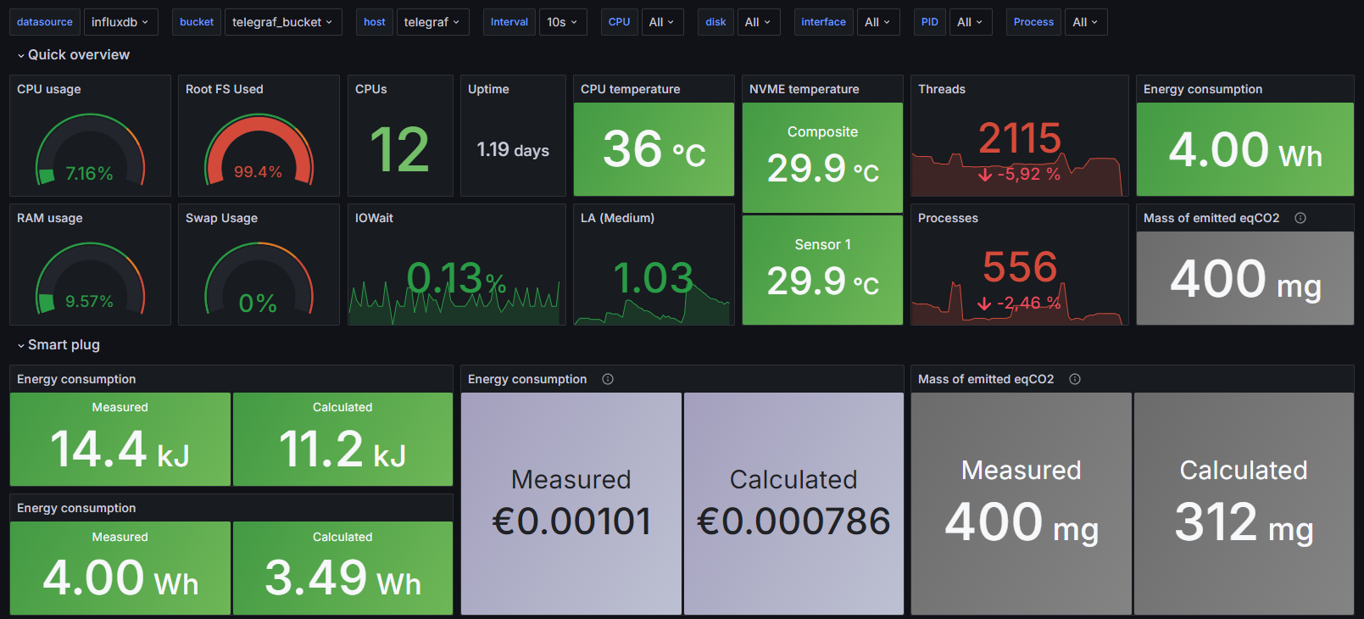
Results
Accessing consumption data
GrafanaLabs. (2024)
InfluxDATA. (2024a)
InfluxDATA. (2024a)
Lando. (2024)
Light. (2017)
19/06/2024
5

Slide 6
Results
19/06/2024
6

Slide 7
What is next ?
Compromise performance v. consumption
Variables influencing consumption
Compare implementations
Suggest optimizations
19/06/2024
7
Notes:
7

Slide 8
References
Nikolaos Ioannis Bountos et al. « Hephaestus: A Large Scale Multitask Dataset Towards InSAR Understanding ». In: Proceedings of the IEEE/CVF Conference on Computer Vision and Pattern Recognition (CVPR) Workshops, juin 2022, p. 1453-1462. doi: 10.48550/arXiv.2204.09435
GrafanaLabs. Grafana version 10.4 documentation. 2024. url : https://grafana.com/docs/grafana/v10.4/.
InfluxDATA. InfluxDB version 2.10 documentation. 2024. url : https://docs.influxdata.com/influxdb/v2/.
InfluxDATA. Telegraf version 1.30 documentation. 2024. url : https://docs.influxdata.com/telegraf/v1/.
Daniel Lando. Z-Wave JS UI version 9.12.0 documentation. 2024. url : https://zwave-js.github.io/zwave-js-ui/.
Roger A Light. « Mosquitto : server and client implementation of the MQTT protocol ». en. In : The Journal of Open Source Software 2.13 (mai 2017), p. 265. issn : 2475-9066. doi : 10.21105/joss.00265. url : http://joss.theoj.org/papers/10.21105/joss.00265 (visité le 10/05/2024).
David Patterson et al., « Carbon Emissions and Large Neural Network Training ». arXiv, 23 avril 2021. doi: 10.48550/arXiv.2104.10350.
Emma Strubell et al., « Energy and Policy Considerations for Deep Learning in NLP ». arXiv, 5 juin 2019. doi: 10.48550/arXiv.1906.02243.
Gencer Sumbul et al. « Bigearthnet : A Large-Scale Benchmark Archive for Remote Sensing Image Understanding ». en. In : IGARSS 2019 - 2019 IEEE International Geoscience and Remote Sensing Symposium. Yokohama, Japan : IEEE, juill. 2019, p. 5901-5904. isbn : 978-1-5386-9154-0. doi : 10.1109/IGARSS.2019.8900532. url : https://ieeexplore.ieee.org/document/8900532/ (visité le 08/04/2024).
19/06/2024
8
Notes:
8

Slide 9
Methods
I. Standard machine learning
Consumption data :
Model performances :
kWh
CPU
GPU
Acc.
AUC
SSIM
Statistical analysis
9

Slide 10
Methods
II. Standard deep learning
I. Standard machine learning
Consumption data :
Model performances :
1. Training from scratch
2. Transfer learning
ImageNet BigEarthNet
3. Looking for new information
kWh
CPU
GPU
Acc.
AUC
SSIM
Statistical analysis
10

