Slide 1

SemEval-2020 Task 7: Assessing Humor in Edited News Headlines
Subtask 1 (Regression)
Matthew Vu
Vu Doan
Prapurna Penmathsa Amrisha Dwivedi
Dr. Marcos Zampieri
AIT – 526 – Introduction to NLP

Slide 2
Introduction
Subtask1:
SemEval-2020 Task 7's objective is to evaluate the humor in modified news headlines, with a focus on how brief adjustments affect the text's funny factor. This assignment is different from standard humor datasets in that it focuses on analyzing how minor changes can turn otherwise unfunny material into humorous content. The dataset is useful for figuring out when regular text becomes hilarious and for comprehending the effects of atomic alterations.

Slide 3
Significance
This job is important because it explores humor intensity in a way that goes beyond simple categorization. The challenge is to test a system's capacity to determine the level of humor in various headlines. Humor can take many different forms. This intensity evaluation may find use in the creation of comedy, where a system may be used to produce perhaps humorous texts and rate them according to how funny they are.

Slide 4
Subtask 1
Regression:
Regression analysis measures a system's capacity to forecast the average level of humor in altered headlines. The Root Mean Squared Error (RMSE) for the entire test set is the evaluation statistic that is employed. It is necessary for participants to send in a zip file with the CSV file "task-1-output.csv" that has two columns in the prescribed sequence.
1: Id: The modified headline's ID as given by the dataset.
2: Pred: The headline's estimated funniness, expressed as an actual number within the 0–3 funniness range.

Slide 5
RELATED WORKS
Jin, Shuning, et al. (2020)
Transformer-based models for humor detection in edited news headlines.
Advocates for future research beyond incongruity.
Highlights the use of RoBERTa and contrastive approach.
Pre-trained transformer models for humor evaluation.
Contrastive vs. non-contrastive approach.
Weak correlations with human judgments but strong inter-model correlations.
Incongruity not sufficient or necessary for humor.
Khwaileh, E., Al-As’ad, M. A. (2020)
Focus on ELMo and BERT.
Overview of models and applications.
Performance measured using RMSE.
ELMo-NB approach achieves a score of 0.5642.
Meaney, Wilson, and Magdy (2020)
ERNIE 2.0 chosen over BERT.
Advantage in capturing lexical, syntactic, and semantic information.
Fine-tuning enhances performance, especially in classification.
Significance of hyperparameter optimization.
Tuncer (2021)
Utilizes ALBERT for predicting mean funniness score.
ALBERT over BERT for faster training (fewer parameters).
Two ALBERT models with RMSprop and Adam optimizers.
RMSprop optimizer outperforms with RMSE values of 0.4569.
INSIGHTS

Slide 6
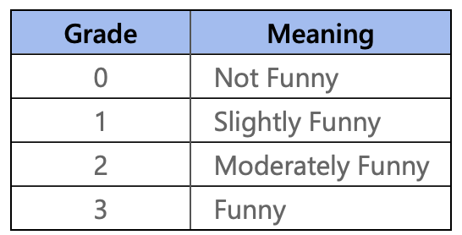
DATA INTRODUCTION
Overview:
Introduction of Humicroedit dataset by Nabil Hossain, John Krumm, and Michael Gamon
Aim: Computational humor research, particularly in humor detection and generation
Data Source:
Original news headlines collected from Reddit (r/worldnews and r/politics)
Timeframe: January 2017 to May 2018
287,076 news headlines initially collected
15,095 unique edited headlines
Annotation Process:
Qualified on Mechanical Turk for humor generation
Task: Make headlines funny through micro-edits (single-word replacements)
Judges:
Qualified for recognizing humor in edited headlines
Grading scale: 0 (Not funny) to 3 (Funny)
Qualification based on internal judge assessment and agreement threshold
Editors:

Slide 7
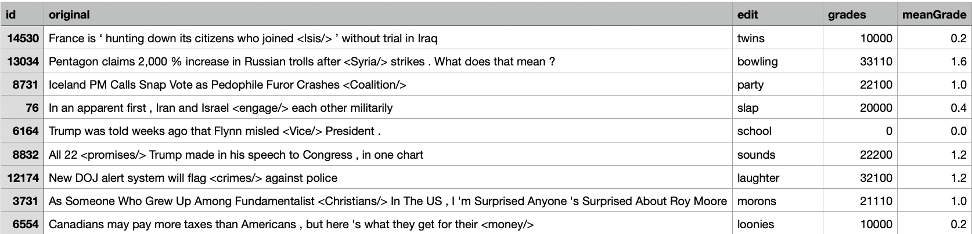
TASK DESCRIPTION & DATASET
Task Description:
Dataset
Dataset provided in three files: "train.csv," "dev.csv," and "test.csv"
Random partitioning: Training (64%), Validation (16%), Test (20%)
Total instances: 9652, 2419, and 3024 in the training, validation, and test sets, respectively (Hossain et al., 2020)
Regression: Given the original and the edited headline, the participant is required to predict the mean funniness of the edited headline.

Slide 8
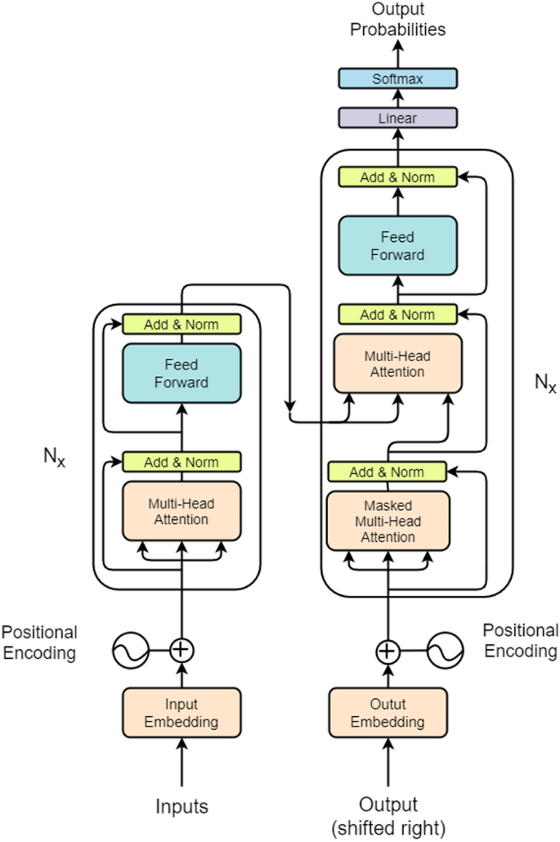
METHODS PART 1: MODELS EXPERIMENTED ON
ALBERT (A-LITE BERT) transformer model (proposed in a paper by Lan et al., 2020):
Model Number | Learning Rate Decay Method | Hyperparameters (Description) | Optimizer | Training Set
1 | Exponential Decay Learning Rate Scheduler to Decrease Learning Rate every 603 Batches | Initial learning rate = 1e-5 Decay steps = 603 Decay rate = 0.9 Epochs = 3 | RMSprop | Train.csv
2 | Exponential Decay Learning Rate Scheduler to Decrease Learning Rate every 603 Batches | Initial learning rate = 1e-5 Decay steps = 603 Decay rate = 0.9 Epochs = 3 | Adam | Train.csv
3 | Constant decay factor to exponentially decrease learning rate every subsequent batch | Initial learning rate = 1e-5 Decay factor = 1e-8 Epochs = 3 | RMSprop | Train.csv
4 | Constant decay factor to exponentially decrease learning rate every subsequent batch | Initial learning rate = 1e-5 Decay factor = 1e-8 Epochs = 3 | Adam | Train.csv
https://link.springer.com/article/10.1007/s00530-020-00690-5
Methods and code inspired by Salih Tuncer (2021)

Slide 9
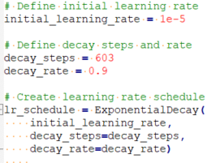
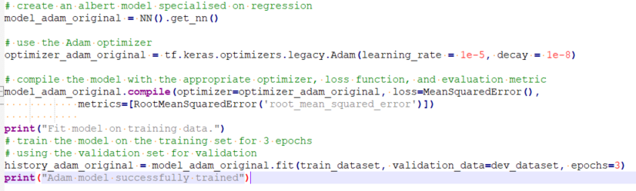
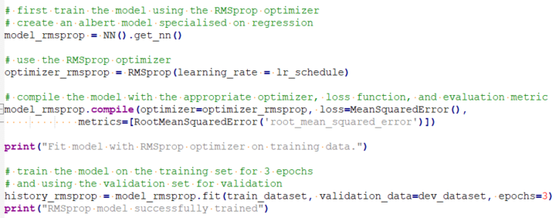
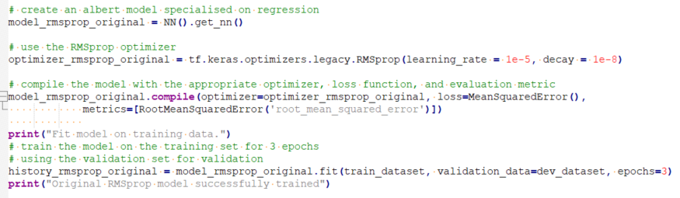
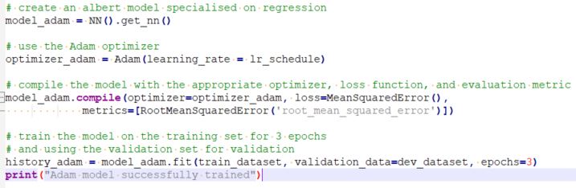
METHODS PART 2: EACH MODEL’S EXAMPLE CODE
Learning Rate Scheduler Code
Model 3 Code
Model 1 Code
Model 4 Code
Model 2 Code

Slide 10
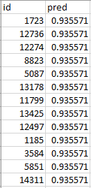
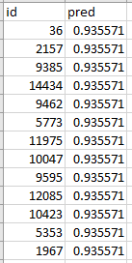
METHODS PART 3: MAXIMUM RMSE BASELINES
In general, the RMSE metric was used to evaluate each model's performance
Training set Average Mean Funniness Score = 0.9356
Validation Set ("dev.csv"):
Test Set ("test.csv")
Dataset | Baseline RMSE
Validation set | 0.5784
Test set | 0.5747

Slide 11
METHODS PART 4: CHOOSING THE BEST MODEL
Model Number | Learning Rate Decay Method | Hyperparameters (Description) | Optimizer | Training Set
1 | Exponential Decay Learning Rate Scheduler to Decrease Learning Rate every 603 Batches | Initial learning rate = 1e-5 Decay steps = 603 Decay rate = 0.9 Epochs = 3 | RMSprop | Train.csv
2 | Exponential Decay Learning Rate Scheduler to Decrease Learning Rate every 603 Batches | Initial learning rate = 1e-5 Decay steps = 603 Decay rate = 0.9 Epochs = 3 | Adam | Train.csv
3 | Constant decay factor to exponentially decrease learning rate every subsequent batch | Initial learning rate = 1e-5 Decay factor = 1e-8 Epochs = 3 | RMSprop | Train.csv
4 | Constant decay factor to exponentially decrease learning rate every subsequent batch | Initial learning rate = 1e-5 Decay factor = 1e-8 Epochs = 3 | Adam | Train.csv
RMSE against Validation Set (dev.csv)
RMSE against Validation Set (dev.csv)
RMSE against Validation Set (dev.csv)
RMSE against Validation Set (dev.csv)
Dataset | Baseline RMSE
Validation set | 0.5784
Test set | 0.5747
Best Model Criteria:
Validation set RMSE lower than the validation set RMSE baseline and the lowest compared to other models

Slide 12
METHODS PART 5: FINAL EVALUATION
Final and best model RMSE against the test set = Generalization Error
Project successful if final model's RMSE against the test set is lower than the test set baseline RMSE
Dataset | Baseline RMSE
Validation set | 0.5784
Test set | 0.5747

Slide 13
METHODS PART 6: CODE, SOFTWARE, AND PROCESSING
Jupyter Notebooks
Python (numpy, pandas, tensorflow)
Data processed for ALBERT by replacing microedits in their corresponding news headlines to turn them into their humorous versions; the words and punctuation were tokenized; an attention mask was created; and labels (mean funniness scores) were extracted and placed in their own vector.

Slide 14
RESULTS AND BEST MODEL PART 1
Model Number | Learning Rate Decay Method | Hyperparameters (Description) | Optimizer | Validation Set RMSE
1 | Exponential Decay Learning Rate Scheduler to Decrease Learning Rate every 603 Batches | Initial learning rate = 1e-5 Decay steps = 603 Decay rate = 0.9 Epochs = 3 | RMSprop | 0.5498
2 | Exponential Decay Learning Rate Scheduler to Decrease Learning Rate every 603 Batches | Initial learning rate = 1e-5 Decay steps = 603 Decay rate = 0.9 Epochs = 3 | Adam | 0.5457
3 | Constant decay factor to exponentially decrease learning rate every subsequent batch | Initial learning rate = 1e-5 Decay factor = 1e-8 Epochs = 3 | RMSprop | 0.5515
4 | Constant decay factor to exponentially decrease learning rate every subsequent batch | Initial learning rate = 1e-5 Decay factor = 1e-8 Epochs = 3 | Adam | 0.5410
Dataset | Baseline RMSE
Validation set | 0.5784
Test set | 0.5747

Slide 15
RESULTS AND BEST MODEL PART 2
BEST MODEL AND SUCCESS!
Model Number | Learning Rate Decay Method | Hyperparameters (Description) | Optimizer | Validation Set RMSE | Test Set RMSE
4 (BEST) | Constant decay factor to exponentially decrease learning rate every subsequent batch | Initial learning rate = 1e-5 Decay factor = 1e-8 Epochs = 3 | Adam | 0.5410 | 0.5510
Dataset | Baseline RMSE
Validation set | 0.5784
Test set | 0.5747

Slide 16
STRANGE RESULTS
Model Number | Learning Rate Decay Method | Hyperparameters (Description) | Optimizer | Validation Set RMSE
3 | Constant decay factor to exponentially decrease learning rate every subsequent batch | Initial learning rate = 1e-5 Decay factor = 1e-8 Epochs = 3 | RMSprop | 0.5515
4 | Constant decay factor to exponentially decrease learning rate every subsequent batch | Initial learning rate = 1e-5 Decay factor = 1e-8 Epochs = 3 | Adam | 0.5410
Our experimental results
Model Number | Learning Rate Decay Method | Hyperparameters (Description) | Optimizer | Validation Set RMSE
3 | Constant decay factor to exponentially decrease learning rate every subsequent batch | Initial learning rate = 1e-5 Decay factor = 1e-8 Epochs = 3 | RMSprop | 0.4569
4 | Constant decay factor to exponentially decrease learning rate every subsequent batch | Initial learning rate = 1e-5 Decay factor = 1e-8 Epochs = 3 | Adam | 0.4944
Tuncer's (2021) experimental results
Issue: Large discrepancies in validation set RMSE values between our experiments and Tuncer's (2021) experiments.
Possible reasons:
We used Tensorflow 2.14 while he used Tensorflow 2.6
We set a random seed (he did not set a random seed)

Slide 17
CONCLUSION
We were able to accomplish SemEval-2020 Task 7 – Subtask 1 by experimenting with several ALBERT models to ultimately choose the best configuration for funniness score prediction. In the end, our best performing ALBERT model used a constant decay factor of 1e-8 to exponentially decrease the learning rate for every subsequent batch during the training process and the Adam Optimizer. The final model's generalized root mean square error against the test set was 0.5510.

Slide 18
ACKNOWLEDGMENTS
Code and Methods Inspired by:
Nabil Hossain, John Krumm, Michael Gamon, and Henry Kautz. 2020. Semeval-2020 task 7: Assessing humor in edited news headlines. In Proceedings of the 14th International Workshop on Semantic Evaluation, pages 746–758, Barcelona, Spain (Online).
Nabil Hossain. 2019. semeval-2020-task-7-humicroedit. GitHub.
Salih Tuncer. 2021. Semeval-2020 task 7: Assessing humor in edited news headlines - subtask 1 (regression). GitHub.

Slide 19

Thank You

