Slide 1
Decimal Variable
Evolution Visualizer
CS399 Project 7
Nahye Park
Ethan Villasin
Matt Walker

Slide 2
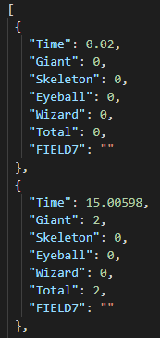
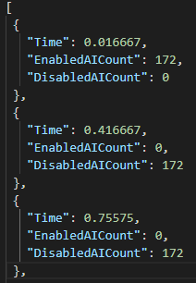
Code Bases
AI Counting:
Taken from Matt’s GAM 300/350 project, we counted the number of Enabled/Disabled AI within a level.
AI Attacks:
Taken from Ethan’s GAM 400/450 project, we counted the number of attacks any AI did in each encounter with the player.

Slide 3
Uses
Can see the variable changes by time with your own json file from codebase.
Gather insight
Test code
Example: Project Atlantis
Locate bugs
View every frame simultaneously, not one at a time
Bugs can create visual anomalies in the graph

Slide 4
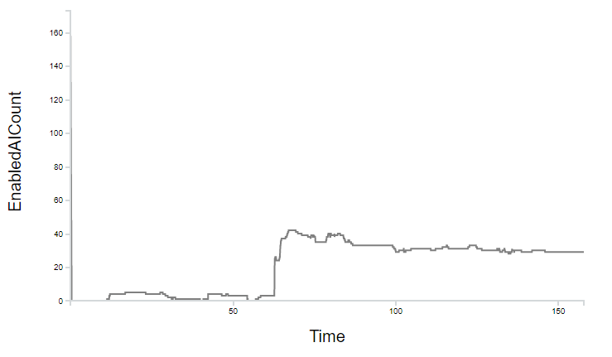
Use Example: Simultaneous Frame View
Saves Time
Avoid Frame-by-Frame in the Debugger
Yields “Big Picture” Insights

Slide 5
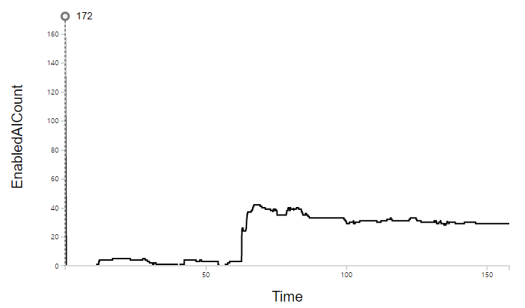
Use Example: Visual Anomaly
Outlier shows that many AI characters are enabled on the very first frame!
Bug?
Loading issues?
FPS dropping?

Slide 6
Features
Slider: Time
Dropdown Menu
Codebase Selection
Variable Selection
Crosshair Tooltip
Ready for Any Codebase

Slide 7

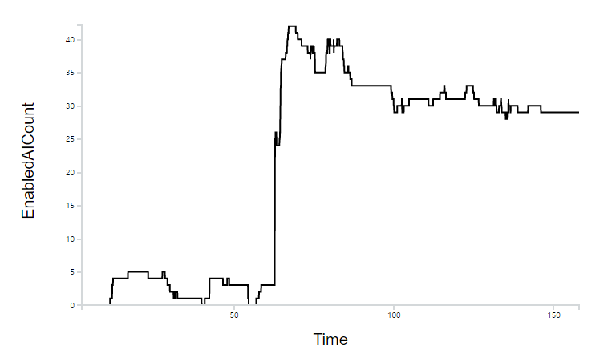
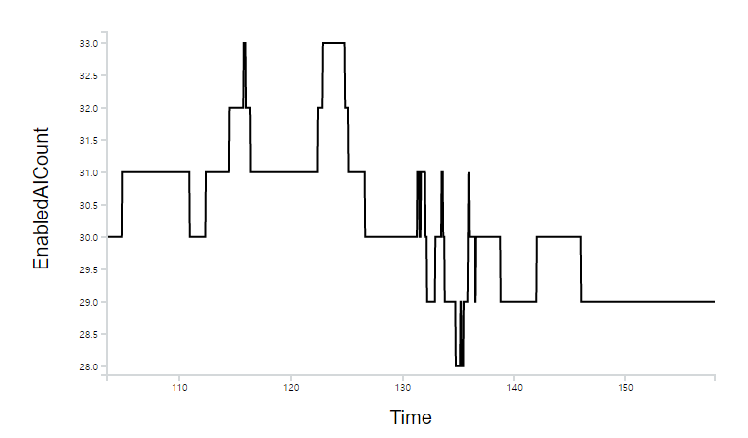
Features: Slider
Zoom in on time frames of interest

Slide 8

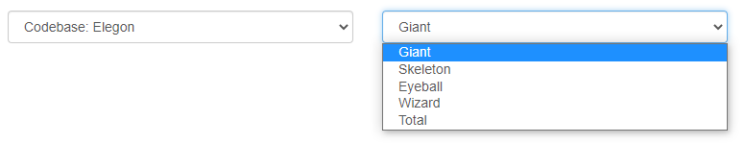
Features: Dropdown Menu
Choose multiple codebases
Visualize different variables in each codebase

Slide 9
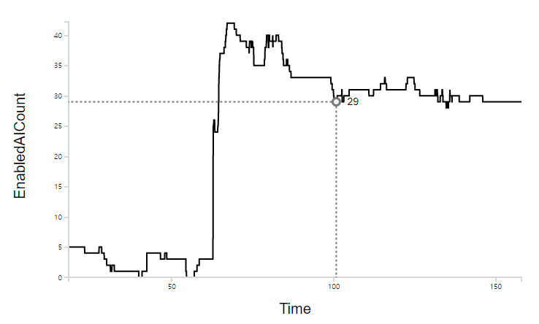
Features: Crosshair Tooltip
View the value at mouse position
Vertical and Horizontal guidelines

Slide 10
Features: Flexibility
Usable in any Codebase
You record data at runtime and create the .json
Variables of interest (as many as you want)
Delta time

Slide 11
DEMO

