Slide 1
FlappyBot
Flappy Bird AI
CSCI-6660
Matthew Windsor & Jay Parmar

Slide 2
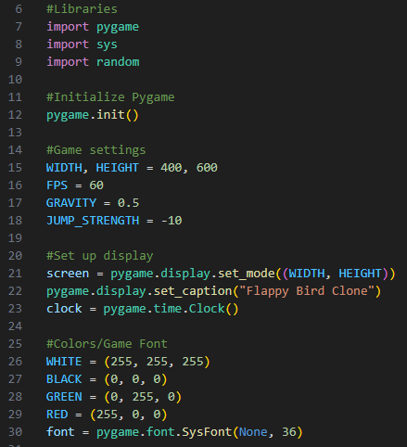
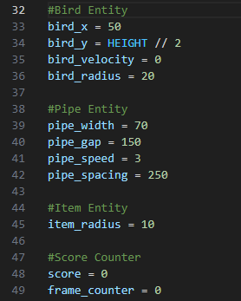
game.py
Game environment for humans, base code for future files.

Slide 3
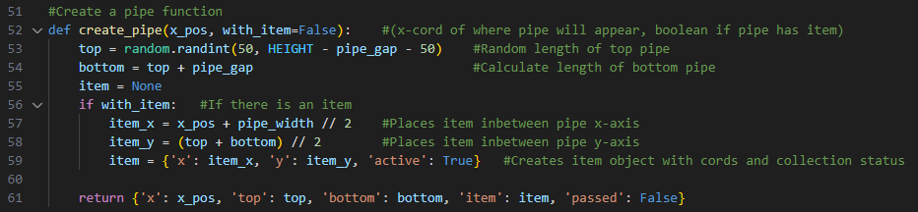
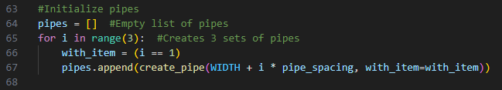
game.py (Pipe Generation)

Slide 4
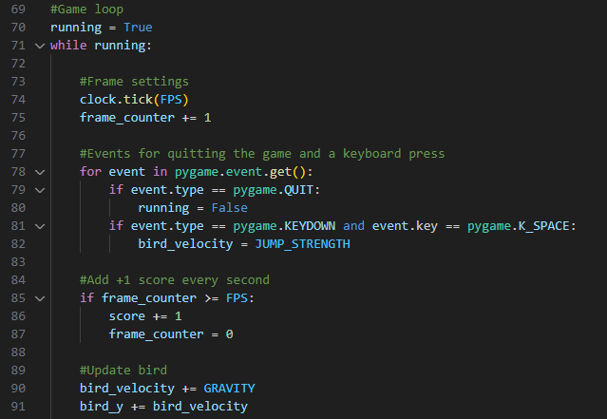
game.py (Game Loop)

Slide 5
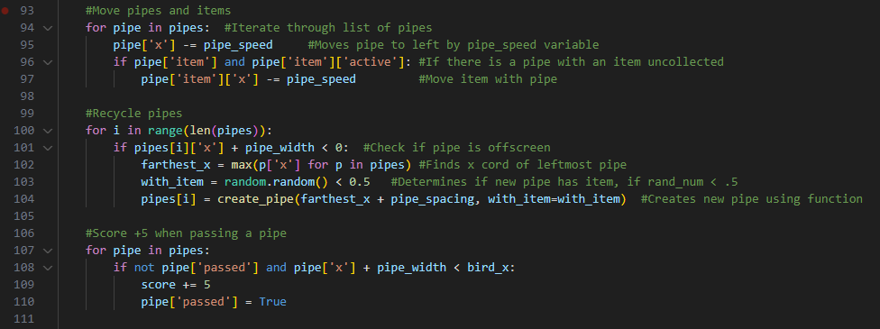
game.py (Game Loop - Pipe Logic)

Slide 6
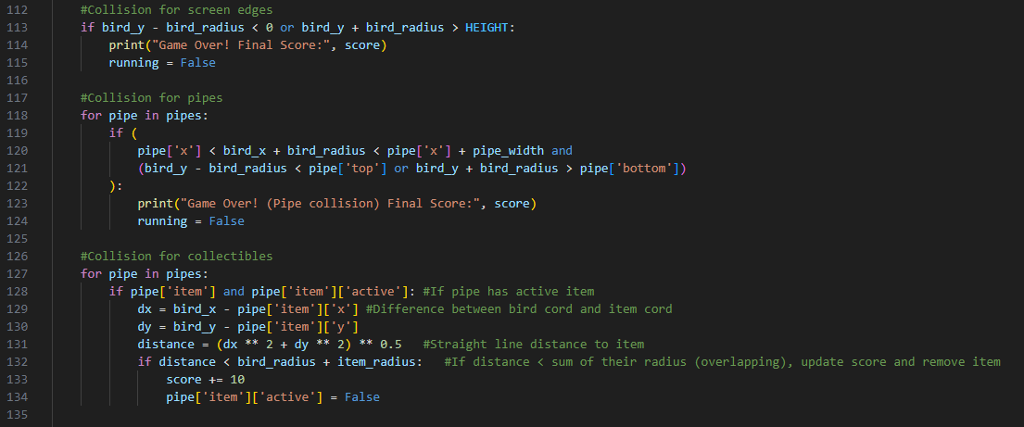
game.py (Game Loop - Collision)

Slide 7
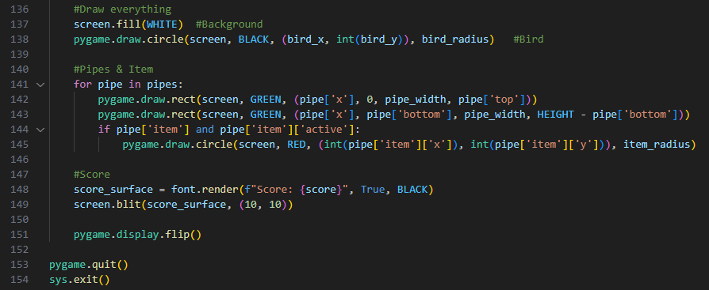
game.py (Game Loop - Rendering)

Slide 8
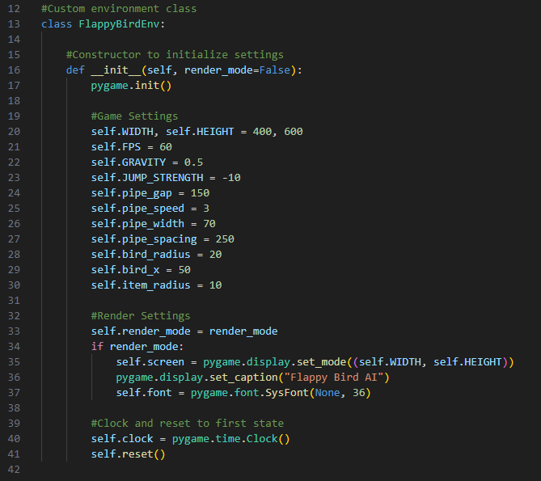
flappy_env.py
Game environment for AI, includes state observations, actions, and rewards along with game settings

Slide 9
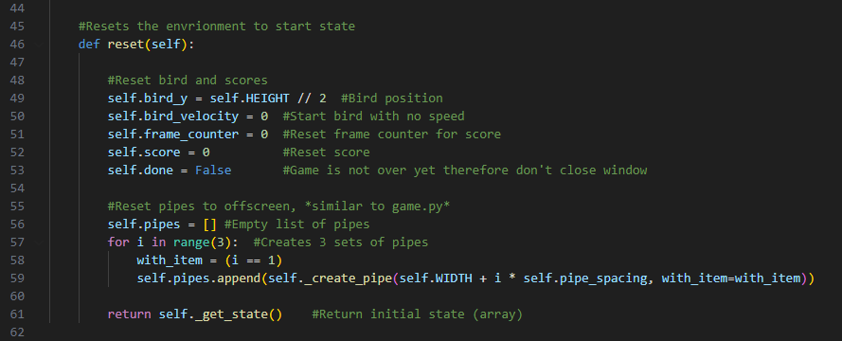
flappy_env.py (Reset)

Slide 10
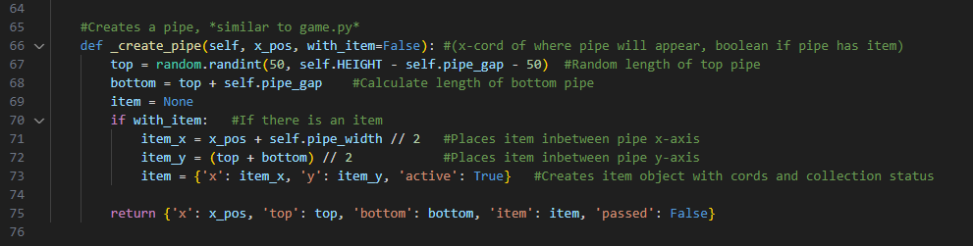
flappy_env.py (Pipe Generation)

Slide 11
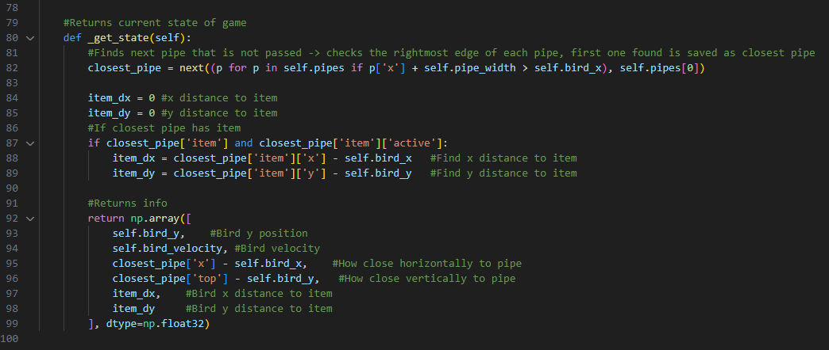

flappy_env.py (Get State)

Slide 12
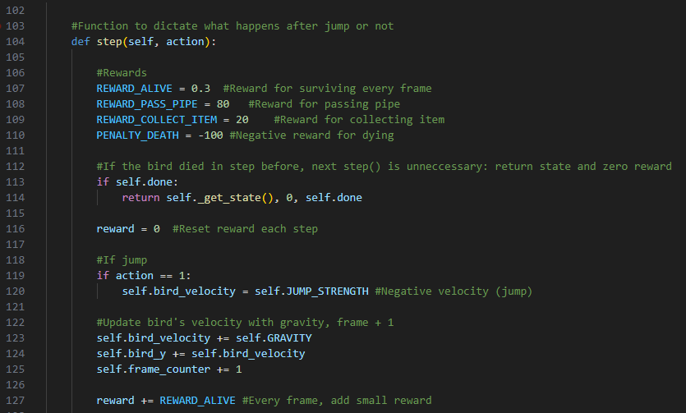
flappy_env.py (Step)

Slide 13
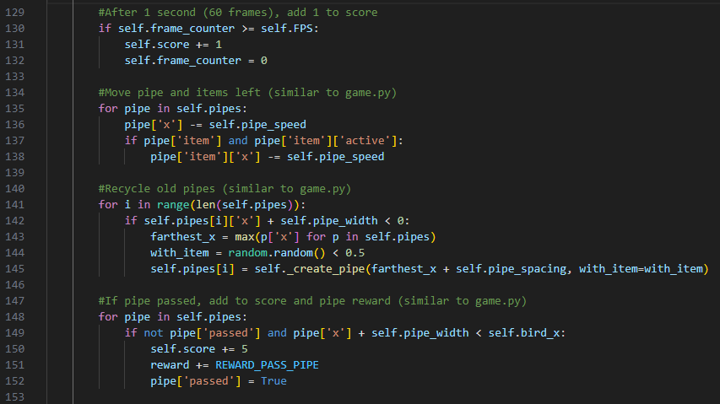
flappy_env.py (Step)

Slide 14
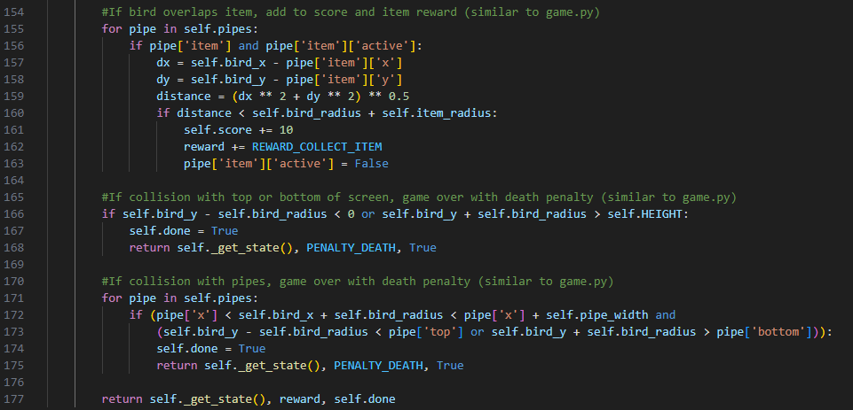
flappy_env.py (Step)

Slide 15
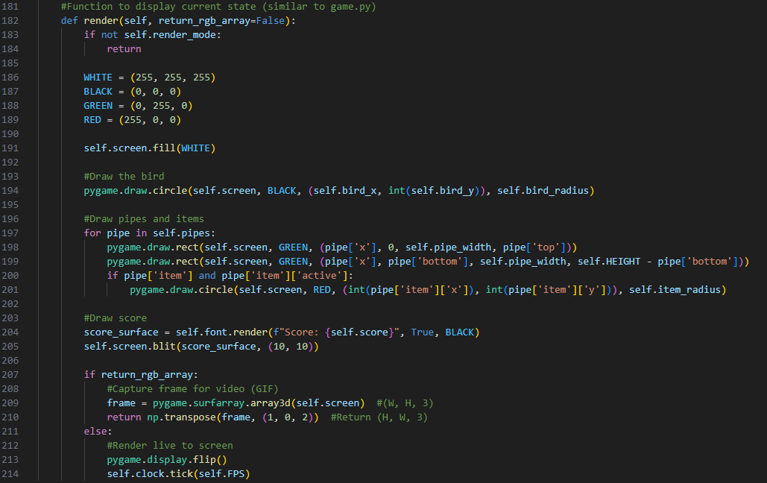
flappy_env.py (Render)

Slide 16
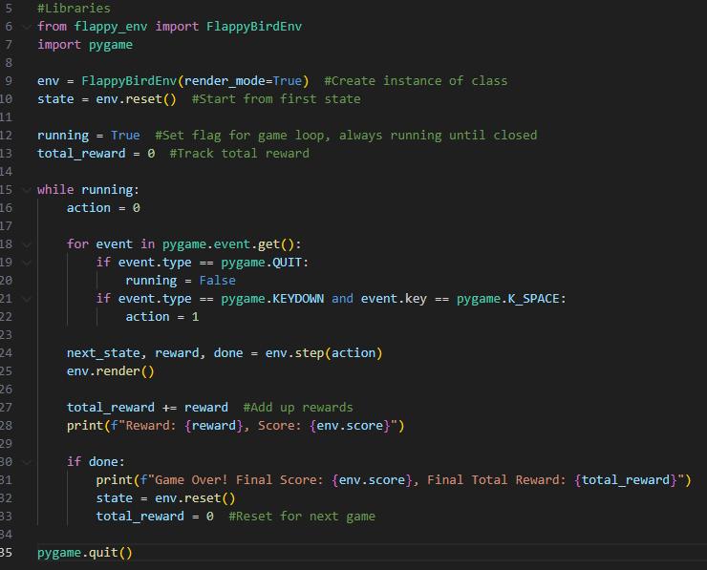
test_flappy_env.py
File to test environment, flappy_env.py

Slide 17
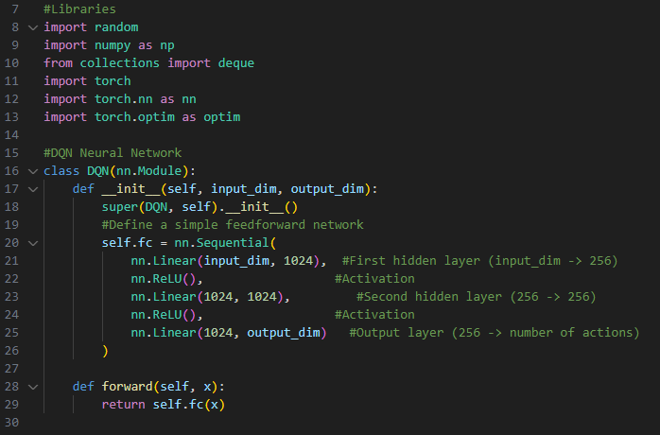
agent.py
Reinforcement Learning DQN Flappy Bird Agent

Slide 18
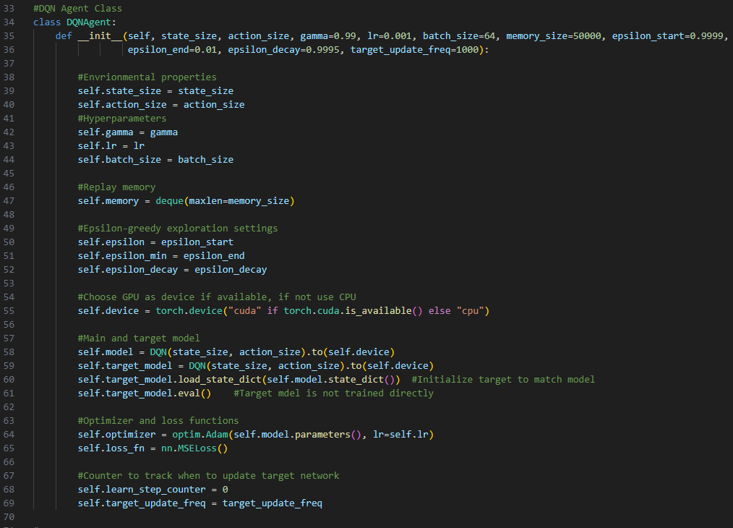
agent.py (Agent Class)

Slide 19
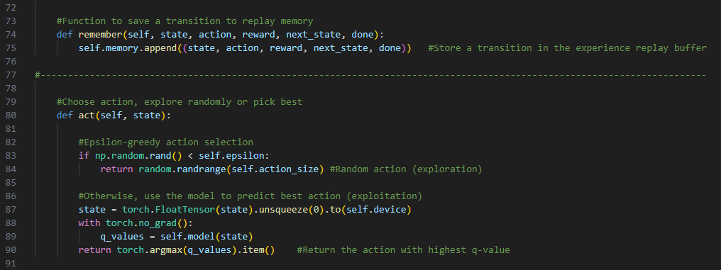
agent.py (Remember & Act)

Slide 20
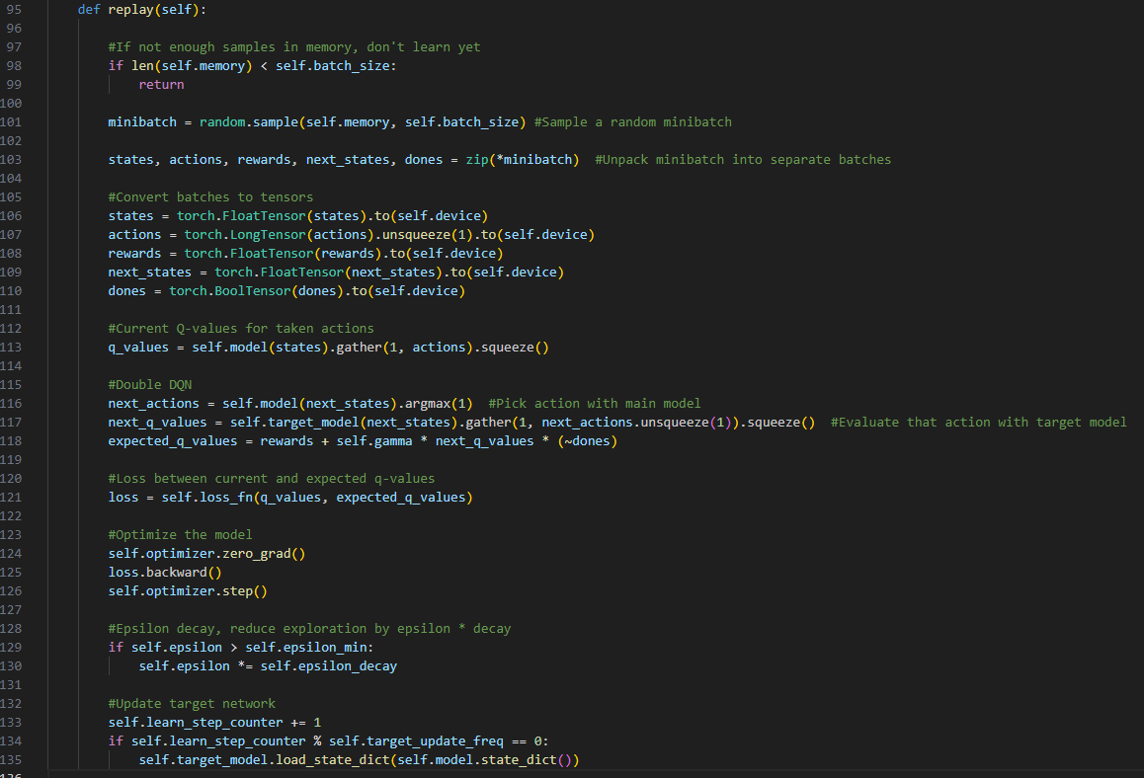
agent.py (Replay)

Slide 21
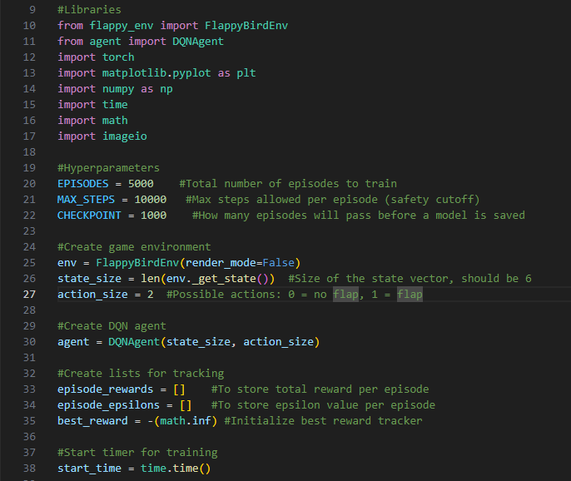
train.py
Script that trains the agent using flappy_env.py, handles training loop, periodic evaluation, saving trained models

Slide 22
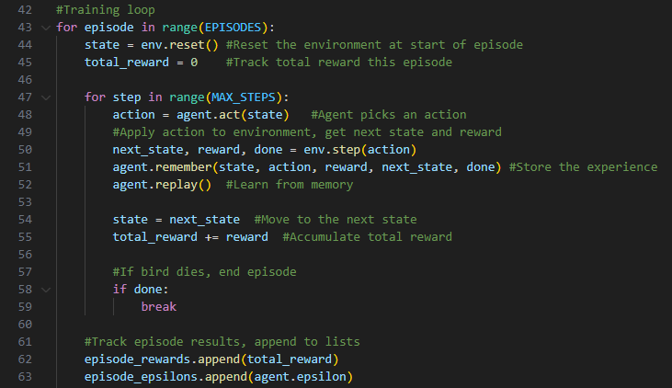
train.py (Training Loop)

Slide 23
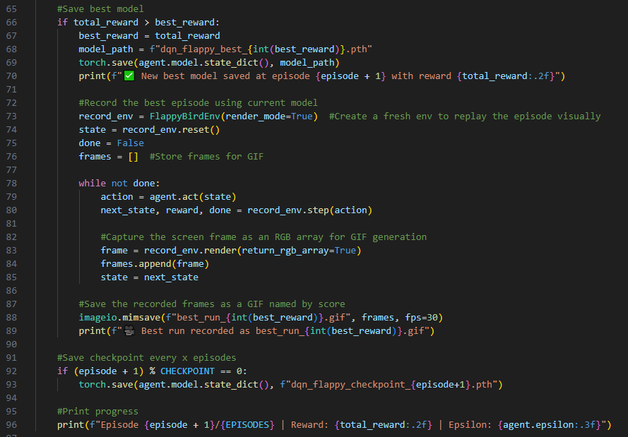
train.py (Saving Models)

Slide 24
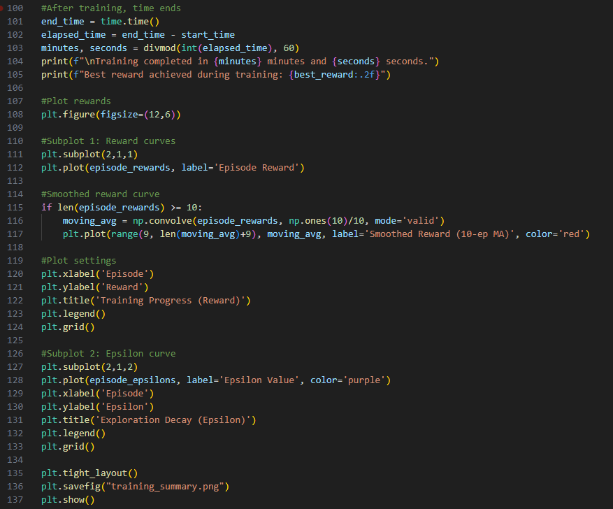
train.py (Saving Models)

Slide 25
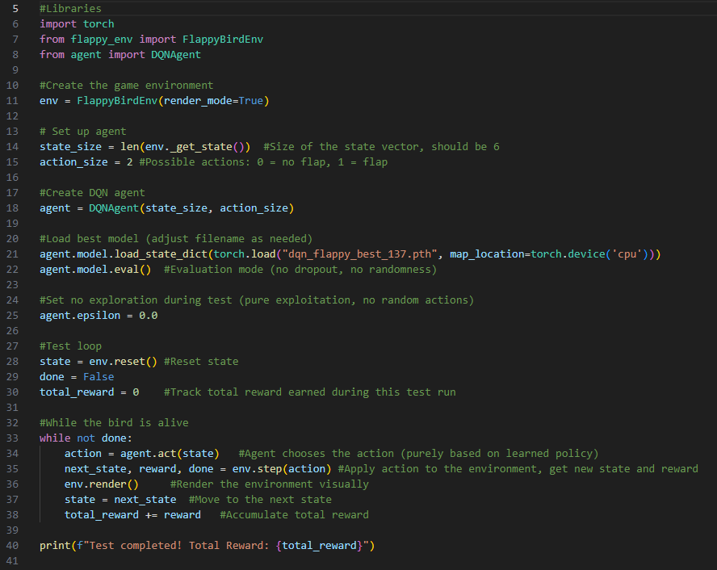
test_agent.py (Saving Models)
Script to run trained models from train.py

