Slide 1

PORTFOLIO PROJECT
Healthcare Claims &
Patient Utilization Analytics
SQL Server data warehouse and Power BI Dashboard
SQL Server Power BI DAX Dimensional modeling
Synthetic healthcare data generated by Synthea
Notes:
Introduce the project as an end-to-end analytics case study covering ingestion, transformation, dimensional modeling, DAX, and Power BI reporting.

Slide 2
Business context and project scope
02
A focused healthcare utilization and claim-cost analytics case study
Stakeholder
Questions addressed
Healthcare analytics team
Which encounter classes account for the most claim cost?
How has utilization changed over time?
Which recorded clinical conditions appear most frequently?
Which organizations handle the most encounters?
How do the results change across patient and payer groups?
The team needs a consistent view of utilization, claim cost, patient populations, and where resources are concentrated.
18 source CSVs
6 core datasets
5 dimensions and 2 facts
Synthetic healthcare data generated by Synthea
Notes:
Keep the problem statement narrow. This dashboard answers utilization, claim-cost concentration, condition volume, and organization volume questions. It does not claim to measure clinical quality or operational efficiency.

Slide 3
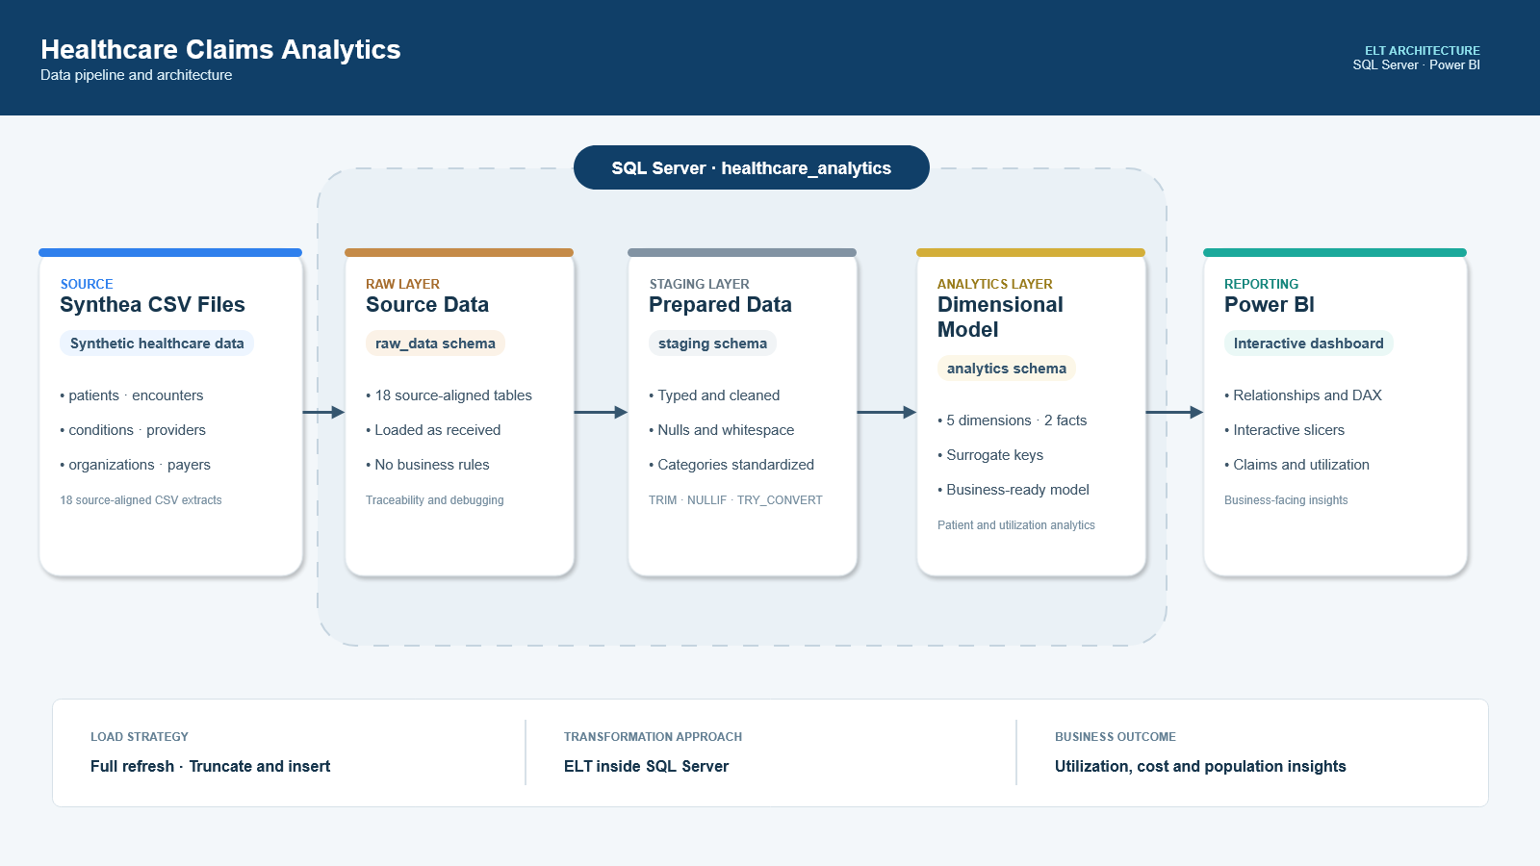
Notes:
Walk from Synthea CSV files through raw_data, staging, analytics, and Power BI. The approach is ELT because the transformations occur inside SQL Server after loading.

Slide 4
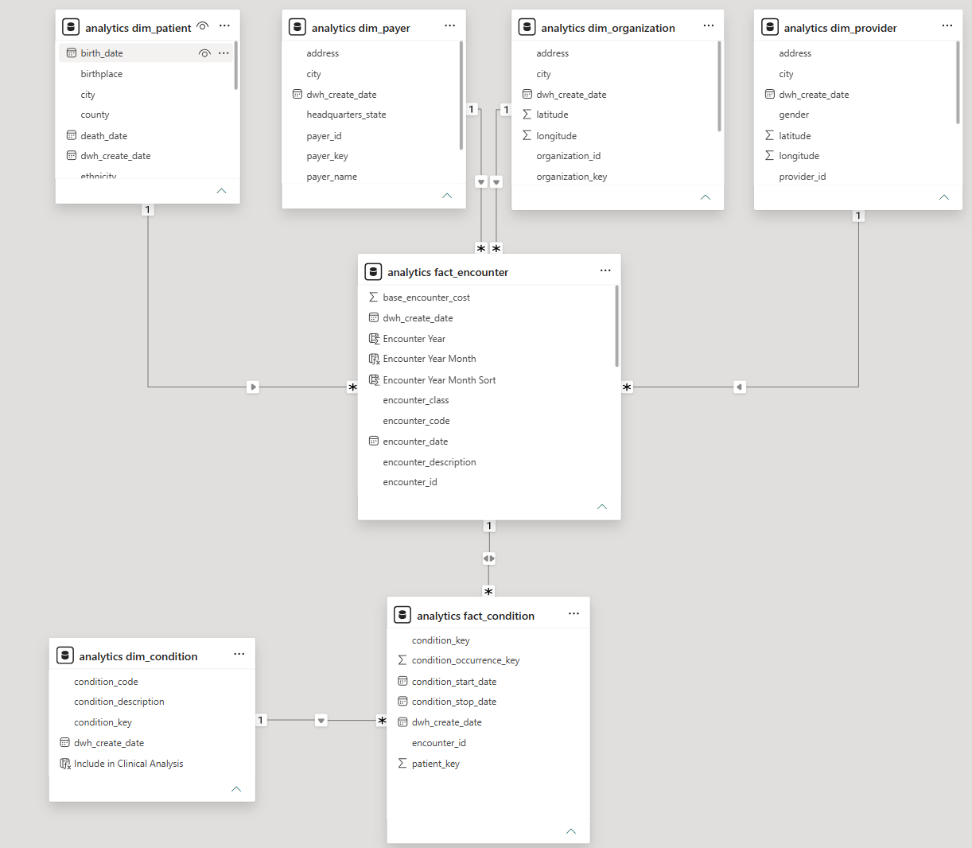
Dimensional analytics model
04
Separate dimensions describe patients, payers, providers, organizations, and conditions
5
dimensions
Patient, payer, provider, organization, and condition context
2
fact tables
One encounter row in fact_encounter. One recorded condition occurrence in fact_condition.
Surrogate integer keys connect the analytical facts to reusable dimension records.
Synthetic healthcare data generated by Synthea
Notes:
Explain the grain before discussing relationships. fact_encounter stores one encounter. fact_condition stores one condition occurrence, so an encounter can link to zero, one, or multiple condition rows.

Slide 5
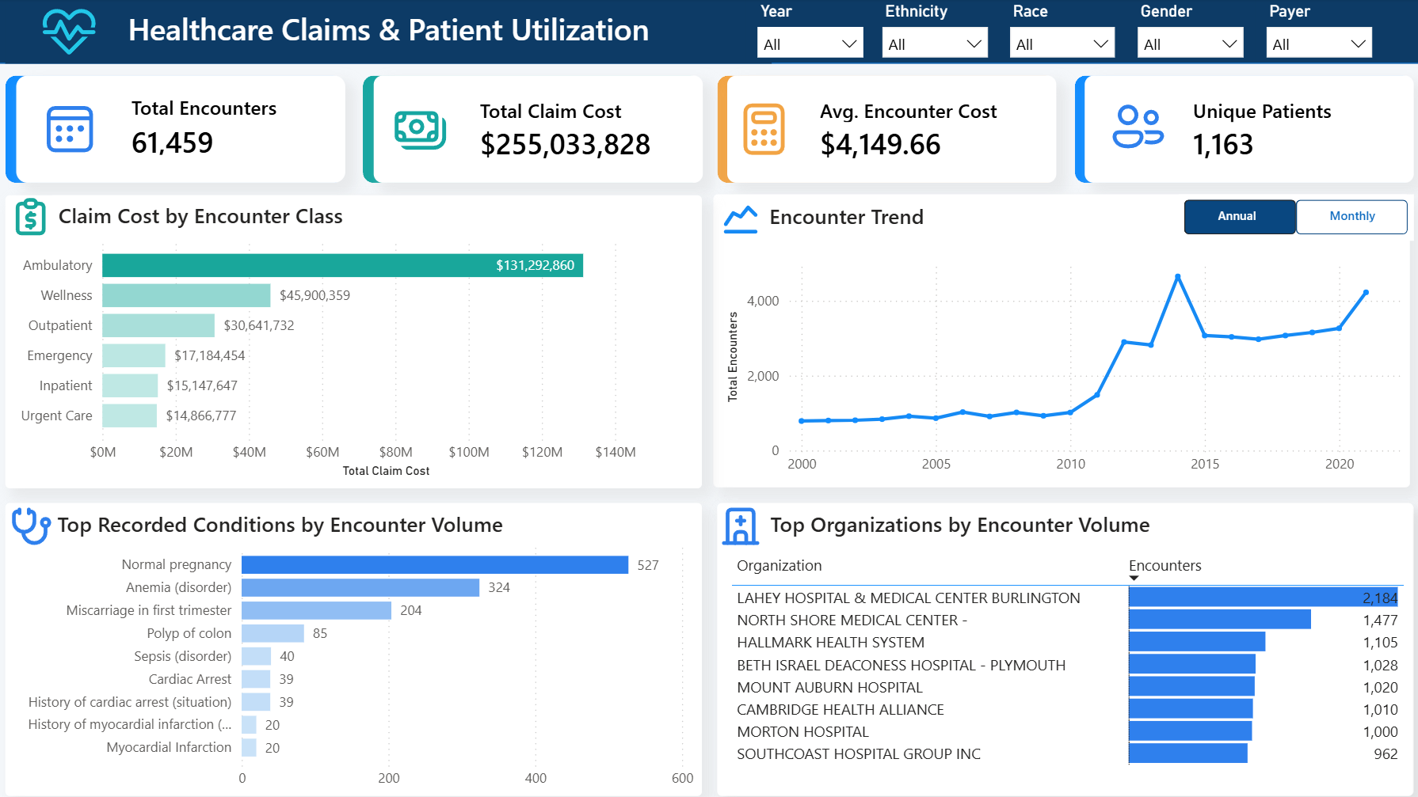
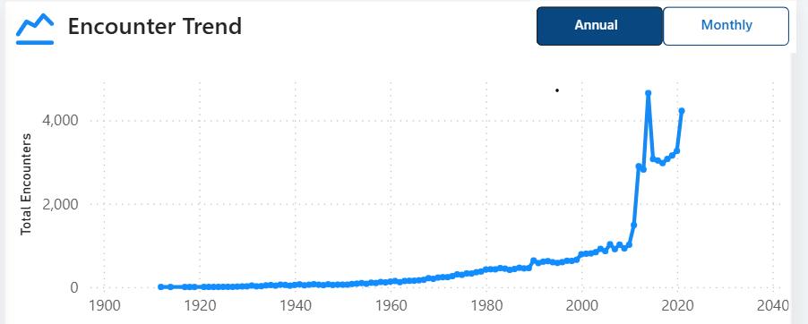
Power BI dashboard
05
Interactive view of claim cost, utilization, recorded conditions, organization volume, and patient filters
Notes:
This is the finished one-page report. The annual or monthly selector changes the trend grain, while the top slicers filter the KPI and analytical visuals. The trend view shown here includes the full historical period.

Slide 6
Ambulatory encounters account for 51% of claim cost
06
Wellness generated more encounters, but ambulatory visits carried substantially higher average cost
3.4×
higher average cost per encounter
Ambulatory
20,124 encounters
$6,524 average cost
Wellness
24,038 encounters
$1,909 average cost
Pregnancy-linked ambulatory encounters represented approximately $27M in claim cost.
Synthetic healthcare data generated by Synthea
Notes:
The main point is that encounter volume and spending are different questions. Pregnancy is associated with about $27M of ambulatory cost, but the condition is not an exclusive allocation and does not prove causation.

Slide 7
Patient growth and higher visit frequency increased utilization
07
Active-patient counts rose while encounters per patient stabilized above earlier levels
+84%
active patients from 2010 to 2021
Encounters per active patient
2.04
in 2004
5.18
2014 peak
≈3.4
stable from 2015 onward
The 2014 peak should be treated as a synthetic-data anomaly unless another breakdown explains it.
Synthetic healthcare data generated by Synthea
Notes:
The rise in total encounters did not come from patient growth alone. The active-patient population expanded, and the average encounter rate settled at about 3.4 per active patient after 2015. Do not infer a real-world cause for the 2014 peak.

Slide 8
Utilization and claim cost concentrate in different segments
08
Lahey leads encounter volume, while the No Insurance category leads total claim costs
Organization volume and average cost
Claim cost by payer category
Organization | Encounters | Patients | Avg. cost
Lahey Hospital & Medical Center | 2,184 | 21 | $3,021
North Shore Medical Center | 1,477 | 48 | $5,224
Hallmark Health System | 1,105 | 56 | $5,700
Lahey recorded the highest volume and the lowest average cost among the three organizations.
Its 21 patients generated roughly 104 encounters each across the full synthetic history, showing high repeating numbers.
39.8%
of total claim cost belonged to encounters categorized as No Insurance
Synthetic healthcare data generated by Synthea
Notes:
The No Insurance category is a grouping from the payer data. The $101.5M is total claim cost associated with those encounters, not an amount paid by an insurer. Organization results describe the synthetic dataset and should not be interpreted as hospital performance.

Slide 9
Findings and interpretation limits
09
Condition records support utilization analysis but do not allocate every dollar of claim cost
Condition linkage coverage
What the analysis supports
Ambulatory encounters are the largest concentration of claim cost.
Utilization increased through both patient growth and higher encounter frequency.
High encounter volume does not automatically mean high average encounter cost.
$255.0M
total claim cost
How to interpret the results
Synthea data is synthetic and does not represent real hospital performance.
The total_claim_cost field represents claim costs, not necessarily insurer payment.
Condition-linked costs may overlap when one encounter contains multiple recorded conditions.
Synthetic Synthea data | Associations describe the modeled dataset and do not establish causation
Notes:
About 43.2% of claim cost links to at least one condition row, while 56.8% belongs to encounters without a fact_condition record. Keep conditions as a utilization view and avoid presenting condition totals as a complete allocation of the $255M.

