Slide 1
Native Americans of Wisconsin
Amanda Wycklendt
Constructivist Unit: Grade 4
Content Reading 650

Slide 2
Unit Overview
4th Grade Social Studies Unit
Native Americans of Wisconsin
Approximately 9-11 days

Slide 3
Learning Objectives
Students will be able to…
Develop answers to the questions: what do you eat, what do you wear, what do you do with your time, and where do you live?
Conduct research on a specific Native American Tribe in Wisconsin using available resources.
Effectively present their information by using Microsoft Powerpoint.

Slide 4
Wisconsin Educator Standards For Teachers
#1: Teachers know the subjects they are teaching.
#2: Teachers know how children grow.
#3: Teachers understand that children learn differently.
#4: Teachers know how to teach.
#6: Teachers communicate well.
#7: Teachers are able to plan different kinds of lessons.
#8: Teachers know how to test for student progress.

Slide 5
Assessments
Reading Exit Slips
Native American Project Grading Rubric
7 Questions about Tribe
Tribal Flag
Wisconsin Map
Group Evaluation

Slide 6
Materials
4 pieces of Butcher Paper with questions written them
The Wisconsin Journey book
Exit Slips for Lessons 1 & 2
Tribe Packet for each Tribe containing directions page, 7 questions, tribal flag, grading rubric, and group evaluation
Enlarged Wisconsin Map
Laptop Cart
Native People of Wisconsin book
Native American books from Library
Websites
Markers, crayons, colored pencils, scissors, and yarn

Slide 7
Day One
Scroll Walk
Students will be put into groups of 5 or 6 and assigned a question to start with.
4 questions will be answered during the lesson: what do you eat, what do you wear, what do you do with your time, and where do you live?
Each group will have 5 minutes to write down answers to the question they have.
Groups will then rotate through the rest of the questions spending 5 minutes at each one.
To conclude, we will look at the answers for each question as a class.
The questions will be addressed again after the readings in The Wisconsin Journey book.

Slide 8
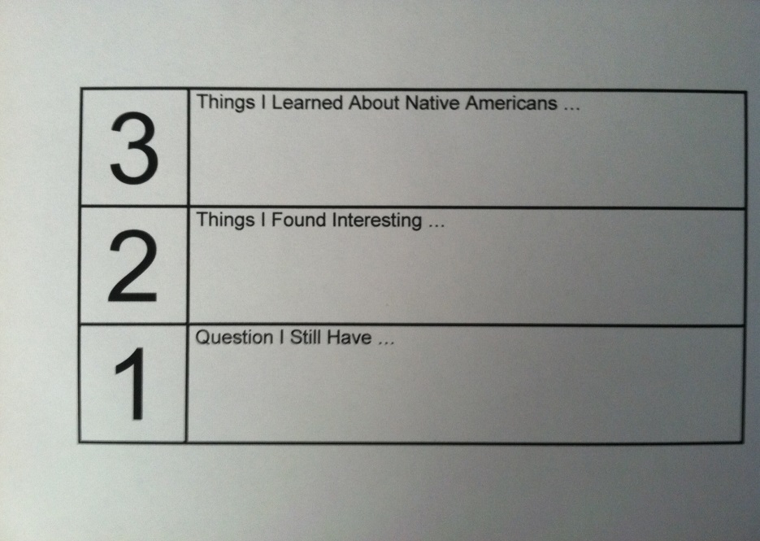
Day Two
Read from The Wisconsin Journey
Chapter 3 “The First People”: Lesson 1 “Prehistoric Indians” pages 32-39
Add to Scroll Walk questions
Exit Slip

Slide 9
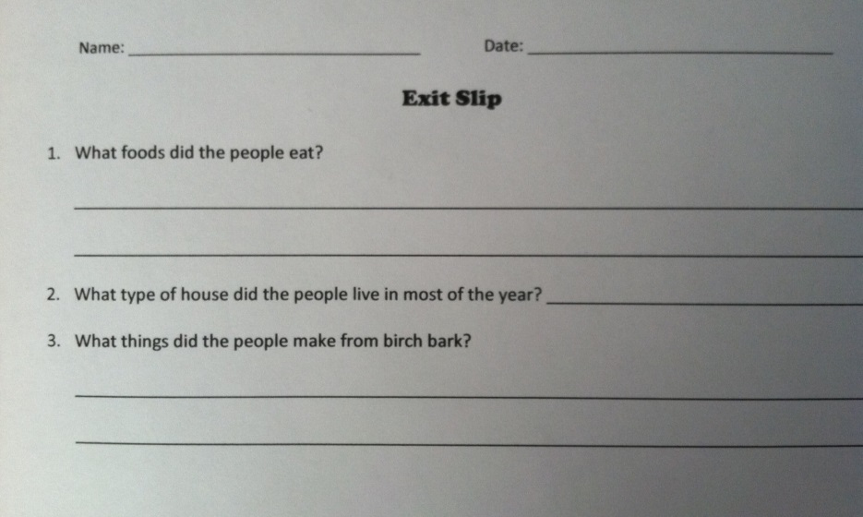
Day Three
Read from The Wisconsin Journey
Chapter 3 “The First People”: Lesson 2 “Historic Indians” pages 39-47
Add to Scroll Walk questions
Exit Slip

Slide 10
Day 4
Introduce Native American Project
Show students a sample Powerpoint that I created.
Go through Tribe Packet and enlarged Wisconsin map.
Explain Powerpoint layout.
Title page with Tribe name and group members, one page for each of the 7 questions, resources page.
Answer questions.
Use “Group Generator” in Smart Notebook to choose Tribe groups. There will be 5 groups with 4-5 students in each group.

Slide 11
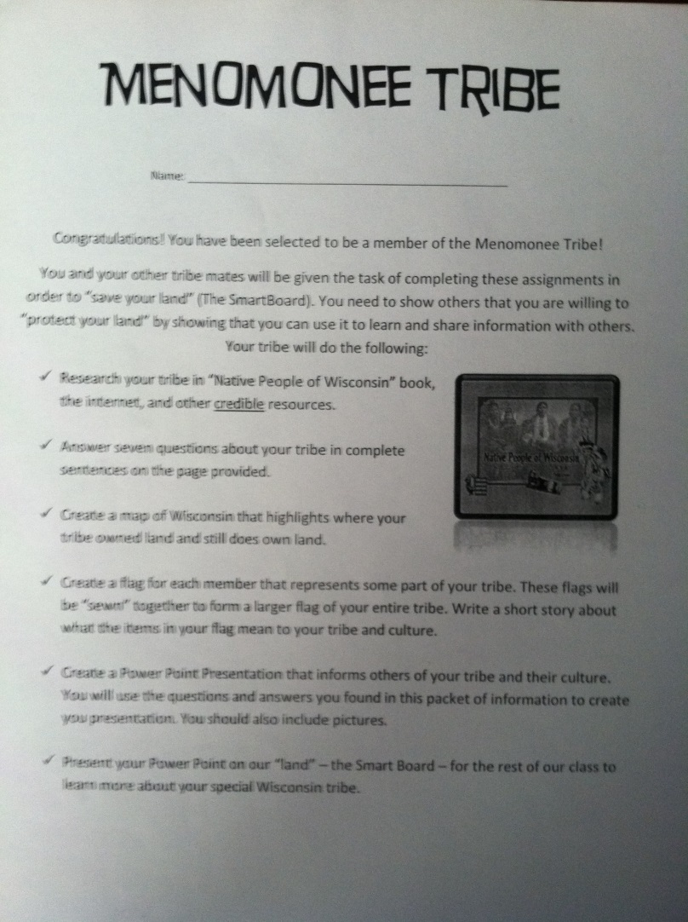
Tribe Directions

Slide 12
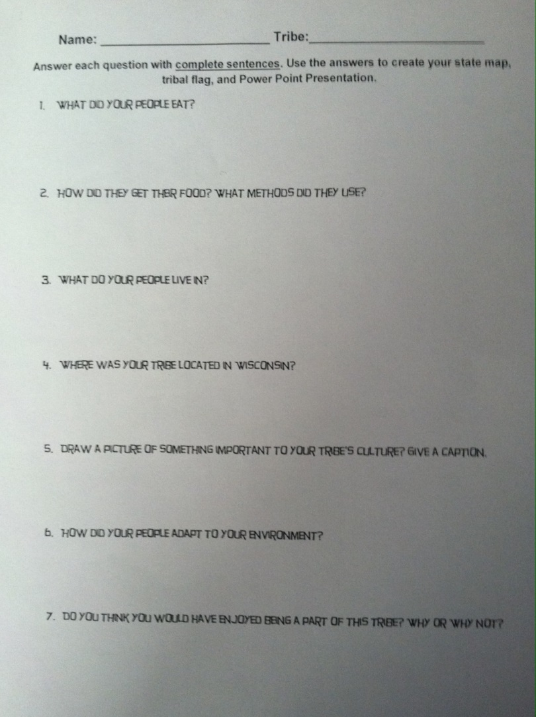
7 Questions

Slide 13

Tribal Flag

Slide 14
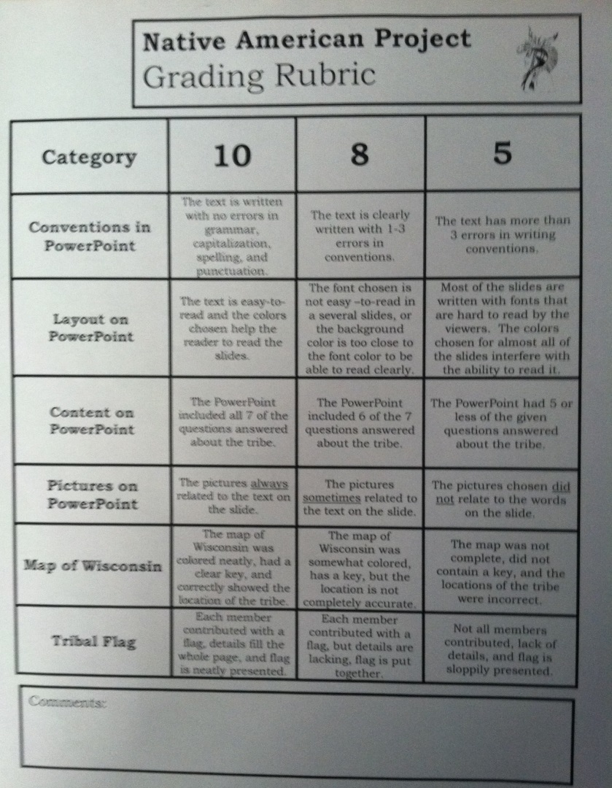
Native American Rubric

Slide 15
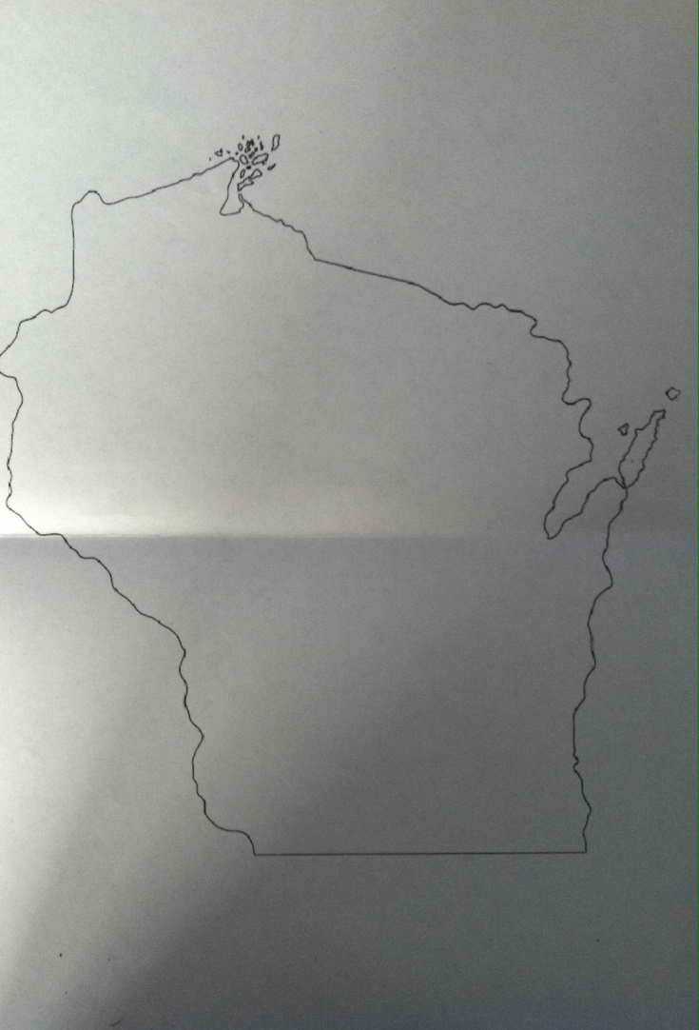
Enlarged Wisconsin Map

Slide 16
Day 5-Day 9
Work Days
Students spend the first day of researching using the Native People of Wisconsin book to answer the 7 questions.
After the first day of research, students can use the Native People of Wisconsin book, Native American books for the Library, and websites to find information.
Once all of the questions have been answered, students create their Powerpoint presentation, design their Tribal Flag, and color their Wisconsin map.
I take a daily participation grade (1-5 points) everyday for each student based on how well and how much they are contributing to the project.

Slide 17
Day 10-11
Presentations
Students present their Powerpoint, Tribal Flag, and Wisconsin map to the class.
Students complete the “Group Evaluation” form.

Slide 18
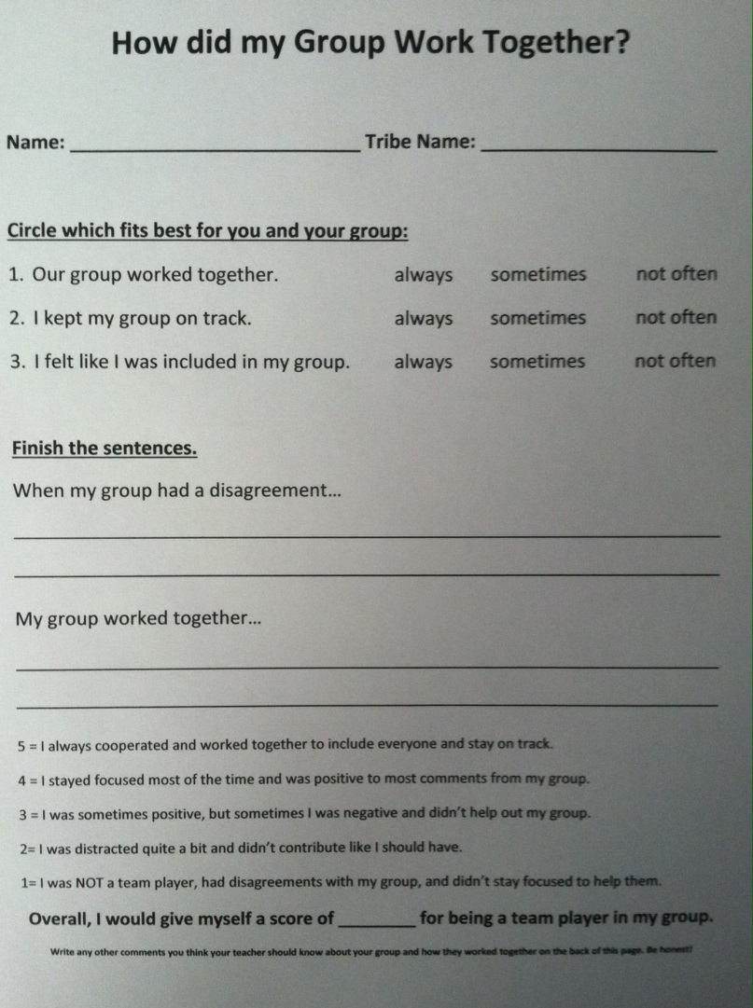
Group Evaluation

Slide 19
Key Ideas That Make This A Constructivist Unit
Provides for active involvement in the learning process.
Creates opportunities for transferring learning.
Creates meaning from experiences.
Accommodates individual and social construction in the learning process.
Knowledge is constructed, not transmitted.
Is self-motivating.
Makes learners problem solvers and efficient thinkers.
Teacher serves as facilitator rather than director.
Is a “hands on” activity.
Does not require extensive memorization.
Involves students in authentic tasks.

Slide 20
Key Ideas That Make This A Constructivist Unit
Encourages use of dialogue.
Cooperation/collaboration are valued as opposed to competition.
Requires patience.
Can be an ongoing process.
Students play a larger role in evaluating or assessing their own progress.
Prior knowledge is accessed/evaluated.
Encourages independent research.
Technology is useful.
Provides motivation to succeed/learn.
Allows for self-reflection.
Involves students in language-rich activities.

Slide 21
Wisconsin Model Academic Standards For Social Studies
B.4.10 Explain the history, culture, tribal sovereignty, and current status of the American Indian tribes and bands in Wisconsin.

Slide 22
Reading Standards For Informational Text K-5
Determine the meaning of general academic and domain-specific words or phrases in a text relevant to a grade 4 topic or subject area.
Interpret information presented visually, orally, or quantitatively (e.g., in charts, graphs, diagrams, time lines, animations, or interactive elements on Web pages) and explain how the information contributes to an understanding of the text in which it appears.
Integrate information from two texts on the same topic in order to write or speak about the subject knowledgeably.
By the end of year, read and comprehend informational texts, including history/social studies, science, and technical texts, in the grades 4–5 text complexity band proficiently, with scaffolding as needed at the high end of the range.

Slide 23
Writing Standards K-5
Conduct short research projects that build knowledge through investigation of different aspects of a topic.

Slide 24
Speaking And Listening Standards K-5
Engage effectively in a range of collaborative discussions (one-on-one, in groups, and teacher-led) with diverse partners on grade 4 topics and texts, building on others’ ideas and expressing their own clearly.
Report on a topic or text, tell a story, or recount an experience in an organized manner, using appropriate facts and relevant, descriptive details to support main ideas or themes; speak clearly at an understandable pace.

Slide 25
Language Standards K-5
Demonstrate command of the conventions of standard English grammar and usage when writing or speaking.
Demonstrate command of the conventions of standard English capitalization, punctuation, and spelling when writing.
Acquire and use accurately grade-appropriate general academic and domain-specific words and phrases, including those that signal precise actions, emotions, or states of being (e.g., quizzed, whined, stammered) and that are basic to a particular topic (e.g., wildlife, conservation, and endangered when discussing animal preservation).

