Slide 1
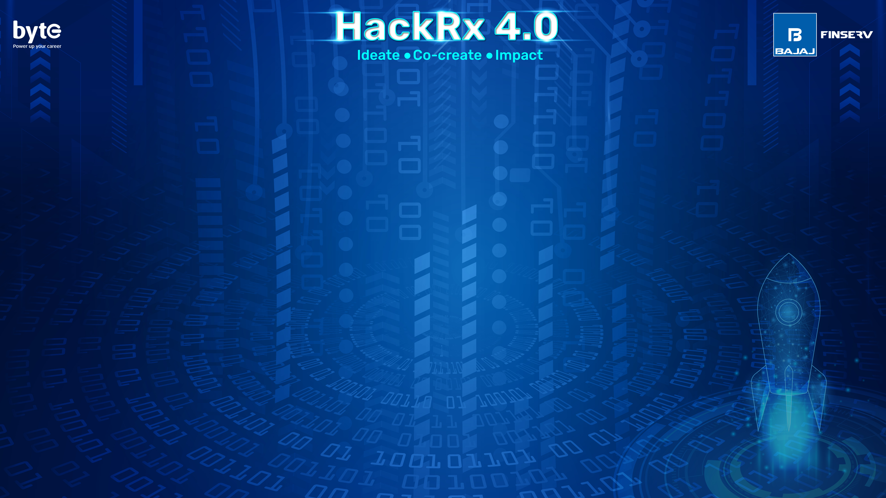
Team Homi
Matta Rithik Reddy 2024. Mahindra University
Nalin Koundinya Aitharaju. 2024 Mahindra University
SriLakshmi Sai Snigdha Rupakula 2024 Mahindra University
Sathvik Reddy Chandupatla 2024 Mahindra University

Slide 2
Tell us a bit about yourself
Our team has prior experience in abstractive text summarization and a keen interest in finance. We have been actively exploring opportunities to apply our machine learning, big data, and DBMS skills in the finance and market domain. This project aligns perfectly with our expertise and interests, allowing us to leverage our knowledge gained through both academic curriculum and continuous self-learning. It presents an exciting opportunity to showcase our capabilities and contribute to the field of finance with cutting-edge technologies.

Slide 3
Problem Statement : Suggest me a Stock
We would like to maintain some flags for knowing the risk profile of the client by prompting them some questions and based on his previous investments . Also by creating an algorithm which calculates the fundamentally strong stocks and technically strong stocks in the time frame we keep the data . Also considering the sectors he is invested in also seeing the sectors which are highly in boom and keeping the macro and micro economic changes that effect the market we set some flags and if based on the client profile we customize the recommendations and suggest them. We can even suggest the stock selling suggestion if he holds if any sudden bad news is going on in the market by using sentiment analysis.

Slide 4
Tech Stack
Please mention your Tech Stack (wherever applicable)
Backend : Python , Flask , Libraries: TensorFlow, Machine Learning Libraries.
Frontend : Html, CSS, JavaScript (May change Based on Prototype)
Cloud Service Providers (AWS/Azure)
Database (MYSQL)
API’s: Yahoo Finance(Financial data), Bloomberg(News for Sentiment Analysis)

Slide 5
Detailed Description of the solution
We provide two options for loading stock data: manual entry or automated retrieval by connecting to data sources. For new investors, we offer pre-processed algorithmic suggestions for stocks.
Once the data is loaded, our algorithm analyzes your risk profile by considering your previous investments and posing relevant questions. We also internally set flags based on the data and other factors. Using this comprehensive analysis, we provide personalized stock recommendations.
To generate these recommendations, we preprocess data related to stock prices and other ratios. This enables us to create a generic list of companies that exhibit strong fundamentals for the next few months. Additionally, we identify technically strong stocks suitable for buying and holding within specific timeframes, with the intention of selling them later.
By incorporating these techniques, we offer a range of suggestions that align with your risk profile and investment goals.

Slide 6
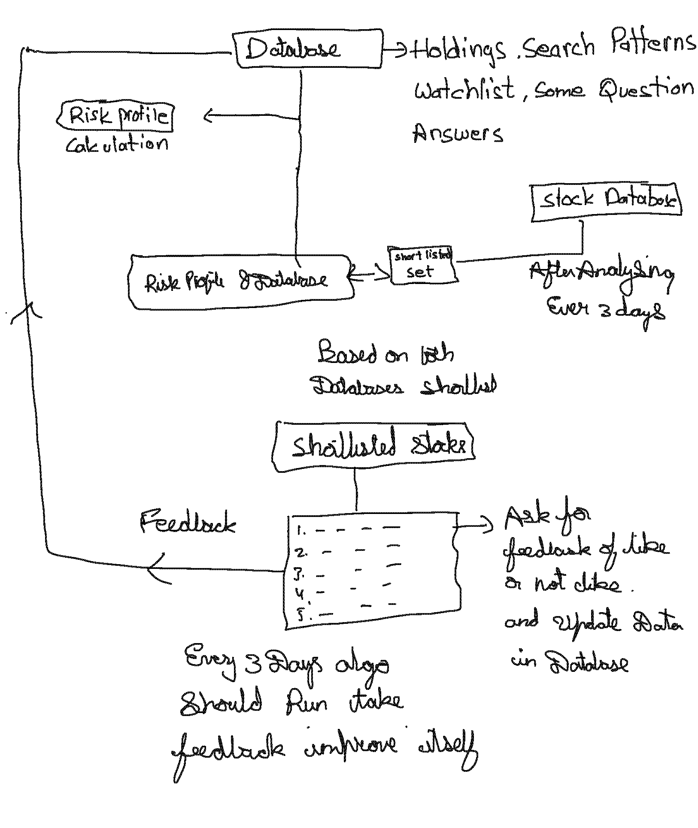
Data Flow Diagram

Slide 7
So, how is your solution different?
Our product's unique selling proposition (USP) lies in its customer-centric approach, where the algorithm adapts to the user's stock interests. Unlike others that provide predetermined suggestions, our algorithm evolves with each search and investment, ensuring dynamic and personalized recommendations. Additionally, we implement comprehensive strategies based on multiple factors, prioritizing holistic analysis over isolated variables. This combination of all-round analysis and customer-specific stock suggestions sets us apart from the competition.

Slide 8
Future possible enhancements
Training an Algorithm /Neural Network more advanced for the heavy amount of variables and 1000’s of stocks to give an accurate prediction and adaptability to identify the stock trends of each stock and more technical analysis capabilities to be added based on the mathematical statistics.
Making the algorithm more advanced to predict the market based on the sentiment analysis which is higher and advanced rather than using a simple n gram approach .So, the Mathematical and emotional psychology of the market could give us a damn sure prediction fo the stock.

Slide 9
Risks/ Challenges / Dependencies
Some of the Technologies are new to us and Handling such a Huge Quantity of Data could Data take time to Process.
We May not see good predictions at start of the project but the improvements can be made to make it the bst.
The main risk is that we may not make a good prediction and this kind of projects could affect a lot if the accuracy if can achieve is less So, getting a high accuracy is a very hard thing in this kind of projects.

Slide 10
Acceptance Criteria Coverage
How many aspects of the problem statement have been covered?
We have Covered the following Aspects:
Risk Profile Calculation & Handling
Holding
Stock Search patterns
Watchlist
Pre-processing the Suggestions for 3 days with/without Customization of the User
We even want to make a Advanced Analytics based on Fundamental Analysis principles and Technical Analysis Principles

Slide 11
Anything Else ?
We Would Like to do this problem at the best and could implement all the things which we thought of implementing and we will sort it out with the mentor or the resources we could use. To make the prototype as good as possible and to a level that we promised.

