Slide 1
Introduction to Java

Slide 2
About Java:
Java is one of the world's most important and widely used computer languages, and it has held this distinction for many years
Java is a high level, robust, object-oriented and a secure and stable programming language
Java is a platform-independent language because it has runtime environment i.e JRE and API.
Creation Of Java:
Java was developed by James Ghosling, Patrick Naughton, Mike Sheridan at Sun Microsystems Inc. in 1991. It took 18 months to develop the first working version.
The initial name was Oak but it was renamed to Java in 1995 as OAK was a registered trademark of another Tech company.

Slide 3
Types of Java Application
Standalone Applications:
Example: Media player, antivirus, Paint, POS Billing software, etc.
Web Applications :
Example: mail, e-commerce website, bank website etc.
Enterprise Application:
Example: e-commerce, accounting, banking information systems etc.
Mobile Application:
Example: WhatsApp, Xender etc.

Slide 4
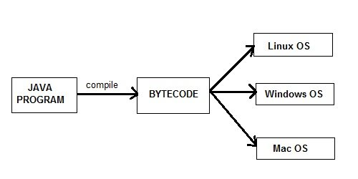
Features of Java
Simple
Object Oriented
Robust
Platform Independent
Secure
Multi Threading
Portable
High Performance
Architectural Neutral
Distributed

Slide 5
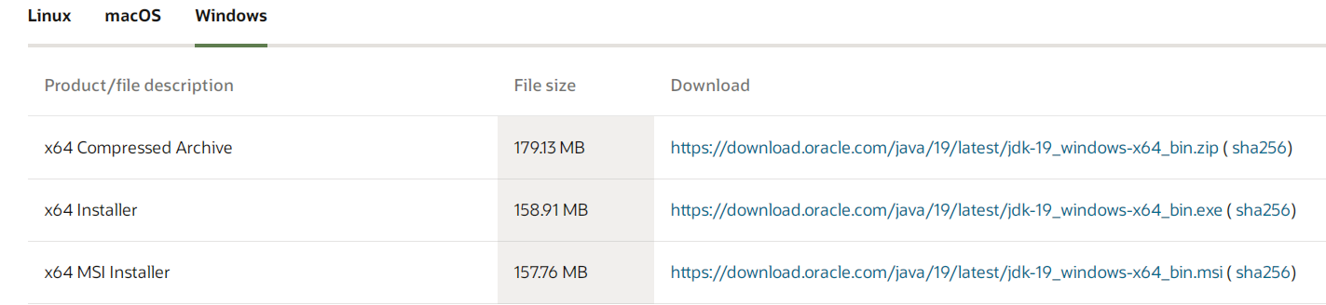
Setting Java Environment and Classpath
Download the Java version:
https://www.oracle.com/in/java/technologies/downloads/#jdk19-windows

Slide 6
Java JVM, JDK and JRE
Now we will cover what Java Virtual Machine is, and what is JRE and JDK.
Java virtual Machine(JVM) is a virtual Machine that provides runtime environment to execute java byte code.
The JVM doesn't understand Java typo, that's why you compile your *.java files to obtain *.class files that contain the bytecodes understandable by the JVM.

Slide 7
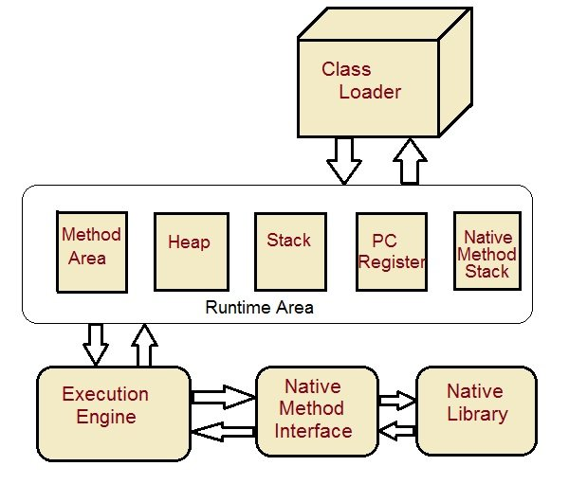
JVM Architecture

Slide 8
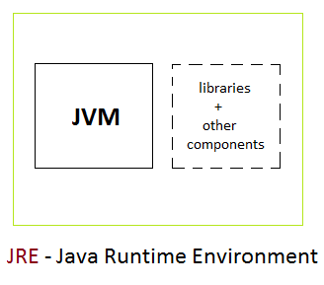
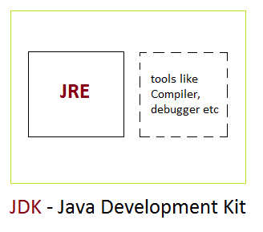
JRE : The Java Runtime Environment (JRE) provides the libraries, the Java Virtual Machine, and other components to run applets and applications written in the Java programming language. JRE does not contain tools and utilities such as compilers or debuggers for developing applets and applications.
JDK : The JDK also called Java Development Kit is a superset of the JRE, and contains everything that is in the JRE, plus tools such as the compilers and debuggers necessary for developing applets and applications.

Slide 9
First Program Java
Creating Hello world program
public class Hello{
public static void main (String[] args)
{
System.out.println (“Welcome to Java World”);
}
Lets understand what above program consists of and its keypoints.
class : class keyword is used to declare classes in Java
public : It is an access specifier. Public means this function is visible to all.
static : static is again a keyword used to make a function static. To execute a static function you do not have to create an Object of the class. The main() method here is called by JVM, without creating any object for class.
void : It is the return type, meaning this function will not return anything.
main : main() method is the most important method in a Java program. This is the method which is executed, hence all the logic must be inside the main() method. If a java class is not having a main() method, it causes compilation error.
String[] args : This represents an array whose type is String and name is args. We will discuss more about array in Java Array section.
System.out.println : This is used to print anything on the console like printf in C language.

Slide 10
Steps to Compile and Run your first Java program
Step 1: Open a text editor and write the code as above.
Step 2: Save the file as Hello.java
Step 3: Open command prompt and go to the directory where you saved your first java program assuming it is saved in C drive.
Step 4: Type javac Hello.java and press Return(Enter KEY) to compile your code.
This command will call the Java Compiler asking it to compile the specified file. If there are no errors in the code the command prompt will take you to the next line.
Step 5: Now type java Hello on command prompt to run your program.
Step 6: You will be able to see Hello world program printed on your command prompt.

Slide 11
Hello World Program using Eclipse
Eclipse is an IDE (Integrated Development Environment) which is used to develop applications. It is design and developed by Eclipse foundation, if you don’t have eclipse download, then download it from its official site by following this download link Download Eclipse from here Here we will see how to create and run hello world program using eclipse IDE. It require following steps that consists of creating project, class file, writing code, running code etc.
Run Eclipse and Create Project
Ex: show in Eclipse

Slide 12
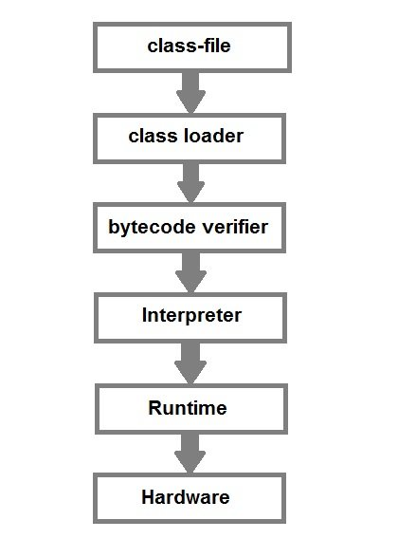
Now let us see What happens at Runtime
After writing your Java program, when you will try to compile it. Compiler will perform some compilation operation on your program.
Once it is compiled successfully byte code(.class file) is generated by the compiler.

Slide 13
Next Topic
Variable
Data types and Identifier
Static block
Conditional statement ,switch statement ,type casting ,loops
Operators ,Arrays, ways to creating the object

Slide 14
Interview Preparation …..?
1. What are the differences between C++ and Java?
2. List the features of the Java Programming language?
3. What do you get in the Java download file? How do they differ from one another?
Ans: We get two major things along with the Java Download file.
JDK and JRE
4. What is a Class Loader?
5. What are the Memory Allocations available in Java?
6. What are the differences between Heap and Stack Memory in Java?
7. Will the program run if we write static public void main?
8. What will happens if I changes the .class file??

