Slide 1
Java String

Slide 2
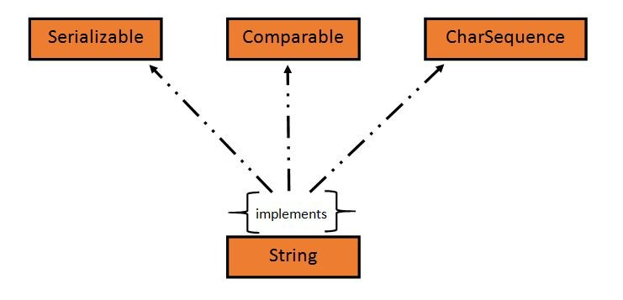
String in Java
String is an object that represents sequence of characters.
In Java, String is represented by String class which is located into java.lang package
String is an object that represents sequence of characters. In Java, String is represented by String class which is located into java.lang package

Slide 3
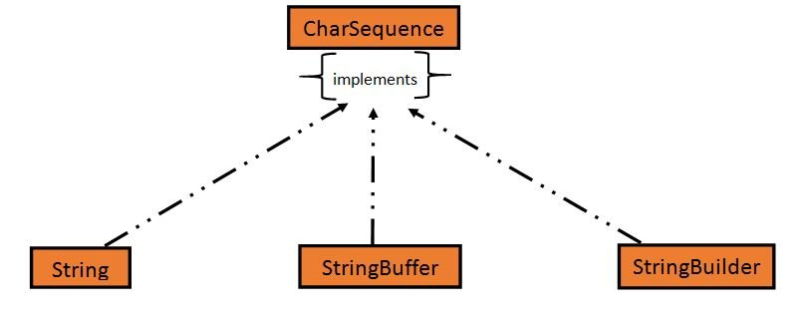
In Java, CharSequence Interface is used for representing a sequence of characters.
CharSequence interface is implemented by String, StringBuffer and StringBuilder classes. This three classes can be used for creating strings in java.
What is an Immutable object?
An object whose state cannot be changed after it is created is known as an Immutable object. String, Integer, Byte, Short, Float, Double and all other wrapper classes objects are immutable.

Slide 4
Creating a String object:
String can be created in number of ways, here are a few ways of creating string object.
1) Using a String literal:
String literal is a simple string enclosed in double quotes " ". A string literal is treated as a String object.
Example: public class Demo{
public static void main(String[] args) {
String s1 = "Hello Java";
System.out.println(s1);
}
}
2) Using new Keyword
We can create a new string object by using new operator that allocates memory for the object.
Example : String s1 = new String("Hello Java“);
Constant Pool:
Each time we create a String literal, the JVM checks the string pool first. If the string literal already exists in the pool, a reference to the pool instance is returned. If string does not exist in the pool, a new string object is created, and is placed in the pool. String objects are stored in a special memory area known as string constant pool inside the heap memory.

Slide 5
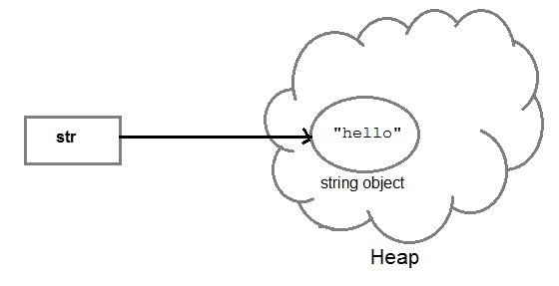
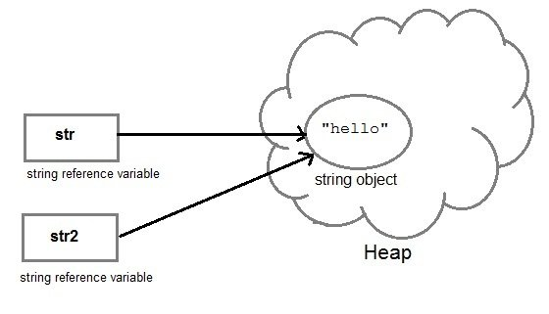
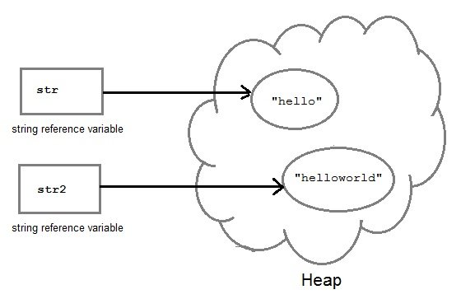
String object and How they are stored
When we create a new string object using string literal, that string literal is added to the string pool, if it is not present there already.
Ex: String str=“Hello”;
And, when we create another object with same string,
then a reference of the string literal already present in
string pool is returned. Ex: String str2=str;
String str1=“Hello”;
But if we change the new string, its reference gets modified.
Ex: str2=str2.concat(“Word”);

Slide 6
Concatenating String
There are 2 methods to concatenate two or more string.
Using concat() method
Using + operator
1) Using concat() method
Concat() method is used to add two or more string into a single string object. It is string class method and returns a string object.
Ex: String str=“java”
String str1=“World”
String str2=str.concat(str1);
2) Using + operator:
Java uses "+" operator to concatenate two string objects into single one. It can also concatenate numeric value with string object. See the below example.
Ex: String s = "Hello";
String str = "Java";
String str1 = s+str;
String str2 = "Java"+11;

Slide 7
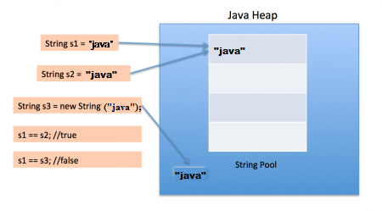
String Comparison
To compare string objects, Java provides methods and operators both. So we can compare string in following three ways.
Using equals() method
Using == operator
By CompareTo() method
1.Using equals() method
equals() method compares two strings for equality. Its general syntax is,
boolean equals(Object str);
2.Using == operator:
The double equal (==) operator compares two object references to check whether they refer to same instance. This also, will return true on successful match else returns false.
Ex: boolean b=(s1==s2)
3: By compareTo() method:
String compareTo() method compares values and returns an integer value which tells if the string compared is less than, equal to or greater than the other string. It compares the String based on natural ordering i.e alphabetically. Its general syntax is.

Slide 8
No. | Method | Description
1 | char charAt(int index) | It returns char value for the particular index
2 | int length() | It returns string length
3 | static String format(String format, Object... args) | It returns a formatted string.
4 | static String format(Locale l, String format, Object... args) | It returns formatted string with given locale.
5 | String substring(int beginIndex) | It returns substring for given begin index.
6 | String substring(int beginIndex, int endIndex) | It returns substring for given begin index and end index.
7 | boolean contains(CharSequence s) | It returns true or false after matching the sequence of char value.
8 | static String join(CharSequence delimiter, CharSequence... elements) | It returns a joined string.
9 | static String join(CharSequence delimiter, Iterable<? extends CharSequence> elements) | It returns a joined string.
10 | boolean equals(Object another) | It checks the equality of string with the given object.
11 | boolean isEmpty() | It checks if string is empty.
12 | String concat(String str) | It concatenates the specified string.
13 | String replace(char old, char new) | It replaces all occurrences of the specified char value.
14 | String replace(CharSequence old, CharSequence new) | It replaces all occurrences of the specified CharSequence.
15 | static String equalsIgnoreCase(String another) | It compares another string. It doesn't check case.

Slide 9
StringBuffer class in Java
StringBuffer class is used to create a mutable string object. It means, it can be changed after it is created. It represents growable and writable character sequence.
It is similar to String class in Java both are used to create string, but stringbuffer object can be changed.
So StringBuffer class is used when we have to make lot of modifications to our string. It is also thread safe i.e multiple threads cannot access it simultaneously.
Important methods of StringBuffer class:
append(): This method will concatenate the string representation of any type of data to the end of the StringBuffer object. append() method
insert(): This method inserts one string into another.
reverse():This method reverses the characters within a StringBuffer object.
replace():This method replaces the string from specified start index to the end index.

Slide 10
Java StringBuilder class
StringBuilder is identical to StringBuffer except for one important difference that it is not synchronized, which means it is not thread safe.
StringBuilder also used for creating string object that is mutable and non synchronized.
The StringBuilder class provides no guarantee of synchronization.
StringBuffer and StringBuilder both are mutable but if synchronization is not required then it is recommend to use StringBuilder class.
StringBuilder sb = new StringBuilder("study");
System.out.println(sb);
// modifying object
sb.append("tonight.com");
System.out.println(sb);

Slide 11
Difference between StringBuffer and StringBuilder class
StringBuffer class | StringBuilder class
StringBuffer is synchronized. | StringBuilder is not synchronized.
Because of synchronisation, StringBuffer operation is slower than StringBuilder. | StringBuilder operates faster.
StringBuffer is thread-safe | StringBuilder is not thread-safe
StringBuffer is less efficient as compare to StringBuilder | StringBuilder is more efficient as compared to StringBuffer.
Its storage area is in the heap | Its storage area is the stack
It is mutable | It is mutable
Methods are synchronized | Methods are not synchronized
It is alternative of string class | It is more flexible as compared to the string class
Introduced in Java 1.0 | Introduced in Java 1.5
Its performance is moderate | Its performance is very high
It consumes more memory | It consumes less memory

Slide 12
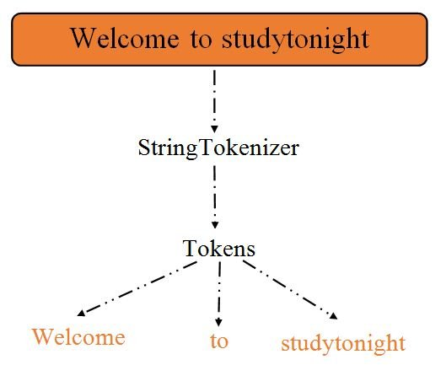
StringBuilder Methods
append ():we are appending a new string using appen() method to the existing string object.
Replace():
It is used to replace a substring from the string object. This method takes three arguments, first is start index, second is last index and third is substring to be replaced.
Reverse Method:
It is used to reverse the string object. It completely reverses the string from start to end characters.
Java String tokenizer:
1.In Java, StringTokenizer is used to break a string into tokens based
on provided delimiter.
2.Delimiter can be specified either at the time of object creation
or on a per-token basis.
3.In string, tokenizer objects are maintained internally and
returns a token of a substring from the given string.
Ref :code

Slide 13
Interview Preparation
1.What is the String class in Java? Is String a data type?
2.What are some different ways to create a String object in Java?
3.Write a Java method to check if an input string is a palindrome.
4.Write a Java method that will remove a given character from a string object.
5.Write a Java method that will remove a given character from a string object.
6.What is the String subSequence method?
7.How do you compare two strings in a Java program?
8.How do you convert a String to a character array in Java?
9.How do you convert a String to a byte array in Java?
10.What are the differences between String, StringBuffer, and StringBuilder in Java?
11.Why is String immutable in Java?
12.How do you split a string in Java?
13.What is the string pool in Java?
14.Is String thread-safe in Java?
15.Why is String a popular HashMap key in Java?

Slide 14
Next Topic?
Exception handling
Collection

