Slide 1
Java Exception Handling

Slide 2
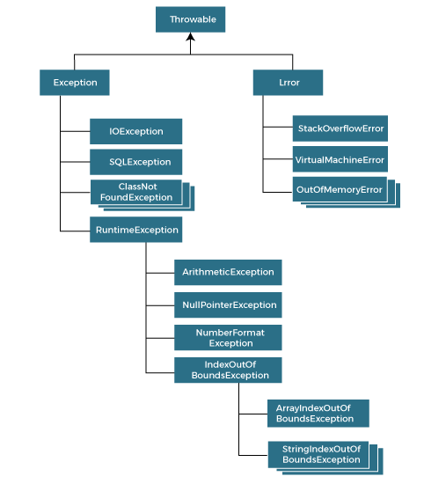
Exception Handling
The Exception Handling in Java is one of the powerful mechanism to handle the runtime errors so that the normal flow of the application can be maintained.
What is Exception Handling?
Exception Handling is a mechanism to handle runtime errors such as ClassNotFoundException, IOException, SQLException, RemoteException, etc.
Hierarchy of Java Exception classes:
The java.lang.Throwable class is the root class of Java
Exception hierarchy inherited by two subclasses: Exception and Error.
The hierarchy of Java Exception classes is given below:

Slide 3
Types of Java Exceptions
There are mainly two types of exceptions: checked and unchecked. An error is considered as the unchecked exception. However, according to Oracle, there are three types of exceptions namely:
Checked Exception
Unchecked Exception
Error
Difference between Checked and Unchecked Exceptions
1) Checked Exception
The classes that directly inherit the Throwable class except RuntimeException and Error are known as checked exceptions. For example, IOException, SQLException, etc. Checked exceptions are checked at compile-time.
2) Unchecked Exception
The classes that inherit the RuntimeException are known as unchecked exceptions. For example, ArithmeticException, NullPointerException, ArrayIndexOutOfBoundsException, etc. Unchecked exceptions are not checked at compile-time, but they are checked at runtime.
3) Error
Error is irrecoverable. Some example of errors are OutOfMemoryError, VirtualMachineError, AssertionError etc.

Slide 4
Java Exception Keywords
Java provides five keywords that are used to handle the exception. The following table describes each.
Keyword | Description
try | The "try" keyword is used to specify a block where we should place an exception code. It means we can't use try block alone. The try block must be followed by either catch or finally.
catch | The "catch" block is used to handle the exception. It must be preceded by try block which means we can't use catch block alone. It can be followed by finally block later.
finally | The "finally" block is used to execute the necessary code of the program. It is executed whether an exception is handled or not.
throw | The "throw" keyword is used to throw an exception.
throws | The "throws" keyword is used to declare exceptions. It specifies that there may occur an exception in the method. It doesn't throw an exception. It is always used with method signature.

Slide 5
Java Exception Handling Example
Let's see an example of Java Exception Handling in which we are using a try-catch statement to handle the exception.
public class JavaExceptionExample{
public static void main(String args[]){
try{
//code that may raise exception
int data=100/0;
}catch(ArithmeticException e){System.out.println(e);}
//rest code of the program
System.out.println("rest of the code...");
}
}

Slide 6
try and catch in Java
Try and catch both are Java keywords and used for exception handling.
The try block is used to enclose the suspected code. Suspected code is a code that may raise an exception during program execution.
try{
int a = 10;
int b = 0
int c = a/b; // exception
}
Catch : The catch block also known as handler is used to handle the exception. It handles the exception thrown by the code enclosed into the try block.
The catch block must be used after the try block only. We can also use multiple catch block with a single try block.
Try –catch Syntax:
try{
// suspected code
}catch(ExceptionClass ec){}
Ref: code …

Slide 7
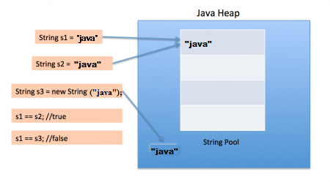
Multiple catch blocks
A try block can be followed by multiple catch blocks. It means we can have any number of catch blocks after a single try block.
try
{
// suspected code
}
catch(Exception1 e)
{
// handler code
}
catch(Exception2 e)
{
// handler code
}

Slide 8
Nested try statement
try statement can be nested inside another block of try. Nested try block is used when a part of a block may cause one error while entire block may cause another error.
Syntax: Try{
try{
}catch(){
}
catch(){
}
Java try with Resource Statement:
try(resource-specification(there can be more than one resource))
{
//use the resource
}
catch()
{
// handler code
}

Slide 9
Java throw, throws and finally Keyword
Throw, throws and finally are the keywords in Java that are used in exception handling.
The throw keyword is used to throw an exception .
throws is used to declare the list of possible exceptions with the method signature.
Whereas finally block is used to execute essential code, specially to release the occupied resources.
Throw:
throw ThrowableInstance; ex: new throw NullpointerException(“Test”);
Throws:
type method_name(parameter_list) throws exception_list
{
// definition of method
}
Finally: A finally keyword is used to create a block of code that follows a try block. A finally block of code is always executed whether an exception has occurred or not.

Slide 10
Difference between throw and throws
throw | throws
throw keyword is used to throw an exception explicitly. | throws keyword is used to declare an exception possible during its execution.
throw keyword is followed by an instance of Throwable class or one of its sub-classes. | throws keyword is followed by one or more Exception class names separated by commas.
throw keyword is declared inside a method body. | throws keyword is used with method signature (method declaration).
We cannot throw multiple exceptions using throw keyword. | We can declare multiple exceptions (separated by commas) using throws keyword.

Slide 11
User defined Exception
Java provides rich set of built-in exception classes like: ArithmeticException, IOException, NullPointerException etc. all are available in the java.lang package and used in exception handling.
These exceptions are already set to trigger on pre-defined conditions such as when you divide a number by zero it triggers ArithmeticException.
Apart from these classes, Java allows us to create our own exception class to provide own exception implementation. These type of exceptions are called user-defined exceptions or custom exceptions.
Why use custom exceptions?
Java exceptions cover almost all the general type of exceptions that may occur in the programming. However, we sometimes need to create custom exceptions.
Following are few of the reasons to use custom exceptions:
To catch and provide specific treatment to a subset of existing Java exceptions.
Business logic exceptions: These are the exceptions related to business logic and workflow. It is useful for the application users or the developers to understand the exact problem.
public class InvalidProductException extends Exception {
public InvalidProductException(String errorMessage) {
super(errorMessage);
}
}

Slide 12
Difference between final, finally and finalize
Sr. no. | Key | final | finally | finalize
1. | Definition | final is the keyword and access modifier which is used to apply restrictions on a class, method or variable. | finally is the block in Java Exception Handling to execute the important code whether the exception occurs or not. | finalize is the method in Java which is used to perform clean up processing just before object is garbage collected.
2. | Applicable to | Final keyword is used with the classes, methods and variables. | Finally block is always related to the try and catch block in exception handling. | finalize() method is used with the objects.
3. | Functionality | (1) Once declared, final variable becomes constant and cannot be modified. (2) final method cannot be overridden by sub class. (3) final class cannot be inherited. | (1) finally block runs the important code even if exception occurs or not. (2) finally block cleans up all the resources used in try block | finalize method performs the cleaning activities with respect to the object before its destruction.
4. | Execution | Final method is executed only when we call it. | Finally block is executed as soon as the try-catch block is executed.It's execution is not dependant on the exception. | finalize method is executed just before the object is destroyed.

Slide 13
Interview Preparation
Describe the difference between unchecked and checked exceptions in Java.
What is the difference between finally, final, and finalize in Java?
Define try-with resource. How can you say that it differs from an ordinary try?
Define Runtime Exception. Describe it with the help of an example.
What is the difference between NoClassDefFoundError and ClassNotFoundException in Java?
Can we throw an exception explicitly or manually?
Describe the use of the throw keyword.
Why should we clean up activities such as I/O resources in the finally block?
Describe OutofMemoryError in exception handling.
What is the error of ClassCastException?
Is there any difference between throw and throws in exception handling in Java?
When should we use the printStackTrace() method?
Provide me with some examples of unchecked exceptions.
Is it illegal to keep an empty catch?
What are the advantages of using exception handling in Java?
Can checked exceptions occur at compiled time?
What happens if a runtime exception occurs?
Describe unreachable catch block error in Java.
In which situation will you not be able to execute the finally block?
Is it possible to throw a statement inside a static block?
Define rethrowing.
Define user-defined or custom exceptions in Java.
What do you understand by a chained exception?
What do you understand about throwables in Java?
Mention the methods in the throwable class.
Give me some examples of checked exceptions.
Define NumberFormatException exception in Java.
What do you understand by ArrayIndexOutOfBoundsException?
Suppose there is a catch block in tune with a try block with 3 statements - 1, 2, and 3. Now, imagine that the statement is thrown in statement 2. Will there be an execution of statement 3?
Define unreachable catch block error.

Slide 14
Next Topic?
Collection

