Slide 1
Java Collection(List)

Slide 2
Collections in Java
Java Collections can achieve all the operations that you perform on a data such as searching, sorting, insertion, manipulation, and deletion.
What is Collection in Java:
Java Collection means a single unit of objects. Java Collection framework provides many interfaces (Set, List, Queue, Deque) and classes (ArrayList, Vector, LinkedList, PriorityQueue, HashSet, LinkedHashSet, TreeSet).
What is Collection framework
The Collection framework represents a unified architecture for storing and manipulating a group of objects. It has:
Interfaces and its implementations, i.e., classes
Algorithm
What is a framework in Java
It provides readymade architecture.
It represents a set of classes and interfaces.
It is optional.

Slide 3
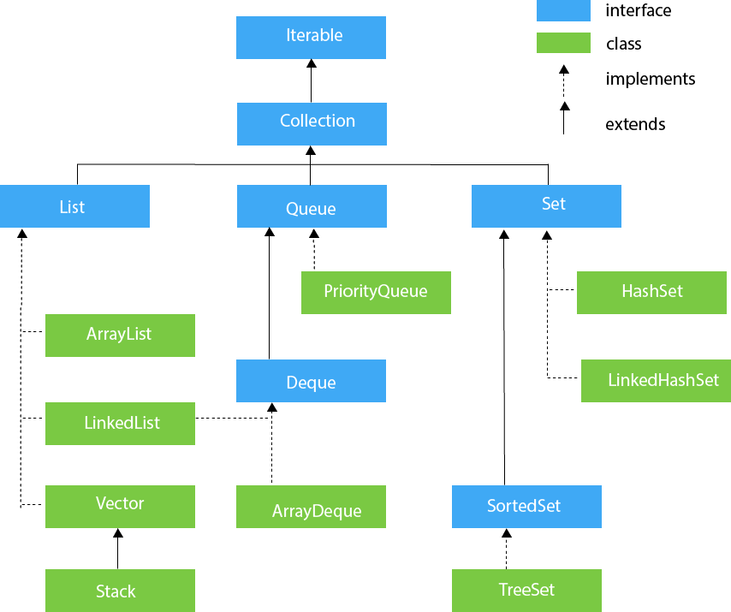
Hierarchy of Collection Framework
Let us see the hierarchy of Collection framework. The java.util package contains all the classes and interfaces for the Collection framework.

Slide 4
Methods of Collection interface
No. | Method | Description
1 | public boolean add(E e) | It is used to insert an element in this collection.
2 | public boolean addAll(Collection<? extends E> c) | It is used to insert the specified collection elements in the invoking collection.
3 | public boolean remove(Object element) | It is used to delete an element from the collection.
4 | public boolean removeAll(Collection<?> c) | It is used to delete all the elements of the specified collection from the invoking collection.
5 | default boolean removeIf(Predicate<? super E> filter) | It is used to delete all the elements of the collection that satisfy the specified predicate.
6 | public boolean retainAll(Collection<?> c) | It is used to delete all the elements of invoking collection except the specified collection.
7 | public int size() | It returns the total number of elements in the collection.
8 | public void clear() | It removes the total number of elements from the collection.
9 | public boolean contains(Object element) | It is used to search an element.
10 | public boolean containsAll(Collection<?> c) | It is used to search the specified collection in the collection.
11 | public Iterator iterator() | It returns an iterator.
12 | public Object[] toArray() | It converts collection into array.
13 | public <T> T[] toArray(T[] a) | It converts collection into array. Here, the runtime type of the returned array is that of the specified array.
14 | public boolean isEmpty() | It checks if collection is empty.
15 | default Stream<E> parallelStream() | It returns a possibly parallel Stream with the collection as its source.
16 | default Stream<E> stream() | It returns a sequential Stream with the collection as its source.
17 | default Spliterator<E> spliterator() | It generates a Spliterator over the specified elements in the collection.
18 | public boolean equals(Object element) | It matches two collections.
19 | public int hashCode() | It returns the hash code number of the collection.

Slide 5
Accessing a Java Collection using Iterators
There are three possible ways to process through the elements of any collection.
Using Iterator interface
Using ListIterator interface
Using for-each loop or for loop
Accessing elements using Iterator:
Iterator is an interface that is used to iterate the collection elements. It is part of java collection framework. It provides some methods that are used to check and access elements of a collection.
Method | Description
boolean hasNext() | Returns true if there are more elements in the collection. Otherwise, returns false.
E next() | Returns the next element present in the collection. Throws NoSuchElementException if there is not a next element.
void remove() | Removes the current element. Throws IllegalStateException if an attempt is made to call remove() method that is not preceded by a call to next() method.

Slide 6
Example :
class Demo
{
public static void main(String[] args)
{
ArrayList< String> ar = new ArrayList< String>();
ar.add("ab");
ar.add("bc");
ar.add("cd");
ar.add("de");
Iterator it = ar.iterator(); //Declaring Iterator
while(it.hasNext())
{
System.out.print(it.next()+" ");
}
}
}

Slide 7
Accessing elements using ListIterator
ListIterator Interface is used to traverse a list in both forward and backward direction.
It is available to only those collections that implements the List Interface.
Method | Description
void add(E obj) | Inserts obj into the list in front of the element that will be returned by the next call to next() method.
boolean hasNext() | Returns true if there is a next element. Otherwise, returns false.
boolean hasPrevious() | Returns true if there is a previous element. Otherwise, returns false.
E next() | Returns the next element. A NoSuchElementException is thrown if there is not a next element.
int nextIndex() | Returns the index of the next element. If there is not a next element, returns the size of the list.
E previous() | Returns the previous element. A NoSuchElementException is thrown if there is not a previous element.
int previousIndex() | Returns the index of the previous element. If there is not a previous element, returns -1.
void remove() | Removes the current element from the list. An IllegalStateException is thrown if remove() method is called before next() or previous() method is invoked.
void set(E obj) | Assigns obj to the current element. This is the element last returned by a call to either next() or previous() method.

Slide 8
for-each loop
for-each version of for loop can also be used for traversing the elements of a collection.
But this can only be used if we don't want to modify the contents of a collection and we don't want any reverse access.
for-each loop can cycle through any collection of object that implements Iterable interface.
LinkedList< String> ls = new LinkedList< String>();
ls.add("a");
ls.add("b");
ls.add("c");
ls.add("d");
for(String str : ls)
{
System.out.print(str+" ");
}
}
Or
for(int i = 0; i<ls.size(); i++)
{
System.out.print(ls.get(i)+" ");
}
}

Slide 9
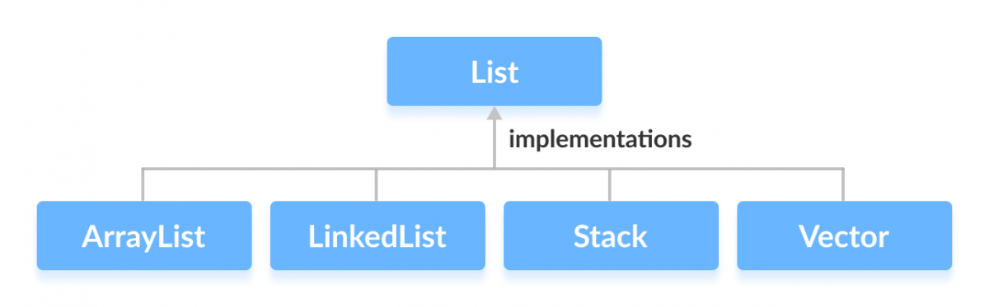
List Interface:
List interface is the child interface of Collection interface. It inhibits a list type data structure in which we can store the ordered collection of objects.
It can have duplicate values.
List interface is implemented by the classes ArrayList, LinkedList, Vector, and Stack.
Syntax :
List <data-type> list1= new ArrayList();
List <data-type> list2 = new LinkedList();
List <data-type> list3 = new Vector();
List <data-type> list4 = new Stack();

Slide 10
ArrayList:
Java ArrayList class uses a dynamic array for storing the elements. It is like an array, but there is no size limit. We can add or remove elements anytime. So, it is much more flexible than the traditional array.
Java ArrayList class can contain duplicate elements.
Java ArrayList class maintains insertion order.
Java ArrayList class is non synchronized.
Java ArrayList allows random access because the array works on an index basis.
In ArrayList, manipulation is a little bit slower than the LinkedList in Java because a lot of shifting needs to occur if any element is removed from the array list.
We can not create an array list of the primitive types, such as int, float, char, etc. It is required to use the required wrapper class in such cases.
For example: ArrayList<int> al = ArrayList<int>(); // does not work
ArrayList<String> list=new ArrayList<String>();//Creating arraylist
list.add("Ravi");//Adding object in arraylist
list.add("Vijay");
list.add("Ravi");
list.add("Ajay");

Slide 11
ArrayList Methods:
Method | Description
void add(int index, E element) | It inserts the specified element at the specified position in a list.
boolean add(E e) | It appends the specified element at the end of a list.
boolean addAll(Collection<? extends E> c) | It appends all of the elements in the specified collection to the end of this list.
boolean addAll(int index, Collection<? extends E> c) | It appends all the elements in the specified collection, starting at the specified position of the list.
void clear() | It removes all of the elements from this list.
void ensureCapacity(int requiredCapacity) | It enhances the capacity of an ArrayList instance.
E get(int index) | It fetches the element from the particular position of the list.
boolean isEmpty() | It returns true if the list is empty, otherwise false.
int lastIndexOf(Object o) | It returns the index in this list of the last occurrence of the specified element, or -1 if the list does not contain this element.
Object[] toArray() | It returns an array containing all of the elements in this list in the correct order.
<T> T[] toArray(T[] a) | It returns an array containing all of the elements in this list in the correct order.
Object clone() | It returns a shallow copy of an ArrayList.
boolean contains(Object o) | It returns true if the list contains the specified element
int indexOf(Object o) | It returns the index in this list of the first occurrence of the specified element, or -1 if the List does not contain this element.
E remove(int index) | It removes the element present at the specified position in the list.
boolean remove(Object o) | It removes the first occurrence of the specified element.
boolean removeAll(Collection<?> c) | It removes all the elements from the list.
boolean removeIf(Predicate<? super E> filter) | It removes all the elements from the list that satisfies the given predicate.
protected void removeRange(int fromIndex, int toIndex) | It removes all the elements lies within the given range.
void replaceAll(UnaryOperator<E> operator) | It replaces all the elements from the list with the specified element.
void trimToSize() | It trims the capacity of this ArrayList instance to be the list's current size.

Slide 12
Java Collection Framework Linked list:
Java LinkedList class uses a doubly linked list to store the elements.
It provides a linked-list data structure.
Java LinkedList class can contain duplicate elements.
Java LinkedList class maintains insertion order.
Java LinkedList class is non synchronized.
In Java LinkedList class, manipulation is fast because no shifting needs to occur.
Java LinkedList class can be used as a list, stack or queue.
// Creating LinkedList
LinkedList< String> linkedList = new LinkedList< String>();
linkedList.add("Ravi");
linkedList.add("Vijay");
linkedList.add("Ravi");
linkedList.add("Ajay");
// Displaying LinkedLIst
System.out.println(linkedList);

Slide 13
LinkedList Methods:
Method | Description
boolean add(E e) | It appends the specified element to the end of a list.
void add(int index, E element) | It inserts the specified element at the specified position index in a list.
boolean addAll(Collection<? extends E> c) | It appends all of the elements in the specified collection to the end of this list.
boolean addAll(Collection<? extends E> c) | It appends all of the elements in the specified collection to the end of this list, in the order that they are returned by the specified collection's iterator.
boolean addAll(int index, Collection<? extends E> c) | It appends all the elements in the specified collection, starting at the specified position of the list.
void addFirst(E e) | It inserts the given element at the beginning of a list.
void addLast(E e) | It appends the given element to the end of a list.
void clear() | It removes all the elements from a list.
Object clone() | It returns a shallow copy of an ArrayList.
boolean contains(Object o) | It returns true if a list contains a specified element.
Iterator<E> descendingIterator() | It returns an iterator over the elements in a deque in reverse sequential order.
E element() | It retrieves the first element of a list.
E get(int index) | It returns the element at the specified position in a list.
E getFirst() | It returns the first element in a list.
E getLast() | It returns the last element in a list.
int indexOf(Object o) | It returns the index in a list of the first occurrence of the specified element, or -1 if the list does not contain any element.
int lastIndexOf(Object o) | It is used to return the index in a list of the last occurrence of the specified element, or -1 if the list does not contain any element.
ListIterator<E> listIterator(int index) | It returns a list-iterator of the elements in proper sequence, starting at the specified position in the list.
boolean offer(E e) | It adds the specified element as the last element of a list.
boolean offerFirst(E e) | It inserts the specified element at the front of a list.
boolean offerLast(E e) | It inserts the specified element at the end of a list.
E peek() | It retrieves the first element of a list
E peekFirst() | It retrieves the first element of a list or returns null if a list is empty.
E peekLast() | It retrieves the last element of a list or returns null if a list is empty.
E poll() | It retrieves and removes the first element of a list.
E pollFirst() | It retrieves and removes the first element of a list, or returns null if a list is empty.
E pollLast() | It retrieves and removes the last element of a list, or returns null if a list is empty.
E pop() | It pops an element from the stack represented by a list.
void push(E e) | It pushes an element onto the stack represented by a list.
E remove() | It is used to retrieve and removes the first element of a list.
E remove(int index) | It is used to remove the element at the specified position in a list.
boolean remove(Object o) | It is used to remove the first occurrence of the specified element in a list.
E removeFirst() | It removes and returns the first element from a list.
boolean removeFirstOccurrence(Object o) | It removes the first occurrence of the specified element in a list (when traversing the list from head to tail).
E removeLast() | It removes and returns the last element from a list.
boolean removeLastOccurrence(Object o) | It removes the last occurrence of the specified element in a list (when traversing the list from head to tail).
E set(int index, E element) | It replaces the element at the specified position in a list with the specified element.
int size() | It returns the number of elements in a list.

Slide 14
Vector
Vector uses a dynamic array to store the data elements.
It is similar to ArrayList. However, It is synchronized and contains many methods that are not the part of Collection framework.
Vector<String> v=new Vector<String>(); //creating Vector
v.add("Ayush");
v.add("Amit");
Stack:
The stack is the subclass of Vector. It implements the last-in-first-out data structure, i.e., Stack. The stack contains all of the methods of Vector class and also provides its methods like boolean push(), boolean peek(), boolean pop(object o), which defines its properties.
Stack<String> stack = new Stack<String>();
stack.push("Ayush");
stack.push("Garvit");

Slide 15
Difference Between ArrayList and LinkedList
ArrayList and LinkedList both implement the List interface and maintain insertion order. Both are non-synchronized classes.
ArrayList | LinkedList
1) ArrayList internally uses a dynamic array to store the elements. | LinkedList internally uses a doubly linked list to store the elements.
2) Manipulation with ArrayList is slow because it internally uses an array. If any element is removed from the array, all the other elements are shifted in memory. | Manipulation with LinkedList is faster than ArrayList because it uses a doubly linked list, so no bit shifting is required in memory.
3) An ArrayList class can act as a list only because it implements List only. | LinkedList class can act as a list and queue both because it implements List and Deque interfaces.
4) ArrayList is better for storing and accessing data. | LinkedList is better for manipulating data.
5) The memory location for the elements of an ArrayList is contiguous. | The location for the elements of a linked list is not contagious.
6) Generally, when an ArrayList is initialized, a default capacity of 10 is assigned to the ArrayList. | There is no case of default capacity in a LinkedList. In LinkedList, an empty list is created when a LinkedList is initialized.
7) To be precise, an ArrayList is a resizable array. | LinkedList implements the doubly linked list of the list interface.

Slide 16
Interview Preparation
Difference between ArrayList and LinkedList
Difference between Array and ArrayList
When to use ArrayList and LinkedList in Java
Difference between ArrayList and Vector
How to Compare Two ArrayList in Java
How to reverse ArrayList in Java
When to use ArrayList and LinkedList in Java
How to make ArrayList Read Only
Difference between length of array and size() of ArrayList in Java
How to Synchronize ArrayList in Java
How to convert ArrayList to Array and Array to ArrayList in java
Array vs ArrayList in Java
How to Sort Java ArrayList in Descending Order
How to remove duplicates from ArrayList in Java

Slide 17
Next Topic?
Set Interface
MAP Interface

