Slide 1
Java Collection(Set)

Slide 2
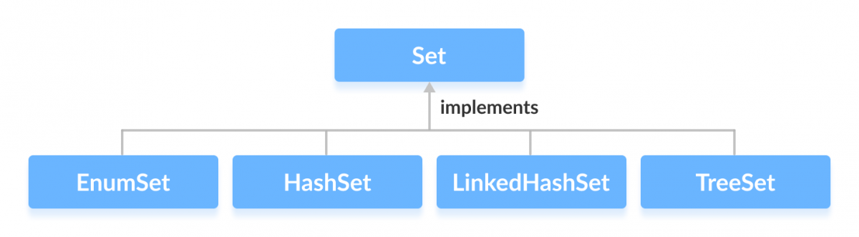
Set Interface:
Set Interface in Java is present in java.util package.
It extends the Collection interface.
It represents the unordered set of elements which doesn't allow us to store the duplicate items.
We can store at most one null value in Set. Set is implemented by HashSet, LinkedHashSet, and TreeSet.
These classes are defined in the Collections framework and implement the Set interface

Slide 3
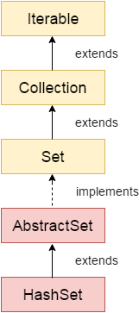
Java HashSet
Java HashSet class is used to store unique elements.
It uses hash table internally to store the elements. It implements Set interface and extends the AbstractSet class. Declaration of the is given below.
Syntax: public class HashSet<E>extends AbstractSet<E>implements Set<E>, Cloneable, Serializable
The important points about Java HashSet class are:
HashSet stores the elements by using a mechanism called hashing.
HashSet contains unique elements only.
HashSet allows null value.
HashSet class is non synchronized.
HashSet doesn't maintain the insertion order. Here, elements are inserted on the basis of their hashcode.
HashSet is the best approach for search operations.
The initial default capacity of HashSet is 16, and the load factor is 0.75.
Ex: // Creating HashSet
HashSet<String> hs = new HashSet<String>();
// Displaying HashSet
System.out.println(hs);

Slide 4
Methods of Java HashSet class
SN | Modifier & Type | Method | Description
1) | boolean | add(E e) | It is used to add the specified element to this set if it is not already present.
2) | void | clear() | It is used to remove all of the elements from the set.
3) | object | clone() | It is used to return a shallow copy of this HashSet instance: the elements themselves are not cloned.
4) | boolean | contains(Object o) | It is used to return true if this set contains the specified element.
5) | boolean | isEmpty() | It is used to return true if this set contains no elements.
6) | Iterator<E> | iterator() | It is used to return an iterator over the elements in this set.
7) | boolean | remove(Object o) | It is used to remove the specified element from this set if it is present.
8) | int | size() | It is used to return the number of elements in the set.
9) | Spliterator<E> | spliterator() | It is used to create a late-binding and fail-fast Spliterator over the elements in the set.

Slide 5
Java HashSet Example
import java.util.*;
class Demo
{
public static void main(String args[])
{
// Creating HashSet
HashSet<String> hs = new HashSet<String>();
// Adding elements
hs.add(“Rama");
hs.add(“Harish");
hs.add(“Krishna");
hs.add(“Rama");
// Displaying HashSet
System.out.println(hs);
// Removing elements
hs.remove("Mohan");
System.out.println("After removing elements: \n"+hs);
}
}

Slide 6
Example :Traversing Elements of HashSet
import java.util.*;
class Demo
{
public static void main(String args[])
{
// Creating HashSet
HashSet<String> hs = new HashSet<String>();
// Adding elements
hs.add("Mohan");
hs.add("Rohan");
hs.add("Sohan");
hs.add("Mohan");
// Traversing ArrayList
for(String element : hs) {
System.out.println(element);
}
}
}

Slide 7
HashSet Method:
Method | Description
add(E e) | It adds the specified element to this set if it is not already present.
clear() | It removes all of the elements from the set.
clone() | It returns a shallow copy of this HashSet instance: the elements themselves are not cloned.
contains(Object o) | It returns true if this set contains the specified element.
isEmpty() | It returns true if this set contains no elements.
iterator() | It returns an iterator over the elements in this set.
remove(Object o) | It removes the specified element from this set if it is present.
size() | It returns the number of elements in the set.
spliterator() | It creates a late-binding and fail-fast Spliterator over the elements in the set.

Slide 8
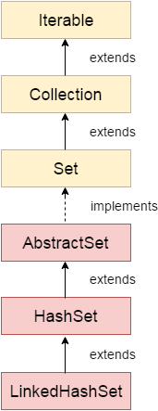
Linked HashSet
Java LinkedHashSet class is a Hashtable and Linked list implementation of the Set interface. It inherits the HashSet class and implements the Set interface.
public class LinkedHashSet<E>extends HashSet<E>implements Set<E>, Cloneable, Serializable
Important Points:
LinkedHashSet class extends HashSet class
It maintains a linked list of entries in the set.
It contains unique elements only
It allows to insert null value.
It stores elements in the order in which elements are inserted i.e it maintains the insertion order.
Java LinkedHashSet class is non synchronized.
LinkedHashSet<String> hs = new LinkedHashSet<String>();
// Displaying LinkedHashSet
System.out.println(hs);

Slide 9
LinkedHashSet Method:
Method | Description
add(E e) | It adds the specified element to this set if it is not already present.
clear() | It removes all of the elements from the set.
clone() | It returns a shallow copy of this LinkedHashSet instance: the elements themselves are not cloned.
contains(Object o) | It returns true if this set contains the specified element.
isEmpty() | It returns true if this set contains no elements.
iterator() | It returns an iterator over the elements in this set.
remove(Object o) | It removes the specified element from this set if it is present.
size() | It returns the number of elements in the set.
spliterator() | It creates a late-binding and fail-fast Spliterator over the elements in the set.

Slide 10
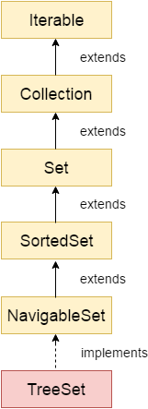
TreeSet:
Java TreeSet class implements the Set interface that uses a tree for storage. It inherits AbstractSet class and implements the NavigableSet interface. The objects of the TreeSet class are stored in ascending order
The important points about the Java TreeSet class are:
Java TreeSet class contains unique elements only like HashSet.
Java TreeSet class access and retrieval times are quiet fast.
Java TreeSet class doesn't allow null element.
Java TreeSet class is non synchronized.
Java TreeSet class maintains ascending order.
Java TreeSet class contains unique elements only like HashSet.
Java TreeSet class access and retrieval times are quite fast.
The TreeSet can only allow those generic types that are comparable. For example The Comparable interface is being implemented by the StringBuffer class.

Slide 11
TreeSet Methods:
Method | Description
boolean add(E e) | It is used to add the specified element to this set if it is not already present.
boolean addAll(Collection<? extends E> c) | It is used to add all of the elements in the specified collection to this set.
E ceiling(E e) | It returns the equal or closest greatest element of the specified element from the set, or null there is no such element.
Comparator<? super E> comparator() | It returns a comparator that arranges elements in order.
Iterator descendingIterator() | It is used to iterate the elements in descending order.
NavigableSet descendingSet() | It returns the elements in reverse order.
E floor(E e) | It returns the equal or closest least element of the specified element from the set, or null there is no such element.
SortedSet headSet(E toElement) | It returns the group of elements that are less than the specified element.
NavigableSet headSet(E toElement, boolean inclusive) | It returns the group of elements that are less than or equal to(if, inclusive is true) the specified element.
E higher(E e) | It returns the closest greatest element of the specified element from the set, or null there is no such element.
Iterator iterator() | It is used to iterate the elements in ascending order.
E lower(E e) | It returns the closest least element of the specified element from the set, or null there is no such element.
E pollFirst() | It is used to retrieve and remove the lowest(first) element.
E pollLast() | It is used to retrieve and remove the highest(last) element.
Spliterator spliterator() | It is used to create a late-binding and fail-fast spliterator over the elements.
NavigableSet subSet(E fromElement, boolean fromInclusive, E toElement, boolean toInclusive) | It returns a set of elements that lie between the given range.
SortedSet subSet(E fromElement, E toElement)) | It returns a set of elements that lie between the given range which includes fromElement and excludes toElement.
SortedSet tailSet(E fromElement) | It returns a set of elements that are greater than or equal to the specified element.
NavigableSet tailSet(E fromElement, boolean inclusive) | It returns a set of elements that are greater than or equal to (if, inclusive is true) the specified element.
boolean contains(Object o) | It returns true if this set contains the specified element.
boolean isEmpty() | It returns true if this set contains no elements.
boolean remove(Object o) | It is used to remove the specified element from this set if it is present.
void clear() | It is used to remove all of the elements from this set.
Object clone() | It returns a shallow copy of this TreeSet instance.
E first() | It returns the first (lowest) element currently in this sorted set.
E last() | It returns the last (highest) element currently in this sorted set.
int size() | It returns the number of elements in this set.

Slide 12
Java EnumSet class
Java EnumSet class is the specialized Set implementation for use with enum types. It inherits AbstractSet class and implements the Set interface.
public abstract class EnumSet<E extends Enum<E>> extends AbstractSet<E> implements Cloneable, Serializable
Methods of Java EnumSet class:
Method | Description
static <E extends Enum<E>> EnumSet<E> allOf(Class<E> elementType) | It is used to create an enum set containing all of the elements in the specified element type.
static <E extends Enum<E>> EnumSet<E> copyOf(Collection<E> c) | It is used to create an enum set initialized from the specified collection.
static <E extends Enum<E>> EnumSet<E> noneOf(Class<E> elementType) | It is used to create an empty enum set with the specified element type.
static <E extends Enum<E>> EnumSet<E> of(E e) | It is used to create an enum set initially containing the specified element.
static <E extends Enum<E>> EnumSet<E> range(E from, E to) | It is used to create an enum set initially containing the specified elements.
EnumSet<E> clone() | It is used to return a copy of this set.

Slide 13
Java Queue Interface
The interface Queue is available in the java.util package and does extend the Collection interface.
It is used to keep the elements that are processed in the First In First Out (FIFO) manner.
the most common classes are the LinkedList and PriorityQueue in Java.
Implementations done by these classes are not thread safe. If it is required to have a thread safe implementation, PriorityBlockingQueue is an available option.
PriorityQueue Class:
PriorityQueue is also class that is defined in the collection framework that gives us a way for processing the objects on the basis of priority.
public class PriorityQueue<E> extends AbstractQueue<E> implements Serializable
Features of a Queue:
As discussed earlier, FIFO concept is used for insertion and deletion of elements from a queue.
The Java Queue provides support for all of the methods of the Collection interface including deletion, insertion, etc.
PriorityQueue, ArrayBlockingQueue and LinkedList are the implementations that are used most frequently.
The NullPointerException is raised, if any null operation is done on the BlockingQueues.

Slide 14
Methods of Java Queue Interface:
Method | Description
boolean add(object) | It is used to insert the specified element into this queue and return true upon success.
boolean offer(object) | It is used to insert the specified element into this queue.
Object remove() | It is used to retrieves and removes the head of this queue.
Object poll() | It is used to retrieves and removes the head of this queue, or returns null if this queue is empty.
Object element() | It is used to retrieves, but does not remove, the head of this queue.
Object peek() | It is used to retrieves, but does not remove, the head of this queue, or returns null if this queue is empty.

Slide 15
Interview Preparation
Difference between Set and List
Difference between HashSet and TreeSet
Difference between HashSet and LinkedHashSet
How to reverse value Treeset in Java

Slide 16
Next Topic?
MAP Interface

