Slide 1
Basics Of Java

Slide 2
Switch Statement:
1.In Java, the switch statement is used for executing one statement from multiple conditions. it is similar to an if-else-if ladder.
2. Switch statement consists of conditional based cases and a default case.
Rules :
1. There can be one or N numbers of cases.
2. The values in the case must be unique.
3. Each statement of the case can have a break statement. It is optional.
Syntax:
switch(expression){
case 1 :
//write some code
break ; ………..>optional
case 2:
//write code
default:
code is execution when none of the case is true;

Slide 3
Java Loops
Loop is an important concept of a programming that allows to iterate over the sequence of statements.
Loop is designed to execute particular code block till the specified condition is true or all the elements of a collection(array, list etc) are completely traversed.
3. The most common use of loop is to perform repetitive tasks.
Java provides mainly three loop based on the loop structure.
1.for loop
2.while loop
3.do while loop
For Loop:
The for loop is used for executing a part of the program repeatedly. When the number of execution is fixed then it is suggested to use for loop. For loop can be categories into two type.
1.for loop
2. for-each loop
Syntax: for(initialization;condition;increment/decrement)
{
//statement
}

Slide 4
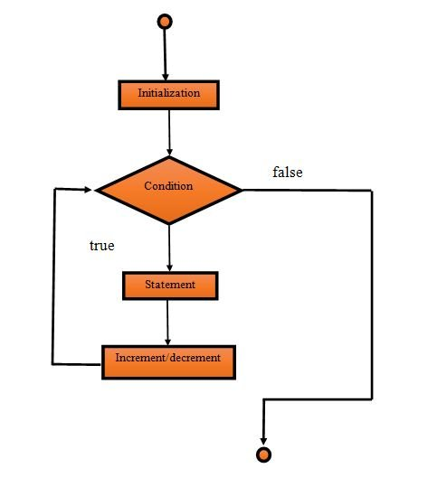
For loop Parameters:
1) Initialization
It is the initial part, where we set initial value for the loop. It is executed only once at the starting of loop. It is optional, if we don’t want to set initial value.
2) Condition
It is used to test a condition each time while executing. The execution continues until the condition is false. It is optional and if we don’t specify, loop will be inifinite.
3) Statement
It is loop body and executed every time until the condition is false.
4) Increment/Decrement
It is used for set increment or decrement value for the loop.

Slide 5
forEach Loop:
In Java, for each loop is used for traversing array or collection elements. In this loop, there is no need for increment or decrement operator.
Syntax:
for(Type var:array)
{
//code for execution
}
Ex: int arr[]= {1,2,3,4};
for (int i : arr) {
System.out.println(i);
}

Slide 6
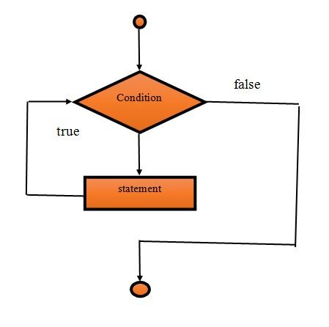
While Loop
1.while loop is also used to execute code repeated.
2.It is used for iterating a part of the program several times.
3.When the number of iteration is not fixed then while loop is used.
Syntax:
while(condition)
{
//code for execution
}

Slide 7
infinite while loop:
A while loop which conditional expression always returns true is called infinite while loop. We can also create infinite loop by passing true literal in the loop.
Be careful, when creating infinite loop because it can issue memory overflow problem.
public class WhileDemo2
{
public static void main(String[] args)
{
while(true)
{
System.out.println("infinitive while loop");
}
}
}

Slide 8
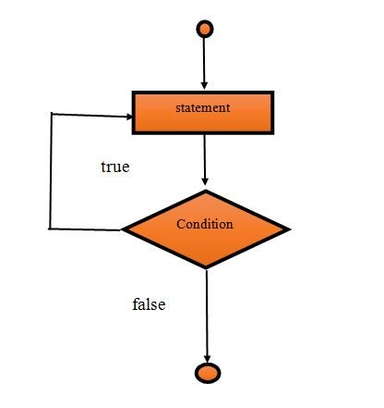
DO-While
In Java, the do-while loop is used to execute statements again and again.
This loop executes at least once because the loop is executed before the condition is checked. It means loop condition evaluates after executing of loop body.
The main difference between while and do-while loop is, in do while loop condition evaluates after executing the loop.
Syntax:
do
{
//code for execution
}
while(condition);

Slide 9
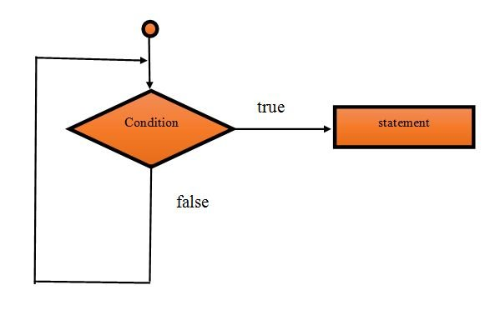
Java Break and Continue Statements
Java break and continue statements are used to manage program flow. We can use them in a loop to control loop iterations.
Break Statement:
1.In Java, break is a statement that is used to break current execution flow of the program.
2. We can use break statement inside loop, switch case etc.
3. If break is used inside loop then it will terminate the loop.
4. If break is used inside the innermost loop then break will terminate the innermost loop only and execution will start from the outer loop.
5. If break is used in switch case then it will terminate the execution after the matched case. Use of break, we have covered in our switch case topic.
Syntax:
jump-statement;
break;

Slide 10
Continue Statement:
1.In Java, the continue statement is used to skip the current iteration of the loop.
2.It jumps to the next iteration of the loop immediately.
3.We can use continue statement with for loop, while loop and do-while loop as well.
Syntax:
jump-statement;
continue;
For(inti=1;i<=10;i++)
{
if(i==5)
{
continue;
}
System.out.println(i);
}

Slide 11
Interview Preparation …..?
1. what is loop..?
2. Types of loops?
3. Difference B/w while and do-while ?
4. what is break statement and Continue statement?

Slide 12
Programs:
I prepared 32 programs based on conditional statements

Slide 13
Next topic…?
Operators in Java
Java Array
Ways to creation of object

