Slide 1
Java OOPS Concepts

Slide 2
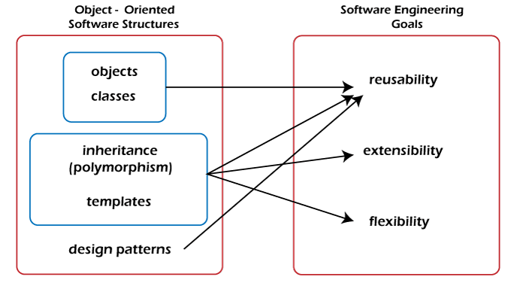
OOPS:
OOPS is a programming approach which provides solution to real life problems with the help of algorithms based on real world.
It uses real world approach to solve a problem.
Ex: Object means a real-world entity such as a pen, chair, table, computer, watch, etc.
Object-Oriented Programming is a methodology or paradigm to design a program using classes and objects. It simplifies software development and maintenance by providing some concepts:
Java is an object oriented language which supports object oriented concepts like: class and object.
Main Features of OOPS:
1.class
2.Objects
3.Inheritence
4.Polymorphism
5. Encapsulation
6. Abstraction

Slide 3
OOPs Features:
Object:
Any entity that has state and behavior is known as an object. For example, a chair, pen, table, keyboard, bike, etc. It can be physical or logical.
An Object can be defined as an instance of a class. An object contains an address and takes up some space in memory.
Example: A dog is an object because it has states like color, name, breed, etc. as well as behaviors like wagging the tail, barking, eating, etc.
Class:
Collection of objects is called class. It is a logical entity. A class can also be defined as a blueprint from which you can create an individual object. Class doesn't consume any space.
Inheritance
When one object acquires all the properties and behaviors of a parent object, it is known as inheritance. It provides code reusability. It is used to achieve runtime polymorphism.
Encapsulation
Binding (or wrapping) code and data together into a single unit are known as encapsulation. For example, a capsule, it is wrapped with different medicines.
Polymorphism
If one task is performed in different ways, it is known as polymorphism. For example: to convince the customer differently, to draw something, for example, shape, triangle, rectangle, etc.
In Java, we use method overloading and method overriding to achieve polymorphism.
Abstraction
Hiding internal details and showing functionality is known as abstraction. For example phone call, we don't know the internal processing.

Slide 4
Class:
1. Class is a set of object which shares common characteristics/ behavior and common properties/ attributes. 2. Class is not a real world entity. It is just a template or blueprint or prototype from which objects are created. 3. Class does not occupy memory. 4. Class is a group of variables of different data types and group of methods.
A class in java can contain: • data member • method • constructor • nested class and • interface
Syntax:
Syntax to declare a class:
access_modifier class<class_name>
{
data member;
method;
constructor;
nested class;
interface;
}

Slide 5
class Student
{
int id;//data member (also instance variable)
String name; //data member (also instance variable)
public static void main(String args[])
{
Student s1=new Student();//creating an object of Student
System.out.println(s1.id);
System.out.println(s1.name);
}
}
Modifiers: A class can be public or has default access
Class keyword: class keyword is used to create a class.
Class name: The name should begin with an initial letter (capitalized by convention).
Superclass(if any): The name of the class’s parent (superclass), if any, preceded by the keyword extends. A class can only extend (subclass) one parent.
Interfaces(if any): A comma-separated list of interfaces implemented by the class, if any, preceded by the keyword implements. A class can implement more than one interface.
Body: The class body is surrounded by braces, { }.

Slide 6
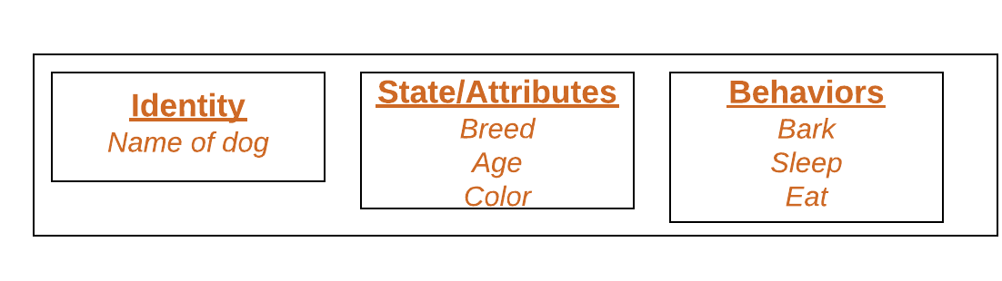
Object:
It is a basic unit of Object-Oriented Programming and represents real life entities.
A typical Java program creates many objects, which as you know, interact by invoking methods. An object consists of :
State: It is represented by attributes of an object. It also reflects the properties of an object.
Behavior: It is represented by methods of an object. It also reflects the response of an object with other objects.
Identity: It gives a unique name to an object and enables one object to interact with other objects.

Slide 7
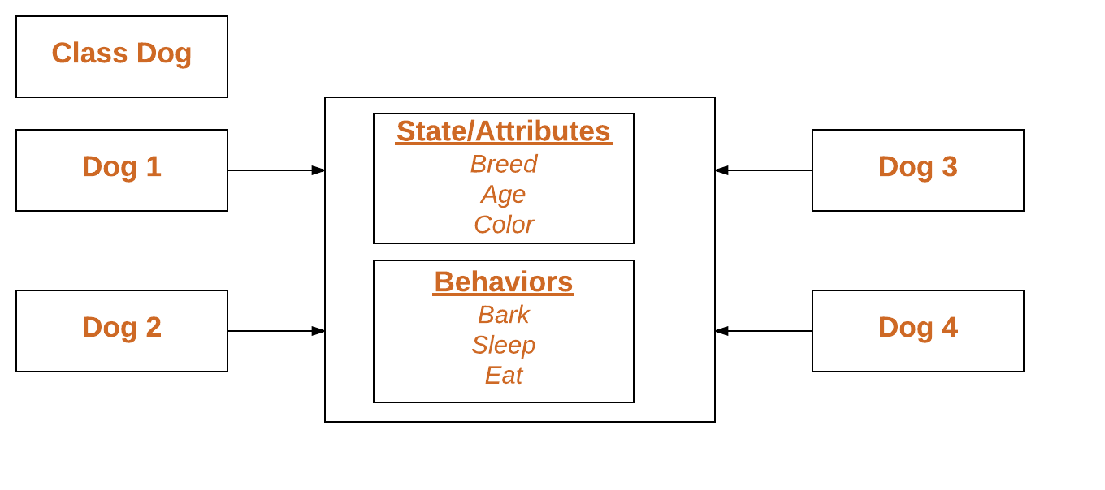
Declaring Objects (Also called instantiating a class)
When an object of a class is created, the class is said to be instantiated. All the instances share the attributes and the behavior of the class
Initializing an object:
The new operator instantiates a class by allocating memory for a new object and returning a reference to that memory. The new operator also invokes the class constructor.
Example : ref code Dog Example

Slide 8
Initialize by using method/function:
/*package whatever //do not write package name here */
public class GFG {
// sw=software
static String sw_name;
static float sw_price;
static void set(String n, float p) {
sw_name = n;
sw_price = p;
}
static void get() {
System.out.println("Software name is: " + sw_name);
System.out.println("Software price is: " + sw_price);
}
public static void main(String args[]) {
GFG.set("Visual studio", 0.0f);
GFG.get();
}
}

Slide 9
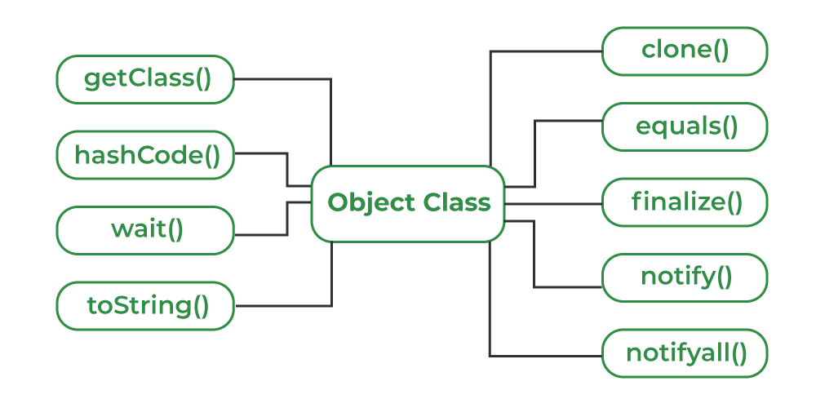
Object Class in Java
Object class is present in java.lang package.
Every class in Java is directly or indirectly derived from the Object class.

Slide 10
Method
a method is a way to perform some task.
Similarly, the method in Java is a collection of instructions that performs a specific task. It provides the reusability of code. We can also easily modify code using methods.
For example, if we have a class Human, then this class should have methods like eating(), walking(), talking() etc, which describes the behavior of the object.
return-type methodName(parameter-list)
{
//body of method
}
return-type refers to the type of value returned by the method.
methodName is a valid meaningful name that represent name of a method.
parameter-list represents list of parameters accepted by this method.
Method may have an optional return statement that is used to return value to the caller function.

Slide 11
Types of Method
There are two types of methods in Java:
Predefined Method
User-defined Method
Predefined Method:
In Java, predefined methods are the method that is already defined in the Java class libraries is known as predefined methods. It is also known as the standard library method or built-in method. We can directly use these methods just by calling them in the program at any point. Some pre-defined methods are length(), equals(), compareTo(), sqrt(), etc.
User-Defined Method:
The method written by the user or programmer is known as a user-defined method. These methods are modified according to the requirement.
How to Call or Invoke a User-defined Method:
Once we have defined a method, it should be called. The calling of a method in a program is simple. When we call or invoke a user-defined method, the program control transfer to the called method.

Slide 12
Static Method
A method that has static keyword is known as static method. In other words, a method that belongs to a class rather than an instance of a class is known as a static method. We can also create a static method by using the keyword static before the method name.
Advantage of Static method : no need to create object for this methods
public class Display {
public static void main(String[] args) {
show();
}
static void show()
{
System.out.println("It is an example of static method.");
}
}

Slide 13
Instance Method
The method of the class is known as an instance method. It is a non-static method defined in the class. Before calling or invoking the instance method, it is necessary to create an object of its class. Let's see an example of an instance method.
public class InstanceMethodExample {
public static void main(String [] args) {
//Creating an object of the class
InstanceMethodExample obj = new InstanceMethodExample();
//invoking instance method
System.out.println("The sum is: "+obj.add(12, 13));
}
int s;
//user-defined method because we have not used static keyword
public int add(int a, int b)
{
s = a+b;
//returning the sum
return s;
}
}

Slide 14
Types of Instance Methods
There are two types of instance method:
Accessor Method
Mutator Method
Accessor Method: The method(s) that reads the instance variable(s) is known as the accessor method. We can easily identify it because the method is prefixed with the word get. It is also known as getters. It returns the value of the private field. It is used to get the value of the private field.
public int getId()
{
return Id;
}
Mutator Method: The method(s) read the instance variable(s) and also modify the values. We can easily identify it because the method is prefixed with the word set. It is also known as setters or modifiers. It does not return anything. It accepts a parameter of the same data type that depends on the field. It is used to set the value of the private field.
public void setRoll(int roll)
{
this.roll = roll;
}

Slide 15
Abstract Method
The method that does not has method body is known as abstract method. In other words, without an implementation is known as abstract method. It always declares in the abstract class. It means the class itself must be abstract if it has abstract method. To create an abstract method, we use the keyword abstract.
Syntax: abstract void method_name();
abstract class Demo //abstract class {
//abstract method declaration
abstract void display();
}
public class MyClass extends Demo {
//method impelmentation
void display() {
System.out.println("Abstract method?");
}
public static void main(String args[]) {
//creating object of abstract class
Demo obj = new MyClass();
//invoking abstract method
obj.display();
}
}

Slide 16
Constructors in Java
In Java, a constructor is a block of codes similar to the method. It is called when an instance of the class is created. At the time of calling constructor, memory for the object is allocated in the memory.
It is a special type of method which is used to initialize the object.
Every time an object is created using the new() keyword, at least one constructor is called.
Java compiler provides a default constructor by default.
There are two types of constructors in Java: no-arg constructor, and parameterized constructor.
Rules for creating Java constructor :
There are two rules defined for the constructor.
Constructor name must be the same as its class name
A Constructor must have no explicit return type
A Java constructor cannot be abstract, static, final, and synchronized

Slide 17
Types of Java constructors
Default constructor (no-arg constructor)
Parameterized constructor
Java Default Constructor:
A constructor is called "Default Constructor" when it doesn't have any parameter.
Syntax: <class_name>(){}
If there is no constructor in a class, compiler automatically creates a default constructor.
Java Parameterized Constructor:
A constructor which has a specific number of parameters is called a parameterized constructor.
<class_name>(int a,String n){}
Constructor Overloading :
Constructor overloading in java is a technique of having more than one constructor with different parameter lists. They are arranged in a way that each constructor performs a different task. They are differentiated by the compiler by the number of parameters in the list and their types.

Slide 18
Static
The static keyword in Java is used for memory management mainly. We can apply static keyword with variables, methods, blocks and nested classes.
Advantages of static variable:
It makes your program memory efficient (i.e., it saves memory).
This Keyword:
There can be a lot of usage of Java this keyword. In Java, this is a reference variable that refers to the current object.
Usage of Java this keyword:
this can be used to refer current class instance variable.
this can be used to invoke current class method (implicitly)
this() can be used to invoke current class constructor.
this can be passed as an argument in the method call.
this can be passed as argument in the constructor call.
this can be used to return the current class instance from the method.

Slide 19
Interview Preparation …..?
1.what is OOPS ?
2. What is class and Object ?
3. what is terminal operator ?
4. what is method and how to call method ?
5. What is constructor ?
6. Types of Constructor?
7.Does constructor return any value ?
8. what is static keyword ?
9. why is the main method static ?
10. can we execute the program without main method ?
11. Difference b/w Constructor and method ?

Slide 20
Java Constructor | Java Method
A constructor is used to initialize the state of an object. | A method is used to expose the behavior of an object.
A constructor must not have a return type. | A method must have a return type.
The constructor is invoked implicitly. | The method is invoked explicitly.
The Java compiler provides a default constructor if you don't have any constructor in a class. | The method is not provided by the compiler in any case.
The constructor name must be same as the class name. | The method name may or may not be same as the class name.

Slide 21
Next topic…?
Java Inheritance
Java Polymorphism
Java Abstraction
Java Encapsulation

