Slide 1
Java Inheritance

Slide 2
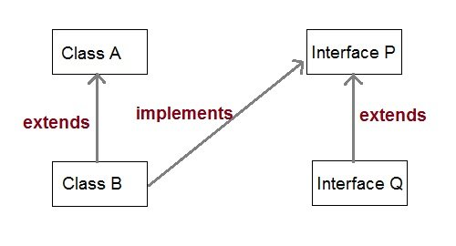
Inheritance (IS-A relationship)
Inheritance is one of the key features of Object Oriented Programming.
Inheritance provided mechanism that allowed a class to inherit property of another class.
When a Class extends another class it inherits all non-private members including fields and methods.
Inheritance in Java can be best understood in terms of Parent and Child relationship, also known as Super class(Parent) and Sub class(child) in Java language.
Inheritance defines is-a relationship between a Super class and its Sub class.
Extends and implements keywords are used to describe inheritance in java .

Slide 3
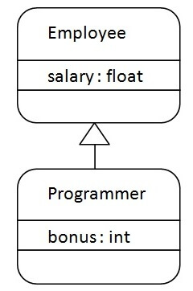
Why use inheritance in java
For Method Overriding (so runtime polymorphism can be achieved).
For Code Reusability.
Disadvantages of Inheritance:
Main disadvantage of using inheritance is that the two classes (parent and child class) gets tightly coupled.
This means that if we change code of parent class, it will affect to all the child classes which is inheriting/deriving the parent class, and hence, it cannot be independent of each other.
The syntax of Java Inheritance:
class Subclass-name extends Superclass-name
{
//methods and fields
}
Ex:

Slide 4
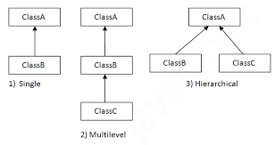
Types of Inheritance
Java mainly supports only three types of inheritance that are listed below.
Single Inheritance
Multilevel Inheritance
Heirarchical Inheritance
NOTE: Multiple inheritance is not supported in java

Slide 5
Single Inheritance
When a class extends to another class then it forms single inheritance.
In the below example, we have two classes in which class A extends to class B that forms single inheritance.
class A{
int a = 10;
void show() {
System.out.println("a = "+a);
}
}
public class B extends A{
public static void main(String[] args) {
B b = new B();
b.show();
}
}

Slide 6
Multilevel Inheritance
When a class extends to another class that also extends some other class forms a multilevel inheritance.
For example a class C extends to class B that also extends to class A and all the data members an methods of class A and B are now accessible in class C.
class A{
int a = 10;
void show() {
System.out.println("a = "+a); }}
class B extends A{
int b = 10;
void showB() {
System.out.println("b = "+b);}}
public class C extends B{
public static void main(String[] args) {
C c = new C();
c.show();
c.showB();
}
}

Slide 7
Hierarchical Inheritance
When a class is extended by two or more classes, it forms hierarchical inheritance.
For example, class B extends to class A and class C also extends to class A in that case both B and C share properties of class A.
class A{
int a = 10;
void show() {
System.out.println("a = "+a);}}
class B extends A{
int b = 10;
void showB() {
System.out.println("b = "+b);}}
public class C extends A{
public static void main(String[] args) {
C c = new C();
c.show();
B b = new B();
b.show();
}
}

Slide 8
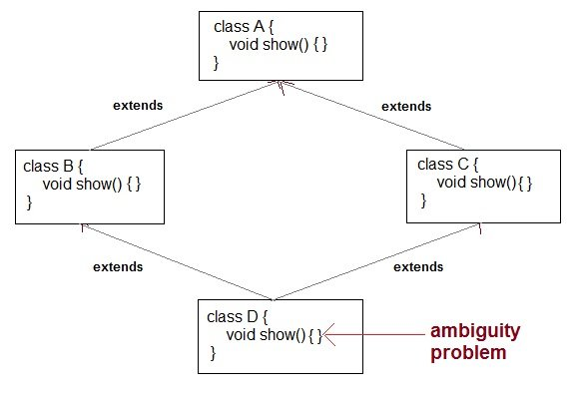
Why multiple inheritance is not supported in Java?
To remove ambiguity.
To provide more maintainable and clear design.

Slide 9
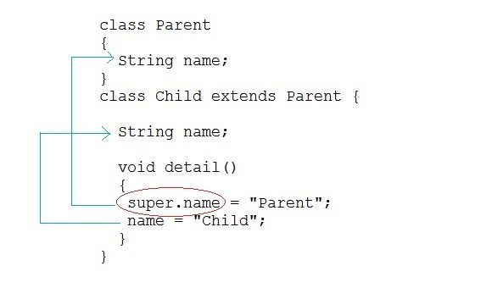
Super Keyword:
In Java, super keyword is used to refer to immediate parent class of a child class.
In other words super keyword is used by a subclass whenever it need to refer to its immediate super class.

Slide 10
Example of Child class referring Parent class property using super keyword
In this examle we will only focus on accessing the parent class property or variables.
class Parent
{String name; }
public class Child extends Parent {
String name;
public void details()
{
super.name = "Parent"; //refers to parent class member
name = "Child";
System.out.println(super.name+" and "+name);
}
public static void main(String[] args)
{
Child cobj = new Child();
cobj.details();
}
}

Slide 11
Example of Child class refering Parent class methods using super keyword
In this examle we will only focus on accessing the parent class methods.
class Parent{
String name;
public void details(){
name = "Parent";
System.out.println(name);}}
public class Child extends Parent {
String name;
public void details() {
super.details(); //calling Parent class details() method
name = "Child";
System.out.println(name); }
public static void main(String[] args)
{
Child cobj = new Child();
cobj.details();
}
}

Slide 12
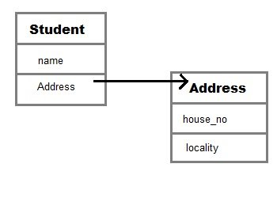
Aggregation in Java
Aggregation is a term which is used to refer one way relationship between two objects. For example, Student class can have reference of Address class but vice versa does not make sense.
Aggregation is a term which is used to refer one way relationship between two objects. For example, Student class can have reference of Address class but vice versa does not make sense.
Lets understand it by an example and consider two classes Student and Address. Each student has own address that makes has-a relationship but address has student not makes any sense. We can understand it more clearly using Java code.

Slide 13
When use Aggregation?
Code reuse is also best achieved by aggregation when there is no is-a relationship.
Inheritance should be used only if the relationship is-a is maintained throughout the lifetime of the objects involved; otherwise, aggregation is the best choice.
Understanding meaningful example of Aggregation:
In this example, Employee has an object of Address, address object contains its own informations such as city, state, country etc. In such case relationship is Employee HAS-A address.
Ref code

Slide 14
Interview Preparation …..?
1. When to use Inheritance and Aggregation?
2. What is Inheritance and Aggregation?
3. Why multiple inheritance is not supported in Java?

Slide 15
Next topic…?
Java Polymorphism
Java Abstraction
Java Encapsulation

