Slide 1
Java Polymorphism

Slide 2
Polymorphism:
If one task is performed in different ways, it is known as polymorphism. For example: to convince the customer differently, to draw something, for example, shape, triangle, rectangle, etc.
In Java, we use method overloading and method overriding to achieve polymorphism.
Method Overloading in Java:
If a class has multiple methods having same name but different in parameters, it is known as Method Overloading.
Method overloading is also known as Compile-time Polymorphism, Static Polymorphism, or Early binding in Java. In Method overloading compared to parent argument, child argument will get the highest priority.
Different Ways of Method Overloading in Java
Changing the Number of Parameters.
Changing Data Types of the Arguments.
Changing the Order of the Parameters of Methods

Slide 3
Example :
// Java program to demonstrate working of method
// overloading in Java
public class Sum {
// Overloaded sum(). This sum takes two int parameters
public int sum(int x, int y) { return (x + y); }
// Overloaded sum(). This sum takes three int parameters
public int sum(int x, int y, int z){
return (x + y + z);
}
// Overloaded sum(). This sum takes two double
// parameters
public double sum(double x, double y){
return (x + y);
}
// Driver code
public static void main(String args[])
{
Sum s = new Sum();
System.out.println(s.sum(10, 20));
System.out.println(s.sum(10, 20, 30));
System.out.println(s.sum(10.5, 20.5));
}
}

Slide 4
1. Changing the Number of Parameters
Method overloading can be achieved by changing the number of parameters while passing to different methods.
Example:
public int multiply(int a, int b)
public int multiply(int a, int b, int c)
2. Changing Data Types of the Arguments
In many cases, methods can be considered Overloaded if they have the same name but have different parameter types, methods are considered to be overloaded.
Example :
public int Prod(int a, int b, int c)
public double Prod(double a, double b, double c)
3. Changing the Order of the Parameters of Methods
Method overloading can also be implemented by rearranging the parameters of two or more overloaded methods. For example, if the parameters of method 1 are (String name, int roll_no) and the other method is (int roll_no, String name) but both have the same name, then these 2 methods are considered to be overloaded with different sequences of parameters.
Example : public void StudentId(String name, int roll_no)
public void StudentId(int roll_no, String name)

Slide 5
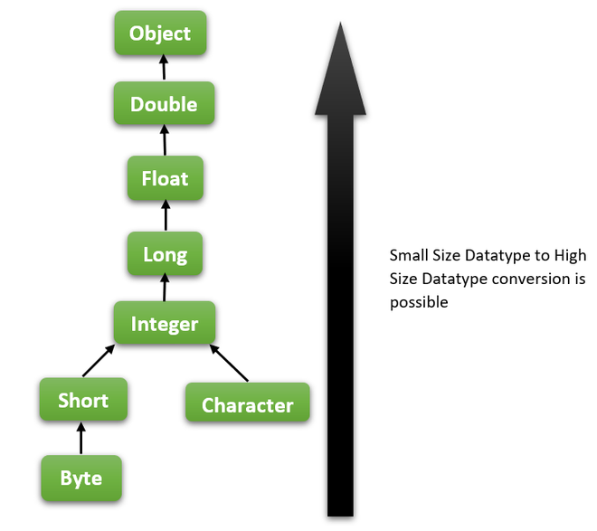
Advantages of Method Overloading
Method overloading improves the Readability and reusability of the program.
Method overloading reduces the complexity of the program.
Using method overloading, programmers can perform a task efficiently and effectively.
Using method overloading, it is possible to access methods performing related functions with slightly different arguments and types.
Objects of a class can also be initialized in different ways using the constructors.
What if the exact prototype does not match with arguments?
Type Conversion but to higher type(in terms of range) in the same family.
Type conversion to the next higher family(suppose if there is no long data type available
for an int data type, then it will search for the float data type).

Slide 6
Method Overriding in Java
If subclass (child class) has the same method as declared in the parent class, it is known as method overriding in Java.
Usage of Java Method Overriding
Method overriding is used to provide the specific implementation of a method which is already provided by its superclass.
Method overriding is used for runtime polymorphism
Rules for Java Method Overriding
The method must have the same name as in the parent class
The method must have the same parameter as in the parent class.
There must be an IS-A relationship (inheritance).

Slide 7
Example
class Animal
{
public void eat()
{
System.out.println("Eat all eatables");
}
}
class Dog extends Animal
{
public void eat() //eat() method overridden by Dog class.
{
System.out.println("Dog like to eat meat");
}
public static void main(String[] args) {
Dog d = new Dog();
d.eat();
}
}

Slide 8
Rules for method overriding:
1.Overriding and Access-Modifiers :
The access modifier for an overriding method can allow more, but not less, access than the overridden method.
For example, a protected instance method in the super-class can be made public, but not private, in the subclass. Doing so, will generate compile-time error.
2.Final methods can not be overridden : If we don’t want a method to be overridden, we declare it as final.
3.Private methods can not be overridden : Private methods cannot be overridden as they are bonded during compile time. Therefore we can’t even override private methods in a subclass.
4.The overriding method must have same return type (or subtype) : From Java 5.0 onwards it is possible to have different return type for a overriding method in child class, but child’s return type should be sub-type of parent’s return type. This phenomena is known as covariant return type.
5.Overriding and constructor : We can not override constructor as parent and child class can never have constructor with same name(Constructor name must always be same as Class name).
6.Overriding and Exception-Handling : Below are two rules to note when overriding methods related to exception-handling.
Rule#1 : If the super-class overridden method does not throw an exception, subclass overriding method can only throws the unchecked exception, throwing checked exception will lead to compile-time error.
Rule#2 : If the super-class overridden method does throws an exception, subclass overriding method can only throw same, subclass exception. Throwing parent exception in Exception hierarchy will lead to compile time error. Also there is no issue if subclass overridden method is not throwing any exception.

Slide 9
Final KeyWord:
The final keyword in java is used to restrict the user. The java final keyword can be used in many context. Final can be:
1.variable
2.method
3. class
1) Java final variable
If you make any variable as final, you cannot change the value of final variable(It will be constant).
final int speedlimit=90;//final variable
2) Java final method
If you make any method as final, you cannot override it.
final void run(){System.out.println("running");}
3) Java final class
If you make any class as final, you cannot extend it.

Slide 10
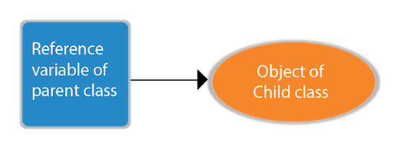
Runtime Polymorphism in Java
Polymorphism in Java is a concept by which we can perform a single action in different ways. Polymorphism is derived from 2 Greek words: poly and morphs. The word "poly" means many and "morphs" means forms. So polymorphism means many forms.
There are two types of polymorphism in Java: compile-time polymorphism and runtime polymorphism. We can perform polymorphism in java by method overloading and method overriding.
Runtime Polymorphism in Java
Runtime polymorphism or Dynamic Method Dispatch is a process in which a call to an overridden method is resolved at runtime rather than compile-time.

Slide 11
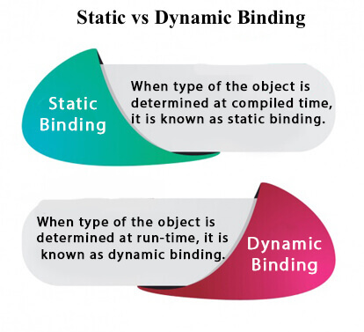
Static Binding and Dynamic Binding
Connecting a method call to the method body is known as binding.
There are two types of binding
Static Binding (also known as Early Binding).
Dynamic Binding (also known as Late Binding).
static binding
When type of the object is determined at compiled
time(by the compiler), it is known as static binding.
If there is any private, final or static method in a class, there is static binding.
Dynamic binding
When type of the object is determined at run-time, it is known as dynamic binding.
Ref code

Slide 12
Method Overloading Vs Method Overriding
No. | Method Overloading | Method Overriding
1) | Method overloading is used to increase the readability of the program. | Method overriding is used to provide the specific implementation of the method that is already provided by its super class.
2) | Method overloading is performed within class. | Method overriding occurs in two classes that have IS-A (inheritance) relationship.
3) | In case of method overloading, parameter must be different. | In case of method overriding, parameter must be same.
4) | Method overloading is the example of compile time polymorphism. | Method overriding is the example of run time polymorphism.
5) | In java, method overloading can't be performed by changing return type of the method only. Return type can be same or different in method overloading. But you must have to change the parameter. | Return type must be same or covariant in method overriding.

Slide 13
Interview Preparation …..?
1. Why Method Overloading is not possible by changing the return type of method only?
2. Can we overload java main() method?
3. What method overloading?
4. Can we overload java main() method?
5. Can we overload methods that differ only by static keywords?
6. Can we overload main() in Java?
7. Does Java support Operator Overloading?
8. Does Java support Operator Overloading?
9.what is overriding ?
10. Can we declare a constructor final?
11. What is final parameter?

Slide 14
Next topic…?
Java Abstraction and Interface
Java Encapsulation

