Slide 1
Java Abstract

Slide 2
Abstract class in Java
A class which is declared with the abstract keyword is known as an abstract class in Java. It can have abstract and non-abstract methods (method with the body).
Abstraction in Java
Abstraction is a process of hiding the implementation details and showing only functionality to the user.
Ways to achieve Abstraction
There are two ways to achieve abstraction in java
Abstract class (0 to 100%)
Interface (100%)
Abstract class in Java
A class which is declared as abstract is known as an abstract class. It can have abstract and non-abstract methods. It needs to be extended and its method implemented. It cannot be instantiated.

Slide 3
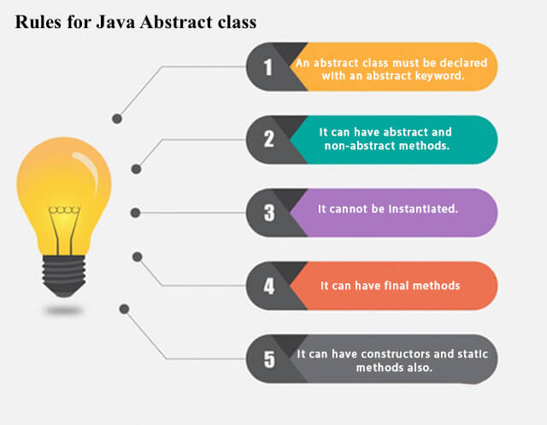

Slide 4
Abstract method
Method that are declared without any body within an abstract class are called abstract method.
The method body will be defined by its subclass.
Abstract method can never be final and static. Any class that extends an abstract class must implement all the abstract methods.
Syntax: abstract return_type function_name (); //No definition
Points to Remember about Abstract Class and Method:
Here are some useful points to remember:
Abstract classes are not Interfaces.
An abstract class may or may not have an abstract method. But if any class has even a single abstract method, then it must be declared abstract.
Abstract classes can have Constructors, Member variables and Normal methods.
Abstract classes are never instantiated.
When you extend Abstract class with abstract method, you must define the abstract method in the child class, or make the child class abstract.

Slide 5
Example of Abstract class:
In this example, we created an abstract class A that contains a method callme() and Using class B, we are extending the abstract class.
abstract class A{
abstract void callme();}
class B extends A
{
void callme()
{
System.out.println("Calling...");
}
public static void main(String[] args)
{
B b = new B();
b.callme();
}
}

Slide 6
Abstract class having constructor, data member and methods
An abstract class can have a data member, abstract method, method body (non-abstract method), constructor, and even main() method.
abstract class Bike{
Bike(){System.out.println("bike is created");}
abstract void run();
void changeGear(){System.out.println("gear changed");}
}
//Creating a Child class which inherits Abstract class
class Honda extends Bike{
void run(){System.out.println("running safely..");}
}

Slide 7
Interface in Java
1.Interface is a concept which is used to achieve abstraction in Java.
2.Interfaces are syntactically similar to classes, but you cannot create instance of an Interface and their methods are declared without any body.
3.It can have only abstract methods and static fields.
4. However, from Java 8, interface can have default and static methods and from Java 9, it can have private methods as well.
5.When an interface inherits another interface extends keyword is used where as class use implements keyword to inherit an interface.
Advantages of Interface:
It Support multiple inheritance
It helps to achieve abstraction
It can be used to achieve loose coupling.
Syntax:
interface interface_name {
// fields
// abstract/private/default methods
}

Slide 8
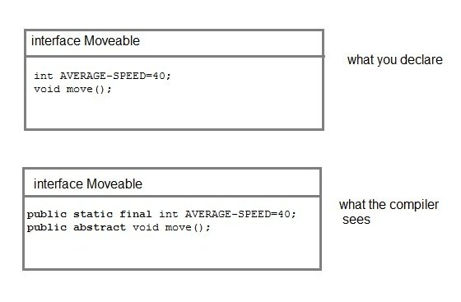
Interface Key Points:
Methods inside interface must not be static, final, native or strictfp.
All variables declared inside interface are implicitly public, static and final.
All methods declared inside interfaces are implicitly public and abstract, even if you don't use public or abstract keyword.
Interface can extend one or more other interface.
Interface cannot implement a class.
Interface can be nested inside another interface.
NOTE: Compiler automatically converts methods of Interface as public and abstract, and the data members as public, static and final by default.
Ref:code

Slide 9
Interfaces supports Multiple Inheritance:
Though classes in Java doesn't support multiple inheritance, but a class can implement more than one interfaces.
In this example, two interfaces are implemented by a class that show implementation of multiple inheritance.
interface Moveable{
boolean isMoveable();
}
interface Rollable{
boolean isRollable();
}
class Tyre implements Moveable, Rollable{
int width;
boolean isMoveable(){
return true;
}
boolean isRollable(){
return true;}
public static void main(String args[])
{
Tyre tr = new Tyre();
System.out.println(tr.isMoveable());
System.out.println(tr.isRollable());
}
}

Slide 10
Interface extends other Interface:
Interface can inherit to another interface by using extends keyword.
But in this case, interface just inherit, does not provide implementation. Implementation can be provided by a class only.
interface NewsPaper
{
news();
}
interface Magazine extends NewsPaper
{
colorful();
}

Slide 11
Default Methods in Interface – Java 8:
In Java 8 version a new feature is added to the interface, which was default method. Default method is a method that can have its body. It means default method is not abstract method, it is used to set some default functionality to the interface.
Static methods in Interface – Java 8:
The purpose of static method is to add utility methods into the interface
Private methods – Java 9:
In Java 9 version, a new feature is added that allows us to declare private methods inside the interface. The purpose of private method is just to share some task between the non-abstract methods of the interface.
Syntax:
default void msg(){
greet();
}
// Private method
private void greet() {
System.out.println("This is private method");
}
static void msg(){
System.out.println("This is static method");
}

Slide 12
Abstract Class Vs Interface
Abstract class | Interface
Abstract class is a class which contain one or more abstract methods, which has to be implemented by its sub classes. | Interface is a Java Object containing method declaration but no implementation. The classes which implement the Interfaces must provide the method definition for all the methods.
Abstract class is a Class prefix with an abstract keyword followed by Class definition. | Interface is a pure abstract class which starts with interface keyword.
Abstract class can also contain concrete methods, non-abstract methods | Whereas, Interface contains all abstract methods and final variable declarations. →By default variable is public ,static and final -→ BY default methods is public and abstract
Abstract classes are useful in a situation that Some general methods should be implemented and specialization behavior should be implemented by child classes. | Interfaces are useful in a situation that all properties should be implemented.

Slide 13
Interview Preparation …..?
1. What is interface ?
2. what is abstraction ?
3.What is the difference between Abstract class and Interface Or When should you use an abstract class, when an interface, when both? Or What is similarities/difference between an Abstract class and Interface? Or What is the difference between interface and an abstract class?
4. What is interface? How to support multiple inhertance in Java?
5. Can you make an instance of an abstract class?
6. Can Abstract Class have constructors? Can interfaces have constructors?
7. If interface & abstract class have same methods and those methods contain no implementation, which one would you prefer?8. Does Java support Operator Overloading?

Slide 14
Next topic…?
Java Encapsulation

