Slide 1
Java Encapsulation

Slide 2
Encapsulation in Java
Encapsulation in Java is a process of wrapping code and data together into a single unit, for example, a capsule which is mixed of several medicines.
It is a way to achieve data hiding in Java because other class will not be able to access the data through the private data members.
Advantage of Encapsulation in Java
By providing only a setter or getter method, you can make the class read-only or write-only. In other words, you can skip the getter or setter methods.
It provides you the control over the data
Java Package:
A java package is a group of similar types of classes, interfaces and sub-packages.
Package in java can be categorized in two form, built-in package and user-defined package.
There are many built-in packages such as java, lang, awt, javax, swing, net, io, util, sql etc.

Slide 3
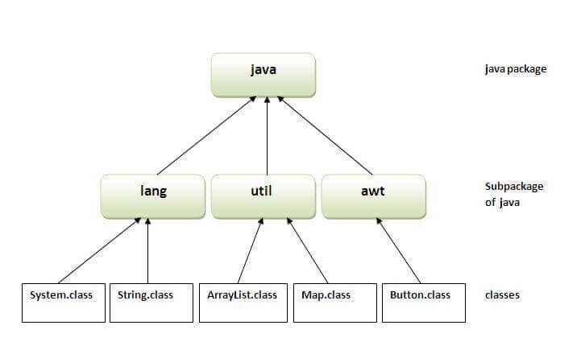
Advantage of Java Package
1) Java package is used to categorize the classes and interfaces so that they can be easily maintained.
2) Java package provides access protection.
3) Java package removes naming collision
How to access package from another package?
There are three ways to access the package from outside the package.
import package.*;
import package.classname;
fully qualified name.

Slide 4
Access Modifiers in Java
There are two types of modifiers in Java: access modifiers and non-access modifiers.
The access modifiers in Java specifies the accessibility or scope of a field, method, constructor, or class.
We can change the access level of fields, constructors, methods, and class by applying the access modifier on it.
There are four types of Java access modifiers:
Private: The access level of a private modifier is only within the class. It cannot be accessed from outside the class.
Default: The access level of a default modifier is only within the package. It cannot be accessed from outside the package. If you do not specify any access level, it will be the default.
Protected: The access level of a protected modifier is within the package and outside the package through child class. If you do not make the child class, it cannot be accessed from outside the package.
Public: The access level of a public modifier is everywhere. It can be accessed from within the class, outside the class, within the package and outside the package.
Non-Access Modifiers:
There are many non-access modifiers, such as static, abstract, synchronized, native, volatile, transient, etc. Here, we are going to learn the access modifiers only.

Slide 5
Understanding Java Access Modifiers
Let's understand the access modifiers in Java by a simple table.
Access Modifier | within class | within package | outside package by subclass only | outside package
Private | Y | N | N | N
Default | Y | Y | N | N
Protected | Y | Y | Y | N
Public | Y | Y | Y | Y

Slide 6
Interview Preparation:
1.what is encapsulation?
2.what is package?
3.what is fully qualified imports ?
4.what is scope of default and protected? 5.what is scope of private and public ?

Slide 7
Next topic…?
String and StringBuilder

