Slide 1
Spring-MVC

Slide 2
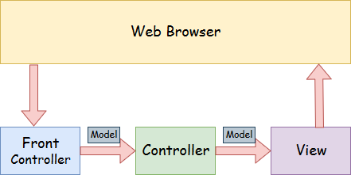
Spring MVC
A Spring MVC is a Java framework which is used to build web applications.
It follows the Model-View-Controller design pattern.
It implements all the basic features of a core spring framework like Inversion of Control, Dependency Injection.
A Spring MVC provides an elegant solution to use MVC in spring framework by the help of DispatcherServlet. Here, DispatcherServlet is a class that receives the incoming request and maps it to the right resource such as controllers, models, and views.
Spring Web Model-View-Controller

Slide 3
Spring Web Model-View-Controller
Model - A model contains the data of the application.
A data can be a single object or a collection of objects.
Controller - A controller contains the business logic of an application. Here,
the @Controller annotation is used to mark the class as the controller.
View - A view represents the provided information in a particular format.
Generally, JSP+JSTL is used to create a view page. Although spring also supports other view technologies such as Apache Velocity, Thymeleaf and FreeMarker.
Front Controller - In Spring Web MVC, the DispatcherServlet class works as the front controller.
It is responsible to manage the flow of the Spring MVC application.

Slide 4
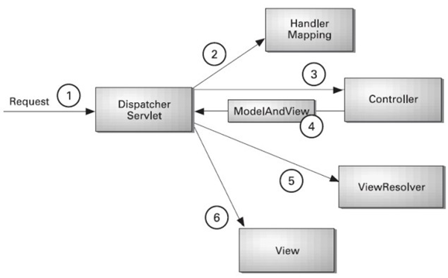
Understanding the flow of Spring Web MVC
As displayed in the figure, all the incoming request is intercepted by the DispatcherServlet that works as the front controller.
The DispatcherServlet gets an entry of handler mapping from the XML file and forwards the request to the controller.
The controller returns an object of ModelAndView.
The DispatcherServlet checks the entry of view resolver in the XML file and invokes the specified view component.

Slide 5
Advantages of Spring MVC Framework
Separate roles - The Spring MVC separates each role, where the model object, controller, command object, view resolver, DispatcherServlet, validator, etc. can be fulfilled by a specialized object.
Light-weight - It uses light-weight servlet container to develop and deploy your application.
Powerful Configuration - It provides a robust configuration for both framework and application classes that includes easy referencing across contexts, such as from web controllers to business objects and validators.
Rapid development - The Spring MVC facilitates fast and parallel development.
Reusable business code - Instead of creating new objects, it allows us to use the existing business objects.
Easy to test - In Spring, generally we create JavaBeans classes that enable you to inject test data using the setter methods.
Flexible Mapping - It provides the specific annotations that easily redirect the page.

Slide 6
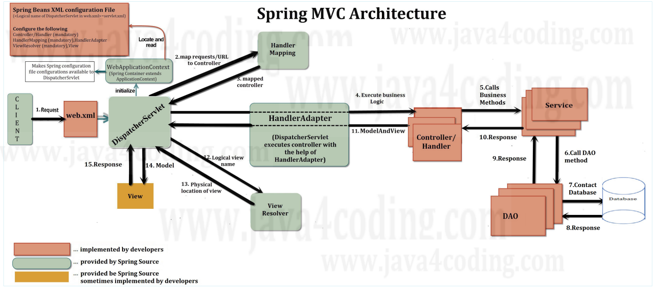
Spring MVC Architecture:
The following diagram shows the spring MVC architecture starting from the point of user sending a request to HTTP server till the response is returned back to user.

Slide 7
Spring MVC Architecture flow: Below steps explains the request and response flow
DispatcherServlet receives the request.
DispatcherServlet dispatches the task of selecting an appropriate controller to HandlerMapping. HandlerMapping selects the controller which is mapped to the incoming request URL and returns the (selected Handler) Controller to DispatcherServlet.
DispatcherServlet dispatches the task of executing of business logic of Controller to HandlerAdapter.
HandlerAdapter calls the business logic process of Controller.
Controller executes the business logic, sets the processing result in Model and returns the logical name (or directly the name of the JSP) to HandlerAdapter.
DispatcherServlet dispatches the task of resolving the view (JSP/ Velocity/ FreeMarker etc. or implementation of View interface) corresponding to the View name to ViewResolver which returns the view (JSP/implementation of View interface) mapped to View name.
DispatcherServlet dispatches the rendering process to returned view (JSP/ implementation of View interface)
View (JSP/ implementation of View interface) renders Model data and returns the response.
DispatcherServlet is the central Servlet that dispatches requests to controllers. Now let us learn step by step flow of request processing in spring MVC.
In Spring MVC DispatcherServlet dispatches the task of selecting an appropriate controller to HandlerMapping.
HandlerMapping selects the controller which is mapped to the incoming request URL and returns the (selected Handler) Controller to DispatcherServlet.
In spring MVC applications the name of spring bean configuration file should be <logical name of DispatcherServlet in web.xml>-servlet.xml

Slide 8
4) Load the jar files required for spring framework
There are mainly three jar files required to run this application.
org.springframework.core-3.0.1.RELEASE-A
com.springsource.org.apache.commons.logging-1.1.1
org.springframework.beans-3.0.1.RELEASE-A
Steps to create spring application in Eclipse IDE
1) Create the Java Project
Go to File menu - New - project - Java Project. Write the project name e.g. firstspring - Finish. Now the java project is created.
2) Add spring jar files
org.springframework.core-3.0.1.RELEASE-A
com.springsource.org.apache.commons.logging-1.1.1
org.springframework.beans-3.0.1.RELEASE-A

Slide 9
IoC Container:
The IoC container is responsible to instantiate, configure and assemble the objects.
The IoC container gets informations from the XML file and works accordingly.
The main tasks performed by IoC container are:
to instantiate the application class
to configure the object
to assemble the dependencies between the objects
There are two types of IoC containers. They are:
BeanFactory
ApplicationContext
The org.springframework.beans.factory.BeanFactory and the org.springframework.context.ApplicationContext interfaces acts as the IoC container.
The ApplicationContext interface is built on top of the BeanFactory interface.
It adds some extra functionality than BeanFactory such as simple integration with Spring's AOP, message resource handling (for I18N), event propagation, application layer specific context (e.g. WebApplicationContext) for web application. So it is better to use ApplicationContext than BeanFactory.

Slide 10
Using BeanFactory :
The XmlBeanFactory is the implementation class for the BeanFactory interface. To use the BeanFactory, we need to create the instance of XmlBeanFactory class as given below:
Resource resource=new ClassPathResource("applicationContext.xml");
BeanFactory factory=new XmlBeanFactory(resource);
The constructor of XmlBeanFactory class receives the Resource object so we need to pass the resource object to create the object of BeanFactory.
Using ApplicationContext:
The ClassPathXmlApplicationContext class is the implementation class of ApplicationContext interface.
We need to instantiate the ClassPathXmlApplicationContext class to use the ApplicationContext as given below:
ApplicationContext context =
new ClassPathXmlApplicationContext("applicationContext.xml");
The constructor of ClassPathXmlApplicationContext class receives string, so we can pass the name of the xml file to create the instance of ApplicationContext.

Slide 11
Dependency Injection in Spring:
Dependency Injection (DI) is a design pattern that removes the dependency from the programming code so that it can be easy to manage and test the application.
Dependency Injection makes our programming code loosely coupled.
In such case we provide the information from the external source such as XML file. It makes our code loosely coupled and easier for testing. In such case we write the code as:
class Employee{
Address address;
Employee(Address address){
this.address=address;
}
public void setAddress(Address address){
this.address=address;
}
In such case, instance of Address class is provided by external souce such as XML file either by constructor or setter method.

Slide 12
Two ways to perform Dependency Injection in Spring framework
Spring framework provides two ways to inject dependency
By Constructor
By Setter method
Dependency Injection by Constructor :
We can inject the dependency by constructor.
The <constructor-arg> subelement of <bean> is used for constructor injection. Here we are going to inject
primitive and String-based values
Dependent object (contained object)
Collection values etc.
Ex: <bean id="e" class="com.springcore.Employee">
<constructor-arg value="10" type="int"></constructor-arg>
</bean>

Slide 13
Injecting primitive and string-based values
Let's see the simple example to inject primitive and string-based values. We have created three files here:
Employee.java
applicationContext.xml
Test.java
Ex:
It is a simple class containing two fields id and name. There are four constructors and one method in this class.
Student -→id ,name
applicationContext.xml:
We are providing the information into the bean by this file. The constructor-arg element invokes the constructor.
<bean id="e" class="com.javatpoint.Employee">
<constructor-arg value="10" type="int"></constructor-arg>
</bean>
Injecting string-based values
<bean id="e" class="com.javatpoint.Employee">
<constructor-arg value="Sonoo"></constructor-arg>
</bean>

Slide 14
Constructor Injection with Dependent Object:
If there is HAS-A relationship between the classes, we create the instance of dependent object (contained object) first then pass it as an argument of the main class constructor. Here, our scenario is Employee HAS-A Address. The Address class object will be termed as the dependent object.
applicationContext.xml:
We are providing the information into the bean by this file. The constructor-arg element invokes the constructor.
The ref attribute is used to define the reference of another object, such way we are passing the dependent object as an constructor argument.
<bean id="a1" class="com.springcore.Address">
<constructor-arg value=“Macherla"></constructor-arg>
<constructor-arg value=“AP"></constructor-arg>
<constructor-arg value="India"></constructor-arg>
</bean>
<bean id="e" class="com.springcore.Employee">
<constructor-arg value="12" type="int"></constructor-arg>
<constructor-arg value=“Harish"></constructor-arg>
<constructor-arg>
<ref bean="a1"/>
</constructor-arg>
</bean>

Slide 15
Constructor Injection with Collection Example:
We can inject collection values by constructor in spring framework. There can be used three elements inside the constructor-arg element. It can be:
list
set
Map
Each collection can have string based and non-string based values.
In this example, we are taking the example of Forum where One question can have multiple answers.
There are three pages:
Question.java
applicationContext.xml
Test.java

Slide 16
Dependency Injection by setter method
We can inject the dependency by setter method also. The <property> subelement of <bean> is used for setter injection. Here we are going to inject
primitive and String-based values
Dependent object (contained object)
Collection values etc.
Example:
<bean id="obj" class=“springcore.Employee">
<property name="id">
<value>20</value>
</property>
<property name="name">
<value>Arun</value>
</property>
<property name="city">
<value>ghaziabad</value>
</property>
</bean>

Slide 17
Autowiring in Spring:
Autowiring feature of spring framework enables you to inject the object dependency implicitly.
It internally uses setter or constructor injection.
Autowiring can't be used to inject primitive and string values. It works with reference only.
Advantage of Autowiring Ex: <bean id="a" class="org.sssit.A" autowire="byName"></bean>
It requires the less code because we don't need to write the code to inject the dependency explicitly.
Disadvantage of Autowiring : No control of programmer.
There are many autowiring modes:
No. | Mode | Description
1) | no | It is the default autowiring mode. It means no autowiring bydefault.
2) | byName | The byName mode injects the object dependency according to name of the bean. In such case, property name and bean name must be same. It internally calls setter method.
3) | byType | The byType mode injects the object dependency according to type. So property name and bean name can be different. It internally calls setter method.
4) | constructor | The constructor mode injects the dependency by calling the constructor of the class. It calls the constructor having large number of parameters.
5) | autodetect | It is deprecated since Spring 3.

Slide 18
Setter vs. Constructor Injection
Setter | Constructor
Dependencies are injected using setter methods. | Dependencies are injected using constructor arguments.
Partial dependency injection is supported; we can ignore any property for injection. We can inject properties only if necessary. | Partial dependency injection is not supported; we cannot ignore the property if it is there in constructor parameter. All the parameters of constructor must be injected. Otherwise an overloaded constructor must be created with those properties need to be injected.
If we use constructor and setter injection both, setter injection will be used because setter methods will be executed after constructor. | If we use constructor and setter injection, constructor injection will not be used.
Default constructor is mandatory. | Default constructor is not mandatory.
More readable | Less Readable when there is more number of properties in class.
Less secure than constructor inject, because while using setter injection, you can override certain dependency by sub-classes overridden setter methods. | More secure than setter inject as dependency cannot be overridden, sub-classes still has to invoke super class constructors.
If two objects dependent each other, the circular dependency has no effect as objects use setter methods of other. | If two objects dependent each other, the circular dependency has an effect and exception will be thrown from spring. One object has to wait for other object creation; both the objects wait for other creation results in ObjectCurrentlyInCreationException.

Slide 19
Spring Bean Scopes
Scope | Description
singleton | Spring container creates only one object for JavaBean class. This single will be used every time whenever the bean is to be injected. Singleton means one object per JVM. This is the default scope of a bean. But we can configure explicitly as below. <bean id="adrress" class="com.javacoding.EmplyeeAdress" scope="singleton"></bean>
prototype | Spring creates new object for each bean consumption. <bean id="adrress" class="com.javacoding.EmplyeeAdress" scope="prototype"></bean>
request | This is applicable with only Spring web module, when using spring ApplicationContext. A bean configured with this scope will be instantiated for each HHTP request. <bean id="adrress" class="com.javacoding.EmplyeeAdress" scope="request"></bean>
session | This is applicable with only Spring web module, when using spring ApplicationContext. A bean configured with this scope will be instantiated for each HHTP session. <bean id="adrress" class="com.javacoding.EmplyeeAdress" scope="session"></bean>
global-session | This is applicable with only portlet applications, when using spring ApplicationContext. A bean configured with this scope will be instantiated for each global session beans for Portlet applications. <bean id="adrress" class="com.javacoding.EmplyeeAdress" scope=" global-session "></bean>

Slide 20
Interview Preparation
What is spring and advantage of spring.
What is spring bean or bean?
What is IOC and Types of IOC.
What is DP Injection and Types of DP Injection..?.
What is Autowired and Types .

Slide 21
Next Topic?
Spring with hubernate

