Slide 1
Spring-JPA

Slide 2
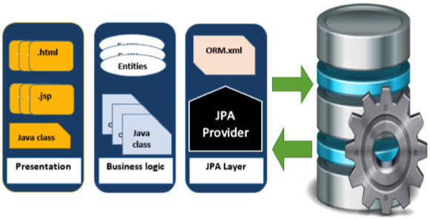
JPA:
Java Persistence API is a collection of classes and methods to persistently store the vast amounts of data into a database which is provided by the Oracle Corporation.
Where to use JPA?
To reduce the burden of writing codes for relational object management, a programmer follows the ‘JPA Provider’ framework.
Java Persistence API is a source to store business entities as relational entities. It shows how to define a PLAIN OLD JAVA OBJECT (POJO) as an entity and how to manage entities with relations.

Slide 3
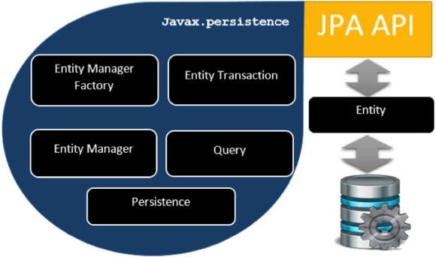
Class Level Architecture
Sr.No | Units & Description
1 | EntityManagerFactory This is a factory class of EntityManager. It creates and manages multiple EntityManager instances.
2 | EntityManager It is an Interface, it manages the persistence operations on objects. It works like factory for Query instance.
3 | Entity Entities are the persistence objects, stores as records in the database.
4 | EntityTransaction It has one-to-one relationship with EntityManager. For each EntityManager, operations are maintained by EntityTransaction class.
5 | Persistence This class contain static methods to obtain EntityManagerFactory instance.
6 | Query This interface is implemented by each JPA vendor to obtain relational objects that meet the criteria.

Slide 4
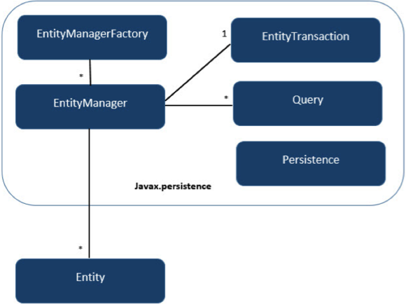
JPA Class Relationships
The relationship between EntityManagerFactory and EntityManager is one-to-many. It is a factory class to EntityManager instances.
The relationship between EntityManager and EntityTransaction is one-to-one. For each EntityManager operation, there is an EntityTransaction instance.
The relationship between EntityManager and Query is one-to-many. Many number of queries can execute using one EntityManager instance.
The relationship between EntityManager and Entity is one-to-many. One EntityManager instance can manage multiple Entities.

Slide 5
Spring Boot JPA - Application Setup
Entity - Entity.java
@Entity
@Table
public class Employee {
@Id
@Column
private int id;

Slide 6
Repository - EmployeeRepository.java
@Repository
public interface EmployeeRepository extends CrudRepository<Employee, Integer> {
}
Service - EmployeeService.java
@Service
public class EmployeeService {
@Autowired
EmployeeRepository repository;
public Employee getEmployeeById(int id) {
return repository.findById(id).get();
}

Slide 7
Spring Boot JPA - Repository methods:
Sr.No | Method & Description
1 | count(): long returns the number of entities available.
2 | delete(Employee entity): void deletes an entity.
3 | deleteAll():void deletes all the entities.
4 | deleteAll(Iterable< extends Employee > entities):void deletes the entities passed as argument.
5 | deleteAll(Iterable< extends Integer > ids):void deletes the entities identified using their ids passed as argument.
6 | existsById(Integer id):boolean checks if an entity exists using its id.
7 | findAll():Iterable< Employee > returns all the entities.
8 | findAllByIds(Iterable< Integer > ids):Iterable< Employee > returns all the entities identified using ids passed as argument.
9 | findById(Integer id):Optional< Employee > returns an entity identified using id.
10 | save(Employee entity): Employee saves an entity and return the updated one.
11 | saveAll(Iterable< Employee> entities): Iterable< Employee> saves all entities passed and return the updated entities.

Slide 8
Interview Preparation
Spring boot JPA Implementation

Slide 9
Next Topic?
Spring boot with Rest Application

