Slide 1
Microservices

Slide 2
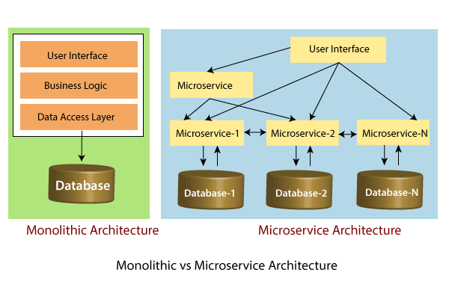
What is Microservices
Microservice Architecture is a Service Oriented Architecture. In the microservice architecture, there are a large number of microservices. By combining all the microservices, it constructs a big service. In the microservice architecture, all the services communicate with each other.
We will learn how to establish communication between microservices, enable load balancing, scaling up and down of microservices. We will also learn to centralize the configuration of microservices with Spring Cloud Config Server. We will implement Eureka Naming Server and Distributed tracing with Spring Cloud Sleuth and Zipkin. We will create fault tolerance microservices with Zipkin.

Slide 3
Difference between (MSA) & (SOA)
Microservice Based Architecture (MSA) | Service-Oriented Architecture (SOA)
Microservices uses lightweight protocols such as REST, and HTTP, etc. | SOA supports multi-message protocols.
It focuses on decoupling. | It focuses on application service reusability.
It uses a simple messaging system for communication. | It uses Enterprise Service Bus (ESB) for communication.
Microservices follows "share as little as possible" architecture approach. | SOA follows "share as much as possible architecture" approach.
Microservices are much better in fault tolerance in comparison to SOA. | SOA is not better in fault tolerance in comparison to MSA.
Each microservice have an independent database. | SOA services share the whole data storage.
MSA used modern relational databases. | SOA used traditional relational databases.
MSA tries to minimize sharing through bounded context (the coupling of components and its data as a single unit with minimal dependencies). | SOA enhances component sharing.
It is better suited for the smaller and well portioned, web-based system. | It is better for a large and complex business application environment.

Slide 4
Components of Microservices
There are the following components of microservices:
Spring Cloud Config Server
Netflix Eureka Naming Server
Hystrix Server
Netflix ZuulAPI Gateway Server
Netflix Ribbon
Zipkin Distributed Tracing Server
Spring Cloud Config Server
Spring Cloud Config Server provides the HTTP resource-based API for external configuration in the distributed system. We can enable the Spring Cloud Config Server by using the annotation @EnableConfigServer.
Netflix Eureka Naming Server:
Netflix Eureka Server is a discovery server. It provides the REST interface to the outside for communicating with it. A microservice after coming up, register itself as a discovery client. The Eureka server also has another software module called Eureka Client.

Slide 5
Hystrix Server
Hystrix server acts as a fault-tolerance robust system. It is used to avoid complete failure of an application. It does this by using the Circuit Breaker mechanism. If the application is running without any issue, the circuit remains closed.
Netflix Zuul API Gateway Server
Netflix Zuul Server is a gateway server from where all the client request has passed through. It acts as a unified interface to a client. It also has an inbuilt load balancer to load the balance of all incoming request from the client.
Netflix Ribbon
Netflix Ribbon is the client-side Inter-Process Communication (IPC) library. It provides the client-side balancing algorithm. It uses a Round Robin Load Balancing:
Load balancing
Fault tolerance
Multiple protocols(HTTP, TCP, UDP)
Caching and Batching

Slide 6
Zipkin Distributed Server
Zipkin is an open-source project m project. That provides a mechanism for sending, receiving, and visualization traces.
Application | Port
Spring Cloud Config Server | 8888
Netflix Eureka Naming Server | 8761
Netflix Zuul API gateway Server | 8765
Zipkin distributed Tracing Server | 9411

Slide 7
Next Topic?
Spring boot with Microservice?

