Slide 1
Microservices-RestTemplate

Slide 2
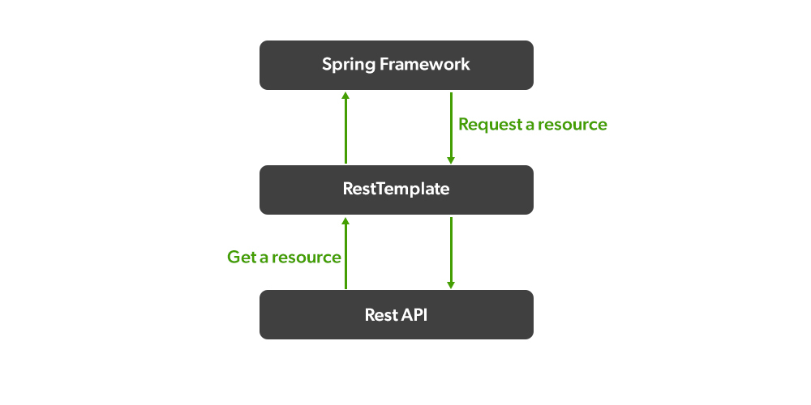
Spring – Rest Template
To consume a RESTful service, Spring provides the RestTemplate class.
This allows you to send HTTP requests to a RESTful server and fetch data in a number of formats - such as JSON and XML.
Due to high traffic and quick access to services, REST APIs are getting more popular. REST is not a protocol or a way of standard, rather it is a set of architectural constraints. It is also called RESTful API or web API.
org.springframework.web.client.RestTemplate
‘RestTemplate’ is a synchronous REST client provided by the core Spring Framework.

Slide 3
Constructors:
- RestTemplate()
- RestTemplate(ClientHttpRequestFactory requestFactory)
- RestTemplate(List<HttpMessageConverter<?>> messageConverters)
It provides a total of 41 methods for interacting with REST resources. But there are only a dozen of unique methods each overloaded to form a complete set of 41 methods.

Slide 4
Operation | Method | Action Performed
DELETE | delete() | Performs an HTTP DELETE request on a resource at a specified URL.
GET | getForEntity() getForObject() | Sends an HTTP GET request, returning a ResponseEntity containing an object mapped from the response body. Sends an HTTP GET request, returning an object mapped from a response body.
POST | postForEntity() postForLocation() postForObject() | POSTs data to a URL, returning a ResponseEntity containing an object mapped from the response body. POSTs data to a URL, returning the URL of the newly created resource. POSTs data to a URL, returning an object mapped from the response body.
PUT | put() | PUTs resource data to the specified URL.
PATCH | patchForObject() | Sends an HTTP PATCH request, returning the resulting object mapped from the response body.
HEAD | headForHeaders() | Sends an HTTP HEAD request, returning the HTTP headers for the specified resource URL.
ANY | exchange() execute() | Executes a specified HTTP method against a URL, returning a ResponseEntity containing an object. Executes a specified HTTP method against a URL, returning an object mapped from the response body.
OPTIONS | optionsForAllow() | – Sends an HTTP OPTIONS request, returning the Allow header for the specified URL.

Slide 5
Syntax:
RestTemplate rest = new RestTemplate();
// Annotation
@Bean
// Method
public RestTemplate restTemplate()
{
return new RestTemplate();
}

Slide 6
For Calling a Get Request of MicroService-2 we use below syntax:
String responseFromMS2 = restTemplate.getForObject("http://localhost:8082/student/showAllStudent",
String.class);
@Autowired
private RestTemplate restTemplate;
@GetMapping("call_MS2_showAllStudent_endPoint")
public String callMicroservice_2_ShowAllStudent() {
try {
String responseFromMS2 = restTemplate.getForObject("http://localhost:8082/student/showAllStudent",
String.class);
logger.info("vvv:: responseFromMS2= " + responseFromMS2);
return responseFromMS2;
} catch (Exception e) {
e.printStackTrace();
return GLOBAL_ERROR;
}
}

Slide 7
@GetMapping("call_MS2_addStudent_endPoint")
public String call_MS_2_addStudent_endPoint() {
HttpHeaders headers = new HttpHeaders();
headers.setContentType(MediaType.APPLICATION_JSON);
JSONObject studentObj = new JSONObject();
studentObj.put("rollNo", 199);
studentObj.put("name", "New_Student");
studentObj.put("email", "new.student@gmail.com");
org.springframework.http.HttpEntity<String> s = new org.springframework.http.HttpEntity<String>(studentObj.toString(),headers);
String postForObject = restTemplate.postForObject("http://localhost:8082/student/addStudent", s, String.class);
return postForObject;
}

Slide 8
Spring Cloud Open Feign Overview
we will learn how to use the Spring Cloud Open Feign library to make REST API calls (Synchronous communication) between multiple microservices.
Feign makes writing web service clients easier with pluggable annotation support, which includes Feign annotations and JAX-RS annotations. Also, Spring Cloud adds support for Spring MVC annotations and for using the same HttpMessageConverters as used in Spring Web.
@FeignClient(value = "DEPARTMENT-SERVICE", url = "http://localhost:8080")
public interface APIClient {
@GetMapping(value = "/api/departments/{id}")
DepartmentDto getDepartmentById(@PathVariable("id") Long departmentId);
}

Slide 9
Next Topic?
Spring boot with Microservice-API Gateway

